Slide 1
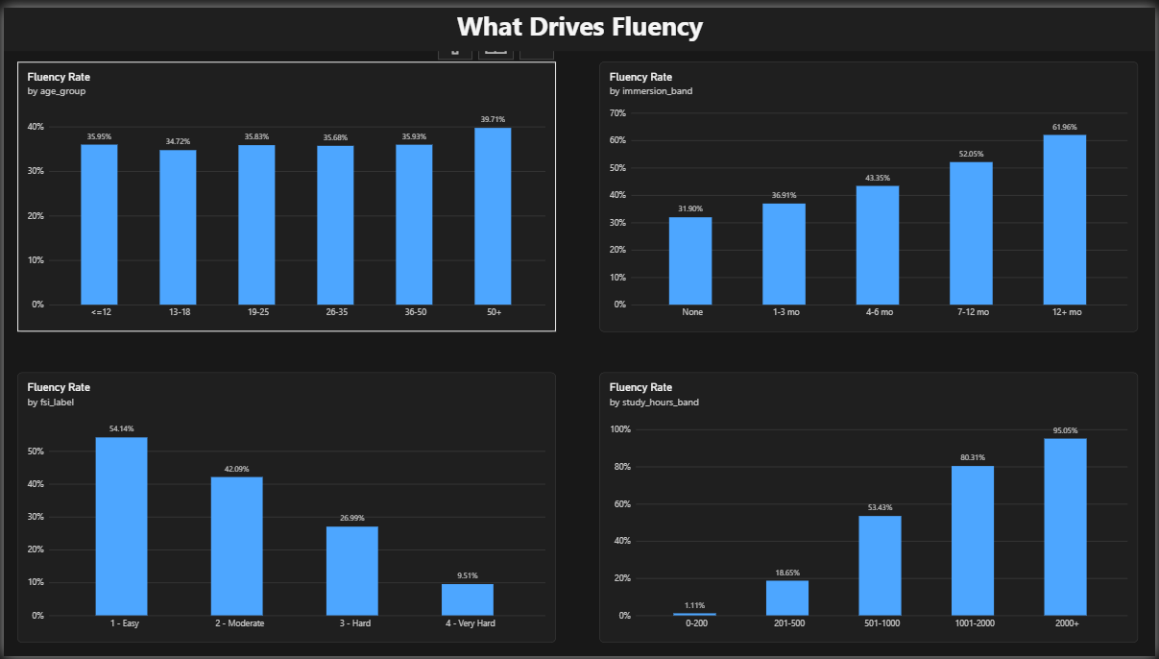
What Gets Language Learners to Fluency?
An end-to-end data project: Python preparation and a 4-page Power BI dashboard
Data Preprocessing & Analysis
Ziad Yahia Eid Mahmoud

Slide 2
45,000 learners, one question
45,000
18
36%
37%
learner records
original columns
reached fluency (B2+)
quit before B2
The question: what separates learners who reach B2 or higher from those who quit? Source: Kaggle, Language Learning to Fluency: Who Gets There? Targets: reached_fluency and dropped_out.

Slide 3
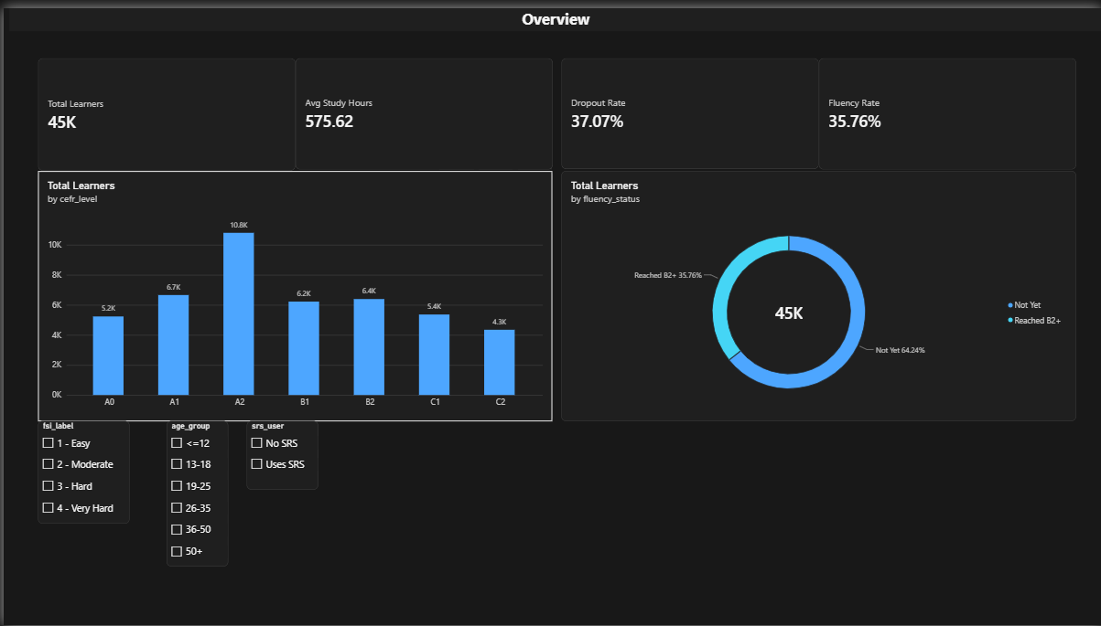
From raw file to dashboard
1
Download and audit
kagglehub in Colab. 45,000 rows by 18 columns: no missing values, no duplicates.
2
Prepare features
12 new columns: readable labels, age, hours and immersion bands, quality score. 18 to 30 columns.
3
Save the clean CSV
UTF-8 file, ready for Power BI.
4
Build the dashboard
Sort ranks made in Power Query: the DAX version caused a circular dependency.
Dashboard, Overview page

Slide 4
Study hours are the biggest lever
1% to 95%
Share reaching fluency under 200 hours versus over 2,000 hours. No other factor comes close.

Slide 5
Difficulty and immersion also matter
Easy to very hard languages: 54% down to 10%. No immersion to 12+ months: 32% up to 62%.

Slide 6
Quitting and age tell different stories
Higher motivation and steadier practice mean fewer learners quit.
Age barely moves fluency (35-40% in every group) but strongly lowers accent.

Slide 7
Takeaways and limits
Hours matter most: 1% to 95% fluency across the bands.
Harder languages take longer: 54% easy versus 10% very hard.
Immersion helps: 32% with none, 62% with 12+ months.
Age changes accent, not the chance of fluency.
Motivation and consistency cut dropout.
Limits
Public dataset that looks synthetic: findings describe this data only.
Dropout means quitting before B2, so high-hour groups show low dropout by definition.
quality_score is our own index, not validated.

