Slide 1

Group Project: MA317
Experimental modelling
Dr. Stella Hadjiantoni
Descriptive Statistical Study on Global Life Expectancy

Slide 2
Group Project: MA317
Experimental modelling
Dr. Stella Hadjiantoni
Zia ullah khan 2101142 zk21867@essex.ac.uk -Question 1 2 4 5 + Report + Presentation
Aeman Hassan 2100681 az21206@essex.ac.uk -Question 3 2 5 1 + Report + Presentation
Akash Kumar 2105425 ak21434@essex.ac.uk -Question 1 2 3 4 + Report + Presentation
Wahyu Maiwa 2107460 wm21615@essex.ac.uk -Question 1 2 3 4 + Report + Presentation
Prateek Tiwary 2100920 pt21775@essex.ac.uk -Question 1 2 3 5 + Report + Presentation
Group Members :

Slide 3

Our Background
Life expectancy is a demographical mapping of a living being's typical life span based on his date of birth, present age, sex, and other factors.
It must be conducted both graphically and numerically. The report focuses on two area of findings. Firstly, to develop a model for predicting the life expectancy for countries in 2019 and secondly to provide a similar prediction for the nations whose data for the evaluation were missing. This can be done by considering the other factors affecting the such the birth rate, mortality rate, GDP and expense on health and safety expenditure.

Slide 4
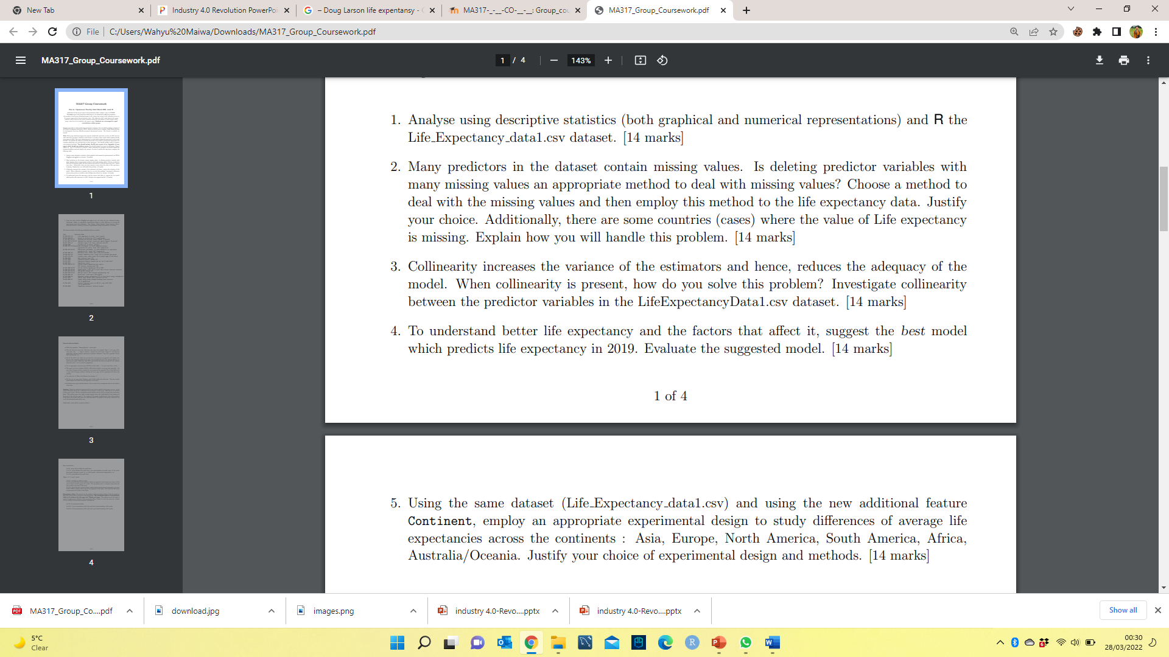

Questions
Our Solution
Pre-processing of Data:
Loading the data set in R,
Using the ‘summary()’ and ‘str()’ functions to acquire a summary of the data set,
Factoring the class label, Continent, to make it a categorical variable,
Some extraneous columns will be deleted as well,
Processing of Data:

Slide 5
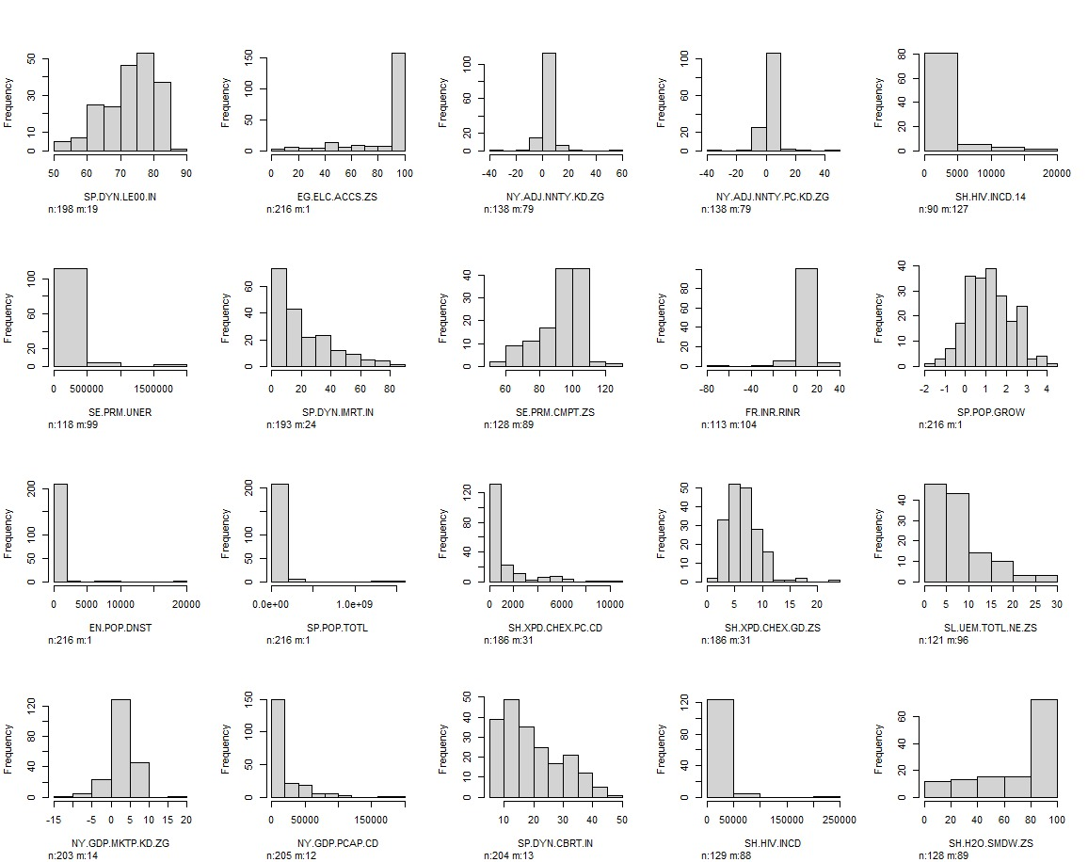
Solution Number 1
Descriptive analysis is defined as one of the blocks in data science which helps in defining or interpreting the data at a very initial level.
It depicts that Among all the column observed, variable such as birth rate, current health and mortality has a wise density distribution. The significance of mortality statistics stems from both the importance of death in an individual's life and their ability to improve public health when utilised to systematically examine and monitor a community's health status, resulting to improved life expectancy.
Figure: Histogram showing Variable summary.

Slide 6
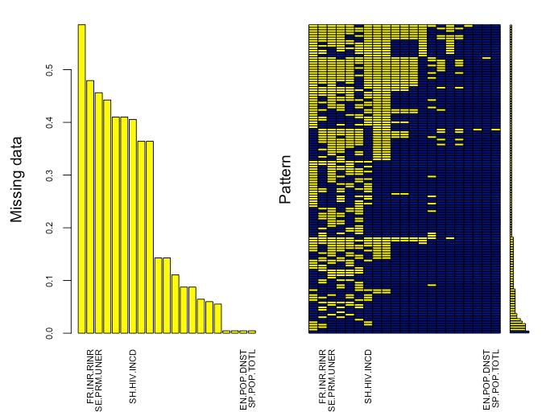

Solution Number 2
5 steps to recognise missing data accurately:
Make sure your data is properly coded
Within each variable, look for missing values.
Look for missing-person patterns.
Examine the data that is missing and the data that is present
Make a decision about how to deal with missing data
The model 5 came out to be the best model for imputation of missing values which have
F-statics =106.5
R-square = 0.9113
P-value = 2.2e16
Residual standard error 2.289
Was used to predict the missing values in independent variable.
Method of resolving missing value:
Dropping columns
Multivariate Imputation by Chained Equations (MICE)
Linear Regression:

Slide 7
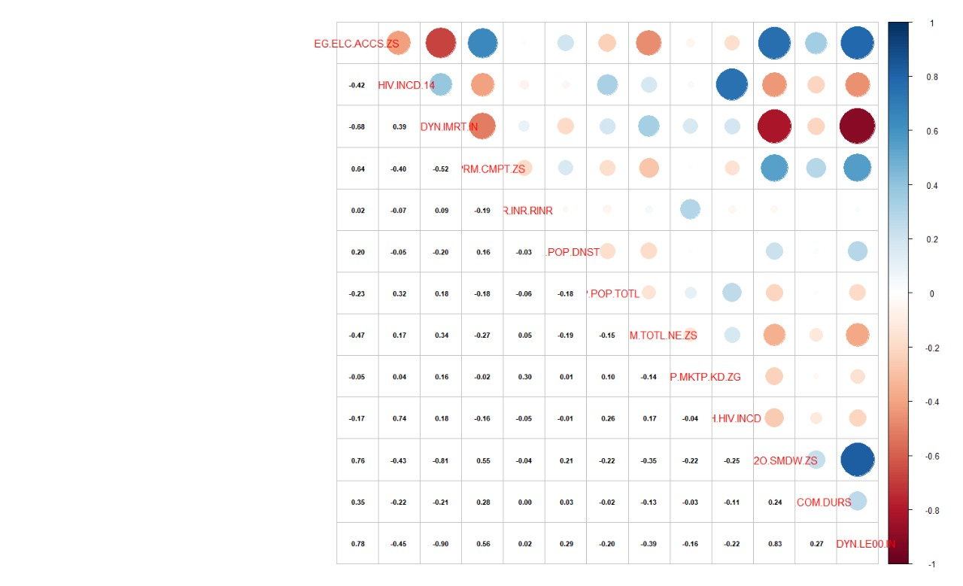
Solution Number 3
Variance Inflation Factor (VIF).
It assesses how much an independent variable's variance is influenced (inflated) by its interaction/correlation with other independent variables.
Correlation Matrix
Correlation metrics are used to determine whether or not two variables are related with each other. A correlation can be either positive or negative.
Positive correlation
both variables increase together linearly proportional
Negative correlation
one rises makes other falls inverse proportional.
Correlation value greater than 0.70 indicated highly correlated and can be dropped!

Slide 8
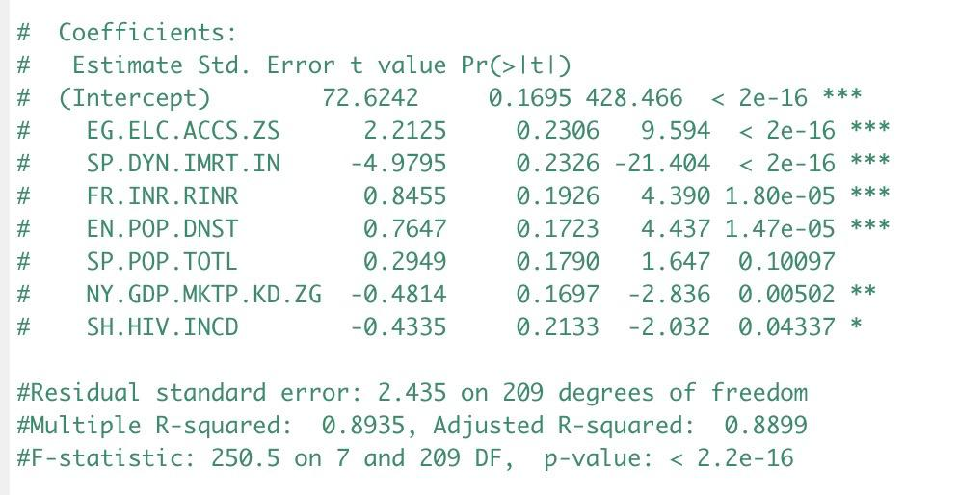
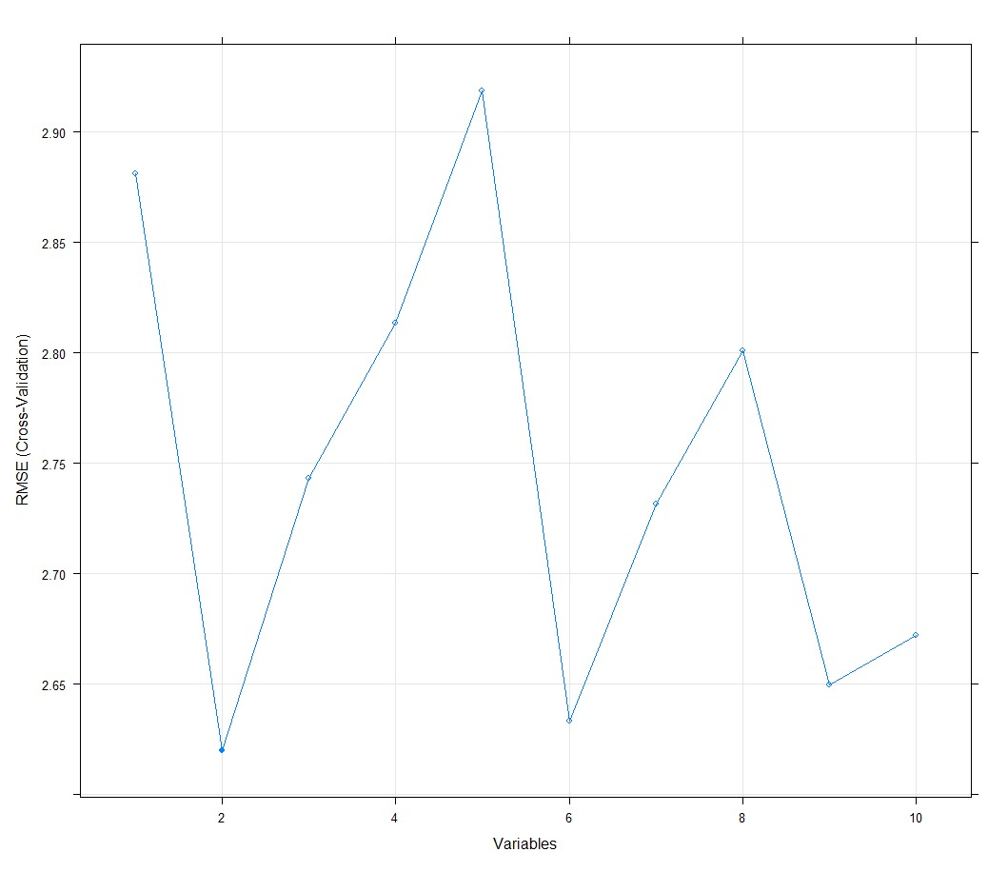
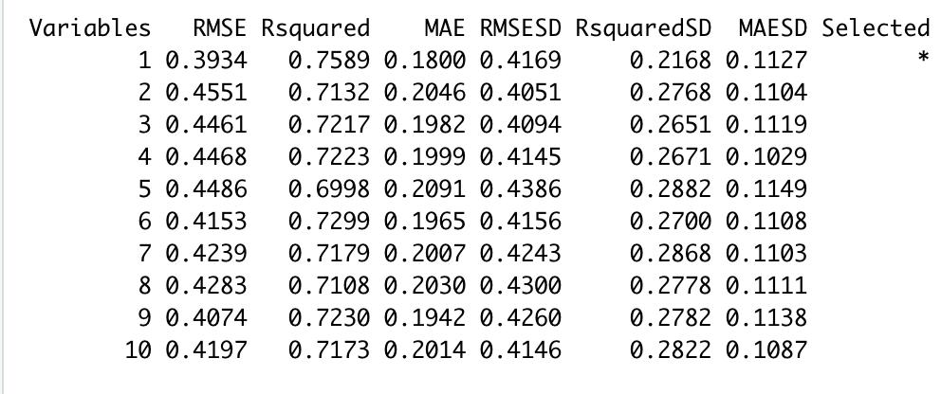

Solution Number 4
Factors affecting Life Expectancy
In the life Expectancy dataset, we have a total 29 features and after pre-processing the dataset we have 14 features for our analysis. Life expectancy at birth (SP.DYN.LE00.IN) is response variable and other 14 are predictor variables.
Recursive feature elimination: A small p-value (less than 5%) is a significant criterion to select the null hypothesis and consequently convey the strength of the relationship with the response variable. R-squared value helps in finding the significance of the selected model.
Summary of life expectancy best model (best AIC)
AIC is designed to locate the variation in data, while penalizing for models that use an excessive number of parameters.
Stepwise regression
Forward selection
Backward elimination

Slide 9
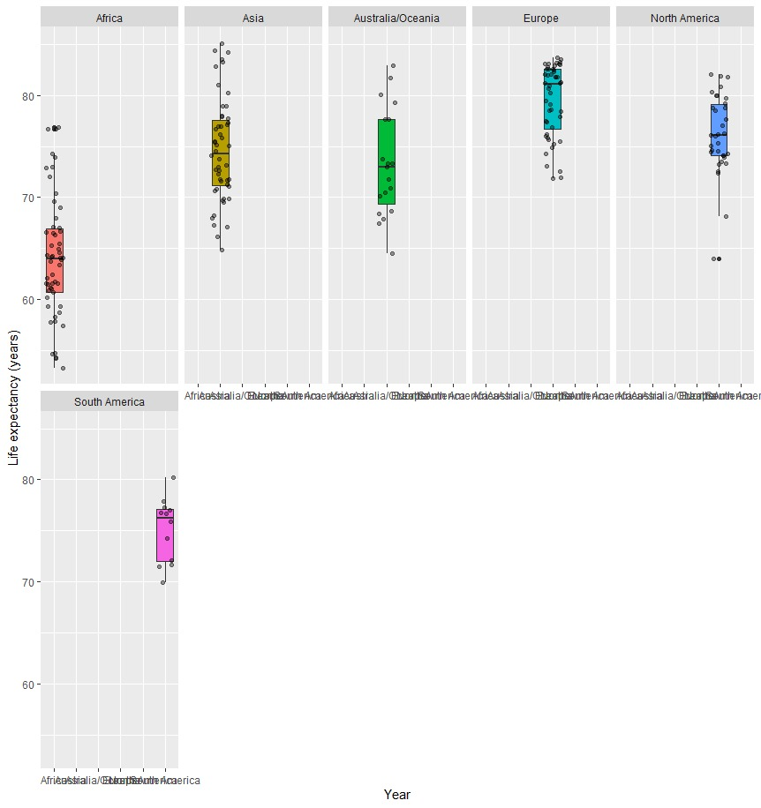
Solution Number 5
ANOVA (Analysis of Variance) is a statistical test that is used to examine the differences between the means of many groups.
Following are the assumptions that oneway ANOVA follows:
• Observational independence;
• normally distributed response variable;
• variance homogeneity
It is quite clear from the graph and from the Anova test there is high Fscore which is the ratio of variance between and within the group and Pvalue is less than 0.05 threshold,so it is statiscally significant and we can there is strong association between life expectancy and continent variable.

Slide 10
Conclusion
“To summarise although the project was quite enriching, however, the data could have been in detail for a better understanding of variation among the variables in the data set.”

Slide 11
MA.317
EXPERIMENTAL MODELLING
Thank You

