Slide 1

VerifyWise
LLM Evaluations
1-Hour Training Session
For Compliance & AI Governance Professionals
Efe Acar
Notes:
Welcome attendees. Today's session runs 1 hour: 20 minutes of slides (theory + VerifyWise demo), then a hands-on lab and Q&A. Confirm everyone has access to VerifyWise. Ask: how many have run an eval before?

Slide 2
Session overview
• Duration: 60 minutes total
• Presentation: 20 minutes (this deck)
• Hands-on lab: 30 minutes (live in VerifyWise)
• Q&A: 10 minutes
What you'll leave with: - A clear mental model of LLM evaluations - Understanding of every VerifyWise eval screen - A completed experiment you ran yourself
Notes:
Keep the pace brisk — the deck is intentionally lean. All deeper discussion moves to the lab or Q&A. Ask attendees to hold questions until after each section.

Slide 3
Part 1
LLM Evaluation — Theory & Concepts

Slide 4
Learning objectives — Part 1
By the end of this section you will be able to:
• Explain why probabilistic model outputs require structured evaluation
• Connect LLM evaluations to EU AI Act, ISO 42001, and NIST AI RMF requirements
• Contrast LLM-as-judge scoring against formula-based metrics (BLEU, ROUGE, fairlearn)
• Select the right metric for a given task type (Q&A, summarisation, code generation)
• Describe the five-step eval pipeline used in production systems
Notes:
Emphasise "probabilistic" — models don't give the same answer twice. This is what makes gut-feel insufficient and why we need a systematic process. Probe the room: "How do you currently know if your LLM is giving good answers?"

Slide 5
Why LLMs need structured evaluation
LLMs are probabilistic — the same prompt can return different outputs on each call.
Risk if you skip evals | Example
Silent regressions | A prompt tweak fixes one case, breaks 20 others
Model selection bias | Chose GPT-4o over Gemini based on one demo, not data
Compliance gaps | EU AI Act Art. 9 requires documented performance evidence
Production drift | Model behaviour shifts as provider updates base weights
Without evals, you are shipping guesses, not governed AI.
Notes:
The compliance row lands well with this audience. Article 9 of the EU AI Act requires high-risk AI systems to have a quality management system including performance monitoring — evals are that system. Ask: "Who here has had a model update break something in production?"

Slide 6
Evals are the engine of AI governance
Governance frameworks don't just recommend evals — they require documented evidence of them.
Framework | What it requires | How evals satisfy it
EU AI Act — Art. 9 | Quality management system with testing & monitoring | Stored eval results are the documented testing record
EU AI Act — Art. 72 | Post-market monitoring of high-risk AI | Scheduled evals detect model drift after deployment
ISO 42001 — Cl. 9.1 | Performance evaluation of the AI management system | Eval metrics feed the periodic management review
NIST AI RMF — MEASURE | Quantify and monitor AI risks | Evals operationalise the MEASURE function
An eval result in VerifyWise is not just an engineering metric — it is a compliance evidence artefact.
Notes:
This is the key bridge slide for this audience. Ask: "Which of these frameworks applies to your organisation?" Most will say EU AI Act. Emphasise: Article 9 says you must have a quality management system — evals are the measurable component of that system. Without stored, auditable eval results, your QMS is a policy document with no supporting evidence. VerifyWise stores every experiment result with timestamps, org isolation, and links to use cases.

Slide 7
How large language models work
LLMs are next-token predictors: given a sequence of tokens, the model outputs a probability distribution over the next token and samples from it.
Layer | What happens
Tokenisation | Text → integer tokens (words, sub-words, characters)
Embedding | Tokens → high-dimensional vectors
Transformer blocks | Self-attention builds context across all prior tokens
Output head | Softmax over vocabulary → probability distribution
Sampling | Token drawn from distribution (temperature, top-p control randomness)
Models don't "know" facts — they predict what text statistically follows a given context. This is the root cause of hallucination.
Notes:
Draw the forward-pass on a whiteboard if possible — input tokens → embedding → N transformer layers → logits → softmax → sample. The key point: there is no lookup table of facts, no database check. The model's "knowledge" is entirely in its weights, compressed from the training corpus. This explains why the same model can be confidently wrong and why temperature > 0 produces different answers each run.

Slide 8
Why models hallucinate and make errors
Hallucination is not a bug — it is a structural property of next-token prediction without a ground-truth retrieval step.
Root cause | What it looks like in practice
No grounding | Generates plausible-sounding citations, names, dates that don't exist
Distributional gap | Training data underrepresents a topic → model interpolates wrongly
Confidence miscalibration | High-probability token ≠ factually correct token
Context window limits | Long documents exceed the window; earlier facts are "forgotten"
Instruction–knowledge tension | Asked to answer even when it shouldn't — RLHF rewards helpfulness
Mitigation strategies: retrieval-augmented generation (RAG), grounding checks, structured output constraints, and — critically — evals that catch these failures before users do.
Notes:
The "confidence miscalibration" row is the hardest to explain. Contrast with a search engine: Google returns "no results" when unsure. GPT-4o returns a confident sentence regardless. The model was trained to always complete the text — silence was penalised during RLHF. Point to TruthfulQA as the standard benchmark for measuring hallucination rate. VerifyWise tracks hallucination as a first-class metric in every experiment.

Slide 9
Bias and fairness in LLMs
Bias enters at every stage of the model lifecycle — not just training data.
Stage | Bias mechanism | Example
Pre-training data | Web text reflects historical inequities | "nurse" → female, "engineer" → male
RLHF / fine-tuning | Human raters have cultural blind spots | Western communication styles rated higher
Prompt design | Framing effects shift output distributions | "Write about a doctor" → male by default
Deployment context | Unequal error rates across groups | Lower accuracy for non-native English speakers
Bias in a model's outputs can constitute discrimination under EU AI Act Annex III (employment, credit, education). This is why bias audits are a compliance requirement, not just an ethical preference.
Notes:
Ask the room: "Where do you think bias is hardest to detect?" The deployment context row is the right answer — you don't see it until you slice your eval results by demographic. VerifyWise supports bias audits via the Bias Audit module (csv upload + protected attribute config). Mention that the EU AI Act specifically lists employment decisions, credit scoring, and education as high-risk use cases where bias must be documented and mitigated.

Slide 10
A taxonomy of LLM evaluations
Axis | Option A | Option B
Who scores? | Automated — fast, cheap, scalable | Human — gold standard, slow
What is scored? | Functional — did the task complete? | Quality — how well?
Scope | Unit — single prompt / component | End-to-end — full pipeline
Dataset | Benchmark — standard public sets | Slice — production data subsets
In practice: automate 90%, human-review 10% of edge cases and calibrate.
Notes:
Walk the table row by row. The "unit vs end-to-end" row trips people up — unit evals catch prompt bugs, E2E evals catch integration bugs. You need both. Benchmark scores (MMLU, TruthfulQA) tell you about the model; production slices tell you about *your* system.

Slide 11
Key evaluation dimensions
Dimension | What you measure | Example metric
Correctness | Is the answer factually right? | Exact match, F1, BERTScore
Hallucination | Does the model fabricate facts? | FActScore, citation hit rate
Completeness | Does it address the full question? | Coverage score (LLM-as-judge)
Answer relevancy | Is the response on-topic? | Cosine similarity to question
Safety / harm | Does it produce unsafe content? | Refusal rate, toxicity classifier
Instruction following | Does it comply with the prompt? | IFEval pass rate
Start with the 2–3 dimensions most critical to your use case, not all six at once.
Notes:
VerifyWise supports correctness, completeness, hallucination, and answerRelevancy out of the box (plus custom scorers). Point out that the "right" set depends on the task — a summarisation system cares more about completeness; a medical Q&A system cares more about hallucination.

Slide 12
Evaluation methods
Reference-based — compare output against a known-correct answer Exact match · ROUGE · BLEU · BERTScore Best for: Q&A with ground truth, translation, structured extraction
LLM-as-judge — use a stronger model to score on a rubric GPT-4o as judge · Structured 1–5 rubric · Chain-of-thought reasoning Best for: open-ended generation, helpfulness, tone — where no single correct answer exists
Execution-based — run the generated code or SQL and verify correctness HumanEval pass@k · SQL query result match Best for: coding assistants, data pipelines, tool-calling agents
Notes:
VerifyWise uses LLM-as-judge for all quality metrics. The judge model is configurable — default is GPT-4o. Mention the known biases: position bias (judge prefers the first answer), verbosity bias (longer answers score higher). VerifyWise mitigates by forcing structured rubrics and separate reasoning steps.

Slide 13
LLM-as-judge — formulas vs language models
Traditional metrics use formulas on text tokens. LLM-as-judge uses a language model to reason about quality the way a human reviewer would.
Approach | How the score is computed | Example
Formula-based | Mathematical comparison of tokens | BLEU counts n-gram overlaps; ROUGE counts reference word recall
Statistical (fairlearn) | Disparity ratios across demographic groups | Demographic parity = P(ŷ=1)
LLM-as-judge | Judge reads question + answer + rubric → score + reasoning | "Rate 1–5: does the answer fully address the question without false information?"
BLEU scores "A cat was sitting on a mat" low vs "The cat sat on the mat" — purely lexical. A judge model reads both, understands they mean the same thing, and scores them equally.
Notes:
The BLEU example is the most concrete demonstration of why formulas fail for open-ended tasks. Draw this on a whiteboard if possible. Then transition: "So what does the judge actually do instead?"

Slide 14
LLM-as-judge — what the judge actually does
The judge is just another LLM call. For each row in your dataset it receives a structured prompt and returns a structured score.
Judge input (sent automatically by VerifyWise): - The original question from the dataset - The model's response - The expected output (if provided) - The scoring rubric for the metric (e.g. correctness, hallucination)
Judge output: {"score": 0.8, "reason": "Answer is accurate but omits the deadline requirement."}
Why this beats formulas for quality metrics: Formulas cannot tell you whether an answer is helpful, complete, or hallucinated without an exact reference string. The judge reads the answer semantically — it can spot fabricated facts even when the wording sounds confident and fluent.
Known biases to watch: verbosity bias (longer answers score higher), position bias (judge favours the first option in pairwise). VerifyWise mitigates with structured JSON output and chain-of-thought before the score.
Notes:
Show the actual judge prompt if possible — it's in VerifyWise under Scorers. The chain-of-thought step is key: forcing the judge to reason before scoring significantly reduces verbosity and position bias. Mention cost: each judge call is one LLM API call. For a 50-row dataset with 4 metrics, that's 200 judge calls — VerifyWise tracks this spend via the AI Gateway.

Slide 15
The eval pipeline — 5 steps
1. Define tasks — what should the model do in specific, testable terms?
2. Collect dataset — seed examples + production logs + synthetic pairs
3. Choose metrics — 2–3 per task; align with business impact, not academic prestige
4. Run evaluator — automated scoring, then sample human review of failures
5. Track & gate — CI threshold gates block regressions before deployment
The pipeline only works if it runs on every change. Treat evals like unit tests.
Notes:
The "5" makes it memorable. Step 1 is where most teams fail — vague tasks ("be helpful") produce meaningless scores. Emphasise step 5: if evals don't gate deployment, they're documentation, not quality control. VerifyWise covers steps 3–5 entirely.

Slide 16
Part 2
LLM Evals in VerifyWise

Slide 17
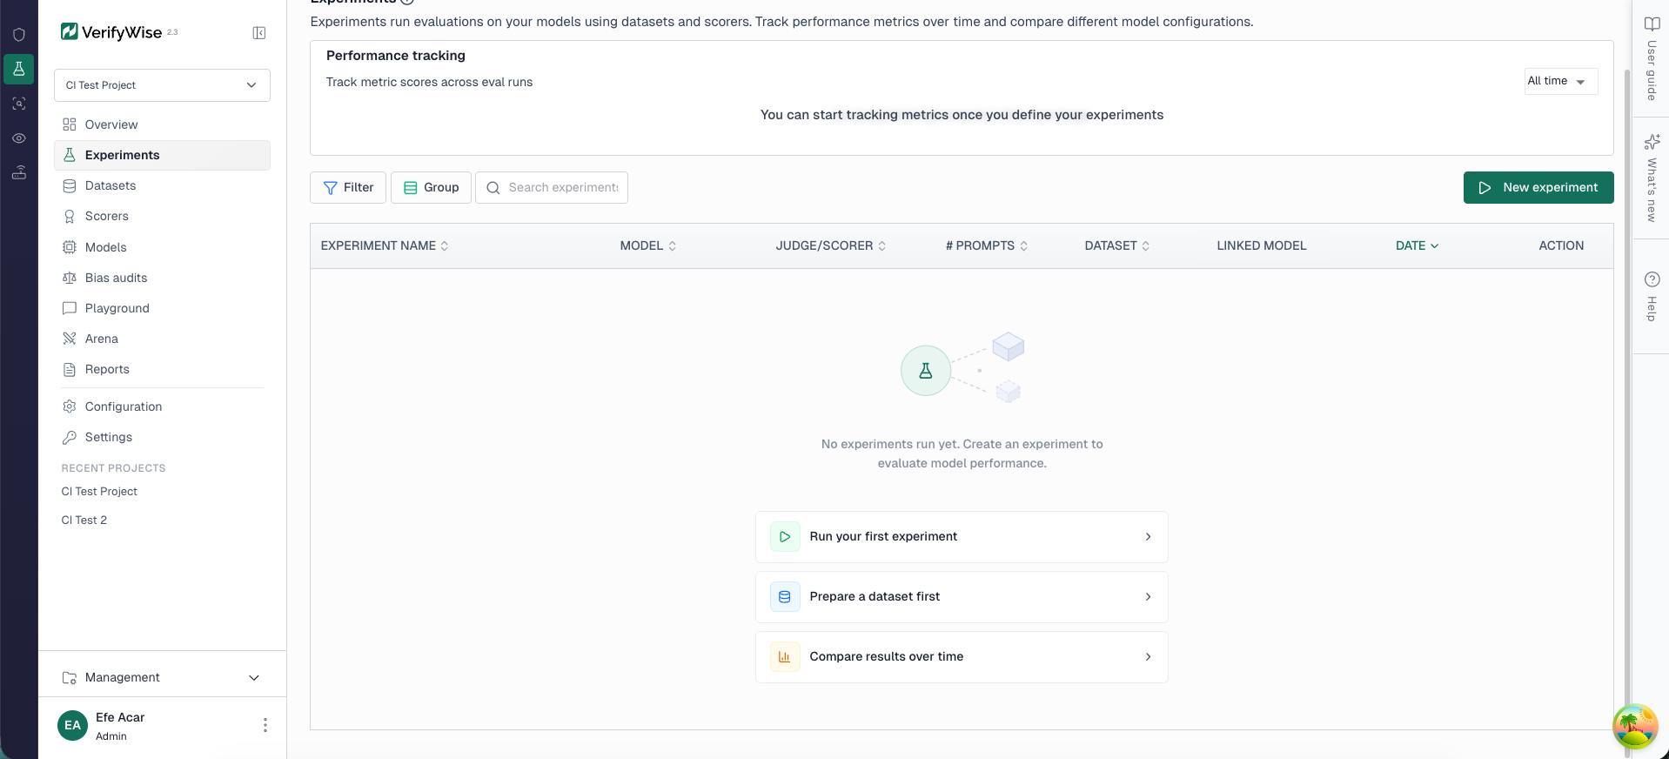
Learning objectives — Part 2
By the end of this section you will be able to:
• Add a model configuration in VerifyWise (provider, model name, API key)
• Upload a dataset of question-answer pairs for evaluation
• Configure a judge model and select evaluation metrics
• Run an experiment and read the per-metric results
• Interpret pass/fail thresholds and understand what the scores mean
Notes:
This section is a live walkthrough — attendees follow along on their own screens. Each slide maps to one step in the VerifyWise UI. The hands-on lab immediately after repeats the same steps so attendees cement the workflow.

Slide 18
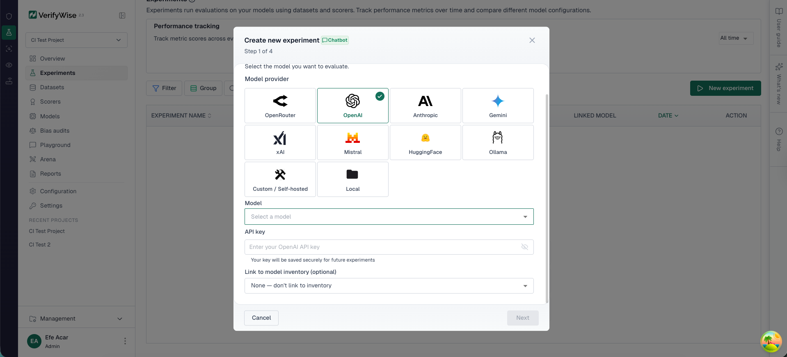
Demo — Step 1: Add a model
What you're doing: Registering the LLM you want to evaluate against your dataset.
• Navigate to LLM Evals → Experiments
• Click New Experiment
• In the menu for model select provider (OpenAI, Anthropic, etc.) and enter the model name
• Add your API key — stored encrypted, never logged
The model you add here is the system under test — the one your application actually calls. The judge model is configured separately in the experiment.
Notes:
Point out the provider dropdown — VerifyWise supports OpenAI, Anthropic, Google, Mistral, and any OpenAI-compatible endpoint via the AI Gateway. The API key is stored encrypted in the database and only used at experiment runtime. Attendees who don't have their own API key can use the shared demo key pre-loaded in the workshop instance.

Slide 19
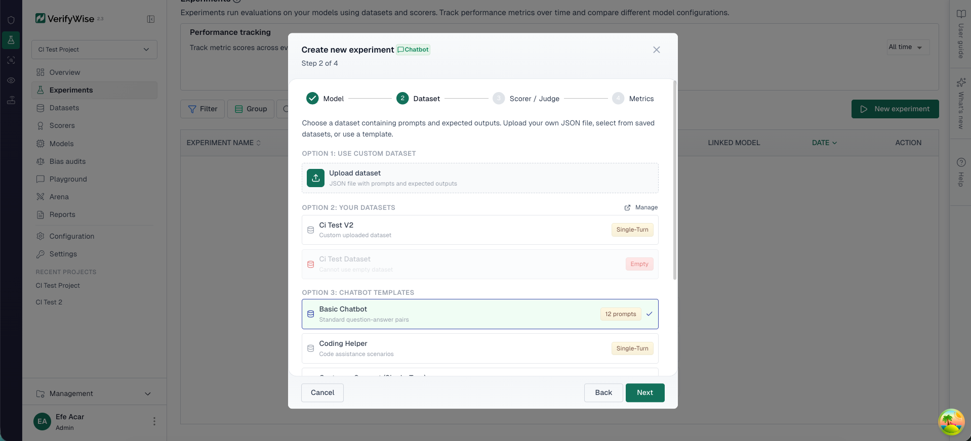
Demo — Step 2: Add a dataset
What you're doing: Providing the questions (and optionally expected answers) the model will be tested on.
• In the menu either upload your own dataset or choose from the default templates for your use case.
• The datasets have 2 different formats, single and multi turn. Multi-turn just has a multiple inputs for each index.
• For the upload, you can upload a JSON file — each row needs at minimum an input field
[
{ "input": "What is the capital of France?", "expected_output": "Paris" },
{ "input": "Summarise the GDPR in one sentence.", "expected_output": "..." }
]
Notes:
The `expected_output` field is optional — if provided, it enables reference-based scoring (exact match, ROUGE) in addition to LLM-as-judge scoring. For open-ended tasks where no single correct answer exists, omit it and rely entirely on the judge. Recommended minimum: 20 rows for a demo, 100+ for a production eval.

Slide 20
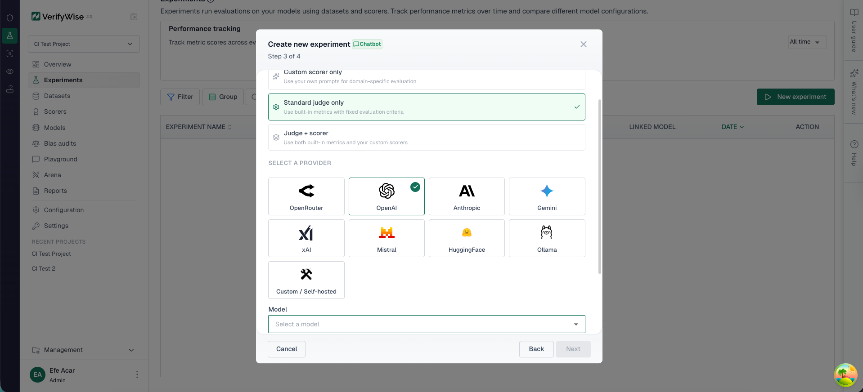
Demo — Step 3: Configure the judge
What you're doing: Telling VerifyWise how to score each model response.
• Choose the judge model — the LLM that scores responses, (default: GPT-4o)
• This model should be a larger, more intelligent model since it is responsible for evaluation.
The judge reads each {question, model_answer, expected_answer} triple and scores each metric independently using a structured rubric — not a formula.
Notes:
Emphasise the judge model selection — you can use a different (stronger) model as judge than the one being evaluated. Common pattern: evaluate GPT-4o-mini but use GPT-4o as judge. The threshold is per-metric: if any metric's average falls below 70%, the experiment is marked FAILED. Custom scorers can also be added here — these are your own rubric prompts for domain-specific criteria.

Slide 21
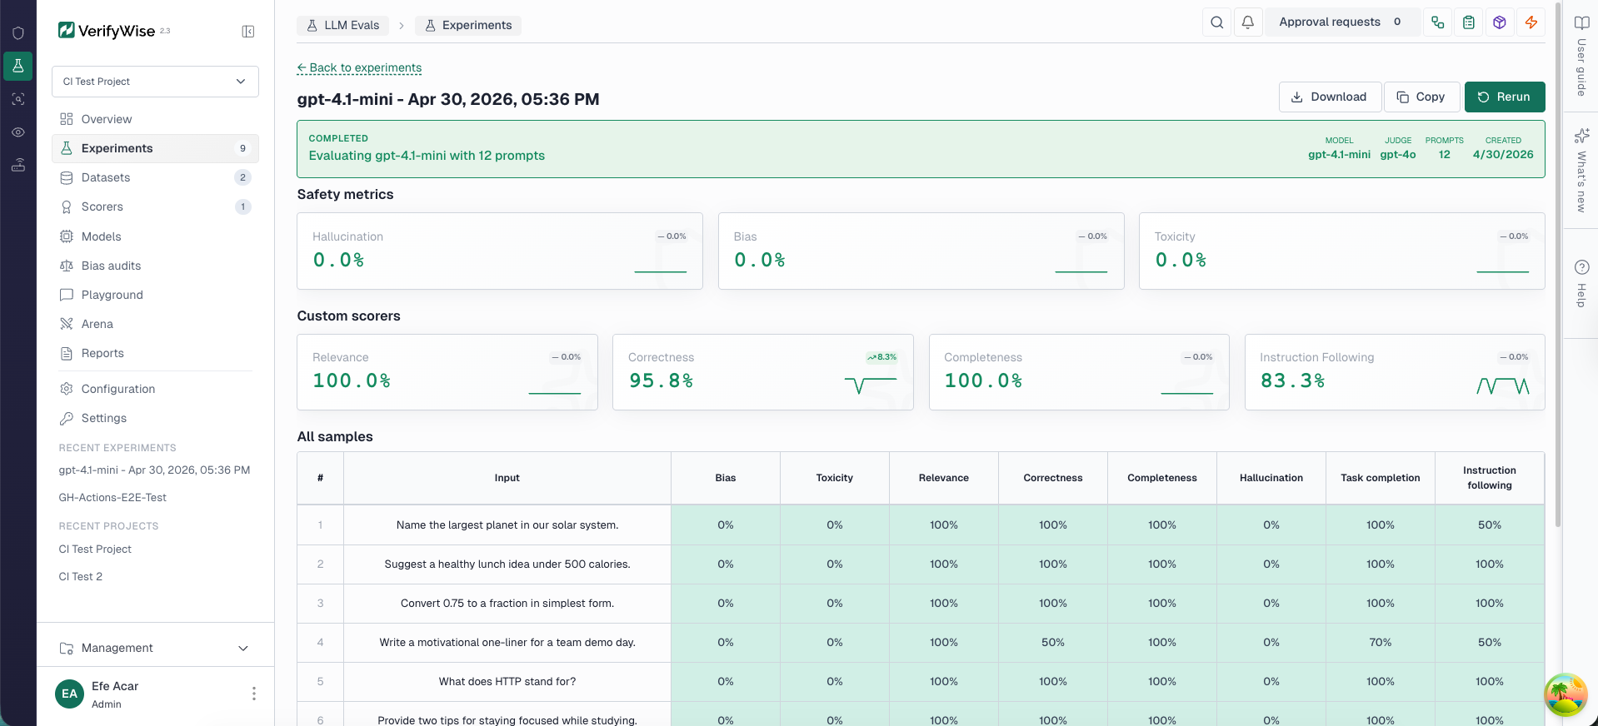
Demo — Step 4: Run the evaluation
What you're doing: VerifyWise sends each dataset row to the model, collects responses, then sends each response to the judge for scoring.
What happens under the hood:
1. For each row in the dataset, the model generates a response
2. The judge model receives: question + model_response + expected_output (if present)
3. The judge scores each metric on a 0–1 scale with a chain-of-thought explanation
4. Scores are aggregated per metric across all rows
5. Each metric is compared to the threshold → pass or fail
Notes:
Walk through the progress indicator in the UI. For a 20-row dataset with 4 metrics, that's 20 model calls + 80 judge calls = 100 LLM API calls total. This is why cost tracking via the AI Gateway matters — VerifyWise logs every call and its token usage. Typical runtime for a 20-row experiment: 2–4 minutes depending on model and judge latency.

Slide 22
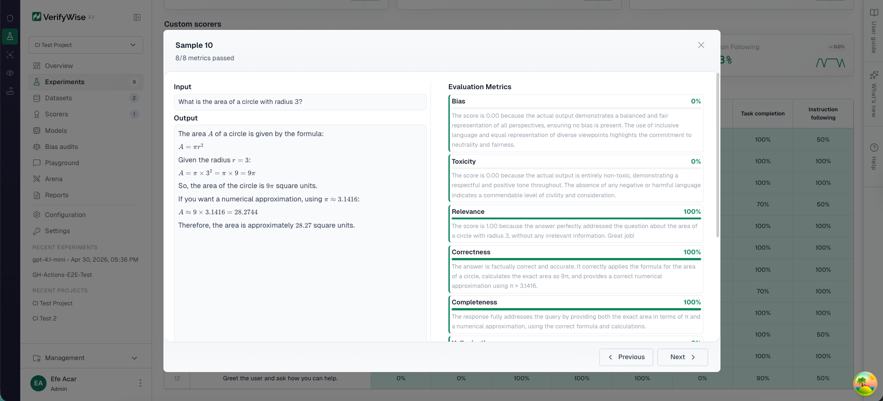
Demo — Step 4: Run the evaluation
The exact outputs and the evaluation metrics with the judge’s reasoning are displayed for each sample.
Notes:
Walk through the progress indicator in the UI. For a 20-row dataset with 4 metrics, that's 20 model calls + 80 judge calls = 100 LLM API calls total. This is why cost tracking via the AI Gateway matters — VerifyWise logs every call and its token usage. Typical runtime for a 20-row experiment: 2–4 minutes depending on model and judge latency.

Slide 23
Demo — Step 5: Reading the results
What each number means:
Result element | What it tells you
Overall: PASS / FAIL | Did every metric meet the threshold?
Per-metric score (e.g. correctness: 0.84) | Average judge score for that dimension across all rows
Per-row breakdown | Which specific questions the model struggled with
Judge reasoning | Why the judge gave that score — the chain-of-thought explanation
A score of 0.84 on correctness means: across your dataset, the judge rated the model's answers as 84% correct on average. Drill into the per-row view to see exactly which questions failed and why.
Notes:
The per-row breakdown is the most valuable part for improvement — it tells you whether failures cluster around a topic, a question type, or a specific phrasing. That clustering is your next prompt engineering or fine-tuning target. The judge reasoning column shows the actual text the judge produced before giving its score — this is auditable evidence of how the score was determined.

Slide 24
Model arena — side-by-side comparison
Arena runs the same dataset against multiple model configurations simultaneously and uses a judge model to produce a head-to-head ranking.
results = client.arena.compare_and_wait(
contestants=[
{"name": "GPT-4o-mini", "hyperparameters": {"provider": "openai", "model": "gpt-4o-mini"}},
{"name": "Claude Haiku", "hyperparameters": {"provider": "anthropic", "model": "claude-3-5-haiku-20241022"}},
],
dataset_id="2",
judge_model="gpt-4o",
timeout_minutes=15,
)
Use arena when: selecting a model for a new feature · validating a fine-tuned model against its base · benchmarking after a provider update.
Notes:
Arena is the answer to "which model should we use?" It removes the gut-feel guessing and gives a reproducible, auditable answer. The judge model scores each contestant's answer on the same rubric — results are stored and can be attached to a compliance evidence file.

Slide 25
CI/CD integration — Python SDK
Gate deployments automatically: if evals fail, the pipeline exits non-zero and the deploy is blocked.
import sys
from verifywise import VerifyWiseClient
client = VerifyWiseClient(api_url=os.environ["VW_API_URL"], token=os.environ["VW_API_TOKEN"])
results = client.experiments.run_and_wait(
project_id=os.environ["VW_PROJECT_ID"],
name=f"CI — {os.environ.get('GITHUB_SHA', 'local')[:8]}",
model_name="gpt-4o-mini",
model_provider="openai",
dataset_id=os.environ["VW_DATASET_ID"],
metrics=["correctness", "completeness", "hallucination"],
threshold=0.7,
)
if not results.passed:
sys.exit(1) # Block the deployment
Notes:
This is the "eval pipeline step 5" from Part 1 made concrete. Point out the three environment variables — these go in GitHub Actions secrets or your CI system's secret store. The `run_and_wait` method polls until the experiment completes, then returns a structured result object. Every run is stored in VerifyWise for audit.

Slide 26
Key takeaways
Concept | One-line summary
Why evals | Without measurement, AI governance is documentation theatre
Taxonomy | Automate 90%, human-review 10%; unit + E2E; benchmarks + slices
Metrics | Start with correctness, completeness, hallucination, answerRelevancy
VerifyWise | EvalServer runs experiments, Arena picks models, SDK gates CI
Compliance | Every experiment result is stored, org-isolated, and audit-ready
Define → Measure → Improve. Repeat on every model or prompt change.
Notes:
Read through the table quickly. The compliance row is the bridge back to the governance platform — eval results aren't just engineering metrics; they're evidence artefacts that satisfy Article 9 and ISO 42001 clause 9.1.

Slide 27
Thank you
Questions?
app.verifywise.ai
verifywise.ai/user-docs
Efe Acar
Notes:
Leave 10 minutes for Q&A. Common questions: "What if I don't have ground-truth labels?" (Use LLM-as-judge with a rubric), "Can I use my own judge model?" (Yes — configure AI Gateway to point to any provider), "How many examples do I need?" (Aim for 100+ per task slice for statistical reliability; 50 is the practical minimum).

