Slide 1
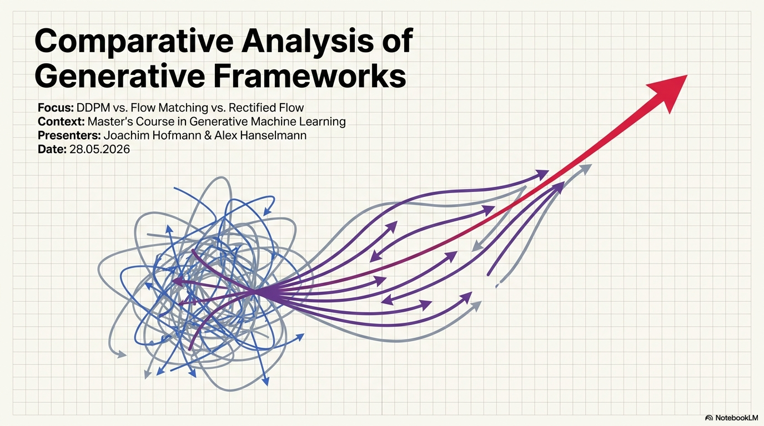

Slide 2
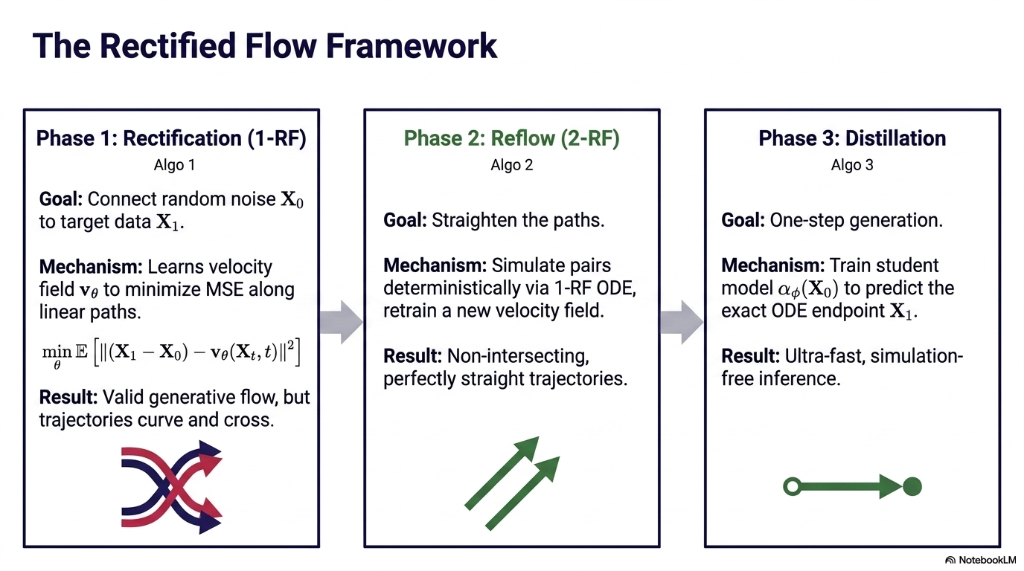

Slide 3
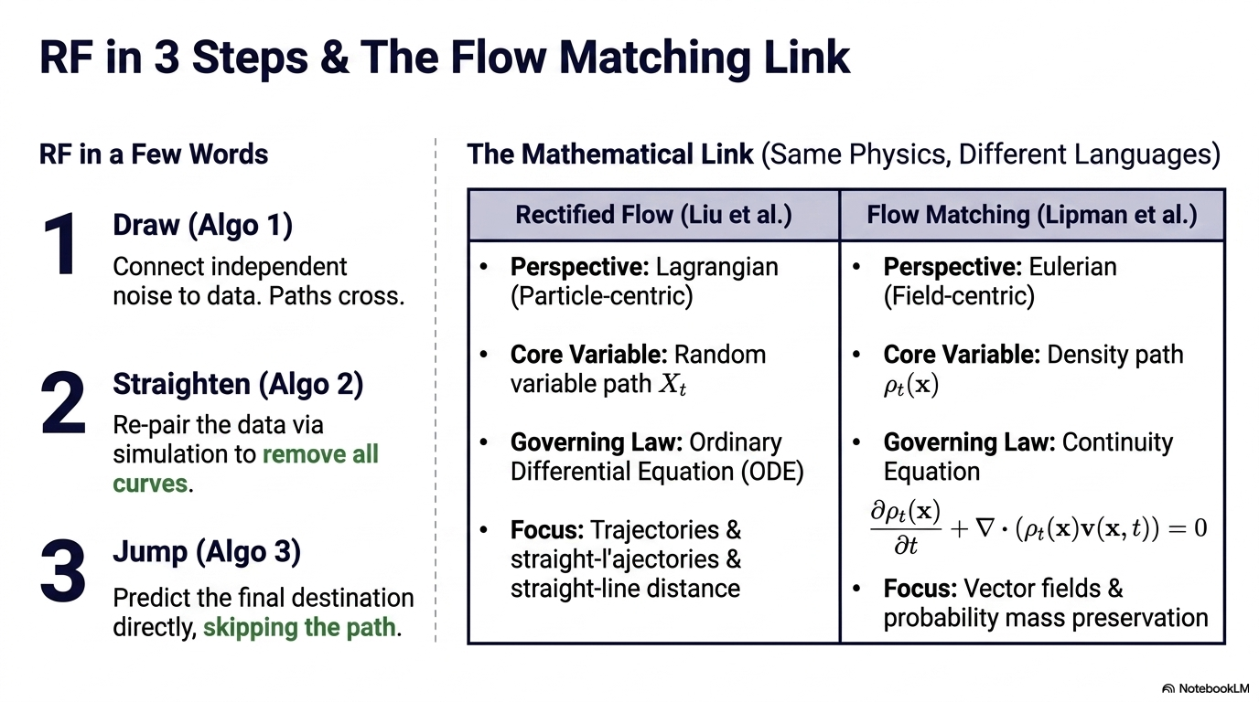

Slide 4
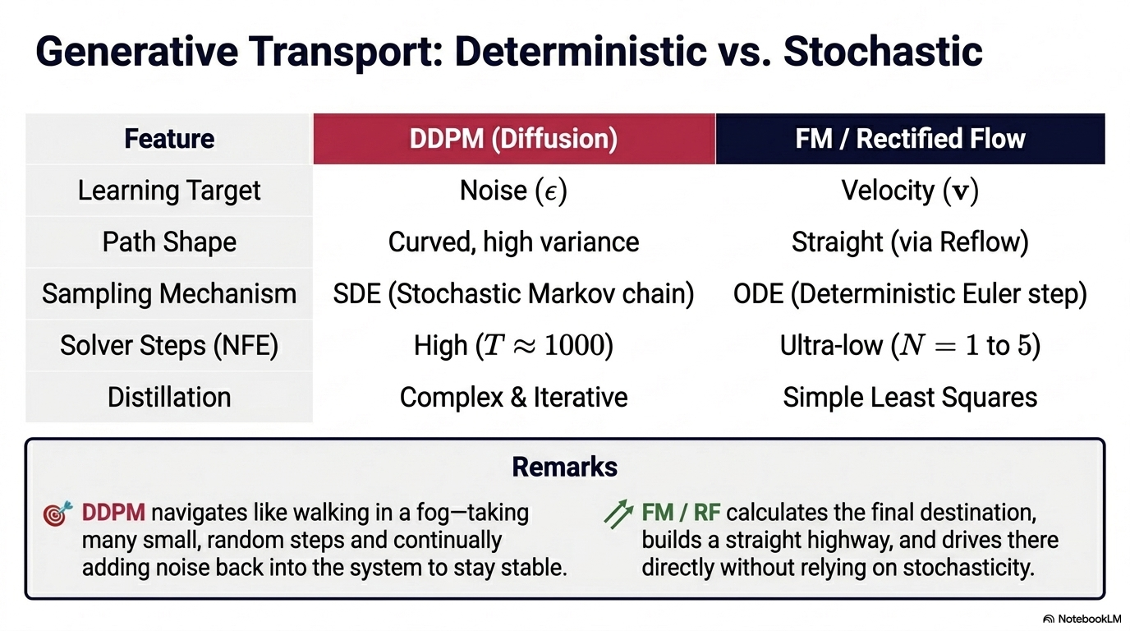

Slide 5
Minimization of Operational Cost ("Wall-Clock Cost" / Inferenz-Effizienz)
NFE (Number of Function Evaluations): The total number of separate times the neural network must be executed to construct a single final image.
Inferenz-Zeit (ms) (Latency): The actual physical time measured in millisekunden (ms) required by the hardware to complete the entire generation cycle.
Mathematical Formulation Stability ("Stability" / Geometrie & Pfad-Präzision)
Abweichung (MSE) (Mean Squared Error): A metric measuring how much the model's predicted path drifts from a perfectly straight line between the starting noise and the target image. A stable, straight path minimizes integration errors.

Slide 6
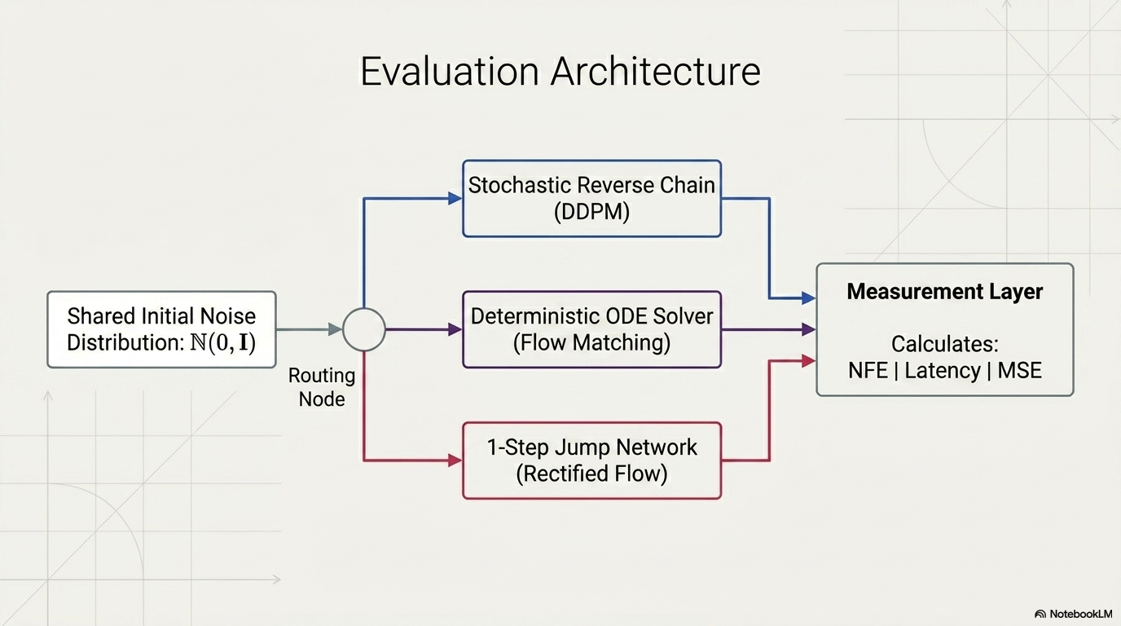

Slide 7
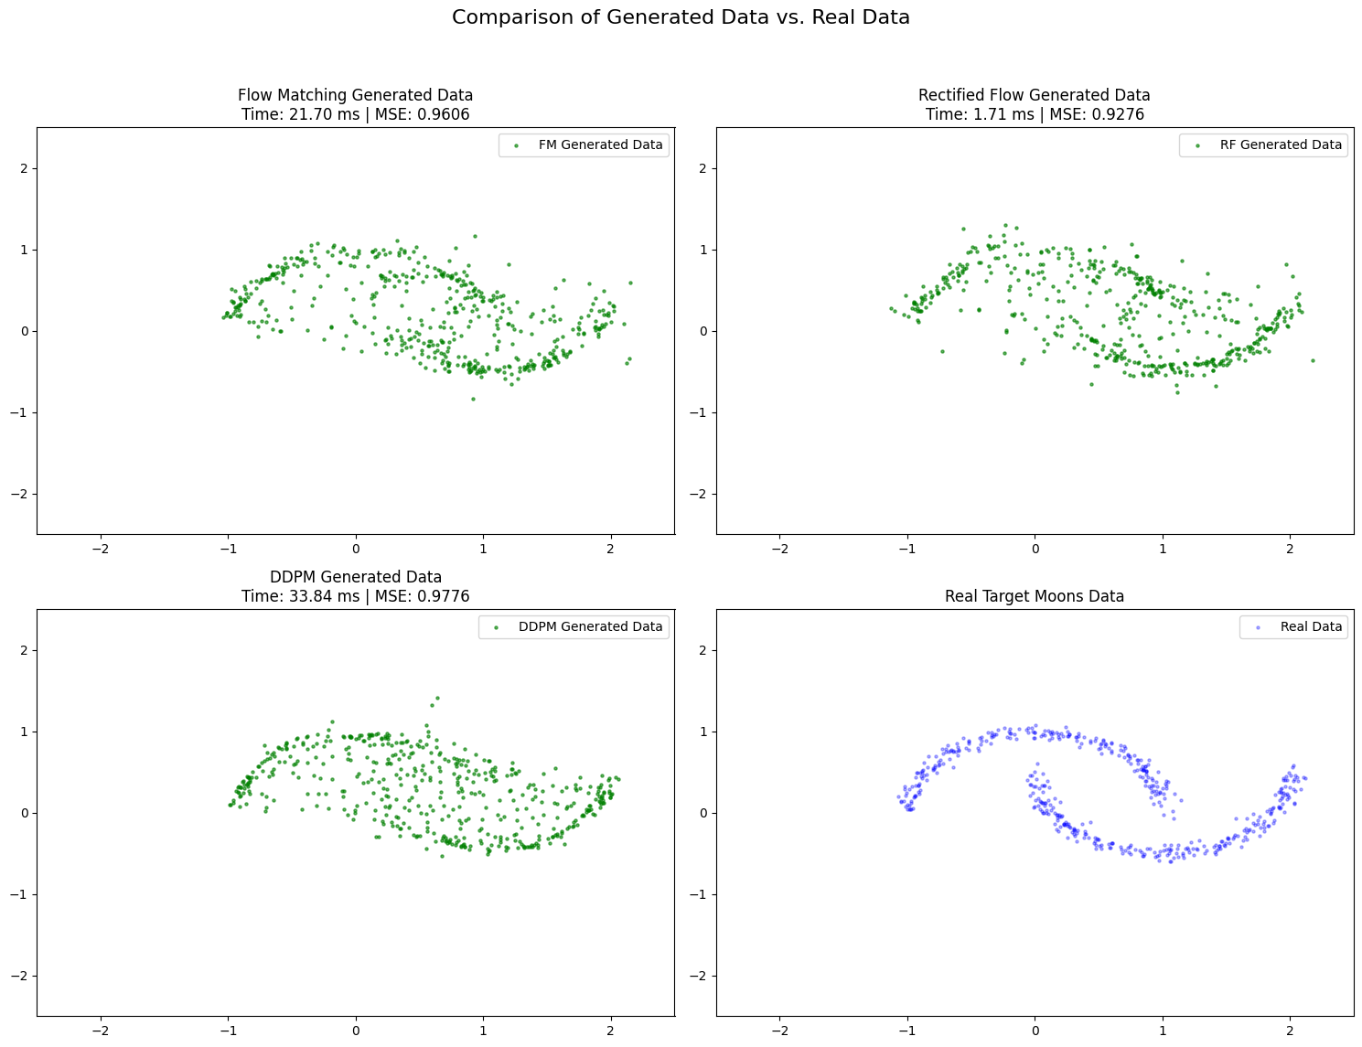

Slide 8
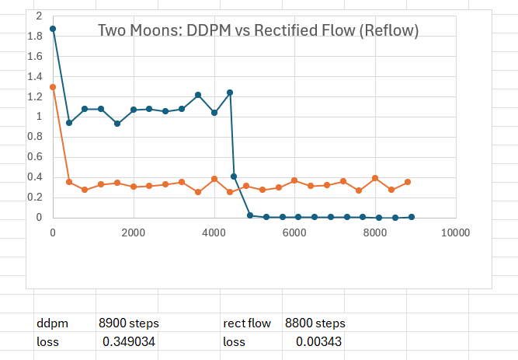

Slide 9
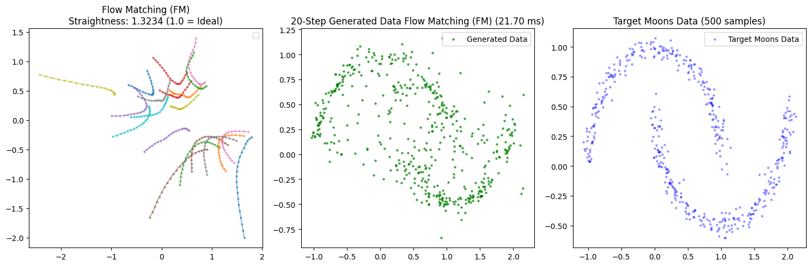
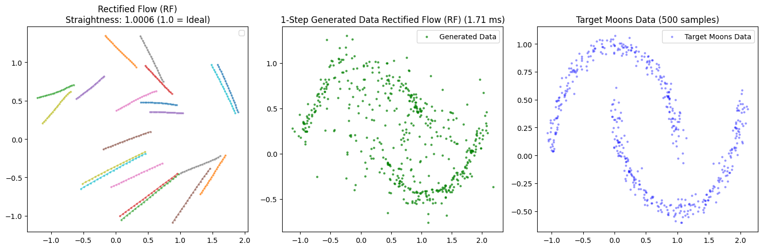

Slide 10
DDPM/RF Models that work on Celeb A64
24k Images for training
½ - 2 days training
NFE 1000 steps
Sinusoidal time embedding
U-net

Slide 11
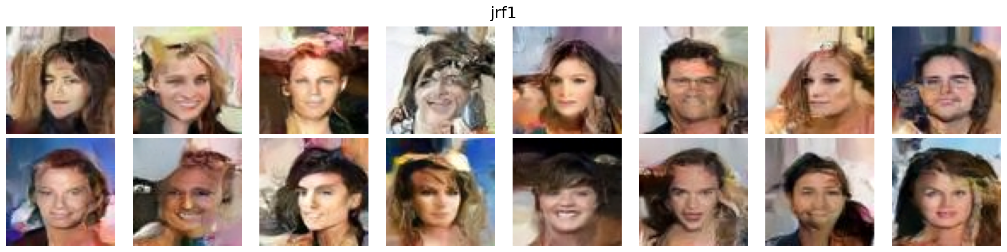
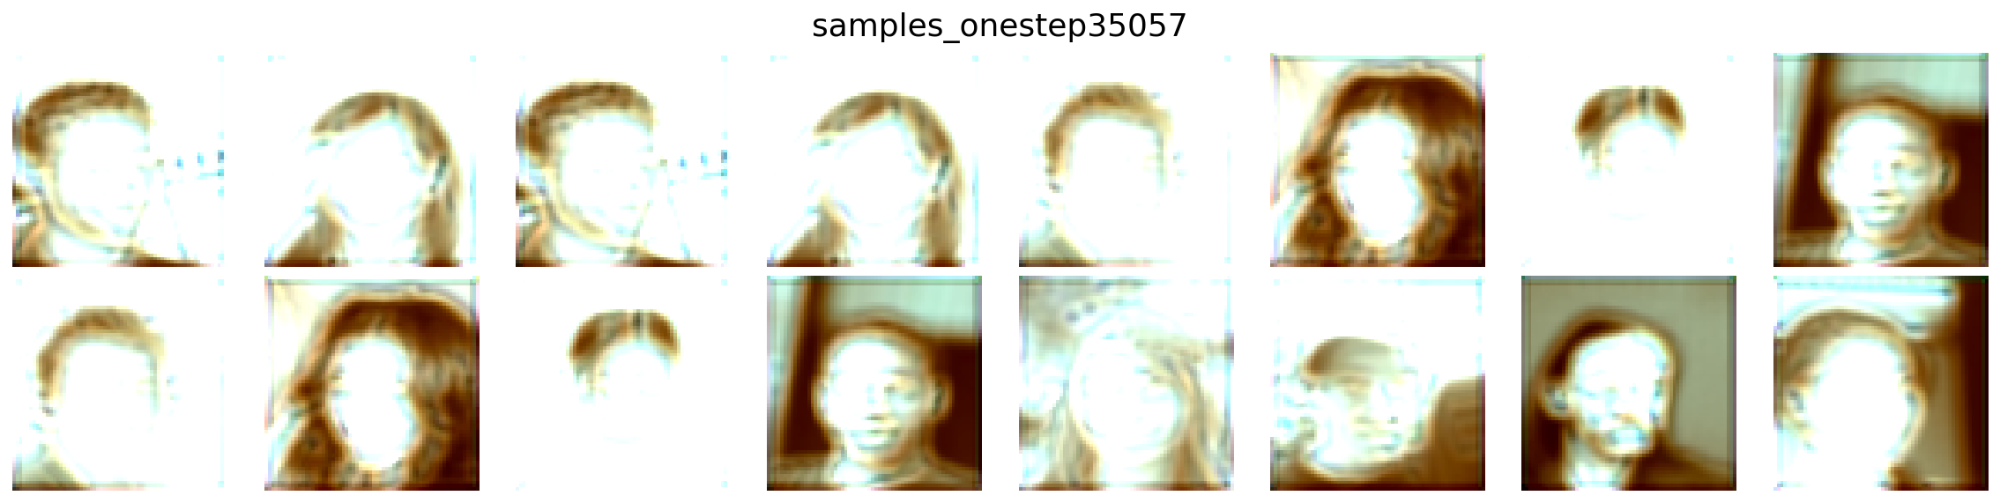
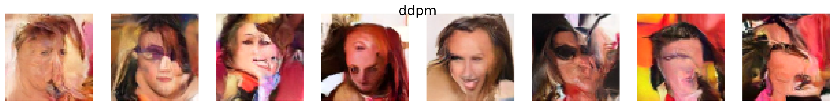

Slide 12
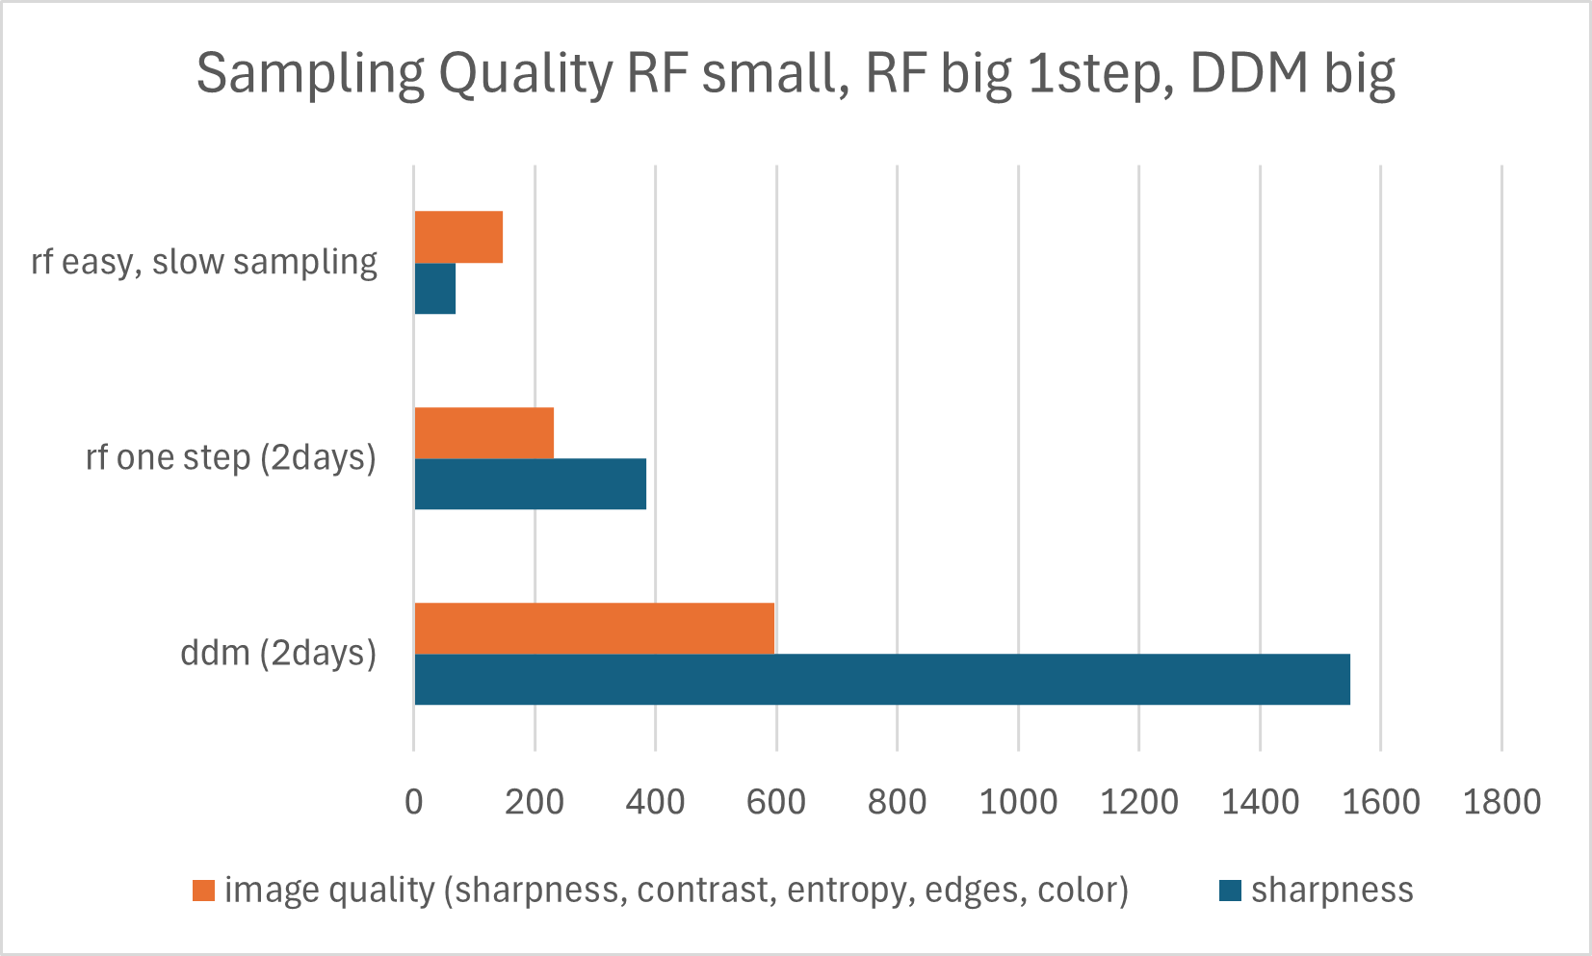
Image Quality CelebA64 - 3 models

Slide 13
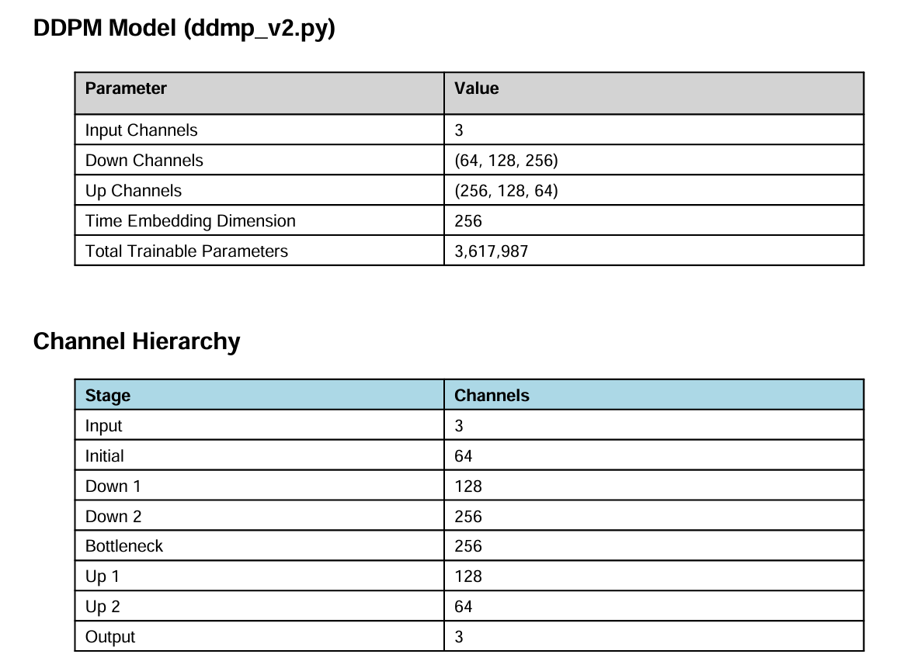
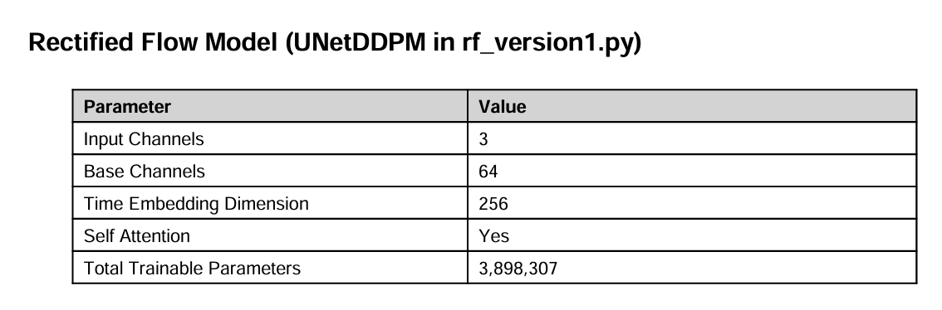

Slide 14
Thank you

Slide 15
Used features DDPM
- Originale DDPM
- Linear beta schedule
- Epsilon prediction objective
- Maxpooling
- Residual Blocks
Group Norm
LOSS MSE
IMAGE_SIZE = 64
BATCH_SIZE = 1
EPOCHS = 20
TIMESTEPS = 1000
LR = 2e-4

Slide 16
Celeb A64 – RF Model
- Maxpooling
- Residual Blocks
Unet
Loss MSE
IMAGE_SIZE = 64
BATCH_SIZE = 64
EPOCHS = 3
TIMESTEPS = 1000
LR = 2e-4

