Slide 1
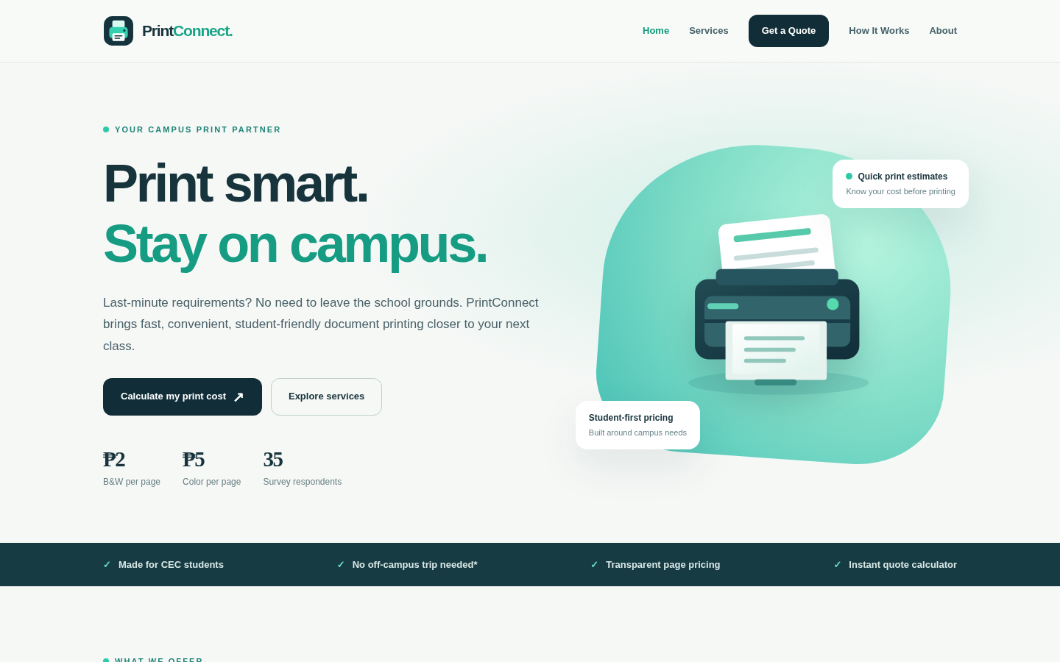
EVENT-DRIVEN PROGRAMMING • FINAL PROJECT
PRINT
CONNECT
An on-campus printing website
powered by Python + PyScript
Zianne B. Pontanar + Daniel D. Pacundo
Notes:
Presenter: Zianne. Suggested duration: 45 seconds.
Good day, everyone. We are Zianne B. Pontanar and Daniel D. Pacundo, the co-founders of PrintConnect. For our Event-Driven Programming final project, we transformed the business idea from our Business Analytics feasibility study into a functional website. The site is made for students who want to estimate the cost of printing academic documents without leaving campus just to ask for a price. Today we will explain the problem, introduce the pages and business process, demonstrate the website, and explain the important code and PyScript events. We will also identify which parts were assigned to each member.

Slide 2
BUSINESS PROBLEM
Why does PrintConnect matter?
Our survey of 35 active students identified a campus printing inconvenience.
94.3%
97.1%
100%
33 out of 35 students print off-campus
34 out of 35 cite high price as a frustration
All 35 rated on-campus use likely or very likely
SOURCE PrintConnect Business Analytics study • 35 respondents • not the whole school population
PRINTCONNECT • EVENT-DRIVEN PROGRAMMING
02
Notes:
Presenter: Zianne. Suggested duration: 45 seconds.
We started by studying the students’ printing habits. In our survey with 35 respondents, 33 students, or 94.3 percent, said they usually print at shops outside the campus. Thirty-four of the 35, or 97.1 percent, identified high prices as a frustration. All 35 respondents said they were likely or very likely to use an on-campus printing service. These results describe only our surveyed group, but they helped us identify a real problem to address. PrintConnect aims to reduce unnecessary trips, make expected charges transparent, and give students a simpler way to plan their printing.

Slide 3
BUSINESS CONCEPT
An easier way to print on campus
PrintConnect proposes an accessible kiosk supported by a simple digital price-estimation website.
01
02
03
Affordable
Convenient
Transparent
Proposed student-oriented prices: ₱2 for B&W and ₱5 for color per printed page.
Students can view services and pricing without asking multiple print shops.
The website calculates a quote before a student visits a physical print station.
Scope: A proposed business and academic website prototype — not a live print kiosk or payment system.
PRINTCONNECT • EVENT-DRIVEN PROGRAMMING
03
Notes:
Presenter: Zianne. Suggested duration: 39 seconds.
Our proposed business is an on-campus printing station that focuses on affordable and accessible services. The main services include black-and-white printing, colored printing, photocopying, scanning, and possible basic formatting assistance. Our website supports the business by introducing these services and allowing a student to calculate a quote. We use two pesos per black-and-white page and five pesos per colored page because those are the rates in our final financial feasibility model. This is a school project prototype, so we do not claim that a real kiosk is currently operating or that the website takes payments.

Slide 4
PROJECT OBJECTIVES
A simple stack, based on what is needed
The instructor requires PyScript interaction and evidence of event-driven programming.
HTML5
Five semantic pages and student forms
CSS3
Modern responsive site, no UI framework
PyScript
Browser-based Python event handlers
Python
Pure pricing calculations and tests
No database
Local on-screen quotations; no records or uploads
PRINTCONNECT • EVENT-DRIVEN PROGRAMMING
04
Notes:
Presenter: Zianne. Suggested duration: 44 seconds.
We decided to keep the technology stack intentionally simple. HTML gives the pages their structure, and CSS handles the visual design and mobile layout. We used a very small amount of ordinary JavaScript only for the mobile navigation menu. The required business functionality comes from Python running through PyScript in the browser. We separated the pricing formula into a pure Python file so it can be tested independently. There is no database, backend server, sign-in, or payment gateway because the site only needs to demonstrate how a print estimate works. That lets us focus clearly on the event-driven requirements.

Slide 5
WEBSITE ARCHITECTURE
Five clear pages
Each page has a purpose, so students can navigate the business without confusion.
01
Home
Welcome, rates and student benefits
02
Services
Printing choices and per-page prices
03
Get a Quote
Interactive PyScript estimator
04
How It Works
Proposed process and FAQ
05
About
Founders, mission and survey data
PRINTCONNECT • EVENT-DRIVEN PROGRAMMING
05
Notes:
Presenter: Zianne. Suggested duration: 43 seconds.
Here is the structure of our website. There are five pages. The Home page introduces PrintConnect, highlights prices, and invites users to estimate their print costs. The Services page explains black-and-white printing, colored printing, photocopying, and scanning. The Get a Quote page contains our main interactive calculator. How It Works explains the proposed business process and answers common questions. Finally, the About page lists the two co-founders and summarizes important survey findings. We kept the navigation consistent throughout the website so that a visitor can move between these pages easily.

Slide 6
WEBSITE DEMONSTRATION
Home page
First impression: brand, service value and a direct call to action.
What to show
Brand and headline
₱2 / ₱5 rates
Quote button
PRINTCONNECT • EVENT-DRIVEN PROGRAMMING
06
Notes:
Presenter: Zianne. Suggested duration: 37 seconds.
This is the Home page. The first section introduces PrintConnect with our name, logo, and the main message: print smart and stay on campus. We display the per-page printing rates and give students a clear button to calculate their printing cost. Further down the page are service cards and a short explanation of the process. In the recorded demo, I will click the buttons and show that they lead to the correct pages. The purpose is to make the website understandable even to someone using it for the first time.

Slide 7
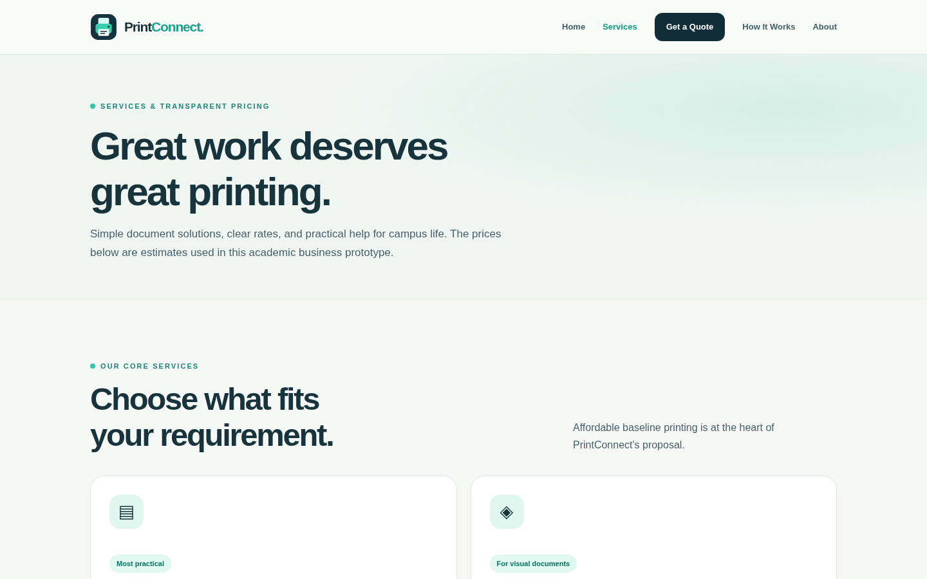
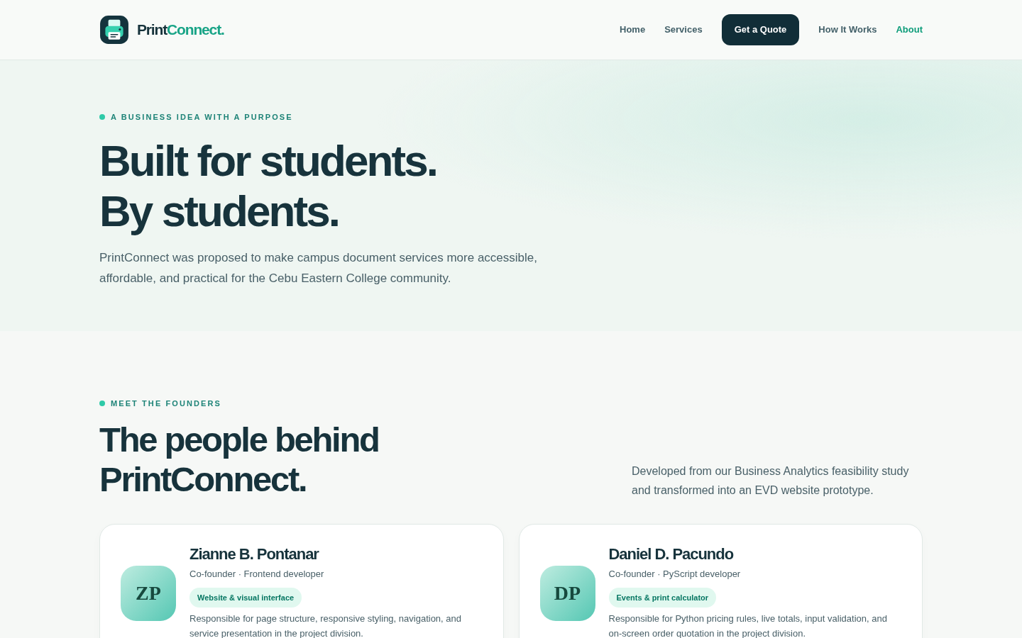
WEBSITE DEMONSTRATION
Services and About pages
Students can view pricing and see who proposed the PrintConnect business.
SERVICES: rates and planned offers
ABOUT: founders and survey evidence
PRINTCONNECT • EVENT-DRIVEN PROGRAMMING
07
Notes:
Presenter: Zianne. Suggested duration: 37 seconds.
On the Services page, we show the two primary printing types and their rates. We also list photocopying, scanning, and formatting as proposed kiosk services. We do not invent separate prices for those because the study did not finalize them. On the About page, we introduce both founders, Zianne B. Pontanar and Daniel D. Pacundo. We also explain why we made the business and show supporting survey statistics. This page gives the website an identity and connects our programming project to the business concept used in our earlier subject.

Slide 8
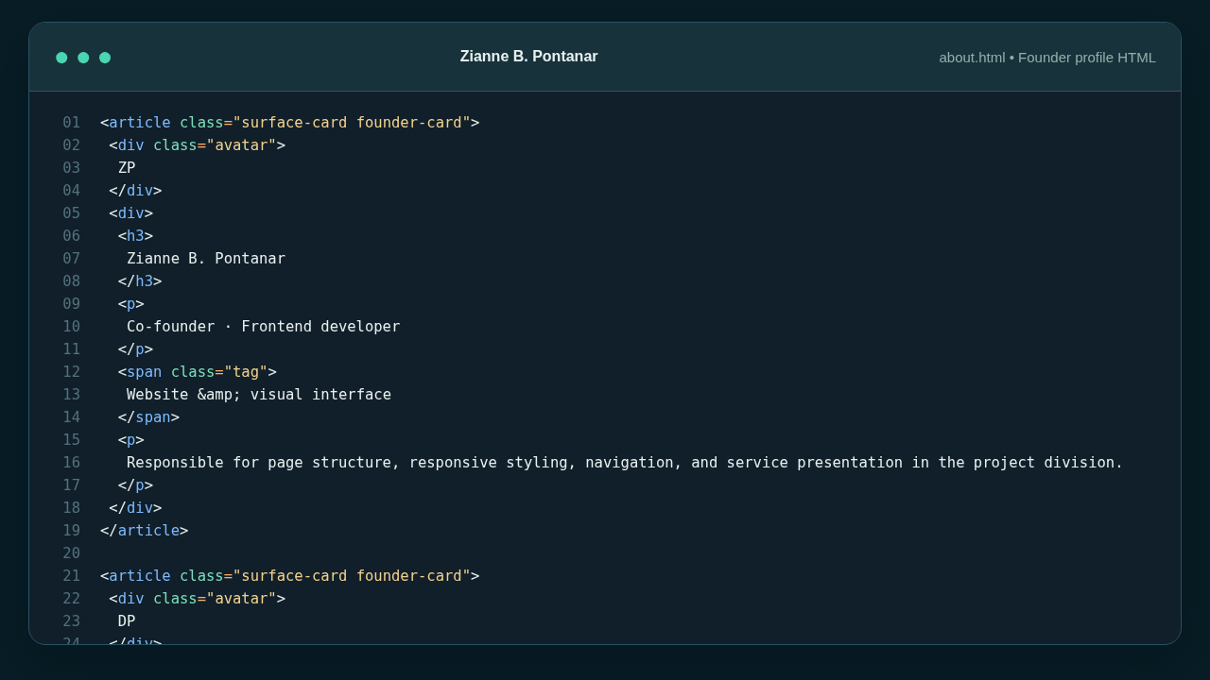
ZIANNE’S CODE CONTRIBUTION
HTML structure and founder information
Actual HTML excerpt assigned to Zianne B. Pontanar.
Key points
Semantic HTML
Founder cards
Readable content
PRINTCONNECT • EVENT-DRIVEN PROGRAMMING
08
Notes:
Presenter: Zianne. Suggested duration: 52 seconds.
This slide shows an actual excerpt of the source code for our About page. For my assigned portion, I worked on structuring the website and presenting business information clearly. Here, the HTML uses article elements for founder cards, headings for the founders’ names, and descriptive text for each role. There are two separate founder cards so both group members are equally represented. Organizing the page into semantic elements makes it easier to style and maintain. I also connected the pages through shared navigation links and maintained a consistent website header and footer. The screenshot comes from the actual project file, not a mock example.

Slide 9
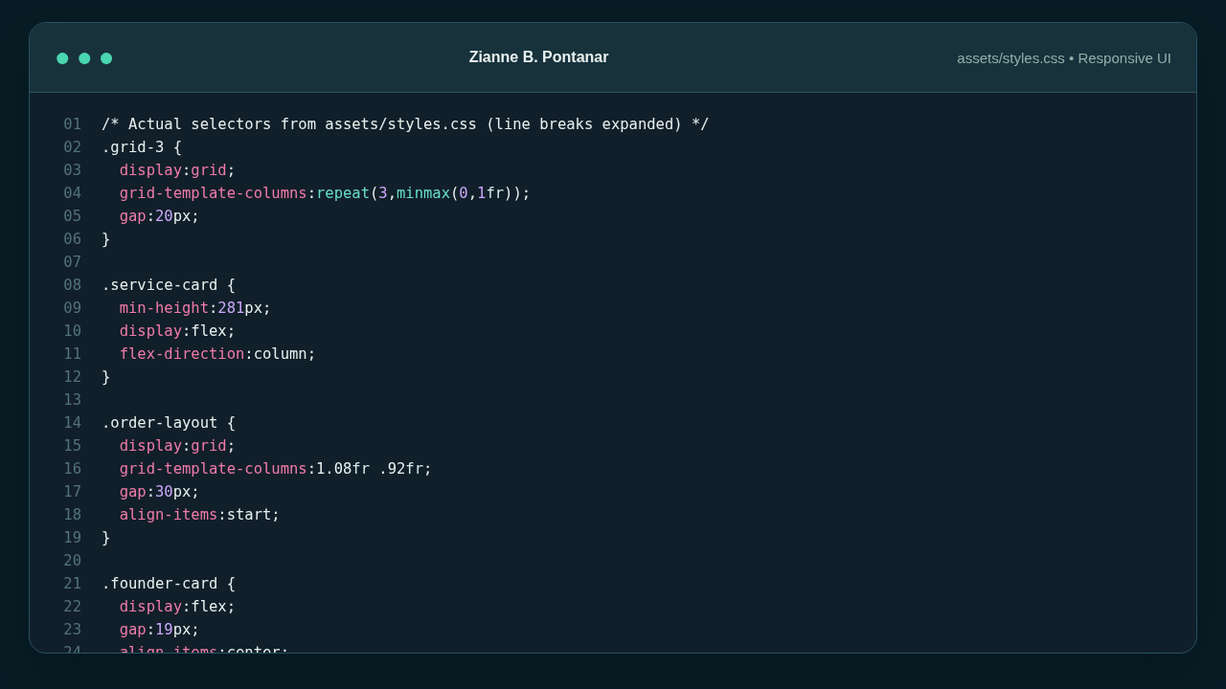
ZIANNE’S CODE CONTRIBUTION
Responsive CSS and mobile layout
The design adapts to narrower screens while keeping the quote page usable.
PRINTCONNECT • EVENT-DRIVEN PROGRAMMING
09
Notes:
Presenter: Zianne. Suggested duration: 55 seconds.
My second main contribution is the CSS. This source screenshot shows selectors for grids, service cards, the navigation menu, and responsive layouts. On large screens, cards can appear in two or three columns. On smaller screens, media queries change them to a single column so the content does not overflow. I also styled the print calculator form, buttons, service cards, and founder cards. The mobile screenshot on the right illustrates how the layout looks on a narrow screen. For the phone navigation, a small JavaScript click listener opens and closes the menu, but our core printing logic is still written with PyScript, as the instructor requires.

Slide 10
DANIEL D. PACUNDO • PYTHON & INTERACTIVITY
From user action
to instant feedback.
INPUT
PYTHON
UPDATE
A student changes a field
PyScript runs a handler
The quote changes on screen
Notes:
Presenter: Daniel. Suggested duration: 34 seconds.
Now I will explain the interaction and Python side of the project. This is the part where the website becomes more than a static business brochure. Event-driven programming means that the program responds to actions instead of simply running all calculations once. For example, when a student changes a number or selects a different printing type, the browser triggers an event. PyScript calls the corresponding Python function, the function recalculates the price, and then the website updates the displayed total immediately.

Slide 11
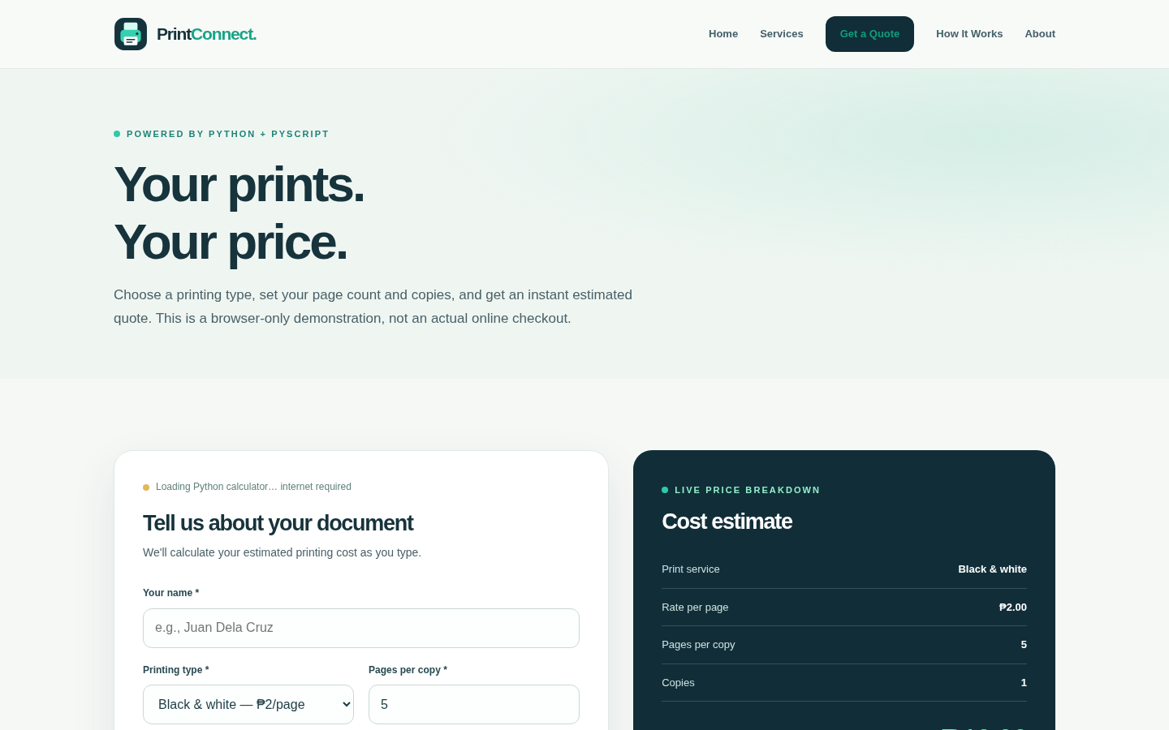
INTERACTIVE WEBSITE DEMONSTRATION
The Get a Quote page
Enter a print type, number of pages and number of copies; the total is recalculated.
Live demo steps
1. Choose color
2. Type 5 pages
3. Set 2 copies
4. Check ₱50.00
5. Generate quote
PRINTCONNECT • EVENT-DRIVEN PROGRAMMING
11
Notes:
Presenter: Daniel. Suggested duration: 55 seconds.
This is the main interactive page. For the demonstration, I will open Get a Quote and wait for the label that says PyScript ready. Then I will choose colored printing, enter five pages, and set two copies. The price per colored page is five pesos, so five multiplied by two multiplied by five is fifty pesos. The cost estimate should update immediately. I will also choose a local reference document so the selected filename appears on the screen. However, the document is never actually uploaded. When I enter a name and generate a quote, the page displays a local summary rather than sending a real print order.

Slide 12
EVENT-DRIVEN PROGRAMMING
How the event flow works
PyScript uses decorators to connect HTML actions to Python functions.
1
2
3
4
Browser action
→
Event listener
→
Validation + math
→
DOM update
Input, change, click, or submit
@when(...) triggers Python
Check values, calculate cost
Change price, alert, preview
Example: CHANGE "bw → color" → Python calculate_total(...) → updated estimated total
PRINTCONNECT • EVENT-DRIVEN PROGRAMMING
12
Notes:
Presenter: Daniel. Suggested duration: 43 seconds.
This diagram summarizes how event-driven programming happens. First, the user performs an action, such as entering a new number or changing the printing type. Second, the browser sends the appropriate event, and the PyScript when decorator identifies which Python function should run. Third, our program reads the input, checks that it is valid, and calculates the price. Finally, Python changes the text of elements already on the webpage through the document object model. For example, choosing color printing changes the rate from two pesos to five pesos and updates the estimated total without needing to reload the page.

Slide 13
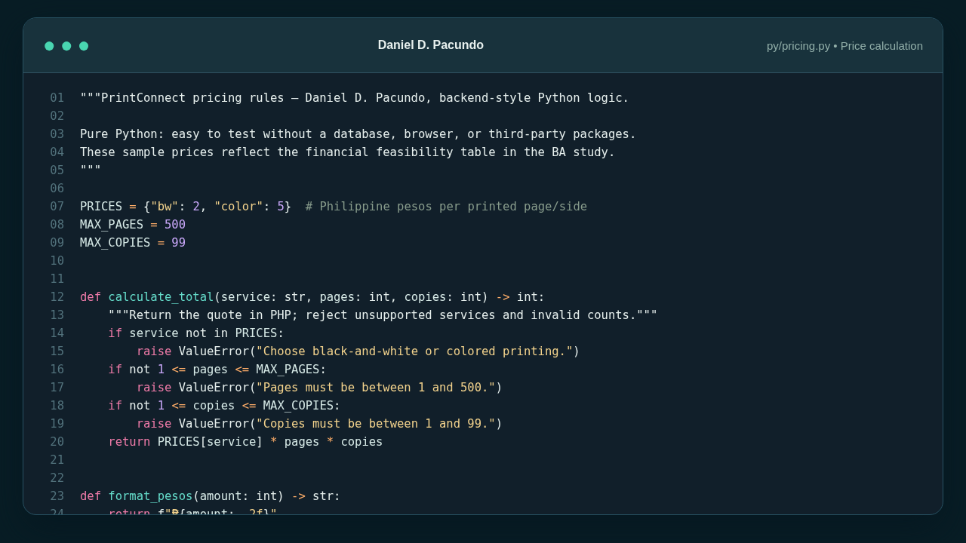
DANIEL’S CODE CONTRIBUTION
Pure Python price calculator
The formula is separate from HTML and works without a database.
Formula
RATE
× PAGES
× COPIES
B&W: ₱2
Color: ₱5
PRINTCONNECT • EVENT-DRIVEN PROGRAMMING
13
Notes:
Presenter: Daniel. Suggested duration: 55 seconds.
This is the pricing module that I am responsible for explaining. The program uses a dictionary named PRICES with two valid services: black-and-white at two pesos and color at five pesos per page. The calculate_total function receives a service, number of pages, and number of copies. It validates that the service is supported, that pages range from one to five hundred, and that copies range from one to ninety-nine. If any input is invalid, it raises a ValueError. Otherwise, the function multiplies the price per page, the number of pages, and the number of copies. We keep this file independent from the webpage so we can test the calculation on its own.

Slide 14
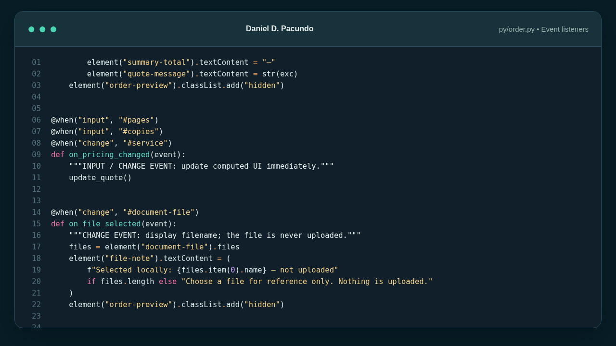
DANIEL’S CODE CONTRIBUTION
Input and change event handlers
PyScript @when decorators respond as students interact with the form.
EVENTS
input
change
update_quote()
PRINTCONNECT • EVENT-DRIVEN PROGRAMMING
14
Notes:
Presenter: Daniel. Suggested duration: 56 seconds.
The next screenshot is a real excerpt of the PyScript event code. I used the when decorator to listen for input events on the pages and copies fields and for change events on the service dropdown. These events call the function that updates the quote. It reads the latest values, uses the pricing module, and writes the new numbers into the summary area using textContent. There is also a change handler for the document selector. It only reads and displays the filename of the chosen local file. It does not read the document contents or upload the file. This shows how the interface reacts immediately to user actions.

Slide 15
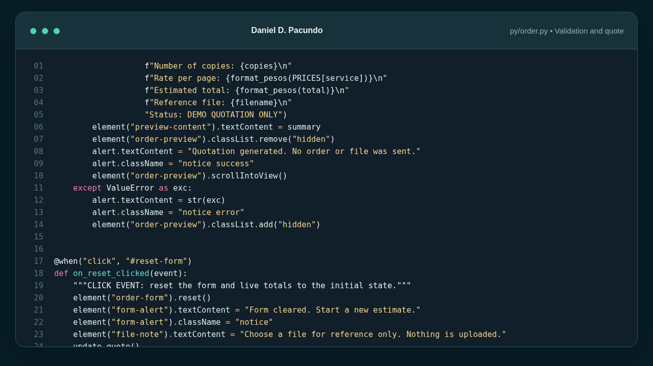
DANIEL’S CODE CONTRIBUTION
Form submission and validation
A submit event generates a browser-only quote and a click event resets the form.
submit
Validate name, service and counts.
click
Reset fields and the estimate.
PRINTCONNECT • EVENT-DRIVEN PROGRAMMING
15
Notes:
Presenter: Daniel. Suggested duration: 54 seconds.
Here is the event handler for the form submission. First, event.preventDefault stops the browser from sending the form to another page. Then Python checks that the student entered a name and that the print details are valid. When the entries pass validation, it builds a text summary and displays it in the order preview panel. The panel is a demonstration quotation only; there is no database and no real order is submitted. If the values are invalid, the user sees an error message instead of an incorrect price. We also listen for a click on Clear Form, which resets the fields, hides the old preview, and restores the default total.

Slide 16
VERIFICATION AND LIMITATIONS
Testing the pricing rules
Pure Python tests verify correct totals and reject invalid inputs.
8 B&W pages × 2 copies
₱32
PASS
3 color pages × 4 copies
₱60
PASS
0 or 501 pages
Rejected
PASS
Invalid service "scan"
Rejected
PASS
Currency display
₱1,234.00
PASS
Scope note: tests cover Python business logic; browser PyScript must also be checked live on your computer.
PRINTCONNECT • EVENT-DRIVEN PROGRAMMING
16
Notes:
Presenter: Daniel. Suggested duration: 45 seconds.
We checked the pure Python pricing calculations using automated unit tests. For example, eight black-and-white pages with two copies should cost thirty-two pesos, and three colored pages with four copies should cost sixty pesos. We also tested invalid zero and very large counts, unsupported services, and the currency formatter. All five test cases passed. We should also run the site in a normal browser and demonstrate that PyScript loads and handles real user events; those runtime interactions are not replaced by the Python unit tests. During our recording, we will show the interactive quotation page and confirm the changing prices manually.

Slide 17
INDIVIDUAL CONTRIBUTION EVIDENCE
Two members, clear ownership
The submission requires real GitHub contributions from every member.
01
02
Zianne B. Pontanar
Daniel D. Pacundo
Frontend pages, HTML structure, navigation, CSS, responsive design, founder profiles.
PyScript event handlers, quotation form, Python pricing module, unit tests.
Before submission: create a PUBLIC repository, add both collaborators, make real commits from each account, and record a 10+ minute video. Do not fake commits.
PRINTCONNECT • EVENT-DRIVEN PROGRAMMING
17
Notes:
Presenter: Zianne + Daniel. Suggested duration: 50 seconds.
Zianne: For the individual contributions, my assigned responsibility is the visual frontend. This includes the page structure, styling, navigation, responsiveness, and founder profiles. The previous code screenshots came from my assigned files. Daniel: My assigned responsibility is the interactive quotation form, PyScript event listeners, calculation logic, validation, and Python test cases. The code screenshots show those parts as well. We also need to demonstrate our own real activity on GitHub. After reviewing the supplied project, we will each use our own GitHub accounts to contribute meaningful work and commits, add both people as collaborators, and include our recorded video. Our actual commit history must match our claims.

Slide 18
THANK YOU
Print smart.
Stay on campus.
PrintConnect • Cebu Eastern College
Zianne B. Pontanar | Daniel D. Pacundo
Notes:
Presenter: Both. Suggested duration: 31 seconds.
Zianne: To conclude, PrintConnect turns the results of our business feasibility study into a practical website concept for students. It introduces services clearly and makes the cost of printing easier to understand. Daniel: For Event-Driven Programming, the main achievement is the interactive PyScript calculator, where the site reacts to input, change, submit, and click events. We intentionally used a simple stack with no database because this meets the project scope without unnecessary complexity. Both: Thank you for watching our presentation. We are Zianne B. Pontanar and Daniel D. Pacundo, the founders of PrintConnect.

