Slide 1
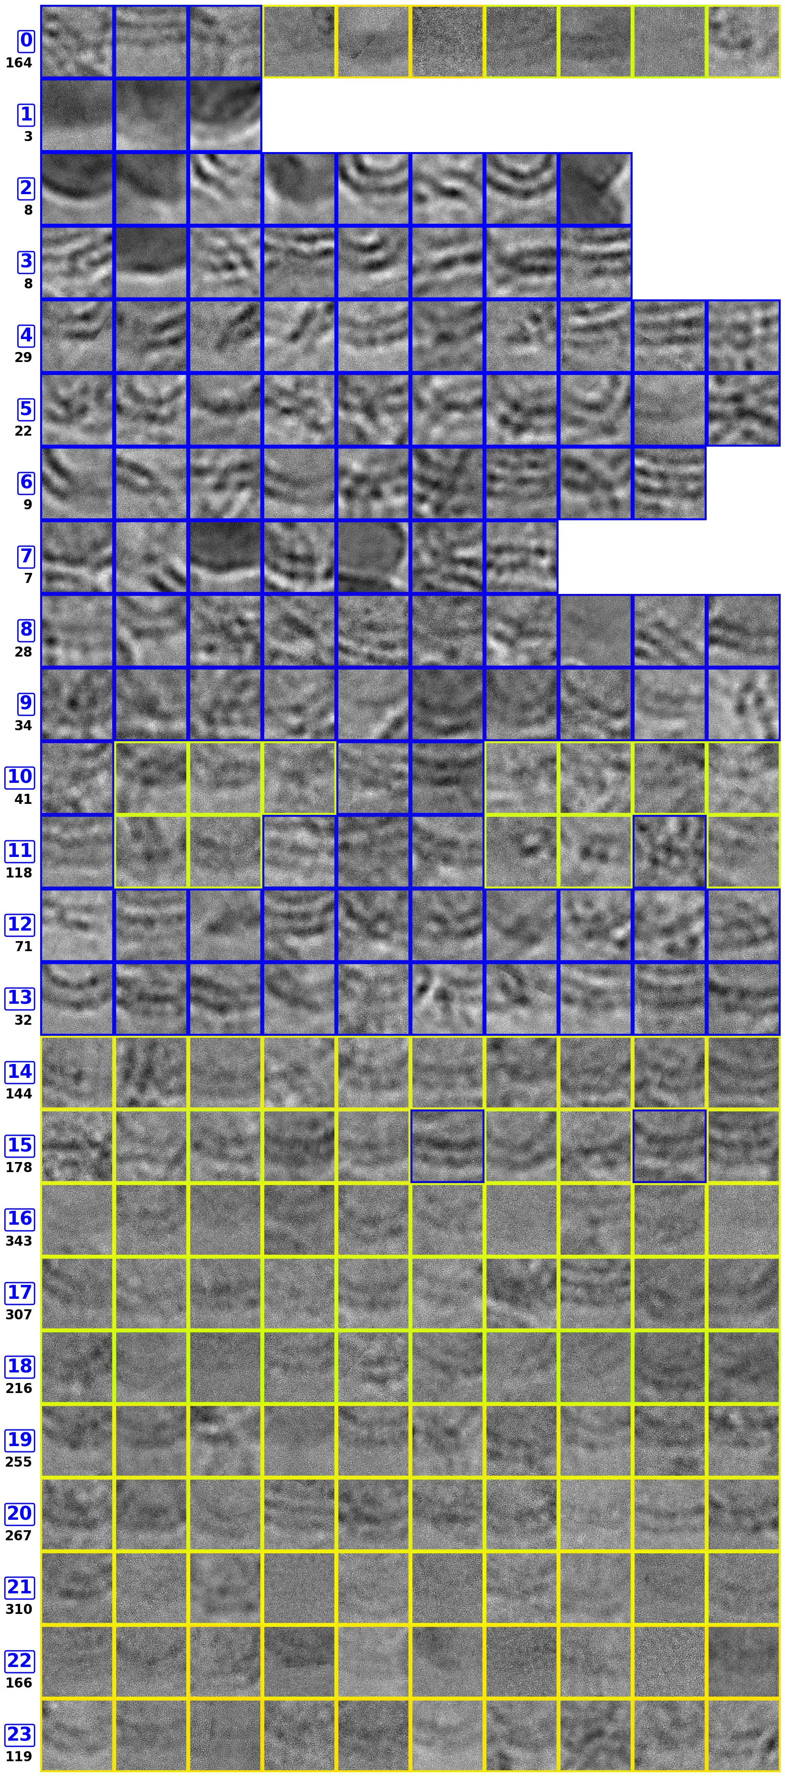
Prestin cryo-EM progress update
Denoising, exploratory embedding, and downstream classification setup
Core problem
Membrane-only patches and membrane-protein patches are visually close; the protein signal is weak and sparse.
Rendered evidence from checkpoint comparison outputs and local exploration assets.

Slide 2
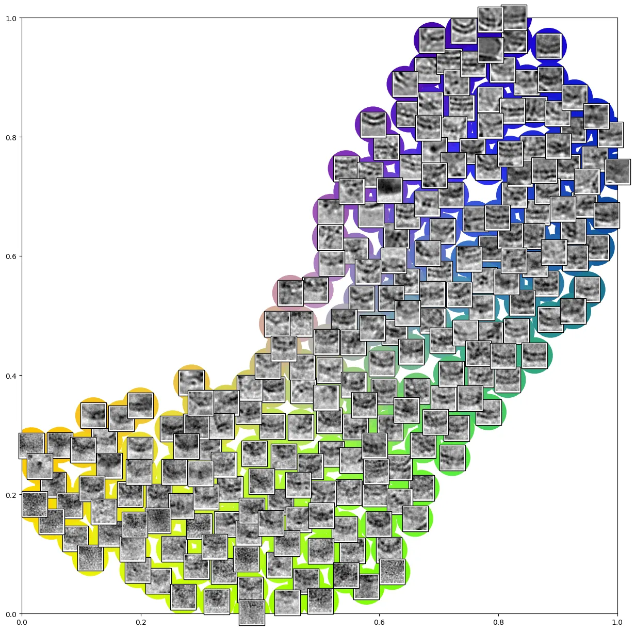
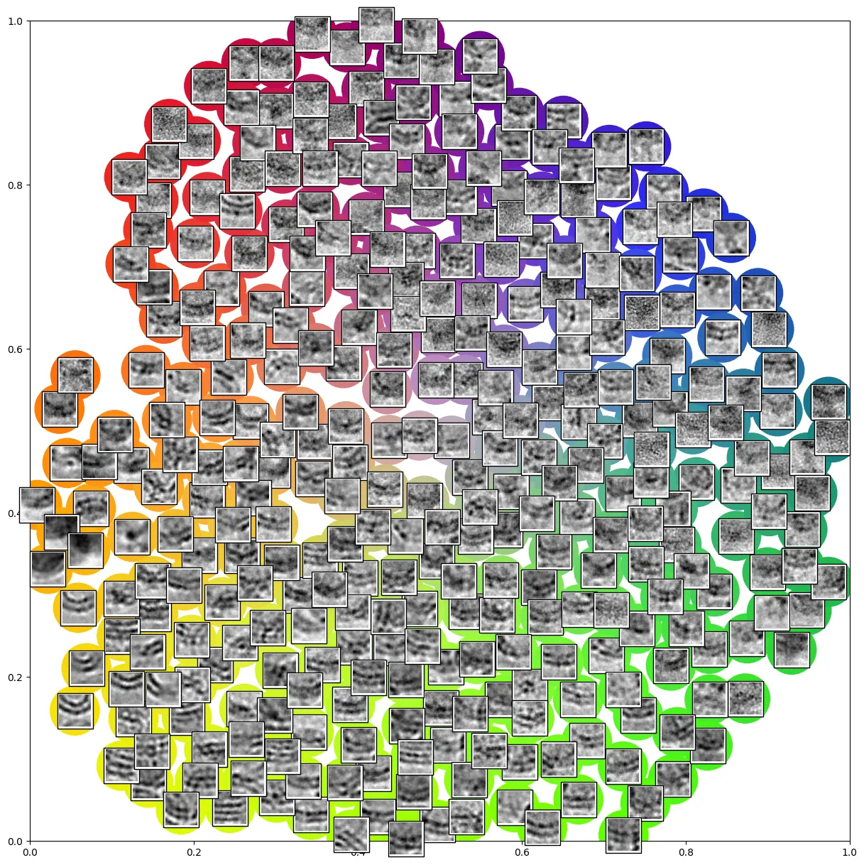
Denoising comparison: checkpoint-rendered micrographs
The denoised patches make membrane structure more readable, but low-signal embedded protein remains the hard case.
ckpt10
Early run
ckpt44
Mid run
ckpt50
Later run
Takeaway: denoising helps reveal membrane continuity and class structure, but the target decision remains subtle: membrane-only regions can look nearly identical to regions with Prestin embedded.
Source: /Users/alanye/Downloads/prestin_ckpt_compare checkpoint render folders.

Slide 3
Segmentation

Slide 4
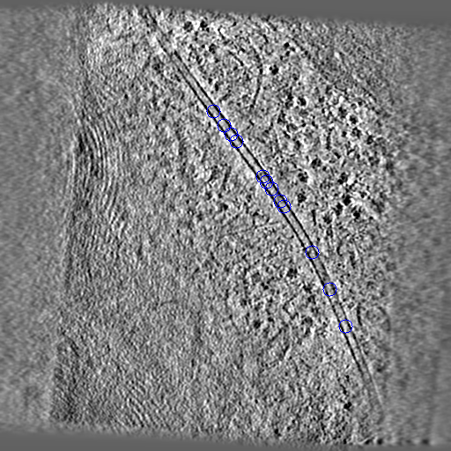
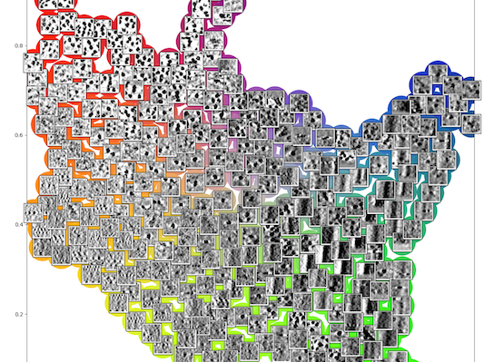
Exploration module: embedding separates structure, not labels
We adapted the MiLoPYP-style exploration path to inspect whether membrane-protein patches form separable neighborhoods.
aligned patches
encoder
projection / predictor
2D embedding
Loss objective
SimSiam-style contrastive objective: minimize negative cosine distance between paired augmented views. Lower loss is used to choose checkpoints before visualization.
Input data
DRACO-denoised micrographs; 3,000 sampled particles, 2,400 train and 600 test; aligned patch cache with box size 128.
L = -cos(p_1, z_2) / 2 - cos(p_2, z_1) / 2
Sources: cet_pick/docs/explore.md and prestin_draco_spa_manifest_3k_with_pkl_masks summaries.

Slide 5
2D CryoSPARC classification: fill-in page
Classification needs to enrich particles with embedded Prestin while rejecting membrane-only picks.
Classification evidence area
Decision challenge
Membrane signal dominates the particle box.
Prestin density is low contrast and spatially local.
Classes must separate true embedded-protein views from clean membrane-only patches.
What to add here: representative good/bad classes, selected class indices, particle counts, and the next export criterion.
Editable page reserved for CryoSPARC 2D class averages and selection notes.

