Slide 1
Introduction to
File Handling

Slide 2

Why do we use Pandas?
Ease of Use
Data cleaning & transformation
Data Analysis & Exploration
Integration with data science tools
Efficient Performance
Handling Complex Data Structures
Data Export & Saving
Using Pandas for file handling in Python streamlines the process of data manipulation, analysis, and integration with other data science tools, making it a popular choice for data professionals and scientists.

Slide 3
What is file handling?
File handling in Python refers to the process of working with files on a computer's filesystem. Python provides several built-in functions and modules to perform various operations on files, including reading, writing, creating, deleting, and closing files.

Slide 4
Pandas
Pandas is a powerful and popular open-source data analysis and data manipulation library for Python. It provides easy-to-use data structures like Series and DataFrame, designed for efficient and intuitive data manipulation, cleaning, and analysis. Developed by Wes McKinney, Pandas simplifies the handling of structured data, making it an essential tool for data scientists, analysts, and developers working with Python.

Slide 5

How to install Pandas
Pandas automatically detects the file format and loads the data into an appropriate DataFrame. Remember that you need to have Pandas and the required dependencies installed in your Python environment to use these functions. You can install them using pip if you haven't already:

Slide 6
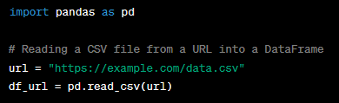
Opening a File & Reading
pd.read_csv(): Reads data from a CSV file into a DataFrame.
pd.read_excel(): Reads data from an Excel file into a DataFrame.
pd.read_json(): Reads data from a JSON file into a DataFrame.
pd.read_sql_query(): Reads data from a SQL database into a DataFrame.
pd.read_csv(url): Reads data directly from a CSV file hosted online into a DataFrame.

Slide 7
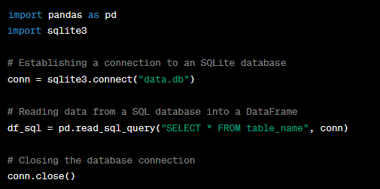
Reading From Database

Slide 8
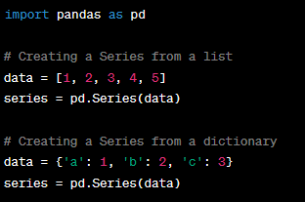
Explore Pandas: Series
A Pandas Series is a one-dimensional labeled array. It can hold data of any type (integers, strings, floats, etc.). Series has two main components: the data (values) and the index (labels). You can create a Series from a list, array, or dictionary.

Slide 9
Explore Pandas: Data Frame
A Pandas DataFrame is a two-dimensional labeled data structure with columns that can hold data of different types. It can be thought of as a table in a relational database, an Excel spreadsheet, or a dictionary of Series objects. You can create a DataFrame from a dictionary, a list of dictionaries, or from reading an external data source like CSV or Excel.

Slide 10
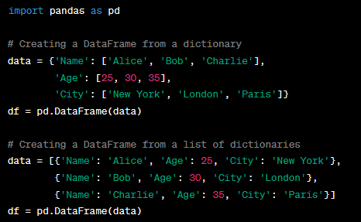
Explore Pandas: Data Frame

Slide 11

Indexing in Series:
By Label: You can access elements in a Series by the index label.
By Position: You can access elements by their position (integer index).

Slide 12



Indexing in Data Frame:
By Column Name: You can access columns in a DataFrame using the column names.
By Label: You can access rows by their index label using the loc accessor.
By Position: You can access rows by their integer position using the iloc accessor.

Slide 13

Understanding Data Types and Handling Missing Data:
Data Types:
Pandas supports various data types: integers, floats, strings, datetimes, and more. You can check the data types of a DataFrame using the dtypes attribute.

Slide 14


Understanding Data Types and Handling Missing Data:
Detecting Missing Data:
Dropping Missing Values:
Filling Missing Values:

Slide 15
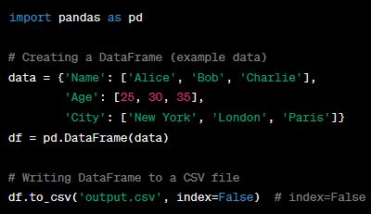
File Output with Pandas
Pandas provides the to_csv() method to write data from a DataFrame to a CSV file. By default, it includes the index and header in the output CSV file.

Slide 16
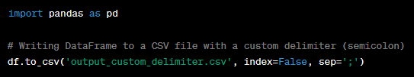
Customizing Output: Delimiter
Customizing Delimiter in CSV:
You can customize the delimiter (separator) used in the CSV file using the sep parameter in to_csv().

Slide 17
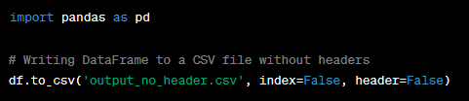
Customizing Output: Header
Customizing Header and Index:
Header: To include or exclude headers in the output file, use the header parameter. Set it to True (default) to include headers, or False to exclude headers.

Slide 18
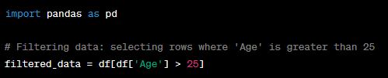
Filtering Data
Pandas allows you to filter data based on specific conditions. For example, you can filter rows where a certain column meets a particular criterion.

Slide 19

Filtering Data
You can sort a DataFrame by one or more columns using the sort_values() method.

Slide 20
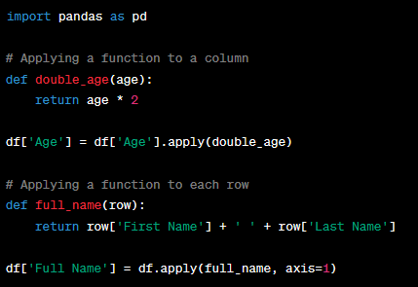
Apply Functions to Data:
Using apply():
You can apply a function to each element or row of a DataFrame using the apply() method.

Slide 21
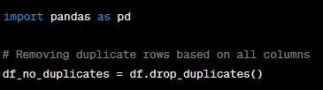
Removing Duplicates
Pandas provides methods to handle duplicate data, like drop_duplicates().

Slide 22
Assignment 17:
Requirement:
Analyze a dataset containing student information
Calculate grades based on scores
Count words in comments
Display specific student information.
Make a Menu for the Operations

Slide 23
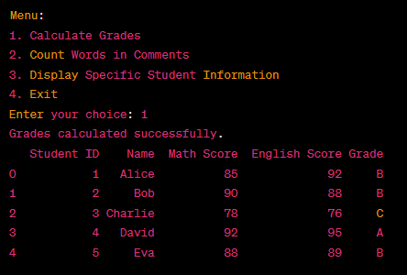
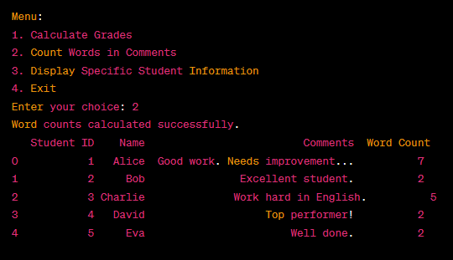
Assignment 17: Output

