Slide 1
Introduction to
Coding

Slide 2


What are Expressions?
An expression is a combination of values, variables, operators, and function calls that can be evaluated to produce a result. In simpler terms, an expression is anything that can be calculated or computed. Expressions can involve arithmetic, comparisons, logical operations, and more. Examples of expressions include:

Slide 3
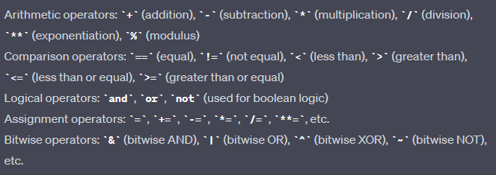
What are Operators?
Operators are symbols or keywords that are used to perform various operations on values and variables. Python provides a wide range of operators for performing arithmetic, comparisons, logical operations, and more.

Slide 4
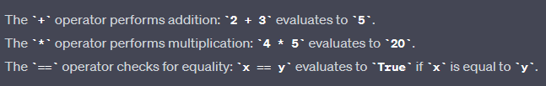
What are Operations?
Operations refer to the actions performed by operators on operands (values or variables). Each operator has a specific operation associated with it. For example:

Slide 5


What is Increment (‘+=’) ?
The increment operation involves adding a value to a variable, effectively increasing its value.
You can also increment by values other than 1:

Slide 6


What is Decrement (‘-=’) ?
The decrement operation involves subtracting a value from a variable, effectively decreasing its value.
Similarly to increment, you can decrement by values other than 1:

Slide 7
Assignment 04: Operations & Operators
Objective: Create a basic calculator program that performs arithmetic operations using assignment operators.
Your program should allow the user to input two numbers.
The user should then choose an arithmetic operation (addition, subtraction, multiplication, division).
Perform the chosen operation using assignment operators and display the result.
Use appropriate error handling to handle division by zero scenarios using conditional statement (Optional).
Provide clear prompts and user instructions throughout the program.

Slide 8
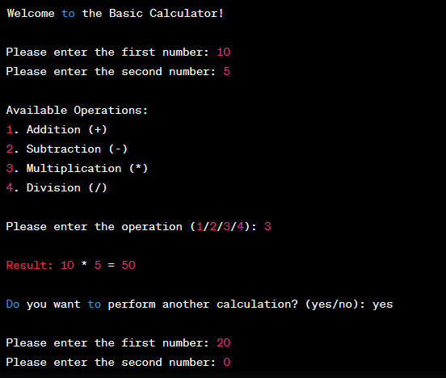
Example Output

Slide 9
Bonus Task: Optional
Objective: Enhance the basic calculator program by incorporating loops and utilizing variable manipulation methods.
Extend the calculator program from the previous assignment.
Add an additional operation to calculate the factorial of a number.
Implement a loop that lets the user perform calculations continuously until they explicitly choose to exit.
Provide an option for the user to see the history of their calculations.
Utilize variable manipulation methods (e.g., swapping variables) in at least one operation.

Slide 10
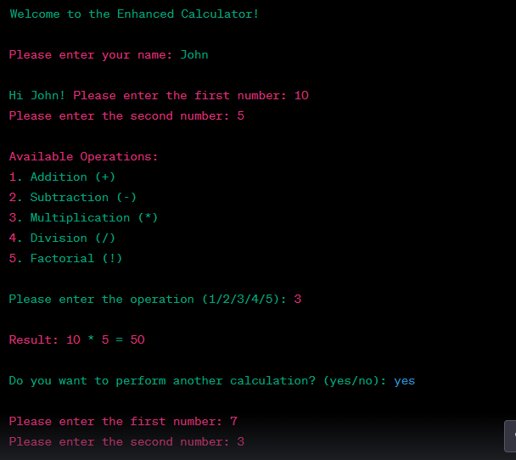
Example Output

