Slide 1
Introduction to
Repeat Statements

Slide 2
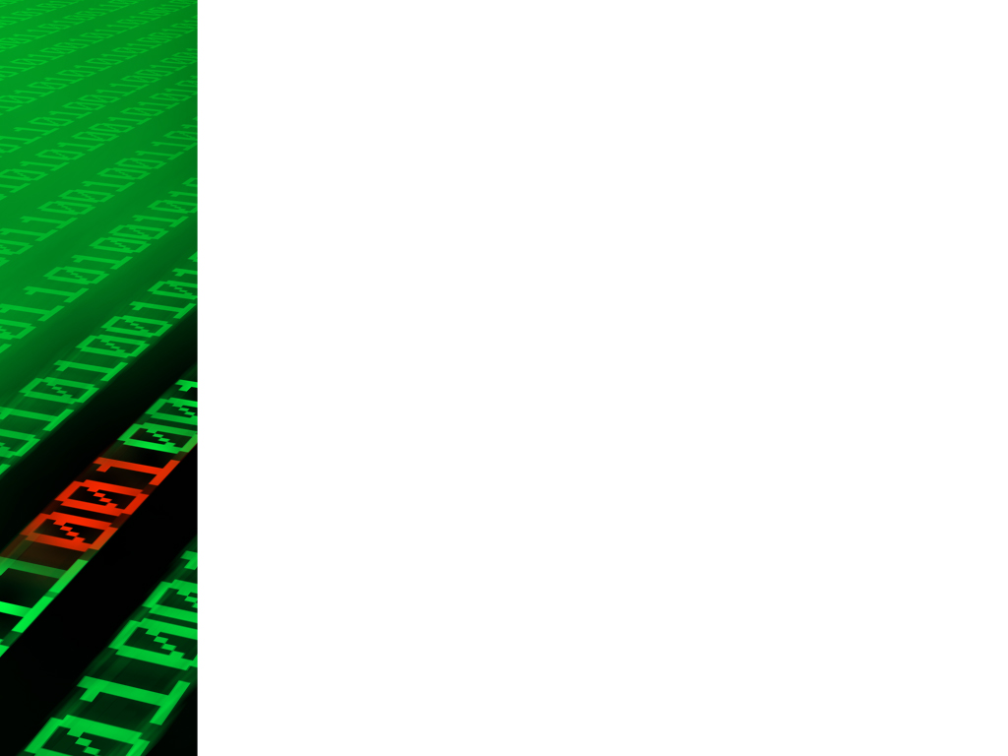
Why do we use Repeat Statements?
In Python, repetition statements (loops) are used for the same fundamental reasons as in any other programming language. Specifically in Python, loops are employed to achieve tasks such as:
Iterating over Collections
Performing Batch Operations
Conditional Processing
Generating Patterns and Sequences
File Processing
User Input Handling

Slide 3
Types of Repeat Statements
There are only two main types of loops in python
For loop
While loop
For Loop:
The ‘for’ loop is primarily used for iterating over a sequence (such as a list, tuple, string, or range) or any iterable object. It iterates over each item in the sequence and executes a specified block of code for each item.

Slide 4



Syntax & Example: for loop
Syntax for loop:
Example:
Output:

Slide 5

While Loop:
The ‘while’ loop is used when you want to execute a block of code repeatedly as long as a certain condition remains true. The loop continues iterating until the condition evaluates to ‘False’.
Syntax of while loop:

Slide 6
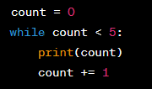
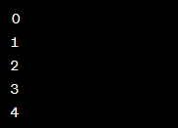
Example: while loop
The block of code inside the loop is executed repeatedly as long as the ‘condition’ remains ‘True’.

Slide 7
Explanation:
Both types of loops have their own advantages and use cases. Use a for loop when you have a predefined sequence or iterable to iterate through. Use a while loop when the number of iterations is uncertain and depends on a condition. It's important to ensure that the condition in a while loop eventually becomes False to prevent infinite loops.

Slide 8
Loops in other languages:
Python does not have a built-in do-while loop or a direct for each loop as found in some other programming languages. However, Python provides alternative constructs and idioms to achieve similar functionality.
Do-while loop:
A do-while loop is used to execute a block of code at least once and then repeatedly as long as a specified condition holds true. Python does not have a direct do-while loop construct like some other languages do, but the same behavior can be achieved using a while loop with a conditional check at the end.

Slide 9
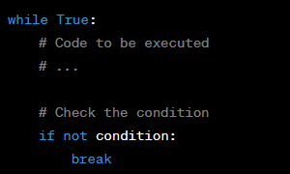
Syntax : do-while

Slide 10

For-each loop:
A for each loop is used to iterate over elements in a collection or sequence without explicitly managing loop variables. While Python does not have a direct for each loop construct, the for loop can effectively achieve the same functionality by iterating over iterable objects.

Slide 11
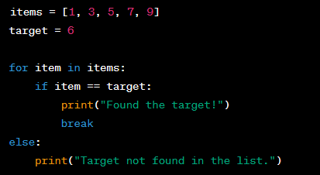
Using else with loops:
This feature can be particularly useful in scenarios where you want to perform an action after a loop finishes running its iterations. For example, let's say you have a loop that searches for a specific item in a list and you want to handle the case where the item isn't found:

Slide 12
Class Activity: Repeat Statements
Lets have some examples to learn more about Repeat Statements. Make Guess a Number Game

Slide 13
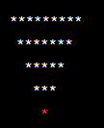
Assignment 06: Repeat Statements
Objective: Print a downward full pyramid pattern of stars using loops.
Output should be:

Slide 14
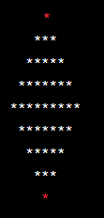
Bonus Task: (Optional)
Objective: Print a full diamond pattern of stars using loops.
Output should be:

Slide 15
Requirements:
Allow the user to input the height for both the downward full pyramid and the full diamond.

