Slide 1


Slide 2
Free Variables and Closures
Remember: Functions defined inside another function can access the outer (nonlocal) variables
def outer():
x = 'python'
this x refers to the one in outer's scope
this nonlocal variable x is called a free variable
when we consider inner, we really are looking at:
the function inner
the free variable x (with current value python)
def inner():
print("{0} rocks!".format(x))
inner()
outer()
→ python rocks!
This is called a closure

Slide 3
Returning the inner function
What happens if, instead of calling (running) inner from inside outer, we return it?
def outer():
x is a free variable in inner
it is bound to the variable x in outer
this happens when outer runs
(i.e. when inner is created)
this the closure
x = 'python'
def inner():
print("{0} rocks!".format(x))
inner() return inner
when we return inner, we are actually "returning" the closure
We can assign that return value to a variable name:
fn() → python rocks!
fn = outer()
When we called fn
at that time Python determined the value of x in the extended scope
But notice that outer had finished running before we called fn – it's scope was "gone"

Slide 4
Python Cells and Multi-Scoped Variables
def outer():
x = 'python'
def inner(): print(x)
return inner
Here the value of x is shared between two scopes:
outer
closure
The label x is in two different scopes
but always reference the same "value"
Python does this by creating a cell as an intermediary object
outer.x cell
0xA500
0xFF100
str
0xFF100
python
indirect reference
inner.x
In effect, both variables x (in outer and inner), point to the same cell
When requesting the value of the variable, Python will "double-hop" to get to the final value

Slide 5
You can think of the closure as a function plus an extended scope that contains the free variables
Closures
The free variable's value is the object the cell points to – so that could change over time! Every time the function in the closure is called and the free variable is referenced:
Python looks up the cell object, and then whatever the cell is pointing to
def outer(): a = 100
closure
cell
0xA500
0xFF100
str
x = 'python'
0xFF100
python
indirect reference
def inner():
a = 10 # local variable print("{0} rocks!".format(x))
return inner fn = outer()
fn →inner
+ extended scope x

Slide 6
You can think of the closure as a function plus an extended scope that contains the free variables
Closures
The free variable's value is the object the cell points to – so that could change over time! Every time the function in the closure is called and the free variable is referenced:
Python looks up the cell object, and then whatever the cell is pointing to
def outer(): a = 100
closure
x = 'python'
def inner():
a = 10 # local variable print("{0} rocks!".format(x))
return inner fn = outer()

Slide 7
Introspection
def outer():
a = 100
x = 'python'
def inner():
a = 10 # local variable
print("{0} rocks!".format(x))
return inner
fn = outer()
cell
0xA500
0xFF100
str
0xFF100
python
indirect reference
fn.__code__.co_freevars
fn.__Closure__
→ ('x',) (a is not a free variable)
→ (<cell at 0xA500: str object at 0xFF100>, )
def outer():
x = 'python'
print(hex(id(x))
def inner():
print(hex(id(x))
print("{0} rocks!".format(x)) return inner
0xFF100
indirect reference
0xFF100
indirect reference
fn = outer()
fn()

Slide 8
Modifying free variables
def counter(): closure
count = 0
count is a free variable
it is bound to the cell count
def inc():
nonlocal count count += 1 return count
return inc
fn
→ inc + count → 0
fn = counter()
fn() → 1
count's (indirect) reference changed from the object 0 to the object 1
fn()
→ 2

Slide 9
Multiple Instances of Closures
Every time we run a function, a new scope is created.
If that function generates a closure, a new closure is created every time as well
def counter():
count = 0
closure
f1 = counter() f2 = counter()
def inc():
nonlocal count count += 1 return count
f1()
f1()
f1()
→1
→2
→3
f1 and f2 do not have the same extended scope
they are different instances of the closure
the cells are different
return inc
f2()
→1

Slide 10
Shared Extended Scopes
You may think this shared extended scope is highly unusual…
but it's not!
def adder(n):
def inner(x):
return x + n
return inner
add_1 | = | adder(1)
add_2 | = | adder(2)
add_3 | = | adder(3)
Three different closures – no shared scopes
add_1(10) add_2(10) add_3(10)
→11
→12
→13

Slide 11
Nested Closures
def incrementer(n):
# inner + n is a closure
def inner(start):
current = start
# inc + current + n is a closure
def inc():
nonlocal current
current += n
return current
return inc
return inner
(inner)
fn = incrementer(2)

Slide 12
Nested Closures
def incrementer(n):
# inner + n is a closure
def inner(start):
current = start
# inc + current + n is a closure
def inc():
nonlocal current
current += n
return current
return inc
return inner
(inner)
fn = incrementer(2) → fn.__code__.co_freevars → 'n’ n=2

Slide 13
Nested Closures
def incrementer(n):
# inner + n is a closure
def inner(start):
current = start
# inc + current + n is a closure
def inc():
nonlocal current
current += n
return current
return inc
return inner
(inner)
fn = incrementer(2) → fn.__code__.co_freevars → 'n’ n=2
(inc)
inc_2 = fn(100)

Slide 14
Nested Closures
def incrementer(n):
# inner + n is a closure
def inner(start):
current = start
# inc + current + n is a closure
def inc():
nonlocal current
current += n
return current
return inc
return inner
(inner)
fn = incrementer(2) → fn.__code__.co_freevars → 'n’ n=2
(inc)
inc_2 = fn(100)
→ inc_2.__code__.co_freevars → 'current', 'n'
current=100, n=2

Slide 15
Nested Closures
def incrementer(n):
# inner + n is a closure
def inner(start):
current = start
# inc + current + n is a closure
def inc():
nonlocal current
current += n
return current
return inc
return inner
(inner)
fn = incrementer(2) → fn.__code__.co_freevars → 'n’ n=2
(inc)
inc_2 = fn(100)
→ inc_2.__code__.co_freevars →'current', 'n'
current=100, n=2
(calls inc) inc_2()

Slide 16
Nested Closures
def incrementer(n):
# inner + n is a closure
def inner(start):
current = start
# inc + current + n is a closure
def inc():
nonlocal current
current += n
return current
return inc
return inner
(inner)
fn = incrementer(2) → fn.__code__.co_freevars → 'n’ n=2
(inc)
inc_2 = fn(100)
→ inc_2.__code__.co_freevars →'current', 'n'
current=100, n=2
(calls inc) inc_2()
→ 102
(current = 102, n=2)

Slide 17
Nested Closures
def incrementer(n):
# inner + n is a closure
def inner(start):
current = start
# inc + current + n is a closure
def inc():
nonlocal current
current += n
return current
return inc
return inner
(inner)
fn = incrementer(2)
(inc)
→ fn.__code__.co_freevars → 'n' n=2
inc_2 = fn(100)
→ inc_2.__code__.co_freevars → 'current', 'n'
current=100, n=2
(calls inc) inc_2()
inc_2()
→ 102
→ 104
(current = 102, n=2) (current = 104, n=2)

Slide 18


Slide 19
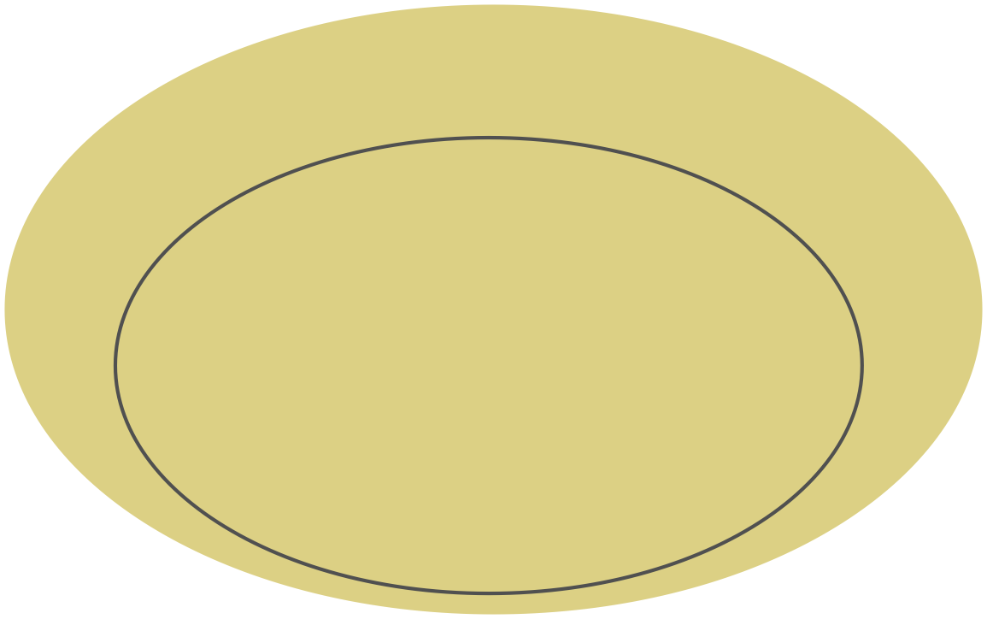
Decorators
In general a decorator function:
takes a function as an argument
returns a closure
the closure usually accepts any combination of parameters
runs some code in the inner function (closure)
the closure function calls the original function using the arguments passed to the closure
returns whatever is returned by that function call
closure
outer function (fn)
inner function
(*args, **kwargs)
does something…
returns fn(*args, **kwargs)
inner function
(*args,**kwargs)
does something…
returns fn(*args, **kwargs)

Slide 20
Assignment Closure
Create a function counter_generator that returns a closure. The closure should behave like a counter. It should take an initial count value as an argument and return a function. This returned function, when called, should increment the count value by the given step (default to 1) and return the updated count.

Slide 21
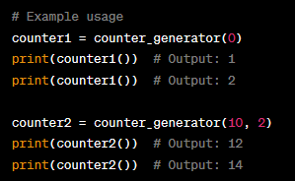
Assignment Closure: Output

