Slide 1
Introduction to
Problem Solving Methods

Slide 2
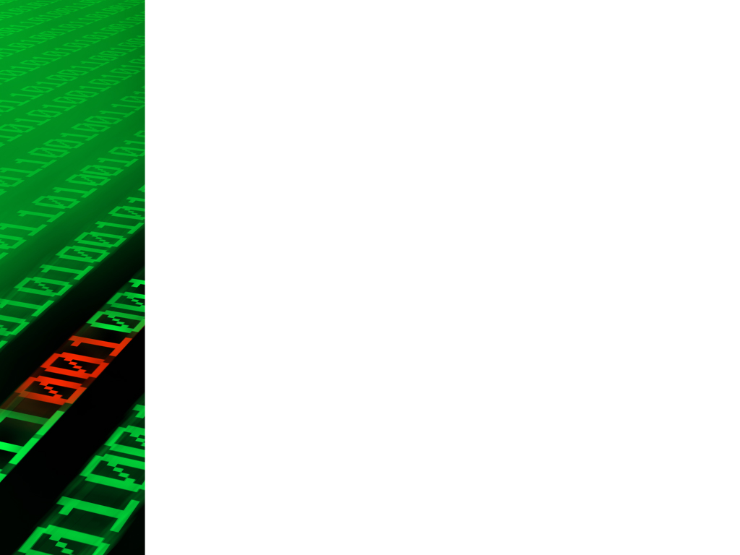
Introduction to Problem Solving Skills
Problem-solving skills are essential abilities that enable individuals to identify, analyze, and resolve challenges, obstacles, and issues they encounter in various aspects of life. These skills encompass a combination of cognitive, analytical, creative, and practical techniques that help individuals approach problems in a systematic and effective manner

Slide 3
What is Problem Solving Method?
Define the Problem
Gather Information
Generate Possible Solutions
Evaluate Options
Select Best Solution
Develop an Action Phase
Implement the Solution
Monitor & Evaluate
Reflect & Learn
Iterate & Refine
Communication & Document the Process

Slide 4
What is Preliminary Investigation
Preliminary Investigation, often referred to as Preliminary Research or Initial Analysis, is a crucial phase in problem-solving and project management. It involves gathering essential information and conducting a preliminary assessment to determine the feasibility, scope, and potential solutions for a particular problem or project. This investigation aims to provide a clear understanding of the problem, identify its underlying causes, and lay the foundation for further planning and decision-making.

Slide 5
Preliminary Investigation Phases
Problem Investigation
Gather Information
Stakeholders Involvement
Feasibility Assessment
Cost-Benefit Analysis
Data Analysis
Solution Exploration
Documentation

Slide 6
What is Analysis?
Analysis is the systematic process of examining, evaluating, and breaking down complex information, data, or phenomena to gain a deeper understanding of their components, relationships, and underlying principles. It involves identifying patterns, trends, insights, and connections within the data or information to extract meaningful conclusions and make informed decisions. Analysis plays a crucial role in various fields, including science, business, engineering, finance, and problem-solving.

Slide 7
What is Algorithm Design?
Algorithm design refers to the process of creating step-by-step instructions or a systematic plan to solve a specific problem or perform a task. Algorithms provide a clear and organized way to outline the sequence of actions needed to achieve a desired outcome. They serve as the building blocks for creating efficient and effective software programs, processes, and systems.

Slide 8
What is Software Coding?
Software coding, also known as programming or writing code, is the process of translating a software design or an algorithm into a formal set of instructions that a computer can understand and execute. Coding involves writing lines of code using a specific programming language to create software applications, scripts, or other computer programs.

Slide 9
Key Aspects of Programming?
Programming Languages: Choose a suitable language.
Syntax: Follow language-specific rules.
Logic and Algorithms: Translate logic into code.
Data Structures: Define and manipulate data.
Functions and Methods: Use modular components.
Object-Oriented Programming: If applicable.
Error Handling: Implement error-catching mechanisms.

Slide 10
Key Aspects of Programming? Cont..
Comments and Documentation: Explain code's purpose.
Testing: Regularly test code for bugs.
Version Control: Use systems like Git.
Efficiency and Performance: Optimize for speed.
Debugging: Identify and fix errors.
Integration: Combine components and libraries.
Security: Implement protection measures.
Best Practices: Follow conventions and patterns.

Slide 11
What is Software Implementation?
Software implementation is the process of translating a software design, which includes specifications and algorithms, into a functional software application. It involves writing the actual code, integrating components, and putting the designed system into action. Software implementation is a critical phase in the software development lifecycle, as it brings the conceptual design to life and makes the software usable by end-users.

Slide 12
Steps for Software Implementation?
Code Development: Write the actual code.
Integration: Combine code modules and components.
Testing: Identify and fix errors and bugs.
Database Creation: Establish data storage structures.
User Interface Design: Develop user-friendly interfaces.
Functionality Implementation: Code software features.
Error Handling and Validation: Address unexpected situations.

Slide 13
Steps for Software Implementation? Continue..
Performance Optimization: Enhance software speed.
Documentation: Create user and technical guides.
User Training: Educate users on software usage.
Data Migration: Transfer data from old systems.
Deployment: Install software in target environments.
User Acceptance Testing: Let users test the software.
Monitoring and Support Setup: Establish support mechanisms.
Launch: Officially release the software.

Slide 14
What is Software Maintenance?
Software maintenance refers to the ongoing process of managing, updating, enhancing, and improving software applications after their initial development and deployment. It involves ensuring the software remains functional, efficient, secure, and aligned with changing user needs and technological advancements. Software maintenance is a crucial phase in the software development lifecycle, as it extends the software's lifespan and provides long-term value to users and organizations.

Slide 15
Steps for Software Maintenance?
Bug Fixing: Resolve errors and defects.
Updates and Patches: Provide regular improvements.
Adaptation to Changing Environments: Stay compatible.
Security Enhancements: Protect against threats.
Performance Optimization: Ensure efficiency.
User Interface Enhancements: Improve usability.
Feature Enhancements: Add new capabilities.
Compliance and Regulations: Meet standards.

Slide 16
Steps for Software Maintenance? Continue..
Data Integrity: Maintain accurate data.
User Support: Address user concerns.
Documentation Updates: Keep guides current.
Regression Testing: Verify updates.
Version Control: Manage different versions.
End-of-Life Planning: Plan for retirement.
Continuous Improvement: Gather feedback for enhancements.

Slide 17
Assignment 02: Getting Started with Python and PyCharm
Objective: The purpose of this assignment is to introduce you to the basics of Python programming and the PyCharm Integrated Development Environment (IDE). By the end of this assignment, you should be able to set up Python, install PyCharm, and run a simple Python program to solidify your understanding of the basic syntax and structure.

Slide 18
Assignment 02: Getting Started with Python and PyCharm
Task 1: Installing Python and PyCharm
Task 2: Creating and Running Your First Python Program
Note:
Make sure to follow the installation instructions carefully to avoid any issues.
If you encounter any problems during the installation or programming process, feel free to reach out for assistance.

Slide 19
Instructions
Download and install Python:
Go to the official Python website at https://www.python.org/downloads/.
Choose the appropriate version of Python (preferably the latest stable version).
Download the installer for your operating system and follow the installation instructions.
Download and install PyCharm:
Go to the official PyCharm website at https://www.jetbrains.com/pycharm/download/.
Download the Community (free) version of PyCharm.
Install PyCharm by following the installation instructions for your operating system.

Slide 20
Task 02
Open PyCharm:
Launch PyCharm after installation.
If prompted, select "Create New Project."
Create a new Python file:
In the project creation wizard, give your project a name and choose a location to save it.
Once the project is created, right-click on the project's root folder in the Project Explorer panel on the left.
Select "New" > "Python File" and name it something like "first_program.py."
Write a simple Python program:
In the newly created "first_program.py" file, enter the following code:
python
print("Hello, Python!")
This program will simply print the text "Hello, Python!" to the console.
Run the program:
Right-click anywhere in the code editor area and select "Run 'first_program.'"
You should see the output in the Run console at the bottom of the PyCharm window.

Slide 21
Bonus Task (Optional)
Task: Calculate and Display Age Difference
Description: In this bonus task, you'll create a simple Python program that calculates and displays the age difference between two individuals. This task will help you practice user input, basic calculations, and printing formatted output.

Slide 22
Bonus Challenge (Optional):
If you're up for a bit more challenge, enhance your program further by adding the following functionality:
Ask the user for their names (or assign default names).
Tip: Use the format() method or f-strings to include the names in the output message.

Slide 23
Desired Output:
Enter the birth year of Person A: 1990
Enter the birth year of Person B: 1985
The age difference between Person A and Person B is 5 years.

