Slide 1
Introduction to
Unpacking,
Advance Slicing

Slide 2

What is Unpacking?
Unpacking in Python refers to the process of extracting elements from a data structure (such as a tuple, list, or dictionary) and assigning them to variables. It allows you to quickly and conveniently access the values within a data structure without having to access them individually.

Slide 3
A Side Note on Tuples
(1, 2, 3)
What defines a tuple in Python, is not (), but ,
1, 2, 3 is also a tuple → (1, 2, 3)
The () are used to make the tuple clearer
To create a tuple with a single element:
(1) will not work as intended → int
1, or (1, ) → tuple
The only exception is when creating an empty tuple: () or tuple()

Slide 4
Packed Values
Packed values refers to values that are bundled together in some way
Tuples and Lists are obvious | t | = | (1, 2, 3)
Even a string is considered to be a packed value: | l s | = = | [1, 2, 3] 'python'
Sets and dictionaries are also packed values:
set1 = {1, 2, 3}
d = {'a': 1, 'b': 2, 'c': 3}
In fact, any iterable can be considered a packed value

Slide 5
Unpacking Packed Values
Unpacking is the act of splitting packed values into individual variables contained in a list or tuple
a, b, c = [1, 2, 3]
3 elements in [1, 2, 3]
→ need 3 variables to unpack
this is actually a tuple of 3 variables: a, b and c
a → 1
b → 2
c → 3
The unpacking into individual variables is based on the relative positions of each element
Does this remind you of how positional arguments were assigned to parameters in function calls?

Slide 6
Unpacking other Iterables
a, b, c = 10, 20, 'hello'
→ a = 10
b = 20
c = 'hello'
this is actually a tuple containing 3 values
a, b, c = 'XYZ'
→ a = 'X'
b = 'Y'
c = 'Z'
instead of writing
a = 10
b = 20
we can write
a, b = 10, 20
In fact, unpacking works with any iterable type
for e in 10, 20, 'hello'
→ loop returns 10, 20, 'hello’
→ loop returns 'X', 'Y', 'Z'
for e in 'XYZ'

Slide 7



Simple Application of Unpacking
swapping values of two variables
a = 10
b = 20
→
b = | 20
a = tmp | 10
"traditional" approach
tmp = a
a
a = b
b = tmp
0x123
10
0xF12
b
20
using unpacking
this works because in Python, the entire RHS is evaluated first and completely
then assignments are made to the LHS
a, b = b, a

Slide 8


Unpacking Sets and Dictionaries
d = {'key1': 1, 'key2': 2, 'key3': 3}
for e in d
→ e iterates through the keys: 'key1', 'key2', 'key3'
so, when unpacking d, we are actually unpacking the keys of d
a, b, c = d
 | → a | = | 'key1', | b | = | 'key2', | c='key3'
or | → a | = | 'key2', | b | = | 'key1', | c='key3'
or | → a etc… | = | 'key3', | b | = | 'key1', | c='key2'
Dictionaries (and Sets) are unordered types.
They can be iterated, but there is no guarantee the order of the results will match your literal!
In practice, we rarely unpack sets and dictionaries in precisely this way.

Slide 9

The use case for *
Much of this section applies to Python >= 3.5
We don't always want to unpack every single item in an iterable
We may, for example, want to unpack the first value, and then unpack the remaining values into another variable
l = [1, 2, 3, 4, 5, 6]
We can achieve this using slicing:
a = l[0] b = l[1:]
or, using simple unpacking:
a, b = l[0], l[1:]
(aka parallel assignment)
We can also use the * operator:
a, *b = l
Apart from cleaner syntax, it also works with any iterable, not just sequence types!

Slide 10
Usage with ordered types
a, *b = [-10, 5, 2, 100]
a = -10
b = [5, 2, 100]
this is still a list!
a, *b = (-10, 5, 2, 100)
a = -10
b = [5, 2, 100]
this is also a list!
a, *b = 'XYZ'
a = 'X'
b = ['Y', 'Z']
The following also works:
a, b, *c = 1, 2, 3, 4, 5
a = 1 b = 2 c = [3, 4, 5]
a, b, *c, d = [1, 2, 3, 4, 5]
a = 1 b = 2 c = [3, 4] d = 5
a, | *b, c, d = | 'python' | a = | 'p' | b | = | ['y', 't', | 'h']
 |  |  | c = | 'o' | d | = | 'n'

Slide 11
The * operator can only be used once in the LHS an unpacking assignment
For obvious reason, you cannot write something like this:
a, *b, *c = [1, 2, 3, 4, 5, 6]
Since both *b and *c mean "the rest", both cannot exhaust the remaining elements

Slide 12
Usage with ordered types
We have seen how to use the * operator in the LHS of an assignment to unpack the RHS
a, *b, c = {1, 2, 3, 4, 5}
However, we can also use it this way:
l1 = [1, 2, 3] l2 = [4, 5, 6] l = [*l1, *l2] | → l = [1, 2, | 3, 4, 5, 6]
l1 = [1, 2, 3] l2 = 'XYZ' l = [*l1, *l2] | → l = [1, 2, | 3, 'X', 'Y', 'Z']

Slide 13

Usage with unordered types
Types such as sets and dictionaries have no ordering
s = {10, -99, 3, 'd'}
print(s) → {10, 3, 'd', -99}
Sets and dictionary keys are still iterable, but iterating has no guarantee of preserving the order in which the elements were created/added
But, the * operator still works, since it works with any iterable
s = {10, -99, 3, 'd'}
a, *b, c = s a = 10 b = [3, 'd’] c = -99
In practice, we rarely unpack sets and dictionaries directly in this way.

Slide 14
Usage with unordered types
It is useful though in a situation where you might want to create single collection containing all the items of multiple sets, or all the keys of multiple dictionaries
d1 | = | {'p': | 1, | 'y': | 2}
d2 | = | {'t': | 3, | 'h': | 4}
d3 | = | {'h': | 5, | 'o': | 6, | 'n': 7}
Note that the key 'h' is in both d2 and d3
l = [*d1, *d2, *d3] | → ['p', | 'y', 't', 'h', 'h', 'o', 'n']
s = {*d1, *d2, *d3} | → {'p', | 'y', 't', 'h, 'o', 'n'}
(order is not guaranteed)

Slide 15
The ** unpacking operator
When working with dictionaries we saw that * essentially iterated the keys
d = {'p': 1, 'y': 2, 't': 3, 'h': 4}
a, *b = d
a = 'p' b = ['y', 't', 'h']
(again, order is not guaranteed)
We might ask the question: can we unpack the key-value pairs of the dictionary?
Yes!
We need to use the ** operator

Slide 16
Using **
d1 | = | {'p': | 1, | 'y': | 2}
d2 | = | {'t': | 3, | 'h': | 4}
d3 | = | {'h': | 5, | 'o': | 6, 'n': 7}
Note that the key 'h' is in both d2 and d3
d = {**d1, **d2, **d3} (note that the ** operator cannot be used in the LHS of an assignment)
{'p': 1, 'y': 2, 't': 3, 'h': 5, 'o': 6, 'n': 7}
Note that the value of 'h' in d3 "overwrote" the first value of 'h' found in d2
(order not guaranteed)

Slide 17
Nested Unpacking
Python will support nested unpacking as well.
l = [1, 2, [3, 4]] Here, the third element of the list is itself a list.
We can certainly unpack it this way: a, b, c = l a = 1 b = 2 c = [3, 4]
We could then unpack c into d and e as follows: d, e = c d = 3 e = 4
Or, we could simply do it this way: |  | a, b, (c, | d) | = | [1, | 2, | [3, 4]] | a | = | 1 | b | = | 2
 |  |  |  |  |  |  |  | c | = | 3 | d | = | 4
Since strings are iterables too: | a, *b, (c, d, |  | e) | = | [1, | 2, | 3, 'XYZ']
a = 1
b = [2, 3]
c, d, e = 'XYZ’ → c = 'X’ d = 'Y’ e = 'Z'

Slide 18
The * operator can only be used once in the LHS an unpacking assignment
How about something like this then?
a, *b, (c, *d) = [1, 2, 3, 'python']
Although this looks like we are using * twice in the same expression, the second * is actually in a nested unpacking – so that's OK
a = 1
b = [2, 3]
c, *d = 'python'
→
c = 'p'
d = ['y', 't', 'h', 'o', 'n']
Try doing the same thing using slicing…

Slide 19
Class Activity 01:
a = [1,2,3,4,'This is python',[1,[1,2,3,4,5,7,8]]]
b = 'is is pyth'
c = [8, 7, 5, 4, 3, 2, 1]

Slide 20
Class Activity 01: Solution
a = [1,2,3,4,'This is python',[1,[1,2,3,4,5,7,8]]]
b = 'is is pyth'
c = [8, 7, 5, 4, 3, 2, 1]
Solution:
a[4][2:12]
c = a[5][1][::-1]

Slide 21
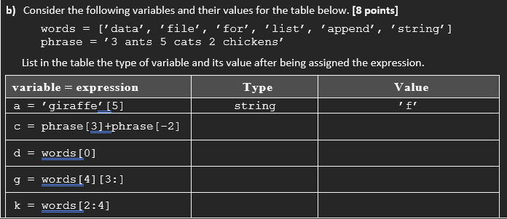
Class Activity 02:

Slide 22
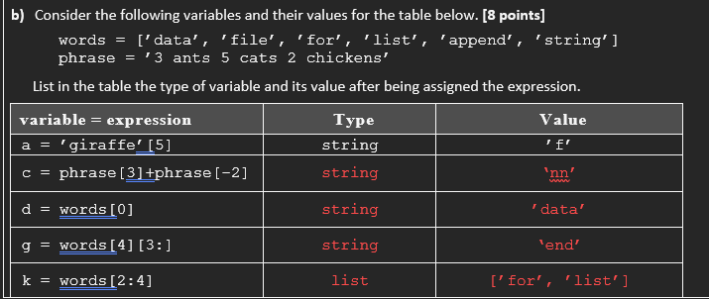
Class Activity 02: Solution

