Slide 1
Introduction to
Tuple – Data Structure

Slide 2

Why do we use tuple?
Immutability
Ordered
Heterogeneity
Efficiency
Functions with multiple return values
Single-element tuples
Packing and unpacking
Use cases
Iteration
Concatenation
Built-in functions
Data integrity

Slide 3
Tuple Creation
Tuples are created by enclosing a comma-separated sequence of values in square brackets ‘( )’
Example:
my_tuple = (1, 2, 3, 'apple')
Mutable:
The primary characteristic of tuples is their immutability. Once you create a tuple, you cannot change, add, or remove elements from it. This immutability ensures data integrity.

Slide 4
Explaining Tuple
Heterogeneous Elements: Tuples can also contain elements of different data types, including numbers, strings, other tuples, or any Python object.
Single-Element Tuple: To create a single-element tuple, you need to include a comma after the element within parentheses, like this:

Slide 5


Explaining Tuple
Accessing Elements: Elements in a tuple are accessed using zero-based indexing. For example, to access the second element in a tuple:
Slicing: You can use slicing to extract subsets of a tuple:

Slide 6

Explaining Tuple
Concatenation: You can concatenate tuples using the + operator to create new tuples:
Built-in Functions: Tuples support several built-in functions like count(), index(), and sorted() for manipulation and analysis.

Slide 7
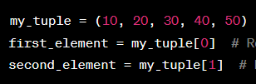
Accessing Values in Tuple: Indexing
Tuple in Python are zero-indexed, which means the index of the first element is 0, the second element is at index 1, and so on.
To access a specific element, you can use square brackets [] with the index of the element you want to retrieve.
Example:

Slide 8

Negative Indexing:
You can also use negative indexing to access elements from the end of the tuple:
Example:

Slide 9

Slicing: Tuple
Slicing allows you to extract a subset of elements from a tuple by specifying a range of indices. The syntax for slicing is start : end, where start is the index of the first element you want to include, and end is the index of the first element you want to exclude.
Example:

Slide 10

Slicing with stride: Tuple
You can also specify a stride (step) when slicing to skip elements.
The slicing notation with a stride is [start:end:step]
Example:

Slide 11

Nested Indexing: Tuple
If a tuple contains nested tuples (tuples within tuples), you can access elements in the nested tuples by chaining indexing or slicing operations.
Example:

Slide 12
Updating Tuple in Python:
Tuples in Python are immutable, which means you cannot directly update or modify the elements of a tuple after it has been created. Once a tuple is defined, its contents cannot be changed. However, there are alternative methods to achieve something similar to "updating" a tuple:

Slide 13

Updating Tuple in Python:
Instead of updating a tuple in place, you can create a new tuple that includes the changes you want. This approach preserves the original tuple and creates a new one with the desired modifications.

Slide 14

Updating Tuple in Python:
You can use tuple concatenation to combine multiple tuples into a new tuple, which effectively "updates" the tuple with new elements.

Slide 15


Updating Tuple in Python:
Convert to List: If you need to perform extensive modifications on the elements of a collection, you can convert the tuple to a list, make the desired changes, and then convert it back to a tuple.

Slide 16

Deletion in Tuple:
Create a New Tuple: Instead of deleting elements from a tuple, you can create a new tuple that excludes the elements you want to "delete." This approach effectively filters out unwanted elements and creates a new tuple with the desired content.
Example:

Slide 17
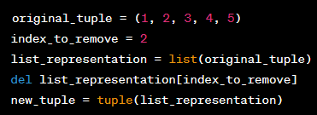
Deletion in Tuple:
Convert to List: Another approach is to convert the tuple to a list, remove elements from the list, and then convert it back to a tuple. This method allows you to perform element removal.

Slide 18
Tuple Functions:
len(): Returns the number of elements in a tuple.
max(): Returns the maximum element in a tuple.
min(): Returns the minimum element in a tuple.
sum(): Returns the sum of all elements in a tuple.

Slide 19
Tuple Methods:
count(): Counts occurrences of a specified value in a tuple.
index(): Finds the index of the first occurrence of a specified value in a tuple.
_asdict() (NamedTuple): Converts a named tuple to an ordered dictionary.
_replace() (NamedTuple): Creates a new named tuple with specified field values replaced.
_make() (NamedTuple): Constructs a named tuple from an iterable.
_fields() (NamedTuple): Returns field names of a named tuple.
_field_defaults() (NamedTuple): Provides default values for named tuple fields.

Slide 20
Assignment 08: Task Managing System
Objective: Create a Python program for managing tasks using lists and tuples.
Description: You will create a program that allows users to add tasks, list tasks, mark tasks as completed, and delete tasks. The program will use lists to store tasks and tuples to represent each task with details.

Slide 21
Assignment 08: Task Managing System
Requirements:
Users can add a new task to the task list. Each task should include a task name, task priority (High, Medium, Low), and an initial status of "Not Done.“
Users can view a list of all tasks with their details, including task name, priority, and status (Done or Not Done). Ensure that tasks are numbered for easy reference.
Users can mark a task as completed, changing its status from "Not Done" to "Done." This helps users keep track of completed tasks.
Users can delete a task from the list. Deleted tasks should be removed from the task list.

Slide 22
Assignment 08: Task Managing System
Bonus Task (Optional): Add the option for users to set due dates for tasks. Each task should have an associated due date. Modify the display to show due dates along with task details.

Slide 23
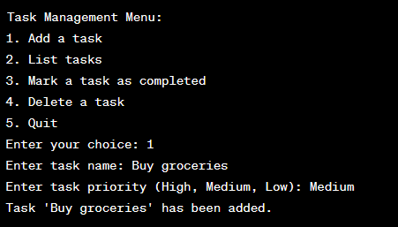
Assignment 08: Task Managing System

Slide 24
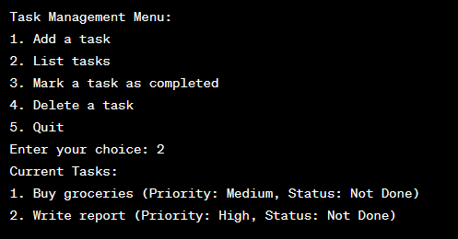
Assignment 08: Task Managing System

Slide 25
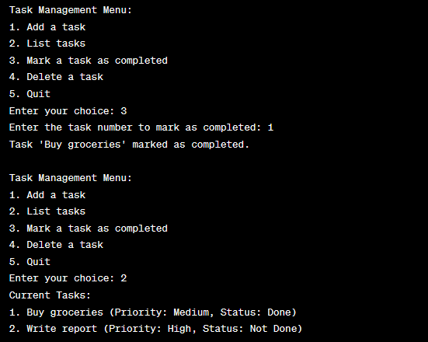
Assignment 08: Task Managing System

Slide 26
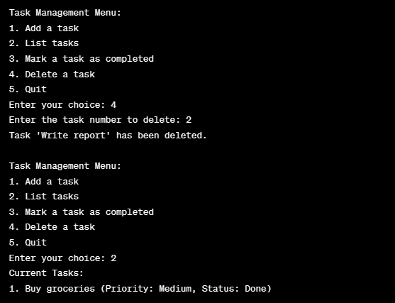
Assignment 08: Task Managing System

Slide 27
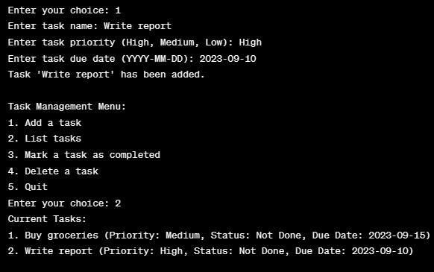
Assignment 08: Bonus Task (Optional)

