Slide 1
Introduction to
Decision Statements

Slide 2

Why do we use Decision Statements?
Decision statements, also known as conditional statements or control structures, are an essential part of programming that allow you to introduce logic and make your program adapt to different situations based on certain conditions. Decision statements are used to control the flow of your program by making choices or decisions based on whether certain conditions are true or false. These statements help your program become more dynamic and capable of responding intelligently to different scenarios.

Slide 3
Reasons To Use Conditional Statements
Conditional Execution
Making Choices
User Interaction
Error Handling
Control Flow
Repetition and Loops
Customized Behavior

Slide 4
Types of Conditional Statements
if statement: Executes a block of code only if a specified condition is true.
if-else statement: Executes one block of code if a condition is true and another block if the condition is false.
if-else-if ladder: Allows you to chain multiple conditions and execute different blocks of code based on the first true condition.
switch statement: Evaluates an expression and matches it with specific cases, executing the code block associated with the matching case.

Slide 5
If-Statement
An "if statement" is a type of decision statement in programming that allows you to execute a block of code only if a certain condition is true. It's used to introduce conditional execution into your code, where different actions are taken based on whether a specified condition evaluates to true or false.

Slide 6
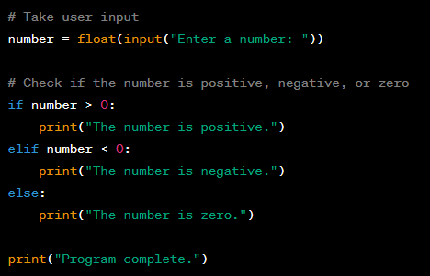
If-else-Statement
Certainly! The if-else statement is used when you want to provide an alternative action to take if the condition in the if statement evaluates to False. In other words, if the condition is not true, the code inside the else block will be executed.

Slide 7
Elif-Statement
The elif statement in Python stands for "else if." It's used in conjunction with the if statement to provide an additional condition to check if the initial if condition evaluates to False. When the if condition is not satisfied, the program moves on to the elif condition to see if that condition is true. If the elif condition is true, the corresponding block of code is executed. If neither the if nor the elif conditions are true, the program can proceed to an optional else block or simply continue with the rest of the code.

Slide 8
Class Activity: Conditional Statements
Lets have some examples to learn more about Conditional Statements. Make a Grading System for College to assign grades to students according to their marks.

Slide 9
Assignment 05: Decision Statements
Objective: You are creating a text-based quiz program that asks the user a series of questions and provides feedback on their answers. The quiz consists of multiple-choice questions with predefined correct answers.

Slide 10
Requirements:
Display a welcome message and introduce the quiz.
Create a list of questions, each with multiple choices and a correct answer.
Get through the list of questions and display each question along with its choices.
Take user input for their selected answer.
Use if, else, elif statements to check whether the user's answer is correct or not.
Provide feedback to the user based on their answer, indicating whether it was correct or incorrect.
Keep track of the user's score and display their total score at the end of the quiz.

Slide 11
