Slide 1
Introduction to
OOP (Object Oriented Programming)

Slide 2

What is OOP?
Object-Oriented Programming (OOP) is a programming paradigm that is widely used in Python and many other programming languages. It is based on the concept of "objects," which are instances of classes. Here's an introduction to OOP in Python.

Slide 3
Understanding OOP
Classes and Objects
Constructor & Destructor
Encapsulation
Inheritance
Polymorphism
Abstraction
OOP in Python promotes code modularity, reusability, and maintainability. It is widely used for building complex software systems and is a fundamental concept for Python programmers.

Slide 4
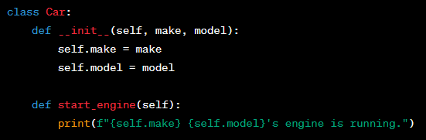
Class
A class is a blueprint or template for creating objects in Python.
It defines the attributes (data) and methods (functions) that the objects created from the class will have.
Classes are like user-defined data types that encapsulate both data and behavior.

Slide 5

Object
An object is an instance of a class. It is a concrete, tangible entity created based on the class's blueprint.
Objects have attributes (data members) that store information and methods (member functions) that define their behavior.
You can create multiple objects from a single class, each with its own set of data and the ability to perform actions defined by the class methods.

Slide 6


Calling Methods
Methods define the behavior of objects.
Call methods using the dot notation.

Slide 7
Calling Methods
Methods define the behavior of objects.
Call methods using the dot notation.

Slide 8
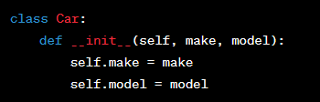
Constructor
A constructor is a special method in Python classes, denoted by __init__().
It is automatically called when an object of a class is created.
The purpose of a constructor is to initialize the object's attributes and perform any necessary setup.
You can define parameters within the constructor to accept values during object creation.

Slide 9
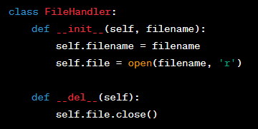
Destructor
A destructor is another special method in Python classes, denoted by __del__().
It is automatically called when an object is about to be destroyed or goes out of scope.
The purpose of a destructor is to release resources, close files, or perform cleanup actions before the object is removed from memory.

Slide 10
Class Activity
Requirements
The Student class has attributes like name, age, and grade.
It has methods like display_student_info to display student information, is_passing to check if a student is passing, and promote to promote a student to the next grade if they haven't reached the highest grade yet.

Slide 11
Inheritance
Inheritance is a fundamental concept in object-oriented programming (OOP) that allows you to create new classes based on existing classes. It promotes code reuse and the creation of a hierarchical structure for organizing and modeling real-world relationships. Inheritance is used to define a new class by inheriting attributes and methods from an existing class, which is referred to as the base class or superclass. The new class is known as the derived class or subclass.

Slide 12
Inheritance types
Single Inheritance:
In single inheritance, a subclass inherits from a single base class.
This is the simplest form of inheritance, where the derived class extends the functionality of a single parent class.
Example: class ChildClass(ParentClass):
Multiple Inheritance:
In multiple inheritance, a subclass can inherit from multiple base classes.
It allows the derived class to inherit attributes and methods from more than one parent class.
Example: class ChildClass(ParentClass1, ParentClass2):
Hierarchical Inheritance:
In hierarchical inheritance, multiple subclasses inherit from a single base class.
It represents a structure where different classes share a common base class but may have distinct functionality.
Example: class BaseClass: ... class ChildClass1(BaseClass): ... class ChildClass2(BaseClass): ...

Slide 13
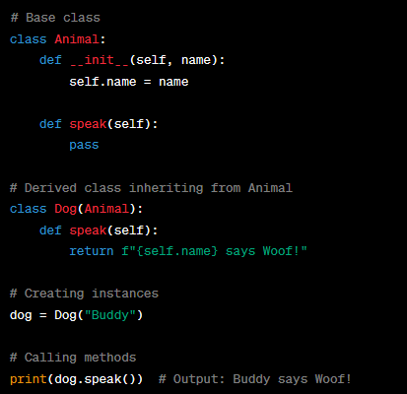
Examples: Single Inheritance

Slide 14
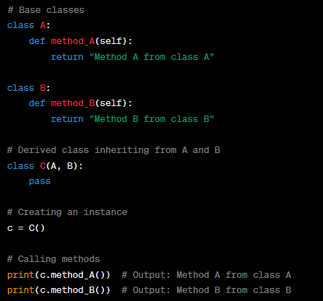
Examples: Multiple Inheritance

Slide 15
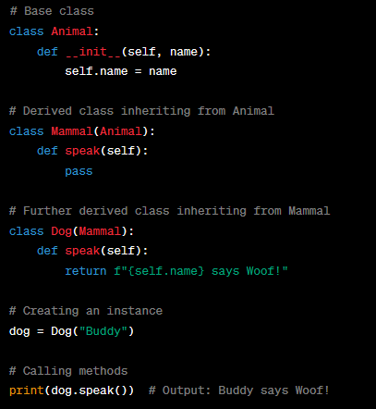
Examples: Multilevel Inheritance

Slide 16
Polymorphism
Polymorphism is a fundamental concept in object-oriented programming that allows objects of different classes to be treated as objects of a common base class. It enables flexibility and dynamic behavior in your code. Polymorphism is often achieved through method overriding, where derived classes provide their own implementations of methods defined in the base class.

Slide 17
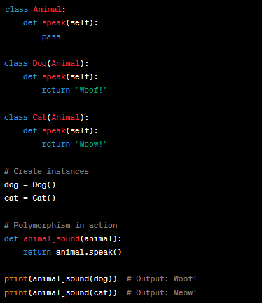
Polymorphism: Example

Slide 18
Encapsulation
Encapsulation is one of the four fundamental principles of object-oriented programming (OOP) and involves bundling data (attributes) and methods (functions) that operate on that data within a single unit called a class. It restricts access to some of the object's components, preventing unintended interference and misuse. Encapsulation helps maintain the integrity of the object's internal state and promotes data hiding.

Slide 19
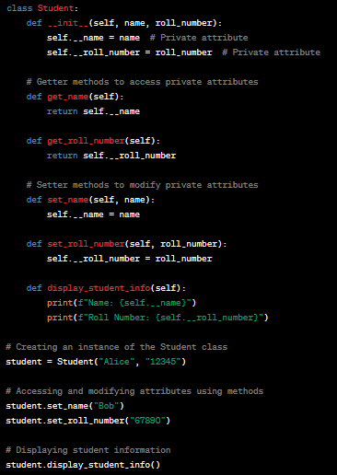
Encapsulation: Example

Slide 20
Abstraction
Abstraction means simplifying complex things by breaking them into smaller, easier-to-understand parts. It's like using a TV remote without knowing how it works inside; you just press the buttons to change channels or adjust the volume.
You create classes and objects that hide complex details and provide a simple interface.
Users of those classes and objects can interact with them without knowing the intricate workings behind the scenes.

Slide 21
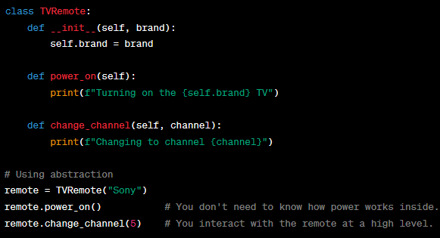
Abstraction: Example

Slide 22
Assignment 14: Classes
Description: Create a Python program for managing a zoo. You will define classes for different types of animals, demonstrate inheritance, use polymorphism to showcase animal behavior, apply abstraction to hide unnecessary details, and use encapsulation to control access to animal attributes.

Slide 23
Assignment 14: Requirements
Base Class: Create an abstract base class called Animal with the following methods:
__init__(self, name, species): Initialize attributes name and species.
speak(self): An abstract method for animals to make sounds.
Derived Classes: Create three classes that inherit from Animal:
Lion: Override the speak method to make a roaring sound.
Elephant: Override the speak method to make a trumpeting sound.
Monkey: Override the speak method to make a chattering sound.
Zoo Management:
Create a Zoo class to manage animals in the zoo. It should have methods to add and display animals.
The Zoo class should use encapsulation to hide the internal list of animals.
Polymorphism and Abstraction:
In the Zoo class, create a method animal activity that accepts an Animal object and calls its speak method to showcase polymorphism.

Slide 24
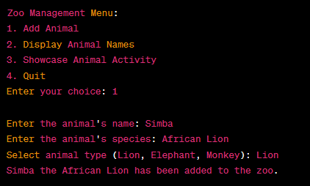
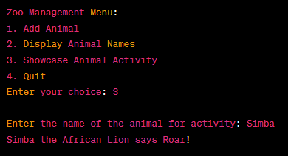
Assignment 14: Output
Create a menu for adding animals, displaying their names, and showcasing their activities, you can modify the existing code. You‘ll use a simple text-based menu that allows the user to interact with the zoo.
Example Output:

