Slide 1
Dual Nature of Radiation and Matter
Chap-14

Slide 2
introduction
Planck proposed a model that says (i) energy is emitted in packets and (ii) at higher frequencies, the energy of a packet is large
Planck assumed that atoms behave like tiny oscillators that emit electromagnetic radiation only in discrete packets (E = nhn), where n is the frequency of oscillator
The emissions occur only when the oscillator makes a jump from one quantized level of energy to another of lower energy

Slide 3
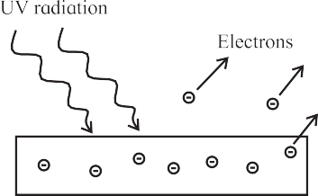
The Photoelectric Effect
Heinrich Hertz discovered photoelectric emission in 1887, while he was working on the production of electromagnetic waves by spark discharge
He noticed that when ultraviolet light is incident on a metal electrode, a high voltage spark passes across the electrodes, due to emission of electron from metal surface.
The surface which emits electrons, when illuminated with appropriate radiation, is known as a photosensitive surface
The phenomenon of emission of electrons from a metal surface, when radiation of appropriate frequency is incident on it, is known as photoelectric effect
For metals like zinc, cadmium, magnesium etc., ultraviolet radiation is necessary while for alkali metals, even visible radiation is sufficient

Slide 4
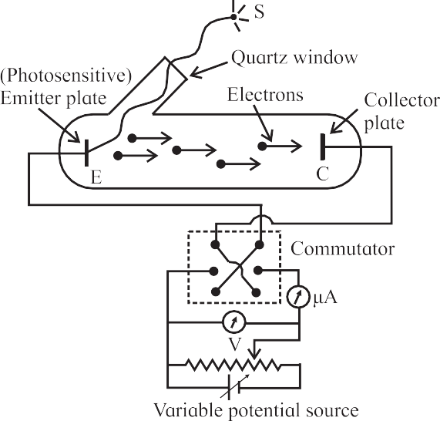
Experimental Set-up of Photoelectric Effect
Setup consists of an evacuated glass tube with a quartz window containing a photosensitive metal plate - the emitter E and another metal plate - the collector C
The emitter and collector are connected to a voltage source whose voltage can be changed and to an ammeter to measure the current in the circuit
A potential difference of V, as measured by the voltmeter, is maintained between the emitter E (the cathode) and collector C (the anode), normally C being at a positive potential with respect to the emitter
When the anode potential V is positive, it accelerates the electrons (hence called accelerating potential) while when the anode potential V is negative, it retards the flow of electrons (therefore known as retarding potential)
A source S of monochromatic light of sufficiently high frequency is used
Light is made to fall on the surface of the metal plate E and electrons are ejected from the metal through its surface
These electrons, called photoelectrons, are collected at the collector C

Slide 5
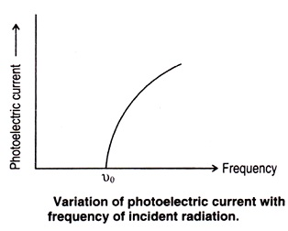

Observations from Experiments on Photoelectric Effect
When ultraviolet radiation was incident on the emitter plate, current I was recorded even if the intensity of radiation was very low
Photocurrent I was observed only if the frequency of the incident radiation was more than some threshold frequency $v_{0}$
$v_{0}$ was same for a given metal and was different for different metals used as the emitter.
There was no time lag between the incidence of light and emission of electrons.
The photocurrent started instantaneously (within 10-9 s) on shining the radiation even if the intensity of radiation was low and as soon as the incident radiation was stopped, the flow of current stopped

Slide 6
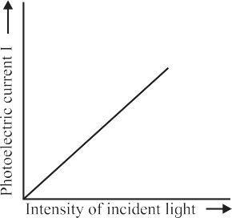

Effect of intensity on photo-electric current
Keeping the frequency $v$of the incident radiation and accelerating potential V fixed, if the intensity was increased, the photo current increased linearly with intensity

Slide 7
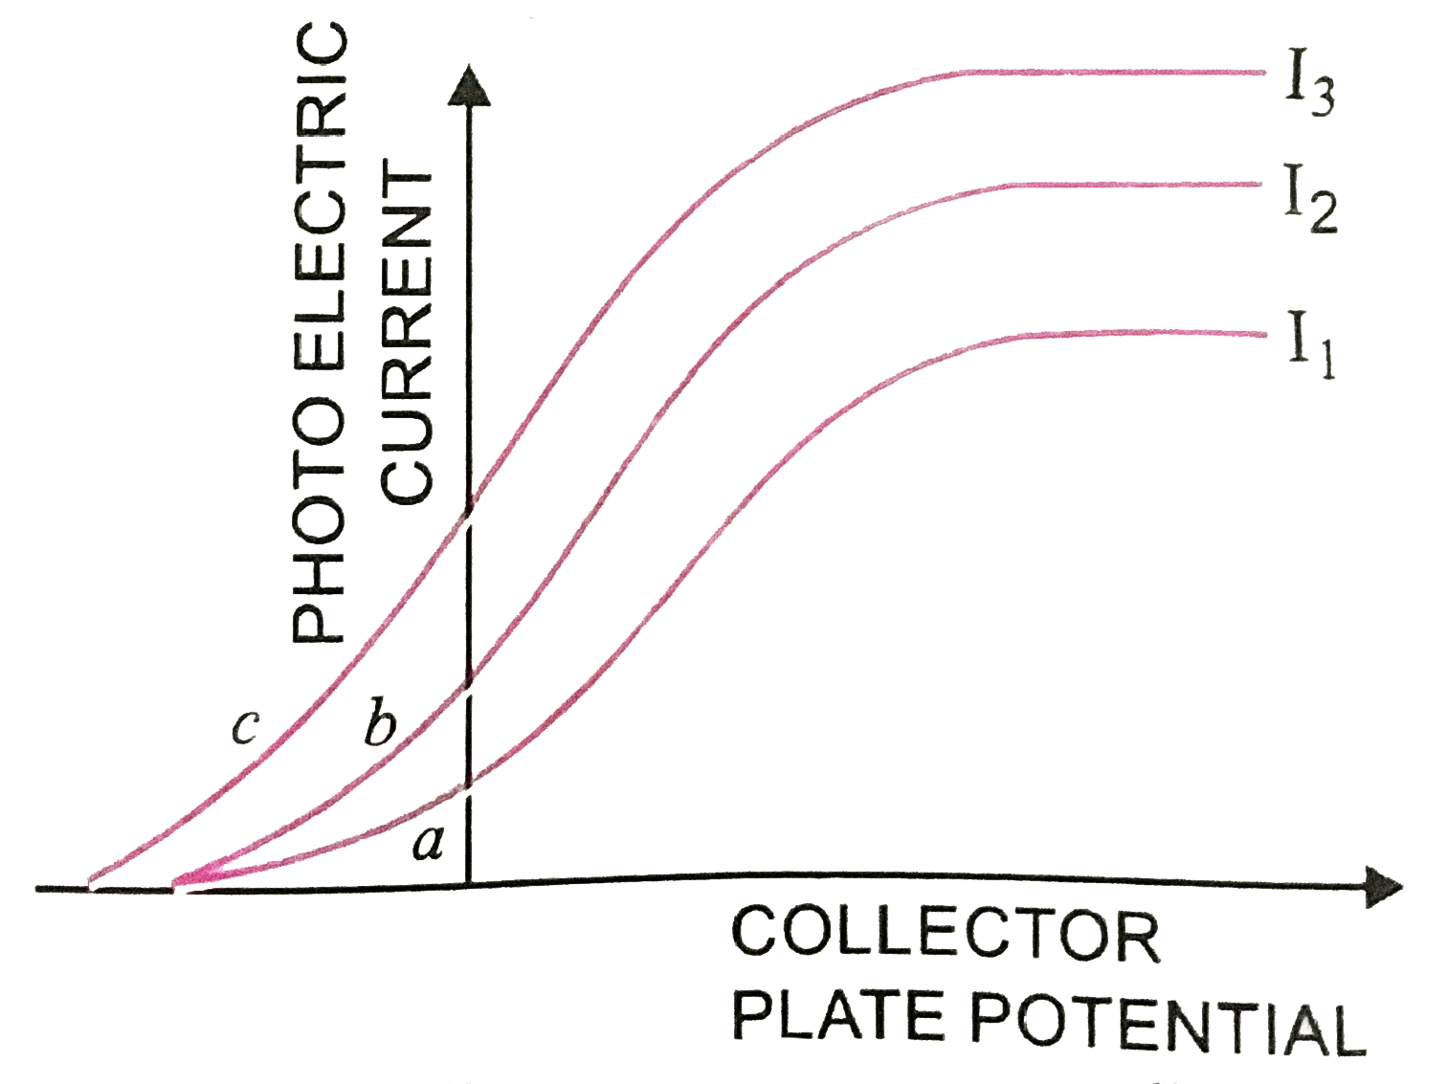

Effect of P.D. on photo-electric current
The photocurrent I could also be varied by changing the potential of the collector plate
I was dependent on the accelerating potential V for given incident radiation
Initially the current increased with voltage but then it remained constant, was termed as the saturation current $I_{0}$
Keeping the accelerating voltage and incident frequency fixed, if the intensity of incident radiation was increased, the value of saturation current also increased in proportion
The maximum kinetic energy KEmax (and hence the maximum velocity) of the electrons depended on the potential V for a given metal used for the emitter plate and for a given frequency of the incident radiation
If the material is changed or the frequency of the incident radiation is changed, KEmax changed.
It did not depend on the intensity of the incident radiation
Thus, even for very small incident intensity, if the frequency of incident radiation was larger than the threshold frequency $v_{0}$, KEmax from a given surface was always the same for a given incident frequency

Slide 8
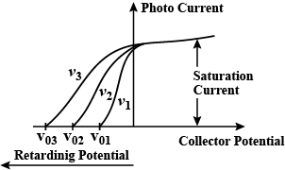

Stopping potential
If increasingly negative potentials were applied to the collector, the photocurrent decreased and for some typical value -$V_{0}$, photocurrent became zero
$V_{0}$ was termed as cut-off or stopping potential
It indicated that when the potential was retarding, the photoelectrons still had enough energy to overcome the retarding (opposing) electric field and reach the collector
Value of $V_{0}$ was same for any incident intensity as long as the incident frequency was same but was different for different emitter materials
If the frequency of incident radiation was changed keeping the intensity and accelerating potential V constant, then the saturation current remained the same but the stopping potential $V_{0}$ changed as shown through graph
The stopping potential $V_{0}$ varied linearly with $v$

Slide 9
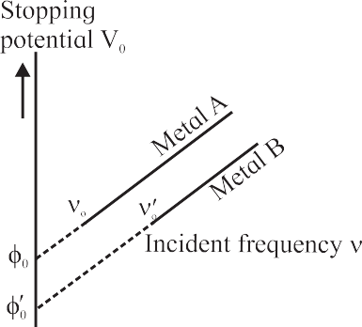

Relationship between stopping potential and frequency of radiation
As The stopping potential $V_{0}$ varied linearly with $v$for given metal
For different metals, the slopes of such straight lines were the same but the intercepts on the frequency and stopping potential axes were different

Slide 10

Conclusion of experiment
The photocurrent and hence the number of electrons depended on the intensity but not on the frequency of incident radiation, as long as the incident frequency was larger than the threshold frequency $v_{0}$ and the potential of anode was higher than that of cathode

Slide 11
Failure of Wave Theory to Explain the Observations
Most of these observations could not be explained by the wave theory of electromagnetic radiation
First and foremost was the instantaneous emission of electrons on incidence of light
Wave picture would expect that the metal surface will absorb the incident energy continuously
The metal surface will require reasonable time (~ few minutes to hours) to accumulate sufficient energy to knock off electrons
Greater the intensity of incident radiation, more will be the incident energy, hence expected time required to knock off the electrons will be less
For small incident intensity, the energy incident on unit area in unit time will be small, and will take longer to knock off the electrons
These arguments were contradictory to observations
Secondly, since larger incident intensity implies larger energy, the electrons are expected to be emitted with larger kinetic energy, But the observation showed that the maximum kinetic energy did not depend on the incident intensity but depended on the incident frequency.
According to wave theory, frequency of incident radiation has no role in determining the kinetic energy of photoelectrons
wave theory expected photoelectrons to be emitted for any frequency if the intensity of radiation was large enough. But observations indicated that for a given metal surface, below threshold frequency no photoelectrons were emitted

Slide 12

Einstein’s Postulate of Quantization of Energy and the Photoelectric Equation
Einstein proposed that under certain conditions, light behaves as if it was a particle and its energy is released or absorbed in bundles or quanta.
He named the quantum of energy of light as photon.
It may be noted that the equation E = h$υ$ is a relation between a particle like property, i.e. energy E and a wave like property, i.e. frequency $υ$.
Above equation holds good for the entire electromagnetic spectrum
It says that energy of electromagnetic radiation is directly proportional to the frequency (and is inversely proportional to the wavelength)
Hence high frequency radiation means high energy radiation
Alternatively, short wavelength radiation means high energy radiation

Slide 13

Einstein's postulate of quantization of energy for the observations
1. Einstein argued that when a photon of ultraviolet radiation arrives at the metal surface and collides with an electron, it gives all of its energy h$υ$ to the electron.
Electrons will be emitted from metal plate if and only if the energy gained by the electrons is more than or equal to some minimum amount of energy called as work function $φ_{0}$ i.e. h$υ$ $≥$ $φ_{0}.$
Thus minimum threshold frequency($υ_{0}$ = $φ_{0}$/h) required to eject electron from metal surface.
2. Energy is given by the photon to the electron as soon as the radiation is incident on the surface
The exchange of energy between the photon and electron is instantaneous
Also when the incident radiation is stopped, there are no photons to transfer the energy to electrons, hence the photoemission stops immediately
3. According to Einstein’s , if the intensity of incident radiation for a given wavelength is increased, there will be an increase in the number of energy quanta (photons) incident on unit area in unit time; the energy of each quantum remain same
Therefore larger intensity radiation will knock off more number of electrons from the surface and hence the current will be larger, provided $υ≥$ $υ_{0}$.
4. Once the electron is emitted from the surface, if the collector is at a higher potential than the emitter, the electric field will accelerate the electrons towards the collector.
Higher is the accelerating potential, more number of electrons will be reaching the collector and current increases in circuit till saturation current reached, it implies that all emitted electrons reached to collector plate
5. Increasing the incident intensity will increase the number of incident photons and eventually the saturation current.

Slide 14

6. If the frequency of incident radiation is more than the threshold frequency, then the energy $φ_{0}$ is used by the electron to escape from the metal surface and remaining energy of the photon becomes the kinetic energy of the electron.
Depending on the energy of the electron inside the metal and other processes like collisions after emission from the surface, the maximum kinetic energy is equal to (h$υ$ - $φ_{0}$).
Hence, ${KE}_{max}$= h$υ$ - $φ_{0}$ known as Einstein’s equation.
7. The electrons that are emitted from the metal surface may have different kinetic energies because, all the electrons in a solid do not possess the same energy, the electrons may be ejected from varying depths inside the metal surface, electrons may suffer collisions before they come out of the metal surface and may lose their energy etc.
If collector potential made low (negative potential applied), an electron will lose its kinetic energy in overcoming the retarding force.
Most energetic electron unable to reach the collector plate at certain potential $V_{0}$ called stopping potential i.e. if ${KE}_{max}=eV_{0},$current will stop flowing in the circuit, thus Einstein’ s equation can be written as $eV_{0}$= h$υ$ - $φ_{0}$
8. $eV_{0}$= h$υ$ - $φ_{0}$ or $V_{0}$= (h$υ$ - $φ_{0}$)/e shows that $V_{0}$ varies linearly with incident frequency $υ$, and the slope of the straight line depends on constants h and e, while the intercept of the line depends on the material through $φ_{0}$
9. All the above arguments thus bring out the fact that the magnitude of photocurrent depends on the incident intensity through the number of emitted photoelectrons and the potential V of the collector but not on the incident frequency n as long as $υ$> $υ_{0}$

Slide 15
Wave-Particle Duality of Electromagnetic Radiation
it was confirmed from other theoretical and experimental investigations that these light quanta can have associated momentum
Hence the question came up whether a particle can be associated with light or electromagnetic radiation in general
Particle nature was confirmed by Compton in 1924 in experiments on scattering of X-rays due to electrons of matter
Compton showed that photon has an associated momentum along with the energy it carries
All photons of electromagnetic radiation of a particular frequency have the same energy and momentum
Photons are electrically neutral and are not deflected by electric or magnetic fields
Photons can have particle-like collisions with other particles such as electrons
In photon – particle collision, energy and momentum of the system are conserved but the number of photons is not conserved
Photons can be absorbed or new photons can be created
Photons can transfer their energy and momentum during collisions with particles and disappear
Photon always moves with the speed of light, it is never at rest
Mass of a photon is not defined as we do for a particle, so rest mass is zero
Effects of wave nature of light were seen in experiments on interference or diffraction when the slit widths or the separation between two slits are smaller than or comparable to the wavelength of light
Also there are some phenomena which can be explained by both the theories
It is therefore essential to consider that both the characters or behaviors hold good; one dominates in some situations and the other works in rest of the situations

Slide 16

De Broglie Hypothesis
De Broglie proposed, on the basis of the symmetry existing in nature, that if radiation has dual nature - sometimes wave nature dominates and sometimes particle nature, matter may also possess dual nature
De Broglie used the properties, frequency $υ$ and wavelength $λ$, of a wave and proposed a relation to connect these with the particle properties, energy E and momentum p
The momentum p carried by a photon of energy E is given by the relation P = $\frac{E}{c}$ , which is valid for a massless particle travelling with the speed of light c according to Einstein's special theory of relativity
Using the Einstein’s relation for E, p= $\frac{E}{c}$ = $\frac{hυ}{c}$ = $\frac{h}{λ}$ ( since c= $υ$ $λ$)
De Broglie proposed that a moving material particle of total energy E and momentum p has associated with it a wave analogous to a photon
Thus frequency and wavelength of a wave associated with a material particle, of mass m moving with a velocity v, are given as $υ$ = E/h and $λ$= h/p = h/mv
He referred to these waves associated with material particles as matter waves.

Slide 17

Wave length of particle moving with speed V
For a particle of mass m moving with a velocity v, the kinetic energy, $E_{k}$= $\frac{1}{2}$ m $v^{2}$=> v = $\sqrt{\frac{{2E}_{k}}{m}}$
By De Broglie hypothesis, $λ$= $\frac{h}{P}$ = $\frac{h}{mv}$ = $\frac{h}{m\sqrt{\frac{{2E}_{k}}{m}}}$ = $\frac{h}{\sqrt{{2mE}_{k}}}$
For a charged particle of charge q, accelerated from rest, through a potential difference V, the work done is qV
This provides the kinetic energy. Thus $E_{k}$ = qV.
Thus, $λ$= $\frac{h}{\sqrt{2meV}}$
when V is very large (say in kV), so that the speed of the particle becomes close to the speed of light, such an equation will not be applicable
For an electron moving through a potential difference of V, the wavelength $λ$=$\frac{h}{\sqrt{2meV}}$ after substituting values of constants, $λ$=$\frac{1.228}{\sqrt{V}}$ nm (if V is in volt)
experimentally found that electrons sub-atomic and atomic particles like protons and neutrons also exhibit wave properties
The wave property of electron was confirmed experimentally in 1927 by Davisson and Germer

Slide 18

Wave-Particle Duality of Matter
Material particles show wave-like nature under certain circumstances, this phenomenon is known as wave-particle duality of matter
Wave-particle duality implies that all moving particles have an associated frequency and an associated wave number and all waves have an associated energy and an associated momentum
the wavelengths associated with macroscopic particles do not play any significant role in our everyday life and we need not consider their wave nature
Also the wavelengths for macroscopic particles are so small that they cannot be measured
For the particle like electron moving with high speed, the wave length is in $A^{o}$, in this case wave property is dominant.
In conclusion, for both electromagnetic radiation and atomic and sub-atomic particles, particle nature is dominant during their interaction with matter
On the other hand, while traveling through space, particularly when their confinement is of same order of magnitude as their associated wavelength, the wave nature is dominant

