Slide 1
Electric current through conductor
Chap-11

Slide 2
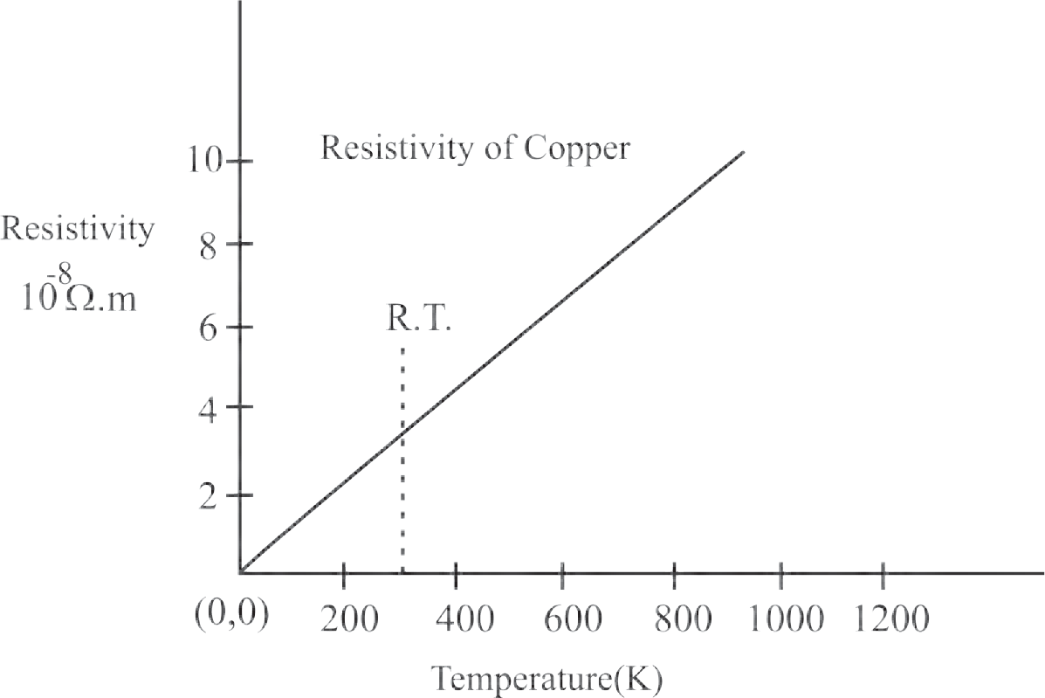
Variation of Resistance with temperature
Resistivity of a material varies with temperature
Fig. shows the variation of resistivity of copper as a function of temperature (K)
It can be seen that the variation is linear over a certain range of temperatures
Such a linear relation can be expressed as, ρ = ρ0[1+ α(T - T0)]
where T is the chosen reference temperature and ρ in the resistivity at the chosen temperature

Slide 3
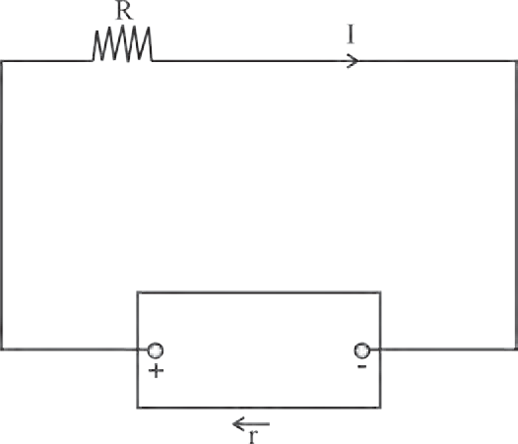

Electromotive Force (emf)
When charges flow through a conductor, a potential difference has to be established between the two ends of the conductor
For a steady flow of charges, this potential difference is required to be maintained across the two ends of the conductor, the terminals
There is a device that does so by doing work on the charges, thereby maintaining the potential difference is called battery.
The work done or energy spent per unit charge by battery to complete one round of close circuit is called electromotive force (EMF) denoted by E
Example of source of EMF, Power cells, batteries,Solar cells, fuel cells, and even generators etc.
Fig. shows a circuit with an emf (E) device with internal resistane r and a resistor R .
Here, the emf device keeps the positive terminal (+) at a higher electric potential than the negative terminal (-).
Now suppose that a charge dq flows through the cross section of conductor of the circuit in time dt
The device must do work dw on the charge dq, to flow from path of circuit and to maintain this flow, device must have to be doing the work.
Thus we define the emf of the emf device E = $\frac{dw}{dq}$
The SI unit of emf is joule/coulomb(J/C) or volt (V)

Slide 4
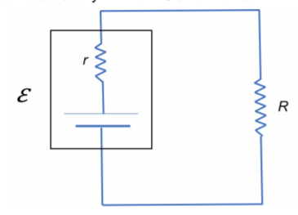

Current passing through close circuit
In a real emf device, there is an internal resistance to the motion of charge carriers
If such a device is not connected in a circuit, there is no current through it and the emf is equal to the potential difference across the two terminals of the emf device.
If a current (I) flows through an emf device, there is an internal resistance (r) and the emf (E) differs from the potential difference across its two terminals (V) i.e. V= E- (I) (r) --------------(I)
The negative sign is due to the fact that the current I flows through the emf device from the negative terminal to the positive terminal
By the application of Ohm’s law, V=IR
Hence, IR = E- (I) (r)
$∴$I R + I r = E => I = $\frac{E}{R+r}$
Thus, the maximum current that can be drawn from the emf device is when R = 0, i.e. $I_{max}= \frac{E}{r}$

Slide 5


Cells in Series
In a series combination, cells are connected in single electrical path, such that the positive terminal of one cell is connected to the negative terminal of the next cell, and so on
The terminal voltage of battery/cell is equal to the sum of voltages of individual cells in series
The equivalent emf of n number of cells in series combination is the algebraic sum of their individual emf
The equivalent internal resistance of n cells in a series combination is the sum of their individual internal resistance
Hence, terminal potential difference, V = $\sum_{i=1}^{i=n}{E_{i}}$ - I $\sum_{i=1}^{i=n}{r_{i}}$
Advantages of cells in series:
The cells connected in series produce a larger resultant voltage
Cells which are damaged can be easily identified, hence can be easily replaced

Slide 6
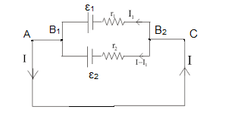

Cells in parallel
In parallel combination, positive terminals of all the cells are connected together and the negative terminals of all the cells are connected together
In parallel connection, the current is divided among the branches i.e. $I_{1}$and $I_{2}$ as shown in fig
Consider points $B_{1}$ and $B_{2}$ having potentials $V_{B1}$ and $V_{B2}$, respectively
Hence, potential difference across terminal is V = $V_{B1}$- $V_{B2}$
for cell $E_{1}$, V = $E_{1}$- $I_{1}$ $r_{1}$ => $I_{1}$ =$\frac{E_{1}\text{−}\text{V}}{r_{1}}$
for cell V= $E_{2}$- $I_{2}$ $r_{2}$ => $I_{2}$= $\frac{E_{2}\text{−}\text{V}}{r_{2}}$
But I = $I_{1}$+ $I_{2}$ = $\frac{E_{1}\text{−}\text{V}}{r_{1}}$ + $\frac{E_{2}\text{−}\text{V}}{r_{2}}$
I = $\frac{E_{1}}{r_{1}}$ - $\frac{\text{V}}{r_{1}}$ + $\frac{E_{2}}{r_{2}}$ - $\frac{\text{V}}{r_{2}}$ = $\frac{E_{1}}{r_{1}}$ + $\frac{E_{2}}{r_{2}}$ - V$\left\{\frac{\text{1}}{r_{1}}+\frac{\text{1}}{r_{2}}\right\}$
V$\left\{\frac{\text{1}}{r_{1}}+\frac{\text{1}}{r_{2}}\right\}$ = $\frac{E_{1}}{r_{1}}$ + $\frac{E_{2}}{r_{2}}$ - I
V = $\frac{E_{1}r_{2}+E_{2}r_{1}}{r_{1}.r_{2}}$ $×$ $\left\{\frac{r_{1}.r_{2}}{r_{1}+r_{2}}\right\}$ - I $\left\{\frac{r_{1}.r_{2}}{r_{1}+r_{2}}\right\}$
= $\frac{E_{1}r_{2}+E_{2}r_{1}}{r_{1}+r_{2}}$ - I $\left\{\frac{r_{1}.r_{2}}{r_{1}+r_{2}}\right\}$
= $E_{eq}−I r_{eq}$
where $E_{eq}$= $\frac{E_{1}r_{2}+E_{2}r_{1}}{r_{1}+r_{2}}$ and $r_{eq}$= $\frac{r_{1}.r_{2}}{r_{1}+r_{2}}$ i.e. $\frac{1}{r_{eq}}$ = $\frac{\text{1}}{r_{1}}+\frac{\text{1}}{r_{2}}$ and $\frac{E_{eq}}{r_{eq}}$ = $\frac{E_{1}}{r_{1}}+\frac{E_{2}}{r_{2}}$
For n number of cells connected in parallel, $\frac{1}{r_{eq}}$ = $\frac{\text{1}}{r_{1}}+\frac{\text{1}}{r_{2}}$ -------+ $\frac{\text{1}}{r_{n}}$ and $\frac{E_{eq}}{r_{eq}}$ = $\frac{E_{1}}{r_{1}}+\frac{E_{2}}{r_{2}}$ ---------+$\frac{E_{n}}{r_{n}}$

Slide 7
Advantage and disadvantage of parallel combination
Advantages of cells in parallel : For cells connected in parallel in a circuit, the circuit will not break open even if a cell gets damaged or open
Disadvantages of cells in parallel : The voltage developed by the cells in parallel connection cannot be increased by increasing number of cells present in circuit

Slide 8
Types of Cells
Primary cell: A primary cell cannot be charged again. It can be used only once.
E.g. Dry cells, alkaline cells etc.
Secondary cell: The secondary cell are rechargeable and can be reused.
The chemical reaction in a secondary cells is reversible
E.g. Lead acid cell, and fuel cell
Fuel cells vehicles (FCVs): Fuel cells vehicles (FCVs) are electric vehicles that use fuel cells instead of lead acid batteries to power the vehicles
Hydrogen is used as a fuel in fuel cells
The by- product after its burning is water
This is important in terms of reducing emission of greenhouse gases produced by traditional gasoline fueled vehicles
The hydrogen fuel cell vehicles are thus more environment friendly

