Slide 1
Electro-Statics

Slide 2
Basic terminologies
Electric field intensity (E):
Line of force:
Electric flux (Φ):
Permitivity(ɛ):
Charge density (ʎ σ ρ):

Slide 3
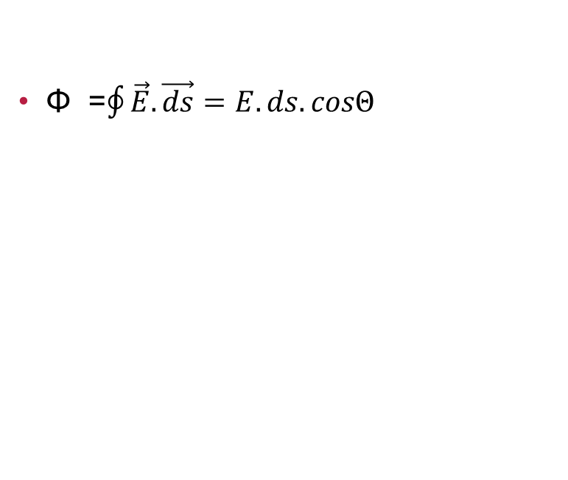
Relation between flux and intensity and gauss’s thrm
Φ =$\oint{\vec{E}.\vec{ds}=E.ds.cosΘ}$
Gauss’s theorem:
Φ = q/ɛo

Slide 4
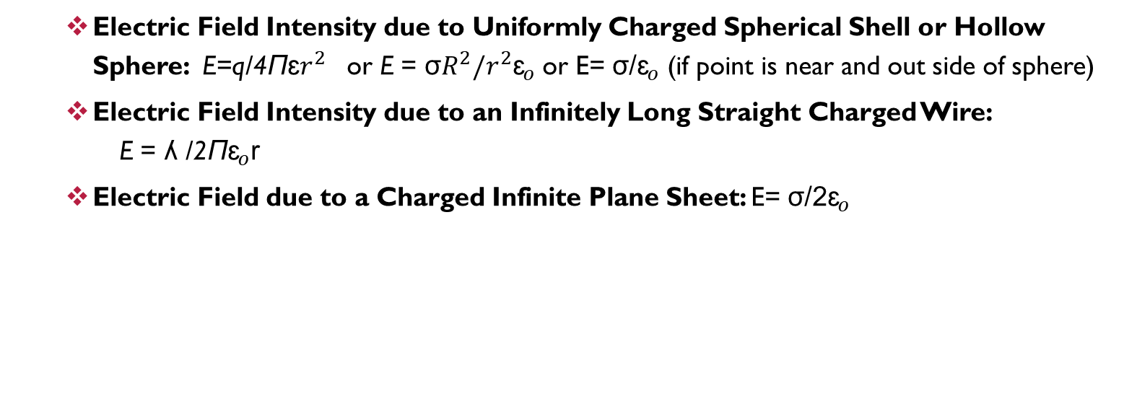
Application of gauss’s theorem
Electric Field Intensity due to Uniformly Charged Spherical Shell or Hollow Sphere: E=q/4Πɛ$r^{2}$ or E = σ$R^{2}/r^{2}{\text{ɛ}}_{o}$ or E= σ/${\text{ɛ}}_{o}$ (if point is near and out side of sphere)
Electric Field Intensity due to an Infinitely Long Straight Charged Wire: E = ʎ /2Π${\text{ɛ}}_{o}$r
Electric Field due to a Charged Infinite Plane Sheet: E= σ/2${\text{ɛ}}_{o}$

Slide 5
Electric potential and potential energy
Electric potential : Electric work done to bring unit point charge at a point in an electric field is called Electric potential at that point of the field.
If charge q displace in electric field is dr, the force acting on charge q by the field is F, then energy increases dU=dW and V at point is = dU/q =dW/q
Electric potential energy: Electric work done to bring point charge at point in electric field, equivalent energy stored in system is called Electric potential energy.
If charge q displace in electric field is dr, the force acting on charge q by the field is F, then energy increases dU=dW=F.dr

Slide 6
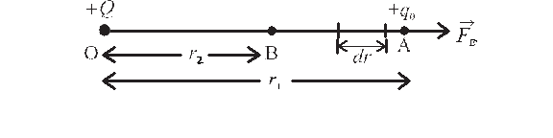
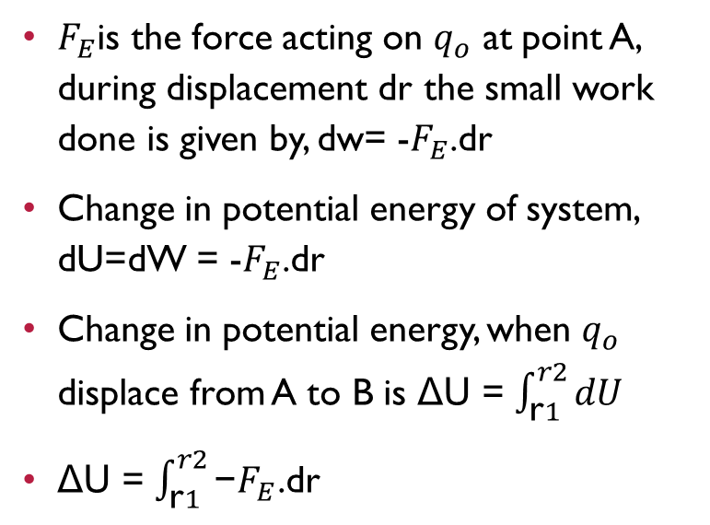
Derivation for potential energy in the system of two point charge:
$F_{E}$is the force acting on $q_{o}$ at point A, during displacement dr the small work done is given by, dw= -$F_{E}$.dr
Change in potential energy of system, dU=dW = -$F_{E}$.dr
Change in potential energy, when $q_{o}$ displace from A to B is ΔU = $\int_{\text{r}1}^{r2}{dU}$
ΔU = $\int_{\text{r}1}^{r2}{\text{−}F_{E}\text{.}\text{dr}}$
Let us consider the electrostatic field due to a source charge +Q placed at the origin O.
Let a small charge + q0 be brought from point A to point B at respective distances r1 and r2
from O, against the repulsive forces on it.

Slide 7
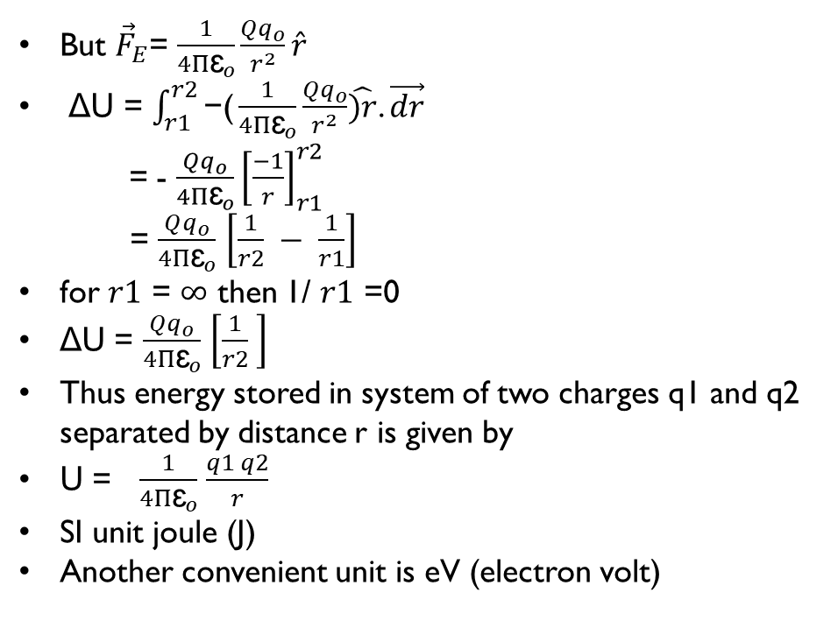
But ${\vec{F}}_{E}$= $\frac{1}{4Π{\text{ɛ}}_{o}}\frac{Qq_{o}}{r^{2}}\hat{r}$
ΔU = $\int_{r1}^{r2}{\text{−}\text{(}\frac{1}{4Π{\text{ɛ}}_{o}}\frac{Qq_{o}}{r^{2}}\hat{)r}\text{.}}\vec{dr}$
= - $\frac{Qq_{o}}{4Π{\text{ɛ}}_{o}}{\left[\frac{−1}{r}\right]}_{r1}^{r2}$
= $\frac{Qq_{o}}{4Π{\text{ɛ}}_{o}}$ $\left[\frac{1}{r2} − \frac{1}{r1}\right]$
for $r1$ = $∞$ then 1/ $r1$ =0
ΔU = $\frac{Qq_{o}}{4Π{\text{ɛ}}_{o}}$ $\left[\frac{1}{r2} \right]$
Thus energy stored in system of two charges q1 and q2 separated by distance r is given by
U = $\frac{1}{4Π{\text{ɛ}}_{o}}$ $\frac{q1 q2}{r}$
SI unit joule (J)
Another convenient unit is eV (electron volt)

Slide 8
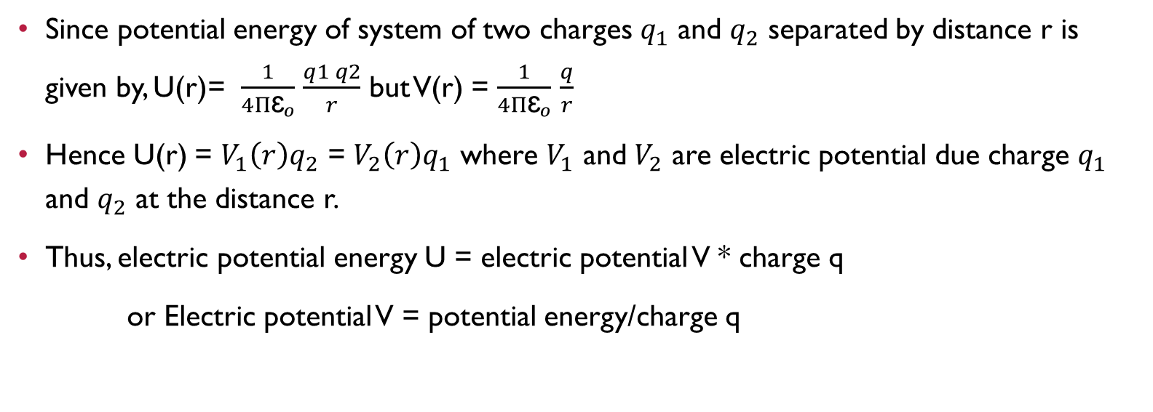
Concept of electric potential
Since potential energy of system of two charges $q_{1}$ and $q_{2}$ separated by distance r is given by, U(r)= $\frac{1}{4Π{\text{ɛ}}_{o}}$ $\frac{q1 q2}{r}$ but V(r) = $\frac{1}{4Π{\text{ɛ}}_{o}}$ $\frac{q}{r}$
Hence U(r) = $V_{1}\left(r\right)q_{2}$ = $V_{2}\left(r\right)q_{1}$ where $V_{1}$ and $V_{2}$ are electric potential due charge $q_{1}$ and $q_{2}$ at the distance r.
Thus, electric potential energy U = electric potential V * charge q
or Electric potential V = potential energy/charge q

Slide 9
Relationship between electric potential and electric field intensity
To displace point charge q under the influence of electrostatic force F in electric field with very small displacement dx, the small work done dw = - F.dx but F = E/q
Hence dw = - E.q.dx and dw=dV.q
=> -E.q.dx = dV.q
=> dV= -E.dx
or E= -dV/dx

Slide 10

Electric potential due to point charge
$F_{E}$is the force acting on $q_{o}$ at point A, during displacement dr the small work done is given by, dw= -$F_{E}$.dr
Change in potential energy of system, dU=dW = -$F_{E}$.dr
Change in potential energy, when $q_{o}$ displace from A to B is ΔW = $\int_{\text{r}1}^{r2}{dU}$
ΔW = $\int_{\text{r}1}^{r2}{\text{−}F_{E}\text{.}\text{dr}}$
Let us consider the electrostatic field due to a source charge +Q placed at the origin O.
Let a small charge + q0 be brought from point A to point B at respective distances r1 and r2
from O, against the repulsive forces on it.

Slide 11
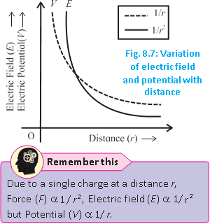
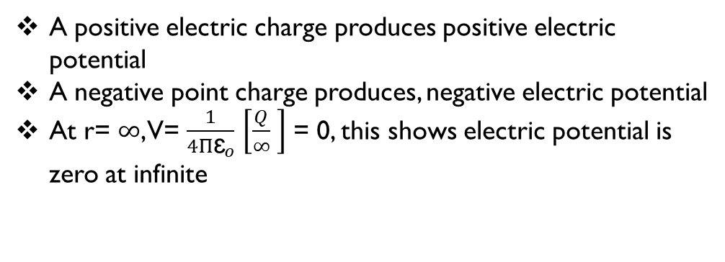
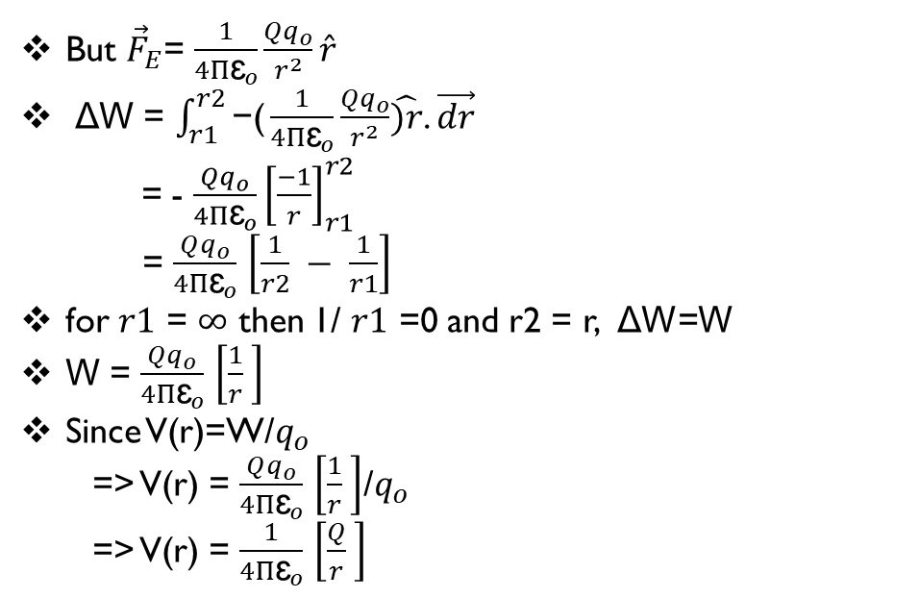
But ${\vec{F}}_{E}$= $\frac{1}{4Π{\text{ɛ}}_{o}}\frac{Qq_{o}}{r^{2}}\hat{r}$
ΔW = $\int_{r1}^{r2}{\text{−}\text{(}\frac{1}{4Π{\text{ɛ}}_{o}}\frac{Qq_{o}}{r^{2}}\hat{)r}\text{.}}\vec{dr}$
= - $\frac{Qq_{o}}{4Π{\text{ɛ}}_{o}}{\left[\frac{−1}{r}\right]}_{r1}^{r2}$
= $\frac{Qq_{o}}{4Π{\text{ɛ}}_{o}}$ $\left[\frac{1}{r2} − \frac{1}{r1}\right]$
for $r1$ = $∞$ then 1/ $r1$ =0 and r2 = r, ΔW=W
W = $\frac{Qq_{o}}{4Π{\text{ɛ}}_{o}}$ $\left[\frac{1}{r} \right]$
Since V(r)=W/$q_{o}$
=> V(r) = $\frac{Qq_{o}}{4Π{\text{ɛ}}_{o}}$ $\left[\frac{1}{r} \right]$/$q_{o}$
=> V(r) = $\frac{1}{4Π{\text{ɛ}}_{o}}$ $\left[\frac{Q}{r} \right]$
A positive electric charge produces positive electric potential
A negative point charge produces, negative electric potential
At r= $∞$, V= $\frac{1}{4Π{\text{ɛ}}_{o}}$ $\left[\frac{Q}{∞} \right]$ = 0, this shows electric potential is zero at infinite

Slide 12
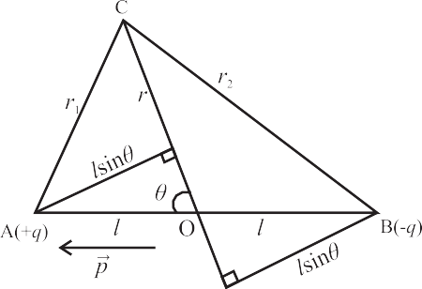
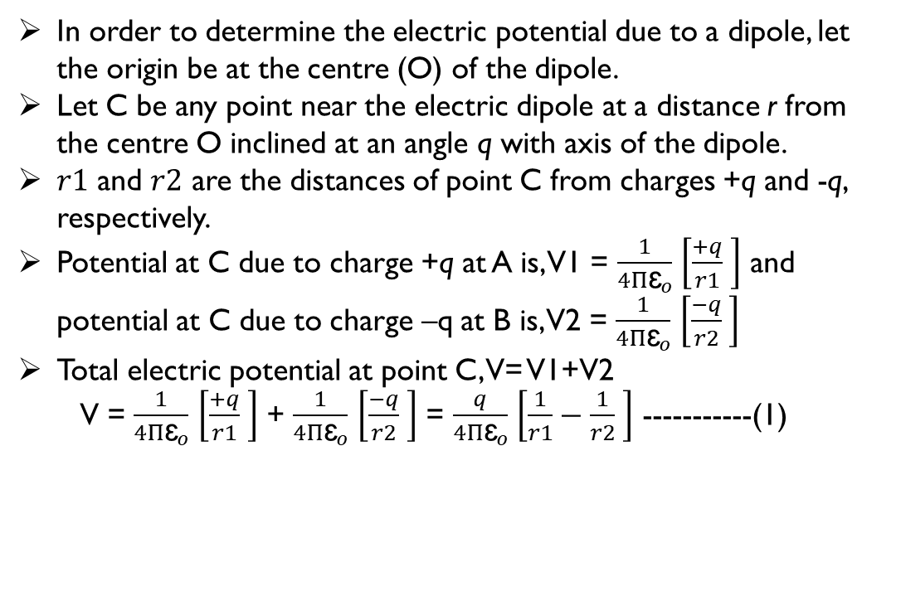
Electric potential due to dipole:
In order to determine the electric potential due to a dipole, let the origin be at the centre (O) of the dipole.
Let C be any point near the electric dipole at a distance r from the centre O inclined at an angle q with axis of the dipole.
$r1$ and $r2$ are the distances of point C from charges +q and -q, respectively.
Potential at C due to charge +q at A is, V1 = $\frac{1}{4Π{\text{ɛ}}_{o}}$ $\left[\frac{+q}{r1} \right]$ and potential at C due to charge –q at B is, V2 = $\frac{1}{4Π{\text{ɛ}}_{o}}$ $\left[\frac{−q}{r2} \right]$
Total electric potential at point C, V= V1+V2
V = $\frac{1}{4Π{\text{ɛ}}_{o}}$ $\left[\frac{+q}{r1} \right]$ + $\frac{1}{4Π{\text{ɛ}}_{o}}$ $\left[\frac{−q}{r2} \right]$ = $\frac{q}{4Π{\text{ɛ}}_{o}}$ $\left[\frac{1}{r1}−\frac{1}{r2} \right]$ -----------(1)

Slide 13

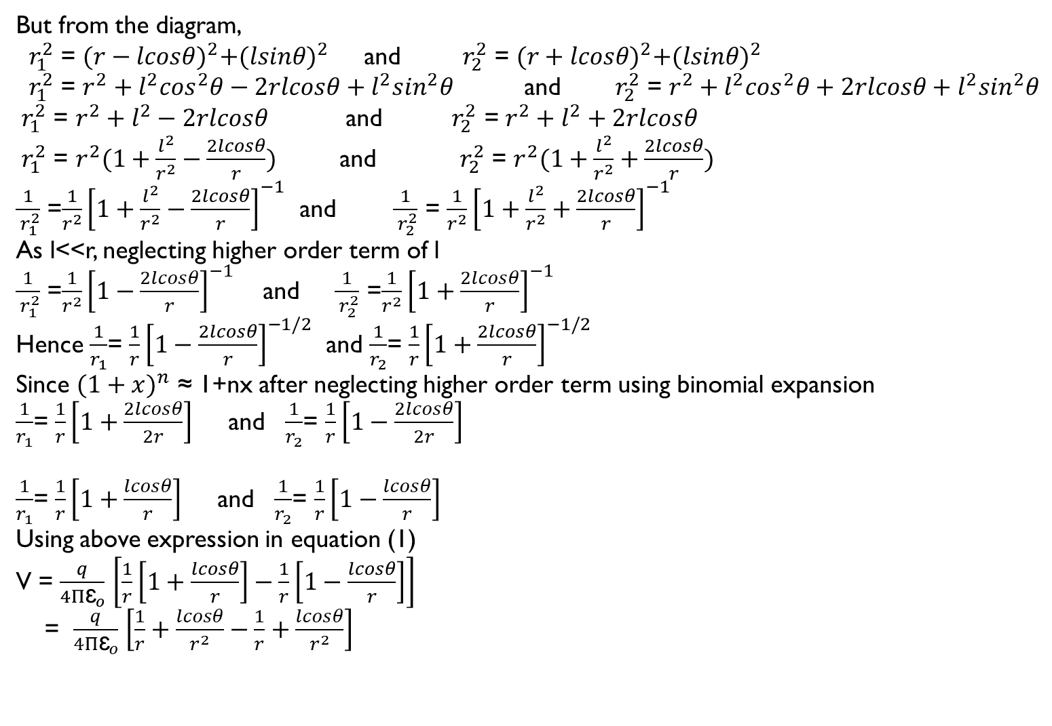
But from the diagram,
${ r}_{1}^{2}$ = ${(r−lcosθ)}^{2}+{(lsinθ)}^{2}$ and ${ r}_{2}^{2}$ = ${(r+lcosθ)}^{2}+{(lsinθ)}^{2}$
${ r}_{1}^{2}$ = $r^{2}+l^{2}\cos^{2}θ−2rlcosθ+l^{2}\sin^{2}θ$ and ${ r}_{2}^{2}$ = $r^{2}+l^{2}\cos^{2}θ+2rlcosθ+l^{2}\sin^{2}θ$
${ r}_{1}^{2}$ = $r^{2}+l^{2}−2rlcosθ$ and ${ r}_{2}^{2}$ = $r^{2}+l^{2}+2rlcosθ$
${ r}_{1}^{2}$ = $r^{2}(1+\frac{l^{2}}{r^{2}}−\frac{2lcosθ}{r})$ and ${ r}_{2}^{2}$ = $r^{2}(1+\frac{l^{2}}{r^{2}}+\frac{2lcosθ}{r})$
$\frac{1}{{ r}_{1}^{2}}$ =$\frac{1}{r^{2}}{\left[1+\frac{l^{2}}{r^{2}}−\frac{2lcosθ}{r}\right]}^{−1}$ and $\frac{1}{{ r}_{2}^{2}}$ = $\frac{1}{r^{2}}{\left[1+\frac{l^{2}}{r^{2}}+\frac{2lcosθ}{r}\right]}^{−1}$
As l<<r, neglecting higher order term of l
$\frac{1}{{ r}_{1}^{2}}$ =$\frac{1}{r^{2}}{\left[1−\frac{2lcosθ}{r}\right]}^{−1}$ and $\frac{1}{{ r}_{2}^{2}}$ =$\frac{1}{r^{2}}{\left[1+\frac{2lcosθ}{r}\right]}^{−1}$
Hence $\frac{1}{r_{1}}$= $\frac{1}{r}{\left[1−\frac{2lcosθ}{r}\right]}^{−1/2}$ and $\frac{1}{r_{2}}$= $\frac{1}{r}{\left[1+\frac{2lcosθ}{r}\right]}^{−1/2}$
Since ${(1+x)}^{n}$ ≈ 1+nx after neglecting higher order term using binomial expansion
$\frac{1}{r_{1}}$= $\frac{1}{r}\left[1+\frac{2lcosθ}{2r}\right]$ and $\frac{1}{r_{2}}$= $\frac{1}{r}\left[1−\frac{2lcosθ}{2r}\right]$
$\frac{1}{r_{1}}$= $\frac{1}{r}\left[1+\frac{lcosθ}{r}\right]$ and $\frac{1}{r_{2}}$= $\frac{1}{r}\left[1−\frac{lcosθ}{r}\right]$
Using above expression in equation (1)
V = $\frac{q}{4Π{\text{ɛ}}_{o}}$ $\left[\frac{1}{r}\left[1+\frac{lcosθ}{r}\right]−\frac{1}{r}\left[1−\frac{lcosθ}{r}\right]\right]$
= $\frac{q}{4Π{\text{ɛ}}_{o}}$ $\left[\frac{1}{r}+\frac{lcosθ}{r^{2}}−\frac{1}{r}+\frac{lcosθ}{r^{2}}\right]$
V= $\frac{q}{4Π{\text{ɛ}}_{o}}$ $\left[\frac{2lcosθ}{r^{2}}\right]$
But electric dipole moment p=q.(2l)
V= $\frac{1}{4Π{\text{ɛ}}_{o}}$ $\left[\frac{p.cosθ}{r^{2}}\right]$
V= $\frac{1}{4Π{\text{ɛ}}_{o}}$ $\left[\frac{\vec{p}.\hat{r}}{r^{2}}\right]$
V= $\frac{1}{4Π{\text{ɛ}}_{o}}$ $\left[\frac{\vec{p}.\vec{r}̂}{r^{3}}\right]$ as $\hat{r}$ = $\frac{\vec{r}̂}{r}$

Slide 14
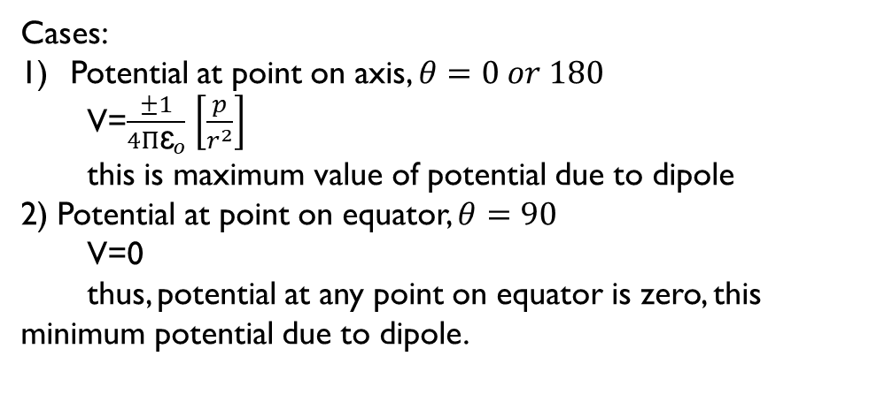
Cases:
Potential at point on axis, $θ=0 or 180$
V=$\frac{±1}{4Π{\text{ɛ}}_{o}}$ $\left[\frac{p}{r^{2}}\right]$
this is maximum value of potential due to dipole
2) Potential at point on equator, $θ=90$
V=0
thus, potential at any point on equator is zero, this minimum potential due to dipole.

Slide 15
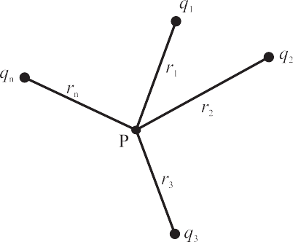
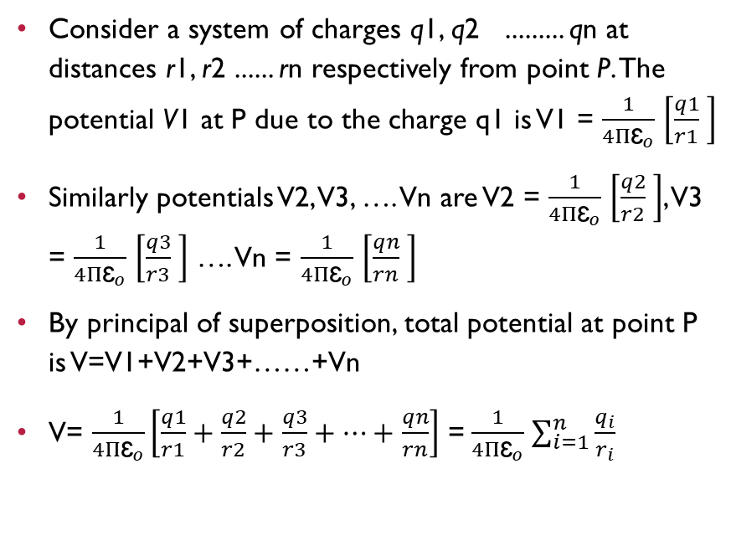
Electrostatics potential due to a system of charges:
Consider a system of charges q1, q2 ......... qn at distances r1, r2 ...... rn respectively from point P. The potential V1 at P due to the charge q1 is V1 = $\frac{1}{4Π{\text{ɛ}}_{o}}$ $\left[\frac{q1}{r1} \right]$
Similarly potentials V2, V3, …. Vn are V2 = $\frac{1}{4Π{\text{ɛ}}_{o}}$ $\left[\frac{q2}{r2} \right]$, V3 = $\frac{1}{4Π{\text{ɛ}}_{o}}$ $\left[\frac{q3}{r3} \right]$ …. Vn = $\frac{1}{4Π{\text{ɛ}}_{o}}$ $\left[\frac{qn}{rn} \right]$
By principal of superposition, total potential at point P is V=V1+V2+V3+……+Vn
V= $\frac{1}{4Π{\text{ɛ}}_{o}}\left[\frac{q1}{r1}+\frac{q2}{r2}+\frac{q3}{r3}+…+\frac{qn}{rn}\right]$ =$\frac{1}{4Π{\text{ɛ}}_{o}}$ $\sum_{i=1}^{n}{\frac{q_{i}}{r_{i}}}$

Slide 16
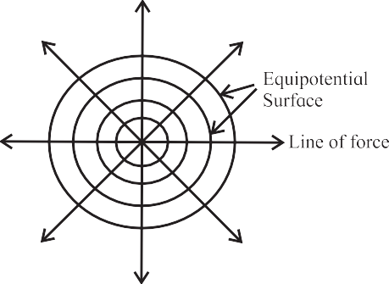
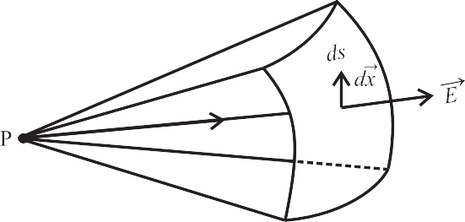
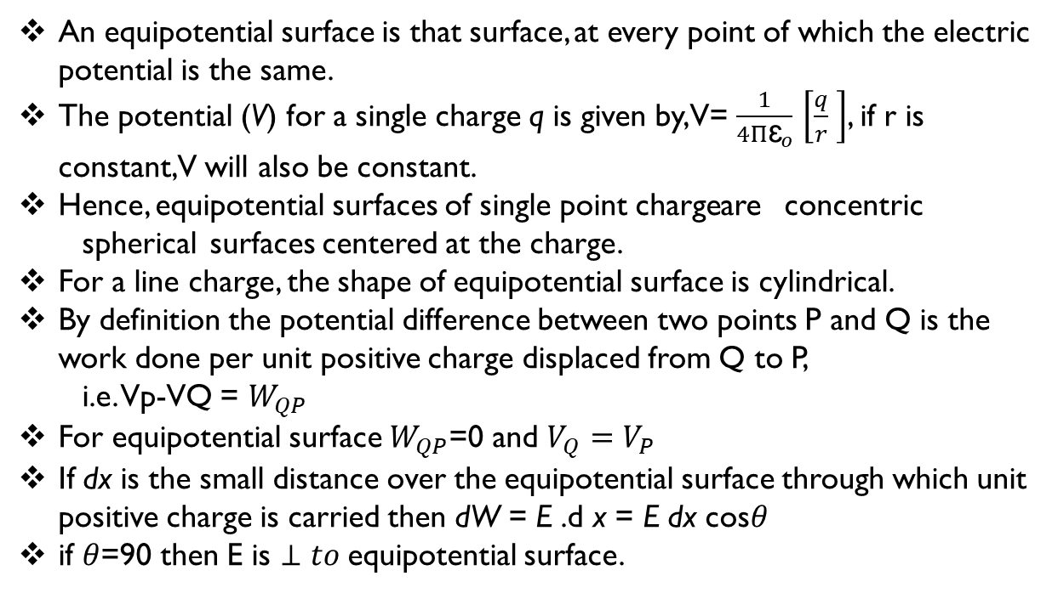
Equipotential Surfaces
An equipotential surface is that surface, at every point of which the electric potential is the same.
The potential (V) for a single charge q is given by, V= $\frac{1}{4Π{\text{ɛ}}_{o}}$ $\left[\frac{q}{r} \right]$, if r is constant, V will also be constant.
Hence, equipotential surfaces of single point charge are concentric spherical surfaces centered at the charge.
For a line charge, the shape of equipotential surface is cylindrical.
By definition the potential difference between two points P and Q is the work done per unit positive charge displaced from Q to P,
i.e. Vp-VQ = $W_{QP}$
For equipotential surface $W_{QP}$=0 and $V_{Q}=V_{P}$
If dx is the small distance over the equipotential surface through which unit positive charge is carried then dW = E .d x = E dx cos$θ$
if $θ$=90 then E is $⊥to$equipotential surface.

Slide 17
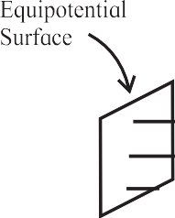
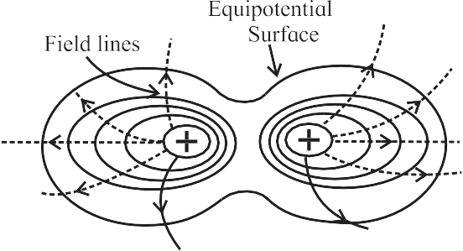

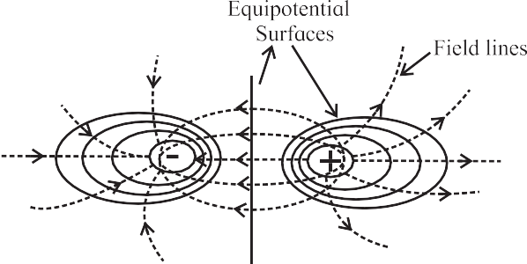
Some Equipotential surface
Equipotential surface of uniform Electric field
Equipotential surfaces for two identical positive charges
Equipotential surfaces for a dipole
Between 2 plane metallic sheets

Slide 18
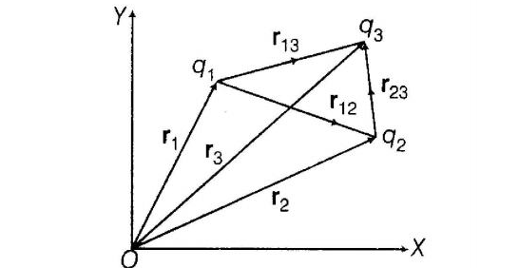
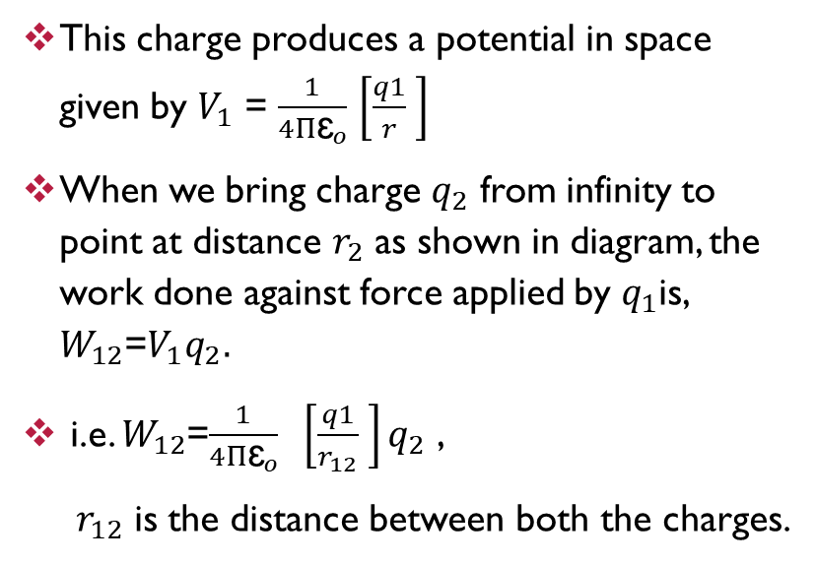
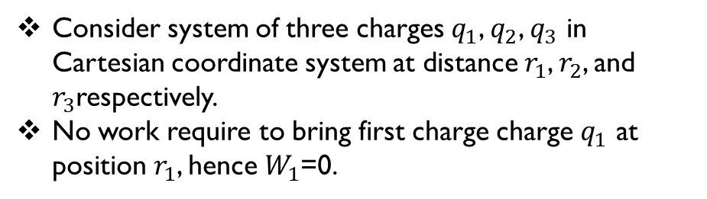
Potential energy of system of three charges
This charge produces a potential in space given by $V_{1}$ = $\frac{1}{4Π{\text{ɛ}}_{o}}$ $\left[\frac{q1}{r} \right]$
When we bring charge $q_{2}$ from infinity to point at distance $r_{2}$ as shown in diagram, the work done against force applied by $q_{1}$is, $W_{12}$=$V_{1}q_{2}.$
i.e. $W_{12}$=$\frac{1}{4Π{\text{ɛ}}_{o}} \left[\frac{q1}{r_{12}} \right]q_{2}$ ,
$r_{12}$ is the distance between both the charges.
Consider system of three charges $q_{1}$, $q_{2}$, $q_{3}$ in Cartesian coordinate system at distance $r_{1}$, $r_{2}$, and $r_{3}$respectively.
No work require to bring first charge charge $q_{1}$ at position $r_{1}$, hence $W_{1}$=0.

Slide 19
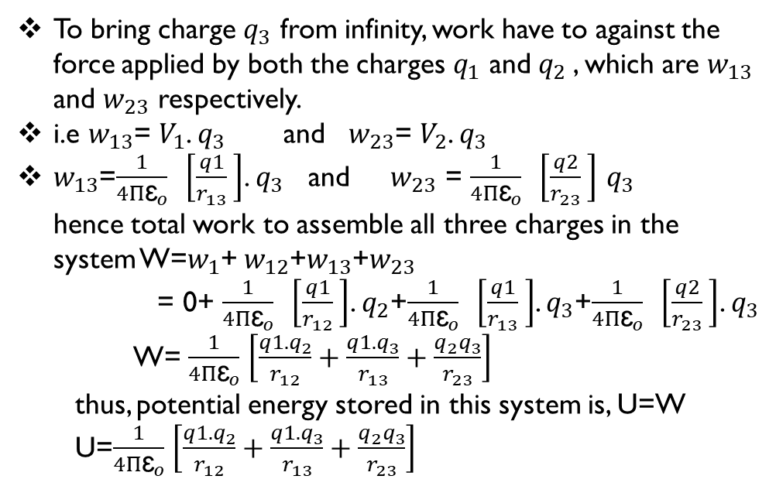
To bring charge $q_{3}$ from infinity, work have to against the force applied by both the charges $q_{1}$ and $q_{2}$, which are $w_{13}$ and $w_{23}$ respectively.
i.e $w_{13}$= $V_{1}$. $q_{3}$ and $w_{23}$= $V_{2}$. $q_{3}$
$w_{13}$=$\frac{1}{4Π{\text{ɛ}}_{o}} \left[\frac{q1}{r_{13}} \right]$. $q_{3}$ and $w_{23}$ = $\frac{1}{4Π{\text{ɛ}}_{o}} \left[\frac{q2}{r_{23}} \right]$ $q_{3}$ hence total work to assemble all three charges in the system W=$w_{1}$+ $w_{12}$+$w_{13}$+$w_{23}$
= 0+ $\frac{1}{4Π{\text{ɛ}}_{o}} \left[\frac{q1}{r_{12}} \right]$. $q_{2}$+$\frac{1}{4Π{\text{ɛ}}_{o}} \left[\frac{q1}{r_{13}} \right]$. $q_{3}$+$\frac{1}{4Π{\text{ɛ}}_{o}} \left[\frac{q2}{r_{23}} \right]$. $q_{3}$
W= $\frac{1}{4Π{\text{ɛ}}_{o}}$ $\left[\frac{q1.q_{2}}{r_{12}}+\frac{q1.q_{3}}{r_{13}}+\frac{q_{2}q_{3}}{r_{23}}\right]$
thus, potential energy stored in this system is, U=W
U=$\frac{1}{4Π{\text{ɛ}}_{o}}$ $\left[\frac{q1.q_{2}}{r_{12}}+\frac{q1.q_{3}}{r_{13}}+\frac{q_{2}q_{3}}{r_{23}}\right]$

Slide 20
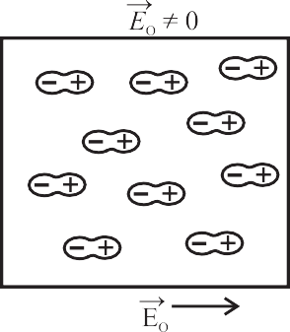
Dielectrics and Electric Polarization
Dielectrics:
Dielectrics are insulates which can be used to store electrical energy
Eg. glass, wax, water, wood , mica, rubber, stone, plastic etc.
Polarization:
when dielectric substances are placed in an external field, the center of positive and center of negative charges get displaced in opposite directions and the molecules develop a net dipole moment. This is called polarization

Slide 21

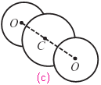
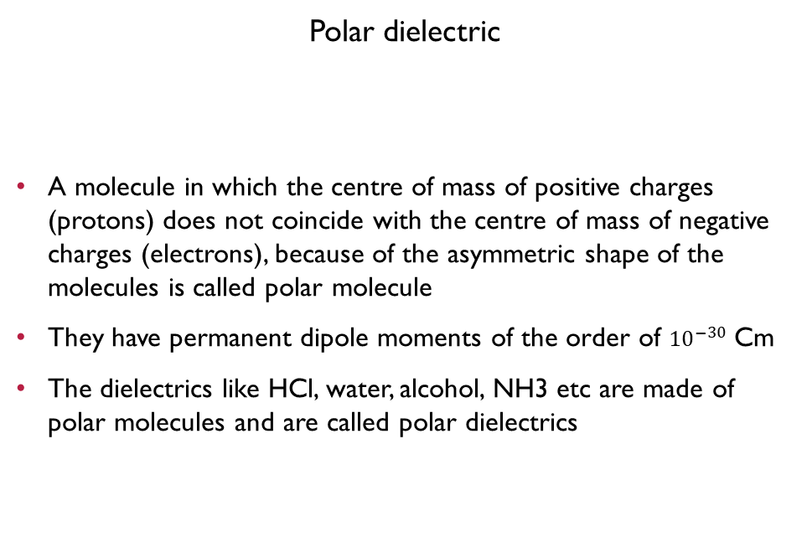
Types of dielectrics
Polar dielectric
A molecule in which the centre of mass of positive charges (protons) does not coincide with the centre of mass of negative charges (electrons), because of the asymmetric shape of the molecules is called polar molecule
They have permanent dipole moments of the order of ${10}^{−30}$ Cm
The dielectrics like HCl, water, alcohol, NH3 etc are made of polar molecules and are called polar dielectrics
Non-Polar dielectric
A molecule in which the centre of mass of the positive charges coincides with the centre of mass of the negative charges is called a non polar molecule
These have symmetrical shapes and have zero dipole moment in the normal state
The dielectrics
like hydrogen, nitrogen, oxygen, CO2, benzene, methane are made up of nonpolar molecules and are called non polar dielectrics

Slide 22
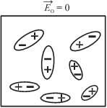
Polarization of a polar dielectric
The molecules of a polar dielectric have tiny permanent dipole moments
Due to thermal agitation in the material in the absence of any external electric field, these dipole moments are randomly oriented
Hence the total dipole moment of dielectric material is zero.
When an external electric field is applied the dipole moments of different molecules tend to align with the field
As a result the dielectric develops a net dipole moment in the direction of the external field and dielectric material is polarized
The extent of polarization depends on the relative values of the two opposing energies
The applied external electric field which tends to align the dipole with the field.
Thermal energy tending to randomise the alignment of the dipole

Slide 23
Polarization of a non-polar dielectric
In the presence of an external electric field Eo, the centres of the positive charge in each molecule of a non-polar dielectric is pulled in the direction of Eo, while the centres of the negative charges are displaced in the opposite direction
The displacement of the charges stops when the force exerted on them by the external field is balanced by the restoring force between the charges in the molecule
Each molecule becomes a tiny dipole having a dipole moment. The induced dipole moments of different molecules add up giving a net dipole moment to the dielectric in the presence of the external field

Slide 24
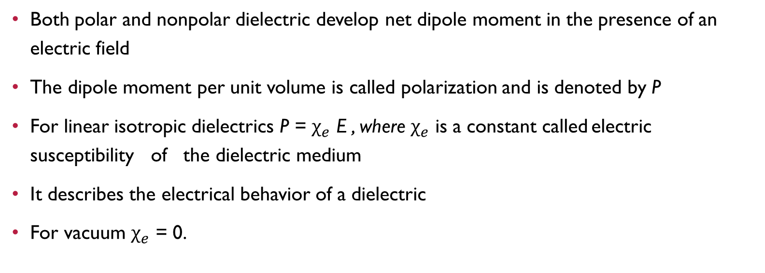
Polarization
Both polar and nonpolar dielectric develop net dipole moment in the presence of an electric field
The dipole moment per unit volume is called polarization and is denoted by P
For linear isotropic dielectrics P = $χ_{e}$ E , where $χ_{e}$ is a constant called electric susceptibility of the dielectric medium
It describes the electrical behavior of a dielectric
For vacuum $χ_{e}$ = 0.

Slide 25
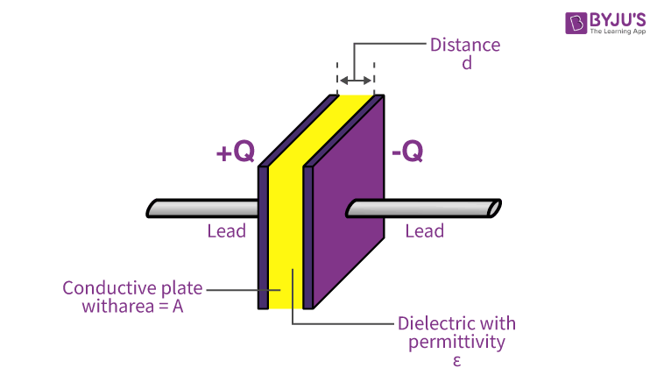
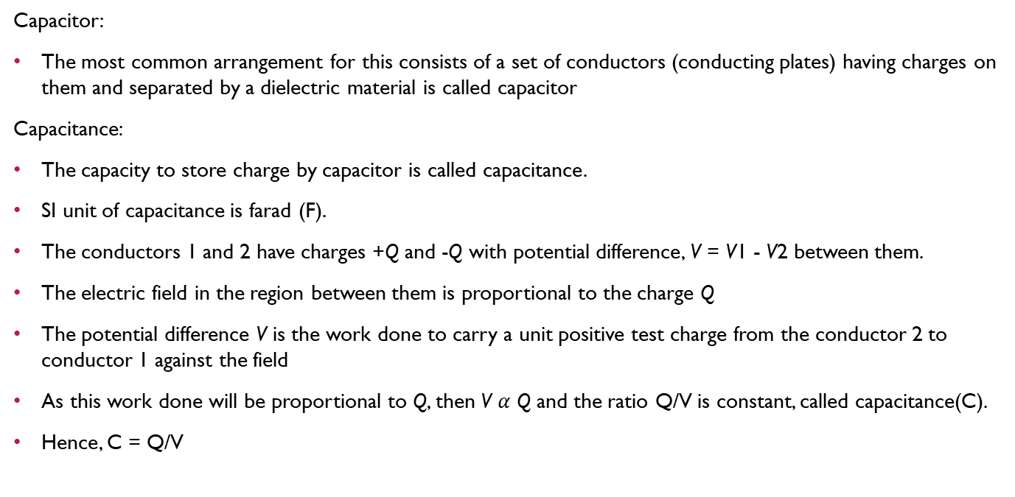
Capacitors and Capacitance
Capacitor:
The most common arrangement for this consists of a set of conductors (conducting plates) having charges on them and separated by a dielectric material is called capacitor
Capacitance:
The capacity to store charge by capacitor is called capacitance.
SI unit of capacitance is farad (F).
The conductors 1 and 2 have charges +Q and -Q with potential difference, V = V1 - V2 between them.
The electric field in the region between them is proportional to the charge Q
The potential difference V is the work done to carry a unit positive test charge from the conductor 2 to conductor 1 against the field
As this work done will be proportional to Q, then V $α$ Q and the ratio Q/V is constant, called capacitance(C).
Hence, C = Q/V

Slide 26
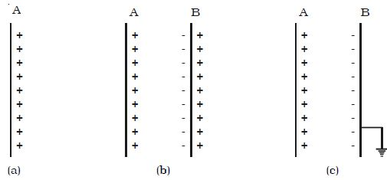
Principle of a capacitor
Consider a metal plate A having positive charge +Q and potential on plate be V, hence capacity of plate C= Q/V.
Now consider another insulated metal plate B held near the plate A.
By induction a negative charge is produced on the nearer face and an equal positive charge develops on the farther face of B.
The induced negative charge lowers the potential of plate A, while the induced positive charge raises its potential
If the outer surface of B is connected to earth, the induced positive charges on B being free and flows to earth, This greatly reduces the potential of B.
If V1 is the potential on plate B due to charge (- Q) then the net potential of the system will now be +V-V1.
Hence, Capacity (C1) = Q/(V-V1) and C1 > C.
Thus capacity of metal plate A, is increased by placing an identical earth connected metal plate B near it

