Slide 1
electrostatics
FYJC
Chap-10

Slide 2
Electrostatics
A branch of physics, which deals with all physical quantity and phenomena linked with the charges, which are at rest.
Eg. Force between charges, electric field, electric potential, potential energy in electric field etc.

Slide 3
Electric charges
historically, opposite electric charges were known to the greeks in the 600 bc
they realized that equal and opposite charges develop on amber and fur when rubbed against each other
Electric charge is a basic property of elementary particles of which matter is made of
These elementary particles are proton, neutron, and electron
A proton is considered to be positively charged and electron to be negatively charged. Neutron is electrically neutral
When certain dissimilar substances, like fur and amber or comb and dry hair are rubbed against each other, electrons get transferred to the other substance making them charged
The substance receiving electrons develops a negative charge while the other is left with an equal amount of positive charge

Slide 4
Additive Nature of Charge
Electric charge is additive, similar to mass
The total electric charge on an object is equal to the algebraic sum of all the electric charges distributed on different parts of the object
while taking the algebraic sum, the sign (positive or negative) of the electric charges must be taken into account
Thus if two bodies have equal and opposite charges, the net charge on the system of the two bodies is zero

Slide 5
Quantization of Charge
Charges are not continuously distributed throughout the material or on the surface of charged object.
The minimum value of the charges grouped together, as determined by the Milikan's oil drop experiment is e = 1.6×10⁻¹⁹ C i.e. on electron.
This is called the elementary charge particle
Since proton (+ve) and electrons (-ve) are the charged particles of constituting matter, the charge on an object must be an integral multiple of ±e, i.e. q = ± ne, where n is an integer
charge on an object can be increased or decreased in multiples of e
It is because, during the charging process an integral number of electrons can be transferred from one body to the other body
This is known as quantization of charge or discrete nature of charge

Slide 6
Conservation of Charge
In any given physical system, charge may get transferred from one part of the system to another, but the total charge in the system remains constant.
for an isolated system total charge cannot be created nor destroyed.

Slide 7
Forces between Charges
charged objects experience force when brought close (not touching) to each other.
This force can be attractive or repulsive
Like charges repel each other and unlike charges attract each other.

Slide 8

Coulomb’s Law
The electric interaction between two charged bodies can be expressed in terms of the forces they exert on each other
Coulomb used point charges at rest to study the interaction
A point charge is a charge whose dimensions are negligibly small compared to its distance from another bodies
The force of attraction or repulsion between two point charges at rest is directly proportional to the product of the magnitude of the charges and inversely proportional to the square of the distance between them.
This force acts along the line joining the two charges
Let $q_{1}$ and $q_{2}$be two point charges at rest with respect to each other and separated by a distance r.
The magnitude F of the force between them is given by, $Fα\frac{q_{1}q_{2}}{r^{2}}$ => $F=K\frac{q_{1}q_{2}}{r^{2}}$ where K is the constant of proportionality
The force between the two charges will be attractive if they are unlike (one positive and one negative)
The force will be repulsive if charges are similar (both positive or both negative)

Slide 9
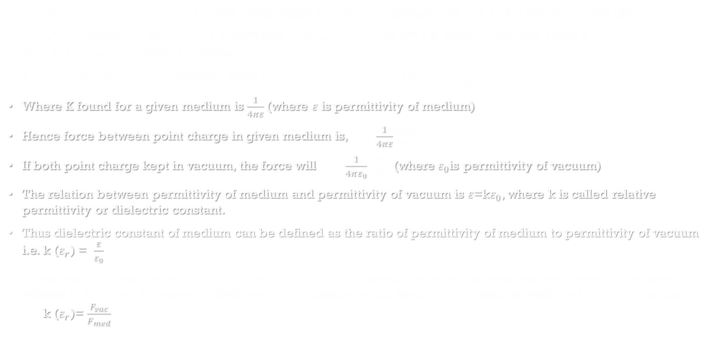
Relative Permittivity or Dielectric Constant
While discussing the coulomb’s law it was assumed that the charges are held stationery in vacuum.
When the charges are kept in a material medium, such as water, mica or parafined paper, the medium affects the force between the charges
As force between the two charges placed in a medium found to be $F=K\frac{q_{1}q_{2}}{r^{2}}$
Where K found for a given medium is $\frac{1}{4πε}$(where $ε$ is permittivity of medium)
Hence force between point charge in given medium is, $F=\frac{1}{4πε}\frac{q_{1}q_{2}}{r^{2}}$
If both point charge kept in vacuum, the force will $F=\frac{1}{4πε_{0}}\frac{q_{1}q_{2}}{r^{2}}$ (where$ε_{0}$is permittivity of vacuum)
The relation between permittivity of medium and permittivity of vacuum is $ε$=k$ε_{0}$, where k is called relative permittivity or dielectric constant.
Thus dielectric constant of medium can be defined as the ratio of permittivity of medium to permittivity of vacuum i.e. k ($ε_{r}$) = $\frac{ε}{ε_{0}}$
It can also be define ratio of the force between two point charges placed a certain distance apart in free space or vacuum to the force between the same two point charges when placed at the same distance in the given medium i.e. k ($ε_{r}$)= $\frac{F_{vac}}{F_{med}}$

Slide 10

Definition of Unit Charge from the Coulomb’s Law
When equal amount of two point charge placed at a distance of one meter apart from each other in vacuum, experiences a force of 9 $×{10}^{9}$N,The magnitude of charge said to be 1 coulomb.
Since the force acting between two point charge in vacuum is given by $F=\frac{1}{4πε_{0}}\frac{q_{1}q_{2}}{r^{2}}$
Let $q_{1 }and q_{2}$ are equal in magnitude i.e. $q_{1 }= q_{2}$= q , is separated by distance 1 m apart i.e. r=1m and F= 9 $×{10}^{9}$N.
since $\frac{1}{4πε_{0}}$= 9 $×{10}^{9}$
Thus using above data in given equation, i.e. $F=\frac{1}{4πε_{0}}\frac{q_{1}q_{2}}{r^{2}}$ => 9 $×{10}^{9}$=9 $×{10}^{9}\frac{q^{2}}{1}$ => $q^{2}$=1
Thus q=1 and unit is allocated as per name of scientist coulomb i.e. q=1C

Slide 11
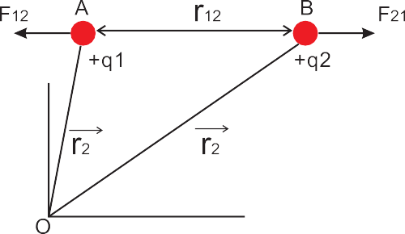
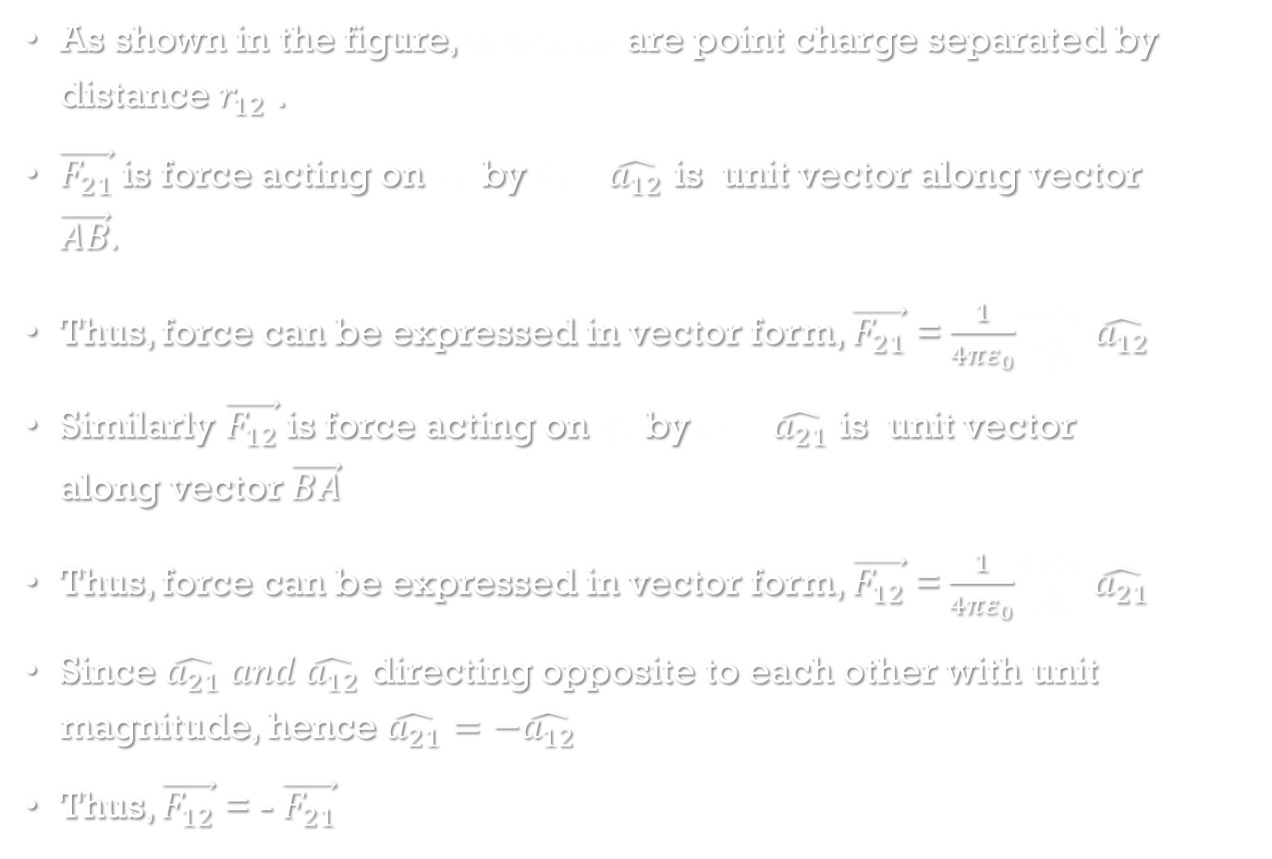


Coulomb’s Law in Vector Form
As shown in the figure, $q_{1}and q_{2}$ are point charge separated by distance $r_{12}$ .
$\vec{F_{21}}$is force acting on $q_{2}$ by $q_{1}, \hat{a_{12}}$ is unit vector along vector $\vec{AB}.$
Thus, force can be expressed in vector form, $\vec{F_{21}}$ = $\frac{1}{4πε_{0}}\frac{q_{1}q_{2}}{r_{12}^{2}}$ $\hat{a_{12}}$
Similarly $\vec{F_{12}}$is force acting on $q_{1}$ by $q_{2}, \hat{a_{21}}$ is unit vector along vector $\vec{BA}$
Thus, force can be expressed in vector form, $\vec{F_{12}}$ = $\frac{1}{4πε_{0}}\frac{q_{1}q_{2}}{r_{12}^{2}}$ $\hat{a_{21}}$
Since $\hat{a_{21}} and \hat{a_{12}}$ directing opposite to each other with unit magnitude, hence $\hat{a_{21}}=−\hat{a_{12}}$
Thus, $\vec{F_{12}}$ = - $\vec{F_{21}}$
$$\hat{a_{12}}$$
$$\hat{a_{21}}$$

Slide 12
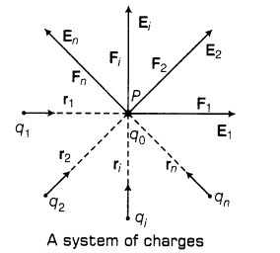

Principle of Superposition
The principle of superposition states that when a number of charges are interacting, the resultant force on a particular charge is given by the vector sum of the forces exerted by individual charges
Consider, charges $q_{0}$, $q_{1}$, $q_{2}$, $q_{i}$, $q_{n}$ interacting each other and the force exerted by $q_{1}$, $q_{2}$, $q_{i}$, $q_{n}$ on $q_{0}$ are $F_{1}$, $F_{2}$, $F_{i}$ and $F_{n}$ respectively.
The total force action on $q_{0}$ ($F_{0}$) can be found by using principle of super position. i.e. $F_{0}$= $F_{1}+$ $F_{2}+$ $F_{i}$+ $F_{n}$

Slide 13
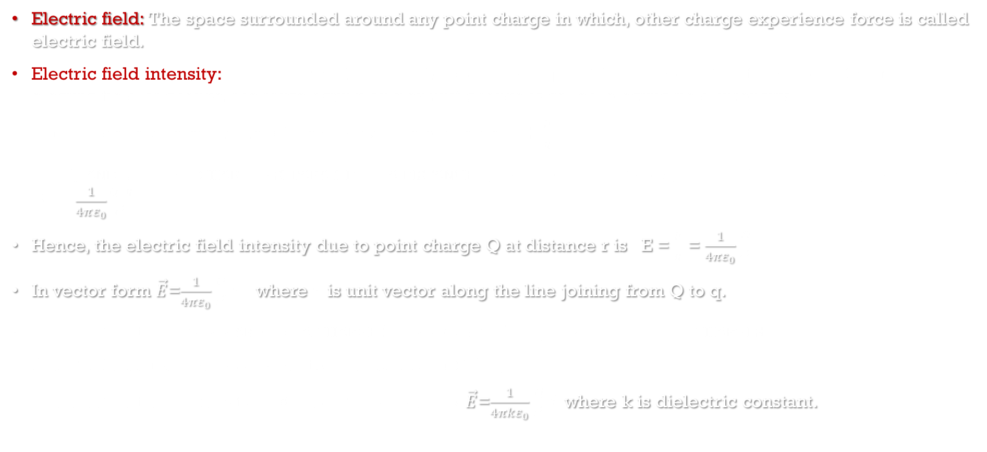
Electric Field and electric field intensity
Electric field: The space surrounded around any point charge in which, other charge experience force is called electric field.
Electric field intensity: the strength of electric field at a given point is called electric field intensity Or In electric field of charge, the force acting on per unit charge is called electric field intensity.
Thus, in general electric field intensity can be expressed, E=$\frac{F}{q}$
Let Q and q be two charges separated by a distance r, as per coulomb's law, force acting on q by Q is given by, $F=\frac{1}{4πε_{0}}\frac{Q. q}{r^{2}}$
Hence, the electric field intensity due to point charge Q at distance r is E = $\frac{F}{q}$ = $\frac{1}{4πε_{0}}\frac{Q}{r^{2}}$
In vector form $\vec{E}$=$\frac{1}{4πε_{0}}\frac{Q}{r^{2}}\hat{r}$ where $\hat{r}$ is unit vector along the line joining from Q to q.
The electric field exists around a charge irrespective of the presence of other charges
SI unit of electric intensity is newton per coulomb (NC⁻¹)
The electric field intensity in a medium is given by $\vec{E}$=$\frac{1}{4πkε_{0}}\frac{Q}{r^{2}}\hat{r}$ where k is dielectric constant.

Slide 14
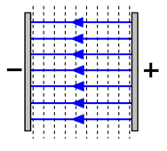
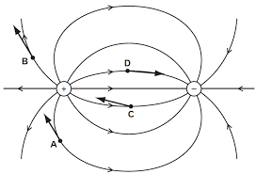
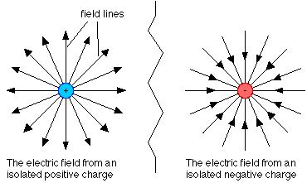
Types of electric field
Uniform electric field: A uniform electric field is a field in which, the magnitude and direction of electric field intensity is same at all points.
For example, field between two parallel plates
Non uniform electric field: A field in which the magnitude and direction of electric field intensity is not the same at all points.
For example, field due to system of two interacting charge.
Radial Electric field: A field in which the direction of electric field intensity is directing towards a common point or outward from a common point
For example field due to positive or negative point charge.

Slide 15

Electric Lines of Force
Michael Faraday (1791-1867) introduced the concept of lines of force for visualising electric and magnetic fields
An electric line of force is an imaginary curve drawn in such a way that the tangent at any given point on this curve gives the direction of the electric field at that point
If a test charge is placed in an electric field it would be acted upon by a force at every point in the field and will move along a path.
Hence The path along which the unit positive charge moves in electric field is called a line of force
The density of field lines indicates the strength of electric fields at the given point in space
(High field)
(Low field)

Slide 16




Characteristics of electric lines of force
The lines of force originate from a positively charged object and terminate on a negatively charged object
The lines of force neither intersect nor meet each other.
The lines of force leave or terminate on a conductor normally
The lines of force do not pass through conductor i.e. electric field inside a conductor is always zero, but they pass through insulators
Magnitude of the electric field intensity is proportional to the number of lines of force per unit area of the surface held perpendicular to the field
Electric lines of force are crowded in a region where electric intensity is large
Electric lines of force are widely separated from each other in a region where electric intensity is small
The lines of force of an uniform electric field are parallel to each other and are equally spaced

Slide 17

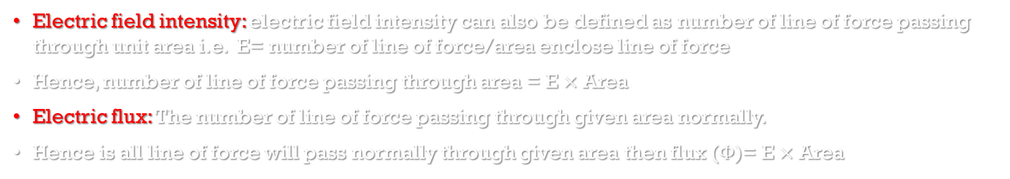
Electric field Intensity and electric flux
Electric field intensity: electric field intensity can also be defined as number of line of force passing through unit area i.e. E= number of line of force/area enclose line of force
Hence, number of line of force passing through area = E $×$ Area
Electric flux: The number of line of force passing through given area normally.
Hence is all line of force will pass normally through given area then flux ($Φ$)= E $×$ Area
Let the angle between electric field E and area vector ds be $Θ$, then the electric flux passing through area dS is given by,
d$Φ$ = (component of ds along E ).(intensity at that point )
d$Φ$= ds cos$Θ$. E
d$Φ$ = E.ds cos$Θ$
d$Φ$ = $\vec{E}.d\vec{s}$
Total flux over the surface ($Φ$) = $\int{\vec{E}.d\vec{s}}$
SI unit is weber or Vm

Slide 18
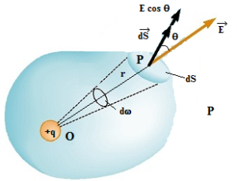

Gauss' Law
The flux of the net electric field through a closed surface equals the net charge enclosed by the surface divided by $ε_{0}$
The magnitude of electric field intensity at point P on ds due to charge +q at point O is, E= $\frac{1}{4πε_{0}}\frac{q}{r^{2}}$
Let q be the angle subtended by normal drawn to area dS and the direction of E
Electric flux, d$φ$, passing through area ds = Ecos$θ$ ds
Hence, d$φ$ = $\frac{1}{4πε_{0}}\frac{q}{r^{2}}$ cos$θ$ ds = $\frac{q}{4πε_{0}}$ $\left(\frac{\text{cos}θ \text{ds}}{r^{2}}\right)$
but $\left(\frac{\text{cos}θ \text{ds}}{r^{2}}\right)$ is solid angle denoted by $dω$
hence d$φ$ = $\frac{q}{4πε_{0}}$ $dω$
Total flux($φ$) on close surface can be given by, $φ$=$\int{\frac{q}{4πε_{0}} dω}$ = $\frac{q}{4πε_{0}}\int{ dω}$ = $\frac{q}{4πε_{0}}$ $4π$ =q/$ε_{0}$

Slide 19
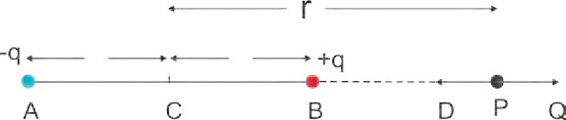





Electric Intensity at a Point on axis of Electric Dipole
Consider an electric dipole consisting of two charges -q and +q separated by a distance 2l as shown in Fig
Let P be a point at a distance r from the centre C of the dipole.
The electric intensity E at P due to the dipole is the vector sum of the field due to the charge - q at A and + q at B
Electric field intensity at P due to the charge -q at A is given by $E_{A}=\frac{1}{4πε_{0}}\frac{−q}{{(r+l)}^{2}}$
Electric intensity at P due to charge +q at B is given by, $E_{B}=\frac{1}{4πε_{0}}\frac{q}{{(r−l)}^{2}}$
Total electric field intensity at point P, is given by, E = $E_{A}$+$E_{B}$
$∴E=$ $\frac{1}{4πε_{0}}\frac{−q}{{(r+l)}^{2}}$ + $\frac{1}{4πε_{0}}\frac{q}{{(r−l)}^{2}}$ = $\frac{q}{4πε_{0}}\left(\frac{1}{{(r−l)}^{2}} −\frac{1}{{(r+l)}^{2}}\right)$
= $\frac{q}{4πε_{0}}$ $\left(\frac{{(r+l)}^{2}−{(r−l)}^{2}}{{(r−l)}^{2}.{(r+l)}^{2}} \right)$ = $\frac{q}{4πε_{0}}$ $\left(\frac{r^{2}+l^{2}+2rl−r^{2}−l^{2}+2rl}{[(r−l).{(r+l)]}^{2}} \right)$ = $\frac{q}{4πε_{0}}$ $\left(\frac{4rl}{{(r^{2}−l^{2})}^{2}} \right)$ as l<<r, we can neglect higher order of l,
$∴E$= $\frac{q}{4πε_{0}}$ $\left(\frac{4rl}{r^{4}} \right)$ = $\frac{q}{4πε_{0}}$ $\left(\frac{4l}{r^{3}} \right)$ = $\frac{2}{4πε_{0}}$ $\left(\frac{q. 2l}{r^{3}} \right)$
(since, p = q. 2l) $∴E$= $\frac{1}{4πε_{0}}$ $\left(\frac{2p}{r^{3}} \right)$

Slide 20
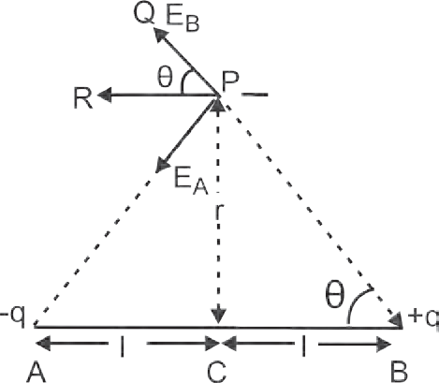
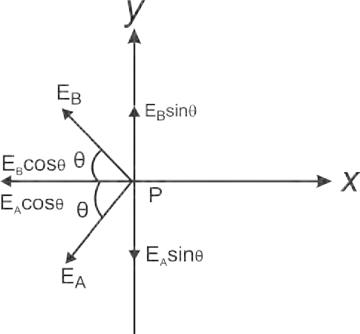
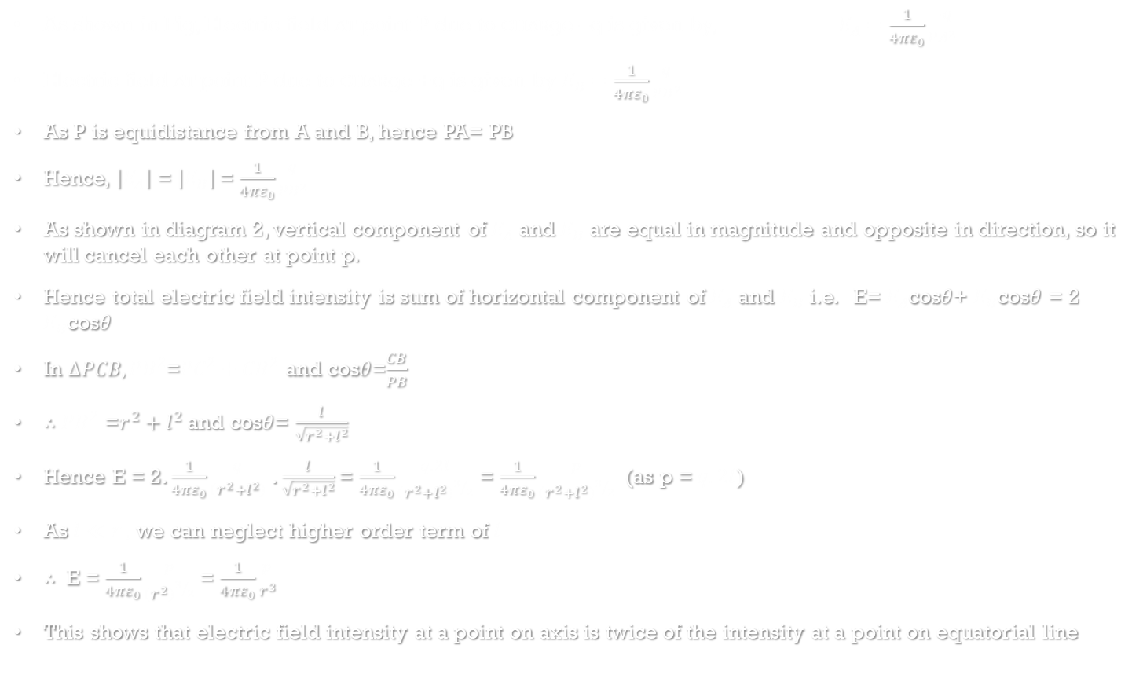
Electric Intensity at a Point on equatorial of Electric Dipole
As shown in Fig, Electric field at point P due to charge –q is given by, $E_{A}=\frac{1}{4πε_{0}}\frac{−q}{{PA}^{2}}$
Electric field at point P due to charge +q is given by $E_{B}=\frac{1}{4πε_{0}}\frac{q}{{PB}^{2}}$
As P is equidistance from A and B, hence PA= PB
Hence, $\left|E_{A}\right|$ = $\left|E_{B}\right|$ = $\frac{1}{4πε_{0}}\frac{q}{{PB}^{2}}$
As shown in diagram 2, vertical component of $E_{A}$ and $E_{B}$ are equal in magnitude and opposite in direction, so it will cancel each other at point p.
Hence total electric field intensity is sum of horizontal component of $E_{A}$ and $E_{B}$ i.e. E= $E_{A}$cos$θ$+ $E_{B}$cos$θ$ = 2 $E_{B}$cos$θ$
In $∆PCB, {PB}^{2}$=${PC}^{2}+{CB}^{2}$ and cos$θ$=$\frac{CB}{PB}$
$∴$ ${PB}^{2}$ =$r^{2}+l^{2}$ and cos$θ$= $\frac{l}{\sqrt{r^{2}+l^{2}}}$
Hence E = 2. $\frac{1}{4πε_{0}}\frac{q}{(r^{2}+l^{2})}$ . $\frac{l}{\sqrt{r^{2}+l^{2}}}$ = $\frac{1}{4πε_{0}}\frac{q.2l}{{(r^{2}+l^{2})}^{3/2}}$ = $\frac{1}{4πε_{0}}\frac{p}{{(r^{2}+l^{2})}^{3/2}}$ (as p = $q.2l$)
As $l≪r ,$we can neglect higher order term of $l$
$∴ \text{E}$ = $\frac{1}{4πε_{0}}\frac{p}{{(r^{2})}^{3/2}}$ = $\frac{1}{4πε_{0}}\frac{p}{r^{3}}$
This shows that electric field intensity at a point on axis is twice of the intensity at a point on equatorial line
r

Slide 21

Continuous Charge Distribution
A system of charges can be considered as a continuous charge distribution, if the charges are located very close together, compared to their distances from the point where the intensity of electric field is to be found out
To find the electric field due to continuous charge distribution, we define following terms for different types of charge distribution
Linear charge density (λ): As shown in Fig. 1 charge q is uniformly distributed along a liner conductor of length l. The linear charge density λ is defined as, λ = q/l
SI unit of λ is (C/m).
For example, charge distributed uniformly on a straight thin rod
Surface charge density (σ): Suppose a charge q is uniformly distributed over a surface of area A, As shown in Fig.2, then the surface charge density σ is defined as, σ = q/A.
SI unit of s is (C/m²)
For example, charge distributed uniformly on a thin disc
Volume charge density (ρ): Suppose a charge q is uniformly distributed throughout a volume V, then the volume charge density ρ is defined as the charge per unit volume. i.e. ρ = q/V.
S.I. unit of r is (C/m³)
For example, charge throughout a solid plastic sphere

