Slide 1
Gravitation
Chap-05

Slide 2
Introduction
Every massive object in the universe experiences gravitational force
It is the force of mutual attraction between any two objects by virtue of their masses
It is always an attractive force with infinite range
It does not depend upon intervening medium
It is much weaker than other fundamental forces

Slide 3
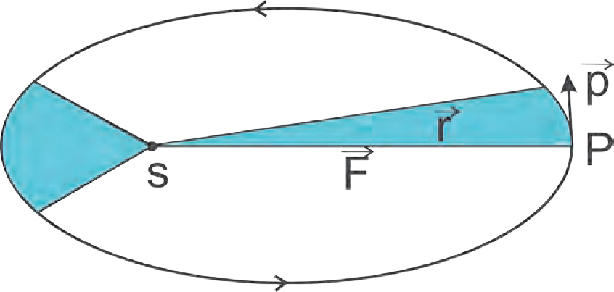
Kepler’s Laws
1st law (Law of Orbit): All planets revolve around sun in elliptical orbits with the Sun situated at one of the foci of the ellipse.
As shown in fig. S and S’ are the foci of the ellipse the Sun being at S
P is the closest point along the orbit from S and is, called ‘Perihelion’
A is the farthest point from S and is, called ‘Aphelion’
Law of areas: The line that joins a planet and the Sun sweeps equal areas in equal intervals of time
Kepler observed that planets do not move around the Sun with uniform speed.
They move faster when they are nearer to the Sun while they move slower when they are farther from the Sun
Fig 2 shows, The shaded areas are the areas swept by SP, the line joining the planet and the Sun, in fixed intervals of time
These are equal according to the second law

Slide 4
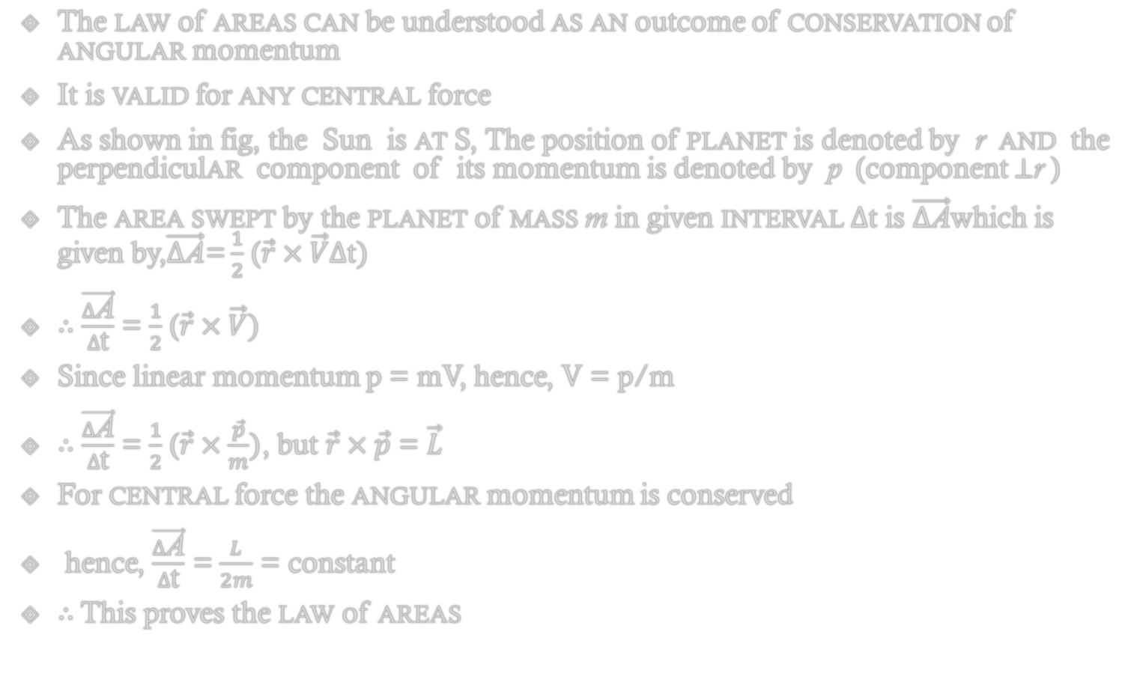
Out come of Kepler’s law of area
The law of areas can be understood as an outcome of conservation of angular momentum
It is valid for any central force
As shown in fig, the Sun is at S, The position of planet is denoted by r and the perpendicular component of its momentum is denoted by p (component $⊥$r )
The area swept by the planet of mass m in given interval $∆$t is $\vec{∆\text{A}}$which is given by,$\vec{∆\text{A}}$= $\frac{1}{2}$ ($\vec{r}×\vec{V}∆\text{t})$
$∴$ $\frac{\vec{∆\text{A}}}{∆\text{t}}$ = $\frac{1}{2}$ ($\vec{r}×\vec{V})$
Since linear momentum p = mV, hence, V = p/m
$∴$ $\frac{\vec{∆\text{A}}}{∆\text{t}}$ = $\frac{1}{2}$ ($\vec{r}×\frac{\vec{p}}{m})$, but $\vec{r}×\vec{p}$ = $\vec{L}$
For central force the angular momentum is conserved
hence, $\frac{\vec{∆\text{A}}}{∆\text{t}}$ = $\frac{L}{2m}$ = constant
$∴$This proves the law of areas

Slide 5

Kepler’s 3rd law (Law of periods)
The square of the time period of revolution of a planet around the Sun is proportional to the cube of the semi major axis of the ellipse traced by the planet
If r is length of semi major axis then, this law states that T ² $α$ r³
Kepler’s laws were based on regular observations of the motion of planets
Kepler did not know why the planets obey these laws,. i.e. he had not derived these laws

Slide 6
Universal Law of Gravitation
When objects are released near the surface of the Earth, they always fall down to the ground, i.e., the Earth attracts objects towards itself
Galileo (1564-1642) pointed out that heavy and light objects, when released from the same height, fall towards the Earth at the same speed, i.e., they have the same acceleration
Newton went beyond (the Earth and objects falling on it) and proposed that the force of attraction between masses is universal
Newton stated the universal law of gravitation which led to an explanation of terrestrial gravitation
It also explains Kepler’s laws and provides the reason behind the observed motion of planets around the Sun

Slide 7
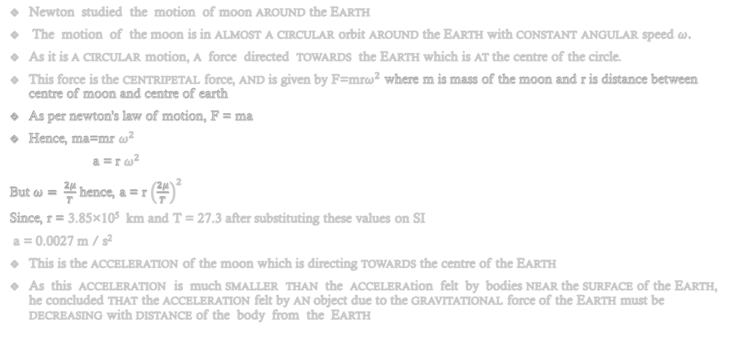
Motion of moon around earth
Newton studied the motion of moon around the Earth
The motion of the moon is in almost a circular orbit around the Earth with constant angular speed $ω$.
As it is a circular motion, a force directed towards the Earth which is at the centre of the circle.
This force is the centripetal force, and is given by F=mr$ω^{2}$ where m is mass of the moon and r is distance between centre of moon and centre of earth
As per newton’s law of motion, F = ma
Hence, ma=mr $ω^{2}$
a = r $ω^{2}$
But $ω= \frac{2μ}{T}$ hence, a = r ${\left(\frac{2μ}{T}\right)}^{2}$
Since, r = 3.85×10⁵ km and T = 27.3 after substituting these values on SI
a = 0.0027 m / s²
This is the acceleration of the moon which is directing towards the centre of the Earth
As this acceleration is much smaller than the acceleration felt by bodies near the surface of the Earth, he concluded that the acceleration felt by an object due to the gravitational force of the Earth must be decreasing with distance of the body from the Earth

Slide 8
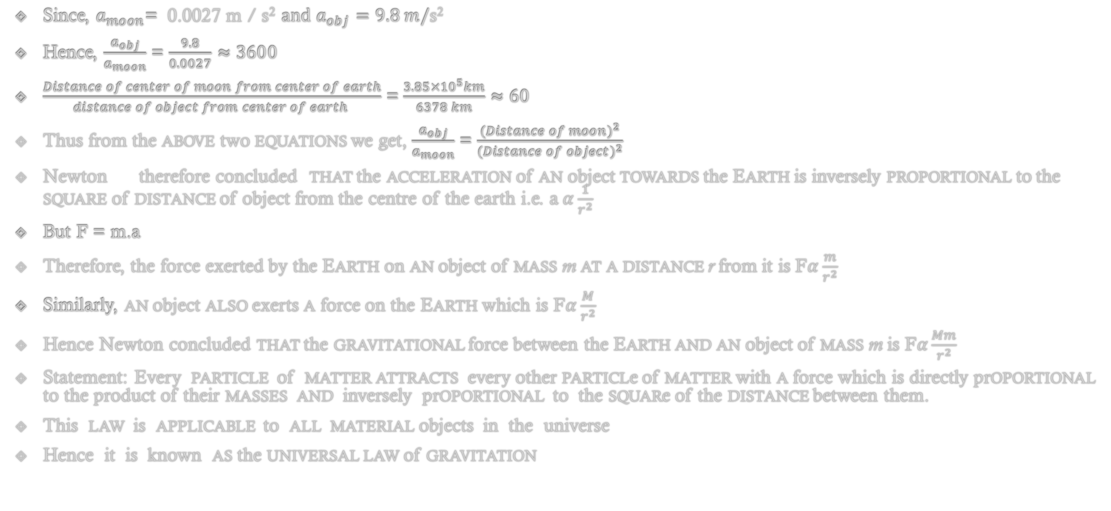
Newton’s law of gravitation with explanation
Since, $a_{moon}$= 0.0027 m / s² $and a_{obj}=9.8 m/\text{s}\text{2}$
Hence, $\frac{a_{obj}}{a_{moon}}$ = $\frac{9.8}{0.0027}≈3600$
$\frac{Distance of center of moon from center of earth}{distance of object from center of earth }$ = $\frac{3.85×{10}^{5}km}{6378 km}$ $≈60$
Thus from the above two equations we get, $\frac{a_{obj}}{a_{moon}}$ = $\frac{{(Distance of moon)}^{2}}{{(Distance of object)}^{2}}$
Newton therefore concluded that the acceleration of an object towards the Earth is inversely proportional to the square of distance of object from the centre of the earth i.e. a$α\frac{1}{r^{2}}$
But F = m.a
Therefore, the force exerted by the Earth on an object of mass m at a distance r from it is F$α\frac{m}{r^{2}}$
Similarly, an object also exerts a force on the Earth which is F$α\frac{M}{r^{2}}$
Hence Newton concluded that the gravitational force between the Earth and an object of mass m is F$α\frac{Mm}{r^{2}}$
Statement: Every particle of matter attracts every other particle of matter with a force which is directly proportional to the product of their masses and inversely proportional to the square of the distance between them.
This law is applicable to all material objects in the universe
Hence it is known as the universal law of gravitation

