Slide 1
Semiconductor
Chap-16

Slide 2
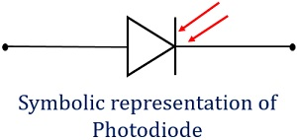
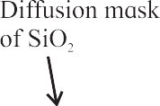


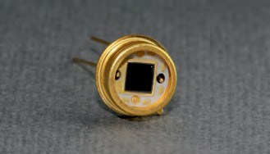
Photo Diode
A photodiode is a special type of a p-n junction diode which converts light energy into electrical energy
It generates current when exposed to light.
It operates in reverse biased mode
Only minority current flows through a photodiode
Figure shows schematic of the structure of a photodiode
The p-n junction of a photodiode is placed inside a glass material so that only the junction of a photodiode is exposed to light
Other part of the diode is generally painted with an opaque colour or covered.
When a p-n junction diode is reverse biased, a reverse saturation current flows through the junction
This current is due to the minority carriers on its either side
The reverse current depends only on the concentration of the minority carriers and not on the applied voltage
This current is called the dark currant in a photodiode because it flows even when the photodiode is not illuminated
n

Slide 3
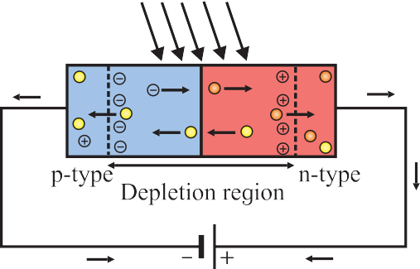
Working of photo diode
When a p-n junction is illuminated, electron-hole pairs are generated in the depletion region
The energy of the incident photons should be larger than the band gap of the semiconductor material used to fabricate the photodiode
The electrons and the holes are separated due to the intrinsic electric field present in the depletion region

