Slide 1
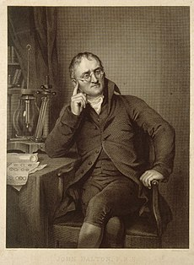
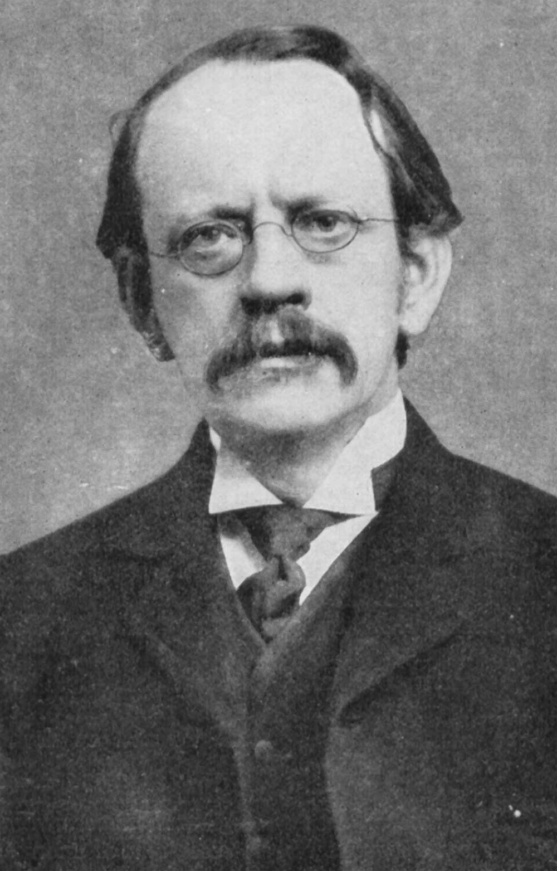
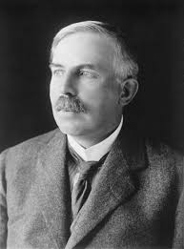
John Dalton
J.J. Thomson
Rutherford

Slide 2
Structure of Atoms & Nuclei
Weightage – 4/6 marks

Slide 3
Dalton theory for structure of atom
Material is made up of indestructible particles
Atoms of a given element are identical
Atoms can combine with other atoms to form new substances
It can also be stated as, atom is tiny, hard and indivisible particle of matter.

Slide 4
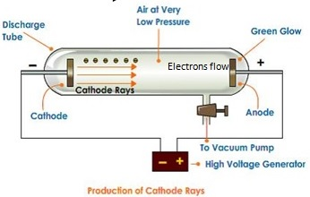
Thomson’s Atomic Model
Thomson performed several experiments with glass vacuum tube wherein a voltage was applied between two electrodes inside an evacuated tube.
The cathode was seen to emit rays which produced a glow when they struck the glass behind the anode
By studying the properties of these rays, he concluded that the rays are made up of negatively charged particles which he called electrons
Thomson proposed his model of an atom in 1903.
According to this model an atom is a sphere having a uniform positive charge in which electrons are embedded
As per this model, the whole solid sphere is uniformly positively charged, the positive charge cannot come out and only the negatively charged electrons which are small, can be emitted

Slide 5
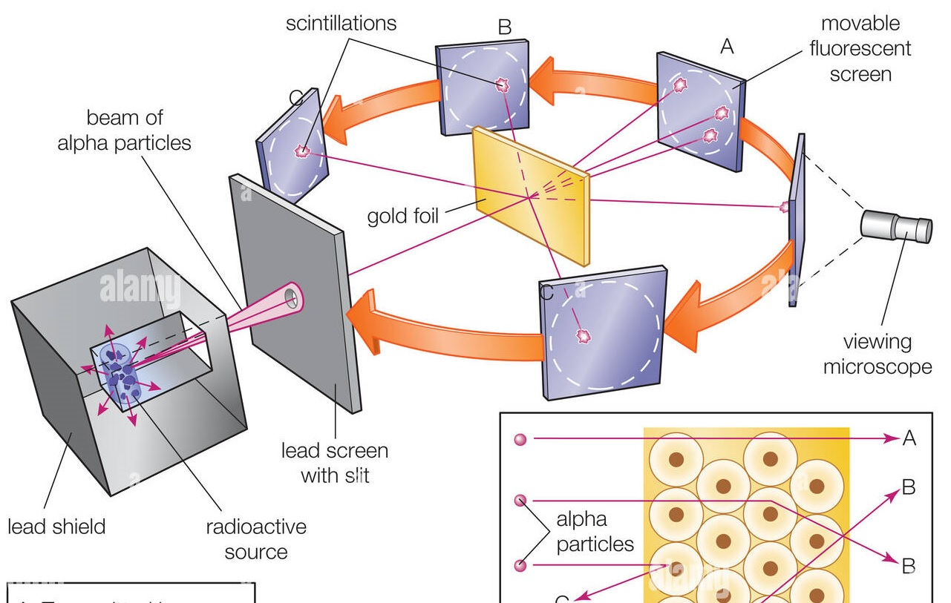
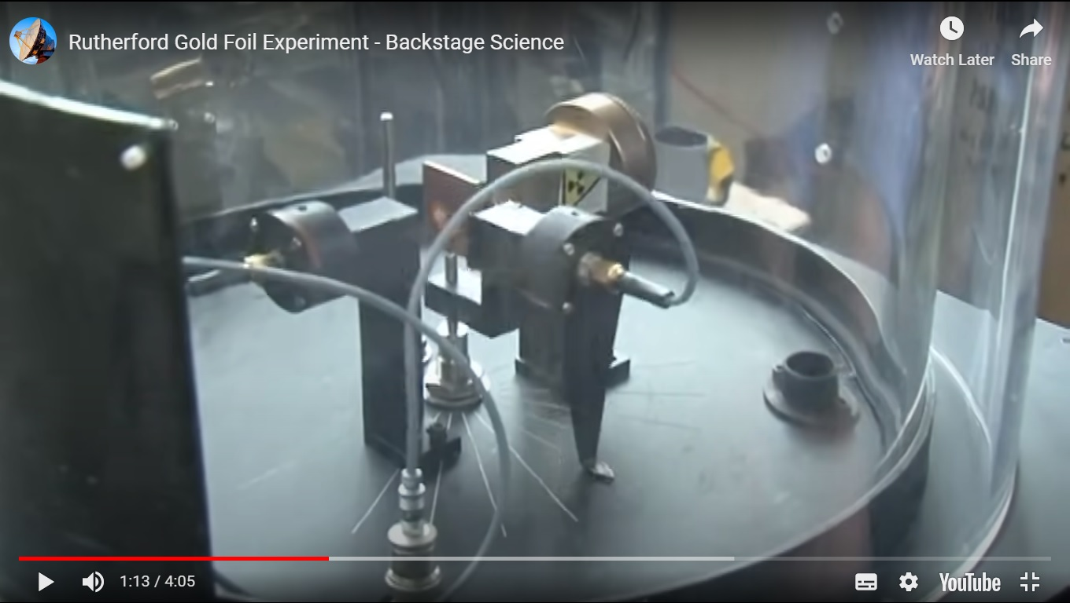
Geiger-Marsden Experiment

Slide 6
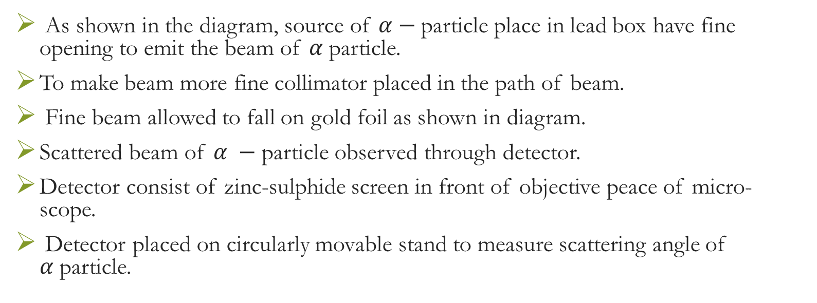
Construction
As shown in the diagram, source of $α−$particle place in lead box have fine opening to emit the beam of $α$particle.
To make beam more fine collimator placed in the path of beam.
Fine beam allowed to fall on gold foil as shown in diagram.
Scattered beam of $α −$particle observed through detector.
Detector consist of zinc-sulphide screen in front of objective peace of micro-scope.
Detector placed on circularly movable stand to measure scattering angle of $α$particle.

Slide 7
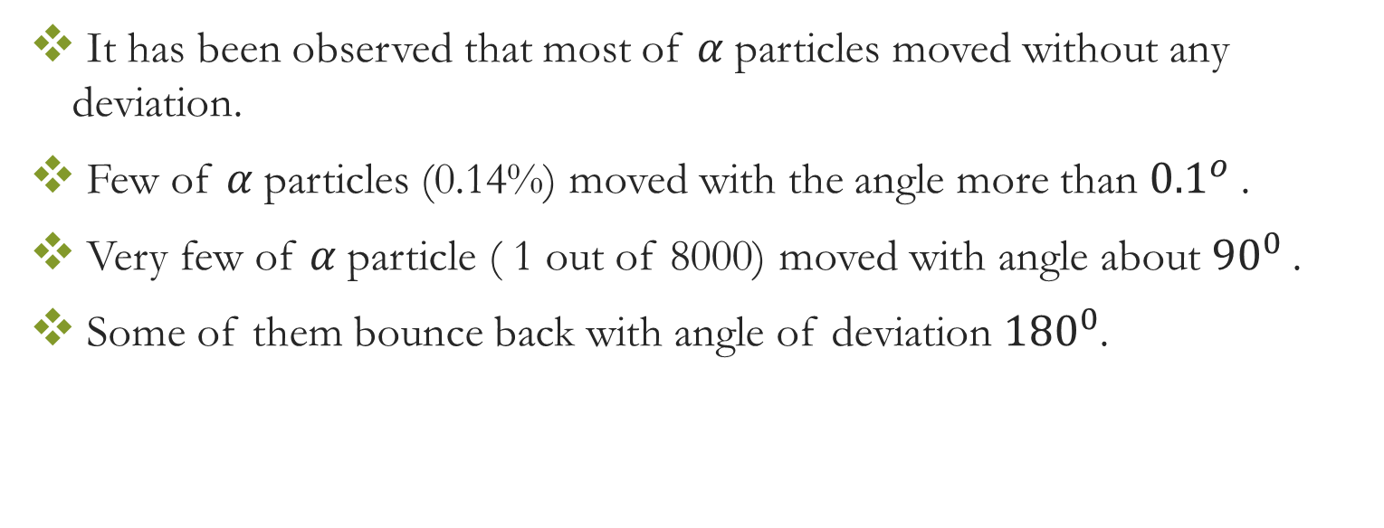
Observation
It has been observed that most of $α$particles moved without any deviation.
Few of $α$particles (0.14%) moved with the angle more than ${0.1}^{o}$.
Very few of $α$particle ( 1 out of 8000) moved with angle about ${90}^{0}$.
Some of them bounce back with angle of deviation ${180}^{0}$.

Slide 8
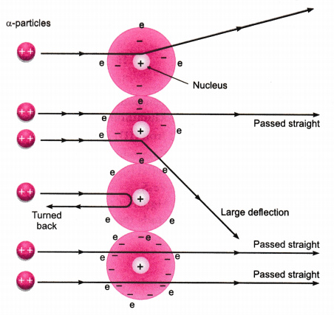
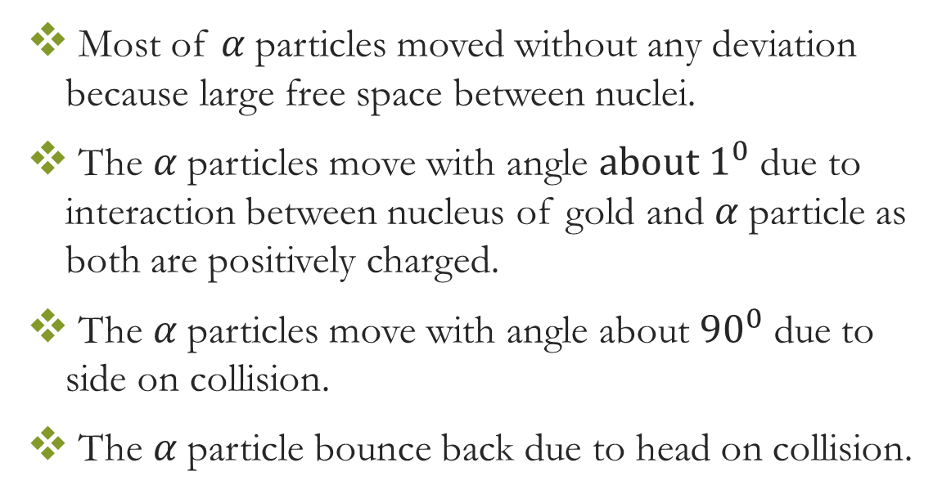
Conclusion
Most of $α$particles moved without any deviation because large free space between nuclei.
The $α$particles move with angle $about 1^{0}$ due to interaction between nucleus of gold and $α$particle as both are positively charged.
The $α$particles move with angle about ${90}^{0}$ due to side on collision.
The $α$particle bounce back due to head on collision.

Slide 9
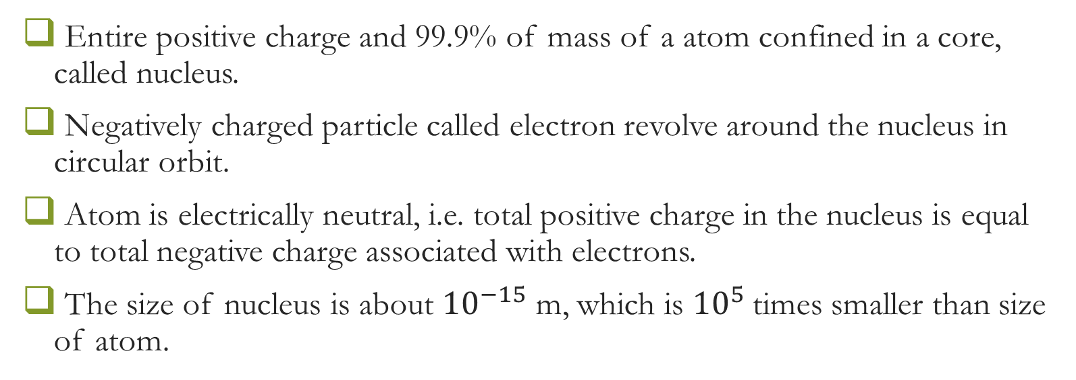
Rutherford atomic model
Entire positive charge and 99.9% of mass of a atom confined in a core, called nucleus.
Negatively charged particle called electron revolve around the nucleus in circular orbit.
Atom is electrically neutral, i.e. total positive charge in the nucleus is equal to total negative charge associated with electrons.
The size of nucleus is about ${10}^{−15}$ m, which is ${10}^{5}$times smaller than size of atom.

Slide 10
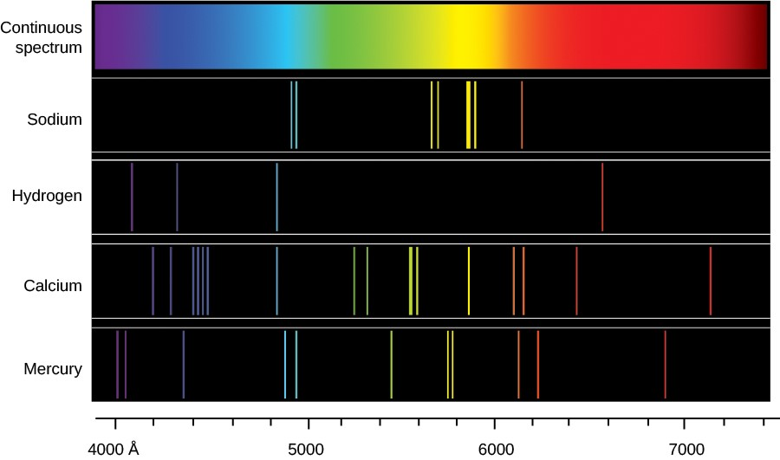
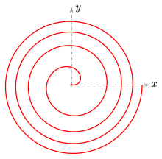
Difficulties with Rutherford’s Model
1) As per Rutherford atomic model, an electron moves with uniform velocity along a circular orbit around the nucleus.
Even though the magnitude of its velocity is constant, its direction changes continuously and so the motion is an accelerated motion
Thus, the electron should emit electromagnetic radiation continuously, but this is not observed.
2) If electron will emits radiation, its energy would decrease and consequently, the radius of its orbit would decrease continuously.
It would then follow spiral path and finally it should fall into the nucleus, causing the atom to collapse and lose its atomic properties, but its not observed too.
In short

Slide 11

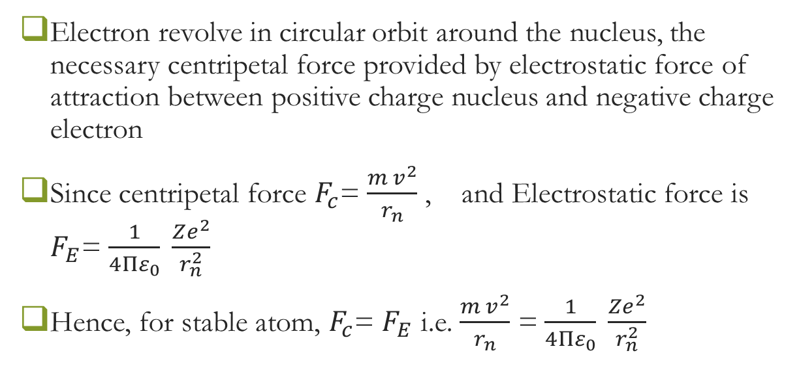


Bohr’s 1st Postulates
Electron revolve in circular orbit around the nucleus, the necessary centripetal force provided by electrostatic force of attraction between positive charge nucleus and negative charge electron
Since centripetal force $F_{c}$= $\frac{m v^{2}}{r_{n}}$, and Electrostatic force is $F_{E}$= $\frac{1}{4Πε_{0}} \frac{Ze^{2}}{r_{n}^{2}}$
Hence, for stable atom, $F_{c}$= $F_{E}$ i.e. $\frac{m v^{2}}{r_{n}}$ = $\frac{1}{4Πε_{0}} \frac{Ze^{2}}{r_{n}^{2}}$
$$r_{n}$$
$$m$$
$$v$$

Slide 12
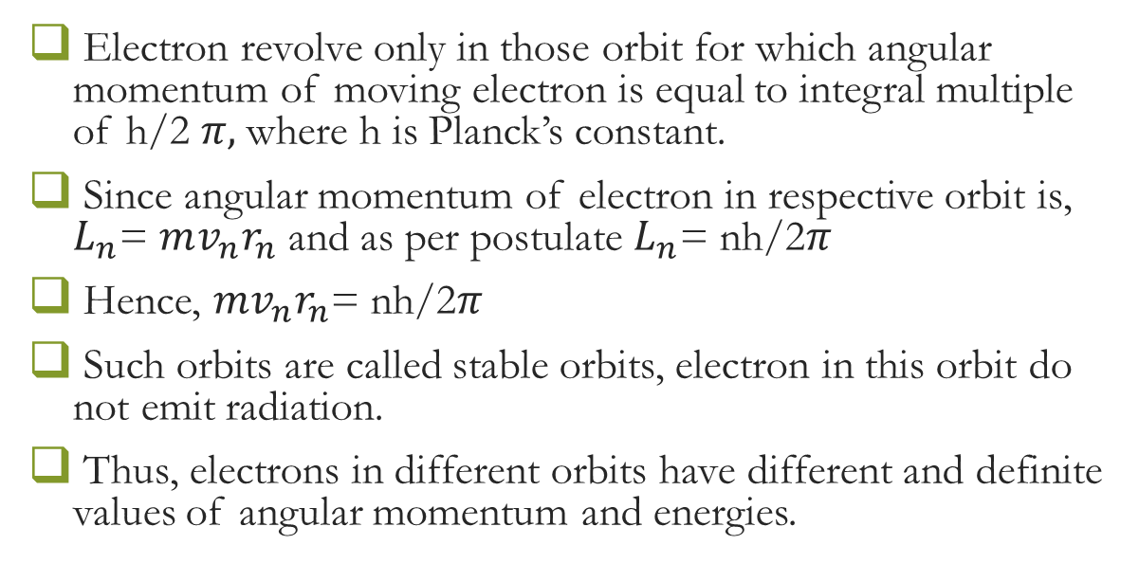
Bohr’s 2nd postulate
Electron revolve only in those orbit for which angular momentum of moving electron is equal to integral multiple of h/2 $π,$where h is Planck’s constant.
Since angular momentum of electron in respective orbit is, $L_{n}$= $mv_{n}r_{n}$ and as per postulate $L_{n}$= nh/2$π$
Hence, $mv_{n}r_{n}$= nh/2$π$
Such orbits are called stable orbits, electron in this orbit do not emit radiation.
Thus, electrons in different orbits have different and definite values of angular momentum and energies.

Slide 13
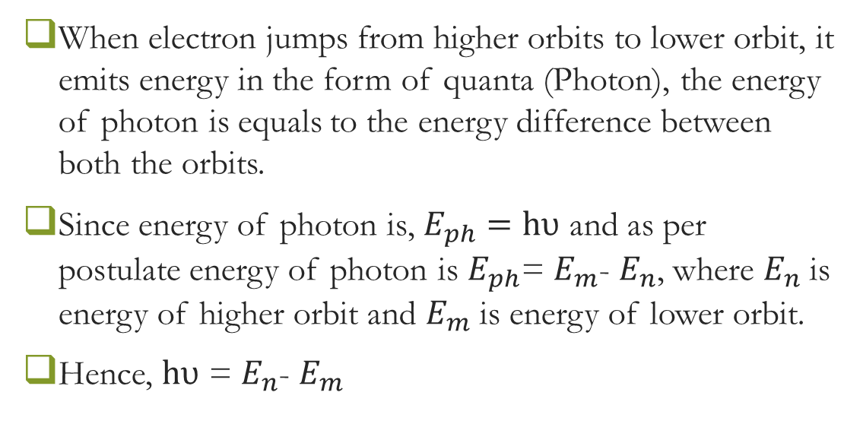
Bohr’s 3rd postulate
When electron jumps from higher orbits to lower orbit, it emits energy in the form of quanta (Photon), the energy of photon is equals to the energy difference between both the orbits.
Since energy of photon is, $E_{ph}=hυ$ and as per postulate energy of photon is $E_{ph}$= $E_{m}$- $E_{n}$, where $E_{n}$ is energy of higher orbit and $E_{m}$ is energy of lower orbit.
Hence, $hυ$ = $E_{n}$- $E_{m}$

