Slide 1
Structure of atom and nuclei
Chap-15

Slide 2
Dalton theory for structure of atom
According to his theory (i) matter is made up of indestructible particles, (ii) atoms of a given element are identical and (iii) atoms can combine with other atoms to form new substances
It can also be stated as, atom is tiny, hard and indivisible particle of matter.

Slide 3
Thomson’s Atomic Model
Thomson performed several experiments with glass vacuum tube wherein a voltage was applied between two electrodes inside an evacuated tube
The cathode was seen to emit rays which produced a glow when they struck the glass behind the anode
By studying the properties of these rays, he concluded that the rays are made up of negatively charged particles which he called electrons
This demonstrated that atoms are not indestructible
Thomson proposed his model of an atom in 1903. According to this model an atom is a sphere having a uniform positive charge in which electrons are embedded
This model is referred to as Plum-pudding model
The total positive charge is equal to the total negative charge of electrons in the atom, rendering it electrically neutral
As per this model, the whole solid sphere is uniformly positively charged, the positive charge cannot come out and only the negatively charged electrons which are small, can be emitted

Slide 4

Geiger-Marsden Experiment

Slide 5
Observation
https://phet.colorado.edu/sims/html/rutherford-scattering/latest/rutherford-scattering_en.html

Slide 6
Conclusion of experiment by Rutherford
As almost all of the incident alpha particles would get deflected only through very small angles, the volume density of the positive charge would thus be very small.
the alpha particles which were deflected back must have encountered a massive particle with large positive charge so that it was repelled back
From the fact that extremely small number of alpha particles turned back while most others passed through almost undeflected, he concluded that the positively charged particle in the atom must be very small in size and must contain most of the mass of the atom.
From the experimental data, the size of this particle was found to be about 10 fm (femtometre, 10-15) which is about 10-5 times the size of the atom
most alpha particles pass through this without deflected, because of large empty space in the atom.
very few which are in direct line with the tiny nucleus or are extremely close to it, get repelled and get deflected through large angles

Slide 7
Rutherford’s atomic model
He proposed that the entire positive charge and most (99.9%) of the mass of an atom and total positive charge are concentrated in the central nucleus and the electrons revolve around it in circular orbits, similar to the revolution of the planets around the Sun in the Solar system
The revolution of the electrons was necessary as without it, the electrons would fall into the positively charged nucleus and the atom would collapse
The space between the orbits of the electrons and the nucleus is mostly empty

Slide 8
Difficulties with Rutherford’s Model
1) As per Rutherford atomic model, an electron in Rutherford’s model moves uniformly along a circular orbit around the nucleus.
Even though the magnitude of its velocity is constant, its direction changes continuously and so the motion is an accelerated motion
Thus, the electron should emit electromagnetic radiation continuously, but this is not observed.
2) If electron will emits radiation, its energy would decrease and consequently, the radius of its orbit would decrease continuously.
It would then spiral into the nucleus, causing the atom to collapse and lose its atomic properties, but its not observed too.

Slide 9


Atomic Spectra
when a metallic object is heated, it emits radiation of different wavelengths
When this radiation is passed through a prism, we get a continuous spectrum
However, the case is different when we heat hydrogen gas inside a glass tube to high temperatures
The emitted radiation has only a few selected wavelengths and when passed through a prism we get what is called a line spectrum
It shows that hydrogen emits radiations of wavelengths 410, 434, 486 and 656 nm and does not emit any radiation with wavelengths in between these wavelengths.
The lines seen in the spectrum are called emission lines
Hydrogen atom also emits radiation at some other values of wavelengths in the ultraviolet (UV), the infrared (IR) and at longer wavelengths
The spectral lines can be divided into groups known as series with names of the scientists who studied them
The series, starting from shorter wavelengths and going to larger wavelengths are called Lyman series, Balmer series, Paschen series, Brackett series, Pfund series, etc.
The observed wavelengths of the emission lines are found to obey the relation given by, $\frac{1}{λ}$ = R $\left(\frac{1}{n^{2}}−\frac{1}{m^{2}}\right)$
Here $λ$is the wavelength of a line, R is amconstant and n and m are integers
UV
visible
IR

Slide 10
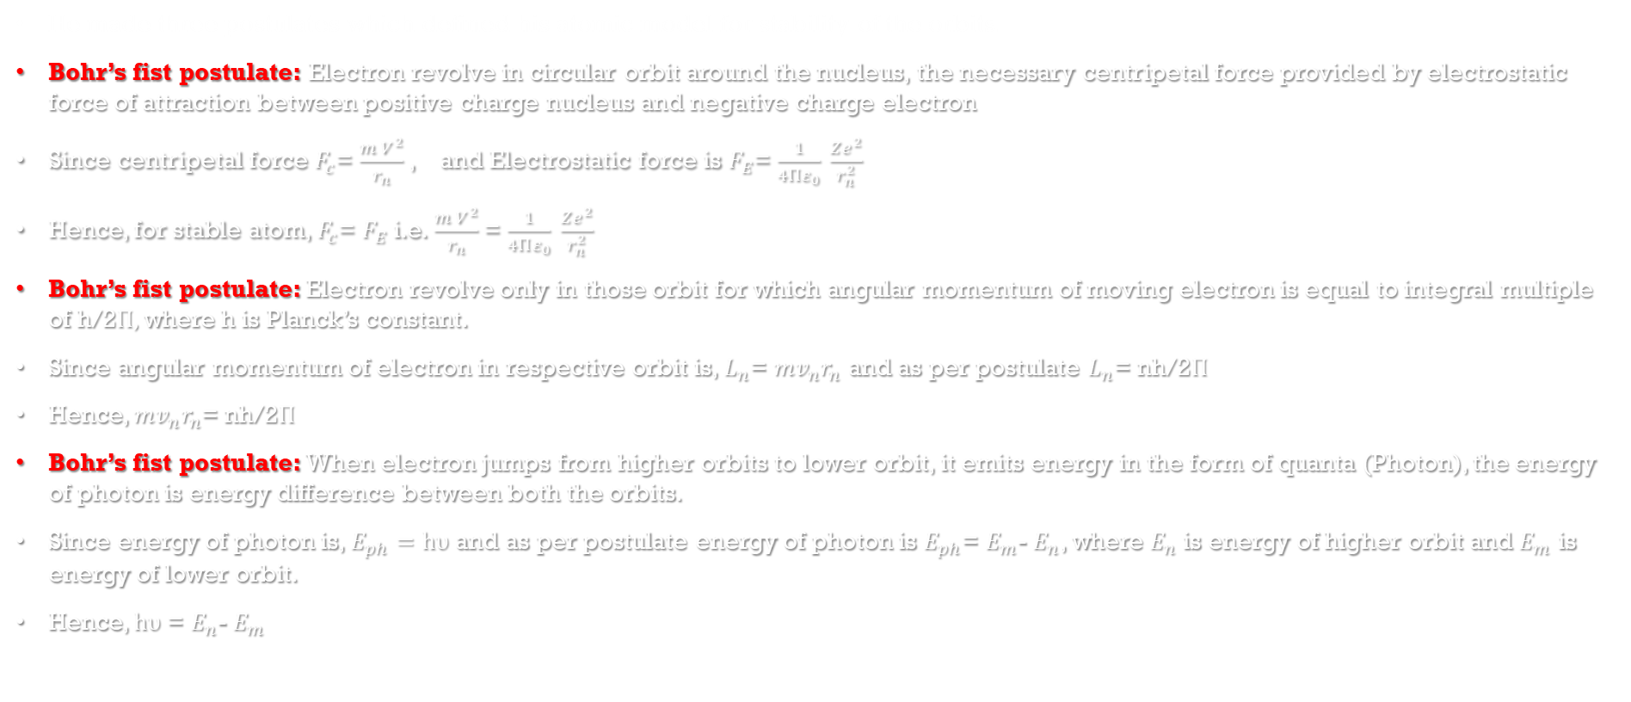
Bohr’s Atomic Model
He made three postulates which defined his atomic model for stability of the orbits.
Bohr’s fist postulate: Electron revolve in circular orbit around the nucleus, the necessary centripetal force provided by electrostatic force of attraction between positive charge nucleus and negative charge electron
Since centripetal force $F_{c}$= $\frac{m V^{2}}{r_{n}}$, and Electrostatic force is $F_{E}$= $\frac{1}{4Πε_{0}} \frac{Ze^{2}}{r_{n}^{2}}$
Hence, for stable atom, $F_{c}$= $F_{E}$ i.e. $\frac{m V^{2}}{r_{n}}$ = $\frac{1}{4Πε_{0}} \frac{Ze^{2}}{r_{n}^{2}}$
Bohr’s fist postulate: Electron revolve only in those orbit for which angular momentum of moving electron is equal to integral multiple of h/2$Π,$where h is Planck’s constant.
Since angular momentum of electron in respective orbit is, $L_{n}$= $mv_{n}r_{n}$ and as per postulate $L_{n}$= nh/2$Π$
Hence, $mv_{n}r_{n}$= nh/2$Π$
Bohr’s fist postulate: When electron jumps from higher orbits to lower orbit, it emits energy in the form of quanta (Photon), the energy of photon is energy difference between both the orbits.
Since energy of photon is, $E_{ph}=hυ$ and as per postulate energy of photon is $E_{ph}$= $E_{m}$- $E_{n}$, where $E_{n}$ is energy of higher orbit and $E_{m}$ is energy of lower orbit.
Hence, $hυ$ = $E_{n}$- $E_{m}$

Slide 11

Energy of the Electrons
Since, as per first postulate of Bohr’s, $\frac{m V^{2}}{r_{n}}$ = $\frac{1}{4Πε_{0}} \frac{Ze^{2}}{r_{n}^{2}}$

Slide 12
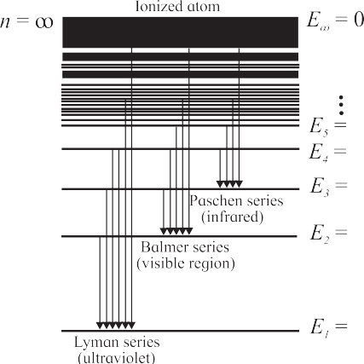
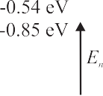
Energy level diagram for hydrogen atom

Slide 13

Rydberg’s formula or empirical formula
According to the third postulate of Bohr, when an electron makes a transition from $p^{th}$ to $n^{th}$ orbit (p > n), the excess energy Ep - En is emitted in the form of a photon.
The energy of the photon which can be written as h$ν$, $ν$being its frequency, is therefore given by h $ν$= Ep – En
But Ep= $−\frac{mZ^{2}e^{4}}{8ε_{0}^{2}p^{2}}$ and En= $−\frac{mZ^{2}e^{4}}{8ε_{0}^{2}n^{2}}$
By using Bohr’s third postulate, h $ν$= Ep – En = $−\frac{mZ^{2}e^{4}}{8ε_{0}^{2}h^{2}p^{2}}$ - $\left(−\frac{mZ^{2}e^{4}}{8ε_{0}^{2}n^{2}}\right)$ = $\frac{mZ^{2}e^{4}}{8ε_{0}^{2}h^{2}}$ $\left(\frac{1}{n^{2}}−\frac{1}{p^{2}} \right)$
=> h $\frac{c}{λ}$ = $\frac{mZ^{2}e^{4}}{8ε_{0}^{2}h^{2}}$ $\left(\frac{1}{n^{2}}−\frac{1}{p^{2}} \right)$
=> $\frac{1}{λ}$ = $\frac{mZ^{2}e^{4}}{8ε_{0}^{2}ch^{3}}$ $\left(\frac{1}{n^{2}}−\frac{1}{p^{2}} \right)$ = R $Z^{2}$ $\left(\frac{1}{n^{2}}−\frac{1}{p^{2}} \right)$
where R = $\frac{mZ^{2}e^{4}}{8ε_{0}^{2}ch^{3}}$is Rydberg’s constant, the value is 1.0973$×{10}^{7}$ per meter
For hydrogen atom(z=1), $\frac{1}{λ}$ = R$\left(\frac{1}{n^{2}}−\frac{1}{p^{2}} \right)$

Slide 14
Limitations of Bohr’s Model
It could not explain the line spectra of atoms other than hydrogen. Even for hydrogen, more accurate study of the observed spectra showed multiple components in some lines which could not be explained on the basis of this model.
The intensities of the emission lines seemed to differ from line to line and Bohr’s model had no explanation for that
On theoretical side also the model was not entirely satisfactory as it arbitrarily assumed orbits following a particular condition to be stable. There was no theoretical basis for that assumption

Slide 15

De Broglie’s Explanation for bohr’s second postulate
De Broglie suggested that instead of considering the orbiting electrons inside atoms as particles, we should view them as standing waves Or wave associated with electron is standing wave.
For stationery wave, only those wave survive, for which the path length, is integral multiple of $λ$.
Since path length of moving electron is = circumference of circle = 2$πr_{n}$
Thus 2$πr_{n}$= n $λ$
As per de Broglie hypothesis, $λ$ = $\frac{h}{p}$ = $\frac{h}{mV_{n}}$
Hence, 2$πr_{n}$= $\frac{nh}{mV_{n}}$
=> $mV_{n}r_{n}$ = $\frac{nh}{\text{2}π}$
=> $L_{n}$= n $\frac{h}{\text{2}π}$

Slide 16

Constituents of a Nucleus
Nucleons: The atomic nucleus is made up of subatomic, meaning smaller than an atom, particles called protons and neutrons. Together, protons and neutrons are referred to as nucleons.
Mass of a proton is about 1836 times that of an electron
Mass of a neutron is nearly same as that of a proton but is slightly higher
The neutron, as the name suggests, is electrically neutral
Atomic number : The number of protons in an atom is called its atomic number and is designated by Z
The number of neutrons in a nucleus is written as N
Mass number : The total number of nucleons in a nucleus is called the mass number of the atom and is designated by A = Z + N
The mass number determines the mass of a nucleus and of the atom
The atoms of an element X are represented by the symbol for the element and its atomic and mass numbers as ${}_{Z}^{A}X$
Isotopes: Atoms having the same number of protons but different number of neutrons are called isotopes.
deuterium and tritium are isotopes of hydrogen
Isobars: The atoms having the same mass number A, are called isobars
Ex. Thus, 3 H and 3 He are isobars
Isotones: Atoms having the same number of neutrons but different values of atomic number Z, are called iosotones.

Slide 17
Units for measuring masses of atoms and subatomic particles
Obviously, kg is not a convenient unit to measure masses of atoms or subatomic particles which are extremely small compared to one kg
Therefore, another unit called the unified atomic mass unit (u) is used for the purpose
One u is equal to 1/12th of the mass of a neutral carbon atom having atomic number 12, in its lowest electronic state.
1 u = 1.6605402 × 10-27 kg

Slide 18

Law of Radioactive Decay
Statement: Number nuclei of radio active material undergoing decay per unit time is directly proportional to number of unchanged nuclei present at that instant of time.
Let us assume that at time t, number of parent nuclei which are left is N, and number of nuclei decays dN in time interval dt.
As per law of radio active decay $−\frac{dN}{dt}α$N
$\frac{dN}{dt}$ = -$λ$N where, $λ$ is a constant of proportionality called the decay constant
Let at time t=0, the number unchanged nuclei $N_{0}$, and after time = t, the number of unchanged nuclei is N(t), that can be found as follows, dN= -$λ$N $dt$ => $\int_{N_{0}}^{N}{\text{dN}}$ =$\int_{0}^{t}{\text{−}λ\text{N} dt}$
$\int_{N_{0}}^{N}{\frac{1}{N}\text{dN}}$ = $\text{−}λ$ $\int_{0}^{t}{ dt}$
${\left[\ln{N}\right]}_{N_{0}}^{N}$ = $\text{−}λt$ => $\ln{N}$- $\ln{N_{0}}$ = $\text{−}λ$t
ln$\left[\frac{N}{N_{0}}\right]$ = $\text{−}λ$t => $\frac{ N}{N_{0}}$ = $e^{\text{−}λ\text{t}}$ => N= $N_{0}$ $e^{\text{−}λ\text{t}}$
$−\frac{dN}{dt}$ is also called Activity A(t),
Activity is measured in units of becquerel (Bq) in SI units, One becquerel is equal to one decay per second.
Another unit to measure activity is curie (Ci). One curie is 3.7 x ${10}^{10}$ decays per second. Thus, 1 Ci = 3.7 x ${10}^{10}$ Bq

Slide 19
Calculate the binding energy of an alpha particle given its mass to be 4.00151 u.
Mass of proton (mp​) = 1.00728u
Mass of neutron (mn​)= 1.00866u
(take u= 939.565 MeV/c2)
The alpha particle has two proton and two neutron.
The combined mass of nuclei = net mass of proton + net mass of neutron
=(2×1.00728)+(2×1.00866)
=4.03188 amu
Binding energy =mass defect
=4.03188−4.00151
=0.03037×u
=0.03037(939.565)
=28.53 MeV

Slide 20
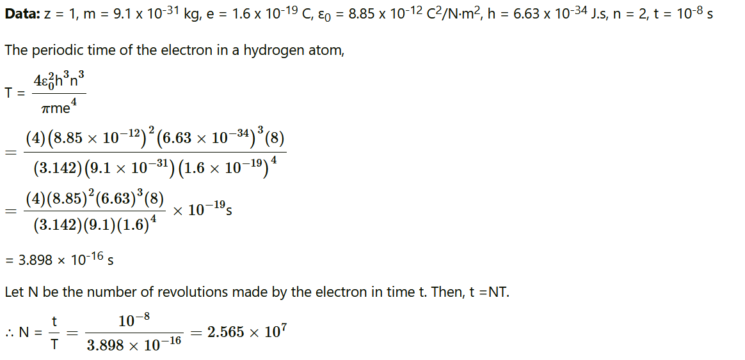
An electron in hydrogen atom stays in its second orbit for 10-8 s. How many revolutions will it make around the nucleus in that time?

