Slide 1

Passenger Train Delay Prediction
Project presentation
Group 5
Machine Learning Engineering PA2595

Slide 2
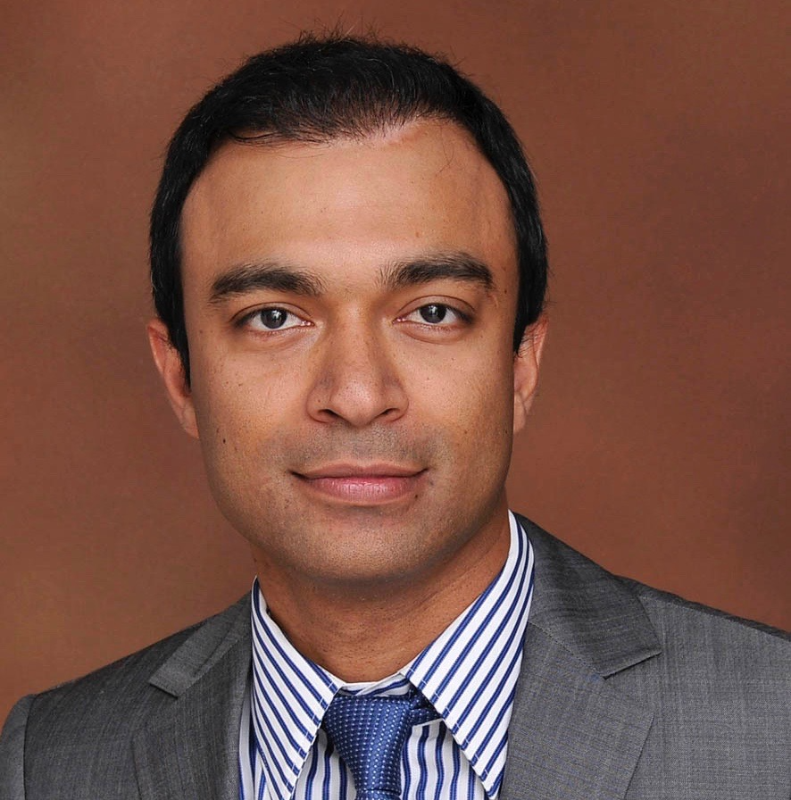


Group 5: Team Members
Ziaul Chowdhury
Software Engineer
Roles:
Software Architect
Data Scientist
Software Engineer
Quality Assurance Engineer
Christina Larsson
Category manager sourcing
Roles:
Requirements Engineer
Data Scientist
Developer
Subject Matter Expert
Suhasini Aswath
Software Engineer
Role:
Solution Architect
Developer
Requirements Engineer
Quality Assurance Engineer

Slide 3
The background to the challenges in passenger train punctuality are many
Trafikverket (Swedish Transport Administration) governs the most of the nation’s railroad infrastructure.
The Swedish rail market has undergone deregulation and traffic volumes of passengers and freight have increased.
The infrastructure has during a long period received insufficient maintenance.
Large increase in passenger train operators
Punctuality for long-distance trains in Sweden
95%
68%
27%
1988
2022
Q1 2024
Gap
Goal
Source: Trafikverket and Trafikanalys

Slide 4
Introduction
Problem Statement : Train delays are a global problem that affect commuters, companies, and transportation networks all around the world.
01
Significance: Dependable train services are essential for economic productivity, environmental sustainability, and urban mobility.
02
Goal: We want to create a machine learning model that can anticipate train delays with accuracy and lessen the effects they have on stakeholders.
03
Objectives: In this presentation, we will delve into the methodologies, results, and implications of our ML project on predicting train delays.
04

Slide 5
Project Goals
Binary Classification Objective: Develop a model that predicts whether a train will be delayed(1) or not delayed(0).
Data: Leverage historical data of train departures for 2 days from the public API - https://api.trafikinfo.trafikverket.se/
Impact: Timely communication and improved passenger experience.
Innovation: Contribute to the advancement of transport technology by leveraging machine learning and real-time data analytics to address real-world challenges in train scheduling and operations.

Slide 6
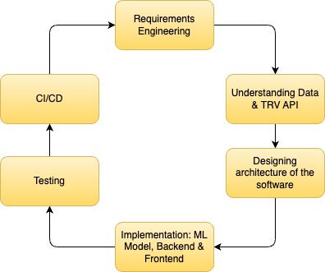
SDLC

Slide 7
Requirements
Data requirements
id11 Use publicly available historical rail data from the Swedish Transport Administration.
id24 The front-end application shall prompt the user to choose from a list a departing station and an arrival station.
Functional requirements
id31 The system shall predict if a train between two specific stations will arrive on time. Trafikverket’s definition is that a deviation of more than 5:59 min after planned time is a delay.
Performance Requirements id41 The model shall achieve a minimum accuracy of [was not set from the start of the project]
System Requirements - Scalability id55 The system shall be designed to scale with an increase in data volume (increasing the time period analyzed) and complexity (other departures, destinations and operators)
Compliance and standards id61 Data privacy - The system shall use only publicly available data from Trafikverket, so avoid issues with data protection regulations. id65 Reporting - The system shall generate a response informing the user if the model predicts that a train between the named locations will arrive to the end location 1) on time 2) delayed.
Notes:
1) Data Requirements - input data specification: id11 Use publicly available historical rail data from the Swedish Transport Administration.
id21 Historical timetable data, departure times and arrival times. id23 Use data for SJ’s long-distance trains. id24 The front-end application shall prompt the user to choose from a list a departing station and an arrival station. 2) Functional Requirements: id31 The system shall predict if a train between two specific stations will arrive on time. Trafikverket’s definition is that a deviation of more than 5:59 min after planned time is a delay. 3) Performance Requirements: id41 The model shall achieve a minimum accuracy of [was not decided in the beginning of the project] 4) System Requirements - Scalability: id55 The system shall be designed to scale with an increase in data volume (increasing the time period analyzed) and complexity (other departures, destinations and operators) 5) Compliance and standards: id61 Data privacy - The system shall use only publicly available data from Trafikverket, so avoid issues with data protection regulations. id65 Reporting - The system shall generate a response informing the user if the model predicts that a train between the named locations will arrive to the end location 1) on time 2) delayed.

Slide 8
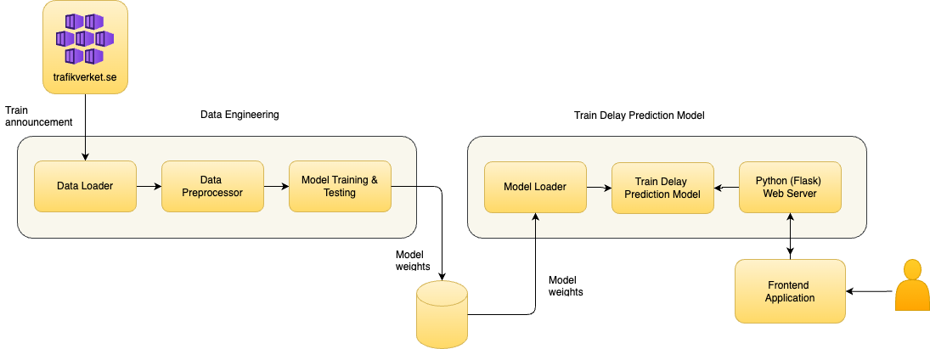
System Architecture

Slide 9
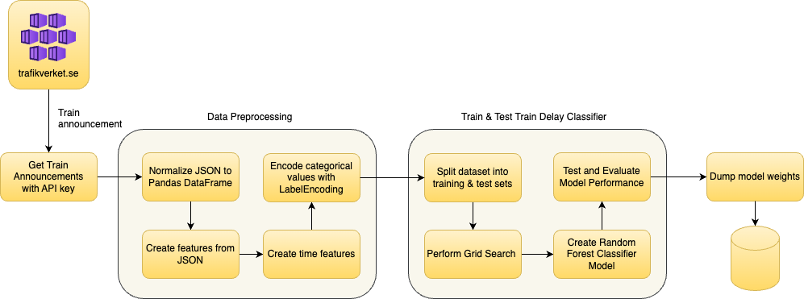
Data Engineering

Slide 10
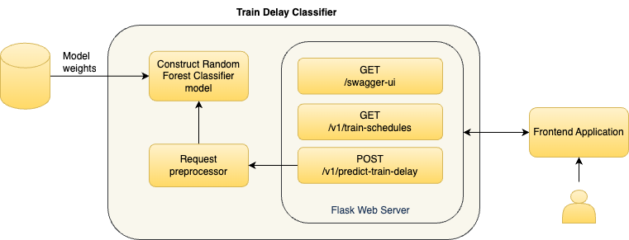
Passenger Train delay Prediction

Slide 11
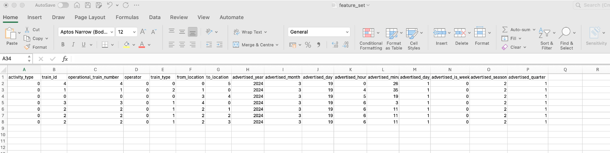
Sample feature set
Data model of train announcement contains many attributes in JSON format
JSON data is converted to Pandas DataFrame and the nested JSON structure is normalized into columns.
Below is the final subset of columns chosen

Slide 12
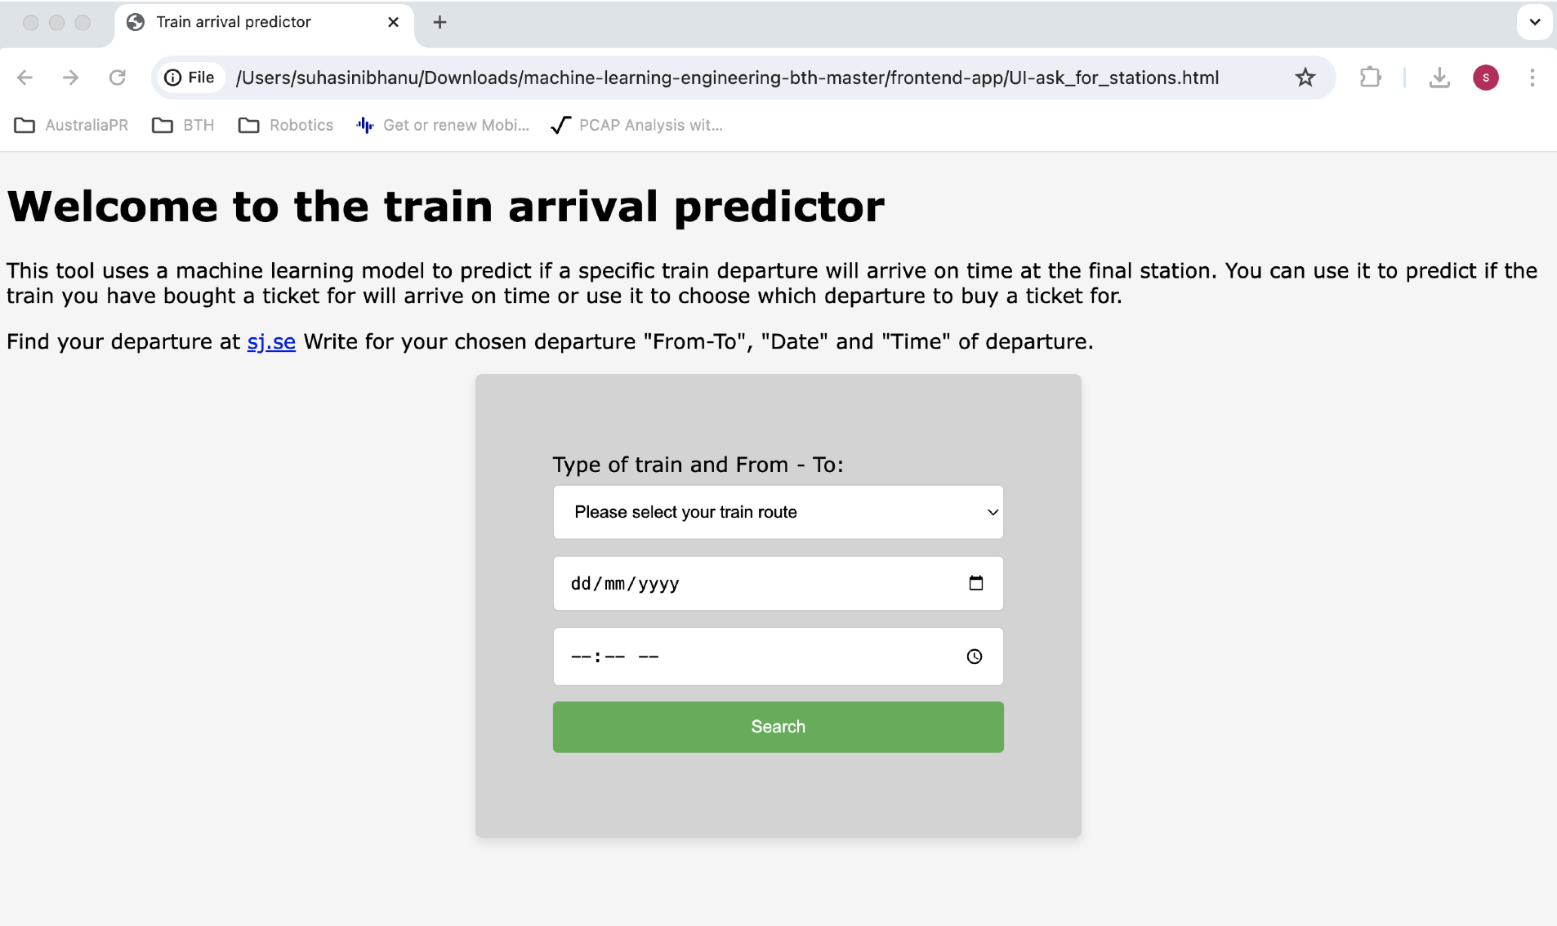
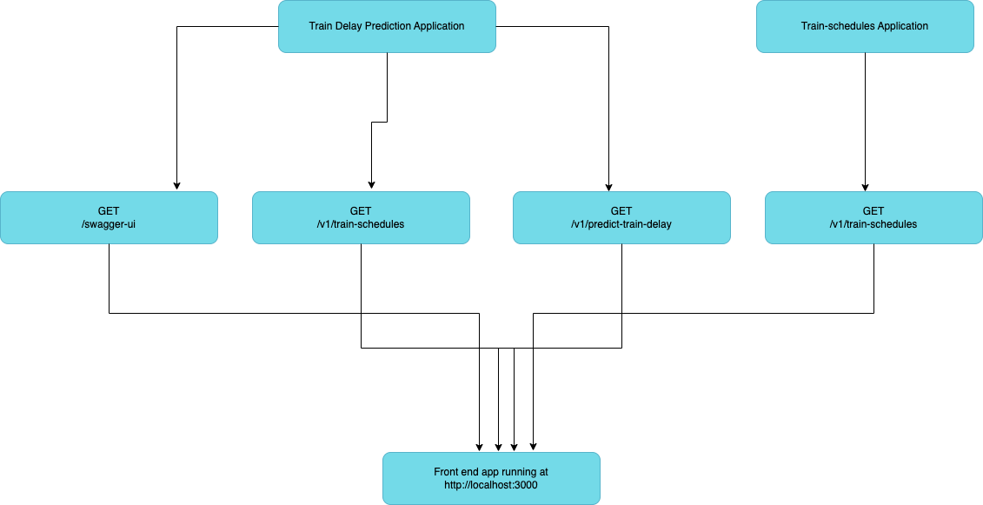
Frontend App
Allow the user to choose a train departure with SJ and predict if it will arrive on time.
A future passenger with a ticket for a specific train departure would like to know if the train is likely to arrive on time.
A potential ticket buyer finds information before purchasing a ticket whether the train will arrive on time.
The first version of the user interface was coded in Python and then it was improved to HTML to enhance the usability.

Slide 13
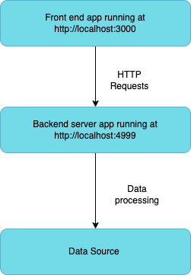
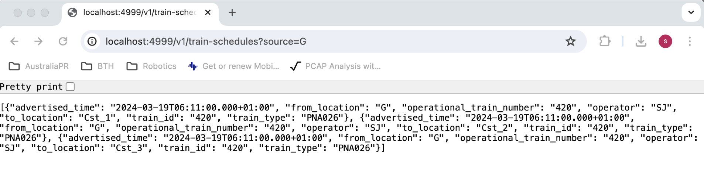
Backend service – Train schedules
A flask-based web application running at http://localhost:4999
Requires a source station and returns a list of possible destinations

Slide 14
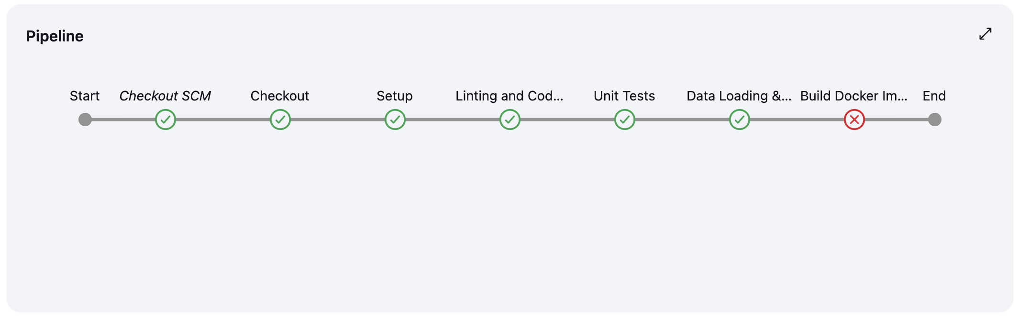
Build pipeline

Slide 15
Testing
Unit Testing
REST API Testing with Postman
Functionality Testing
Integration testing

Slide 16
Results: Classification Report
Label | Precision | Recall | F1-Score
0 (On-Time) | 1 | 1 | 1
1 (Delay) | 1 | 1 | 1

Slide 17
Advantages
Operational Efficiency: Proactive management and improve train scheduling.
Passenger Experience: Increased reliability and better communication.
Cost savings: Efficient resource allocation, delay management and predictive maintenance.
Improved safety measures: Identifying potential safety issues that cause delays, leading to better preventive measures.

Slide 18
Future work
C to insert
Scale it
Increase the training data to a larger time span, ideally one year to take into account seasonal effects
Include all passenger train operators in Sweden
Finalize deployment
Finalize the connection between the backend and frontend service.
Improve performance Develop the model so that it predict how large the delay will be in brackets of 5 minutes.
Notes:
Future work can include increase the training data to a larger time span, for example one year, so that for a search on a Wednesday train departure train the model on one earlier non-holiday Wednesday departures. Another future development of the model is to predict how large the delay will be in spans of 5 minutes.
Data Quality and Availability: Reliable and comprehensive historical data and Continuous integration of real-time data for ongoing predictions can be complex.
Model Accuracy and Reliability: model needs to be trained on a diverse set of data and there could be False positives.
Scalability: Ensuring that the infrastructure can handle the computational load for real-time predictions.
Security: Protecting the prediction system from cyber-attacks that could disrupt operations

Slide 19
The End
Thank you

