Slide 1

Final Project
Passenger Train Delay Prediction
Group 5
Machine Learning Engineering

Slide 2


Group 5: Team Members
Ziaul Chowdhury
Software Engineer
Roles:
Software Architect
Data Scientist
Software Engineer
Quality Assurance Engineer
Christina Larsson
Suhasini Aswath

Slide 3
Background

Slide 4
Introduction
Problem Statement : Train delays are a global problem that affect commuters, companies, and transportation networks all around the world.
01
Significance: Dependable train services are essential for economic productivity, environmental sustainability, and urban mobility.
02
Goal: We want to create a machine learning model that can anticipate train delays with accuracy and lessen the effects they have on stakeholders.
03
Objectives: In this presentation, we will delve into the methodologies, results, and implications of our ML project on predicting train delays.
04

Slide 5
Project Goals
Binary Classification Objective: Develop a model that predicts whether a train will be delayed(1) or not delayed(0).
Data: Leverage historical data of train departures for 2 days from the public API - https://api.trafikinfo.trafikverket.se/
Impact: Timely communication and improved passenger experience.
Innovation: Contribute to the advancement of transport technology by leveraging machine learning and real-time data analytics to address real-world challenges in train scheduling and operations.

Slide 6
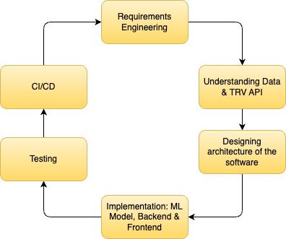
SDLC

Slide 7
Requirements

Slide 8
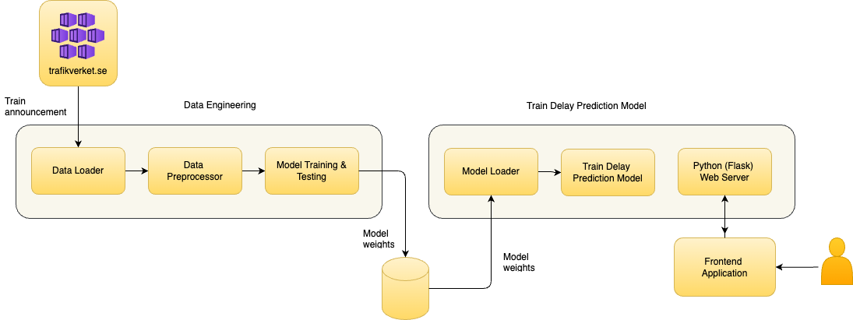
System Architecture

Slide 9
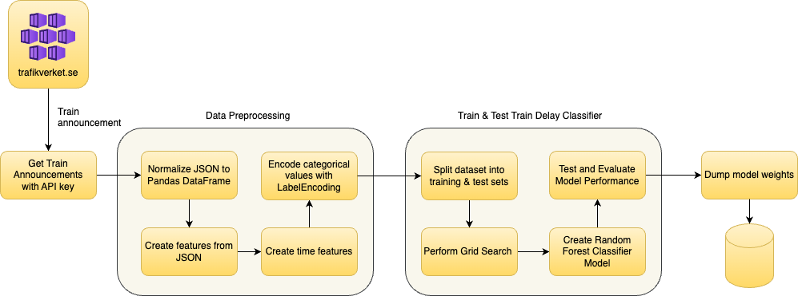
Data Engineering

Slide 10
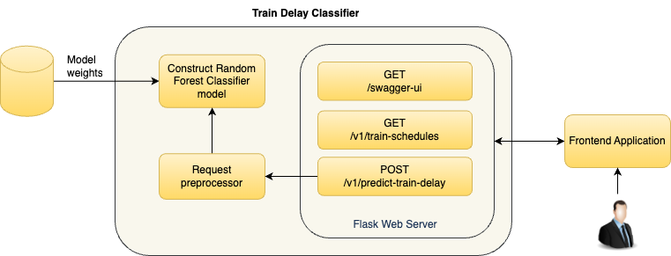
Passenger Train delay Prediction

Slide 11
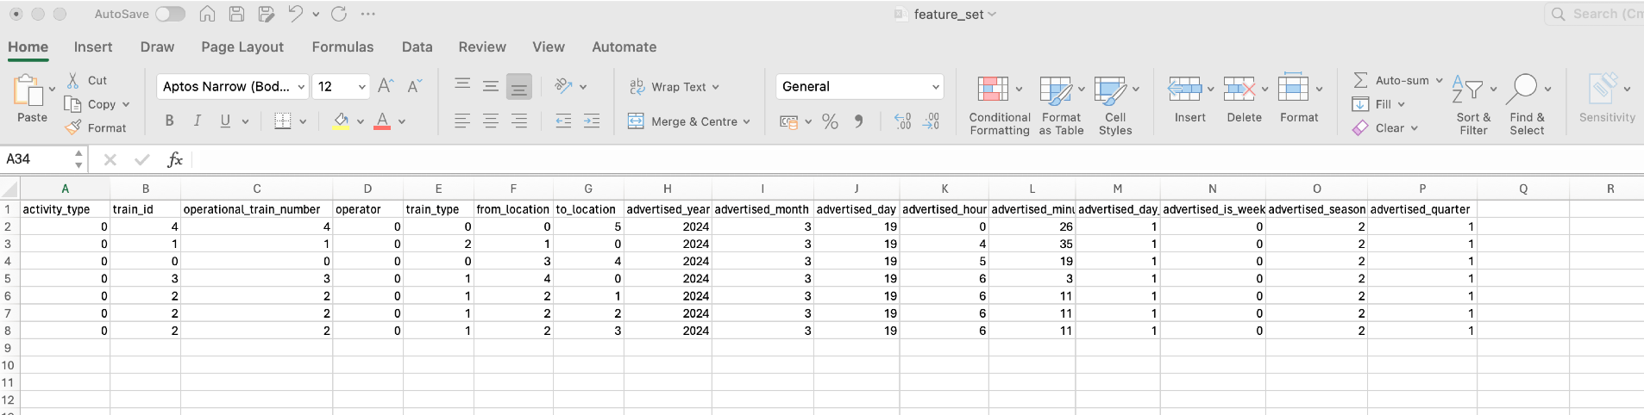
Sample feature set
Data model of train announcement contains many attributes in JSON format
JSON data is converted to Pandas DataFrame and the nested JSON structure is normalized into columns.
Below is the final subset of columns chosen

Slide 12
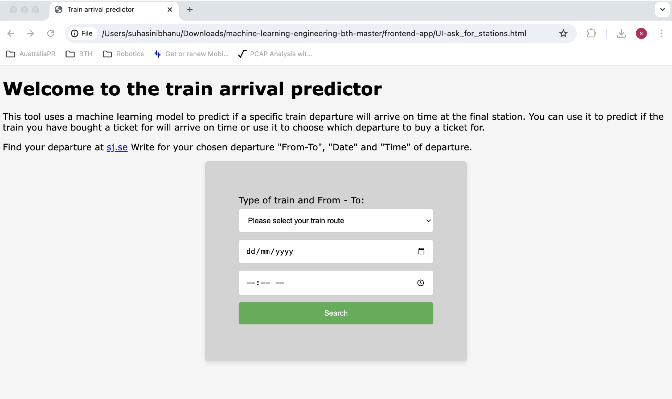
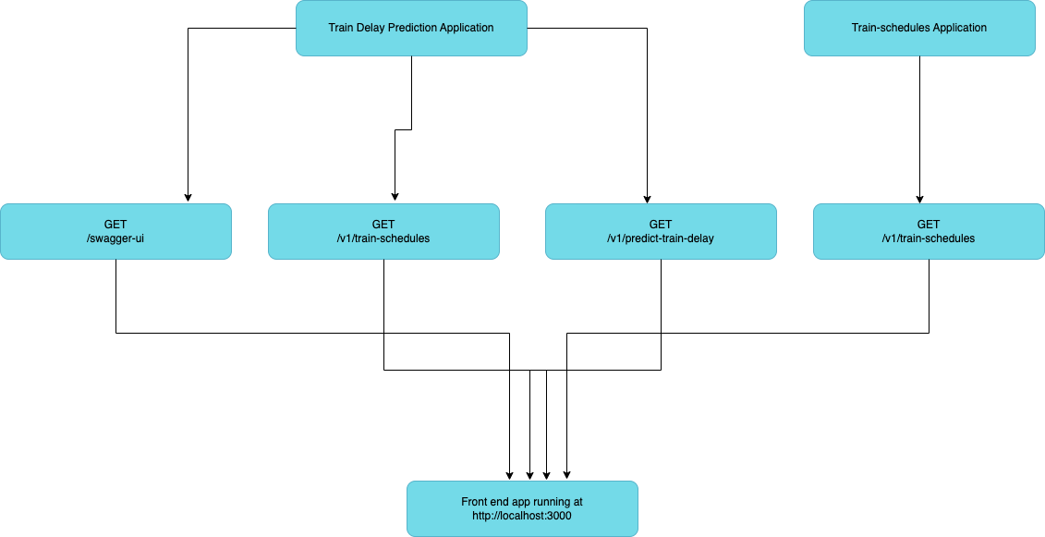
Frontend App
Allow the user to choose a train departure with SJ and predict if it will arrive on time.
A future passenger with a ticket for a specific train departure would like to know if the train is likely to arrive on time.
A potential ticket buyer finds information before purchasing a ticket whether the train will arrive on time.
The first version of the user interface was coded in Python and then it was improved to HTML to enhance the usability.

Slide 13
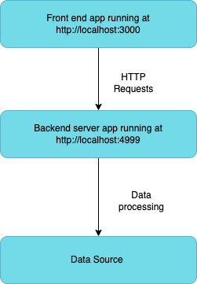
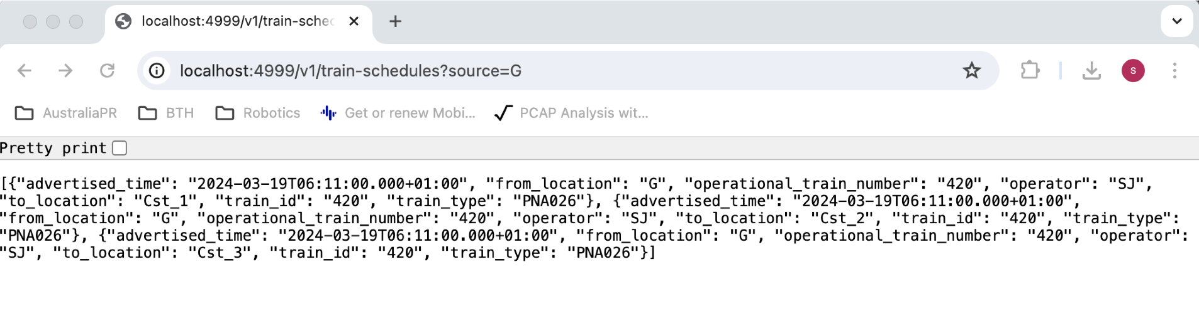
Backend service – Train schedules
A flask-based web application running at http://localhost:4999
Requires a source station and returns a list of possible destinations

Slide 14
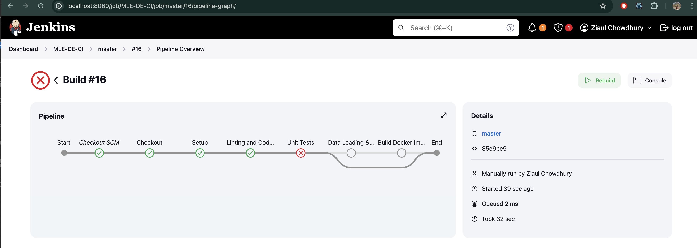
Build pipeline
To automate the build and deployment of data engineering and train delay prediction system, Jenkins tool was installed on local Docker.
Unfortunately, the pipeline doesn’t work as expected and it wasn’t possible to fix the Docker related issue

Slide 15
Testing
Unit Testing
REST API Testing with Postman
Functionality Testing
Integration testing

Slide 16
Results: Classification Report
Label | Precision | Recall | F1-Score
0 (On-Time) | 1 | 1 | 1
1 (Delay) | 1 | 1 | 1

Slide 17
Advantages
Operational Efficiency: Proactive management and improve train scheduling.
Passenger Experience: Increased reliability and better communication.
Cost savings: Efficient resource allocation, delay management and predictive maintenance.
Improved safety measures: Identifying potential safety issues that cause delays, leading to better preventive measures.

Slide 18
Future Work
Data Quality and Availability: Reliable and comprehensive historical data and Continuous integration of real-time data for ongoing predictions can be complex.
Model Accuracy and Reliability: model needs to be trained on a diverse set of data and there could be False positives.
Scalability: Ensuring that the infrastructure can handle the computational load for real-time predictions.
Security: Protecting the prediction system from cyber-attacks that could disrupt operations.

Slide 19
The End
Thank you

