Slide 1
Machine Learning Project
Train Delay Prediction
By,
Ziaul Chowdhury
Christina Larsson
Suhasini Aswath

Slide 2
Team

Slide 3
Background

Slide 4
Introduction
Problem Statement : Train delays are a global problem that affect commuters, companies, and transportation networks all around the world.
01
Significance: Dependable train services are essential for economic productivity, environmental sustainability, and urban mobility.
02
Goal: We want to create a machine learning model that can anticipate train delays with accuracy and lessen the effects they have on stakeholders.
03
Objectives: In this presentation, we will delve into the methodologies, results, and implications of our ML project on predicting train delays.
04

Slide 5
Project Goals
Binary Classification Objective: Develop a model that predicts whether a train will be delayed(1) or not delayed(0).
Data: Leverage historical data of train departures for 2 days from the public API - https://api.trafikinfo.trafikverket.se/
Impact: Timely communication and improved passenger experience.
Innovation: Contribute to the advancement of transport technology by leveraging machine learning and real-time data analytics to address real-world challenges in train scheduling and operations.

Slide 6
SDLC

Slide 7
Requirements

Slide 8
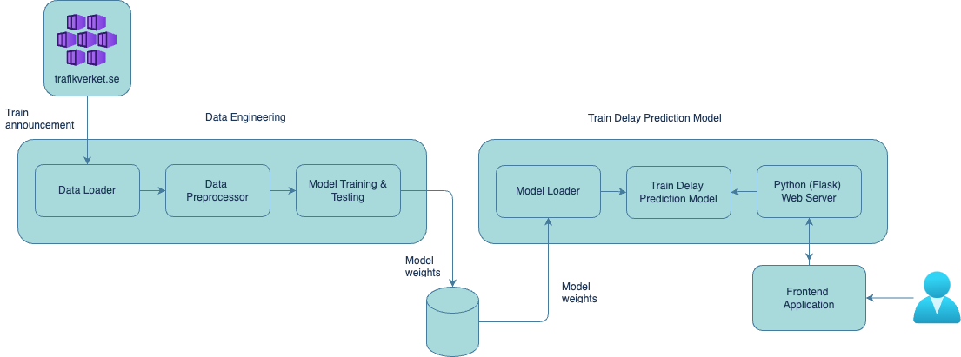
Architecture
Flexible Model Deployment: Enables seamless integration of the train delay prediction model into the production backend service.
Data Processing Pipeline: The system employs a structured data processing pipeline, starting with data retrieval from Trafikverket.se's REST API.
Model Selection and Deployment: A Random Forest classifier from the Scikit-learn Python package is chosen as the binary classification model.

Slide 9
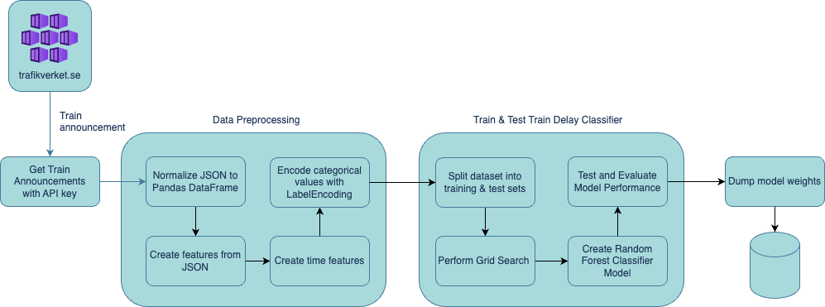
Data Engineering
Data Retrieval and Pre-processing: The TRV REST API facilitates train announcements retrieval, requiring an API key obtained through registration.
Model Training and Evaluation: The preprocessed dataset is split into training and testing sets (75% and 25% respectively).
Model Deployment and Maintenance: Separation of the train delay prediction backend service from the data engineering allows for model weights to be stored in the file system, ensuring flexibility and efficiency in model deployment and maintenance.

Slide 10
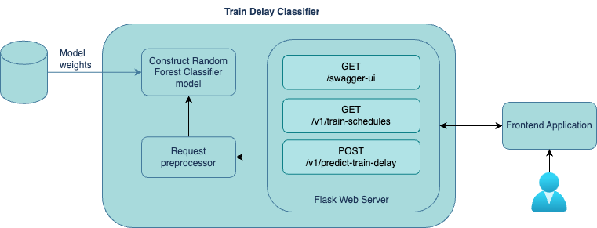
Train delay Prediction
Model Initialization and Server Configuration: The Random Forest Classifier model is initialized from stored weights, accompanied by label encoders, within the architecture
API Documentation and User Interface: Open API documentation, integrated with Swagger, aids in development and API management by listing available REST services and offering execution options via Swagger UI.
Prediction Process and Response Handling: The frontend application interacts with the backend by retrieving a list of available train schedules and presenting them to users.

Slide 11
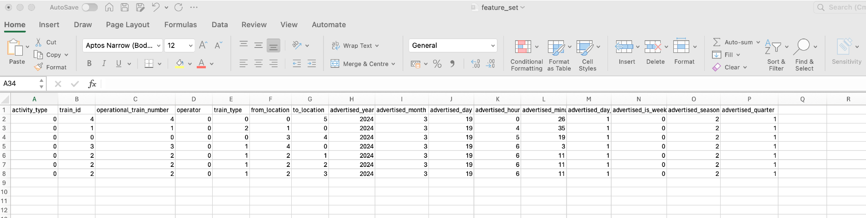
Sample feature set
Data model of train announcement contains many attributes in JSON format
JSON data is converted to Pandas DataFrame and the nested JSON structure is normalized into columns.
Below is the final subset of columns chosen

Slide 12
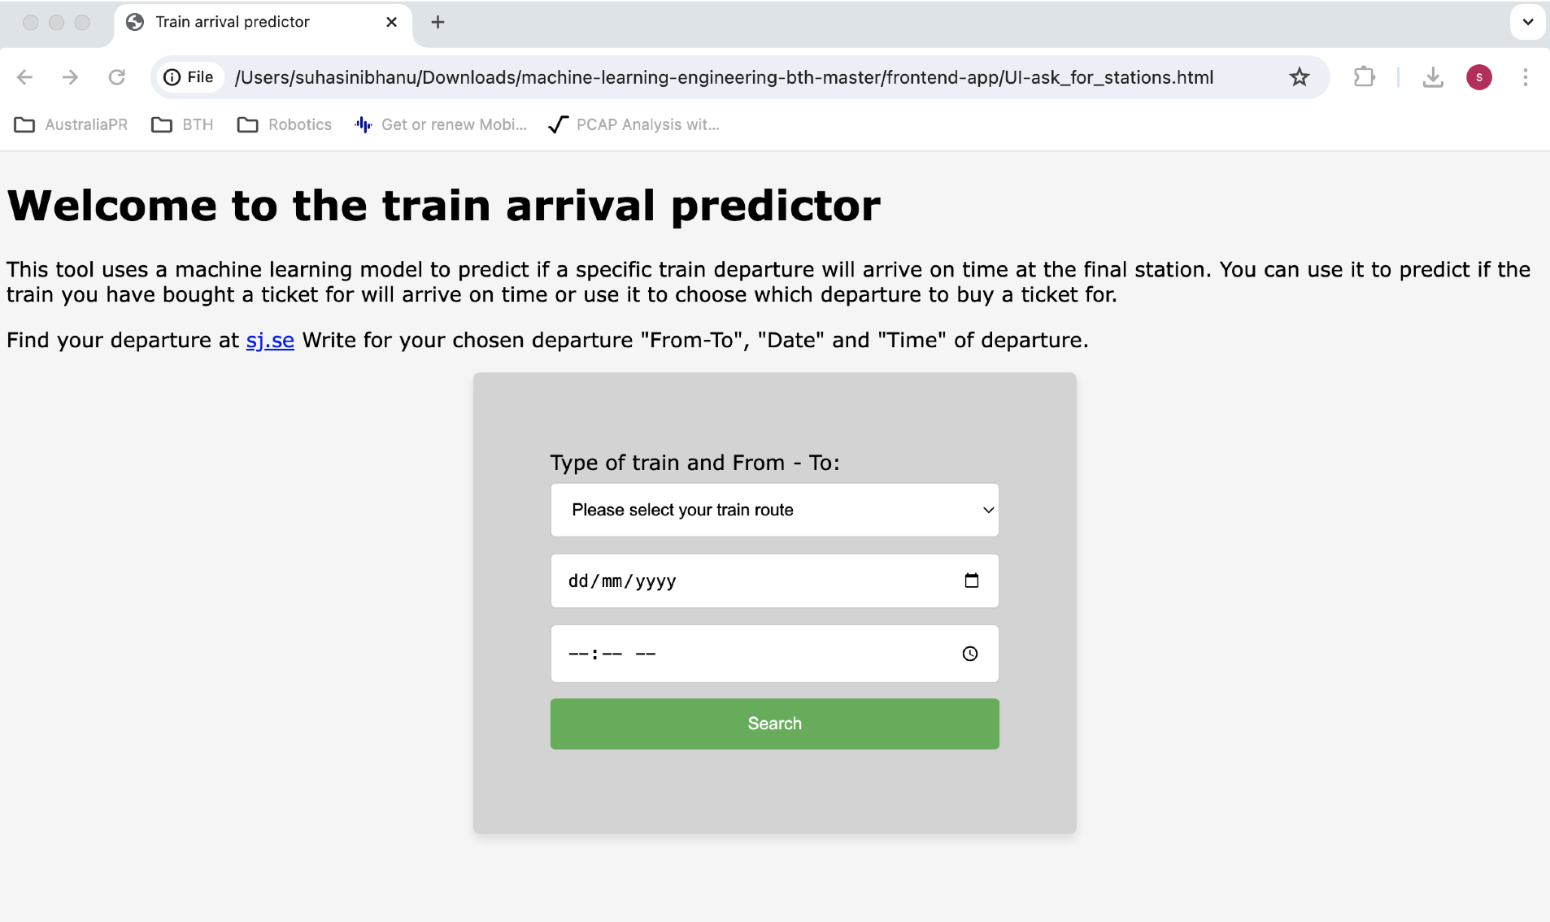
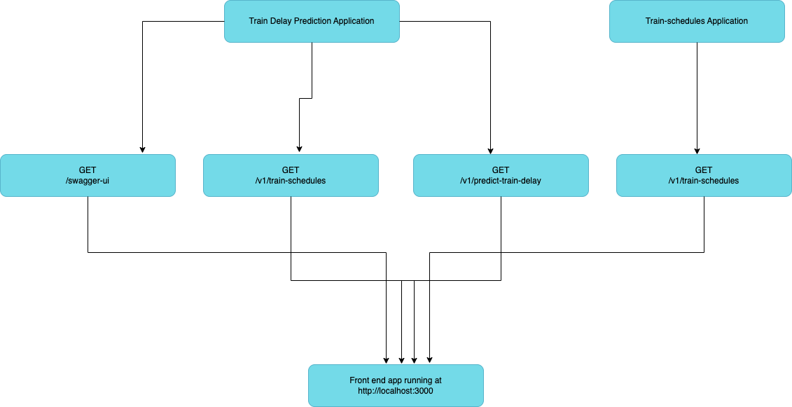
Frontend App
Allow the user to choose a train departure with SJ and predict if it will arrive on time.
A future passenger with a ticket for a specific train departure would like to know if the train is likely to arrive on time.
A potential ticket buyer finds information before purchasing a ticket whether the train will arrive on time.
The first version of the user interface was coded in Python and then it was improved to HTML to enhance the usability.

Slide 13
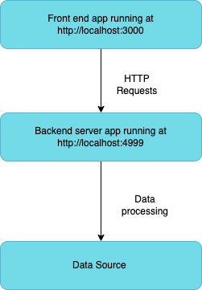
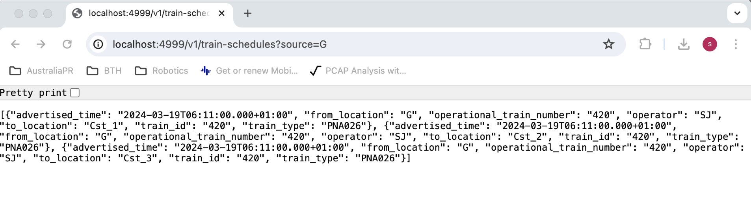
Backend service – Train schedules
A flask-based web application running at http://localhost:4999
Requires a source station and returns a list of possible destinations

Slide 14
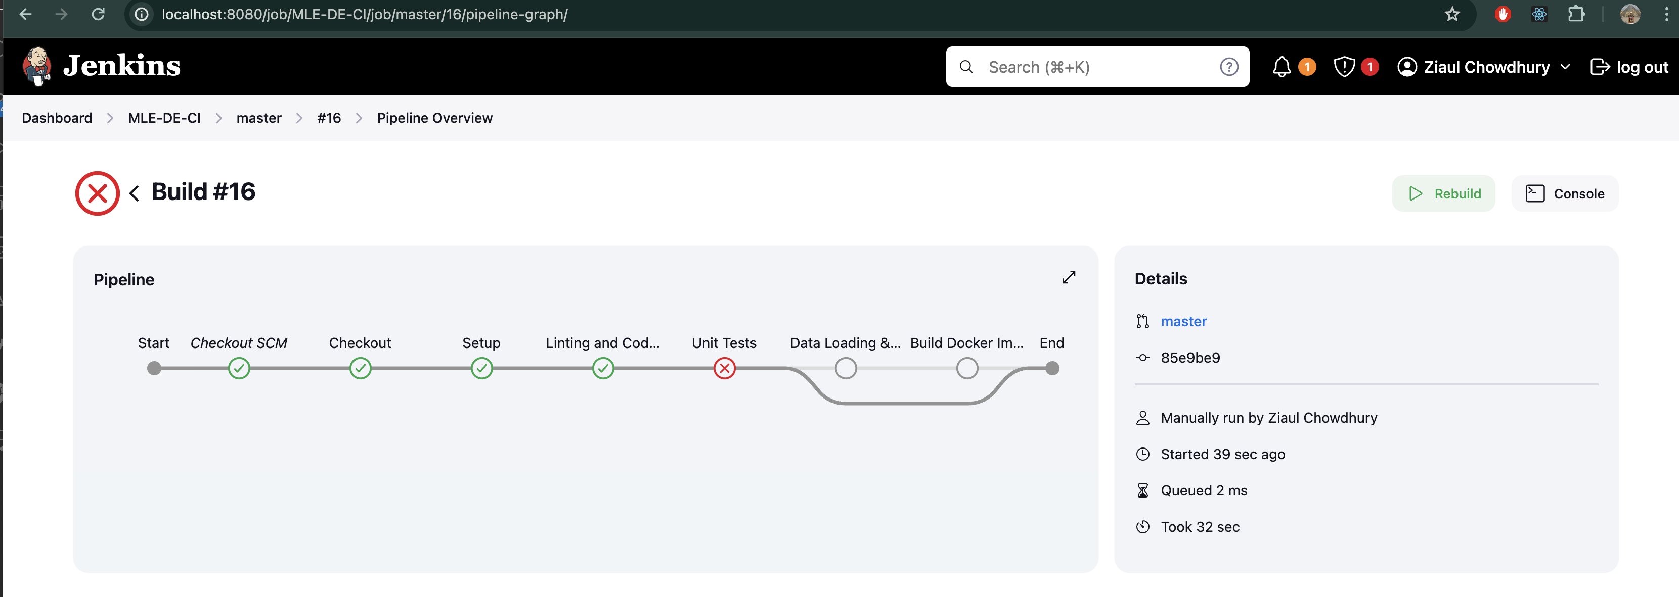
Build pipeline
To automate the build and deployment of data engineering and train delay prediction system, Jenkins tool was installed on local Docker.
Unfortunately, the pipeline doesn’t work as expected and it wasn’t possible to fix the Docker related issue

Slide 15
Testing

Slide 16
Results

Slide 17
Advantages
Operational Efficiency: Proactive management and improve train scheduling.
Passenger Experience: Increased reliability and better communication.
Cost savings: Efficient resource allocation, delay management and predictive maintenance.
Improved safety measures: Identifying potential safety issues that cause delays, leading to better preventive measures.

Slide 18
Future Work
Data Quality and Availability: Reliable and comprehensive historical data and Continuous integration of real-time data for ongoing predictions can be complex.
Model Accuracy and Reliability: model needs to be trained on a diverse set of data and there could be False positives.
Scalability: Ensuring that the infrastructure can handle the computational load for real-time predictions.
Security: Protecting the prediction system from cyber-attacks that could disrupt operations.

Slide 19
Thank you

