Slide 1
Azure Functions
[ Konstantinos Ziazios ]
[ Azure Day 2018]

Slide 2
@ziaziosk
Senior Software Engineer @ Pheron Ltd
Co-Organizer of Thessaloniki.net Meetup
15+ years experience in software (5yrs with cloud services)
ziaziosk@gmail.com / ziaziosk

Slide 3


Thessaloniki.net meetup
https://www.meetup.com/Thessaloniki-NET-Meetup/
Member of .Net Foundation meetups
Microsoft technical community
56 Meetups last 3 years – 500 Members
Largest .net community in Thessaloniki

Slide 4

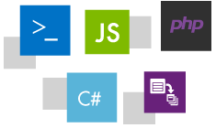

Build apps faster with a serverless architecture
Manage your apps instead of infrastructure
Develop your way in the language you choose
Bind into services easily interact with Azure Cosmos DB, Storage, and more, and external services including Twilio, SendGrid
Notes:
Manage your apps instead of infrastructure
Focus on building great apps. Don’t worry about provisioning and maintaining servers, especially when your workload grows. Azure Functions provides a fully managed compute platform with high reliability and security. With scale on demand, you get the resources you need—when you need them
Develop your way
Create Functions in the language you choose, such as JavaScript, C#, and Java, and scripting options such as Python, PHP, Bash, Batch, and PowerShell. Write code in an easy-to-use web-based interface, or upload precompiled code built with your favorite development tool. Take advantage of continuous deployment to integrate with your DevOps pipeline and use monitoring tools to troubleshoot.
Bind into services
Build rich, serverless scenarios by capitalizing on a range of Azure and external services. Easily interact with Azure Cosmos DB, Storage, and more, and external services including Twilio, SendGrid, and others—by adding input/output bindings to Functions. Save costs with less code to maintain.

Slide 5
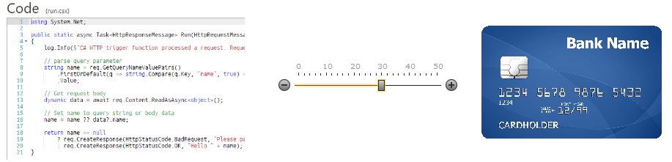
What is serverless computing
"Serverless Computing" doesn't really mean there's no server.
Serverless means there's no server you need to worry about
As close to "cloudy" as The Cloud can get.
Notes:
here's a lot of confusing terms in the Cloud space. And that's not counting the term "Cloud." ;)
IaaS (Infrastructure as a Services) - Virtual Machines and stuff on demand.
PaaS (Platform as a Service) - You deploy your apps but try not to think about the Virtual Machines underneath. They exist, but we pretend they don't until forced.
SaaS (Software as a Service) - Stuff like Office 365 and Gmail. You pay a subscription and you get email/whatever as a service. It Just Works.
"Serverless Computing" doesn't really mean there's no server. Serverless means there's no server you need to worry about. That might sound like PaaS, but it's higher level that than.
Serverless Computing is like this - Your code, a slider bar, and your credit card. You just have your function out there and it will scale as long as you can pay for it. It's as close to "cloudy" as The Cloud can get.
Serveless is to servers as wireless is to wired. Wireless still needs wires but we don’t interact with them
“Scott Hansleman

Slide 6
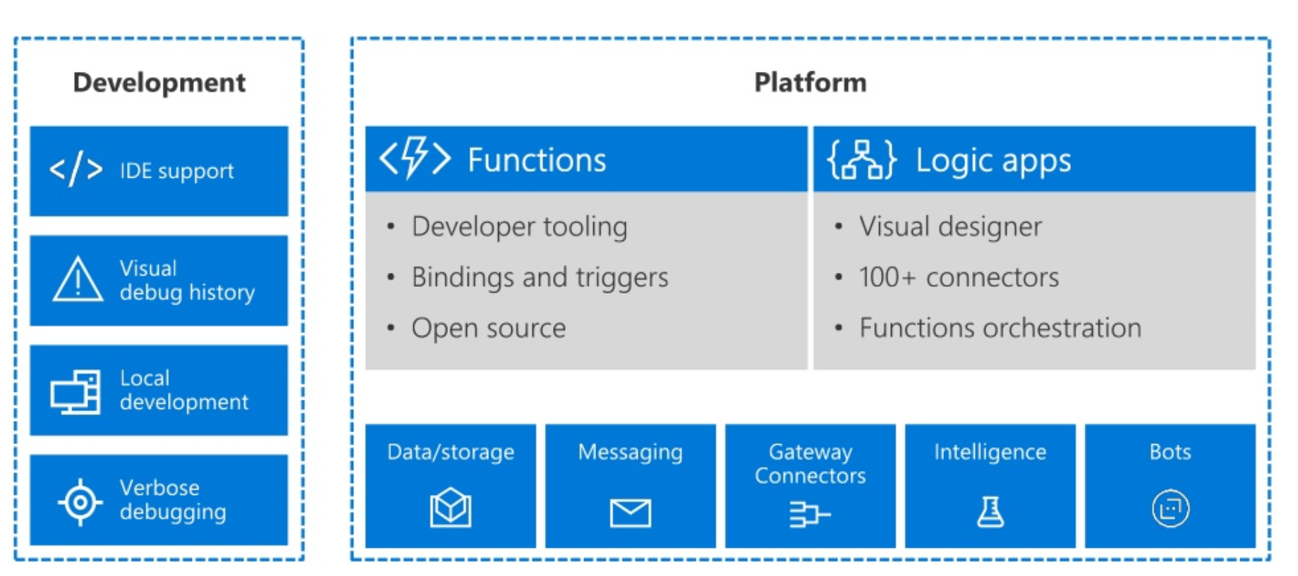
Serverless architecture in Azure
Notes:
here's a lot of confusing terms in the Cloud space. And that's not counting the term "Cloud." ;)
IaaS (Infrastructure as a Services) - Virtual Machines and stuff on demand.
PaaS (Platform as a Service) - You deploy your apps but try not to think about the Virtual Machines underneath. They exist, but we pretend they don't until forced.
SaaS (Software as a Service) - Stuff like Office 365 and Gmail. You pay a subscription and you get email/whatever as a service. It Just Works.
"Serverless Computing" doesn't really mean there's no server. Serverless means there's no server you need to worry about. That might sound like PaaS, but it's higher level that than.
Serverless Computing is like this - Your code, a slider bar, and your credit card. You just have your function out there and it will scale as long as you can pay for it. It's as close to "cloudy" as The Cloud can get.
Serveless is to servers as wireless is to wired. Wireless still needs wires but we don’t interact with them
“Scott Hansleman

Slide 7
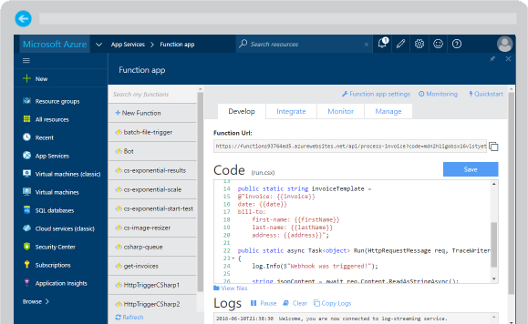
Azure Functions
Create a “serverless” event-driven experience that extends the existing Azure App Service platform by building “nanoservices” that can scale based on demand
Notes:
Azure Functions are part of the Azure Web + Mobile suite of App Services and are designed to enable the creation of small pieces of meaningful, reusable methods, easily shared across services. These serverless, event-driven methods are often referred to as “nanoservices” due to their small size. Although an Azure Function can contain quite a bit of code, they are typically designed to serve a single purpose, and respond to events in connected services.

Slide 8
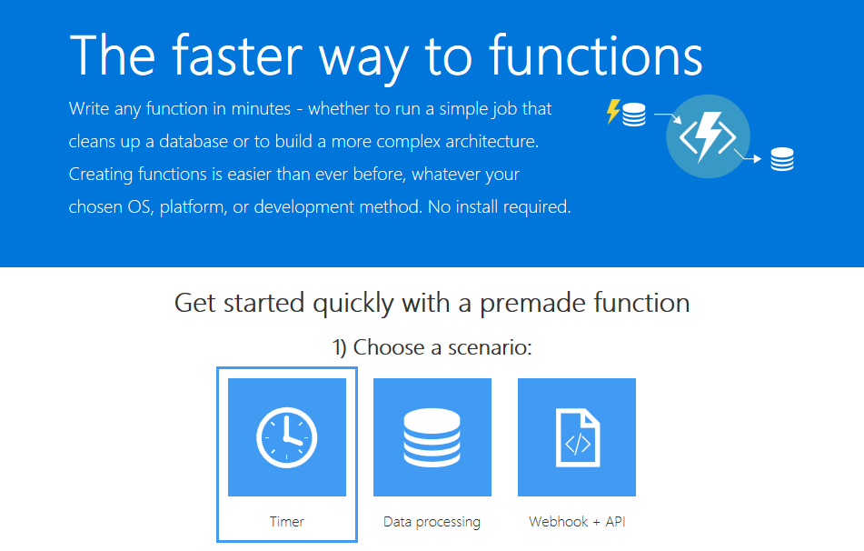
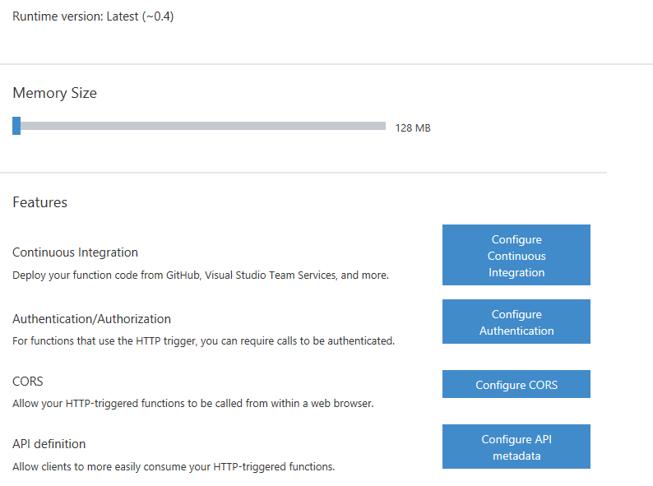
Supported Languages and Tools
Create functions in JavaScript, C#, Python, and PHP, as well as scripting options such as Bash, Batch, and PowerShell, that can be triggered by virtually any event in Azure, 3rd party services, or on premise systems
Notes:
Azure Functions can be created in most common development and scripting languages, and can be “triggered” by events in other Azure App Services, such as Web, Mobile, Logic, and API apps. Azure Functions can also be exposed via HTTP URL schemes for easy integration into legacy systems.

Slide 9
Azure Functions usage patterns
“Brown field” – used as an integration, scripting tool (typically enterprises or larger ISV’s)
“Green field” – used for backend creation (typically start-ups or smaller ISV’s)
IoT – leveraged autonomously or as part of Azure iot implementations

Slide 10

Common Scenarios
Timer-based processing
Azure service event processing
SaaS event processing
Serverless web application architectures
Serverless mobile backends
Real-time stream processing
Real-time bot messaging
Your App or Service
Office 365
Office Graph
Azure Storage
Legacy Systems
Web Services
Other Functions
Notes:
Azure Functions are “event-driven” meaning they run based on associated and configure events, or “triggers”. For example an Azure Function could be triggered by a simple timer, such as running a process once every 24-hours, or triggered by an event in a document management system, such as when a new document is uploaded to a SharePoint library. Azure Functions can also respond to Azure-specific events, such as an image added to a Storage Blob or a notification arriving in a Message Queue.

Slide 11
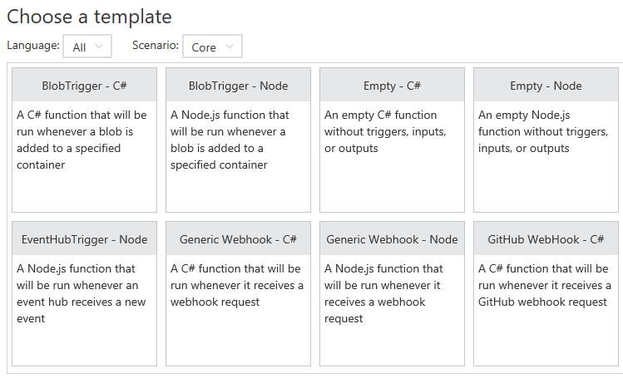
Function App Templates
Function App templates are categorized into general areas of Timer, Data Processing, and Webhook & API
BlobTrigger
EventHubTrigger
Generic webhook
GitHub webhook
HTTPTrigger
QueueTrigger
ServiceBusQueueTrigger
ServiceBusTopicTrigger
TimerTrigger
Blank & Experimental
Notes:
Although Azure Functions can be created from scratch”, the Azure Portal exposes a large number of ever-growing templates to help get developers started. These templates are typically designed with specific triggers in mind, such as a Blob Storage event, or a GitHub webhook event. Templates can easily form the basis for robust function creation, and are really designed just to get a developer started.

Slide 12
Timer Function Apps
Run at explicitly specified intervals, like every day at 2:00 am using CRON expressions, like “0 */5 * * * *“ (every 5 minutes)
Can send information to other systems, but typically don’t “return” information, only write to logs
Great for redundant cleanup and data management
Great for checking state of services
Can be combined with other functions
Notes:
Timer Functions are exactly what they sound like: Functions triggered by a specific time event. Timer Functions are perfect for clean up and maintenance processes and can easily be combined with other functions for more robust scenarios. Timer Functions us CRON expressions to configure schedules. It’s a good idea to get familiar with CRON syntax, but in the meantime there are a number of tools online to help you build CRON expressions.

Slide 13

Data Processing Function Apps
Run when triggered by a data event, such as an item being added to a queue or container
Typically have in and out parameters
Great for responding to CRUD events
Great for performing CRUD events
Great for moving content
Access data across services
Notes:
Data Processing Functions are triggered by activity in a datastore, such as a table, queue, or container. Data Processing Functions also typically have both “in” and “out” parameters, meaning they can accept an object as a parameter, and then process information and then return another object from within the function. This is not the same as a “return” value, as most Azure Functions either return void, or an HTTP response such as “created”, “accepted”, or “OK”.

Slide 14
Webhook & API Function Apps
Triggered by events in other services, like GitHub, Team Foundation Services, Office 365, OneDrive, Microsoft PowerApps
Takes in a request and sends back a response
Often mimic Web API and legacy web services flows
Typically need CORS settings managed
Best for exposing functionality to other apps and services
Great for building Logic Apps
Notes:
Webhook and API Functions are designed to easily integrate with 3rd party systems, like GitHub, Office 365, and especially Microsoft PowerApps. Since Webhook and API Functions are often exposed to external or legacy systems, they typically need CORS settings managed in order to “allow” external resources to “see” and execute the function. Most Azure Logic Apps leverage Webhook and API Functions directly.

Slide 15
Anatomy of a Function
A “Run” file that containing the function code
A “Function” file containing all service and trigger bindings and parameters
A “Project” file containing project assembly and NuGet package references
App Service settings, such as connection strings and API keys
code
Executable code
Function configuration
.NET Core and Project references
Notes:
An Azure Function is really a group of a few files that work in harmony. All actual function logic resides in a “Run” file written in a language of choice. A “Project” file is similar to a project file in other technologies such as .NET Core or Universal Windows Platform and contains “secondary” assembly references such as NuGet packages. Finally a “Function” file contains information about triggers and parameters, such as locations of Storage Queue connection strings and whether the parameter is design as an “in”, “out” or “bi-directional”. Optionally, additional configuration is also found in the Function App Settings such as an API Key or database connection string.

Slide 16
Function Bindings
Bindings serve as the basis for all connections to and from a function. Many bindings can be “bi-directional” as well.
Type | Service | Trigger | Input | Output
Schedule | Azure Functions | ✔
HTTP (REST or webhook) | Azure Functions | ✔ |  | ✔*
Blob Storage | Azure Storage | ✔ | ✔ | ✔
Events | Azure Event Hubs | ✔ |  | ✔
Queues | Azure Storage | ✔ |  | ✔
Tables | Azure Storage |  | ✔ | ✔
Tables | Azure Mobile Apps |  | ✔ | ✔
No-SQL DB | Azure DocumentDB |  | ✔ | ✔
Push Notifications | Azure Notification Hubs |  |  | ✔
Notes:
Without bindings, an Azure Function would just be a “disconnected” algorithm without any way to serve a purpose. Bindings server to connect functions and output to other services. Some of the most common binding types and features are listed in the table, however variations and adaptations can and do exist.

Slide 17
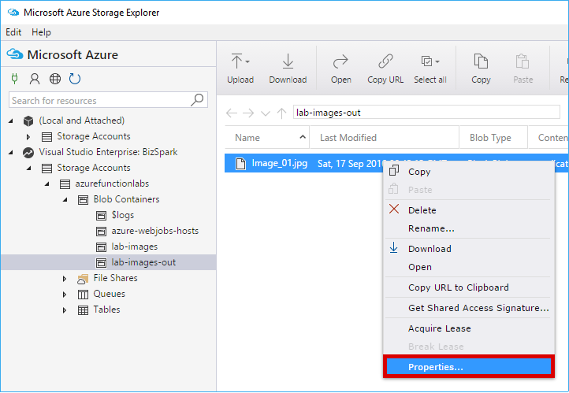
Testing Functions
Command-line tools
3rd party products such as Postman and Swagger
Direct web calls via cURL
Nested functions
Microsoft Azure Storage Explorer
Visual Studio Cloud Explorer
Notes:
Many Azure Functions are exposed via an actual URL that can be called directly from a web client or browser. When an Azure Function is not exposed via a URL its common practice to call the function from another dunction, such as a Timer-based Function for testing purposes only. Since Azure Functions can be nested, testing scenarios can be quite varied. For managing and testing Azure Functions that integrate with Storage Containers, Microsoft provides the Microsoft Azure Storage Explorer, as well as the Visual Studio Cloud Explorer. The Logs console in the Azure Function Designer is also a great way to view and trace function processing.

Slide 18
Best practices
Should do one thing
Should finish as quickly as possible
Should be stateless
Should be idempotent
Scenarios like:
Stateless → Scale
Not worth deploying a traditional backend
Workload is sporadic
Integration of different services
Notes:
Many Azure Functions are exposed via an actual URL that can be called directly from a web client or browser. When an Azure Function is not exposed via a URL its common practice to call the function from another dunction, such as a Timer-based Function for testing purposes only. Since Azure Functions can be nested, testing scenarios can be quite varied. For managing and testing Azure Functions that integrate with Storage Containers, Microsoft provides the Microsoft Azure Storage Explorer, as well as the Visual Studio Cloud Explorer. The Logs console in the Azure Function Designer is also a great way to view and trace function processing.

Slide 19
Quick Example
Process Images with Azure functions

Slide 20
Azure function in use
Costa farms
IoT processing for Costa farms
http://aka.ms/costafarms
Simple Recon
https://github.com/simpledealersuite/media2azure
Using Azure Functions for ETL jobs to process incoming customer files and images.
Missing Children Society of Canada
Processing streams from social media
https://github.com/Missing-Children-Society-Canada

Slide 21

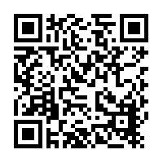
Global Azure Day 2018
https://www.meetup.com/Thessaloniki-NET-Meetup/events/248099525/
21 April 2018
Largest community event
Topics: Azure Functions, Cognitive Services, Blockchain, DevOps,
App Insights and more

Slide 22
References
Microsoft – TechnicalCommunityContent
Scott Hansleman - What is Serverless Computing? Exploring Azure Functions
Joe Raio – Building Serverless Applications in Azure
Notes:
Manage your apps instead of infrastructure
Focus on building great apps. Don’t worry about provisioning and maintaining servers, especially when your workload grows. Azure Functions provides a fully managed compute platform with high reliability and security. With scale on demand, you get the resources you need—when you need them
Develop your way
Create Functions in the language you choose, such as JavaScript, C#, and Java, and scripting options such as Python, PHP, Bash, Batch, and PowerShell. Write code in an easy-to-use web-based interface, or upload precompiled code built with your favorite development tool. Take advantage of continuous deployment to integrate with your DevOps pipeline and use monitoring tools to troubleshoot.
Bind into services
Build rich, serverless scenarios by capitalizing on a range of Azure and external services. Easily interact with Azure Cosmos DB, Storage, and more, and external services including Twilio, SendGrid, and others—by adding input/output bindings to Functions. Save costs with less code to maintain.

