Slide 1

Notes:
Presenter: Uchekwe Uchechukwu Hephzibah. Welcome the audience and introduce TutorConnect Nigeria as a full-stack marketplace intended to help Nigerian learners find and request sessions with tutors. State your leadership and frontend responsibilities, and explain that you will open the presentation, lead the frontend and user-workflow sections, then return for the proposed revenue model and conclusion. Set the expectation that the presentation distinguishes what currently works from what remains proposed.

Slide 2
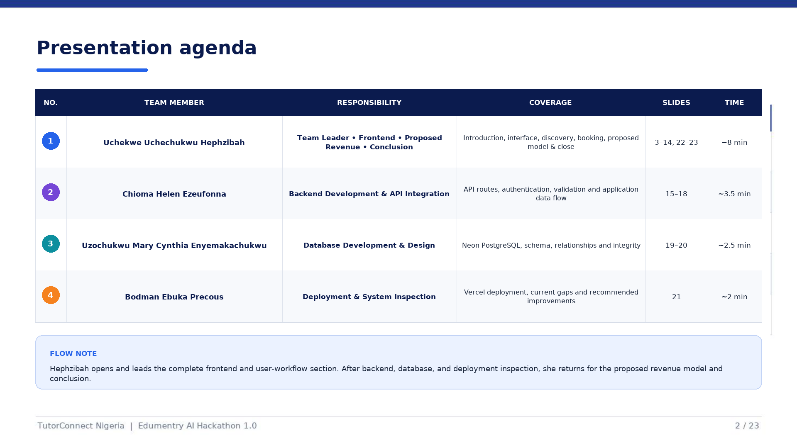
Notes:
Presenter: Uchekwe Uchechukwu Hephzibah. Walk through the agenda by responsibility rather than reading every table cell. Explain that you lead the introduction, frontend, tutor discovery, booking workflow, proposed revenue model and conclusion; Chioma covers backend and API integration; Cynthia covers database development and design; and Bodman covers deployment and system inspection. Clarify that you will return after Bodman's section. Keep this overview brief so the team can spend time on the implementation.

Slide 3
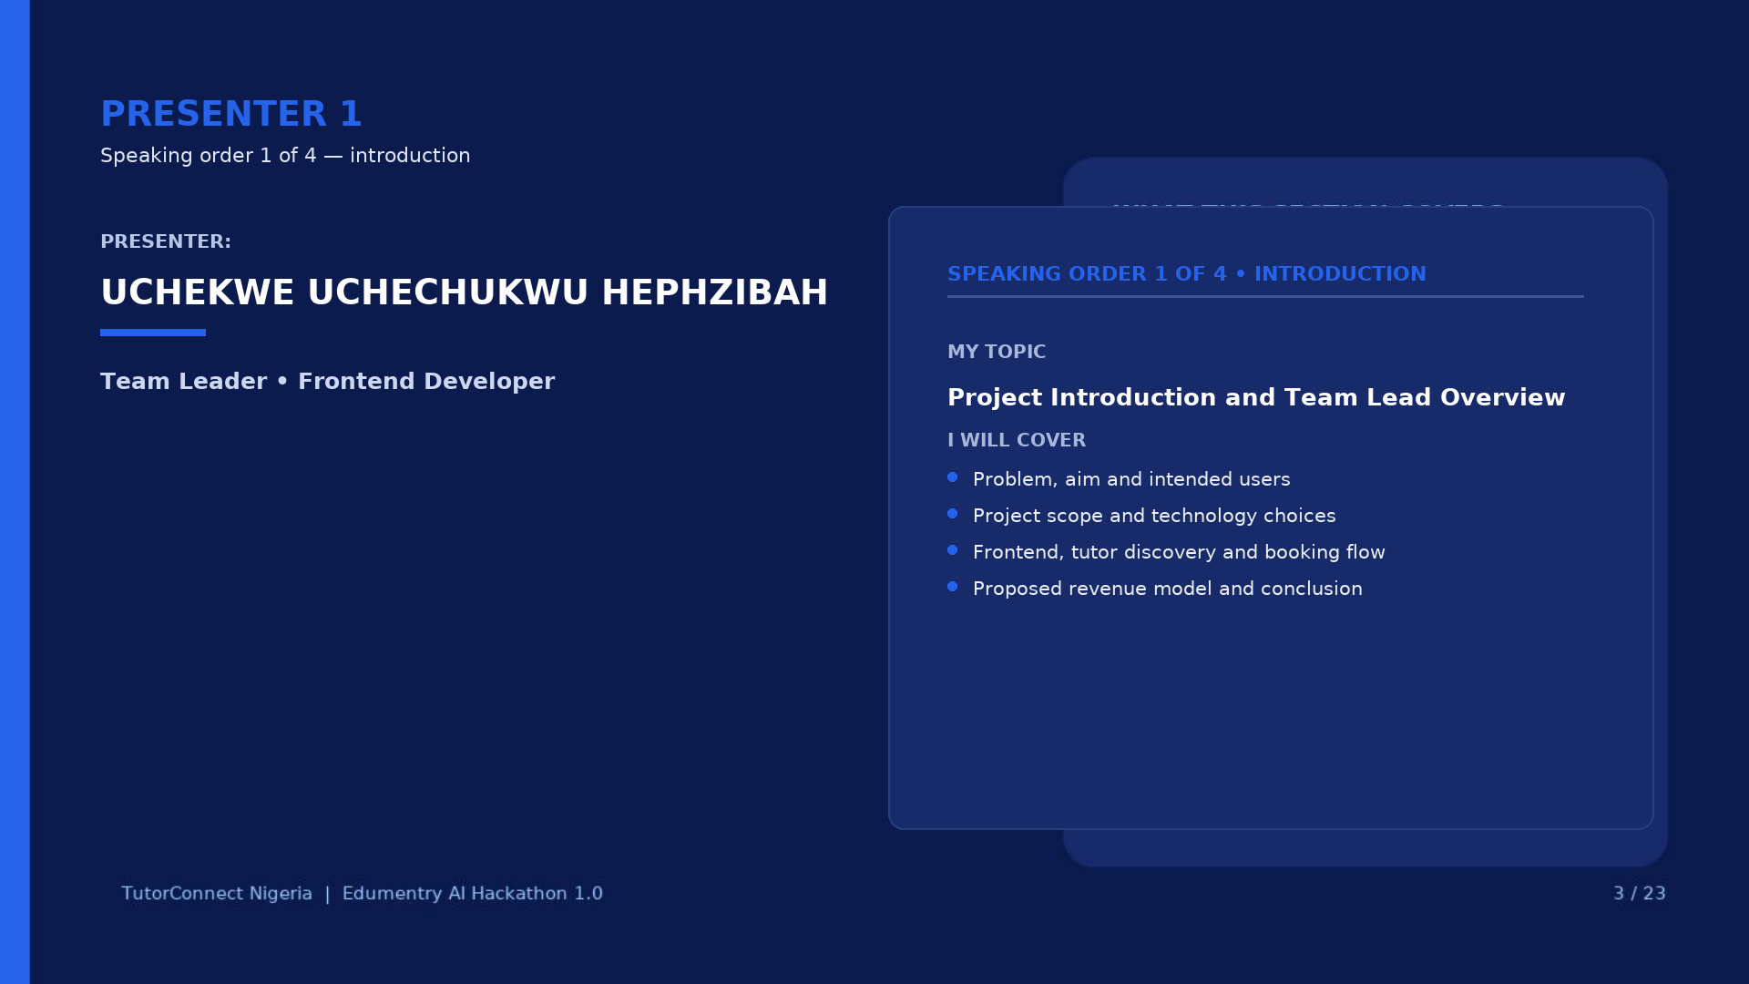
Notes:
Presenter: Uchekwe Uchechukwu Hephzibah. Frame the project before discussing individual screens. Explain the user problem, the product goal and the intended roles. Note that your section links the business problem to the frontend implementation and the main user journeys. Emphasise that the team worked on one connected application, with responsibilities divided for explanation.

Slide 4
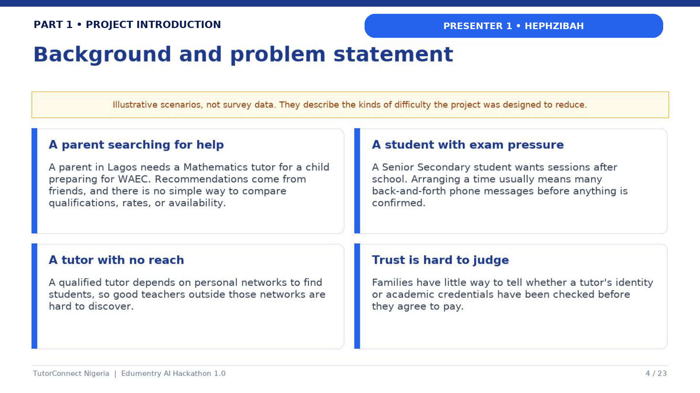
Notes:
Presenter: Uchekwe Uchechukwu Hephzibah. Explain the trust and coordination problems in informal tutor discovery: limited information, difficulty comparing options, and fragmented scheduling. Connect each problem to the product response—structured tutor profiles, search and filters, availability information and booking requests. Avoid claiming that the platform guarantees tutor quality; verification is a platform process that still needs strong administration.

Slide 5
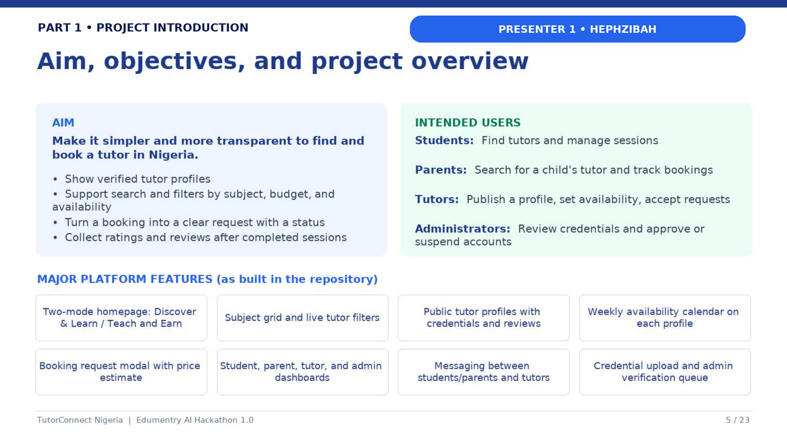
Notes:
Presenter: Uchekwe Uchechukwu Hephzibah. Describe the aim as making tutor discovery and session requests easier for learners and parents while giving tutors a place to manage their information and bookings. Introduce the principal users and the scope demonstrated in the application. Distinguish the implemented marketplace workflow from future payment or subscription ideas, which are not current functionality.

Slide 6
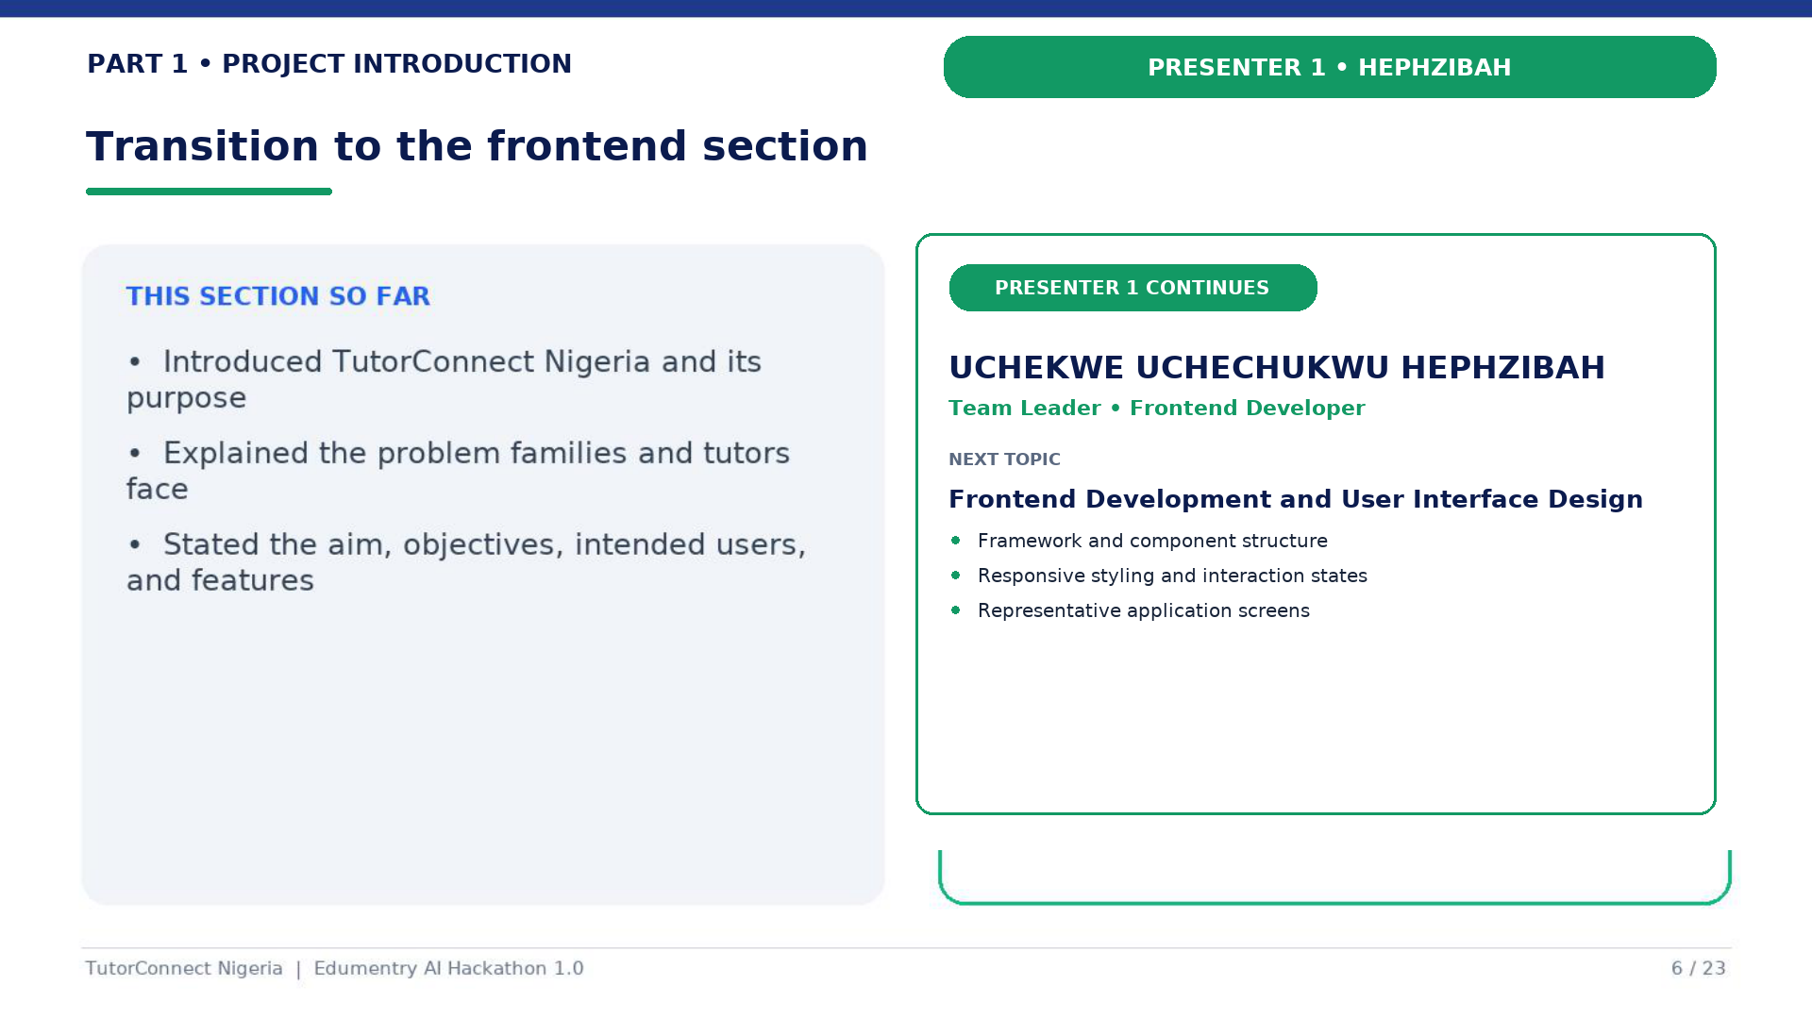
Notes:
Presenter: Uchekwe Uchechukwu Hephzibah. Summarise the introduction in one sentence: the project addresses discovery, trust and coordination through a connected web platform. Then continue—this is not a handover. Exact transition: “With the problem, users, and project aim established, I will now move into the frontend implementation and show how the interface supports those goals.”

Slide 7
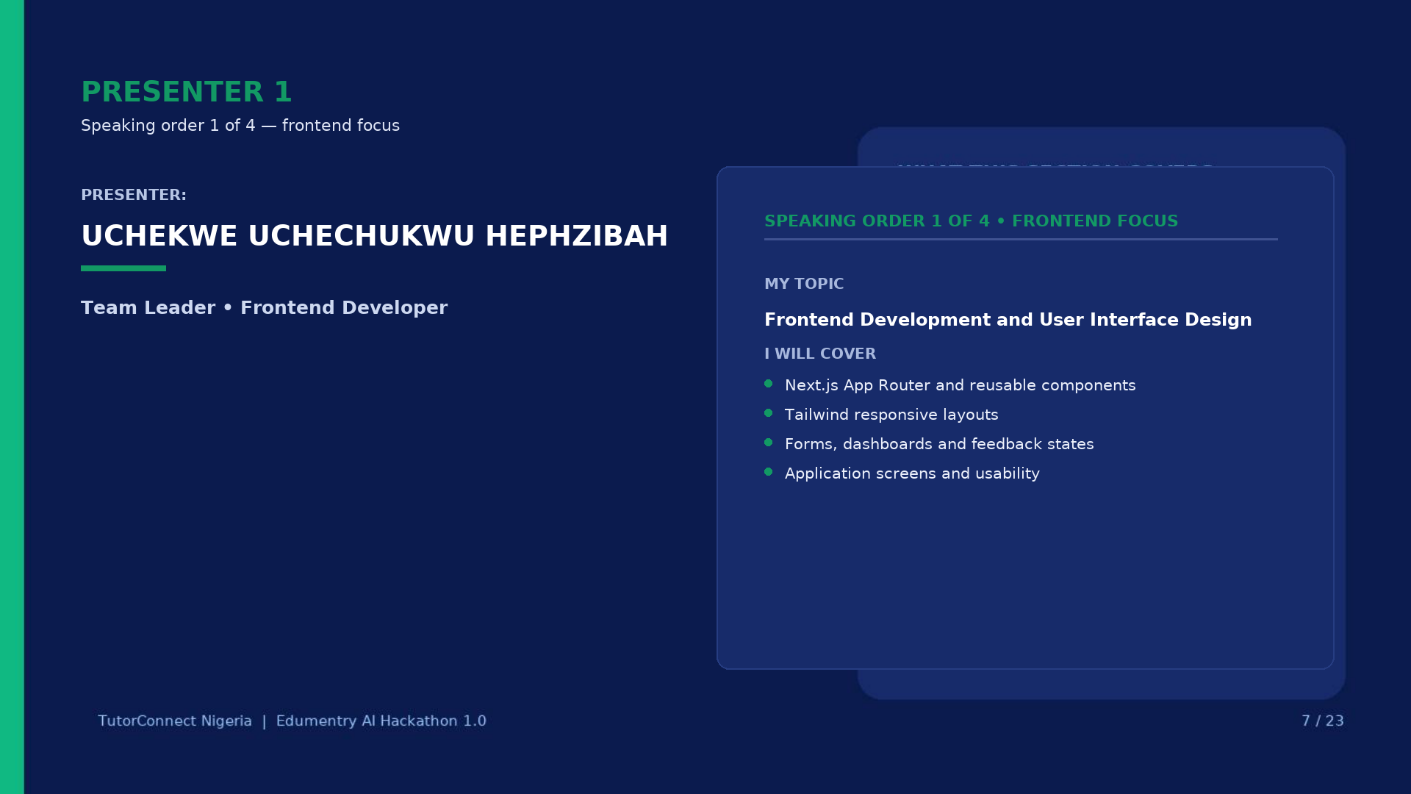
Notes:
Presenter: Uchekwe Uchechukwu Hephzibah. Open the frontend section by describing your responsibility for the interface and responsive user experience. Explain that frontend work includes page composition, reusable components, visual states, navigation and forms—not only visual styling. Preview the technology choices and representative screens shown on the next slides.

Slide 8
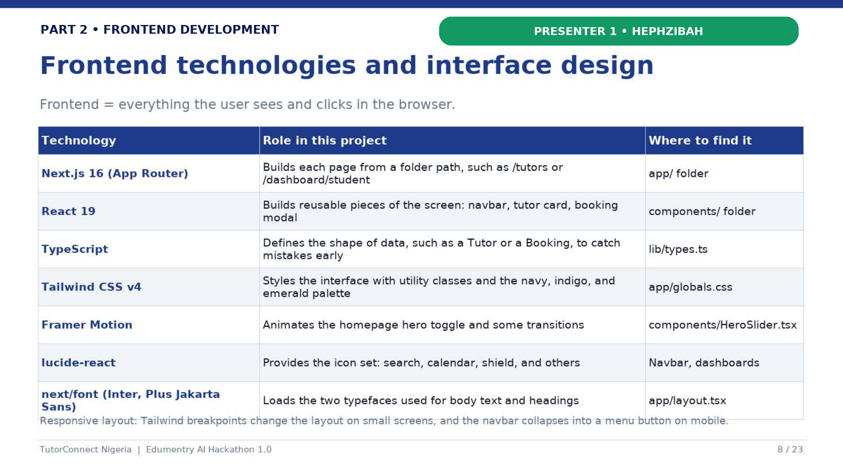
Notes:
Presenter: Uchekwe Uchechukwu Hephzibah. Explain why the selected frontend technologies suit the project. Next.js supplies routing and application structure; React components support reuse; TypeScript reduces type-related mistakes; Tailwind CSS enables consistent responsive styling; and Framer Motion provides controlled interaction feedback. Mention that responsive breakpoints support mobile, tablet and desktop layouts.

Slide 9
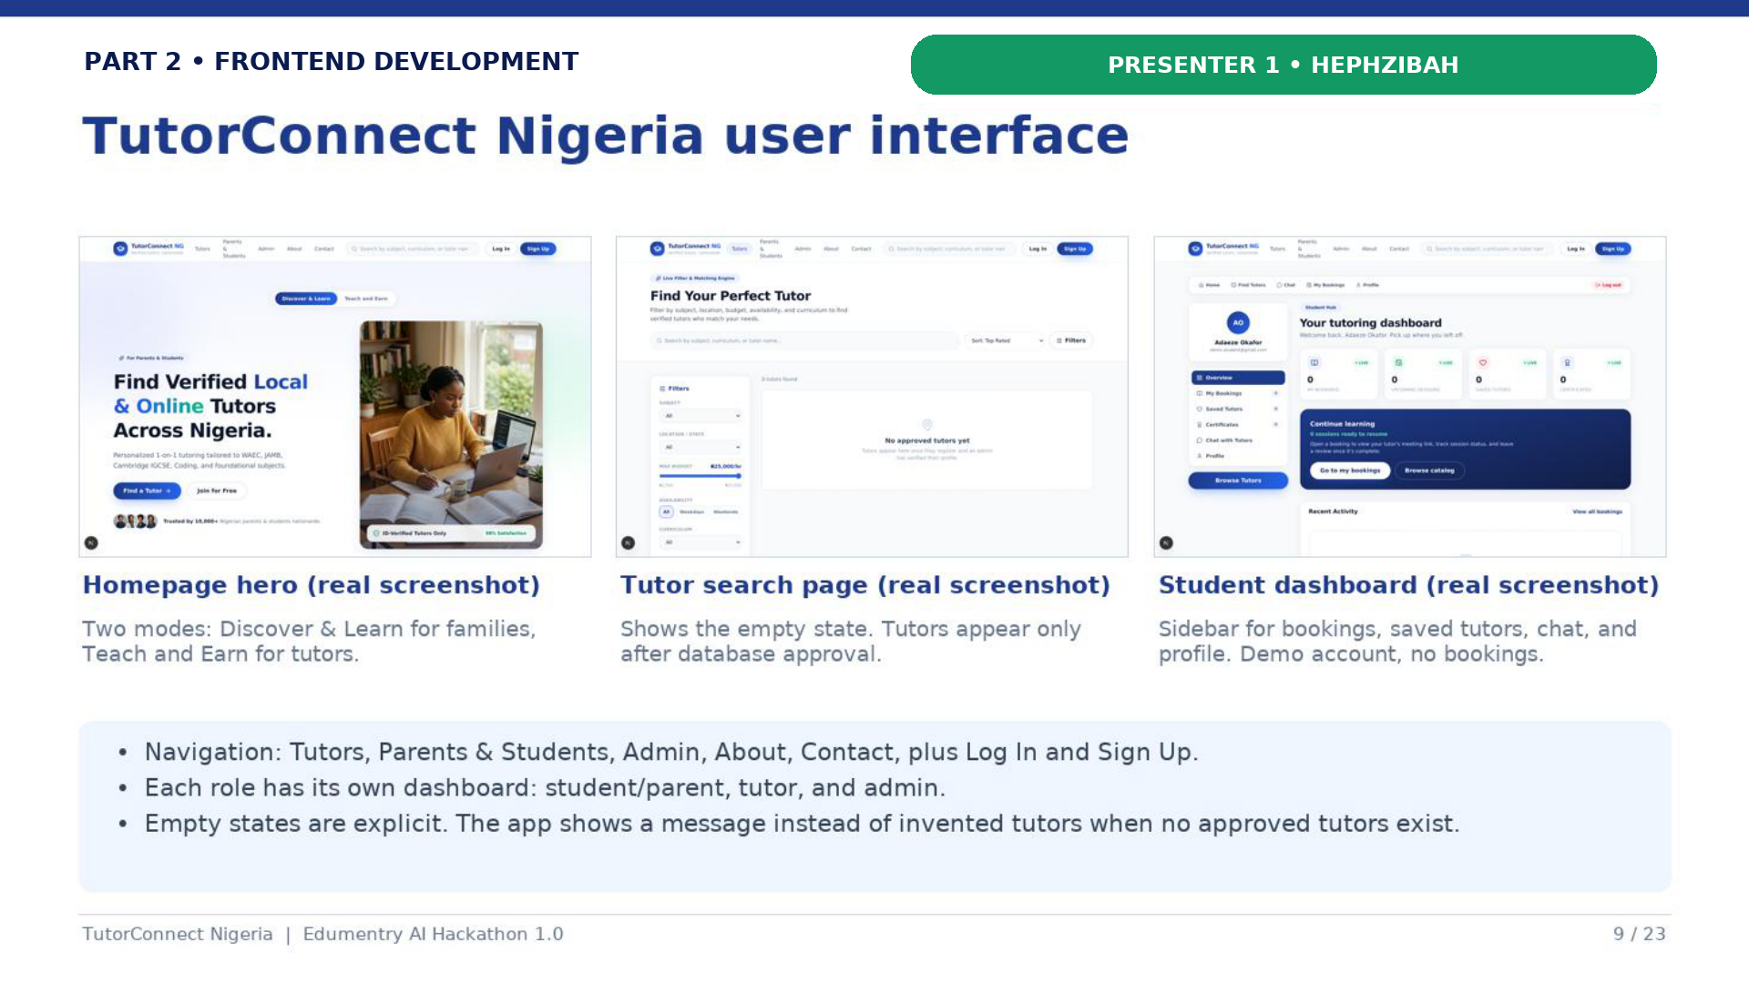
Notes:
Presenter: Uchekwe Uchechukwu Hephzibah. Use the screenshots as evidence of the interface rather than reading labels. Point out visual hierarchy, repeated navigation patterns, responsive cards, form feedback and dashboard organisation. Explain how the interface gives different user roles a focused experience while keeping the visual language consistent across the platform.

Slide 10
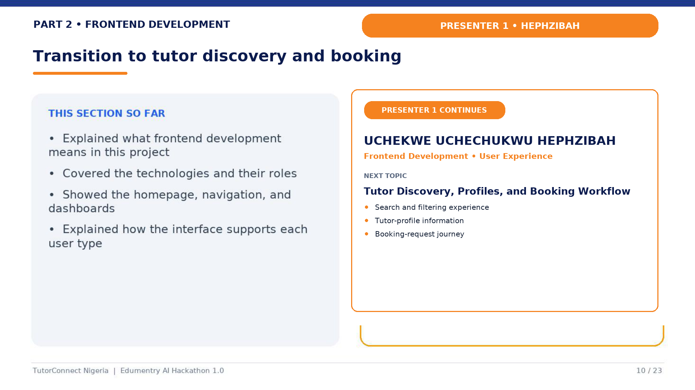
Notes:
Presenter: Uchekwe Uchechukwu Hephzibah. Close the general frontend overview, then continue into the two most important user journeys. Exact transition: “The interface foundation is now clear. I will continue by showing how a learner discovers a tutor, reviews the tutor's information, and moves into the booking-request workflow.”

Slide 11
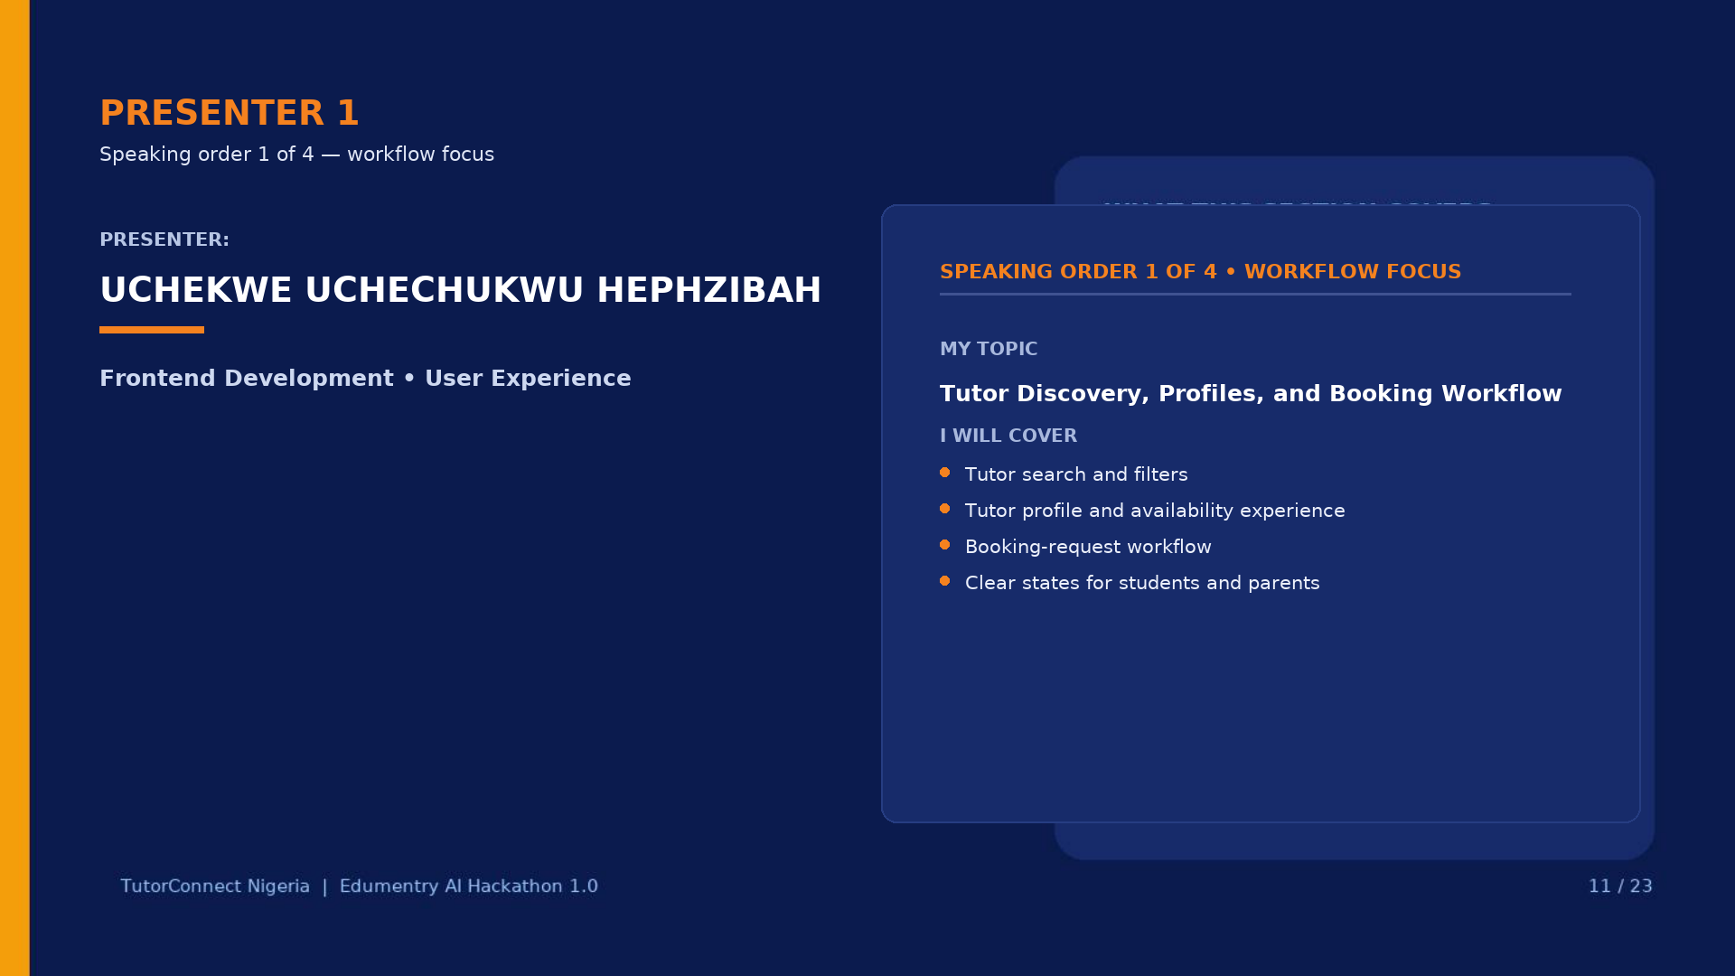
Notes:
Presenter: Uchekwe Uchechukwu Hephzibah. Introduce tutor discovery and booking as the practical connection between interface design and user goals. Explain that this subsection follows the journey in sequence: find suitable tutors, evaluate a profile and availability, then submit a booking request. Do not describe booking as payment; it is a request and status-management workflow.

Slide 12
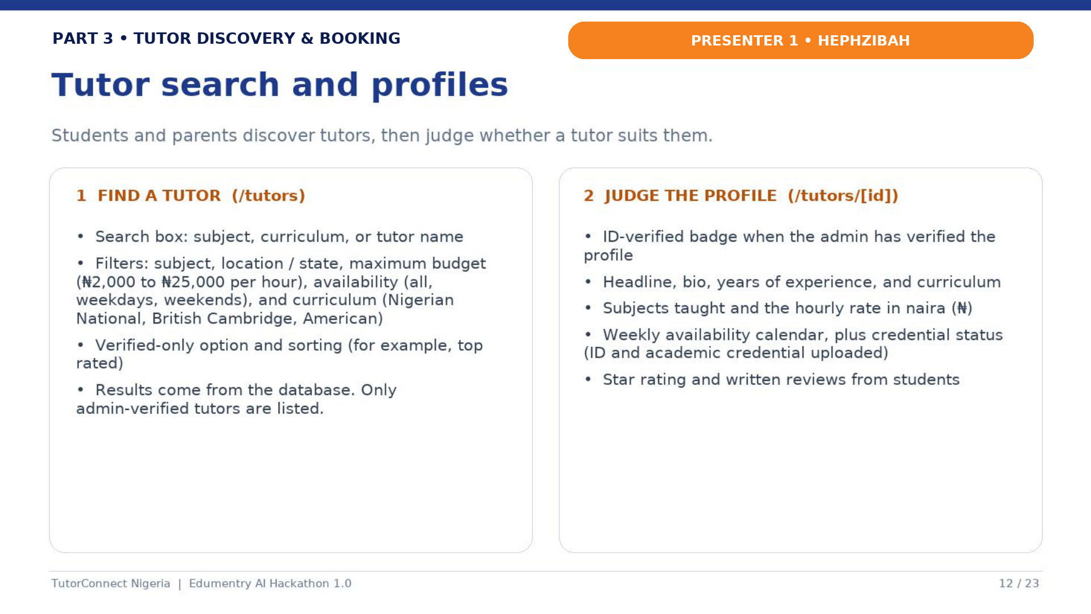
Notes:
Presenter: Uchekwe Uchechukwu Hephzibah. Explain how subject, location, teaching mode and related filters narrow the tutor list. Show that a profile should provide enough context for comparison, including subjects, rate, experience, verification status and availability where present. Note that search and filtering should remain clear on small screens, not only desktop.

Slide 13
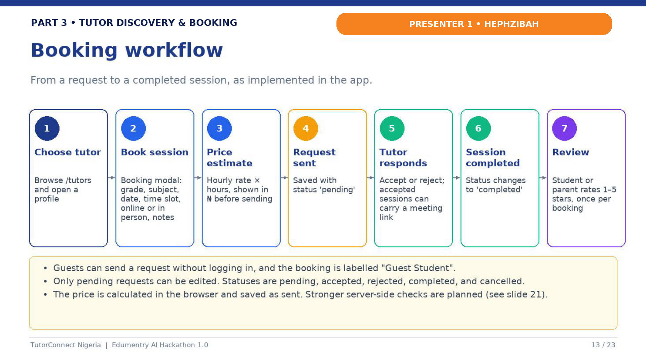
Notes:
Presenter: Uchekwe Uchechukwu Hephzibah. Walk through the booking flow in order: the learner selects details, the interface validates input, the API receives the request and the booking receives a status. Explain that tutors can accept or decline and that dashboards surface state changes. Be precise that the current application does not process an online payment during this flow.

Slide 14
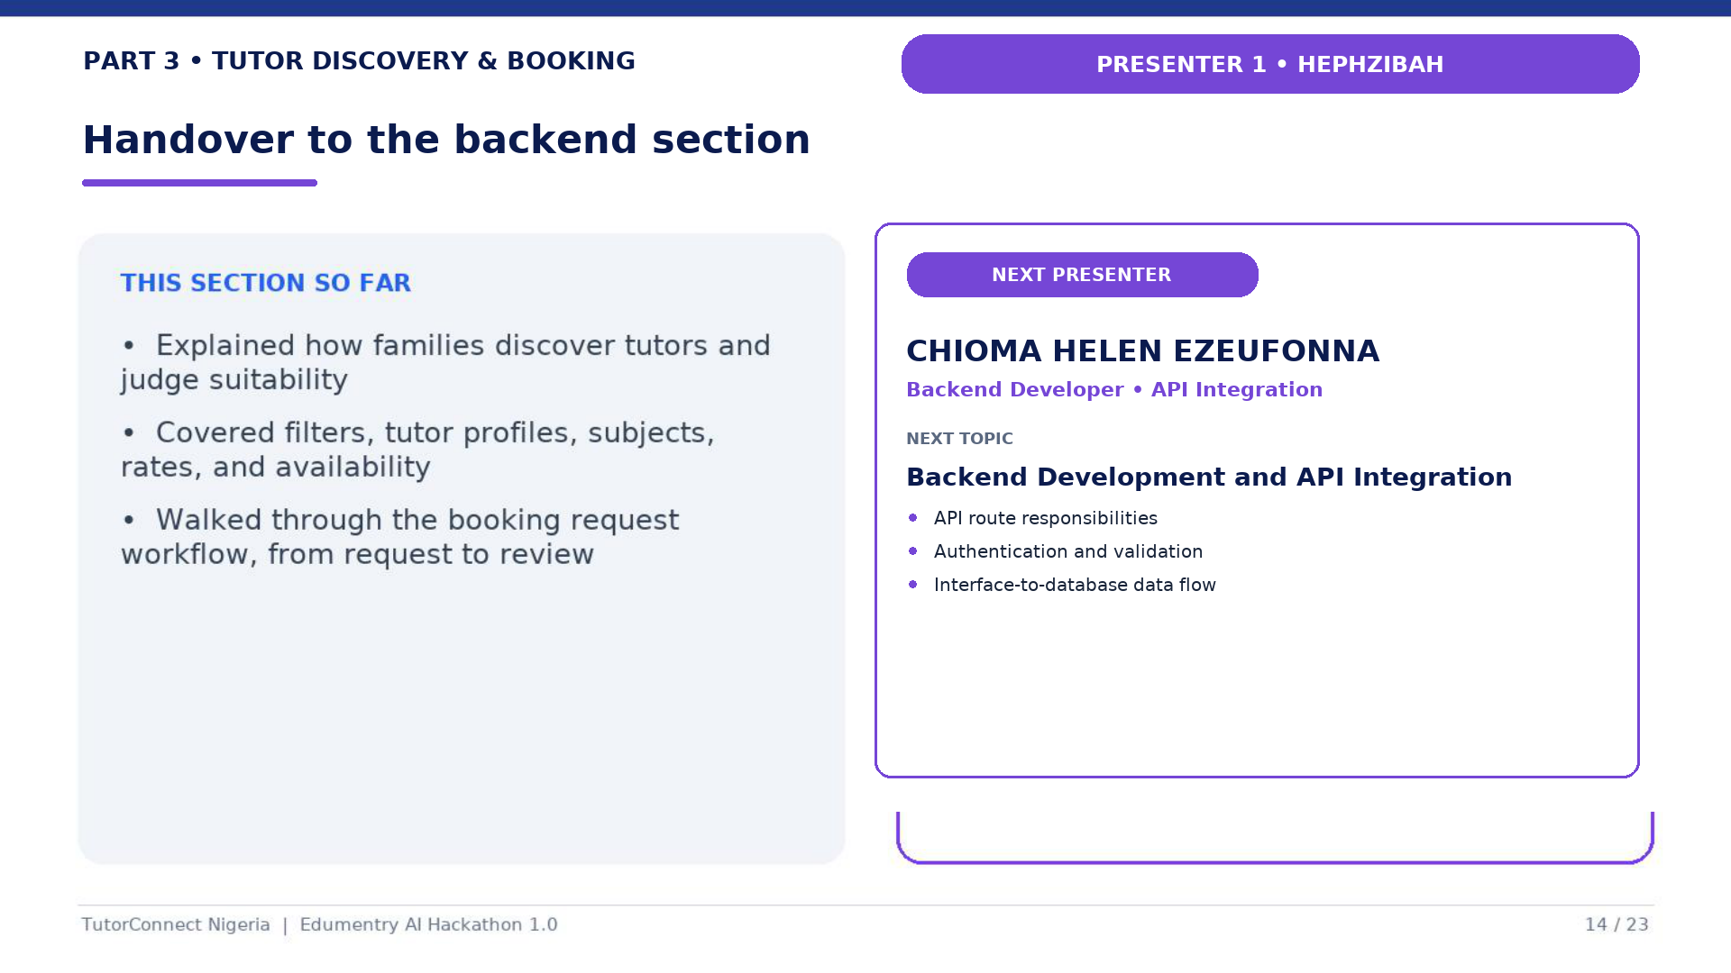
Notes:
Presenter: Uchekwe Uchechukwu Hephzibah. Summarise the frontend and workflow contribution: users can discover tutors, view relevant information and create a booking request through a responsive interface. Then make the handover exactly: “That concludes my introduction, frontend development, and user-workflow section. I will now hand over to Chioma Helen Ezeufonna, who will explain the backend development and API integration.”

Slide 15
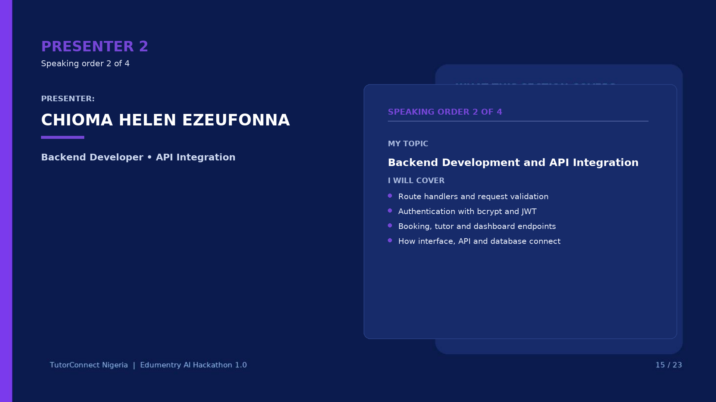
Notes:
Presenter: Chioma Helen Ezeufonna. Begin by defining the backend as the layer that validates requests, applies application rules and coordinates data access. Explain your responsibility for backend development and API integration. Preview authentication, tutor data, booking operations and the flow from interface requests to database responses.

Slide 16
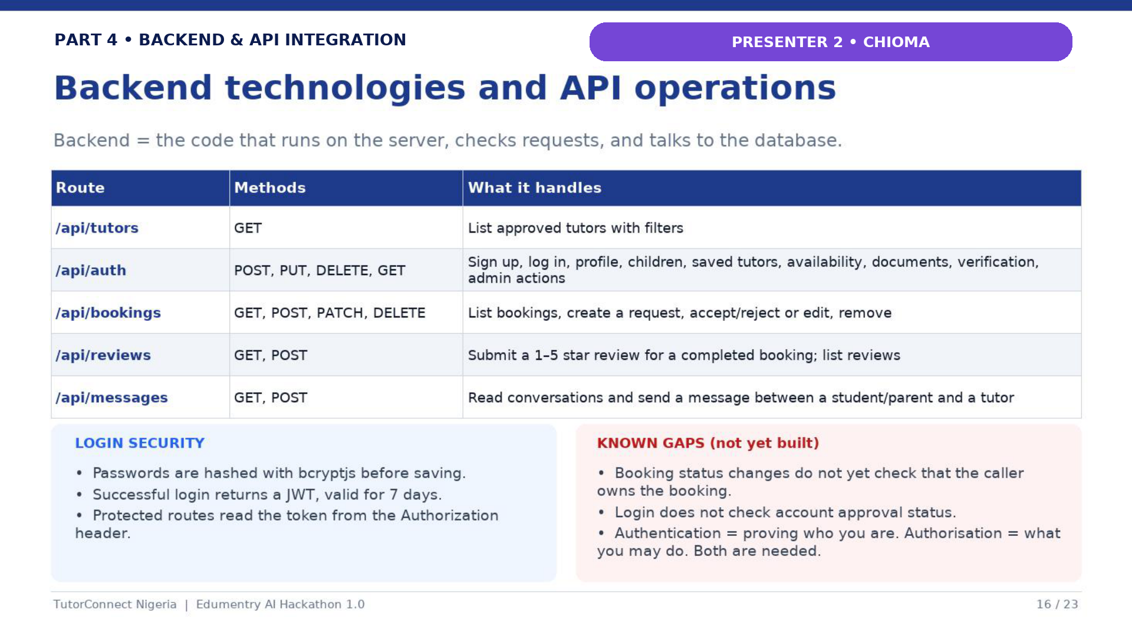
Notes:
Presenter: Chioma Helen Ezeufonna. Describe the API routes by responsibility rather than reciting every path. Explain that authentication routes handle account actions, tutor routes provide discovery data, booking routes create and update requests, and dashboard-related routes assemble user-specific information. Mention that route handlers return structured JSON and use appropriate HTTP methods.

Slide 17
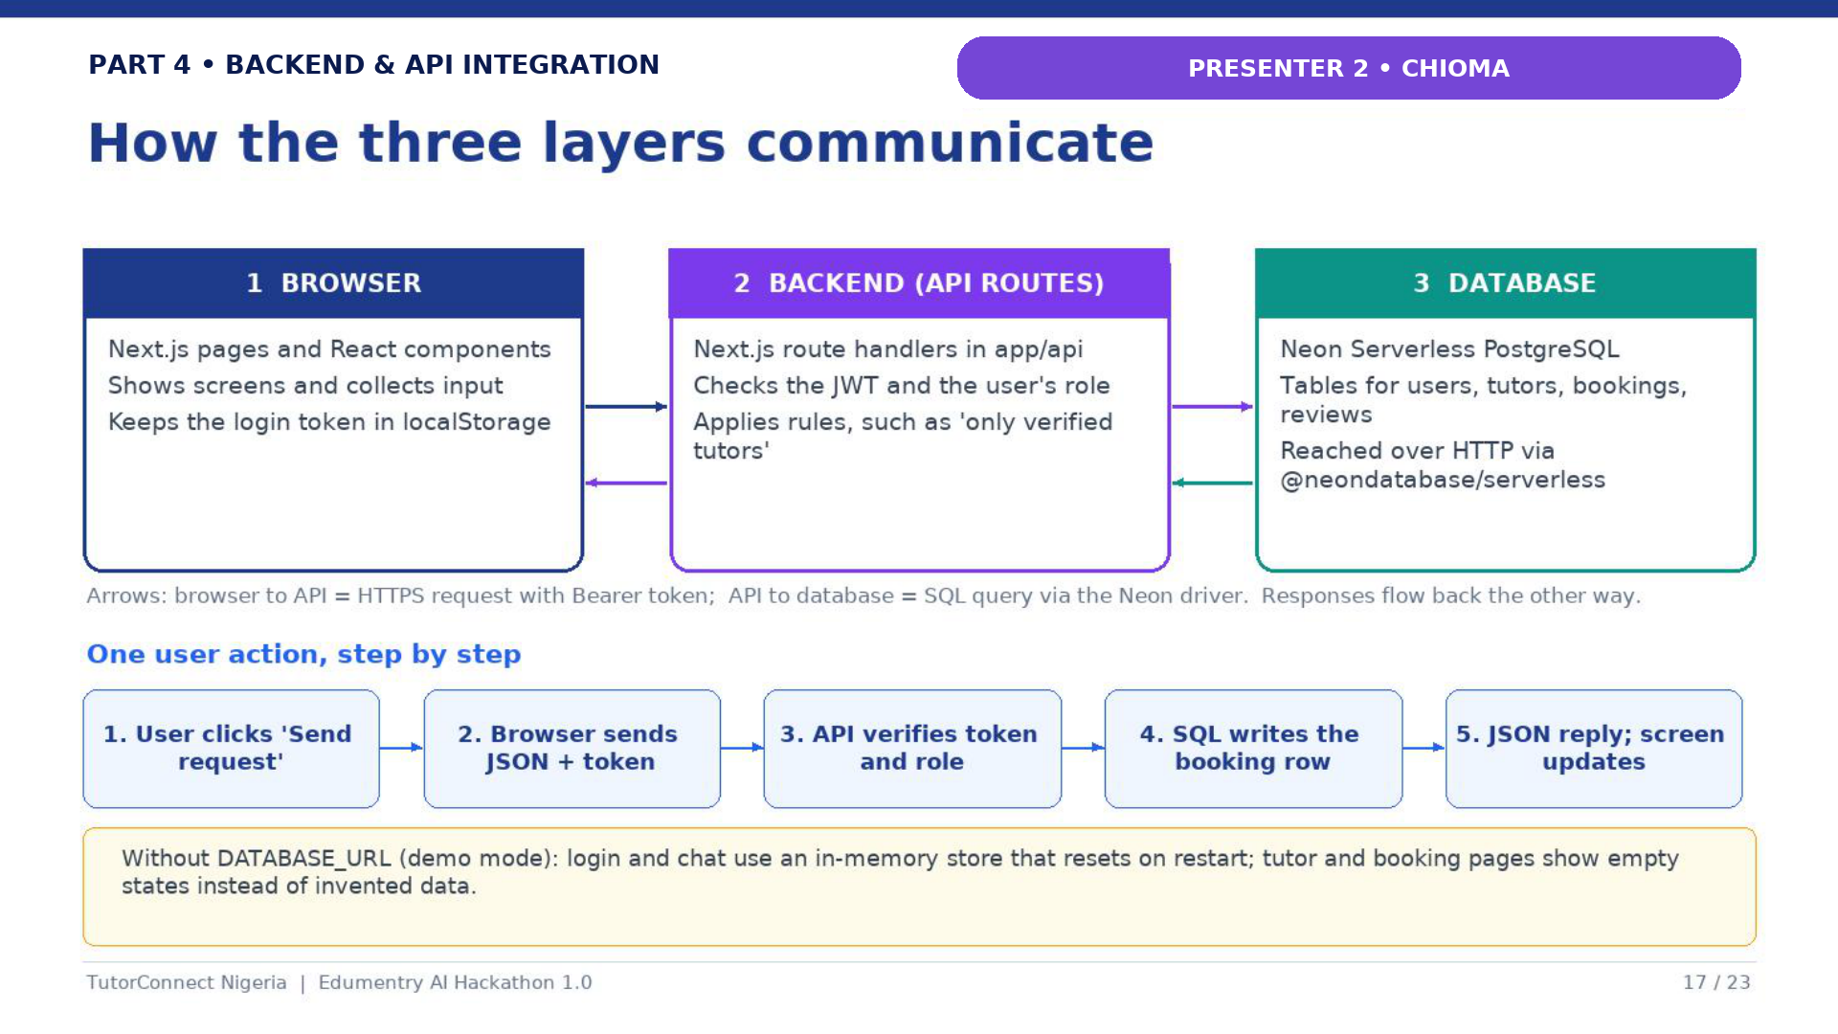
Notes:
Presenter: Chioma Helen Ezeufonna. Follow one request through the three layers: a user action starts in the browser, a Next.js route validates and authorises the request, and the database stores or retrieves the relevant record. Explain that bcrypt protects passwords and JWTs identify authenticated users. Also acknowledge that stronger server-side role and ownership enforcement is part of the improvement plan.

Slide 18
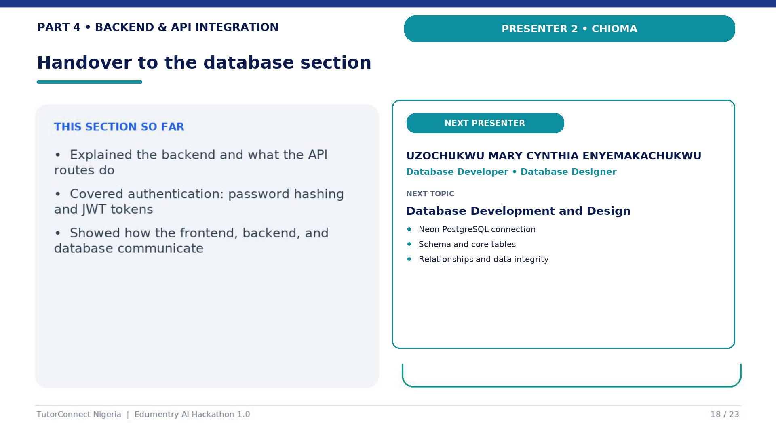
Notes:
Presenter: Chioma Helen Ezeufonna. Summarise how the API connects the interface to persistent data and where authentication participates. Then make the handover exactly: “That concludes the backend development and API integration section. I will now hand over to Uzochukwu Mary Cynthia Enyemakachukwu, who will explain the database development, schema, and relationships.”

Slide 19
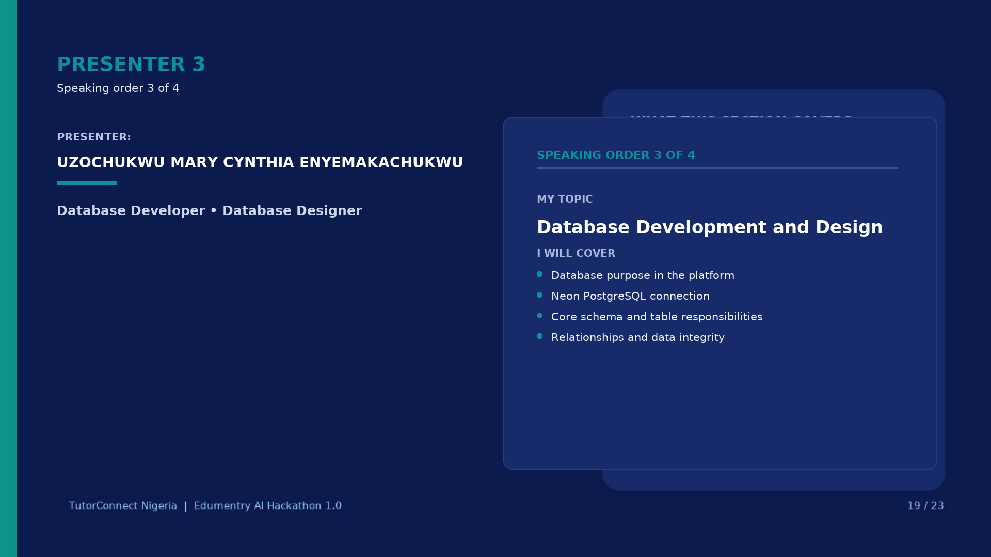
Notes:
Presenter: Uzochukwu Mary Cynthia Enyemakachukwu. Introduce the database as the persistence layer behind users, tutor details, availability, bookings, conversations and reviews. Explain your responsibility for database development and design. State that Neon PostgreSQL supplies the hosted relational database and that the schema is designed around clear relationships between marketplace entities.

Slide 20
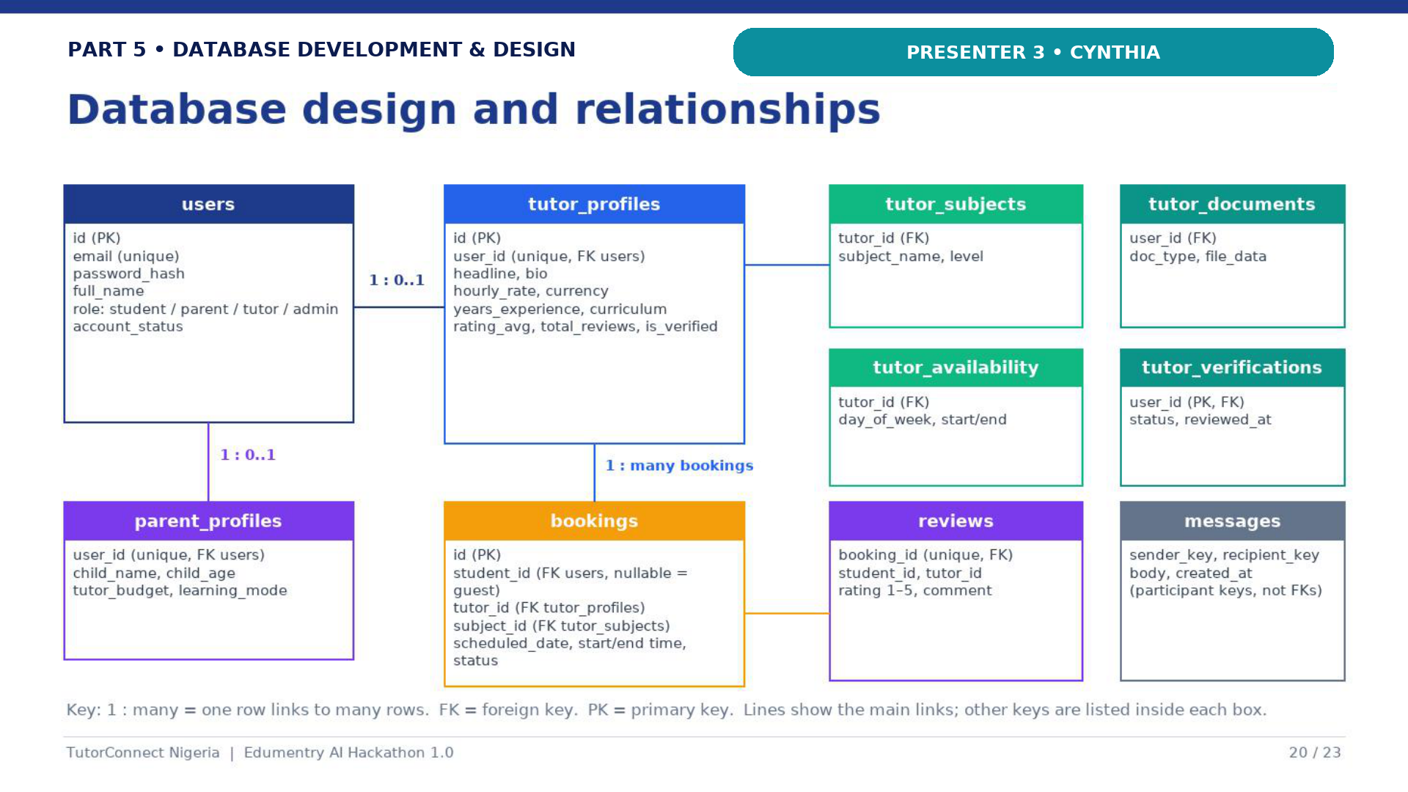
Notes:
Presenter: Uzochukwu Mary Cynthia Enyemakachukwu. Explain the schema from the user outward: a user may have tutor-specific profile data; tutors have subjects and availability; learners create bookings; bookings can relate to reviews and communication records. Point out primary and foreign keys and why relational integrity matters. Do not reveal connection strings or environment values. Close with the exact handover: “That completes the database development and design section. I will now hand over to Bodman Ebuka Precous for deployment and system inspection.”

Slide 21
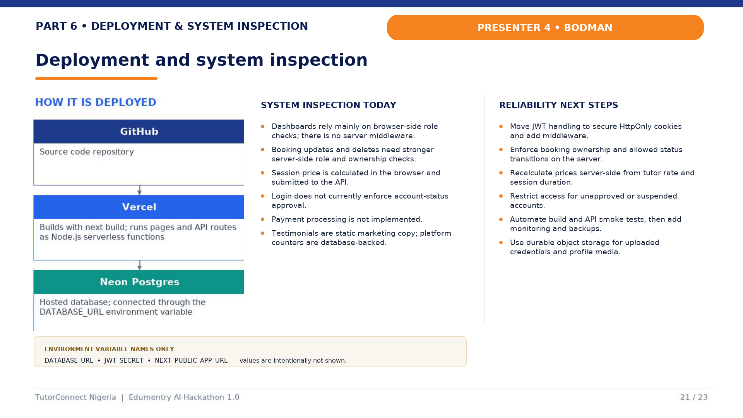
Notes:
Presenter: Bodman Ebuka Precous. Explain the deployment path from the Git repository to Vercel and the environment-variable names without exposing values. Then present the inspection findings candidly: browser-side dashboard checks are not a substitute for server middleware; booking changes need role and ownership checks; price should be recalculated server-side; login should enforce account status; and payment processing is not implemented. Clarify that platform counters are database-backed while testimonials remain static marketing content. End with the exact return: “That concludes deployment and system inspection. I will now hand the presentation back to our team leader, Uchekwe Uchechukwu Hephzibah, for the proposed revenue model and conclusion.”

Slide 22
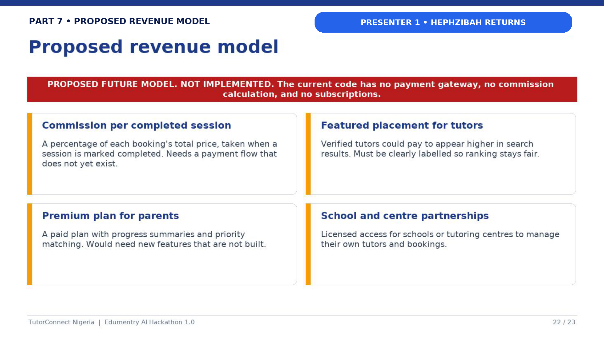
Notes:
Presenter: Uchekwe Uchechukwu Hephzibah. Explicitly introduce this as a proposed business model, not implemented functionality. Explain the three possible future streams—commission on completed sessions, optional tutor subscriptions and institutional partnerships—only as options for later product development. State clearly that the current application does not process payments, collect commissions or charge subscriptions. Note that implementation would require payment integration, policy design, reconciliation, security and compliance work.

Slide 23
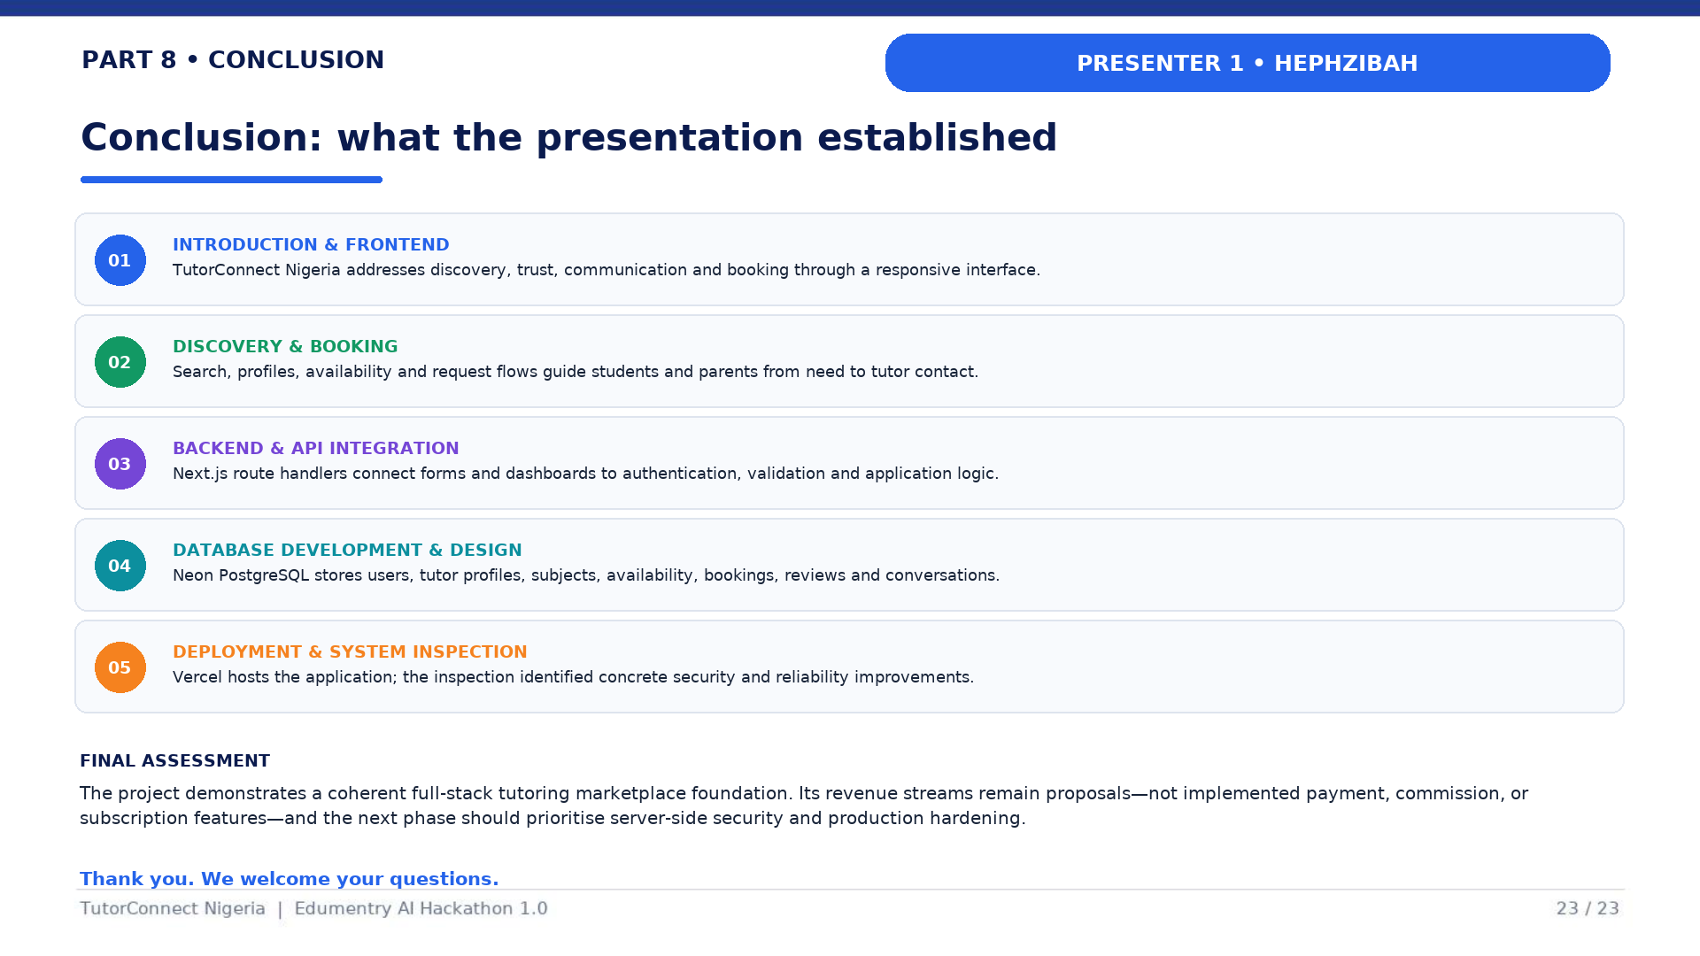
Notes:
Presenter: Uchekwe Uchechukwu Hephzibah. Conclude by connecting the sections: a responsive frontend supports discovery and booking requests; APIs coordinate application logic; Neon PostgreSQL persists marketplace data; and Vercel provides deployment. Acknowledge the documented hardening priorities. Reiterate that revenue streams are proposals, not current features. Thank the audience, invite questions and direct technical questions to the teammate responsible for the relevant section.

