Slide 1

TutorConnect Nigeria
Uchekwe Uchechukwu Hephzibah
Chioma Helen Ezeufonna
Uzochukwu Mary Cynthia Enyemakachukwu
Bodman Ebuka Precous
Edumentry AI Hackathon 1.0
Notes:
Presenter: Uchekwe Uchechukwu Hephzibah — Team Leader and Frontend Developer
Suggested time: 45 seconds
Speaking script:
Good day, everyone. We are presenting TutorConnect Nigeria, a full-stack education-technology marketplace designed to help Nigerian students and parents discover verified local or online tutors and manage the tutoring journey in one place. This project was developed for Edumentry AI Hackathon 1.0. Our current four-member team is listed on the slide. I am Uchekwe Uchechukwu Hephzibah, the team leader and frontend developer. Chioma Helen Ezeufonna developed and will explain the backend; Uzochukwu Mary Cynthia Enyemakachukwu will present the database; and Bodman Ebuka Precous will explain deployment.
Visual cue:
Point to the two learner-and-tutor images as the two sides of the marketplace, then acknowledge all four team members.
Transition:
I will begin by showing how our presentation is organised and when each member will speak.

Slide 2
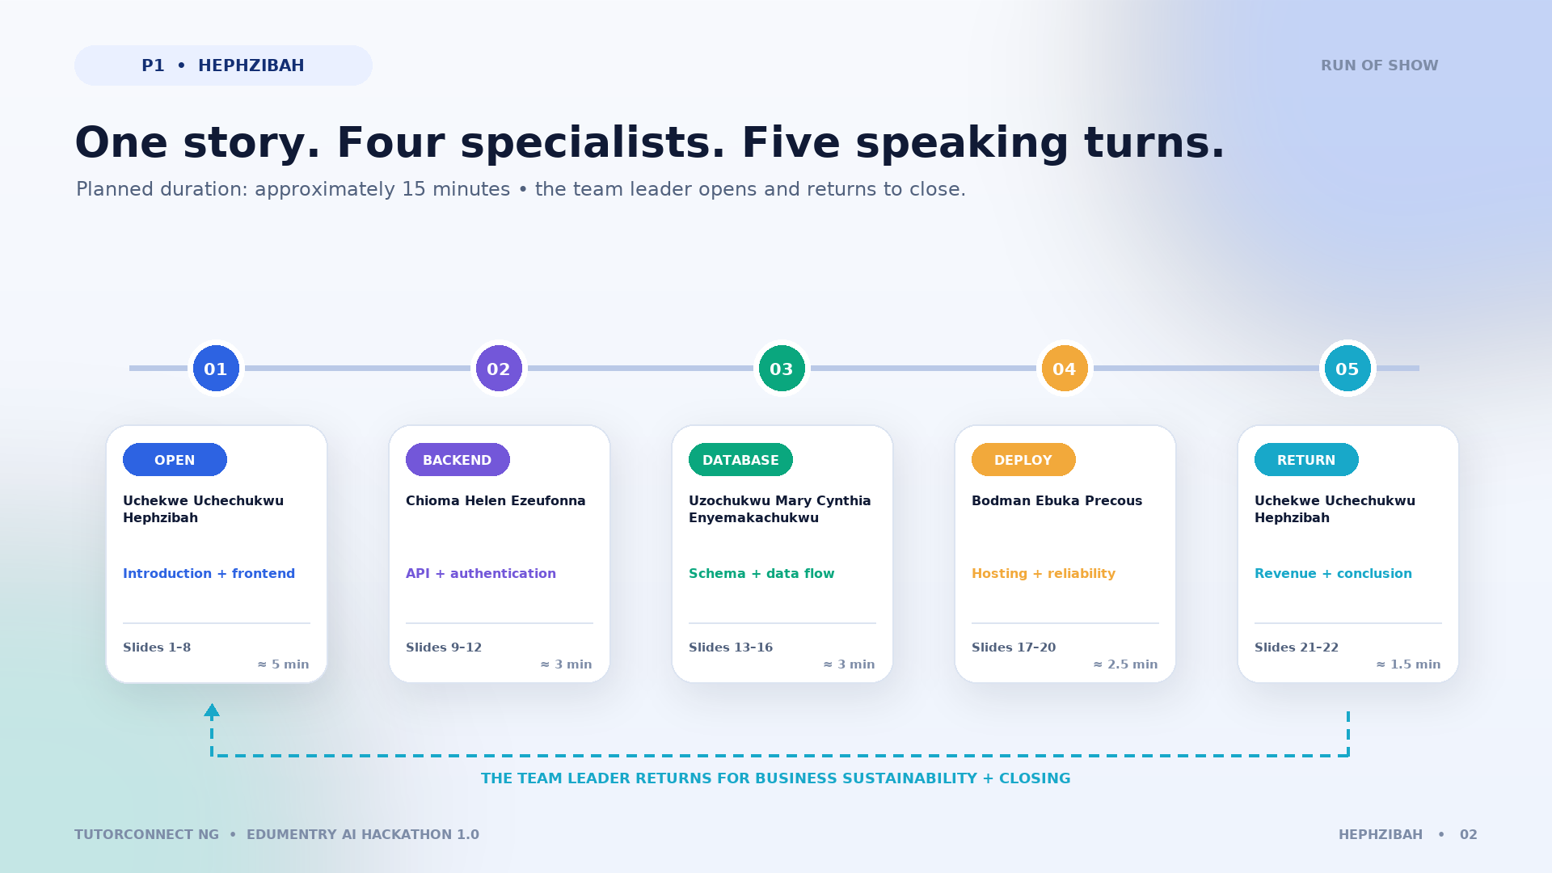
Presentation agenda
1 Uchekwe Uchechukwu Hephzibah introduction and frontend; 2 Chioma Helen Ezeufonna backend; 3 Uzochukwu Mary Cynthia Enyemakachukwu database; 4 Bodman Ebuka Precous deployment; 5 Uchekwe Uchechukwu Hephzibah proposed revenue and conclusion.
Notes:
Presenter: Uchekwe Uchechukwu Hephzibah — Team Leader and Frontend Developer
Suggested time: 50 seconds
Speaking script:
Our presentation follows the same order as the application layers. I will first introduce the problem, users, features, frontend technologies, and actual interface. I will then hand over to Chioma Helen Ezeufonna for the backend and API integration. Chioma will hand over to Uzochukwu Mary Cynthia Enyemakachukwu for database design. Cynthia will then hand over to Bodman Ebuka Precous for deployment and reliability. After the technical sections, Bodman will return the presentation to me for the proposed revenue model, sustainability, and conclusion. The planned total is about fifteen minutes, with slightly more time for the opening and frontend demonstration.
Visual cue:
Trace the numbered route from one to five and emphasise that the team leader returns at the end.
Transition:
Let me now begin Presenter One's opening section.

Slide 3
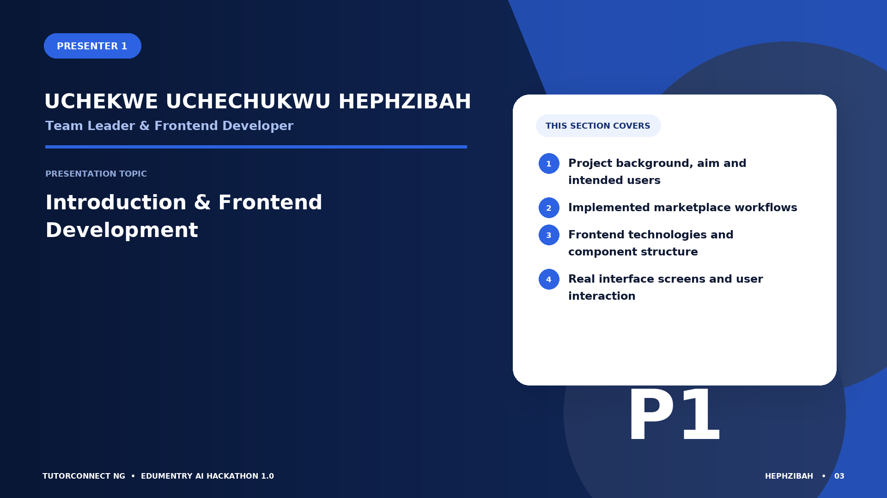
Presenter 1: Uchekwe Uchechukwu Hephzibah
Team Leader & Frontend Developer — Introduction & Frontend Development — Project background, aim and intended users; Implemented marketplace workflows; Frontend technologies and component structure; Real interface screens and user interaction
Notes:
Presenter: Uchekwe Uchechukwu Hephzibah — Team Leader and Frontend Developer
Suggested time: 35 seconds
Speaking script:
I am Uchekwe Uchechukwu Hephzibah, the team leader and frontend developer. In this opening section, I will explain the problem TutorConnect Nigeria addresses, its aim and objectives, the people who use it, and the major implemented workflows. I will then explain the frontend stack and show real screens captured from the application running locally. My responsibility is to connect the project idea to the experience users can see and interact with.
Visual cue:
Use the section roadmap on the right to preview the five topics without reading every word mechanically.
Transition:
We start with the challenge faced by learners and parents when searching for a suitable tutor.

Slide 4
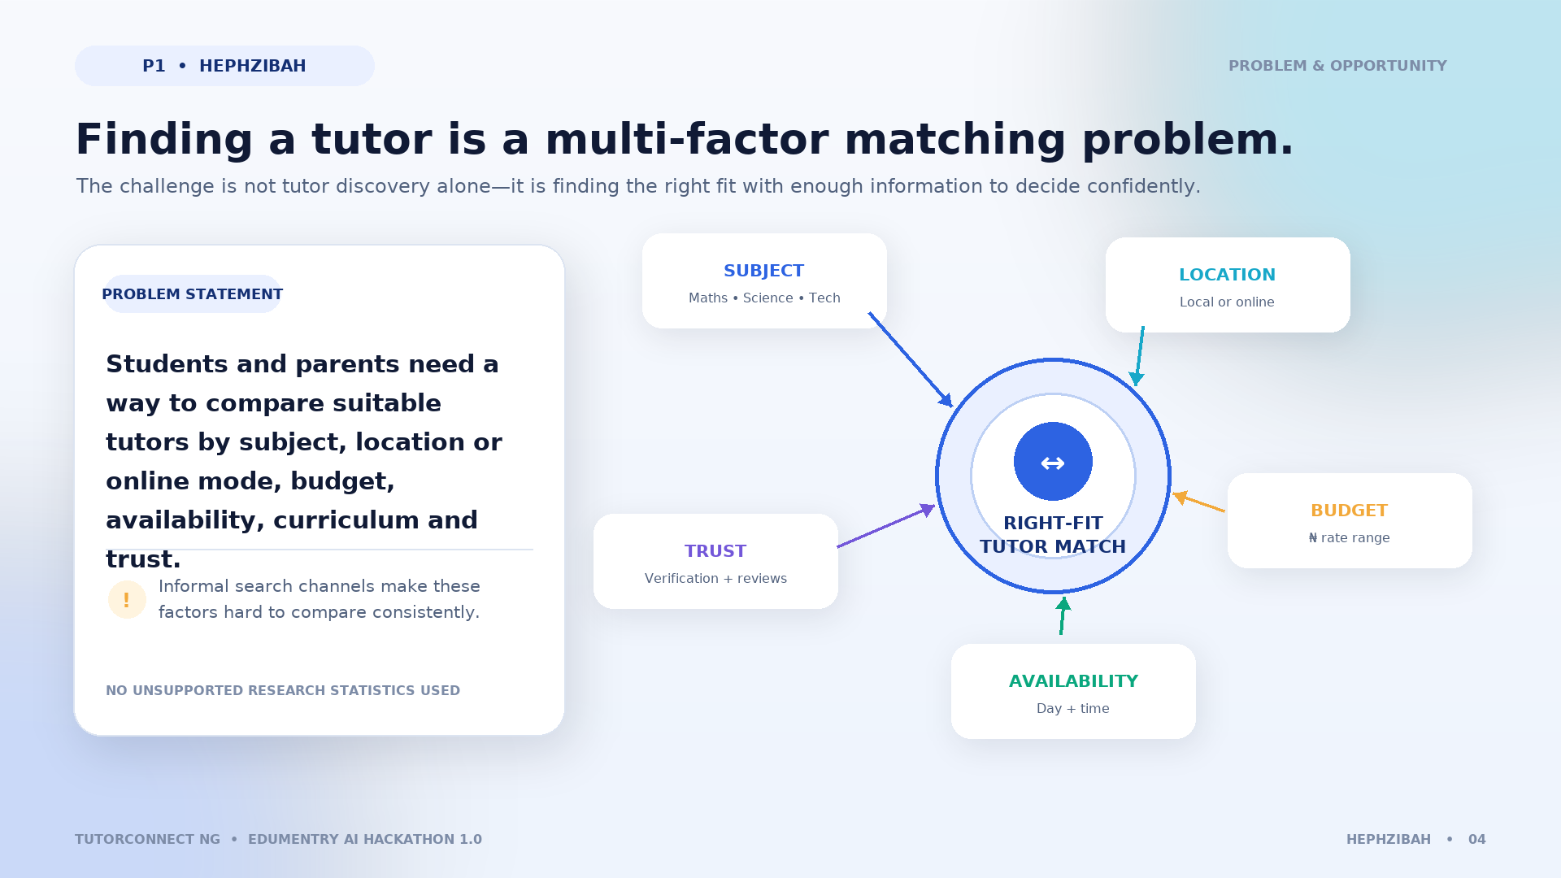
Project background and problem statement
Learners need to match subject, location or online mode, budget, availability, curriculum, and trust. TutorConnect Nigeria structures the comparison without inventing research statistics.
Notes:
Presenter: Uchekwe Uchechukwu Hephzibah — Team Leader and Frontend Developer
Suggested time: 65 seconds
Speaking script:
The project begins with a practical matching problem. A student or parent may need a tutor for a specific subject, but subject knowledge alone is not enough. The tutor must also fit the learner's location or online preference, budget, available days and times, curriculum, and trust requirements. Searching through informal contacts makes those factors difficult to compare consistently. TutorConnect Nigeria brings them into one guided experience: users can search and filter, view verified profiles and availability, request a session, and track the request. This slide states a design problem rather than a research statistic; we are not claiming a measured national percentage.
Visual cue:
Move clockwise through the five matching factors and finish at the central learner–tutor connection.
Transition:
From that problem, we defined a focused aim, clear users, and implementable objectives.

Slide 5
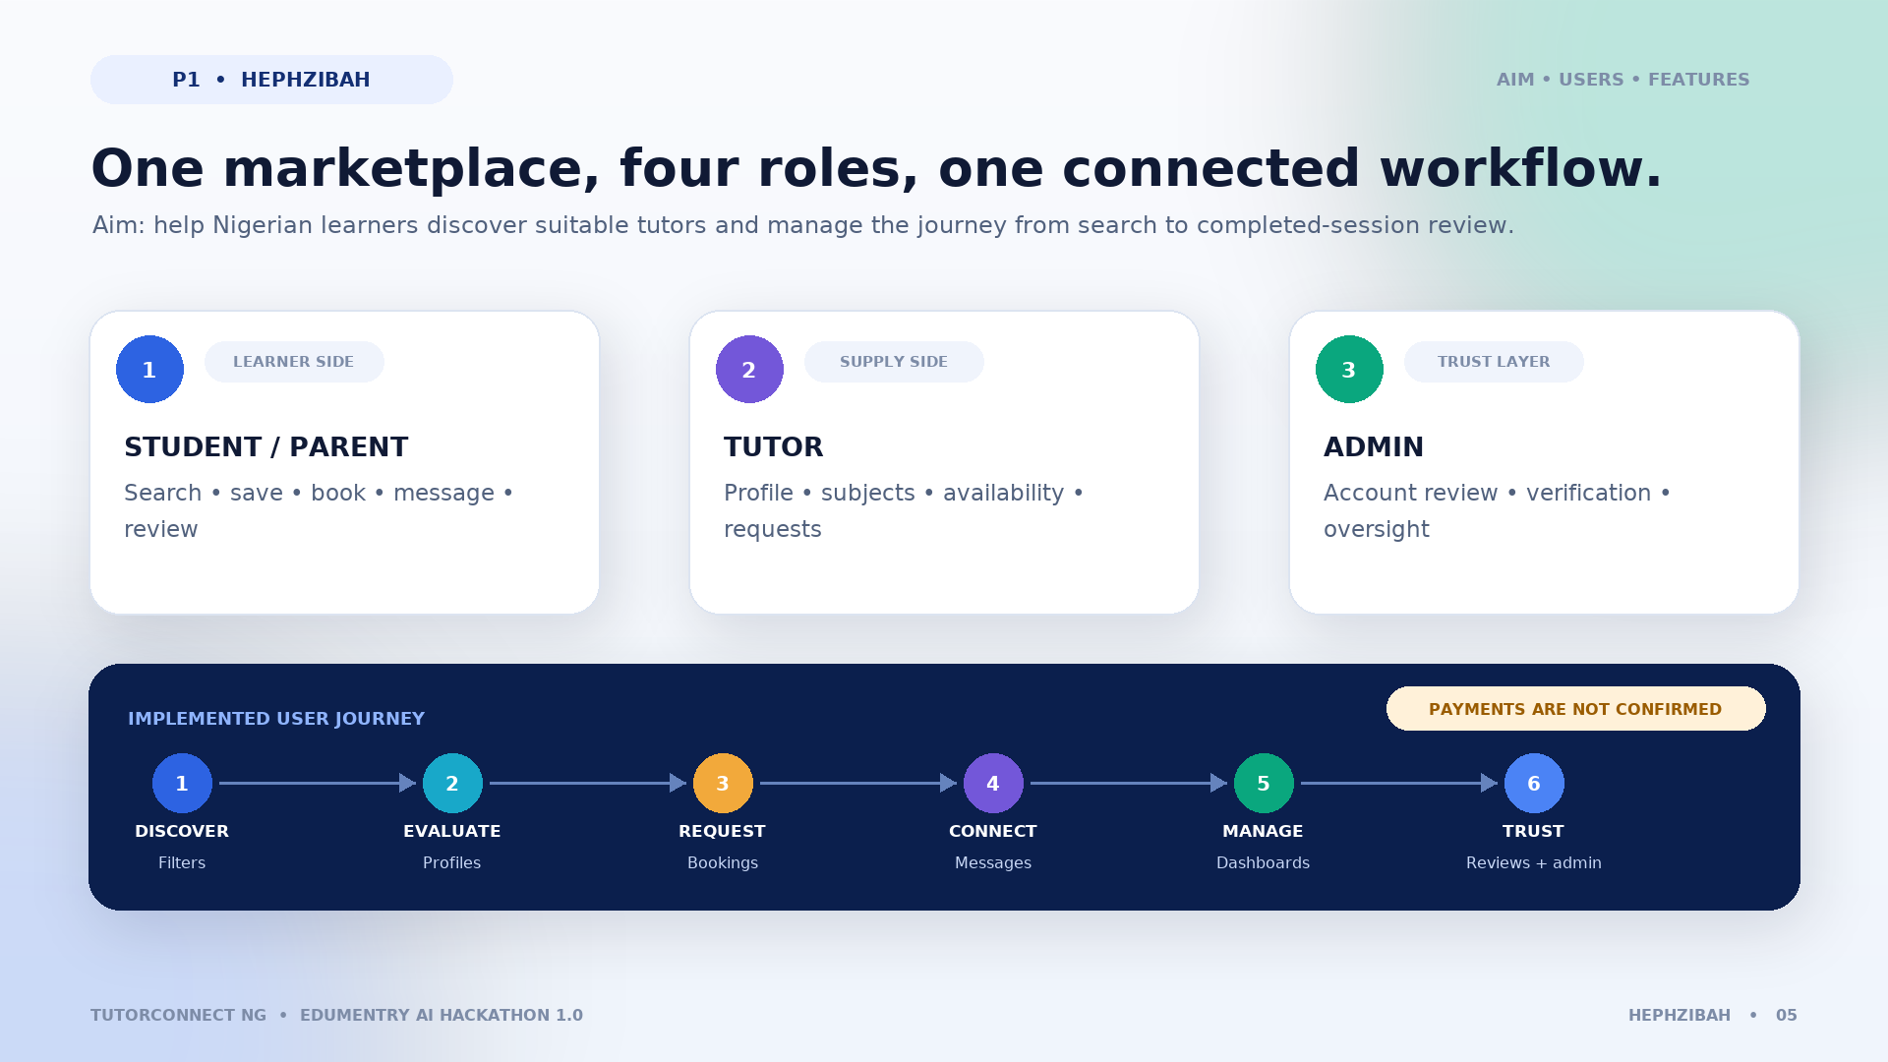
Aim, objectives, users, and major features
Users: students and parents, tutors, administrators. Implemented: role-based signup and dashboards, filters, profiles, booking, messages, reviews, verification. Payments are not confirmed.
Notes:
Presenter: Uchekwe Uchechukwu Hephzibah — Team Leader and Frontend Developer
Suggested time: 80 seconds
Speaking script:
The aim is to provide a structured marketplace where Nigerian learners can discover suitable tutors and manage tutoring requests. Students and parents search, save tutors, make bookings, message tutors, and review completed sessions. Tutors create profiles, state subjects and availability, upload verification documents, and respond to requests. Administrators review accounts and credentials, approve or suspend tutors, and monitor platform activity. In the current implementation, the major workflows include role-based signup and dashboards, filtering by subject, location, budget, availability and curriculum, tutor profiles, booking status management, private messaging, reviews, and admin verification. Online payment collection is not part of the confirmed current implementation and will appear later only as a proposal.
Visual cue:
Explain the three user groups first, then point to the feature strip across the bottom as the shared workflow.
Transition:
Next, I will show the technologies and navigation structure that turn these workflows into a usable interface.

Slide 6
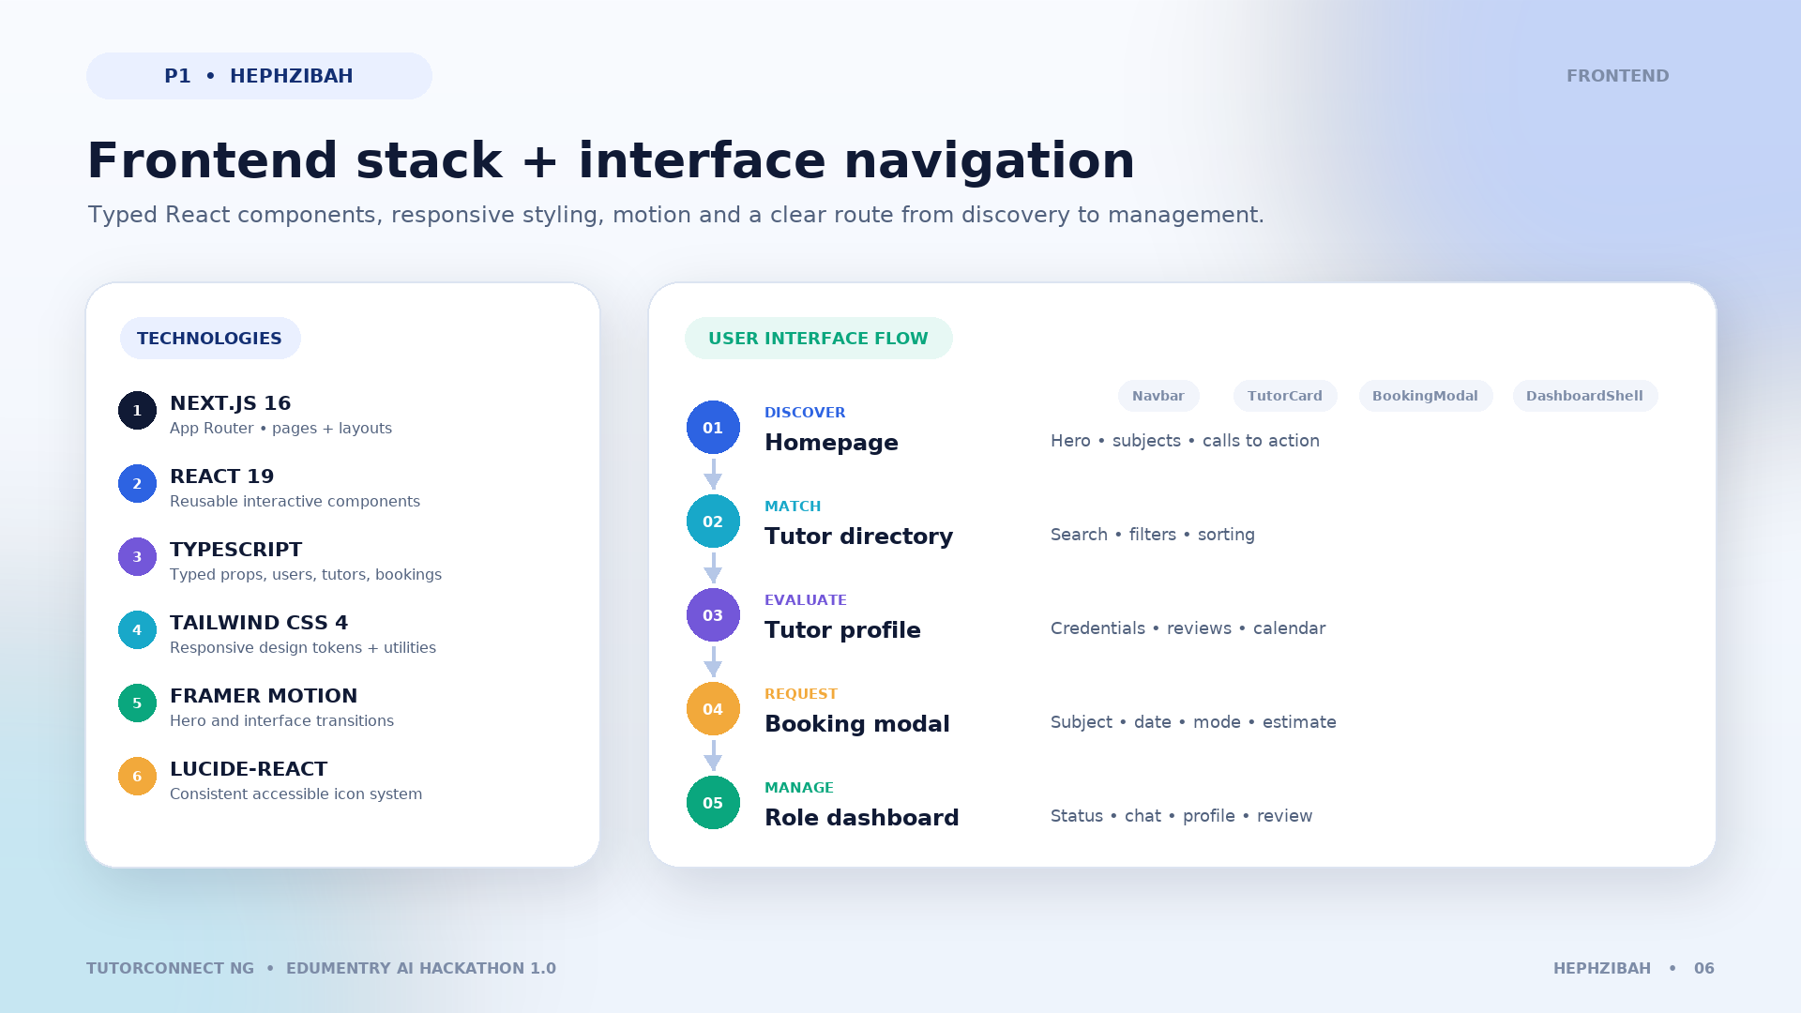
Frontend technologies and user interface
Next.js 16 App Router, React 19, TypeScript, Tailwind CSS v4, Framer Motion, lucide-react. Navigation: homepage to tutor directory to profile to booking to role dashboard.
Notes:
Presenter: Uchekwe Uchechukwu Hephzibah — Team Leader and Frontend Developer
Suggested time: 75 seconds
Speaking script:
The frontend uses Next.js 16 with the App Router as the application framework, React 19 for component-based interfaces, and TypeScript for typed data and safer development. Tailwind CSS version 4 provides the design system and responsive layouts. Framer Motion powers animated elements such as the changing hero, while lucide-react supplies consistent icons. The user journey begins on the homepage, continues to the filterable tutor directory and a tutor profile, then moves into the booking flow and the appropriate role dashboard. Shared components such as the Navbar, TutorCard, BookingModal, DashboardShell, and PrivateChat help keep the interface consistent.
Visual cue:
Read the technology stack from left to right, then trace the navigation arrows from Discover to Manage.
Transition:
The next slide shows what those components look like in the running application.

Slide 7
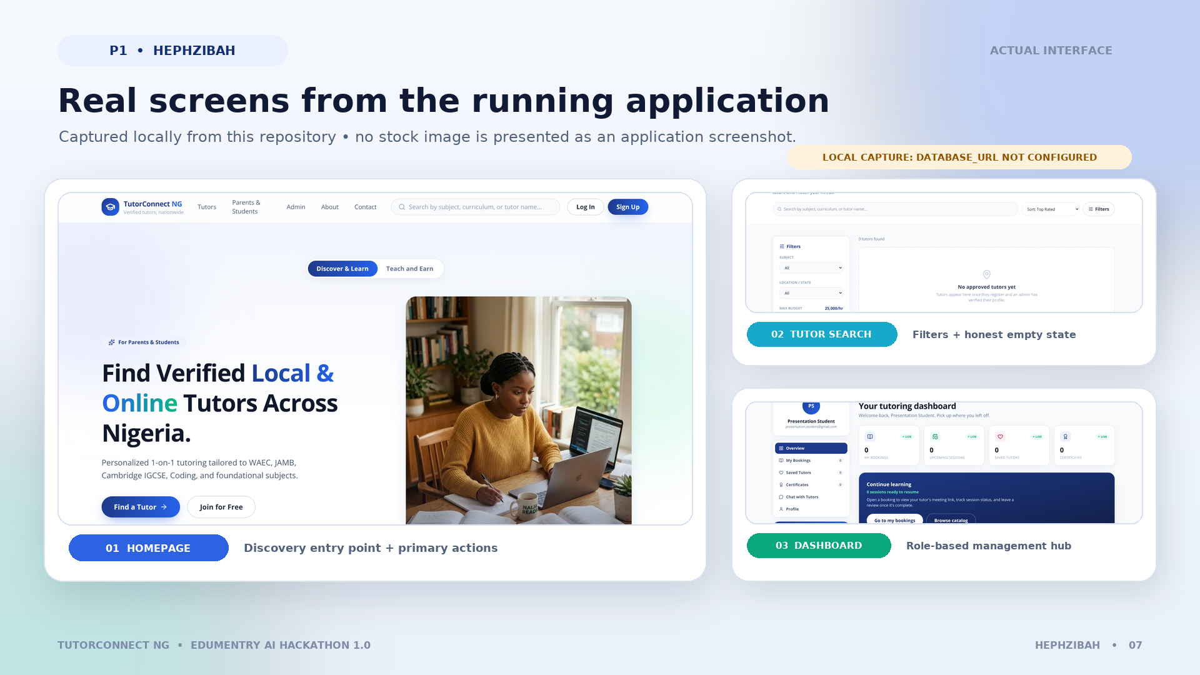
Actual TutorConnect Nigeria interface
Genuine local screenshots: homepage, tutor search with no approved tutors because database was not configured, and student dashboard after temporary local signup.
Notes:
Presenter: Uchekwe Uchechukwu Hephzibah — Team Leader and Frontend Developer
Suggested time: 85 seconds
Speaking script:
These are genuine screenshots captured from the current application running locally. The large screen is the homepage, with clear calls to find a tutor or join the platform. The tutor directory provides search, sorting, and filters for subject, location, budget, availability, curriculum, and verification. In this local capture, DATABASE_URL was intentionally not configured, so the directory correctly shows an explicit “No approved tutors yet” state instead of fabricated records. The dashboard screen was captured after creating a temporary local student account; it shows role-based navigation, booking counters, saved tutors, chat, and profile access. This demonstrates both the visual design and the application's honest empty-state behaviour.
Visual cue:
Discuss the homepage first, then the filter controls, and finish with the dashboard navigation.
Transition:
That completes my opening section on the project and frontend.

Slide 8
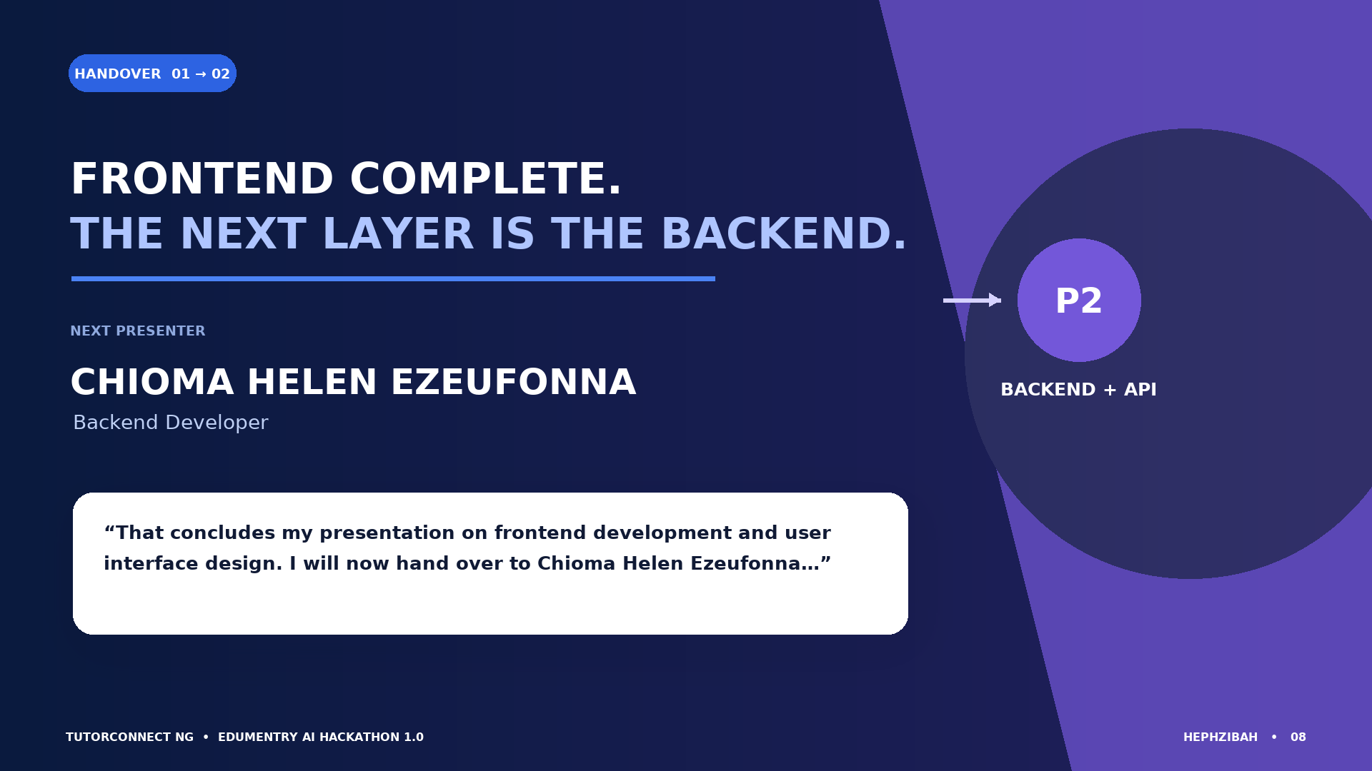
Handover to Chioma Helen Ezeufonna
Frontend complete. Next presenter: Chioma Helen Ezeufonna, Backend Developer. Exact handover is in speaker notes.
Notes:
Presenter: Uchekwe Uchechukwu Hephzibah — Team Leader and Frontend Developer
Suggested time: 15 seconds
Exact handover wording:
“That concludes my presentation on frontend development and user interface design. I will now hand over to Chioma Helen Ezeufonna, who will explain the backend technologies and API integration that support TutorConnect Nigeria.”
Visual cue:
Pause briefly after Chioma's name and invite her to begin.
Transition:
Chioma starts on the next slide.

Slide 9
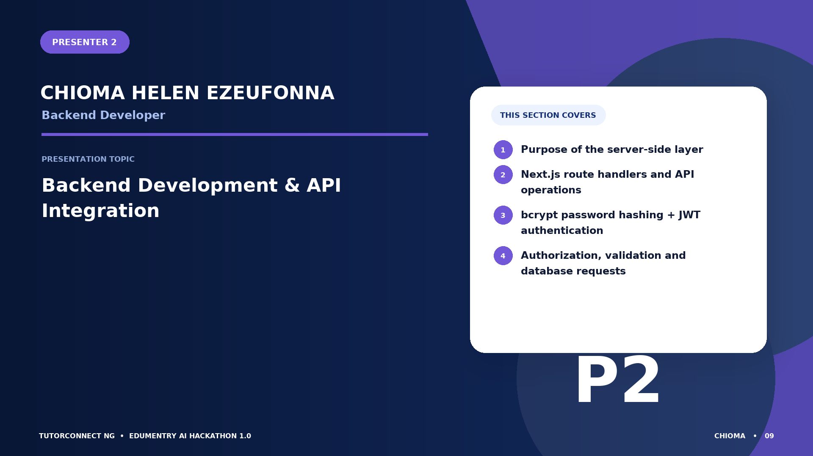
Presenter 2: Chioma Helen Ezeufonna
Backend Developer — Backend Development & API Integration — Purpose of the server-side layer; Next.js route handlers and API operations; bcrypt password hashing + JWT authentication; Authorization, validation and database requests
Notes:
Presenter: Chioma Helen Ezeufonna — Backend Developer
Suggested time: 35 seconds
Speaking script:
I am Chioma Helen Ezeufonna, the backend developer. My section explains what happens after a user clicks a button or submits a form. I will describe the Next.js API routes, how frontend requests reach those routes, how passwords are hashed, how JWT authentication identifies a user, how authorization restricts actions and records, and how tutor, booking, review, and messaging operations are processed.
Visual cue:
Use the four topic cards to preview the backend responsibilities.
Transition:
I will begin with the API surface and the main technologies used on the server side.

Slide 10
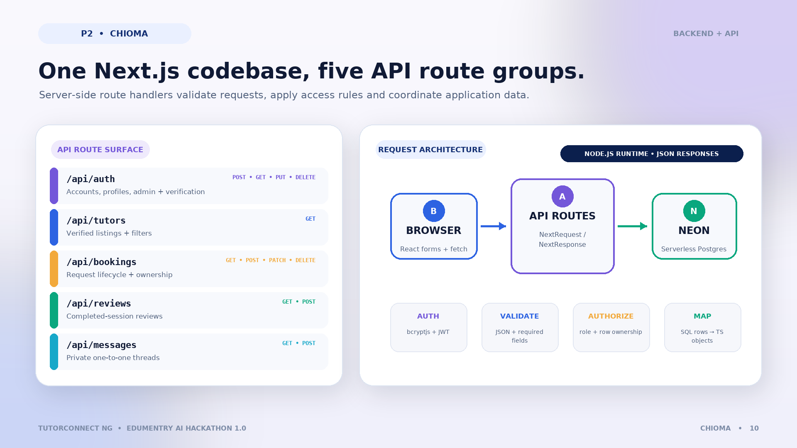
Backend technologies and API routes
Next.js route handlers: /api/auth, /api/tutors, /api/bookings, /api/reviews, /api/messages. bcryptjs, jsonwebtoken, NextRequest/NextResponse, Neon serverless client, Node.js runtime.
Notes:
Presenter: Chioma Helen Ezeufonna — Backend Developer
Suggested time: 80 seconds
Speaking script:
TutorConnect Nigeria uses Next.js API route handlers in the same repository as the frontend. The auth route supports login, signup, profile, admin, saved-tutor, child, availability, and verification actions through POST, GET, PUT, and DELETE handlers. The tutors route returns approved tutor listings and applies filters. The bookings route supports reading, creating, updating, and deleting booking requests. Reviews use GET and POST, while messages use GET and POST for private threads. Every route declares the Node.js runtime, which is compatible with bcryptjs and jsonwebtoken. Requests and responses use JSON, and database-enabled operations call Neon through the serverless SQL client.
Visual cue:
First explain the route matrix on the left, then follow the architecture across Browser, API routes, domain checks, and Neon.
Transition:
The most security-sensitive request is authentication, so the next slide follows that process step by step.

Slide 11
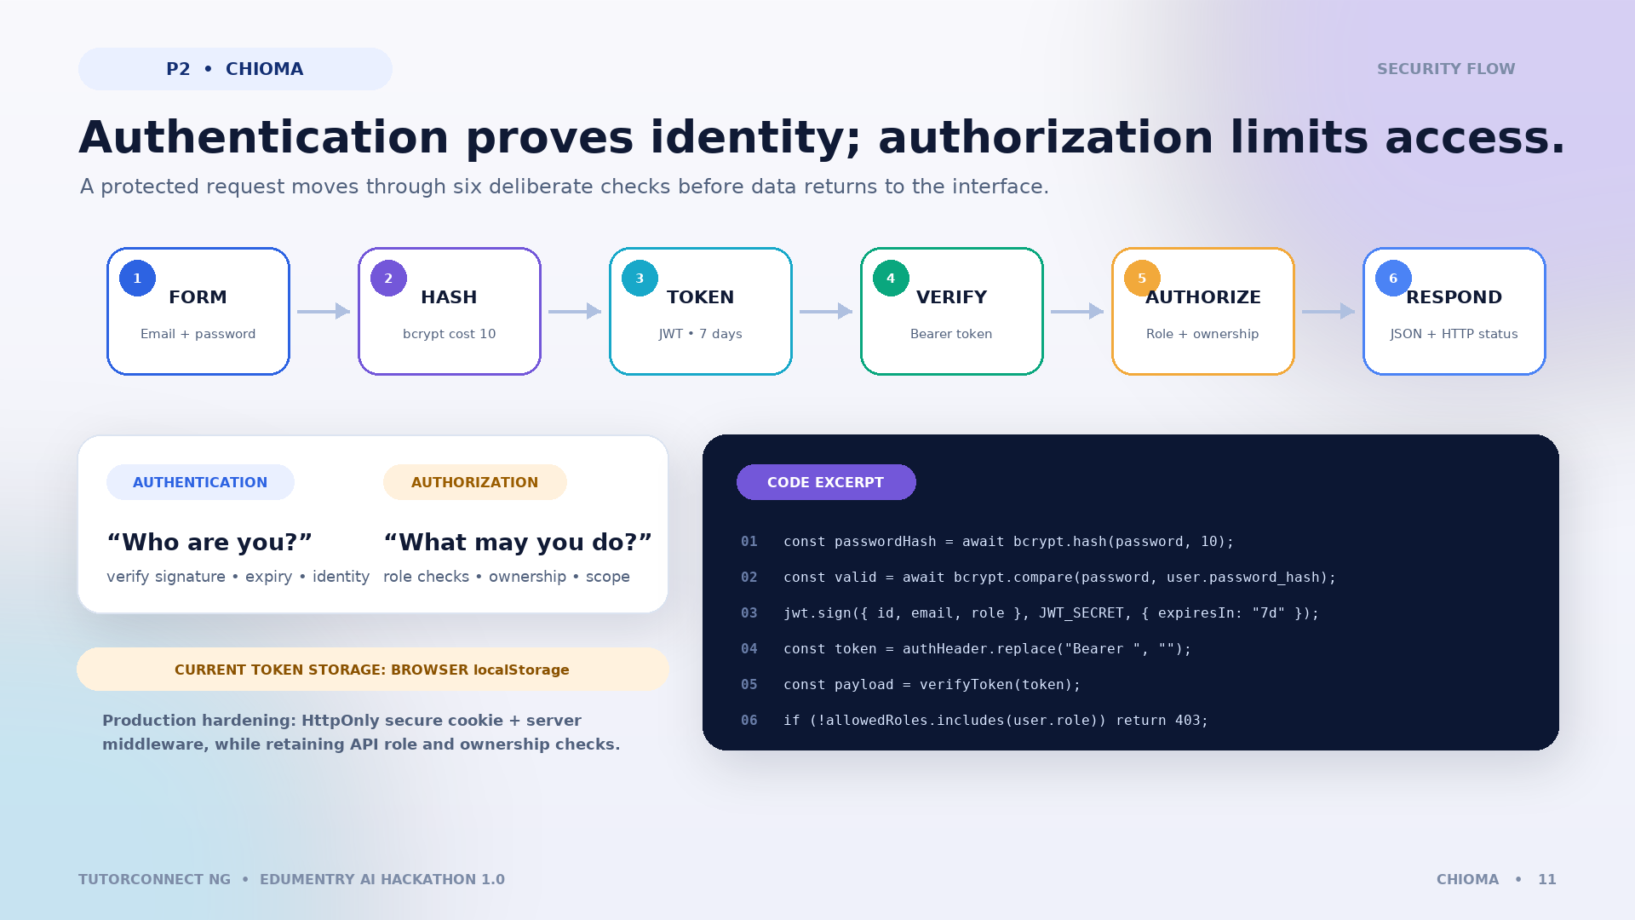
Authentication and request processing
bcrypt hashes passwords with cost 10; JWT signs id, email, role for 7 days; Bearer token verification authenticates; role and ownership checks authorize; parameterized database request returns JSON. Current localStorage token should be hardened for production.
Notes:
Presenter: Chioma Helen Ezeufonna — Backend Developer
Suggested time: 90 seconds
Speaking script:
During signup, bcrypt hashes the password with a cost factor of ten before storage; the application never needs to store the plain password. During login, bcrypt compares the submitted password with the stored hash. If it matches, jsonwebtoken signs a JWT containing the user's id, email, and role, with a seven-day expiry. For protected API operations, the route reads the Bearer token, verifies its signature and expiry, and obtains the user identity. Authentication answers “Who are you?” Authorization is a separate step: role checks and record scoping decide “What are you allowed to do?” For example, non-admin users cannot read another person's bookings, and only permitted roles can submit reviews. The server validates input before parameterized SQL queries and returns an appropriate HTTP status and JSON response.
Technical caution to explain:
The current browser stores the token in localStorage and dashboards also perform client-side role redirects. A production hardening step is an HttpOnly secure cookie plus server-side middleware, while keeping API ownership checks.
Visual cue:
Trace the numbered flow, then point to the exact code excerpt and the authentication-versus-authorization callout.
Transition:
That is the backend request lifecycle implemented in the project.

Slide 12
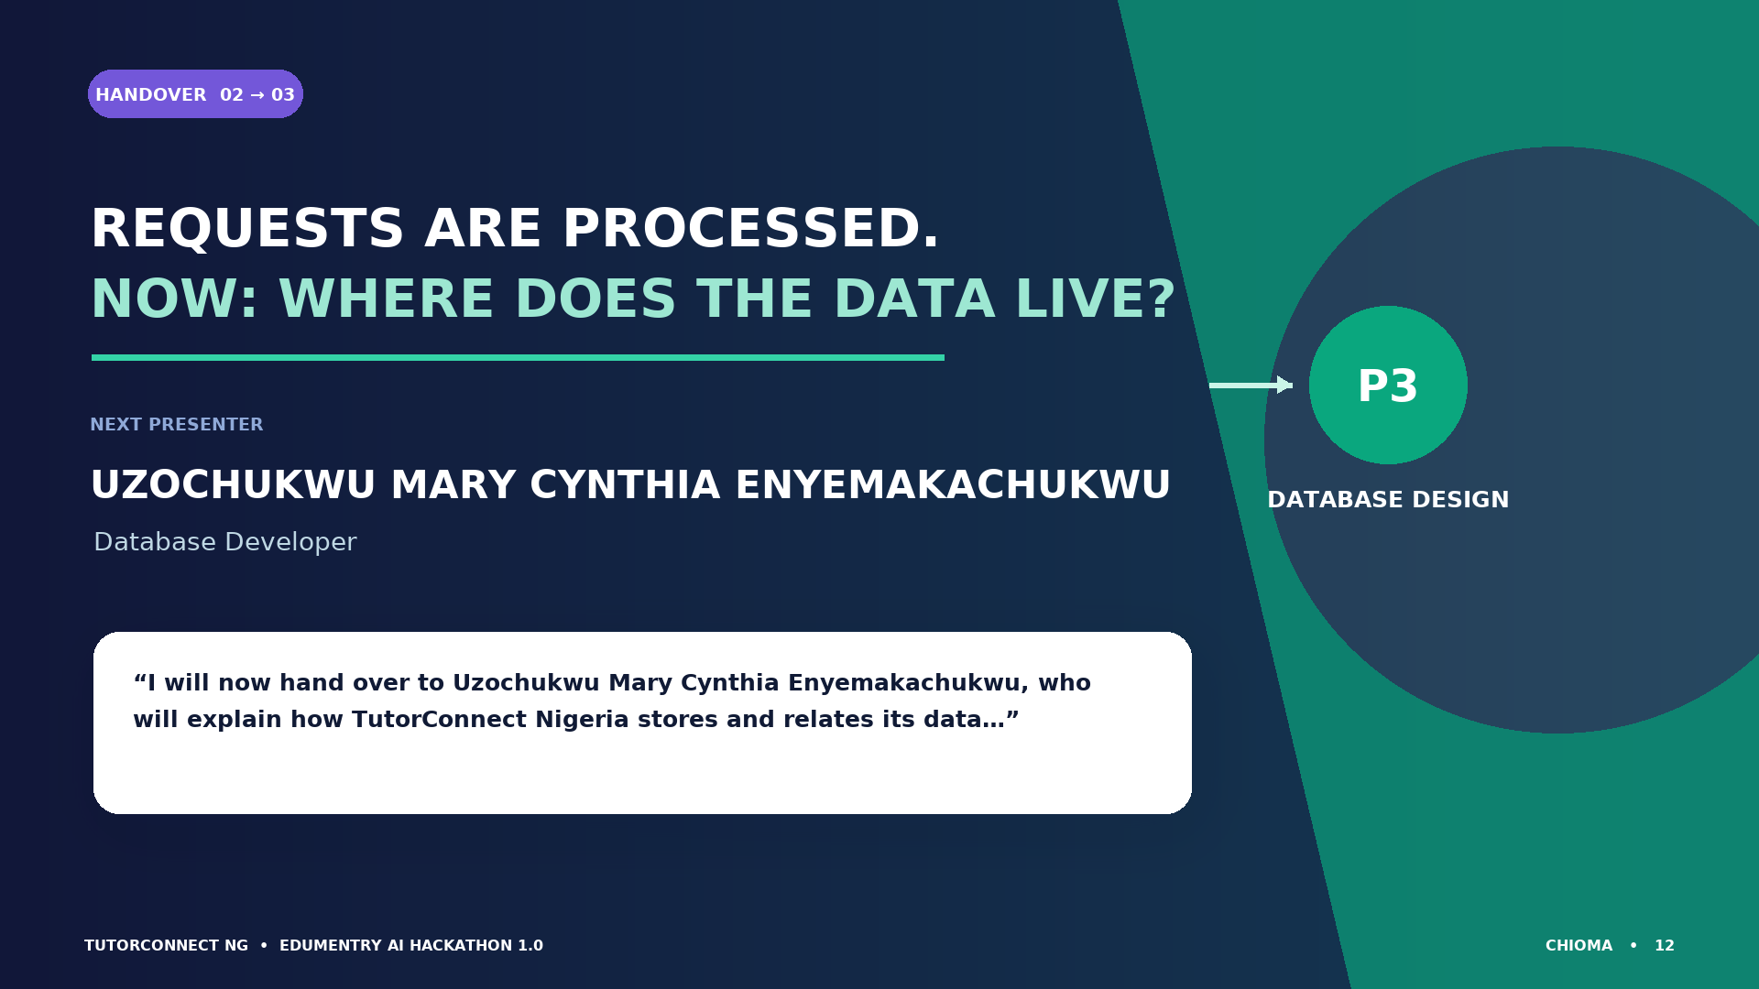
Handover to Uzochukwu Mary Cynthia Enyemakachukwu
Backend complete. Next presenter: Uzochukwu Mary Cynthia Enyemakachukwu, Database Developer. Exact handover is in speaker notes.
Notes:
Presenter: Chioma Helen Ezeufonna — Backend Developer
Suggested time: 18 seconds
Exact handover wording:
“That concludes my explanation of the backend technologies, API routes, and request-processing flow. I will now hand over to Uzochukwu Mary Cynthia Enyemakachukwu, who will explain how TutorConnect Nigeria stores and relates its data using Neon Serverless PostgreSQL.”
Visual cue:
Pause after Cynthia's full name and allow her to take the floor.
Transition:
The database section begins on the next slide.

Slide 13
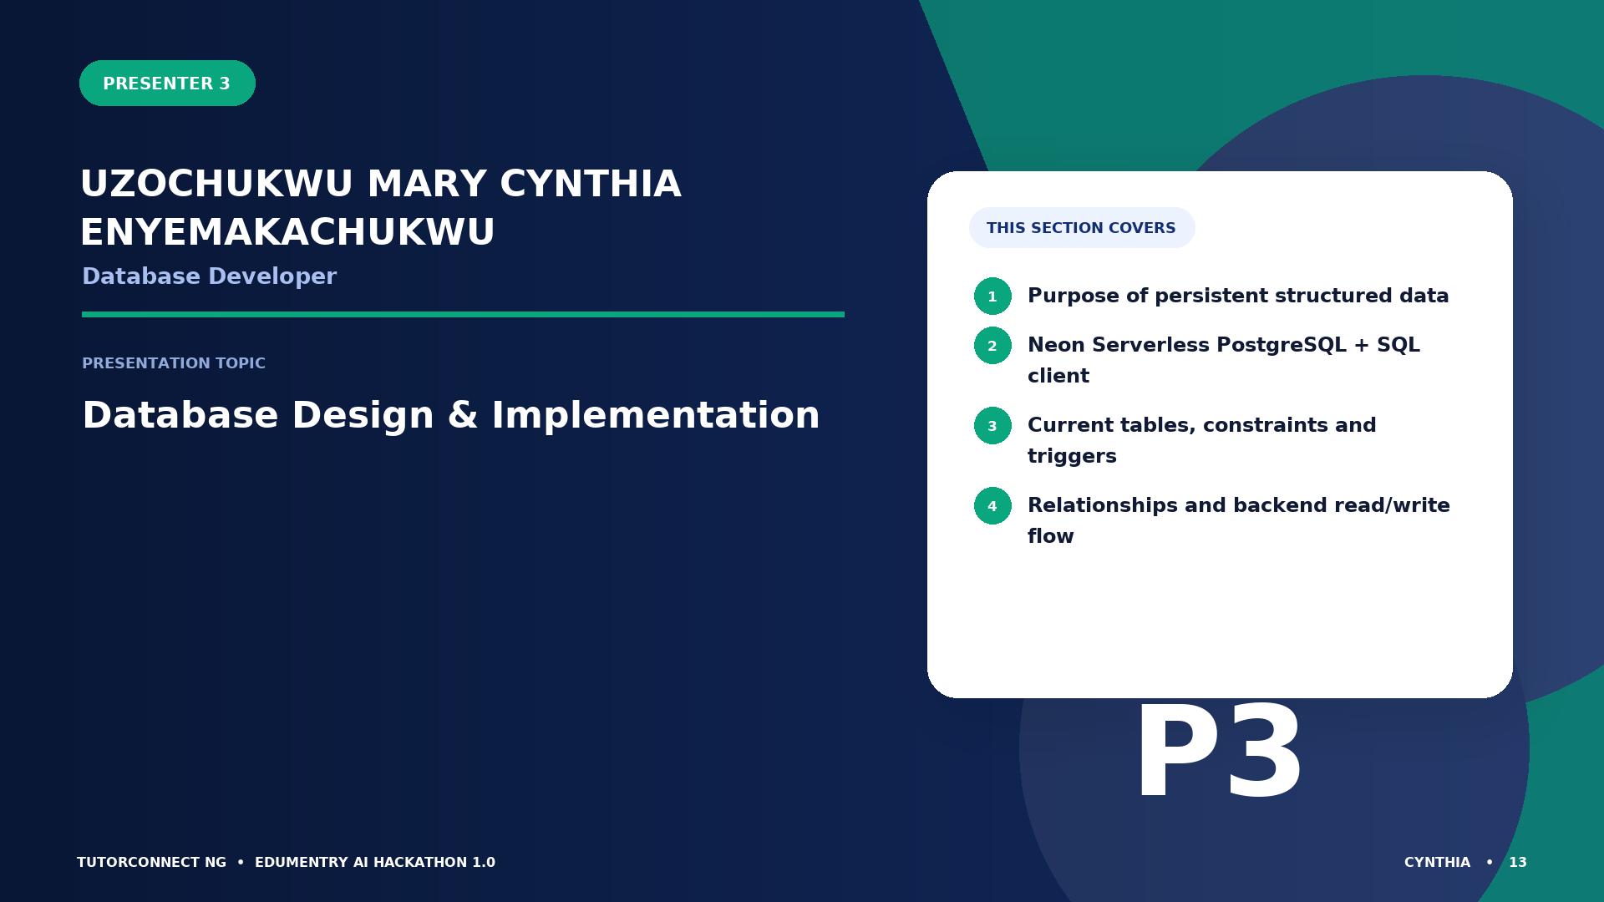
Presenter 3: Uzochukwu Mary Cynthia Enyemakachukwu
Database Developer — Database Design & Implementation — Purpose of persistent structured data; Neon Serverless PostgreSQL + SQL client; Current tables, constraints and triggers; Relationships and backend read/write flow
Notes:
Presenter: Uzochukwu Mary Cynthia Enyemakachukwu — Database Developer
Suggested time: 35 seconds
Speaking script:
I am Uzochukwu Mary Cynthia Enyemakachukwu, the database developer. I will explain why the system needs persistent, structured data, why Neon Serverless PostgreSQL suits a serverless Next.js application, the ten tables currently defined in the schema, the most important relationships, and the constraints and triggers that protect data integrity. I will also show how API routes read and write the database.
Visual cue:
Use the roadmap to distinguish database design from the broader backend responsibilities already explained.
Transition:
First, let us look at the database technology and how the tables are grouped.

Slide 14
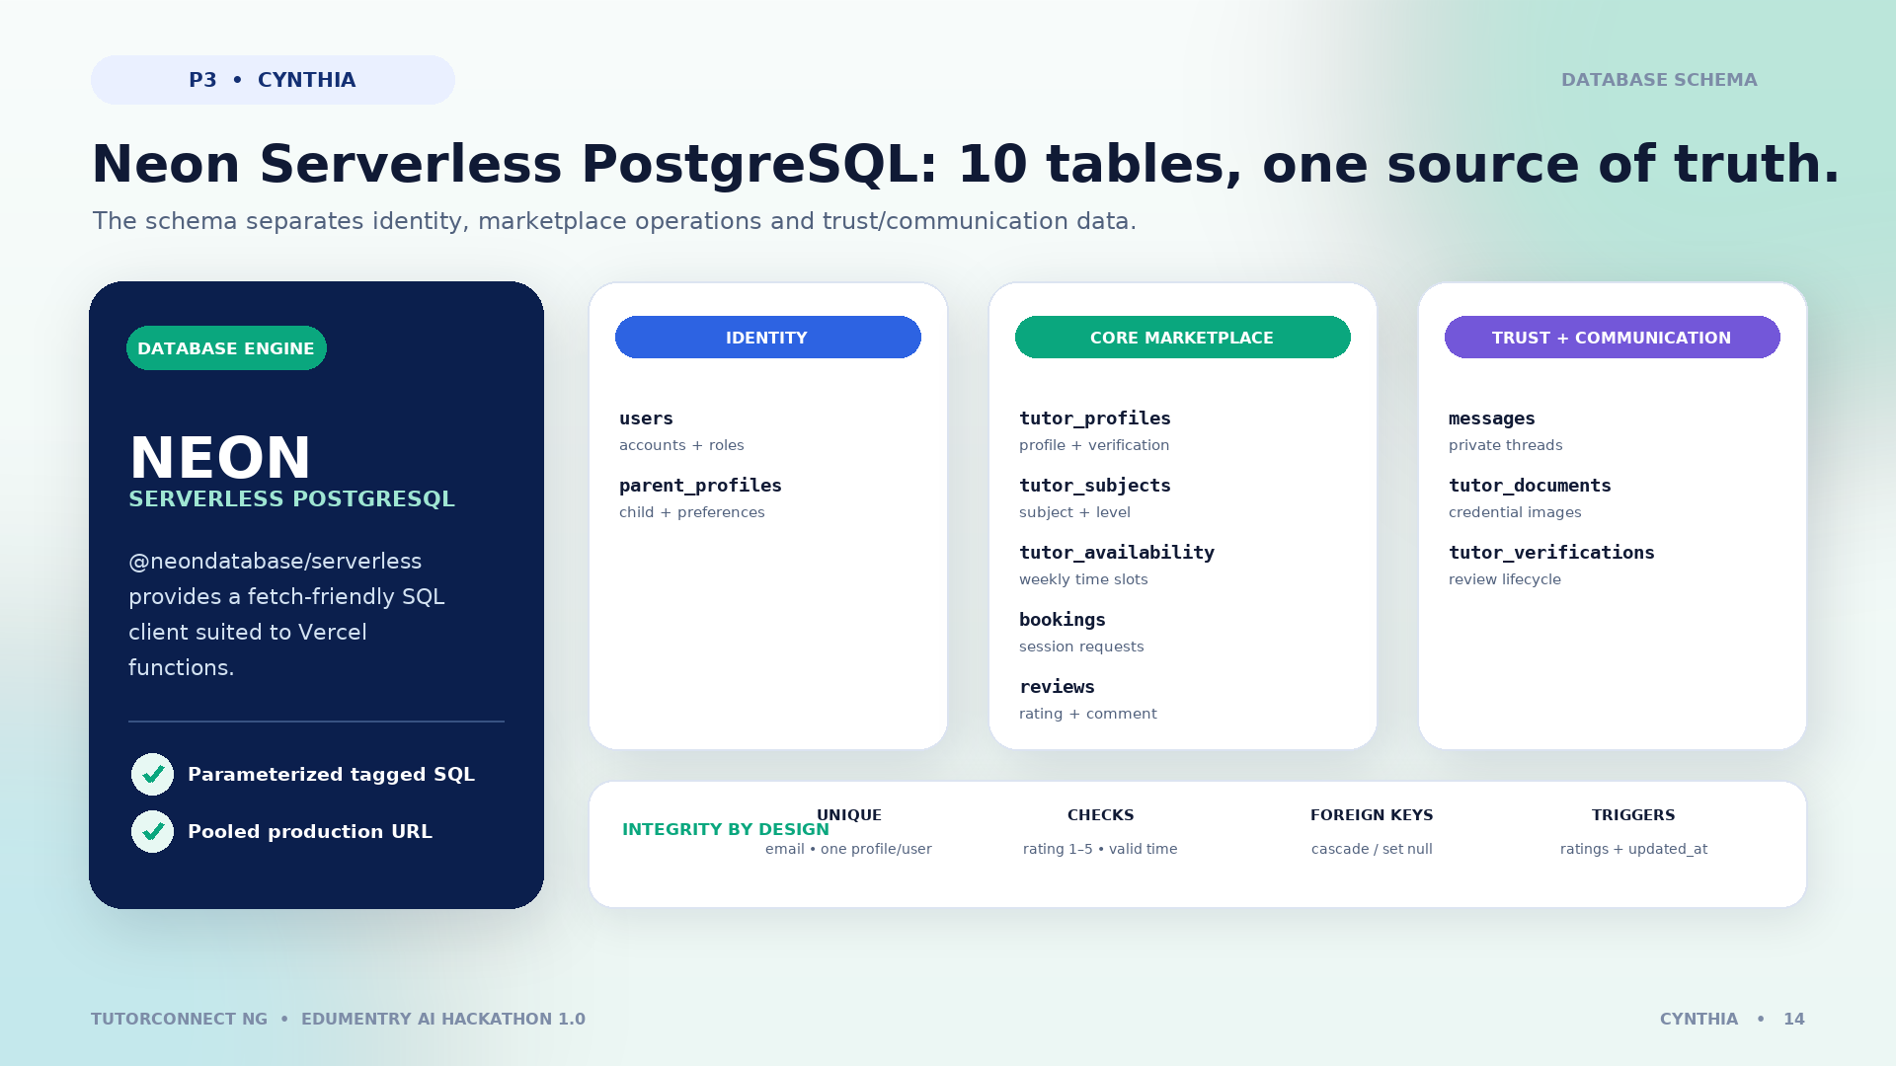
Database technology and schema
Neon Serverless PostgreSQL via @neondatabase/serverless. Ten tables: users, parent_profiles, tutor_profiles, tutor_subjects, tutor_availability, bookings, reviews, messages, tutor_documents, tutor_verifications. Unique keys, foreign keys, checks, indexes and triggers.
Notes:
Presenter: Uzochukwu Mary Cynthia Enyemakachukwu — Database Developer
Suggested time: 80 seconds
Speaking script:
A database allows accounts, tutor profiles, availability, bookings, reviews, messages, and verification records to remain available across requests and deployments. TutorConnect Nigeria uses Neon Serverless PostgreSQL through the @neondatabase/serverless client, which sends parameterized queries over a serverless-friendly connection. The current schema defines ten tables. The core marketplace path contains users, tutor_profiles, tutor_subjects, tutor_availability, bookings, and reviews. Supporting tables store parent details, private messages, tutor documents, and verification applications. PostgreSQL enums model roles, booking status, session mode, and curriculum. Unique keys, foreign keys, checks, indexes, and triggers enforce important rules.
Visual cue:
Explain the three table groups, then highlight the integrity strip: unique email and profiles, valid ratings and time ranges, one review per booking when attached, and automatic rating updates.
Transition:
The relationship diagram now shows how those core records connect.

Slide 15
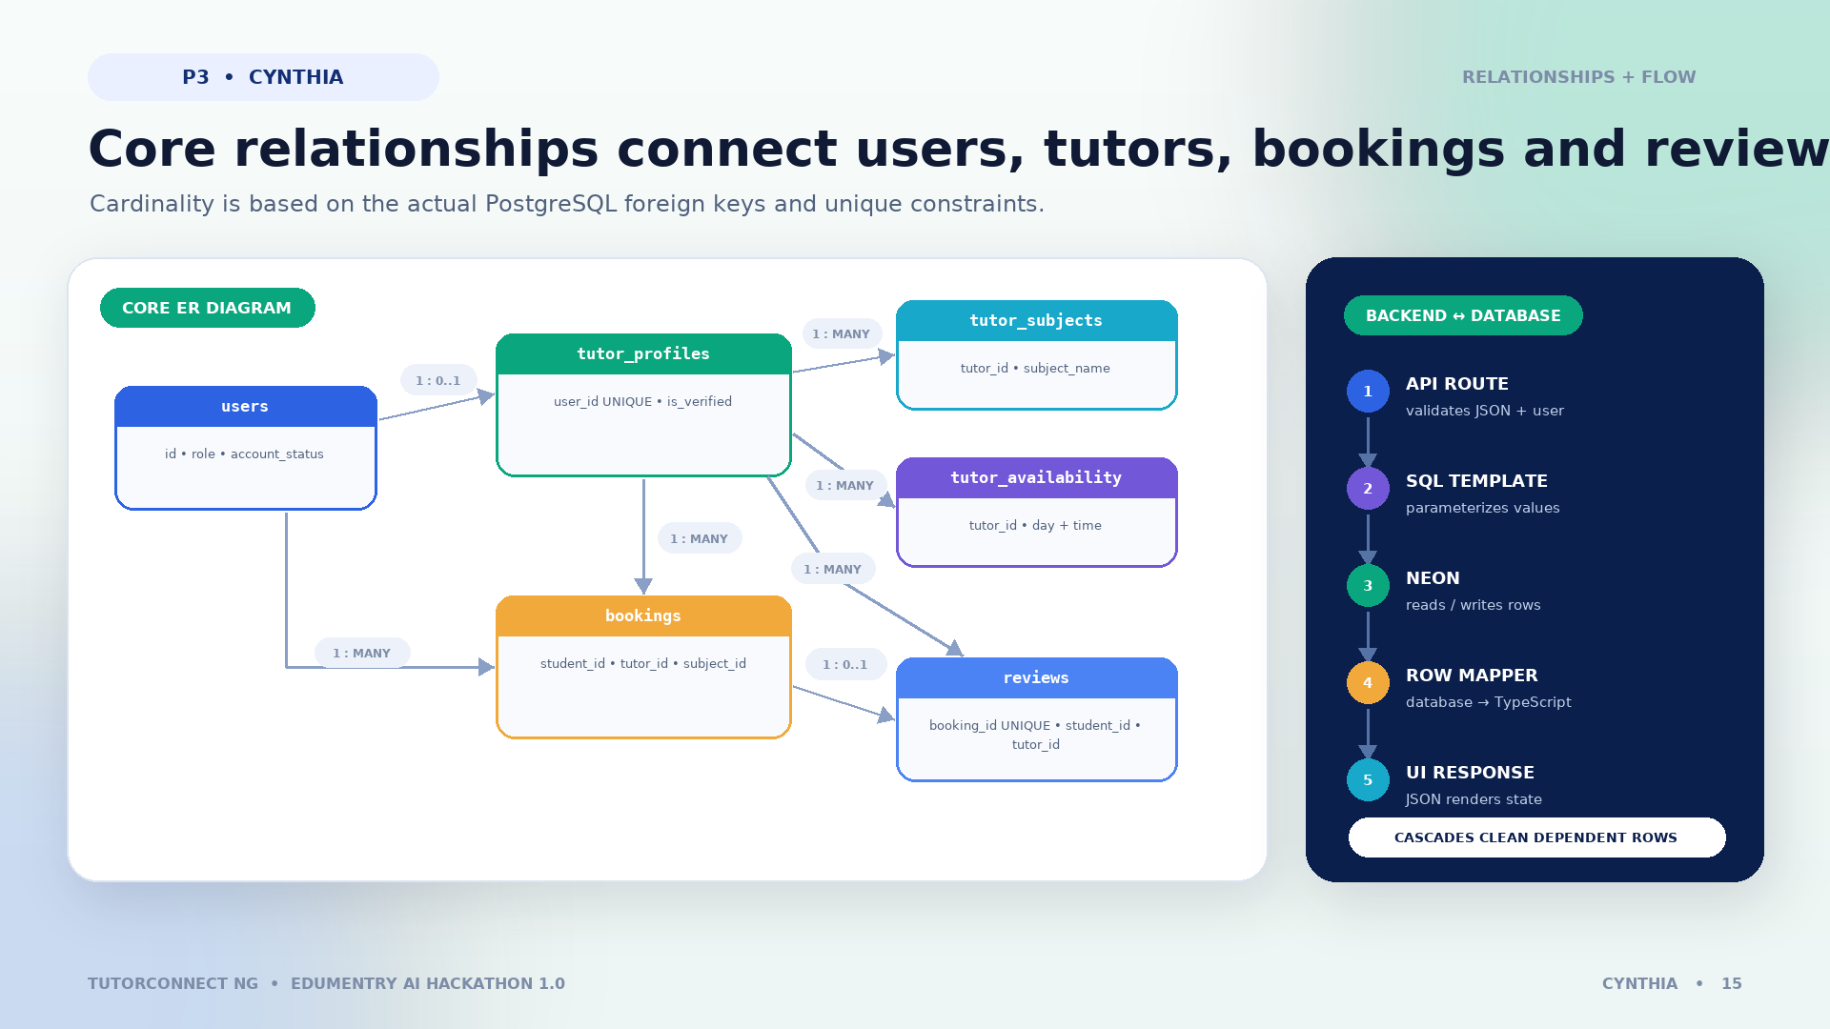
Database relationships and data flow
users 1 to optional tutor_profiles; tutor_profiles one to many tutor_subjects, tutor_availability, bookings, reviews; users one to many bookings; booking optional one review due unique booking_id. API routes use parameterized SQL and row mapping.
Notes:
Presenter: Uzochukwu Mary Cynthia Enyemakachukwu — Database Developer
Suggested time: 90 seconds
Speaking script:
Each users row represents a student, parent, tutor, or administrator. A tutor user can have one tutor_profiles row, which in turn has many subjects and availability slots. A student user can create many bookings. Each booking belongs to one tutor profile and may reference one of that tutor's subject rows. A completed booking can have at most one linked review because reviews.booking_id is unique; reviews also point to the student and tutor. The rating trigger recalculates a tutor's average and review count after review changes. Parent profiles, credential documents, verification applications, and messages support the wider workflow. The API uses parameterized tagged-template SQL, then maps database rows to TypeScript objects consumed by the interface. Cascading deletes clean up dependent records, while subject references on bookings use SET NULL.
Visual cue:
Start at users, follow the tutor branch, then the student-to-booking branch, and finish with the API-to-Neon data-flow panel.
Transition:
That concludes the database structure and how data moves through it.

Slide 16
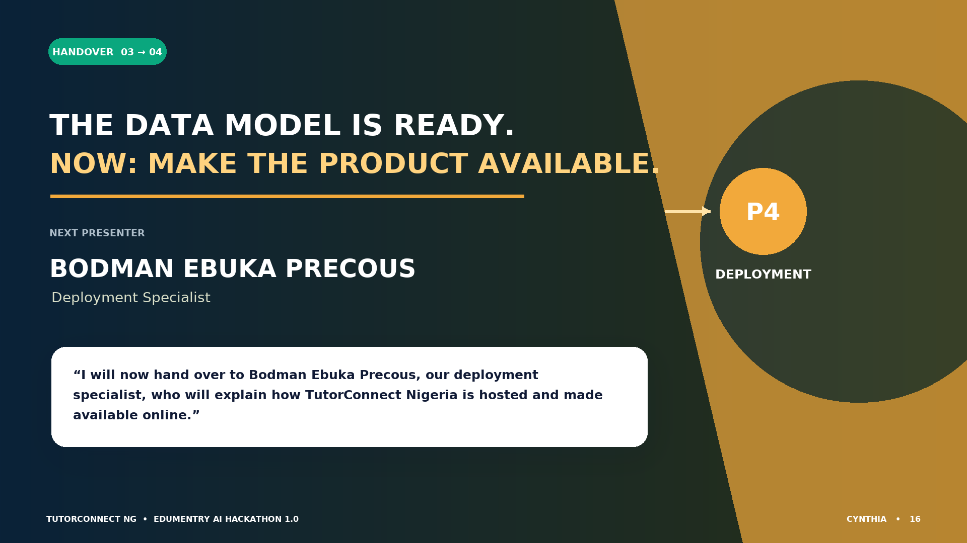
Handover to Bodman Ebuka Precous
Database complete. Next presenter: Bodman Ebuka Precous, Deployment Specialist. Exact handover is in speaker notes.
Notes:
Presenter: Uzochukwu Mary Cynthia Enyemakachukwu — Database Developer
Suggested time: 18 seconds
Exact handover wording:
“That concludes my presentation on the database design and data flow. I will now hand over to Bodman Ebuka Precous, our deployment specialist, who will explain how TutorConnect Nigeria is hosted and made available online.”
Visual cue:
Pause after Bodman's name and invite him to begin.
Transition:
The deployment section starts on the next slide.

Slide 17
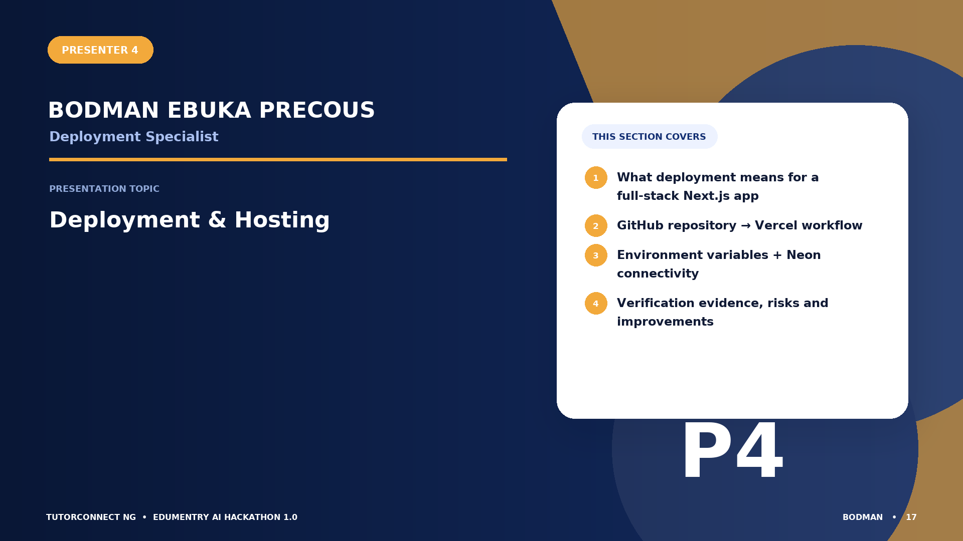
Presenter 4: Bodman Ebuka Precous
Deployment Specialist — Deployment & Hosting — What deployment means for a full-stack Next.js app; GitHub repository → Vercel workflow; Environment variables + Neon connectivity; Verification evidence, risks and improvements
Notes:
Presenter: Bodman Ebuka Precous — Deployment Specialist
Suggested time: 35 seconds
Speaking script:
I am Bodman Ebuka Precous, the deployment specialist. Deployment is the process of turning the source code into a version that users can access online. I will explain the repository-to-Vercel workflow, how the Next.js frontend and Node.js API routes run together, how production environment variables connect the application to Neon, what deployment evidence was verified, and which reliability improvements are realistic.
Visual cue:
Use the four topic cards to introduce hosting, configuration, verification, and reliability.
Transition:
We begin with the actual deployment arrangement documented by the repository and GitHub records.

Slide 18
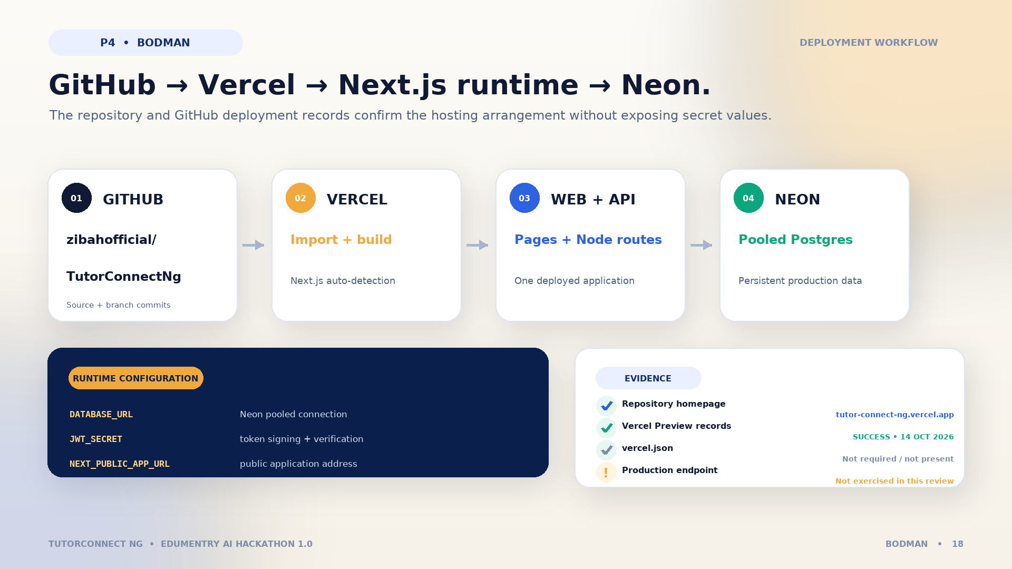
How TutorConnect Nigeria is deployed
GitHub repository zibahofficial/TutorConnectNg imports into Vercel; Vercel builds Next.js pages and Node runtime API routes; APIs connect to Neon pooled Postgres. Required environment variable names: DATABASE_URL, JWT_SECRET, NEXT_PUBLIC_APP_URL. GitHub deployment records show successful previews on 14 October 2026; production endpoint was not exercised.
Notes:
Presenter: Bodman Ebuka Precous — Deployment Specialist
Suggested time: 80 seconds
Speaking script:
The source repository is hosted on GitHub under zibahofficial/TutorConnectNg. Vercel imports the repository, detects Next.js, runs the build, serves the React pages, and deploys route handlers as Node.js serverless functions. The functions connect to Neon Serverless PostgreSQL using a pooled DATABASE_URL. JWT_SECRET is required to sign and verify tokens, while NEXT_PUBLIC_APP_URL identifies the public application address; no secret values are shown here. The repository homepage lists tutor-connect-ng.vercel.app, and GitHub deployment records show successful Vercel Preview deployments on 14 October 2026. The project has no vercel.json, so it relies on Vercel's standard Next.js integration.
Verification boundary:
Those records verify the arrangement and successful previews, but this review did not exercise the public production endpoint from the sandbox.
Visual cue:
Trace GitHub to Vercel, then split to the web/API runtime and Neon. Finish with the evidence panel.
Transition:
Next, I will explain what was tested and what should be improved before production use.

Slide 19
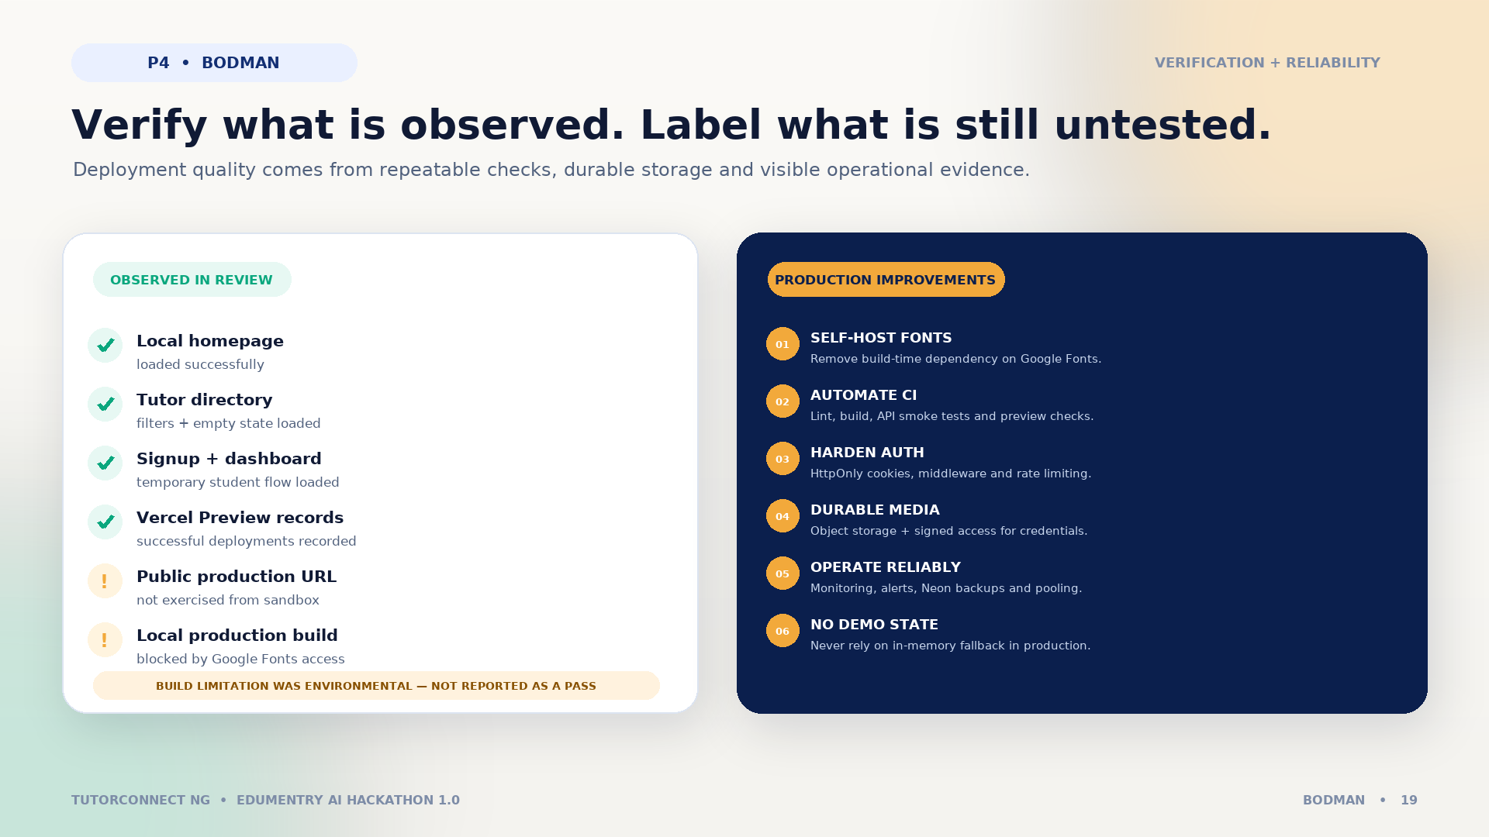
Deployment verification and improvements
Observed: local homepage, tutor directory, signup and student dashboard loaded; GitHub Vercel preview records successful. Not verified: public production endpoint. Local production build blocked by sandbox access to Google Fonts. Improvements: self-host fonts, CI checks, secure cookies and middleware, rate limiting, object storage, monitoring, backups, pooled connections, no in-memory production state.
Notes:
Presenter: Bodman Ebuka Precous — Deployment Specialist
Suggested time: 85 seconds
Speaking script:
Verification should cover more than whether the homepage opens. In this review, the local homepage, tutor directory, signup flow, and student dashboard loaded successfully, and the API returned deliberate empty states when no database was configured. GitHub records show successful Vercel Preview deployments. The production URL itself was not tested from this environment. A local production build was also attempted, but the sandbox could not reach Google Fonts used by next/font, so the build could not be confirmed here. A practical fix is to self-host the required fonts. Other production improvements include automated CI smoke tests, HttpOnly cookie and middleware-based access control, rate limiting, monitoring and alerts, Neon backups and pooled connections, and object storage for uploaded credential images instead of large base64 data in PostgreSQL. In-memory fallbacks should never be treated as durable production storage.
Visual cue:
Clearly separate observed evidence from proposed improvements; do not describe the untested production endpoint as passed.
Transition:
That completes the technical deployment section.

Slide 20
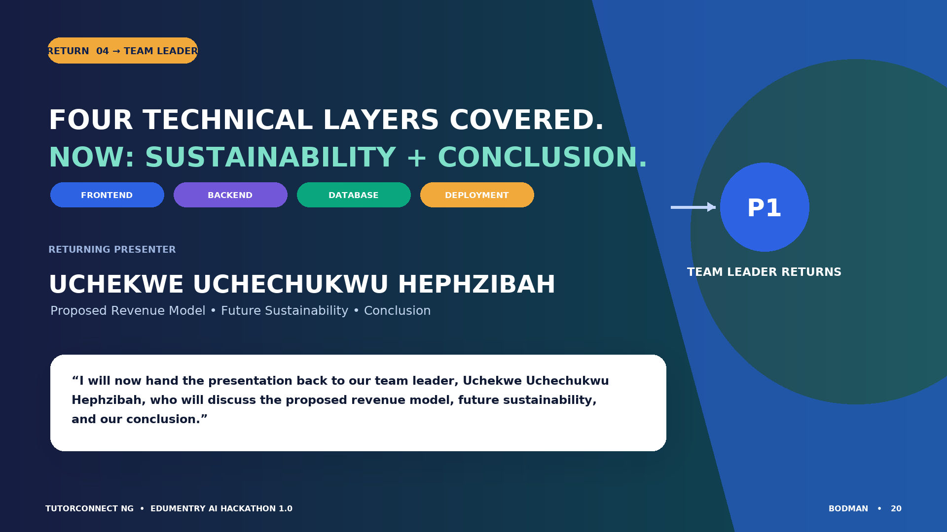
Handover back to Uchekwe Uchechukwu Hephzibah
Technical sections complete. Team leader Uchekwe Uchechukwu Hephzibah returns for proposed revenue model, future sustainability and conclusion. Exact handover is in speaker notes.
Notes:
Presenter: Bodman Ebuka Precous — Deployment Specialist
Suggested time: 18 seconds
Exact handover wording:
“We have now covered the frontend, backend, database, and deployment of TutorConnect Nigeria. I will now hand the presentation back to our team leader, Uchekwe Uchechukwu Hephzibah, who will discuss the proposed revenue model, future sustainability, and our conclusion.”
Visual cue:
Pause after the team leader's full name and invite her back.
Transition:
The proposed business model follows on the next slide.

Slide 21
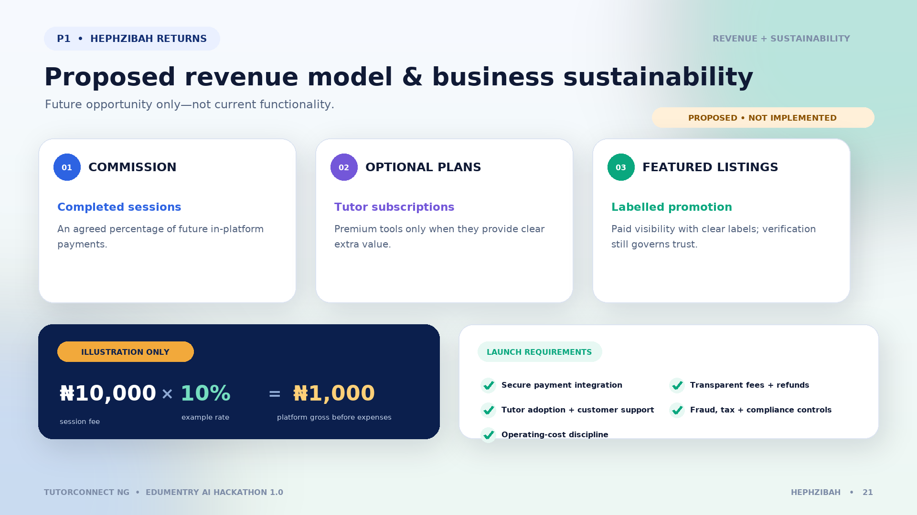
Proposed revenue model and business sustainability
Proposed only: commission on completed sessions paid through a future secure payment flow; optional tutor subscription plans; clearly labelled featured tutor listings. Illustration: 10% of ₦10,000 is ₦1,000 before expenses. Online payment and commission processing are not confirmed implemented.
Notes:
Presenter: Uchekwe Uchechukwu Hephzibah — Team Leader and Frontend Developer, returning
Suggested time: 90 seconds
Speaking script:
The ideas on this slide are proposals for a future launch; they are not confirmed current features. First, TutorConnect Nigeria could charge an agreed commission only on tutoring sessions completed and paid through a future secure payment flow. As an illustration, not a business decision, a ten-percent commission on a ten-thousand-naira session would give the platform one thousand naira before expenses. Second, tutors could choose an optional subscription if it provides real value, such as advanced analytics or scheduling tools; basic participation should remain useful. Third, tutors could pay for clearly labelled featured placement, but promotion must never replace verification or mislead learners about quality. Sustainability depends on secure payments, transparent fees and refunds, tutor adoption, customer support, fraud controls, tax and regulatory compliance, and careful control of hosting and operating costs.
Visual cue:
Point first to the “proposed—not implemented” banner, explain each stream, then walk through the arithmetic example and launch requirements.
Transition:
I will close by summarising the value of the project and the most important next steps.

Slide 22

Conclusion, thank you, and questions
TutorConnect Nigeria combines frontend experience, backend routes and authentication, Neon PostgreSQL data, and Vercel deployment. Next priorities: production authentication, self-hosted fonts, automated testing, end-to-end production verification, and secure payments before monetisation. Thank you. Questions?
Notes:
Presenter: Uchekwe Uchechukwu Hephzibah — Team Leader and Frontend Developer
Suggested time: 75 seconds
Speaking script:
In conclusion, TutorConnect Nigeria addresses a real coordination problem by combining tutor discovery, trust signals, booking, communication, reviews, role-based dashboards, and administration in one full-stack application. The frontend makes the journey clear; the backend processes requests and applies identity and access rules; Neon PostgreSQL preserves structured records; and Vercel provides a practical deployment path. The next priorities are to harden production authentication, self-host fonts and automate build checks, verify the production environment end to end, add a secure payment and refund process before introducing commission, and measure outcomes with real users rather than unsupported statistics. Thank you to Edumentry AI Hackathon 1.0 and everyone listening. We welcome your questions.
Visual cue:
Summarise the four technical layers, then finish at the “Questions?” prompt.
Final words:
“Thank you for listening. We are ready to answer your questions.”

