Slide 1
The mean difference analysis between Diseased and non-disease samples
TTEST 过程
变量: BMI (BMI)
HavingCVD | 方法 | 数目 | 均值 | 标准差 | 标准误差
No |  | 2246 | 27.4085 | 5.7074 | 0.1204
Yes |  | 2223 | 28.8559 | 6.0237 | 0.1278
差 (1-2) | 汇总 |  | -1.4473 | 5.8669 | 0.1755
差 (1-2) | Satterthwaite |  | -1.4473 |  | 0.1756

Slide 2
The mean difference analysis between Diseased and non-disease samples
TTEST 过程
变量: BMI (BMI)
HavingCVD | 方法 | 最小值 | 最大值
No |  | 14.8800 | 62.5000
Yes |  | 14.8600 | 59.7200
差 (1-2) | 汇总
差 (1-2) | Satterthwaite

Slide 3
The mean difference analysis between Diseased and non-disease samples
TTEST 过程
变量: BMI (BMI)
HavingCVD | 方法 | 均值 | 95% 置信限均值 |  | 标准差
No |  | 27.4085 | 27.1724 | 27.6447 | 5.7074
Yes |  | 28.8559 | 28.6053 | 29.1064 | 6.0237
差 (1-2) | 汇总 | -1.4473 | -1.7914 | -1.1032 | 5.8669
差 (1-2) | Satterthwaite | -1.4473 | -1.7915 | -1.1031

Slide 4
The mean difference analysis between Diseased and non-disease samples
TTEST 过程
变量: BMI (BMI)
HavingCVD | 方法 | 95% 置信限标准差
No |  | 5.5452 | 5.8794
Yes |  | 5.8517 | 6.2062
差 (1-2) | 汇总 | 5.7477 | 5.9911
差 (1-2) | Satterthwaite

Slide 5
The mean difference analysis between Diseased and non-disease samples
TTEST 过程
变量: BMI (BMI)
方法 | 方差 | 自由度 | t 值 | Pr > |t|
汇总 | 等于 | 4467 | -8.25 | <.0001
Satterthwaite | 不等于 | 4448.7 | -8.24 | <.0001

Slide 6
The mean difference analysis between Diseased and non-disease samples
TTEST 过程
变量: BMI (BMI)
方差齐性
方法 | 分子自由度 | 分母自由度 | F 值 | Pr > F
折叠的 F | 2222 | 2245 | 1.11 | 0.0108

Slide 7
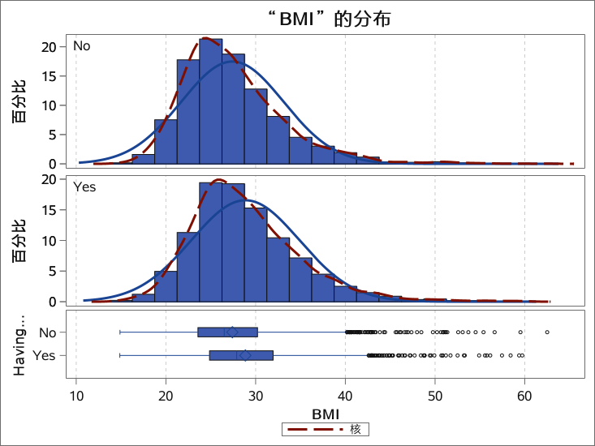
The mean difference analysis between Diseased and non-disease samples
TTEST 过程
变量: BMI (BMI)

Slide 8
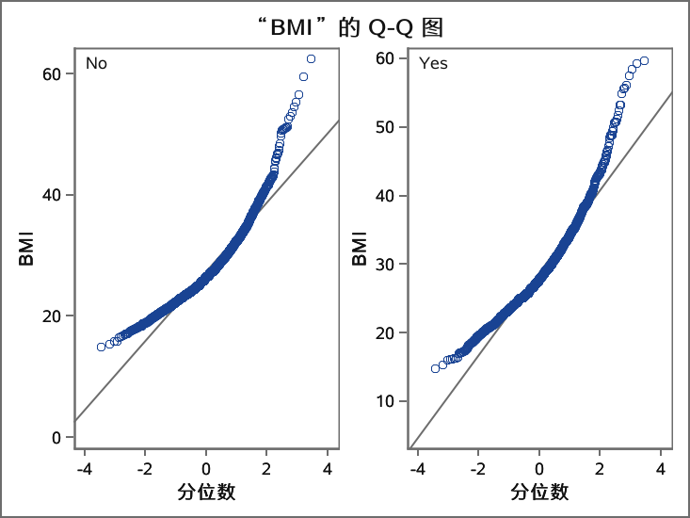
The mean difference analysis between Diseased and non-disease samples
TTEST 过程
变量: BMI (BMI)

Slide 9
The BMI difference between Male and Female samples
TTEST 过程
变量: BMI (BMI)
GENDER | 方法 | 数目 | 均值 | 标准差 | 标准误差
Male |  | 2553 | 28.3500 | 5.6795 | 0.1124
Female |  | 1916 | 27.8333 | 6.1946 | 0.1415
差 (1-2) | 汇总 |  | 0.5167 | 5.9058 | 0.1785
差 (1-2) | Satterthwaite |  | 0.5167 |  | 0.1807
GENDER | 方法 | 最小值 | 最大值
Male |  | 15.3400 | 62.5000
Female |  | 14.8600 | 59.7200
差 (1-2) | 汇总
差 (1-2) | Satterthwaite

Slide 10
The BMI difference between Male and Female samples
TTEST 过程
变量: BMI (BMI)
GENDER | 方法 | 均值 | 95% 置信限均值 |  | 标准差
Male |  | 28.3500 | 28.1296 | 28.5704 | 5.6795
Female |  | 27.8333 | 27.5557 | 28.1108 | 6.1946
差 (1-2) | 汇总 | 0.5167 | 0.1668 | 0.8667 | 5.9058
差 (1-2) | Satterthwaite | 0.5167 | 0.1624 | 0.8711
GENDER | 方法 | 95% 置信限标准差
Male |  | 5.5279 | 5.8397
Female |  | 6.0045 | 6.3972
差 (1-2) | 汇总 | 5.7859 | 6.0309
差 (1-2) | Satterthwaite

Slide 11
The BMI difference between Male and Female samples
TTEST 过程
变量: BMI (BMI)
方法 | 方差 | 自由度 | t 值 | Pr > |t|
汇总 | 等于 | 4467 | 2.89 | 0.0038
Satterthwaite | 不等于 | 3922 | 2.86 | 0.0043

Slide 12
The BMI difference between Male and Female samples
TTEST 过程
变量: BMI (BMI)
方差齐性
方法 | 分子自由度 | 分母自由度 | F 值 | Pr > F
折叠的 F | 1915 | 2552 | 1.19 | <.0001

Slide 13
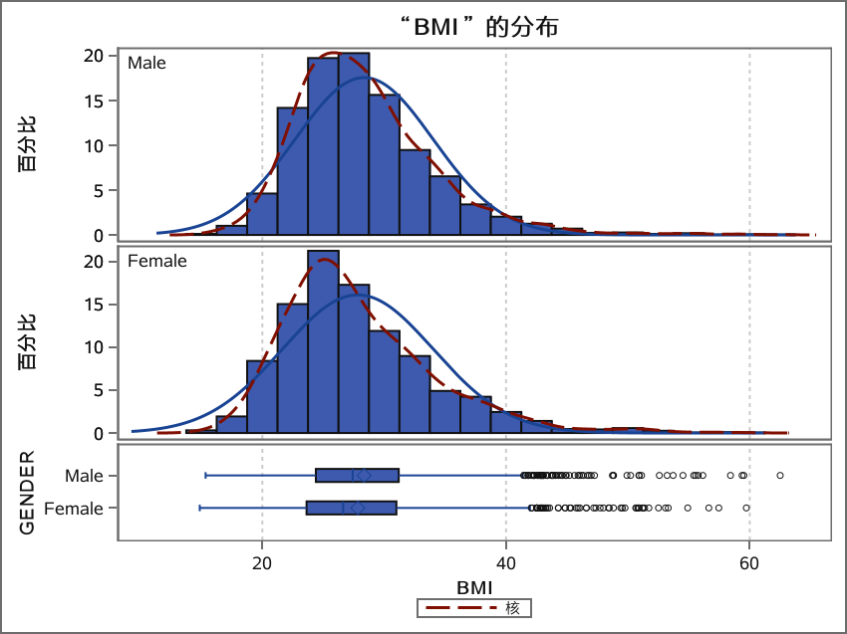
The BMI difference between Male and Female samples
TTEST 过程
变量: BMI (BMI)

Slide 14
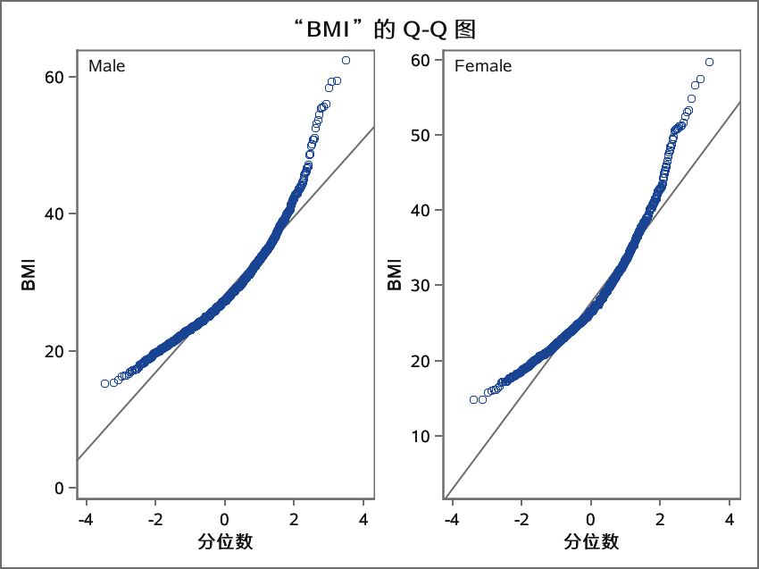
The BMI difference between Male and Female samples
TTEST 过程
变量: BMI (BMI)

Slide 15
The association analysis between
Discrete Data and CVD status
FREQ 过程
HavingCVD-GENDER表
HavingCVD | GENDER
频数 百分比 行百分比 列百分比 | Male | Female | 合计
No | 1191 26.65 53.03 46.65 | 1055 23.61 46.97 55.06 | 2246 50.26
Yes | 1362 30.48 61.27 53.35 | 861 19.27 38.73 44.94 | 2223 49.74

Slide 16
The association analysis between
Discrete Data and CVD status
FREQ 过程
HavingCVD-GENDER表
HavingCVD | GENDER
频数 百分比 行百分比 列百分比 | Male | Female | 合计
合计 | 2553 57.13 | 1916 42.87 | 4469 100.00
表“GENDER-HavingCVD”的统计量
统计量 | 自由度 | 值 | 概率
卡方 | 1 | 30.9790 | <.0001
似然比卡方检验 | 1 | 31.0205 | <.0001

Slide 17
The association analysis between
Discrete Data and CVD status
FREQ 过程
表“GENDER-HavingCVD”的统计量
统计量 | 自由度 | 值 | 概率
连续调整卡方 | 1 | 30.6435 | <.0001
Mantel-Haenszel 卡方 | 1 | 30.9721 | <.0001
Phi 系数 |  | -0.0833
列联系数 |  | 0.0830
Cramer V |  | -0.0833

Slide 18
The association analysis between
Discrete Data and CVD status
FREQ 过程
表“GENDER-HavingCVD”的统计量
Fisher 精确检验
单元格 (1,1) 频数 (F) | 1191
左侧 Pr <= F | <.0001
右侧 Pr >= F | 1.0000
表概率 (P) | <.0001
双侧 Pr <= P | <.0001
样本大小 = 4469

Slide 19
The association analysis between
Discrete Data and CVD status
FREQ 过程
HavingCVD-Age_Range表
HavingCVD | Age_Range
频数 百分比 行百分比 列百分比 | <= 40 | 41-45 | 46-50 | 51-55 | 56-60 | 61-65 | 66-70
No | 427 9.55 19.01 89.52 | 254 5.68 11.31 75.15 | 229 5.12 10.20 60.90 | 329 7.36 14.65 57.22 | 300 6.71 13.36 49.42 | 239 5.35 10.64 38.42 | 154 3.45 6.86 38.69
Yes | 50 1.12 2.25 10.48 | 84 1.88 3.78 24.85 | 147 3.29 6.61 39.10 | 246 5.50 11.07 42.78 | 307 6.87 13.81 50.58 | 383 8.57 17.23 61.58 | 244 5.46 10.98 61.31

Slide 20
The association analysis between
Discrete Data and CVD status
FREQ 过程
HavingCVD-Age_Range表
HavingCVD | Age_Range
频数 百分比 行百分比 列百分比 | 71-75 | 76-80 | >= 80 | 合计
No | 143 3.20 6.37 36.95 | 78 1.75 3.47 25.16 | 93 2.08 4.14 24.54 | 2246 50.26
Yes | 244 5.46 10.98 63.05 | 232 5.19 10.44 74.84 | 286 6.40 12.87 75.46 | 2223 49.74

Slide 21
The association analysis between
Discrete Data and CVD status
FREQ 过程
HavingCVD-Age_Range表
HavingCVD | Age_Range
频数 百分比 行百分比 列百分比 | <= 40 | 41-45 | 46-50 | 51-55 | 56-60 | 61-65 | 66-70
合计 | 477 10.67 | 338 7.56 | 376 8.41 | 575 12.87 | 607 13.58 | 622 13.92 | 398 8.91

Slide 22
The association analysis between
Discrete Data and CVD status
FREQ 过程
HavingCVD-Age_Range表
HavingCVD | Age_Range
频数 百分比 行百分比 列百分比 | 71-75 | 76-80 | >= 80 | 合计
合计 | 387 8.66 | 310 6.94 | 379 8.48 | 4469 100.00
表“Age_Range-HavingCVD”的统计量
统计量 | 自由度 | 值 | 概率
卡方 | 9 | 668.1453 | <.0001
似然比卡方检验 | 9 | 724.5825 | <.0001

Slide 23
The association analysis between
Discrete Data and CVD status
FREQ 过程
表“Age_Range-HavingCVD”的统计量
统计量 | 自由度 | 值 | 概率
Mantel-Haenszel 卡方 | 1 | 619.3930 | <.0001
Phi 系数 |  | 0.3867
列联系数 |  | 0.3606
Cramer V |  | 0.3867
样本大小 = 4469

Slide 24
The association analysis between
Discrete Data and CVD status
FREQ 过程
HavingCVD-BMI_Class表
HavingCVD | BMI_Class
频数 百分比 行百分比 列百分比 | OVER-THIN | NORMAL | OVER-FAT | OBESITY | 合计
No | 38 0.85 1.69 59.38 | 622 13.92 27.69 60.92 | 742 16.60 33.04 51.24 | 844 18.89 37.58 43.60 | 2246 50.26
Yes | 26 0.58 1.17 40.63 | 399 8.93 17.95 39.08 | 706 15.80 31.76 48.76 | 1092 24.43 49.12 56.40 | 2223 49.74

Slide 25
The association analysis between
Discrete Data and CVD status
FREQ 过程
HavingCVD-BMI_Class表
HavingCVD | BMI_Class
频数 百分比 行百分比 列百分比 | OVER-THIN | NORMAL | OVER-FAT | OBESITY | 合计
合计 | 64 1.43 | 1021 22.85 | 1448 32.40 | 1936 43.32 | 4469 100.00
表“BMI_Class-HavingCVD”的统计量
统计量 | 自由度 | 值 | 概率
卡方 | 3 | 83.5036 | <.0001
似然比卡方检验 | 3 | 83.9972 | <.0001

Slide 26
The association analysis between
Discrete Data and CVD status
FREQ 过程
表“BMI_Class-HavingCVD”的统计量
统计量 | 自由度 | 值 | 概率
Mantel-Haenszel 卡方 | 1 | 80.9919 | <.0001
Phi 系数 |  | 0.1367
列联系数 |  | 0.1354
Cramer V |  | 0.1367
样本大小 = 4469

Slide 27
The association analysis between
Discrete Data and CVD status
FREQ 过程
GENDER-BMI_Class表
GENDER | BMI_Class
频数 百分比 行百分比 列百分比 | OVER-THIN | NORMAL | OVER-FAT | OBESITY | 合计
Male | 26 0.58 1.02 40.63 | 522 11.68 20.45 51.13 | 838 18.75 32.82 57.87 | 1167 26.11 45.71 60.28 | 2553 57.13
Female | 38 0.85 1.98 59.38 | 499 11.17 26.04 48.87 | 610 13.65 31.84 42.13 | 769 17.21 40.14 39.72 | 1916 42.87

Slide 28
The association analysis between
Discrete Data and CVD status
FREQ 过程
GENDER-BMI_Class表
GENDER | BMI_Class
频数 百分比 行百分比 列百分比 | OVER-THIN | NORMAL | OVER-FAT | OBESITY | 合计
合计 | 64 1.43 | 1021 22.85 | 1448 32.40 | 1936 43.32 | 4469 100.00

Slide 29
The association analysis between
Discrete Data and CVD status
观测 | HavingCVD | Age_Range | COUNT | PERCENT
1 | No | <= 40 | 427 | 9.55471
2 | No | 41-45 | 254 | 5.68360
3 | No | 46-50 | 229 | 5.12419
4 | No | 51-55 | 329 | 7.36183
5 | No | 56-60 | 300 | 6.71291
6 | No | 61-65 | 239 | 5.34795
7 | No | 66-70 | 154 | 3.44596
8 | No | 71-75 | 143 | 3.19982
9 | No | 76-80 | 78 | 1.74536
10 | No | >= 80 | 93 | 2.08100
11 | Yes | <= 40 | 50 | 1.11882

Slide 30
The association analysis between
Discrete Data and CVD status
观测 | PCT_ROW | PCT_COL
1 | 19.0116 | 89.5178
2 | 11.3090 | 75.1479
3 | 10.1959 | 60.9043
4 | 14.6483 | 57.2174
5 | 13.3571 | 49.4234
6 | 10.6411 | 38.4244
7 | 6.8566 | 38.6935
8 | 6.3669 | 36.9509
9 | 3.4728 | 25.1613
10 | 4.1407 | 24.5383
11 | 2.2492 | 10.4822

Slide 31
The association analysis between
Discrete Data and CVD status
观测 | HavingCVD | Age_Range | COUNT | PERCENT
12 | Yes | 41-45 | 84 | 1.87962
13 | Yes | 46-50 | 147 | 3.28933
14 | Yes | 51-55 | 246 | 5.50459
15 | Yes | 56-60 | 307 | 6.86955
16 | Yes | 61-65 | 383 | 8.57015
17 | Yes | 66-70 | 244 | 5.45983
18 | Yes | 71-75 | 244 | 5.45983
19 | Yes | 76-80 | 232 | 5.19132
20 | Yes | >= 80 | 286 | 6.39964

Slide 32
The association analysis between
Discrete Data and CVD status
观测 | PCT_ROW | PCT_COL
12 | 3.7787 | 24.8521
13 | 6.6127 | 39.0957
14 | 11.0661 | 42.7826
15 | 13.8102 | 50.5766
16 | 17.2290 | 61.5756
17 | 10.9762 | 61.3065
18 | 10.9762 | 63.0491
19 | 10.4363 | 74.8387
20 | 12.8655 | 75.4617

Slide 33
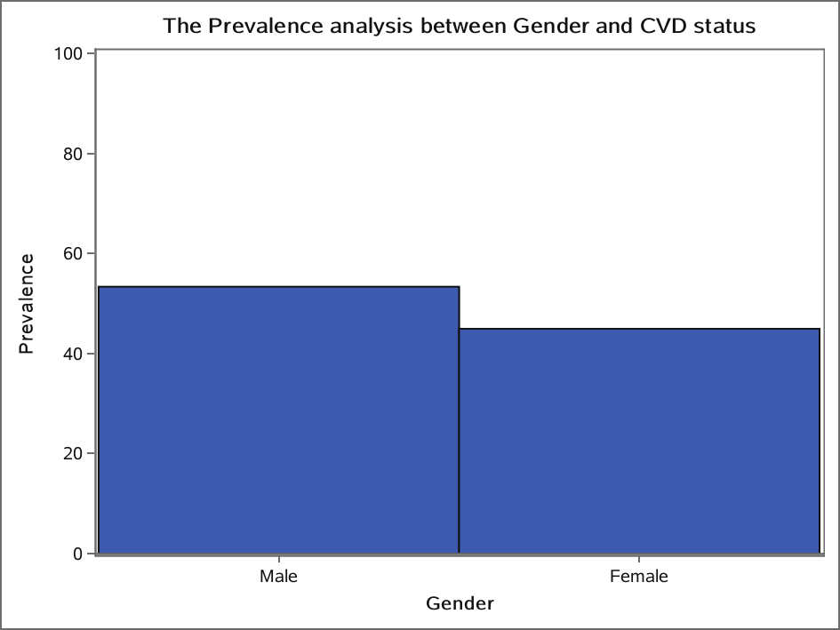

Slide 34
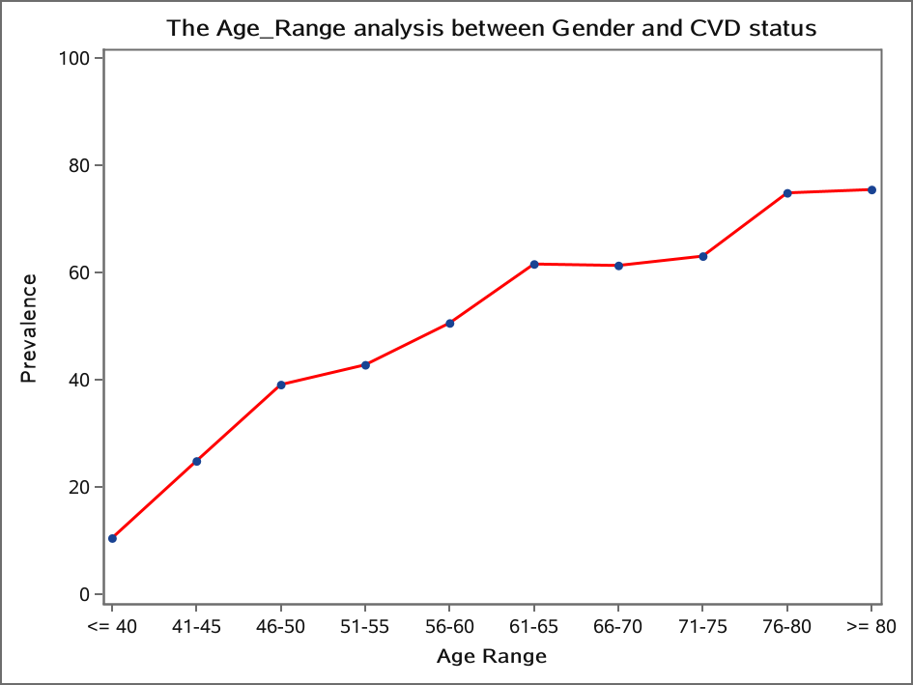

Slide 35
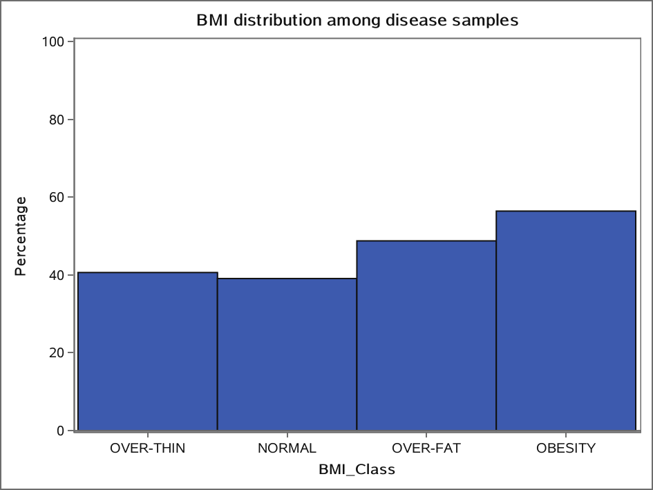

Slide 36
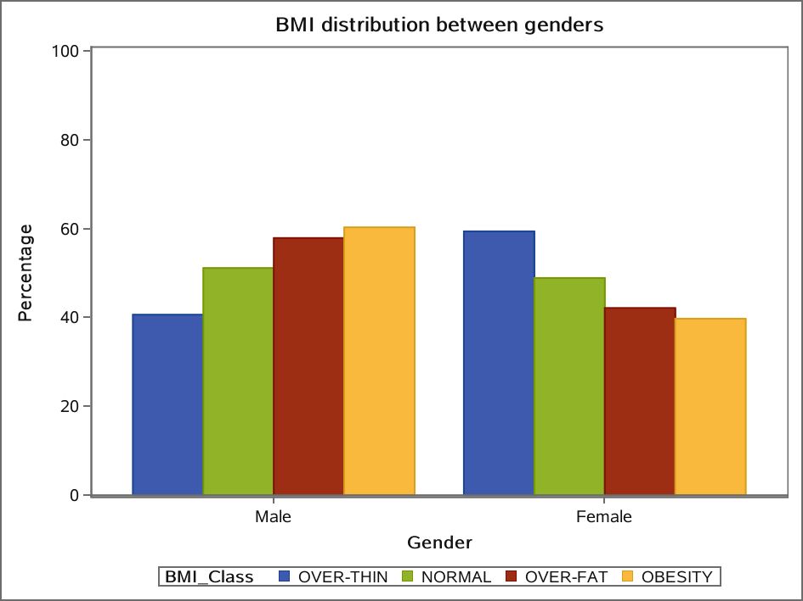

Slide 37
BMI distribution between genders
ANOVA 过程
分类水平信息
分类 | 水平 | 值
Age_Range | 10 | 41-45 46-50 51-55 56-60 61-65 66-70 71-75 76-80 <= 40 >= 80

Slide 38
BMI distribution between genders
ANOVA 过程
读取的观测数 | 4469
使用的观测数 | 4469

Slide 39
BMI distribution between genders
ANOVA 过程
因变量: BMI BMI
源 | 自由度 | 平方和 | 均方 | F 值 | Pr > F
模型 | 9 | 3654.3516 | 406.0391 | 11.88 | <.0001
误差 | 4459 | 152441.3486 | 34.1873
校正合计 | 4468 | 156095.7002

Slide 40
BMI distribution between genders
ANOVA 过程
因变量: BMI BMI
R 方 | 变异系数 | 均方根误差 | BMI 均值
0.023411 | 20.78674 | 5.846994 | 28.12849

Slide 41
BMI distribution between genders
ANOVA 过程
因变量: BMI BMI
源 | 自由度 | Anova SS | 均方 | F 值 | Pr > F
Age_Range | 9 | 3654.351607 | 406.039067 | 11.88 | <.0001

Slide 42
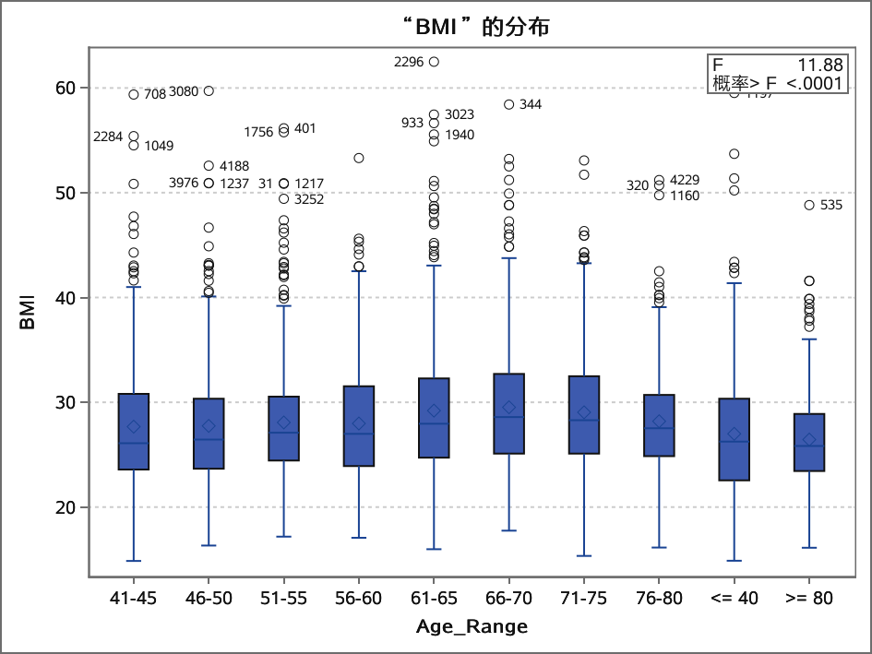
BMI distribution between genders
ANOVA 过程
因变量: BMI BMI

Slide 43
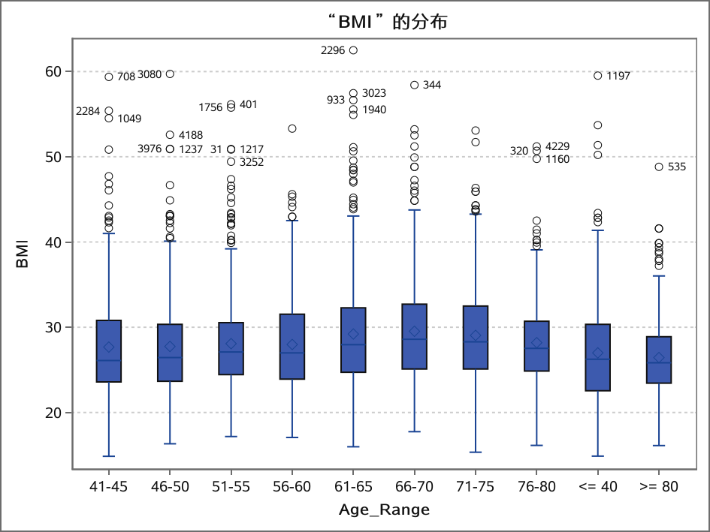
BMI distribution between genders
ANOVA 过程

Slide 44
BMI distribution between genders
ANOVA 过程
Tukey's Studentized Range (HSD) Test for BMI
NOTE: This test controls the Type I experimentwise error rate.
Alpha | 0.05
Error Degrees of Freedom | 4459
Error Mean Square | 34.18734
Critical Value of Studentized Range | 4.47634

Slide 45
BMI distribution between genders
ANOVA 过程
Tukey's Studentized Range (HSD) Test for BMI
Comparisons significant at the 0.05 level are indicated by ***.
Age_Range 比较 | 均值 间 差值 | Simultaneous 95% 置信限
66-70 - 61-65 | 0.3192 | -0.8688 | 1.5071
66-70 - 71-75 | 0.4801 | -0.8412 | 1.8013
66-70 - 76-80 | 1.3346 | -0.0673 | 2.7366
66-70 - 51-55 | 1.4489 | 0.2421 | 2.6557 | ***
66-70 - 56-60 | 1.5474 | 0.3538 | 2.7411 | ***
66-70 - 46-50 | 1.7771 | 0.4461 | 3.1081 | ***
66-70 - 41-45 | 1.8511 | 0.4822 | 3.2200 | ***
66-70 - <= 40 | 2.5318 | 1.2753 | 3.7882 | ***

Slide 46
BMI distribution between genders
ANOVA 过程
Tukey's Studentized Range (HSD) Test for BMI
Comparisons significant at the 0.05 level are indicated by ***.
Age_Range 比较 | 均值 间 差值 | Simultaneous 95% 置信限
66-70 - >= 80 | 3.0811 | 1.7528 | 4.4094 | ***
61-65 - 66-70 | -0.3192 | -1.5071 | 0.8688
61-65 - 71-75 | 0.1609 | -1.0373 | 1.3591
61-65 - 76-80 | 1.0155 | -0.2712 | 2.3022
61-65 - 51-55 | 1.1297 | 0.0591 | 2.2004 | ***
61-65 - 56-60 | 1.2283 | 0.1724 | 2.2842 | ***
61-65 - 46-50 | 1.4579 | 0.2490 | 2.6669 | ***
61-65 - 41-45 | 1.5319 | 0.2813 | 2.7825 | ***

Slide 47
BMI distribution between genders
ANOVA 过程
Tukey's Studentized Range (HSD) Test for BMI
Comparisons significant at the 0.05 level are indicated by ***.
Age_Range 比较 | 均值 间 差值 | Simultaneous 95% 置信限
61-65 - <= 40 | 2.2126 | 1.0862 | 3.3390 | ***
61-65 - >= 80 | 2.7619 | 1.5559 | 3.9679 | ***
71-75 - 66-70 | -0.4801 | -1.8013 | 0.8412
71-75 - 61-65 | -0.1609 | -1.3591 | 1.0373
71-75 - 76-80 | 0.8546 | -0.5561 | 2.2652
71-75 - 51-55 | 0.9688 | -0.2480 | 2.1857
71-75 - 56-60 | 1.0674 | -0.1365 | 2.2712
71-75 - 46-50 | 1.2970 | -0.0431 | 2.6372

Slide 48
BMI distribution between genders
ANOVA 过程
Tukey's Studentized Range (HSD) Test for BMI
Comparisons significant at the 0.05 level are indicated by ***.
Age_Range 比较 | 均值 间 差值 | Simultaneous 95% 置信限
71-75 - 41-45 | 1.3710 | -0.0068 | 2.7488
71-75 - <= 40 | 2.0517 | 0.7855 | 3.3178 | ***
71-75 - >= 80 | 2.6010 | 1.2636 | 3.9385 | ***
76-80 - 66-70 | -1.3346 | -2.7366 | 0.0673
76-80 - 61-65 | -1.0155 | -2.3022 | 0.2712
76-80 - 71-75 | -0.8546 | -2.2652 | 0.5561
76-80 - 51-55 | 0.1143 | -1.1898 | 1.4183
76-80 - 56-60 | 0.2128 | -1.0792 | 1.5048

Slide 49
BMI distribution between genders
ANOVA 过程
Tukey's Studentized Range (HSD) Test for BMI
Comparisons significant at the 0.05 level are indicated by ***.
Age_Range 比较 | 均值 间 差值 | Simultaneous 95% 置信限
76-80 - 46-50 | 0.4425 | -0.9773 | 1.8623
76-80 - 41-45 | 0.5165 | -0.9390 | 1.9719
76-80 - <= 40 | 1.1971 | -0.1530 | 2.5473
76-80 - >= 80 | 1.7464 | 0.3292 | 3.1637 | ***
51-55 - 66-70 | -1.4489 | -2.6557 | -0.2421 | ***
51-55 - 61-65 | -1.1297 | -2.2004 | -0.0591 | ***
51-55 - 71-75 | -0.9688 | -2.1857 | 0.2480
51-55 - 76-80 | -0.1143 | -1.4183 | 1.1898

Slide 50
BMI distribution between genders
ANOVA 过程
Tukey's Studentized Range (HSD) Test for BMI
Comparisons significant at the 0.05 level are indicated by ***.
Age_Range 比较 | 均值 间 差值 | Simultaneous 95% 置信限
51-55 - 56-60 | 0.0985 | -0.9785 | 1.1756
51-55 - 46-50 | 0.3282 | -0.8992 | 1.5557
51-55 - 41-45 | 0.4022 | -0.8663 | 1.6707
51-55 - <= 40 | 1.0829 | -0.0633 | 2.2291
51-55 - >= 80 | 1.6322 | 0.4077 | 2.8567 | ***
56-60 - 66-70 | -1.5474 | -2.7411 | -0.3538 | ***
56-60 - 61-65 | -1.2283 | -2.2842 | -0.1724 | ***
56-60 - 71-75 | -1.0674 | -2.2712 | 0.1365

Slide 51
BMI distribution between genders
ANOVA 过程
Tukey's Studentized Range (HSD) Test for BMI
Comparisons significant at the 0.05 level are indicated by ***.
Age_Range 比较 | 均值 间 差值 | Simultaneous 95% 置信限
56-60 - 76-80 | -0.2128 | -1.5048 | 1.0792
56-60 - 51-55 | -0.0985 | -1.1756 | 0.9785
56-60 - 46-50 | 0.2297 | -0.9849 | 1.4442
56-60 - 41-45 | 0.3037 | -0.9524 | 1.5597
56-60 - <= 40 | 0.9843 | -0.1481 | 2.1167
56-60 - >= 80 | 1.5337 | 0.3220 | 2.7453 | ***
46-50 - 66-70 | -1.7771 | -3.1081 | -0.4461 | ***
46-50 - 61-65 | -1.4579 | -2.6669 | -0.2490 | ***

Slide 52
BMI distribution between genders
ANOVA 过程
Tukey's Studentized Range (HSD) Test for BMI
Comparisons significant at the 0.05 level are indicated by ***.
Age_Range 比较 | 均值 间 差值 | Simultaneous 95% 置信限
46-50 - 71-75 | -1.2970 | -2.6372 | 0.0431
46-50 - 76-80 | -0.4425 | -1.8623 | 0.9773
46-50 - 51-55 | -0.3282 | -1.5557 | 0.8992
46-50 - 56-60 | -0.2297 | -1.4442 | 0.9849
46-50 - 41-45 | 0.0740 | -1.3132 | 1.4612
46-50 - <= 40 | 0.7547 | -0.5217 | 2.0310
46-50 - >= 80 | 1.3040 | -0.0431 | 2.6511
41-45 - 66-70 | -1.8511 | -3.2200 | -0.4822 | ***

Slide 53
BMI distribution between genders
ANOVA 过程
Tukey's Studentized Range (HSD) Test for BMI
Comparisons significant at the 0.05 level are indicated by ***.
Age_Range 比较 | 均值 间 差值 | Simultaneous 95% 置信限
41-45 - 61-65 | -1.5319 | -2.7825 | -0.2813 | ***
41-45 - 71-75 | -1.3710 | -2.7488 | 0.0068
41-45 - 76-80 | -0.5165 | -1.9719 | 0.9390
41-45 - 51-55 | -0.4022 | -1.6707 | 0.8663
41-45 - 56-60 | -0.3037 | -1.5597 | 0.9524
41-45 - 46-50 | -0.0740 | -1.4612 | 1.3132
41-45 - <= 40 | 0.6807 | -0.6352 | 1.9965
41-45 - >= 80 | 1.2300 | -0.1546 | 2.6146

Slide 54
BMI distribution between genders
ANOVA 过程
Tukey's Studentized Range (HSD) Test for BMI
Comparisons significant at the 0.05 level are indicated by ***.
Age_Range 比较 | 均值 间 差值 | Simultaneous 95% 置信限
<= 40 - 66-70 | -2.5318 | -3.7882 | -1.2753 | ***
<= 40 - 61-65 | -2.2126 | -3.3390 | -1.0862 | ***
<= 40 - 71-75 | -2.0517 | -3.3178 | -0.7855 | ***
<= 40 - 76-80 | -1.1971 | -2.5473 | 0.1530
<= 40 - 51-55 | -1.0829 | -2.2291 | 0.0633
<= 40 - 56-60 | -0.9843 | -2.1167 | 0.1481
<= 40 - 46-50 | -0.7547 | -2.0310 | 0.5217
<= 40 - 41-45 | -0.6807 | -1.9965 | 0.6352

Slide 55
BMI distribution between genders
ANOVA 过程
Tukey's Studentized Range (HSD) Test for BMI
Comparisons significant at the 0.05 level are indicated by ***.
Age_Range 比较 | 均值 间 差值 | Simultaneous 95% 置信限
<= 40 - >= 80 | 0.5493 | -0.7242 | 1.8228
>= 80 - 66-70 | -3.0811 | -4.4094 | -1.7528 | ***
>= 80 - 61-65 | -2.7619 | -3.9679 | -1.5559 | ***
>= 80 - 71-75 | -2.6010 | -3.9385 | -1.2636 | ***
>= 80 - 76-80 | -1.7464 | -3.1637 | -0.3292 | ***
>= 80 - 51-55 | -1.6322 | -2.8567 | -0.4077 | ***
>= 80 - 56-60 | -1.5337 | -2.7453 | -0.3220 | ***
>= 80 - 46-50 | -1.3040 | -2.6511 | 0.0431

Slide 56
BMI distribution between genders
ANOVA 过程
Tukey's Studentized Range (HSD) Test for BMI
Comparisons significant at the 0.05 level are indicated by ***.
Age_Range 比较 | 均值 间 差值 | Simultaneous 95% 置信限
>= 80 - 41-45 | -1.2300 | -2.6146 | 0.1546
>= 80 - <= 40 | -0.5493 | -1.8228 | 0.7242

