Slide 1
Association Analysis
FREQ 过程
HavingCVD-SmokingStatus表
HavingCVD | SmokingStatus
频数 百分比 行百分比 列百分比 | No | Yes | 合计
No | 896 29.97 59.81 59.46 | 602 20.13 40.19 40.59 | 1498 50.10
Yes | 611 20.43 40.95 40.54 | 881 29.46 59.05 59.41 | 1492 49.90
合计 | 1507 50.40 | 1483 49.60 | 2990 100.00

Slide 2
Association Analysis
FREQ 过程
表“SmokingStatus-HavingCVD”的统计量
统计量 | 自由度 | 值 | 概率
卡方 | 1 | 106.3757 | <.0001
似然比卡方检验 | 1 | 107.0154 | <.0001
连续调整卡方 | 1 | 105.6226 | <.0001
Mantel-Haenszel 卡方 | 1 | 106.3402 | <.0001
Phi 系数 |  | 0.1886
列联系数 |  | 0.1854
Cramer V |  | 0.1886

Slide 3
Association Analysis
FREQ 过程
表“SmokingStatus-HavingCVD”的统计量
Fisher 精确检验
单元格 (1,1) 频数 (F) | 896
左侧 Pr <= F | 1.0000
右侧 Pr >= F | <.0001
表概率 (P) | <.0001
双侧 Pr <= P | <.0001
样本大小 = 2990

Slide 4
Association Analysis
FREQ 过程
HavingCVD-Diabetes表
HavingCVD | Diabetes
频数 百分比 行百分比 列百分比 | No | Yes | 合计
No | 1351 45.18 90.19 58.13 | 147 4.92 9.81 22.07 | 1498 50.10
Yes | 973 32.54 65.21 41.87 | 519 17.36 34.79 77.93 | 1492 49.90
合计 | 2324 77.73 | 666 22.27 | 2990 100.00

Slide 5
Association Analysis
FREQ 过程
表“Diabetes-HavingCVD”的统计量
统计量 | 自由度 | 值 | 概率
卡方 | 1 | 269.2548 | <.0001
似然比卡方检验 | 1 | 281.9615 | <.0001
连续调整卡方 | 1 | 267.8143 | <.0001
Mantel-Haenszel 卡方 | 1 | 269.1647 | <.0001
Phi 系数 |  | 0.3001
列联系数 |  | 0.2874
Cramer V |  | 0.3001

Slide 6
Association Analysis
FREQ 过程
表“Diabetes-HavingCVD”的统计量
Fisher 精确检验
单元格 (1,1) 频数 (F) | 1351
左侧 Pr <= F | 1.0000
右侧 Pr >= F | <.0001
表概率 (P) | <.0001
双侧 Pr <= P | <.0001
样本大小 = 2990

Slide 7
Association Analysis
FREQ 过程
HavingCVD-Exercise表
HavingCVD | Exercise
频数 百分比 行百分比 列百分比 | No | Yes | 合计
No | 324 10.84 21.63 38.53 | 1174 39.26 78.37 54.63 | 1498 50.10
Yes | 517 17.29 34.65 61.47 | 975 32.61 65.35 45.37 | 1492 49.90
合计 | 841 28.13 | 2149 71.87 | 2990 100.00

Slide 8
Association Analysis
FREQ 过程
表“Exercise-HavingCVD”的统计量
统计量 | 自由度 | 值 | 概率
卡方 | 1 | 62.7072 | <.0001
似然比卡方检验 | 1 | 63.1305 | <.0001
连续调整卡方 | 1 | 62.0646 | <.0001
Mantel-Haenszel 卡方 | 1 | 62.6862 | <.0001
Phi 系数 |  | -0.1448
列联系数 |  | 0.1433
Cramer V |  | -0.1448

Slide 9
Association Analysis
FREQ 过程
表“Exercise-HavingCVD”的统计量
Fisher 精确检验
单元格 (1,1) 频数 (F) | 324
左侧 Pr <= F | <.0001
右侧 Pr >= F | 1.0000
表概率 (P) | <.0001
双侧 Pr <= P | <.0001
样本大小 = 2990

Slide 10
Association Analysis
FREQ 过程
GENDER-SmokingStatus表
GENDER | SmokingStatus
频数 百分比 行百分比 列百分比 | No | Yes | 合计
Male | 725 24.25 45.31 48.11 | 875 29.26 54.69 59.00 | 1600 53.51
Female | 782 26.15 56.26 51.89 | 608 20.33 43.74 41.00 | 1390 46.49
合计 | 1507 50.40 | 1483 49.60 | 2990 100.00

Slide 11
Association Analysis
FREQ 过程
表“SmokingStatus-GENDER”的统计量
统计量 | 自由度 | 值 | 概率
卡方 | 1 | 35.6534 | <.0001
似然比卡方检验 | 1 | 35.7291 | <.0001
连续调整卡方 | 1 | 35.2169 | <.0001
Mantel-Haenszel 卡方 | 1 | 35.6415 | <.0001
Phi 系数 |  | -0.1092
列联系数 |  | 0.1086
Cramer V |  | -0.1092

Slide 12
Association Analysis
FREQ 过程
表“SmokingStatus-GENDER”的统计量
Fisher 精确检验
单元格 (1,1) 频数 (F) | 725
左侧 Pr <= F | <.0001
右侧 Pr >= F | 1.0000
表概率 (P) | <.0001
双侧 Pr <= P | <.0001
样本大小 = 2990

Slide 13
Association Analysis
FREQ 过程
GENDER-Diabetes表
GENDER | Diabetes
频数 百分比 行百分比 列百分比 | No | Yes | 合计
Male | 1207 40.37 75.44 51.94 | 393 13.14 24.56 59.01 | 1600 53.51
Female | 1117 37.36 80.36 48.06 | 273 9.13 19.64 40.99 | 1390 46.49
合计 | 2324 77.73 | 666 22.27 | 2990 100.00

Slide 14
Association Analysis
FREQ 过程
表“Diabetes-GENDER”的统计量
统计量 | 自由度 | 值 | 概率
卡方 | 1 | 10.4092 | 0.0013
似然比卡方检验 | 1 | 10.4651 | 0.0012
连续调整卡方 | 1 | 10.1268 | 0.0015
Mantel-Haenszel 卡方 | 1 | 10.4057 | 0.0013
Phi 系数 |  | -0.0590
列联系数 |  | 0.0589
Cramer V |  | -0.0590

Slide 15
Association Analysis
FREQ 过程
表“Diabetes-GENDER”的统计量
Fisher 精确检验
单元格 (1,1) 频数 (F) | 1207
左侧 Pr <= F | 0.0007
右侧 Pr >= F | 0.9995
表概率 (P) | 0.0002
双侧 Pr <= P | 0.0013
样本大小 = 2990

Slide 16
Association Analysis
FREQ 过程
Age_Range-SmokingStatus表
Age_Range | SmokingStatus
频数 百分比 行百分比 列百分比 | No | Yes | 合计
<= 40 | 295 9.87 67.35 19.58 | 143 4.78 32.65 9.64 | 438 14.65
41-45 | 64 2.14 44.14 4.25 | 81 2.71 55.86 5.46 | 145 4.85

Slide 17
Association Analysis
FREQ 过程
Age_Range-SmokingStatus表
Age_Range | SmokingStatus
频数 百分比 行百分比 列百分比 | No | Yes | 合计
46-50 | 72 2.41 53.73 4.78 | 62 2.07 46.27 4.18 | 134 4.48
51-55 | 115 3.85 57.21 7.63 | 86 2.88 42.79 5.80 | 201 6.72

Slide 18
Association Analysis
FREQ 过程
Age_Range-SmokingStatus表
Age_Range | SmokingStatus
频数 百分比 行百分比 列百分比 | No | Yes | 合计
56-60 | 124 4.15 51.67 8.23 | 116 3.88 48.33 7.82 | 240 8.03
61-65 | 177 5.92 49.44 11.75 | 181 6.05 50.56 12.20 | 358 11.97

Slide 19
Association Analysis
FREQ 过程
Age_Range-SmokingStatus表
Age_Range | SmokingStatus
频数 百分比 行百分比 列百分比 | No | Yes | 合计
66-70 | 181 6.05 45.48 12.01 | 217 7.26 54.52 14.63 | 398 13.31
71-75 | 176 5.89 45.48 11.68 | 211 7.06 54.52 14.23 | 387 12.94

Slide 20
Association Analysis
FREQ 过程
Age_Range-SmokingStatus表
Age_Range | SmokingStatus
频数 百分比 行百分比 列百分比 | No | Yes | 合计
76-80 | 123 4.11 39.68 8.16 | 187 6.25 60.32 12.61 | 310 10.37
>= 80 | 180 6.02 47.49 11.94 | 199 6.66 52.51 13.42 | 379 12.68
合计 | 1507 50.40 | 1483 49.60 | 2990 100.00

Slide 21
Association Analysis
FREQ 过程
表“SmokingStatus-Age_Range”的统计量
统计量 | 自由度 | 值 | 概率
卡方 | 9 | 80.3833 | <.0001
似然比卡方检验 | 9 | 81.6161 | <.0001
Mantel-Haenszel 卡方 | 1 | 51.1734 | <.0001
Phi 系数 |  | 0.1640
列联系数 |  | 0.1618
Cramer V |  | 0.1640
样本大小 = 2990

Slide 22
Association Analysis
FREQ 过程
Age_Range-Diabetes表
Age_Range | Diabetes
频数 百分比 行百分比 列百分比 | No | Yes | 合计
<= 40 | 430 14.38 98.17 18.50 | 8 0.27 1.83 1.20 | 438 14.65
41-45 | 132 4.41 91.03 5.68 | 13 0.43 8.97 1.95 | 145 4.85

Slide 23
Association Analysis
FREQ 过程
Age_Range-Diabetes表
Age_Range | Diabetes
频数 百分比 行百分比 列百分比 | No | Yes | 合计
46-50 | 121 4.05 90.30 5.21 | 13 0.43 9.70 1.95 | 134 4.48
51-55 | 163 5.45 81.09 7.01 | 38 1.27 18.91 5.71 | 201 6.72

Slide 24
Association Analysis
FREQ 过程
Age_Range-Diabetes表
Age_Range | Diabetes
频数 百分比 行百分比 列百分比 | No | Yes | 合计
56-60 | 191 6.39 79.58 8.22 | 49 1.64 20.42 7.36 | 240 8.03
61-65 | 260 8.70 72.63 11.19 | 98 3.28 27.37 14.71 | 358 11.97

Slide 25
Association Analysis
FREQ 过程
Age_Range-Diabetes表
Age_Range | Diabetes
频数 百分比 行百分比 列百分比 | No | Yes | 合计
66-70 | 271 9.06 68.09 11.66 | 127 4.25 31.91 19.07 | 398 13.31
71-75 | 258 8.63 66.67 11.10 | 129 4.31 33.33 19.37 | 387 12.94

Slide 26
Association Analysis
FREQ 过程
Age_Range-Diabetes表
Age_Range | Diabetes
频数 百分比 行百分比 列百分比 | No | Yes | 合计
76-80 | 202 6.76 65.16 8.69 | 108 3.61 34.84 16.22 | 310 10.37
>= 80 | 296 9.90 78.10 12.74 | 83 2.78 21.90 12.46 | 379 12.68
合计 | 2324 77.73 | 666 22.27 | 2990 100.00

Slide 27
Association Analysis
FREQ 过程
表“Diabetes-Age_Range”的统计量
统计量 | 自由度 | 值 | 概率
卡方 | 9 | 217.0016 | <.0001
似然比卡方检验 | 9 | 270.3479 | <.0001
Mantel-Haenszel 卡方 | 1 | 150.7173 | <.0001
Phi 系数 |  | 0.2694
列联系数 |  | 0.2601
Cramer V |  | 0.2694
样本大小 = 2990

Slide 28
Association Analysis
“LOGISTIC”过程
模型信息
数据集 | WORK.ANALYSIS_DATA
响应变量 | HavingCVD
响应水平数 | 2
模型 | 二元 Logit
优化方法 | Fisher 评分法

Slide 29
Association Analysis
“LOGISTIC”过程
读取的观测数 | 2990
使用的观测数 | 2990

Slide 30
Association Analysis
“LOGISTIC”过程
响应概略
有序 值 | HavingCVD | 总 频数
1 | No | 1498
2 | Yes | 1492
建模的概率为 HavingCVD='Yes'。

Slide 31
Association Analysis
“LOGISTIC”过程
分类水平信息
分类 | 值 | 设计变量
SmokingStatus | No | 0
 | Yes | 1
Diabetes | No | 0
 | Yes | 1
Age_Range | 41-45 | 1 | 0 | 0 | 0 | 0 | 0 | 0 | 0 | 0
 | 46-50 | 0 | 1 | 0 | 0 | 0 | 0 | 0 | 0 | 0
 | 51-55 | 0 | 0 | 1 | 0 | 0 | 0 | 0 | 0 | 0
 | 56-60 | 0 | 0 | 0 | 1 | 0 | 0 | 0 | 0 | 0
 | 61-65 | 0 | 0 | 0 | 0 | 1 | 0 | 0 | 0 | 0
 | 66-70 | 0 | 0 | 0 | 0 | 0 | 1 | 0 | 0 | 0

Slide 32
Association Analysis
“LOGISTIC”过程
分类水平信息
分类 | 值 | 设计变量
 | 71-75 | 0 | 0 | 0 | 0 | 0 | 0 | 1 | 0 | 0
 | 76-80 | 0 | 0 | 0 | 0 | 0 | 0 | 0 | 1 | 0
 | <= 40 | 0 | 0 | 0 | 0 | 0 | 0 | 0 | 0 | 0
 | >= 80 | 0 | 0 | 0 | 0 | 0 | 0 | 0 | 0 | 1
GENDER | Female | 0
 | Male | 1
Exercise | No | 0
 | Yes | 1

Slide 33
Association Analysis
“LOGISTIC”过程
模型收敛状态
满足收敛准则 (GCONV=1E-8)。

Slide 34
Association Analysis
“LOGISTIC”过程
模型拟合统计量
准则 | 仅截距 | 截距和协变量
AIC | 4147.008 | 3242.971
SC | 4153.011 | 3333.016
-2 Log L | 4145.008 | 3212.971

Slide 35
Association Analysis
“LOGISTIC”过程
检验全局原假设: BETA=0
检验 | 卡方 | 自由度 | Pr > 卡方
似然比 | 932.0371 | 14 | <.0001
评分 | 821.7718 | 14 | <.0001
Wald | 616.5676 | 14 | <.0001

Slide 36
Association Analysis
“LOGISTIC”过程
3 型效应分析
效应 | 自由度 | Wald 卡方 | Pr > 卡方
Age_Range | 9 | 390.7384 | <.0001
BMI | 1 | 12.7540 | 0.0004
SmokingStatus | 1 | 43.4949 | <.0001
Diabetes | 1 | 90.3666 | <.0001
GENDER | 1 | 34.8981 | <.0001
Exercise | 1 | 8.7631 | 0.0031

Slide 37
Association Analysis
“LOGISTIC”过程
最大似然估计分析
参数 |  | 自由度 | 估计 | 标准 误差 | Wald 卡方 | Pr > 卡方
Intercept |  | 1 | -3.3170 | 0.2890 | 131.7190 | <.0001
Age_Range | 41-45 | 1 | 0.6256 | 0.2733 | 5.2403 | 0.0221
Age_Range | 46-50 | 1 | 1.0031 | 0.2640 | 14.4362 | 0.0001
Age_Range | 51-55 | 1 | 1.6807 | 0.2257 | 55.4685 | <.0001
Age_Range | 56-60 | 1 | 1.5197 | 0.2185 | 48.3696 | <.0001
Age_Range | 61-65 | 1 | 2.2200 | 0.2024 | 120.2900 | <.0001
Age_Range | 66-70 | 1 | 2.3334 | 0.2000 | 136.1066 | <.0001
Age_Range | 71-75 | 1 | 2.4274 | 0.2019 | 144.5503 | <.0001
Age_Range | 76-80 | 1 | 2.9757 | 0.2167 | 188.5502 | <.0001
Age_Range | >= 80 | 1 | 3.2708 | 0.2095 | 243.7237 | <.0001

Slide 38
Association Analysis
“LOGISTIC”过程
最大似然估计分析
参数 |  | 自由度 | 估计 | 标准 误差 | Wald 卡方 | Pr > 卡方
BMI |  | 1 | 0.1298 | 0.0363 | 12.7540 | 0.0004
SmokingStatus | Yes | 1 | 0.5766 | 0.0874 | 43.4949 | <.0001
Diabetes | Yes | 1 | 1.0749 | 0.1131 | 90.3666 | <.0001
GENDER | Male | 1 | 0.5182 | 0.0877 | 34.8981 | <.0001
Exercise | Yes | 1 | -0.2929 | 0.0989 | 8.7631 | 0.0031

Slide 39
Association Analysis
“LOGISTIC”过程
优比估计
效应 | 点估计 | 95% Wald 置信限
Age_Range 41-45 vs <= 40 | 1.869 | 1.094 | 3.194
Age_Range 46-50 vs <= 40 | 2.727 | 1.625 | 4.575
Age_Range 51-55 vs <= 40 | 5.369 | 3.450 | 8.356
Age_Range 56-60 vs <= 40 | 4.571 | 2.979 | 7.014
Age_Range 61-65 vs <= 40 | 9.207 | 6.192 | 13.690
Age_Range 66-70 vs <= 40 | 10.313 | 6.969 | 15.263
Age_Range 71-75 vs <= 40 | 11.330 | 7.627 | 16.829
Age_Range 76-80 vs <= 40 | 19.603 | 12.819 | 29.978
Age_Range >= 80 vs <= 40 | 26.331 | 17.464 | 39.701
BMI | 1.139 | 1.060 | 1.223

Slide 40
Association Analysis
“LOGISTIC”过程
优比估计
效应 | 点估计 | 95% Wald 置信限
SmokingStatus Yes vs No | 1.780 | 1.500 | 2.113
Diabetes Yes vs No | 2.930 | 2.347 | 3.656
GENDER Male vs Female | 1.679 | 1.414 | 1.994
Exercise Yes vs No | 0.746 | 0.615 | 0.906

Slide 41
Association Analysis
“LOGISTIC”过程
预测概率和观测响应的关联
一致部分所占百分比 | 80.3 | Somers D | 0.606
不一致部分所占百分比 | 19.7 | Gamma | 0.606
结值百分比 | 0.0 | Tau-a | 0.303
对 | 2235016 | c | 0.803

Slide 42
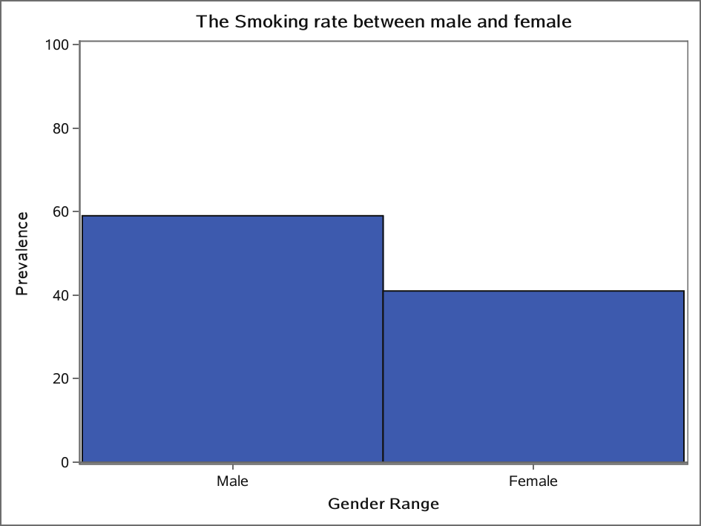

Slide 43
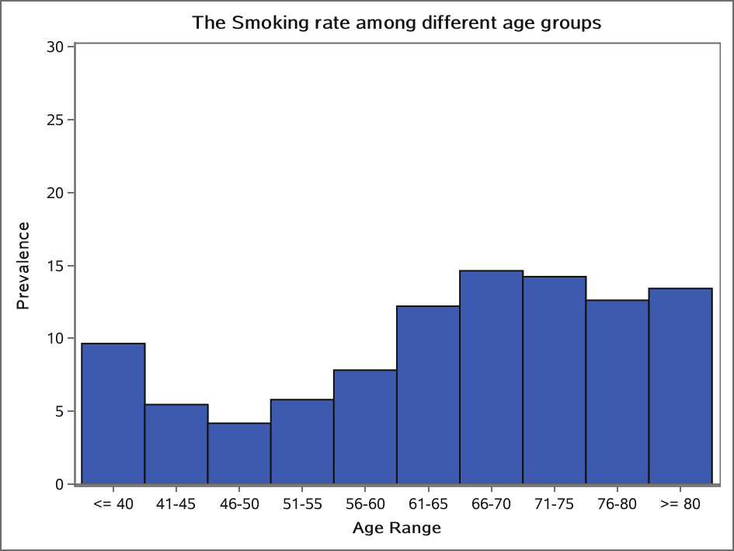

Slide 44
The Smoking rate among different age groups
“LOGISTIC”过程
模型信息
数据集 | WORK.ANALYSIS_DATA
响应变量 | HavingCVD
响应水平数 | 2
模型 | 二元 Logit
优化方法 | Fisher 评分法

Slide 45
The Smoking rate among different age groups
“LOGISTIC”过程
读取的观测数 | 2990
使用的观测数 | 2990

Slide 46
The Smoking rate among different age groups
“LOGISTIC”过程
响应概略
有序 值 | HavingCVD | 总 频数
1 | No | 1498
2 | Yes | 1492
建模的概率为 HavingCVD='Yes'。

Slide 47
The Smoking rate among different age groups
“LOGISTIC”过程
分类水平信息
分类 | 值 | 设计变量
SmokingStatus | No | 0
 | Yes | 1
Diabetes | No | 0
 | Yes | 1
Age_Range | 41-45 | 1 | 0 | 0 | 0 | 0 | 0 | 0 | 0 | 0
 | 46-50 | 0 | 1 | 0 | 0 | 0 | 0 | 0 | 0 | 0
 | 51-55 | 0 | 0 | 1 | 0 | 0 | 0 | 0 | 0 | 0
 | 56-60 | 0 | 0 | 0 | 1 | 0 | 0 | 0 | 0 | 0
 | 61-65 | 0 | 0 | 0 | 0 | 1 | 0 | 0 | 0 | 0

Slide 48
The Smoking rate among different age groups
“LOGISTIC”过程
分类水平信息
分类 | 值 | 设计变量
 | 66-70 | 0 | 0 | 0 | 0 | 0 | 1 | 0 | 0 | 0
 | 71-75 | 0 | 0 | 0 | 0 | 0 | 0 | 1 | 0 | 0
 | 76-80 | 0 | 0 | 0 | 0 | 0 | 0 | 0 | 1 | 0
 | <= 40 | 0 | 0 | 0 | 0 | 0 | 0 | 0 | 0 | 0
 | >= 80 | 0 | 0 | 0 | 0 | 0 | 0 | 0 | 0 | 1
GENDER | Female | 0
 | Male | 1
Exercise | No | 0
 | Yes | 1

Slide 49
The Smoking rate among different age groups
“LOGISTIC”过程
模型收敛状态
满足收敛准则 (GCONV=1E-8)。

Slide 50
The Smoking rate among different age groups
“LOGISTIC”过程
模型拟合统计量
准则 | 仅截距 | 截距和协变量
AIC | 4147.008 | 3242.971
SC | 4153.011 | 3333.016
-2 Log L | 4145.008 | 3212.971

Slide 51
The Smoking rate among different age groups
“LOGISTIC”过程
检验全局原假设: BETA=0
检验 | 卡方 | 自由度 | Pr > 卡方
似然比 | 932.0371 | 14 | <.0001
评分 | 821.7718 | 14 | <.0001
Wald | 616.5676 | 14 | <.0001

Slide 52
The Smoking rate among different age groups
“LOGISTIC”过程
3 型效应分析
效应 | 自由度 | Wald 卡方 | Pr > 卡方
Age_Range | 9 | 390.7384 | <.0001
BMI | 1 | 12.7540 | 0.0004
SmokingStatus | 1 | 43.4949 | <.0001
Diabetes | 1 | 90.3666 | <.0001
GENDER | 1 | 34.8981 | <.0001
Exercise | 1 | 8.7631 | 0.0031

Slide 53
The Smoking rate among different age groups
“LOGISTIC”过程
最大似然估计分析
参数 |  | 自由度 | 估计 | 标准 误差 | Wald 卡方 | Pr > 卡方
Intercept |  | 1 | -3.3170 | 0.2890 | 131.7190 | <.0001
Age_Range | 41-45 | 1 | 0.6256 | 0.2733 | 5.2403 | 0.0221
Age_Range | 46-50 | 1 | 1.0031 | 0.2640 | 14.4362 | 0.0001
Age_Range | 51-55 | 1 | 1.6807 | 0.2257 | 55.4685 | <.0001
Age_Range | 56-60 | 1 | 1.5197 | 0.2185 | 48.3696 | <.0001
Age_Range | 61-65 | 1 | 2.2200 | 0.2024 | 120.2900 | <.0001
Age_Range | 66-70 | 1 | 2.3334 | 0.2000 | 136.1066 | <.0001
Age_Range | 71-75 | 1 | 2.4274 | 0.2019 | 144.5503 | <.0001

Slide 54
The Smoking rate among different age groups
“LOGISTIC”过程
最大似然估计分析
参数 |  | 自由度 | 估计 | 标准 误差 | Wald 卡方 | Pr > 卡方
Age_Range | 76-80 | 1 | 2.9757 | 0.2167 | 188.5502 | <.0001
Age_Range | >= 80 | 1 | 3.2708 | 0.2095 | 243.7237 | <.0001
BMI |  | 1 | 0.1298 | 0.0363 | 12.7540 | 0.0004
SmokingStatus | Yes | 1 | 0.5766 | 0.0874 | 43.4949 | <.0001
Diabetes | Yes | 1 | 1.0749 | 0.1131 | 90.3666 | <.0001
GENDER | Male | 1 | 0.5182 | 0.0877 | 34.8981 | <.0001
Exercise | Yes | 1 | -0.2929 | 0.0989 | 8.7631 | 0.0031

Slide 55
The Smoking rate among different age groups
“LOGISTIC”过程
优比估计
效应 | 点估计 | 95% Wald 置信限
Age_Range 41-45 vs <= 40 | 1.869 | 1.094 | 3.194
Age_Range 46-50 vs <= 40 | 2.727 | 1.625 | 4.575
Age_Range 51-55 vs <= 40 | 5.369 | 3.450 | 8.356
Age_Range 56-60 vs <= 40 | 4.571 | 2.979 | 7.014
Age_Range 61-65 vs <= 40 | 9.207 | 6.192 | 13.690
Age_Range 66-70 vs <= 40 | 10.313 | 6.969 | 15.263
Age_Range 71-75 vs <= 40 | 11.330 | 7.627 | 16.829
Age_Range 76-80 vs <= 40 | 19.603 | 12.819 | 29.978

Slide 56
The Smoking rate among different age groups
“LOGISTIC”过程
优比估计
效应 | 点估计 | 95% Wald 置信限
Age_Range >= 80 vs <= 40 | 26.331 | 17.464 | 39.701
BMI | 1.139 | 1.060 | 1.223
SmokingStatus Yes vs No | 1.780 | 1.500 | 2.113
Diabetes Yes vs No | 2.930 | 2.347 | 3.656
GENDER Male vs Female | 1.679 | 1.414 | 1.994
Exercise Yes vs No | 0.746 | 0.615 | 0.906

Slide 57
The Smoking rate among different age groups
“LOGISTIC”过程
预测概率和观测响应的关联
一致部分所占百分比 | 80.3 | Somers D | 0.606
不一致部分所占百分比 | 19.7 | Gamma | 0.606
结值百分比 | 0.0 | Tau-a | 0.303
对 | 2235016 | c | 0.803

Slide 58


Slide 59


Slide 60
The Diabete rate between male and female
观测 | GENDER | Diabetes | COUNT | PERCENT | PCT_ROW | PCT_COL
1 | Male | No | 1207 | 40.3679 | 75.4375 | 51.9363
2 | Male | Yes | 393 | 13.1438 | 24.5625 | 59.0090
3 | Female | No | 1117 | 37.3579 | 80.3597 | 48.0637
4 | Female | Yes | 273 | 9.1304 | 19.6403 | 40.9910

Slide 61
The Diabete rate between male and female
观测 | GENDER | SmokingStatus | COUNT | PERCENT
1 | Male | No | 725 | 24.2475
2 | Male | Yes | 875 | 29.2642
3 | Female | No | 782 | 26.1538
4 | Female | Yes | 608 | 20.3344
观测 | PCT_ROW | PCT_COL
1 | 45.3125 | 48.1088
2 | 54.6875 | 59.0020
3 | 56.2590 | 51.8912
4 | 43.7410 | 40.9980

