Slide 1
FREQ 过程
HavingCVD-Stroke表
HavingCVD | Stroke
频数 百分比 行百分比 列百分比 | No | Yes | 合计
No | 724 48.59 96.79 54.19 | 24 1.61 3.21 15.58 | 748 50.20
Yes | 612 41.07 82.48 45.81 | 130 8.72 17.52 84.42 | 742 49.80
合计 | 1336 89.66 | 154 10.34 | 1490 100.00
表“Stroke-HavingCVD”的统计量

Slide 2
FREQ 过程
表“Stroke-HavingCVD”的统计量
统计量 | 自由度 | 值 | 概率
卡方 | 1 | 82.3274 | <.0001
似然比卡方检验 | 1 | 89.5896 | <.0001
连续调整卡方 | 1 | 80.7904 | <.0001
Mantel-Haenszel 卡方 | 1 | 82.2722 | <.0001
Phi 系数 |  | 0.2351
列联系数 |  | 0.2288
Cramer V |  | 0.2351

Slide 3
FREQ 过程
表“Stroke-HavingCVD”的统计量
Fisher 精确检验
单元格 (1,1) 频数 (F) | 724
左侧 Pr <= F | 1.0000
右侧 Pr >= F | <.0001
表概率 (P) | <.0001
双侧 Pr <= P | <.0001
样本大小 = 1490

Slide 4
FREQ 过程
HavingCVD-Asthma表
HavingCVD | Asthma
频数 百分比 行百分比 列百分比 | No | Yes | 合计
No | 644 43.22 86.10 51.73 | 104 6.98 13.90 42.45 | 748 50.20
Yes | 601 40.34 81.00 48.27 | 141 9.46 19.00 57.55 | 742 49.80
合计 | 1245 83.56 | 245 16.44 | 1490 100.00
表“Asthma-HavingCVD”的统计量

Slide 5
FREQ 过程
表“Asthma-HavingCVD”的统计量
统计量 | 自由度 | 值 | 概率
卡方 | 1 | 7.0488 | 0.0079
似然比卡方检验 | 1 | 7.0705 | 0.0078
连续调整卡方 | 1 | 6.6826 | 0.0097
Mantel-Haenszel 卡方 | 1 | 7.0441 | 0.0080
Phi 系数 |  | 0.0688
列联系数 |  | 0.0686
Cramer V |  | 0.0688

Slide 6
FREQ 过程
表“Asthma-HavingCVD”的统计量
Fisher 精确检验
单元格 (1,1) 频数 (F) | 644
左侧 Pr <= F | 0.9968
右侧 Pr >= F | 0.0048
表概率 (P) | 0.0016
双侧 Pr <= P | 0.0096
样本大小 = 1490

Slide 7
FREQ 过程
HavingCVD-Exercise表
HavingCVD | Exercise
频数 百分比 行百分比 列百分比 | No | Yes | 合计
No | 160 10.74 21.39 40.40 | 588 39.46 78.61 53.75 | 748 50.20
Yes | 236 15.84 31.81 59.60 | 506 33.96 68.19 46.25 | 742 49.80
合计 | 396 26.58 | 1094 73.42 | 1490 100.00
表“Exercise-HavingCVD”的统计量

Slide 8
FREQ 过程
表“Exercise-HavingCVD”的统计量
统计量 | 自由度 | 值 | 概率
卡方 | 1 | 20.7083 | <.0001
似然比卡方检验 | 1 | 20.8046 | <.0001
连续调整卡方 | 1 | 20.1780 | <.0001
Mantel-Haenszel 卡方 | 1 | 20.6944 | <.0001
Phi 系数 |  | -0.1179
列联系数 |  | 0.1171
Cramer V |  | -0.1179

Slide 9
FREQ 过程
表“Exercise-HavingCVD”的统计量
Fisher 精确检验
单元格 (1,1) 频数 (F) | 160
左侧 Pr <= F | <.0001
右侧 Pr >= F | 1.0000
表概率 (P) | <.0001
双侧 Pr <= P | <.0001
样本大小 = 1490

Slide 10
FREQ 过程
HavingCVD-SleepTime表
HavingCVD | SleepTime
频数 百分比 行百分比 列百分比 | 3 | 4 | 5 | 6 | 7 | 8 | 9 | 10
No | 9 0.60 1.20 47.37 | 13 0.87 1.74 26.53 | 48 3.22 6.42 47.52 | 155 10.40 20.72 50.32 | 232 15.57 31.02 59.18 | 224 15.03 29.95 50.22 | 43 2.89 5.75 42.16 | 16 1.07 2.14 32.00
Yes | 10 0.67 1.35 52.63 | 36 2.42 4.85 73.47 | 53 3.56 7.14 52.48 | 153 10.27 20.62 49.68 | 160 10.74 21.56 40.82 | 222 14.90 29.92 49.78 | 59 3.96 7.95 57.84 | 34 2.28 4.58 68.00
合计 | 19 1.28 | 49 3.29 | 101 6.78 | 308 20.67 | 392 26.31 | 446 29.93 | 102 6.85 | 50 3.36

Slide 11
FREQ 过程
HavingCVD-SleepTime表
HavingCVD | SleepTime
频数 百分比 行百分比 列百分比 | 11 | 12 | 13 | 14 | 15 | 合计
No | 0 0.00 0.00 0.00 | 5 0.34 0.67 35.71 | 1 0.07 0.13 33.33 | 1 0.07 0.13 100.00 | 1 0.07 0.13 33.33 | 748 50.20
Yes | 2 0.13 0.27 100.00 | 9 0.60 1.21 64.29 | 2 0.13 0.27 66.67 | 0 0.00 0.00 0.00 | 2 0.13 0.27 66.67 | 742 49.80
合计 | 2 0.13 | 14 0.94 | 3 0.20 | 1 0.07 | 3 0.20 | 1490 100.00
表“SleepTime-HavingCVD”的统计量

Slide 12
FREQ 过程
表“SleepTime-HavingCVD”的统计量
统计量 | 自由度 | 值 | 概率
卡方 | 12 | 38.1183 | 0.0001
似然比卡方检验 | 12 | 39.9754 | <.0001
Mantel-Haenszel 卡方 | 1 | 0.4335 | 0.5103
Phi 系数 |  | 0.1599
列联系数 |  | 0.1579
Cramer V |  | 0.1599
WARNING: 31% 的单元格包含小于 5 的期望计数。卡方不是有效的检验。
样本大小 = 1490

Slide 13
“LOGISTIC”过程
模型信息
数据集 | WORK.ANALYSIS_DATA
响应变量 | HavingCVD
响应水平数 | 2
模型 | 二元 Logit
优化方法 | Fisher 评分法

Slide 14
“LOGISTIC”过程
读取的观测数 | 1490
使用的观测数 | 1490

Slide 15
“LOGISTIC”过程
响应概略
有序 值 | HavingCVD | 总 频数
1 | No | 748
2 | Yes | 742
建模的概率为 HavingCVD='Yes'。

Slide 16
“LOGISTIC”过程
分类水平信息
分类 | 值 | 设计变量
Stroke | No | 0
 | Yes | 1
Asthma | No | 0
 | Yes | 1
Exercise | No | 0
 | Yes | 1
GENDER | Female | 0
 | Male | 1
Age_Range | 41-45 | 1 | 0 | 0 | 0 | 0 | 0 | 0 | 0 | 0
 | 46-50 | 0 | 1 | 0 | 0 | 0 | 0 | 0 | 0 | 0
 | 51-55 | 0 | 0 | 1 | 0 | 0 | 0 | 0 | 0 | 0
 | 56-60 | 0 | 0 | 0 | 1 | 0 | 0 | 0 | 0 | 0

Slide 17
“LOGISTIC”过程
分类水平信息
分类 | 值 | 设计变量
 | 61-65 | 0 | 0 | 0 | 0 | 1 | 0 | 0 | 0 | 0
 | 66-70 | 0 | 0 | 0 | 0 | 0 | 1 | 0 | 0 | 0
 | 71-75 | 0 | 0 | 0 | 0 | 0 | 0 | 1 | 0 | 0
 | 76-80 | 0 | 0 | 0 | 0 | 0 | 0 | 0 | 1 | 0
 | <= 40 | 0 | 0 | 0 | 0 | 0 | 0 | 0 | 0 | 0
 | >= 80 | 0 | 0 | 0 | 0 | 0 | 0 | 0 | 0 | 1
BMI_Class | NORMAL | 0 | 0 | 0
 | OBESITY | 1 | 0 | 0
 | OVER-FAT | 0 | 1 | 0
 | OVER-THIN | 0 | 0 | 1
MentalHealth | 0 days | 0 | 0 | 0 | 0 | 0
 | 1-7 days | 1 | 0 | 0 | 0 | 0

Slide 18
“LOGISTIC”过程
分类水平信息
分类 | 值 | 设计变量
 | 15-21 days | 0 | 1 | 0 | 0 | 0
 | 22-28 days | 0 | 0 | 1 | 0 | 0
 | 8-14 days | 0 | 0 | 0 | 1 | 0
 | >28 days | 0 | 0 | 0 | 0 | 1
SleepTime | 3 | 1 | 0 | 0 | 0 | 0 | 0 | 0 | 0 | 0 | 0 | 0 | 0
 | 4 | 0 | 0 | 0 | 0 | 0 | 0 | 0 | 0 | 0 | 0 | 0 | 0
 | 5 | 0 | 1 | 0 | 0 | 0 | 0 | 0 | 0 | 0 | 0 | 0 | 0
 | 6 | 0 | 0 | 1 | 0 | 0 | 0 | 0 | 0 | 0 | 0 | 0 | 0
 | 7 | 0 | 0 | 0 | 1 | 0 | 0 | 0 | 0 | 0 | 0 | 0 | 0
 | 8 | 0 | 0 | 0 | 0 | 1 | 0 | 0 | 0 | 0 | 0 | 0 | 0
 | 9 | 0 | 0 | 0 | 0 | 0 | 1 | 0 | 0 | 0 | 0 | 0 | 0
 | 10 | 0 | 0 | 0 | 0 | 0 | 0 | 1 | 0 | 0 | 0 | 0 | 0

Slide 19
“LOGISTIC”过程
分类水平信息
分类 | 值 | 设计变量
 | 11 | 0 | 0 | 0 | 0 | 0 | 0 | 0 | 1 | 0 | 0 | 0 | 0
 | 12 | 0 | 0 | 0 | 0 | 0 | 0 | 0 | 0 | 1 | 0 | 0 | 0
 | 13 | 0 | 0 | 0 | 0 | 0 | 0 | 0 | 0 | 0 | 1 | 0 | 0
 | 14 | 0 | 0 | 0 | 0 | 0 | 0 | 0 | 0 | 0 | 0 | 1 | 0
 | 15 | 0 | 0 | 0 | 0 | 0 | 0 | 0 | 0 | 0 | 0 | 0 | 1

Slide 20
“LOGISTIC”过程
模型收敛状态
满足收敛准则 (GCONV=1E-8)。

Slide 21
“LOGISTIC”过程
模型拟合统计量
准则 | 仅截距 | 截距和协变量
AIC | 2067.554 | 1613.521
SC | 2072.861 | 1793.943
-2 Log L | 2065.554 | 1545.521

Slide 22
“LOGISTIC”过程
检验全局原假设: BETA=0
检验 | 卡方 | 自由度 | Pr > 卡方
似然比 | 520.0334 | 33 | <.0001
评分 | 446.7910 | 33 | <.0001
Wald | 319.9994 | 33 | <.0001

Slide 23
“LOGISTIC”过程
3 型效应分析
效应 | 自由度 | Wald 卡方 | Pr > 卡方
Stroke | 1 | 33.3459 | <.0001
Asthma | 1 | 6.5937 | 0.0102
Exercise | 1 | 0.3396 | 0.5601
SleepTime | 12 | 22.9976 | 0.0277
GENDER | 1 | 40.9775 | <.0001
Age_Range | 9 | 229.3793 | <.0001
BMI_Class | 3 | 12.5407 | 0.0057
MentalHealth | 5 | 7.8755 | 0.1632

Slide 24
“LOGISTIC”过程
最大似然估计分析
参数 |  | 自由度 | 估计 | 标准 误差 | Wald 卡方 | Pr > 卡方
Intercept |  | 1 | -2.0199 | 0.4838 | 17.4348 | <.0001
Stroke | Yes | 1 | 1.4978 | 0.2594 | 33.3459 | <.0001
Asthma | Yes | 1 | 0.4586 | 0.1786 | 6.5937 | 0.0102
Exercise | Yes | 1 | -0.0858 | 0.1472 | 0.3396 | 0.5601
SleepTime | 3 | 1 | -1.2902 | 0.6791 | 3.6095 | 0.0574
SleepTime | 5 | 1 | -1.1468 | 0.4589 | 6.2460 | 0.0124
SleepTime | 6 | 1 | -1.0848 | 0.4176 | 6.7467 | 0.0094
SleepTime | 7 | 1 | -1.5647 | 0.4197 | 13.8967 | 0.0002
SleepTime | 8 | 1 | -1.3524 | 0.4174 | 10.4987 | 0.0012
SleepTime | 9 | 1 | -1.0144 | 0.4700 | 4.6569 | 0.0309
SleepTime | 10 | 1 | -0.4943 | 0.5402 | 0.8374 | 0.3601
SleepTime | 11 | 1 | 10.2968 | 510.3 | 0.0004 | 0.9839

Slide 25
“LOGISTIC”过程
最大似然估计分析
参数 |  | 自由度 | 估计 | 标准 误差 | Wald 卡方 | Pr > 卡方
SleepTime | 12 | 1 | -1.0775 | 0.7571 | 2.0257 | 0.1547
SleepTime | 13 | 1 | -0.7604 | 1.3642 | 0.3107 | 0.5773
SleepTime | 14 | 1 | -13.1893 | 736.2 | 0.0003 | 0.9857
SleepTime | 15 | 1 | -1.2689 | 1.5450 | 0.6746 | 0.4115
GENDER | Male | 1 | 0.8428 | 0.1317 | 40.9775 | <.0001
Age_Range | 41-45 | 1 | 0.9191 | 0.3741 | 6.0358 | 0.0140
Age_Range | 46-50 | 1 | 0.5749 | 0.3928 | 2.1427 | 0.1432
Age_Range | 51-55 | 1 | 1.8879 | 0.3080 | 37.5738 | <.0001
Age_Range | 56-60 | 1 | 1.7850 | 0.3071 | 33.7834 | <.0001
Age_Range | 61-65 | 1 | 2.6559 | 0.2863 | 86.0717 | <.0001
Age_Range | 66-70 | 1 | 2.5335 | 0.2798 | 81.9731 | <.0001
Age_Range | 71-75 | 1 | 3.1066 | 0.2857 | 118.2369 | <.0001

Slide 26
“LOGISTIC”过程
最大似然估计分析
参数 |  | 自由度 | 估计 | 标准 误差 | Wald 卡方 | Pr > 卡方
Age_Range | 76-80 | 1 | 3.5522 | 0.3149 | 127.2285 | <.0001
Age_Range | >= 80 | 1 | 3.3879 | 0.2966 | 130.5094 | <.0001
BMI_Class | OBESITY | 1 | 0.5561 | 0.1709 | 10.5832 | 0.0011
BMI_Class | OVER-FAT | 1 | 0.3181 | 0.1803 | 3.1143 | 0.0776
BMI_Class | OVER-THIN | 1 | -0.3062 | 0.4879 | 0.3937 | 0.5303
MentalHealth | 1-7 days | 1 | 0.0193 | 0.1705 | 0.0129 | 0.9097
MentalHealth | 15-21 days | 1 | 0.6703 | 0.3282 | 4.1711 | 0.0411
MentalHealth | 22-28 days | 1 | 0.8943 | 0.8231 | 1.1806 | 0.2772
MentalHealth | 8-14 days | 1 | 0.2970 | 0.3253 | 0.8338 | 0.3612
MentalHealth | >28 days | 1 | 0.4676 | 0.2638 | 3.1425 | 0.0763

Slide 27
“LOGISTIC”过程
优比估计
效应 | 点估计 | 95% Wald 置信限
Stroke Yes vs No | 4.472 | 2.690 | 7.435
Asthma Yes vs No | 1.582 | 1.115 | 2.245
Exercise Yes vs No | 0.918 | 0.688 | 1.225
SleepTime 3 vs 4 | 0.275 | 0.073 | 1.042
SleepTime 5 vs 4 | 0.318 | 0.129 | 0.781
SleepTime 6 vs 4 | 0.338 | 0.149 | 0.766
SleepTime 7 vs 4 | 0.209 | 0.092 | 0.476
SleepTime 8 vs 4 | 0.259 | 0.114 | 0.586
SleepTime 9 vs 4 | 0.363 | 0.144 | 0.911
SleepTime 10 vs 4 | 0.610 | 0.212 | 1.758
SleepTime 11 vs 4 | >999.999 | <0.001 | >999.999
SleepTime 12 vs 4 | 0.340 | 0.077 | 1.501

Slide 28
“LOGISTIC”过程
优比估计
效应 | 点估计 | 95% Wald 置信限
SleepTime 13 vs 4 | 0.467 | 0.032 | 6.776
SleepTime 14 vs 4 | <0.001 | <0.001 | >999.999
SleepTime 15 vs 4 | 0.281 | 0.014 | 5.808
GENDER Male vs Female | 2.323 | 1.795 | 3.007
Age_Range 41-45 vs <= 40 | 2.507 | 1.204 | 5.219
Age_Range 46-50 vs <= 40 | 1.777 | 0.823 | 3.837
Age_Range 51-55 vs <= 40 | 6.605 | 3.612 | 12.080
Age_Range 56-60 vs <= 40 | 5.960 | 3.265 | 10.880
Age_Range 61-65 vs <= 40 | 14.238 | 8.124 | 24.953
Age_Range 66-70 vs <= 40 | 12.597 | 7.279 | 21.800
Age_Range 71-75 vs <= 40 | 22.345 | 12.764 | 39.118
Age_Range 76-80 vs <= 40 | 34.890 | 18.821 | 64.679

Slide 29
“LOGISTIC”过程
优比估计
效应 | 点估计 | 95% Wald 置信限
Age_Range >= 80 vs <= 40 | 29.604 | 16.555 | 52.939
BMI_Class OBESITY vs NORMAL | 1.744 | 1.247 | 2.438
BMI_Class OVER-FAT vs NORMAL | 1.375 | 0.965 | 1.957
BMI_Class OVER-THIN vs NORMAL | 0.736 | 0.283 | 1.916
MentalHealth 1-7 days vs 0 days | 1.020 | 0.730 | 1.424
MentalHealth 15-21 days vs 0 days | 1.955 | 1.027 | 3.720
MentalHealth 22-28 days vs 0 days | 2.446 | 0.487 | 12.275
MentalHealth 8-14 days vs 0 days | 1.346 | 0.711 | 2.546
MentalHealth >28 days vs 0 days | 1.596 | 0.952 | 2.677

Slide 30
“LOGISTIC”过程
预测概率和观测响应的关联
一致部分所占百分比 | 81.9 | Somers D | 0.638
不一致部分所占百分比 | 18.1 | Gamma | 0.639
结值百分比 | 0.1 | Tau-a | 0.319
对 | 555016 | c | 0.819

Slide 31
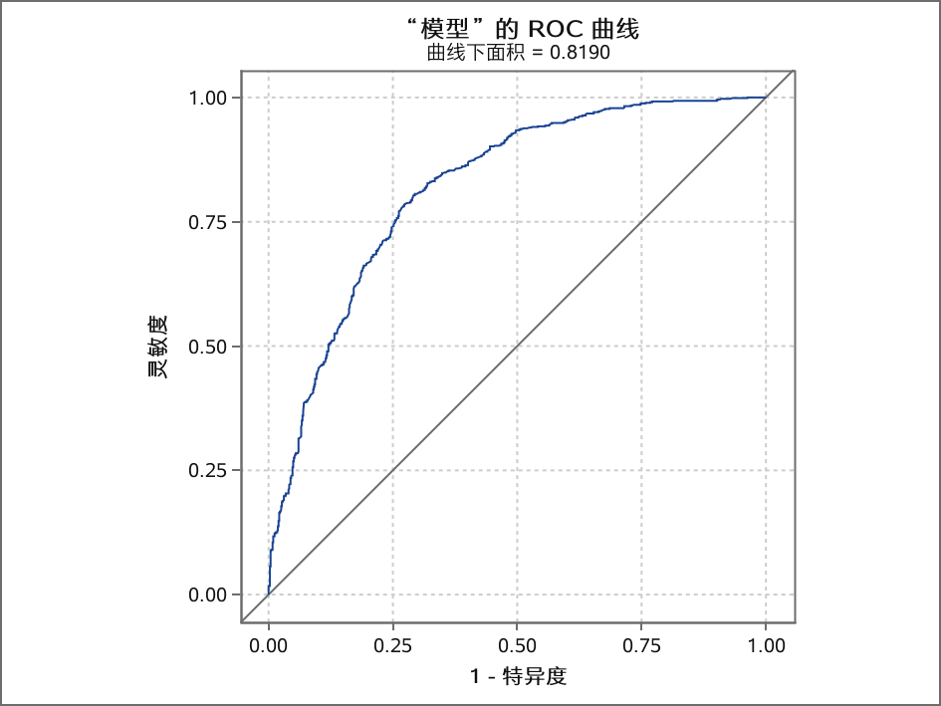
“LOGISTIC”过程

