Slide 1
Mean difference of
Alcohol_Consumption between
Male and Female
TTEST 过程
变量: Alcohol_Consumption (Alcohol_Consumption)
GENDER | 方法 | 数目 | 均值 | 标准差 | 标准误差
Male |  | 824 | 5.4612 | 8.7098 | 0.3034
Female |  | 676 | 3.8062 | 7.5849 | 0.2917
差 (1-2) | 汇总 |  | 1.6550 | 8.2220 | 0.4267
差 (1-2) | Satterthwaite |  | 1.6550 |  | 0.4209

Slide 2
Mean difference of
Alcohol_Consumption between
Male and Female
TTEST 过程
变量: Alcohol_Consumption (Alcohol_Consumption)
GENDER | 方法 | 最小值 | 最大值
Male |  | 0 | 30.0000
Female |  | 0 | 30.0000
差 (1-2) | 汇总
差 (1-2) | Satterthwaite

Slide 3
Mean difference of
Alcohol_Consumption between
Male and Female
TTEST 过程
变量: Alcohol_Consumption (Alcohol_Consumption)
GENDER | 方法 | 均值 | 95% 置信限均值 |  | 标准差
Male |  | 5.4612 | 4.8656 | 6.0567 | 8.7098
Female |  | 3.8062 | 3.2334 | 4.3790 | 7.5849
差 (1-2) | 汇总 | 1.6550 | 0.8180 | 2.4919 | 8.2220
差 (1-2) | Satterthwaite | 1.6550 | 0.8293 | 2.4806

Slide 4
Mean difference of
Alcohol_Consumption between
Male and Female
TTEST 过程
变量: Alcohol_Consumption (Alcohol_Consumption)
GENDER | 方法 | 95% 置信限标准差
Male |  | 8.3086 | 9.1519
Female |  | 7.2010 | 8.0124
差 (1-2) | 汇总 | 7.9378 | 8.5274
差 (1-2) | Satterthwaite

Slide 5
Mean difference of
Alcohol_Consumption between
Male and Female
TTEST 过程
变量: Alcohol_Consumption (Alcohol_Consumption)
方法 | 方差 | 自由度 | t 值 | Pr > |t|
汇总 | 等于 | 1498 | 3.88 | 0.0001
Satterthwaite | 不等于 | 1492.7 | 3.93 | <.0001

Slide 6
Mean difference of
Alcohol_Consumption between
Male and Female
TTEST 过程
变量: Alcohol_Consumption (Alcohol_Consumption)
方差齐性
方法 | 分子自由度 | 分母自由度 | F 值 | Pr > F
折叠的 F | 823 | 675 | 1.32 | 0.0002

Slide 7
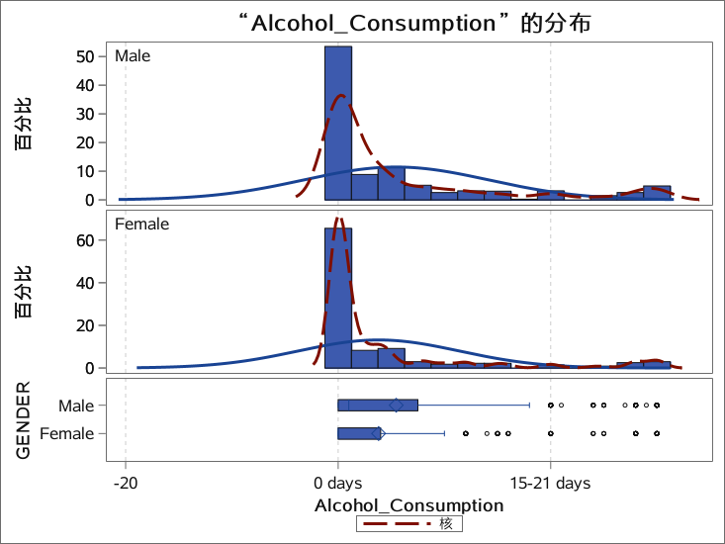
Mean difference of
Alcohol_Consumption between
Male and Female
TTEST 过程
变量: Alcohol_Consumption (Alcohol_Consumption)

Slide 8
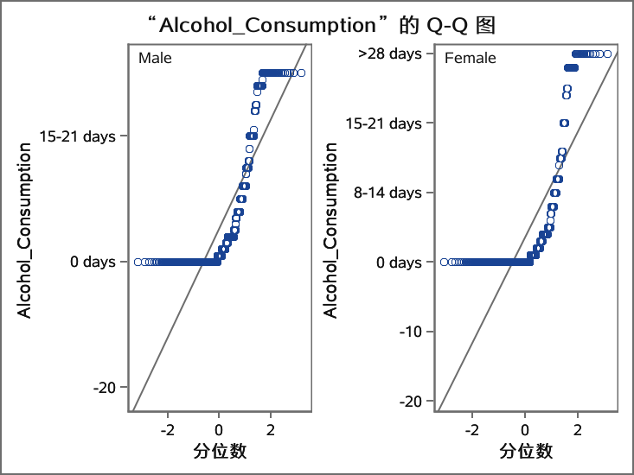
Mean difference of
Alcohol_Consumption between
Male and Female
TTEST 过程
变量: Alcohol_Consumption (Alcohol_Consumption)

