Slide 1
FREQ 过程
GENDER-Alcohol_Consumption表
GENDER | Alcohol_Consumption(Alcohol_Consumption)
频数 百分比 行百分比 列百分比 | 0 days | 1-7 days | 8-14 days | 15-21 days | 22-28 days | >28 days | 合计
Male | 384 25.60 46.60 50.00 | 234 15.60 28.40 56.52 | 83 5.53 10.07 64.84 | 50 3.33 6.07 67.57 | 33 2.20 4.00 58.93 | 40 2.67 4.85 66.67 | 824 54.93
Female | 384 25.60 56.80 50.00 | 180 12.00 26.63 43.48 | 45 3.00 6.66 35.16 | 24 1.60 3.55 32.43 | 23 1.53 3.40 41.07 | 20 1.33 2.96 33.33 | 676 45.07
合计 | 768 51.20 | 414 27.60 | 128 8.53 | 74 4.93 | 56 3.73 | 60 4.00 | 1500 100.00
表“Alcohol_Consumption-GENDER”的统计量

Slide 2
FREQ 过程
表“Alcohol_Consumption-GENDER”的统计量
统计量 | 自由度 | 值 | 概率
卡方 | 5 | 21.5191 | 0.0006
似然比卡方检验 | 5 | 21.8146 | 0.0006
Mantel-Haenszel 卡方 | 1 | 11.9107 | 0.0006
Phi 系数 |  | 0.1198
列联系数 |  | 0.1189
Cramer V |  | 0.1198
样本大小 = 1500

Slide 3
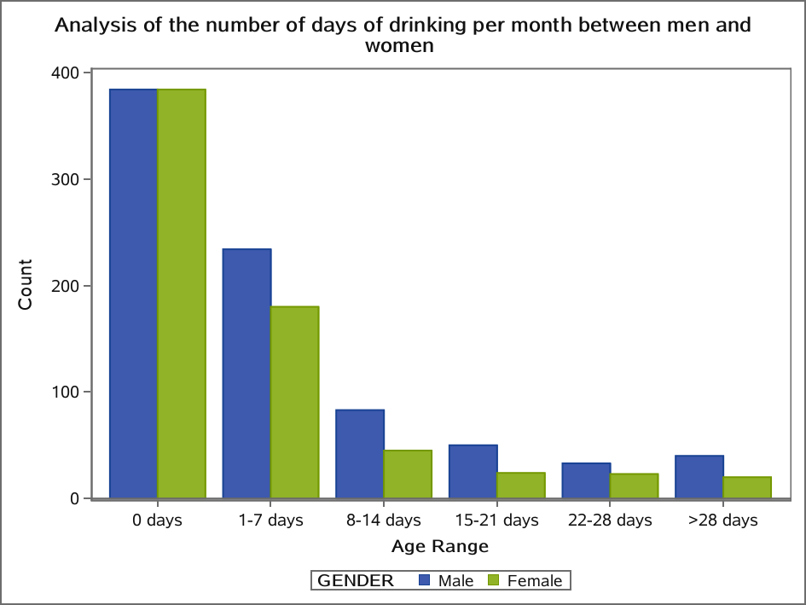

Slide 4
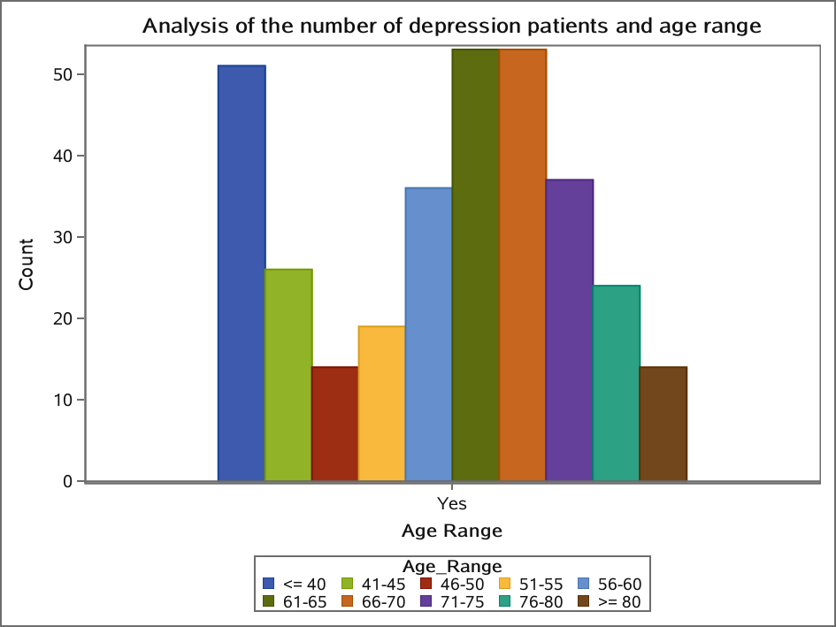

Slide 5
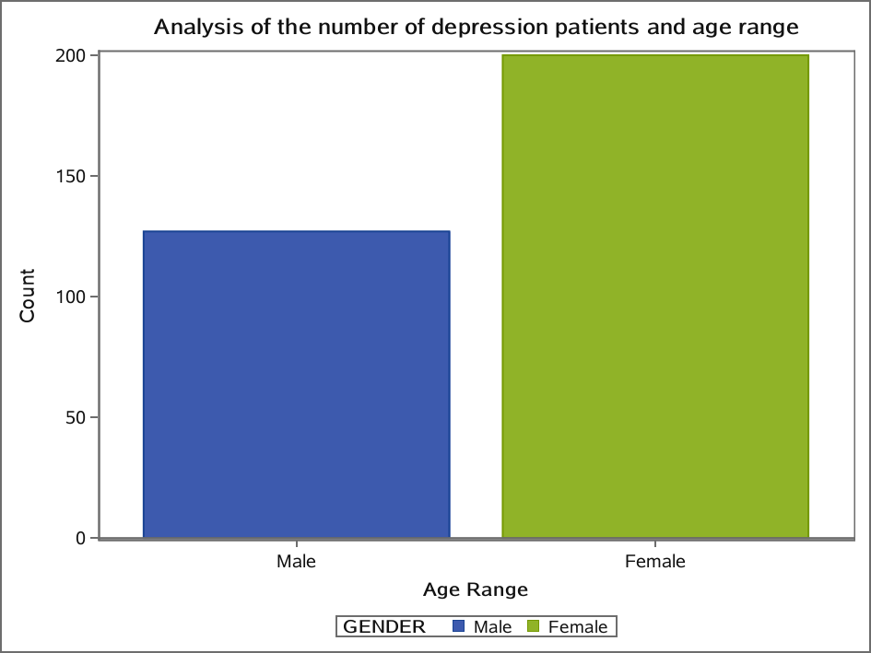

Slide 6
Analysis of the number of depression patients and age range
FREQ 过程
HavingCVD-Depression表
HavingCVD | Depression
频数 百分比 行百分比 列百分比 | No | Yes | 合计
No | 597 39.80 79.60 50.90 | 153 10.20 20.40 46.79 | 750 50.00
Yes | 576 38.40 76.80 49.10 | 174 11.60 23.20 53.21 | 750 50.00

Slide 7
Analysis of the number of depression patients and age range
FREQ 过程
HavingCVD-Depression表
HavingCVD | Depression
频数 百分比 行百分比 列百分比 | No | Yes | 合计
合计 | 1173 78.20 | 327 21.80 | 1500 100.00
表“Depression-HavingCVD”的统计量
统计量 | 自由度 | 值 | 概率
卡方 | 1 | 1.7246 | 0.1891
似然比卡方检验 | 1 | 1.7255 | 0.1890

Slide 8
Analysis of the number of depression patients and age range
FREQ 过程
表“Depression-HavingCVD”的统计量
统计量 | 自由度 | 值 | 概率
连续调整卡方 | 1 | 1.5642 | 0.2110
Mantel-Haenszel 卡方 | 1 | 1.7234 | 0.1893
Phi 系数 |  | 0.0339
列联系数 |  | 0.0339
Cramer V |  | 0.0339

Slide 9
Analysis of the number of depression patients and age range
FREQ 过程
表“Depression-HavingCVD”的统计量
Fisher 精确检验
单元格 (1,1) 频数 (F) | 597
左侧 Pr <= F | 0.9156
右侧 Pr >= F | 0.1055
表概率 (P) | 0.0211
双侧 Pr <= P | 0.2110
样本大小 = 1500

Slide 10
Analysis of the number of depression patients and age range
FREQ 过程
HavingCVD-Skin_Cancer表
HavingCVD | Skin_Cancer
频数 百分比 行百分比 列百分比 | No | Yes | 合计
No | 676 45.07 90.13 52.61 | 74 4.93 9.87 34.42 | 750 50.00
Yes | 609 40.60 81.20 47.39 | 141 9.40 18.80 65.58 | 750 50.00

Slide 11
Analysis of the number of depression patients and age range
FREQ 过程
HavingCVD-Skin_Cancer表
HavingCVD | Skin_Cancer
频数 百分比 行百分比 列百分比 | No | Yes | 合计
合计 | 1285 85.67 | 215 14.33 | 1500 100.00
表“Skin_Cancer-HavingCVD”的统计量
统计量 | 自由度 | 值 | 概率
卡方 | 1 | 24.3725 | <.0001
似然比卡方检验 | 1 | 24.7258 | <.0001

Slide 12
Analysis of the number of depression patients and age range
FREQ 过程
表“Skin_Cancer-HavingCVD”的统计量
统计量 | 自由度 | 值 | 概率
连续调整卡方 | 1 | 23.6503 | <.0001
Mantel-Haenszel 卡方 | 1 | 24.3562 | <.0001
Phi 系数 |  | 0.1275
列联系数 |  | 0.1264
Cramer V |  | 0.1275

Slide 13
Analysis of the number of depression patients and age range
FREQ 过程
表“Skin_Cancer-HavingCVD”的统计量
Fisher 精确检验
单元格 (1,1) 频数 (F) | 676
左侧 Pr <= F | 1.0000
右侧 Pr >= F | <.0001
表概率 (P) | <.0001
双侧 Pr <= P | <.0001
样本大小 = 1500

Slide 14
Analysis of the number of depression patients and age range
FREQ 过程
HavingCVD-Other_Cancer表
HavingCVD | Other_Cancer
频数 百分比 行百分比 列百分比 | No | Yes | 合计
No | 678 45.20 90.40 53.09 | 72 4.80 9.60 32.29 | 750 50.00
Yes | 599 39.93 79.87 46.91 | 151 10.07 20.13 67.71 | 750 50.00

Slide 15
Analysis of the number of depression patients and age range
FREQ 过程
HavingCVD-Other_Cancer表
HavingCVD | Other_Cancer
频数 百分比 行百分比 列百分比 | No | Yes | 合计
合计 | 1277 85.13 | 223 14.87 | 1500 100.00
表“Other_Cancer-HavingCVD”的统计量
统计量 | 自由度 | 值 | 概率
卡方 | 1 | 32.8738 | <.0001
似然比卡方检验 | 1 | 33.4938 | <.0001

Slide 16
Analysis of the number of depression patients and age range
FREQ 过程
表“Other_Cancer-HavingCVD”的统计量
统计量 | 自由度 | 值 | 概率
连续调整卡方 | 1 | 32.0468 | <.0001
Mantel-Haenszel 卡方 | 1 | 32.8519 | <.0001
Phi 系数 |  | 0.1480
列联系数 |  | 0.1464
Cramer V |  | 0.1480

Slide 17
Analysis of the number of depression patients and age range
FREQ 过程
表“Other_Cancer-HavingCVD”的统计量
Fisher 精确检验
单元格 (1,1) 频数 (F) | 678
左侧 Pr <= F | 1.0000
右侧 Pr >= F | <.0001
表概率 (P) | <.0001
双侧 Pr <= P | <.0001
样本大小 = 1500

Slide 18
Analysis of the number of depression patients and age range
FREQ 过程
HavingCVD-Exercise表
HavingCVD | Exercise
频数 百分比 行百分比 列百分比 | No | Yes | 合计
No | 164 10.93 21.87 36.85 | 586 39.07 78.13 55.55 | 750 50.00
Yes | 281 18.73 37.47 63.15 | 469 31.27 62.53 44.45 | 750 50.00

Slide 19
Analysis of the number of depression patients and age range
FREQ 过程
HavingCVD-Exercise表
HavingCVD | Exercise
频数 百分比 行百分比 列百分比 | No | Yes | 合计
合计 | 445 29.67 | 1055 70.33 | 1500 100.00
表“Exercise-HavingCVD”的统计量
统计量 | 自由度 | 值 | 概率
卡方 | 1 | 43.7372 | <.0001
似然比卡方检验 | 1 | 44.1285 | <.0001

Slide 20
Analysis of the number of depression patients and age range
FREQ 过程
表“Exercise-HavingCVD”的统计量
统计量 | 自由度 | 值 | 概率
连续调整卡方 | 1 | 42.9927 | <.0001
Mantel-Haenszel 卡方 | 1 | 43.7080 | <.0001
Phi 系数 |  | -0.1708
列联系数 |  | 0.1683
Cramer V |  | -0.1708

Slide 21
Analysis of the number of depression patients and age range
FREQ 过程
表“Exercise-HavingCVD”的统计量
Fisher 精确检验
单元格 (1,1) 频数 (F) | 164
左侧 Pr <= F | <.0001
右侧 Pr >= F | 1.0000
表概率 (P) | <.0001
双侧 Pr <= P | <.0001
样本大小 = 1500

Slide 22
Analysis of the number of depression patients and age range
FREQ 过程
HavingCVD-Diabetes表
HavingCVD | Diabetes
频数 百分比 行百分比 列百分比 | No | Yes | 合计
No | 670 44.67 89.33 58.67 | 80 5.33 10.67 22.35 | 750 50.00
Yes | 472 31.47 62.93 41.33 | 278 18.53 37.07 77.65 | 750 50.00

Slide 23
Analysis of the number of depression patients and age range
FREQ 过程
HavingCVD-Diabetes表
HavingCVD | Diabetes
频数 百分比 行百分比 列百分比 | No | Yes | 合计
合计 | 1142 76.13 | 358 23.87 | 1500 100.00
表“Diabetes-HavingCVD”的统计量
统计量 | 自由度 | 值 | 概率
卡方 | 1 | 143.8376 | <.0001
似然比卡方检验 | 1 | 150.4167 | <.0001

Slide 24
Analysis of the number of depression patients and age range
FREQ 过程
表“Diabetes-HavingCVD”的统计量
统计量 | 自由度 | 值 | 概率
连续调整卡方 | 1 | 142.3884 | <.0001
Mantel-Haenszel 卡方 | 1 | 143.7417 | <.0001
Phi 系数 |  | 0.3097
列联系数 |  | 0.2958
Cramer V |  | 0.3097

Slide 25
Analysis of the number of depression patients and age range
FREQ 过程
表“Diabetes-HavingCVD”的统计量
Fisher 精确检验
单元格 (1,1) 频数 (F) | 670
左侧 Pr <= F | 1.0000
右侧 Pr >= F | <.0001
表概率 (P) | <.0001
双侧 Pr <= P | <.0001
样本大小 = 1500

Slide 26
Analysis of the number of depression patients and age range
FREQ 过程
HavingCVD-SmokingStatus表
HavingCVD | SmokingStatus
频数 百分比 行百分比 列百分比 | No | Yes | 合计
No | 444 29.60 59.20 59.04 | 306 20.40 40.80 40.91 | 750 50.00
Yes | 308 20.53 41.07 40.96 | 442 29.47 58.93 59.09 | 750 50.00

Slide 27
Analysis of the number of depression patients and age range
FREQ 过程
HavingCVD-SmokingStatus表
HavingCVD | SmokingStatus
频数 百分比 行百分比 列百分比 | No | Yes | 合计
合计 | 752 50.13 | 748 49.87 | 1500 100.00
表“SmokingStatus-HavingCVD”的统计量
统计量 | 自由度 | 值 | 概率
卡方 | 1 | 49.3230 | <.0001
似然比卡方检验 | 1 | 49.5970 | <.0001

Slide 28
Analysis of the number of depression patients and age range
FREQ 过程
表“SmokingStatus-HavingCVD”的统计量
统计量 | 自由度 | 值 | 概率
连续调整卡方 | 1 | 48.6003 | <.0001
Mantel-Haenszel 卡方 | 1 | 49.2901 | <.0001
Phi 系数 |  | 0.1813
列联系数 |  | 0.1784
Cramer V |  | 0.1813

Slide 29
Analysis of the number of depression patients and age range
FREQ 过程
表“SmokingStatus-HavingCVD”的统计量
Fisher 精确检验
单元格 (1,1) 频数 (F) | 444
左侧 Pr <= F | 1.0000
右侧 Pr >= F | <.0001
表概率 (P) | <.0001
双侧 Pr <= P | <.0001
样本大小 = 1500

Slide 30
Analysis of the number of depression patients and age range
FREQ 过程
HavingCVD-GENDER表
HavingCVD | GENDER
频数 百分比 行百分比 列百分比 | Male | Female | 合计
No | 378 25.20 50.40 45.87 | 372 24.80 49.60 55.03 | 750 50.00
Yes | 446 29.73 59.47 54.13 | 304 20.27 40.53 44.97 | 750 50.00

Slide 31
Analysis of the number of depression patients and age range
FREQ 过程
HavingCVD-GENDER表
HavingCVD | GENDER
频数 百分比 行百分比 列百分比 | Male | Female | 合计
合计 | 824 54.93 | 676 45.07 | 1500 100.00
表“GENDER-HavingCVD”的统计量
统计量 | 自由度 | 值 | 概率
卡方 | 1 | 12.4519 | 0.0004
似然比卡方检验 | 1 | 12.4699 | 0.0004

Slide 32
Analysis of the number of depression patients and age range
FREQ 过程
表“GENDER-HavingCVD”的统计量
统计量 | 自由度 | 值 | 概率
连续调整卡方 | 1 | 12.0883 | 0.0005
Mantel-Haenszel 卡方 | 1 | 12.4436 | 0.0004
Phi 系数 |  | -0.0911
列联系数 |  | 0.0907
Cramer V |  | -0.0911

Slide 33
Analysis of the number of depression patients and age range
FREQ 过程
表“GENDER-HavingCVD”的统计量
Fisher 精确检验
单元格 (1,1) 频数 (F) | 378
左侧 Pr <= F | 0.0003
右侧 Pr >= F | 0.9998
表概率 (P) | <.0001
双侧 Pr <= P | 0.0005
样本大小 = 1500

Slide 34
Analysis of the number of depression patients and age range
FREQ 过程
HavingCVD-BMI_Class表
HavingCVD | BMI_Class
频数 百分比 行百分比 列百分比 | OVER-THIN | NORMAL | OVER-FAT | OBESITY | 合计
No | 6 0.40 0.80 50.00 | 183 12.20 24.40 58.28 | 232 15.47 30.93 50.22 | 329 21.93 43.87 46.21 | 750 50.00
Yes | 6 0.40 0.80 50.00 | 131 8.73 17.47 41.72 | 230 15.33 30.67 49.78 | 383 25.53 51.07 53.79 | 750 50.00

Slide 35
Analysis of the number of depression patients and age range
FREQ 过程
HavingCVD-BMI_Class表
HavingCVD | BMI_Class
频数 百分比 行百分比 列百分比 | OVER-THIN | NORMAL | OVER-FAT | OBESITY | 合计
合计 | 12 0.80 | 314 20.93 | 462 30.80 | 712 47.47 | 1500 100.00
表“BMI_Class-HavingCVD”的统计量
统计量 | 自由度 | 值 | 概率
卡方 | 3 | 12.7156 | 0.0053
似然比卡方检验 | 3 | 12.7594 | 0.0052

Slide 36
Analysis of the number of depression patients and age range
FREQ 过程
表“BMI_Class-HavingCVD”的统计量
统计量 | 自由度 | 值 | 概率
Mantel-Haenszel 卡方 | 1 | 11.4489 | 0.0007
Phi 系数 |  | 0.0921
列联系数 |  | 0.0917
Cramer V |  | 0.0921
样本大小 = 1500

Slide 37
Analysis of the number of depression patients and age range
FREQ 过程
Depression-Age_Range表
Depression | Age_Range
频数 百分比 行百分比 列百分比 | <= 40 | 41-45 | 46-50 | 51-55 | 56-60 | 61-65 | 66-70
No | 153 10.20 13.04 75.00 | 49 3.27 4.18 65.33 | 50 3.33 4.26 78.13 | 72 4.80 6.14 79.12 | 83 5.53 7.08 69.75 | 131 8.73 11.17 71.20 | 162 10.80 13.81 75.35
Yes | 51 3.40 15.60 25.00 | 26 1.73 7.95 34.67 | 14 0.93 4.28 21.88 | 19 1.27 5.81 20.88 | 36 2.40 11.01 30.25 | 53 3.53 16.21 28.80 | 53 3.53 16.21 24.65

Slide 38
Analysis of the number of depression patients and age range
FREQ 过程
Depression-Age_Range表
Depression | Age_Range
频数 百分比 行百分比 列百分比 | 71-75 | 76-80 | >= 80 | 合计
No | 159 10.60 13.55 81.12 | 137 9.13 11.68 85.09 | 177 11.80 15.09 92.67 | 1173 78.20
Yes | 37 2.47 11.31 18.88 | 24 1.60 7.34 14.91 | 14 0.93 4.28 7.33 | 327 21.80

Slide 39
Analysis of the number of depression patients and age range
FREQ 过程
Depression-Age_Range表
Depression | Age_Range
频数 百分比 行百分比 列百分比 | <= 40 | 41-45 | 46-50 | 51-55 | 56-60 | 61-65 | 66-70
合计 | 204 13.60 | 75 5.00 | 64 4.27 | 91 6.07 | 119 7.93 | 184 12.27 | 215 14.33

Slide 40
Analysis of the number of depression patients and age range
FREQ 过程
Depression-Age_Range表
Depression | Age_Range
频数 百分比 行百分比 列百分比 | 71-75 | 76-80 | >= 80 | 合计
合计 | 196 13.07 | 161 10.73 | 191 12.73 | 1500 100.00

Slide 41
Analysis of the number of depression patients and age range
FREQ 过程
Depression-Age_Range表
Depression | Age_Range
频数 百分比 行百分比 列百分比 | <= 40 | 41-45 | 46-50 | 51-55 | 56-60 | 61-65 | 66-70
No | 153 10.20 13.04 75.00 | 49 3.27 4.18 65.33 | 50 3.33 4.26 78.13 | 72 4.80 6.14 79.12 | 83 5.53 7.08 69.75 | 131 8.73 11.17 71.20 | 162 10.80 13.81 75.35
Yes | 51 3.40 15.60 25.00 | 26 1.73 7.95 34.67 | 14 0.93 4.28 21.88 | 19 1.27 5.81 20.88 | 36 2.40 11.01 30.25 | 53 3.53 16.21 28.80 | 53 3.53 16.21 24.65

Slide 42
Analysis of the number of depression patients and age range
FREQ 过程
Depression-Age_Range表
Depression | Age_Range
频数 百分比 行百分比 列百分比 | 71-75 | 76-80 | >= 80 | 合计
No | 159 10.60 13.55 81.12 | 137 9.13 11.68 85.09 | 177 11.80 15.09 92.67 | 1173 78.20
Yes | 37 2.47 11.31 18.88 | 24 1.60 7.34 14.91 | 14 0.93 4.28 7.33 | 327 21.80

Slide 43
Analysis of the number of depression patients and age range
FREQ 过程
Depression-Age_Range表
Depression | Age_Range
频数 百分比 行百分比 列百分比 | <= 40 | 41-45 | 46-50 | 51-55 | 56-60 | 61-65 | 66-70
合计 | 204 13.60 | 75 5.00 | 64 4.27 | 91 6.07 | 119 7.93 | 184 12.27 | 215 14.33

Slide 44
Analysis of the number of depression patients and age range
FREQ 过程
Depression-Age_Range表
Depression | Age_Range
频数 百分比 行百分比 列百分比 | 71-75 | 76-80 | >= 80 | 合计
合计 | 196 13.07 | 161 10.73 | 191 12.73 | 1500 100.00

Slide 45
Analysis of the number of depression patients and age range
“LOGISTIC”过程
模型信息
数据集 | WORK.ANALYSIS_DATA
响应变量 | HavingCVD
响应水平数 | 2
模型 | 二元 Logit
优化方法 | Fisher 评分法

Slide 46
Analysis of the number of depression patients and age range
“LOGISTIC”过程
读取的观测数 | 1500
使用的观测数 | 1500

Slide 47
Analysis of the number of depression patients and age range
“LOGISTIC”过程
响应概略
有序 值 | HavingCVD | 总 频数
1 | No | 750
2 | Yes | 750
建模的概率为 HavingCVD='Yes'。

Slide 48
Analysis of the number of depression patients and age range
“LOGISTIC”过程
分类水平信息
分类 | 值 | 设计变量
Depression | No | 0
 | Yes | 1
Skin_Cancer | No | 0
 | Yes | 1
Other_Cancer | No | 0
 | Yes | 1
Exercise | No | 0
 | Yes | 1
Diabetes | No | 0

Slide 49
Analysis of the number of depression patients and age range
“LOGISTIC”过程
分类水平信息
分类 | 值 | 设计变量
 | Yes | 1
SmokingStatus | No | 0
 | Yes | 1
GENDER | Female | 0
 | Male | 1
Age_Range | 41-45 | 1 | 0 | 0 | 0 | 0 | 0 | 0 | 0 | 0
 | 46-50 | 0 | 1 | 0 | 0 | 0 | 0 | 0 | 0 | 0
 | 51-55 | 0 | 0 | 1 | 0 | 0 | 0 | 0 | 0 | 0
 | 56-60 | 0 | 0 | 0 | 1 | 0 | 0 | 0 | 0 | 0

Slide 50
Analysis of the number of depression patients and age range
“LOGISTIC”过程
分类水平信息
分类 | 值 | 设计变量
 | 61-65 | 0 | 0 | 0 | 0 | 1 | 0 | 0 | 0 | 0
 | 66-70 | 0 | 0 | 0 | 0 | 0 | 1 | 0 | 0 | 0
 | 71-75 | 0 | 0 | 0 | 0 | 0 | 0 | 1 | 0 | 0
 | 76-80 | 0 | 0 | 0 | 0 | 0 | 0 | 0 | 1 | 0
 | <= 40 | 0 | 0 | 0 | 0 | 0 | 0 | 0 | 0 | 0
 | >= 80 | 0 | 0 | 0 | 0 | 0 | 0 | 0 | 0 | 1

Slide 51
Analysis of the number of depression patients and age range
“LOGISTIC”过程
模型收敛状态
满足收敛准则 (GCONV=1E-8)。

Slide 52
Analysis of the number of depression patients and age range
“LOGISTIC”过程
模型拟合统计量
准则 | 仅截距 | 截距和协变量
AIC | 2081.442 | 1596.945
SC | 2086.755 | 1697.896
-2 Log L | 2079.442 | 1558.945

Slide 53
Analysis of the number of depression patients and age range
“LOGISTIC”过程
检验全局原假设: BETA=0
检验 | 卡方 | 自由度 | Pr > 卡方
似然比 | 520.4969 | 18 | <.0001
评分 | 449.9168 | 18 | <.0001
Wald | 325.9361 | 18 | <.0001

Slide 54
Analysis of the number of depression patients and age range
“LOGISTIC”过程
3 型效应分析
效应 | 自由度 | Wald 卡方 | Pr > 卡方
Alcohol_Consumption | 1 | 30.0046 | <.0001
Depression | 1 | 9.1387 | 0.0025
Skin_Cancer | 1 | 0.9191 | 0.3377
Other_Cancer | 1 | 2.3019 | 0.1292
Exercise | 1 | 5.3700 | 0.0205
Diabetes | 1 | 39.3412 | <.0001
SmokingStatus | 1 | 27.0963 | <.0001
GENDER | 1 | 19.5449 | <.0001

Slide 55
Analysis of the number of depression patients and age range
“LOGISTIC”过程
3 型效应分析
效应 | 自由度 | Wald 卡方 | Pr > 卡方
BMI | 1 | 0.8378 | 0.3600
Age_Range | 9 | 180.3083 | <.0001

Slide 56
Analysis of the number of depression patients and age range
“LOGISTIC”过程
最大似然估计分析
参数 |  | 自由度 | 估计 | 标准 误差 | Wald 卡方
Intercept |  | 1 | -3.0577 | 0.4296 | 50.6615
Alcohol_Consumption |  | 1 | -0.0429 | 0.00784 | 30.0046
Depression | Yes | 1 | 0.4801 | 0.1588 | 9.1387
Skin_Cancer | Yes | 1 | 0.1725 | 0.1799 | 0.9191
Other_Cancer | Yes | 1 | 0.2724 | 0.1795 | 2.3019
Exercise | Yes | 1 | -0.3272 | 0.1412 | 5.3700
Diabetes | Yes | 1 | 0.9951 | 0.1587 | 39.3412
SmokingStatus | Yes | 1 | 0.6661 | 0.1280 | 27.0963

Slide 57
Analysis of the number of depression patients and age range
“LOGISTIC”过程
最大似然估计分析
参数 |  | Pr > 卡方
Intercept |  | <.0001
Alcohol_Consumption |  | <.0001
Depression | Yes | 0.0025
Skin_Cancer | Yes | 0.3377
Other_Cancer | Yes | 0.1292
Exercise | Yes | 0.0205
Diabetes | Yes | <.0001
SmokingStatus | Yes | <.0001

Slide 58
Analysis of the number of depression patients and age range
“LOGISTIC”过程
最大似然估计分析
参数 |  | 自由度 | 估计 | 标准 误差 | Wald 卡方
GENDER | Male | 1 | 0.5762 | 0.1303 | 19.5449
BMI |  | 1 | 0.00956 | 0.0104 | 0.8378
Age_Range | 41-45 | 1 | 0.6838 | 0.4090 | 2.7954
Age_Range | 46-50 | 1 | 1.5238 | 0.3910 | 15.1842
Age_Range | 51-55 | 1 | 1.8047 | 0.3524 | 26.2295
Age_Range | 56-60 | 1 | 1.5430 | 0.3355 | 21.1452
Age_Range | 61-65 | 1 | 2.2710 | 0.3124 | 52.8301
Age_Range | 66-70 | 1 | 2.7153 | 0.3103 | 76.5945

Slide 59
Analysis of the number of depression patients and age range
“LOGISTIC”过程
最大似然估计分析
参数 |  | Pr > 卡方
GENDER | Male | <.0001
BMI |  | 0.3600
Age_Range | 41-45 | 0.0945
Age_Range | 46-50 | <.0001
Age_Range | 51-55 | <.0001
Age_Range | 56-60 | <.0001
Age_Range | 61-65 | <.0001
Age_Range | 66-70 | <.0001

Slide 60
Analysis of the number of depression patients and age range
“LOGISTIC”过程
最大似然估计分析
参数 |  | 自由度 | 估计 | 标准 误差 | Wald 卡方
Age_Range | 71-75 | 1 | 2.3644 | 0.3134 | 56.9275
Age_Range | 76-80 | 1 | 2.9570 | 0.3322 | 79.2548
Age_Range | >= 80 | 1 | 3.7085 | 0.3355 | 122.1728
最大似然估计分析
参数 |  | Pr > 卡方
Age_Range | 71-75 | <.0001
Age_Range | 76-80 | <.0001
Age_Range | >= 80 | <.0001

Slide 61
Analysis of the number of depression patients and age range
“LOGISTIC”过程
优比估计
效应 | 点估计 | 95% Wald 置信限
Alcohol_Consumption | 0.958 | 0.943 | 0.973
Depression Yes vs No | 1.616 | 1.184 | 2.207
Skin_Cancer Yes vs No | 1.188 | 0.835 | 1.691
Other_Cancer Yes vs No | 1.313 | 0.924 | 1.867
Exercise Yes vs No | 0.721 | 0.547 | 0.951
Diabetes Yes vs No | 2.705 | 1.982 | 3.692
SmokingStatus Yes vs No | 1.947 | 1.515 | 2.502
GENDER Male vs Female | 1.779 | 1.378 | 2.297

Slide 62
Analysis of the number of depression patients and age range
“LOGISTIC”过程
优比估计
效应 | 点估计 | 95% Wald 置信限
BMI | 1.010 | 0.989 | 1.030
Age_Range 41-45 vs <= 40 | 1.981 | 0.889 | 4.416
Age_Range 46-50 vs <= 40 | 4.590 | 2.133 | 9.877
Age_Range 51-55 vs <= 40 | 6.078 | 3.047 | 12.126
Age_Range 56-60 vs <= 40 | 4.679 | 2.424 | 9.031
Age_Range 61-65 vs <= 40 | 9.689 | 5.252 | 17.875
Age_Range 66-70 vs <= 40 | 15.109 | 8.225 | 27.755
Age_Range 71-75 vs <= 40 | 10.637 | 5.756 | 19.660

Slide 63
Analysis of the number of depression patients and age range
“LOGISTIC”过程
优比估计
效应 | 点估计 | 95% Wald 置信限
Age_Range 76-80 vs <= 40 | 19.240 | 10.034 | 36.893
Age_Range >= 80 vs <= 40 | 40.791 | 21.134 | 78.732

Slide 64
Analysis of the number of depression patients and age range
“LOGISTIC”过程
预测概率和观测响应的关联
一致部分所占百分比 | 81.8 | Somers D | 0.636
不一致部分所占百分比 | 18.2 | Gamma | 0.636
结值百分比 | 0.0 | Tau-a | 0.318
对 | 562500 | c | 0.818

Slide 65
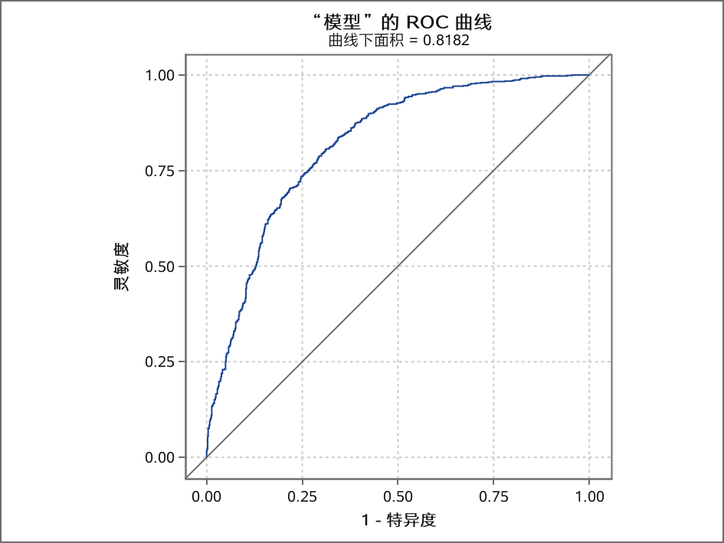
Analysis of the number of depression patients and age range
“LOGISTIC”过程

