Slide 1
The mean difference analysis between Diseased and non-disease samples
TTEST 过程
变量: BMI (BMI)
HavingCVD | 方法 | 数目 | 均值 | 标准差 | 标准误差
No |  | 2244 | 5.4761 | 1.1261 | 0.0238
Yes |  | 2221 | 5.7663 | 1.1945 | 0.0253
差 (1-2) | 汇总 |  | -0.2903 | 1.1606 | 0.0347
差 (1-2) | Satterthwaite |  | -0.2903 |  | 0.0347

Slide 2
The mean difference analysis between Diseased and non-disease samples
TTEST 过程
变量: BMI (BMI)
HavingCVD | 方法 | 最小值 | 最大值
No |  | 2.9760 | 11.9040
Yes |  | 2.9720 | 11.9440
差 (1-2) | 汇总
差 (1-2) | Satterthwaite

Slide 3
The mean difference analysis between Diseased and non-disease samples
TTEST 过程
变量: BMI (BMI)
HavingCVD | 方法 | 均值 | 95% 置信限均值 |  | 标准差
No |  | 5.4761 | 5.4295 | 5.5227 | 1.1261
Yes |  | 5.7663 | 5.7166 | 5.8160 | 1.1945
差 (1-2) | 汇总 | -0.2903 | -0.3584 | -0.2222 | 1.1606
差 (1-2) | Satterthwaite | -0.2903 | -0.3584 | -0.2221

Slide 4
The mean difference analysis between Diseased and non-disease samples
TTEST 过程
变量: BMI (BMI)
HavingCVD | 方法 | 95% 置信限标准差
No |  | 1.0941 | 1.1601
Yes |  | 1.1604 | 1.2307
差 (1-2) | 汇总 | 1.1371 | 1.1852
差 (1-2) | Satterthwaite

Slide 5
The mean difference analysis between Diseased and non-disease samples
TTEST 过程
变量: BMI (BMI)
方法 | 方差 | 自由度 | t 值 | Pr > |t|
汇总 | 等于 | 4463 | -8.36 | <.0001
Satterthwaite | 不等于 | 4441.8 | -8.35 | <.0001

Slide 6
The mean difference analysis between Diseased and non-disease samples
TTEST 过程
变量: BMI (BMI)
方差齐性
方法 | 分子自由度 | 分母自由度 | F 值 | Pr > F
折叠的 F | 2220 | 2243 | 1.13 | 0.0054

Slide 7
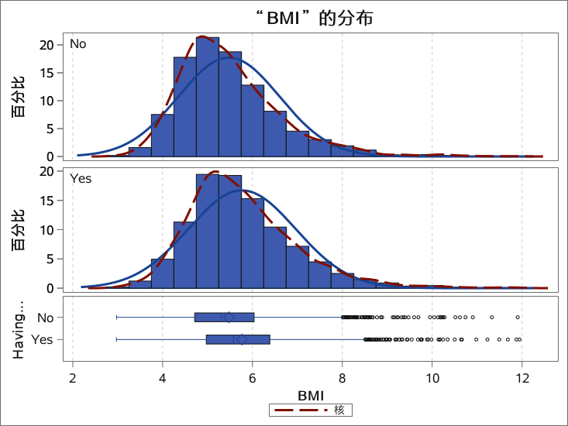
The mean difference analysis between Diseased and non-disease samples
TTEST 过程
变量: BMI (BMI)

Slide 8
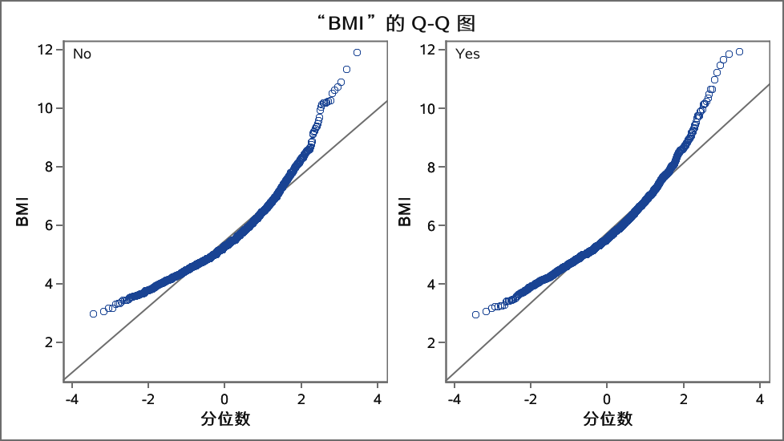
The mean difference analysis between Diseased and non-disease samples
TTEST 过程
变量: BMI (BMI)

Slide 9
The BMI difference between Male and Female samples
TTEST 过程
变量: BMI (BMI)
GENDER | 方法 | 数目 | 均值 | 标准差 | 标准误差
Male |  | 2549 | 5.6609 | 1.1131 | 0.0220
Female |  | 1916 | 5.5667 | 1.2389 | 0.0283
差 (1-2) | 汇总 |  | 0.0943 | 1.1687 | 0.0353
差 (1-2) | Satterthwaite |  | 0.0943 |  | 0.0359
GENDER | 方法 | 最小值 | 最大值
Male |  | 3.0680 | 11.9040
Female |  | 2.9720 | 11.9440
差 (1-2) | 汇总
差 (1-2) | Satterthwaite

Slide 10
The BMI difference between Male and Female samples
TTEST 过程
变量: BMI (BMI)
GENDER | 方法 | 均值 | 95% 置信限均值 |  | 标准差
Male |  | 5.6609 | 5.6177 | 5.7041 | 1.1131
Female |  | 5.5667 | 5.5111 | 5.6222 | 1.2389
差 (1-2) | 汇总 | 0.0943 | 0.0250 | 0.1635 | 1.1687
差 (1-2) | Satterthwaite | 0.0943 | 0.0239 | 0.1646
GENDER | 方法 | 95% 置信限标准差
Male |  | 1.0834 | 1.1445
Female |  | 1.2009 | 1.2794
差 (1-2) | 汇总 | 1.1450 | 1.1935
差 (1-2) | Satterthwaite

Slide 11
The BMI difference between Male and Female samples
TTEST 过程
变量: BMI (BMI)
方法 | 方差 | 自由度 | t 值 | Pr > |t|
汇总 | 等于 | 4463 | 2.67 | 0.0077
Satterthwaite | 不等于 | 3872.4 | 2.63 | 0.0086

Slide 12
The BMI difference between Male and Female samples
TTEST 过程
变量: BMI (BMI)
方差齐性
方法 | 分子自由度 | 分母自由度 | F 值 | Pr > F
折叠的 F | 1915 | 2548 | 1.24 | <.0001

Slide 13
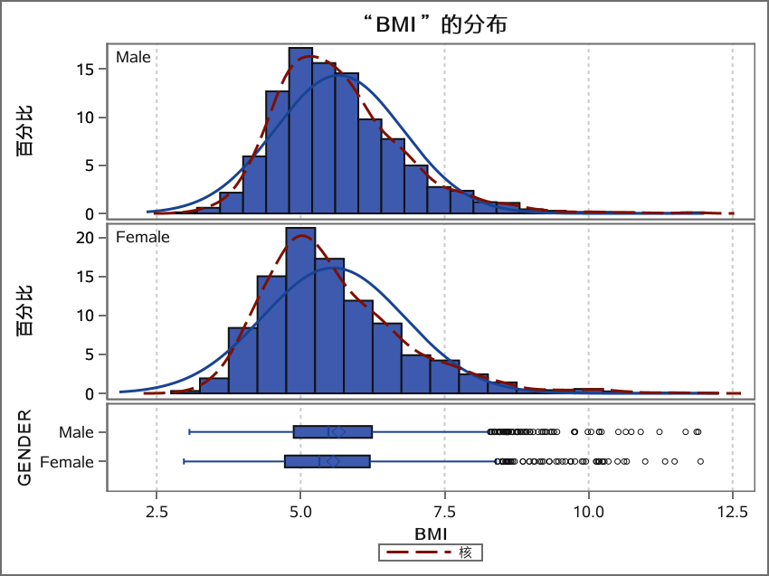
The BMI difference between Male and Female samples
TTEST 过程
变量: BMI (BMI)

Slide 14
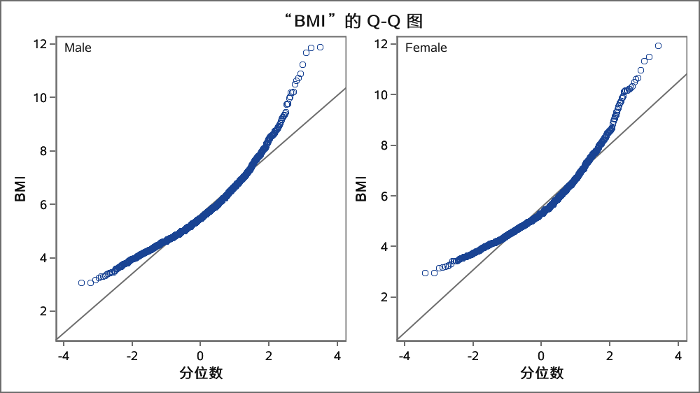
The BMI difference between Male and Female samples
TTEST 过程
变量: BMI (BMI)

Slide 15
The association analysis between
Discrete Data and CVD status
FREQ 过程
HavingCVD-GENDER表
HavingCVD | GENDER
频数 百分比 行百分比 列百分比 | Male | Female | 合计
No | 1189 26.63 52.99 46.65 | 1055 23.63 47.01 55.06 | 2244 50.26
Yes | 1360 30.46 61.23 53.35 | 861 19.28 38.77 44.94 | 2221 49.74

Slide 16
The association analysis between
Discrete Data and CVD status
FREQ 过程
HavingCVD-GENDER表
HavingCVD | GENDER
频数 百分比 行百分比 列百分比 | Male | Female | 合计
合计 | 2549 57.09 | 1916 42.91 | 4465 100.00
表“GENDER-HavingCVD”的统计量
统计量 | 自由度 | 值 | 概率
卡方 | 1 | 30.9969 | <.0001
似然比卡方检验 | 1 | 31.0384 | <.0001

Slide 17
The association analysis between
Discrete Data and CVD status
FREQ 过程
表“GENDER-HavingCVD”的统计量
统计量 | 自由度 | 值 | 概率
连续调整卡方 | 1 | 30.6611 | <.0001
Mantel-Haenszel 卡方 | 1 | 30.9900 | <.0001
Phi 系数 |  | -0.0833
列联系数 |  | 0.0830
Cramer V |  | -0.0833

Slide 18
The association analysis between
Discrete Data and CVD status
FREQ 过程
表“GENDER-HavingCVD”的统计量
Fisher 精确检验
单元格 (1,1) 频数 (F) | 1189
左侧 Pr <= F | <.0001
右侧 Pr >= F | 1.0000
表概率 (P) | <.0001
双侧 Pr <= P | <.0001
样本大小 = 4465

Slide 19
The association analysis between
Discrete Data and CVD status
FREQ 过程
HavingCVD-Age_Range表
HavingCVD | Age_Range
频数 百分比 行百分比 列百分比 | <= 40 | 41-45 | 46-50 | 51-55 | 56-60 | 61-65 | 66-70
No | 427 9.56 19.03 89.52 | 253 5.67 11.27 75.07 | 229 5.13 10.20 60.90 | 329 7.37 14.66 57.32 | 300 6.72 13.37 49.42 | 238 5.33 10.61 38.39 | 154 3.45 6.86 38.69
Yes | 50 1.12 2.25 10.48 | 84 1.88 3.78 24.93 | 147 3.29 6.62 39.10 | 245 5.49 11.03 42.68 | 307 6.88 13.82 50.58 | 382 8.56 17.20 61.61 | 244 5.46 10.99 61.31

Slide 20
The association analysis between
Discrete Data and CVD status
FREQ 过程
HavingCVD-Age_Range表
HavingCVD | Age_Range
频数 百分比 行百分比 列百分比 | 71-75 | 76-80 | >= 80 | 合计
No | 143 3.20 6.37 36.95 | 78 1.75 3.48 25.16 | 93 2.08 4.14 24.54 | 2244 50.26
Yes | 244 5.46 10.99 63.05 | 232 5.20 10.45 74.84 | 286 6.41 12.88 75.46 | 2221 49.74

Slide 21
The association analysis between
Discrete Data and CVD status
FREQ 过程
HavingCVD-Age_Range表
HavingCVD | Age_Range
频数 百分比 行百分比 列百分比 | <= 40 | 41-45 | 46-50 | 51-55 | 56-60 | 61-65 | 66-70
合计 | 477 10.68 | 337 7.55 | 376 8.42 | 574 12.86 | 607 13.59 | 620 13.89 | 398 8.91

Slide 22
The association analysis between
Discrete Data and CVD status
FREQ 过程
HavingCVD-Age_Range表
HavingCVD | Age_Range
频数 百分比 行百分比 列百分比 | 71-75 | 76-80 | >= 80 | 合计
合计 | 387 8.67 | 310 6.94 | 379 8.49 | 4465 100.00
表“Age_Range-HavingCVD”的统计量
统计量 | 自由度 | 值 | 概率
卡方 | 9 | 667.8124 | <.0001
似然比卡方检验 | 9 | 724.1932 | <.0001

Slide 23
The association analysis between
Discrete Data and CVD status
FREQ 过程
表“Age_Range-HavingCVD”的统计量
统计量 | 自由度 | 值 | 概率
Mantel-Haenszel 卡方 | 1 | 619.1073 | <.0001
Phi 系数 |  | 0.3867
列联系数 |  | 0.3607
Cramer V |  | 0.3867
样本大小 = 4465

Slide 24
The association analysis between
Discrete Data and CVD status
FREQ 过程
HavingCVD-BMI_Class表
HavingCVD | BMI_Class
频数 百分比 行百分比 列百分比 | OVER-THIN | NORMAL | OVER-FAT | OBESITY | 合计
No | 38 0.85 1.69 59.38 | 622 13.93 27.72 60.92 | 742 16.62 33.07 51.24 | 842 18.86 37.52 43.58 | 2244 50.26
Yes | 26 0.58 1.17 40.63 | 399 8.94 17.96 39.08 | 706 15.81 31.79 48.76 | 1090 24.41 49.08 56.42 | 2221 49.74

Slide 25
The association analysis between
Discrete Data and CVD status
FREQ 过程
HavingCVD-BMI_Class表
HavingCVD | BMI_Class
频数 百分比 行百分比 列百分比 | OVER-THIN | NORMAL | OVER-FAT | OBESITY | 合计
合计 | 64 1.43 | 1021 22.87 | 1448 32.43 | 1932 43.27 | 4465 100.00
表“BMI_Class-HavingCVD”的统计量
统计量 | 自由度 | 值 | 概率
卡方 | 3 | 83.5693 | <.0001
似然比卡方检验 | 3 | 84.0634 | <.0001

Slide 26
The association analysis between
Discrete Data and CVD status
FREQ 过程
表“BMI_Class-HavingCVD”的统计量
统计量 | 自由度 | 值 | 概率
Mantel-Haenszel 卡方 | 1 | 81.0580 | <.0001
Phi 系数 |  | 0.1368
列联系数 |  | 0.1355
Cramer V |  | 0.1368
样本大小 = 4465

Slide 27
The association analysis between
Discrete Data and CVD status
FREQ 过程
GENDER-BMI_Class表
GENDER | BMI_Class
频数 百分比 行百分比 列百分比 | OVER-THIN | NORMAL | OVER-FAT | OBESITY | 合计
Male | 26 0.58 1.02 40.63 | 522 11.69 20.48 51.13 | 838 18.77 32.88 57.87 | 1163 26.05 45.63 60.20 | 2549 57.09
Female | 38 0.85 1.98 59.38 | 499 11.18 26.04 48.87 | 610 13.66 31.84 42.13 | 769 17.22 40.14 39.80 | 1916 42.91

Slide 28
The association analysis between
Discrete Data and CVD status
FREQ 过程
GENDER-BMI_Class表
GENDER | BMI_Class
频数 百分比 行百分比 列百分比 | OVER-THIN | NORMAL | OVER-FAT | OBESITY | 合计
合计 | 64 1.43 | 1021 22.87 | 1448 32.43 | 1932 43.27 | 4465 100.00

Slide 29
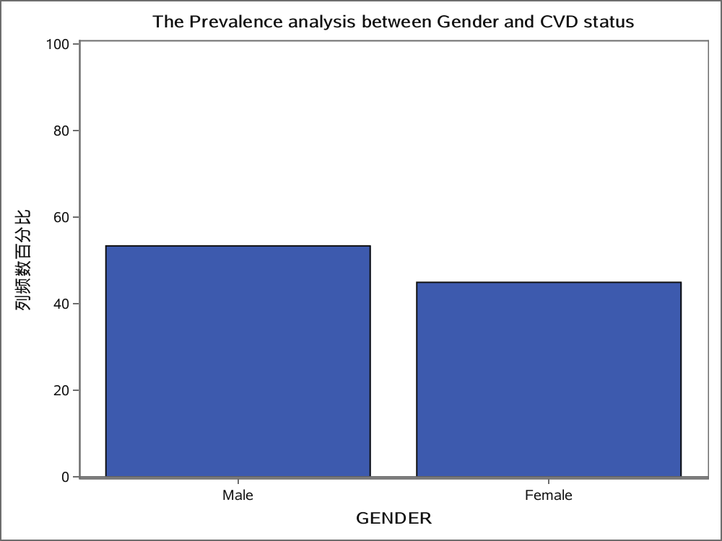

Slide 30
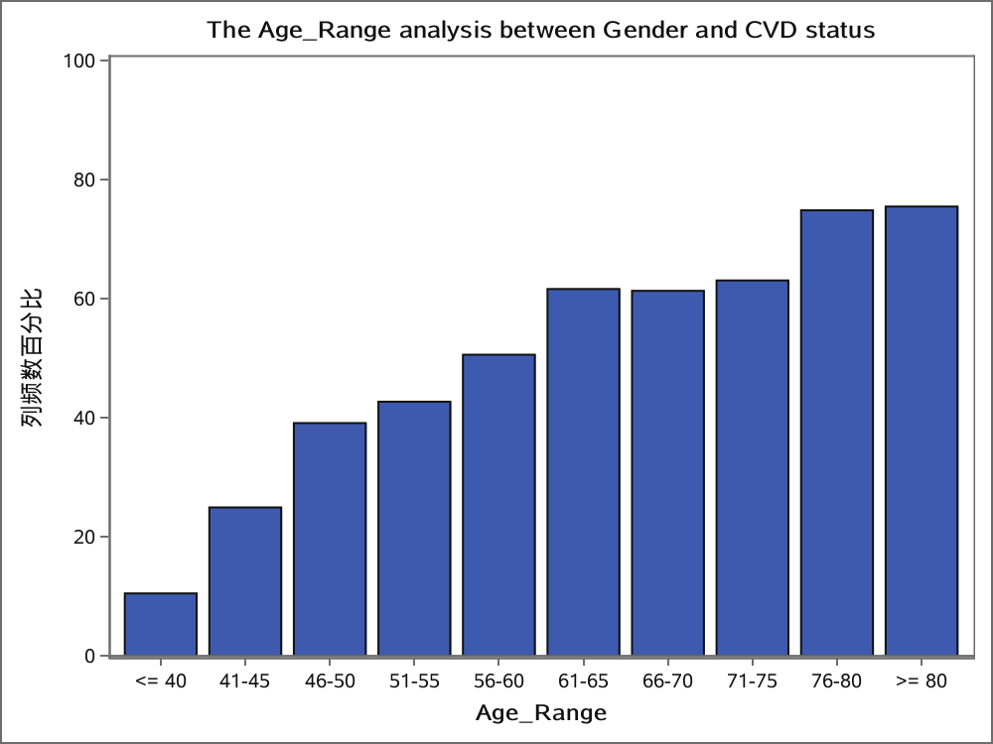

Slide 31
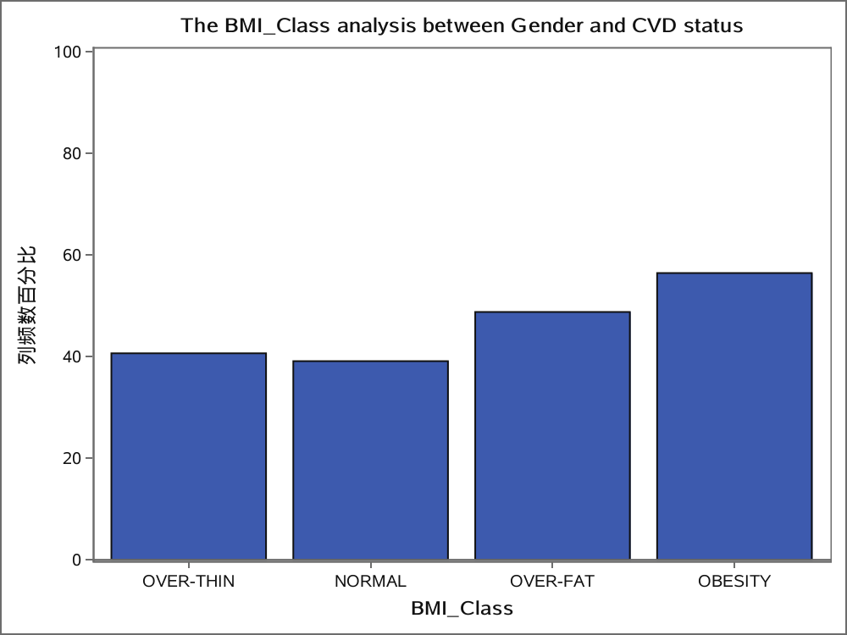

Slide 32
