Slide 1
Decision Tree is a Supervised Learning Classification Method (labeled data → model)
Root Node (feature)
Leaf Node
(output)
Internal Node (feature)
Leaf Node
Leaf Node

Slide 2
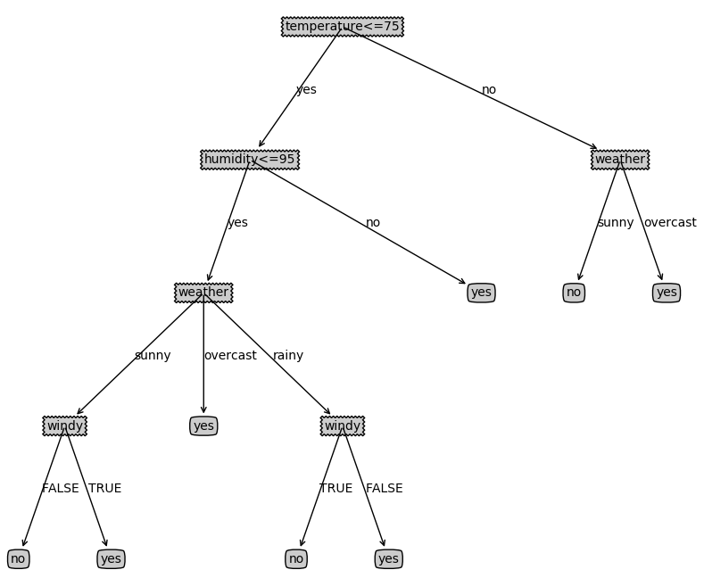
Make decision based on 4 attributes Play outdoor?
 | Weather | Humidity | Temprerature | Windy | (label) Play outdoor
1 | sunny | 85 | 85 | FALSE | no
2 | sunny | 80 | 90 | TRUE | no
3 | overcast | 83 | 86 | FALSE | yes
4 | rainy | 70 | 96 | FALSE | yes
5 | rainy | 68 | 80 | FALSE | yes
6 | rainy | 65 | 70 | TRUE | no
7 | overcast | 64 | 65 | TRUE | yes
8 | sunny | 72 | 95 | FALSE | no
9 | sunny | 69 | 70 | FALSE | yes
10 | rainy | 75 | 80 | FALSE | yes
11 | sunny | 75 | 70 | TRUE | yes
12 | overcast | 72 | 90 | TRUE | yes
13 | overcast | 81 | 75 | FALSE | yes
14 | rainy | 71 | 91 | TRUE | no

Slide 3
How to build a decision tree?
1. Define nodes based on attributes
2. Which attribute should be chosen as the node?
3. Make the tree
According the number of values to define the way of branching
Windy (2 values) : True, False
Weather (3 values): sunny, overcast, rainy
Temp/Humid : continus value
Windy
Weather
Humidity
Temperature
True
False
Sunny
overcast
Rainy
<95
>95
(0,75)
(75,100)

Slide 4
Which attribute should be chosen as the root node?
Two Metrics
Information gain
ID3, C4.5
Gini impurity
CART

Slide 5
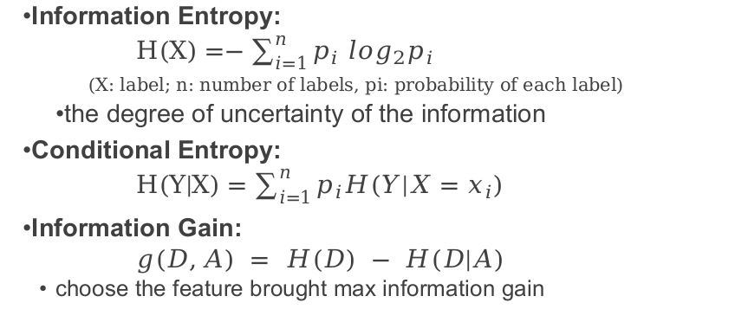
Information Entropy:
$H(X)=−\sum_{i=1}^{n}{p_{i} \log_{2}p_{i}}$
(X: label; n: number of labels, pi: probability of each label)
the degree of uncertainty of the information
Conditional Entropy:
$H(Y|X)=\sum_{i=1}^{n}{p_{i}H(Y|X=x_{i})}$
Information Gain:
$g(D,A) = H(D) − H(D|A)$
choose the feature brought max information gain

Slide 6


Entropy: $H(X)=−\sum_{i=1}^{n}{p_{i} \log_{2}p_{i}}$
Play outdoor
no
no
yes
yes
yes
no
yes
no
yes
yes
yes
yes
yes
no
Entropy of “Play outdoor”
P(yes) = 9/14
P(no) = 5/14
$H(Play)= −\left(\frac{9}{14}*\log_{2}\frac{9}{14} + \frac{5}{14}*\log_{2}\frac{5}{14}\right)=0.94$bits

Slide 7
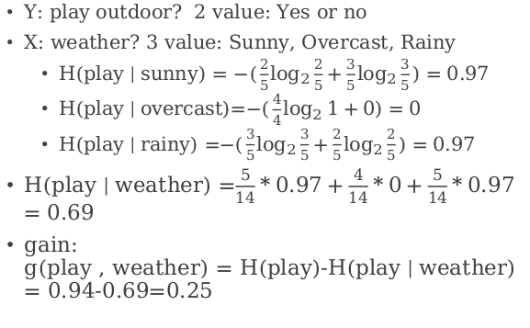

Conditional Entropy: $H(Y|X)=\sum_{i=1}^{n}{p_{i}H(Y|X=x_{i})}$
 | Weather | Humidity | Temprerature | Windy | (label) Play outdoor
1 | sunny | 85 | 85 | FALSE | no
2 | sunny | 80 | 90 | TRUE | no
8 | sunny | 72 | 95 | FALSE | no
9 | sunny | 69 | 70 | FALSE | yes
11 | sunny | 75 | 70 | TRUE | yes
3 | overcast | 83 | 86 | FALSE | yes
7 | overcast | 64 | 65 | TRUE | yes
12 | overcast | 72 | 90 | TRUE | yes
13 | overcast | 81 | 75 | FALSE | yes
4 | rainy | 70 | 96 | FALSE | yes
5 | rainy | 68 | 80 | FALSE | yes
6 | rainy | 65 | 70 | TRUE | no
10 | rainy | 75 | 80 | FALSE | yes
14 | rainy | 71 | 91 | TRUE | no
Y: play outdoor? 2 value: Yes or no
X: weather? 3 value: Sunny, Overcast, Rainy
H(play | sunny) = $−(\frac{2}{5}\log_{2}{\frac{2}{5}}+\frac{3}{5}\log_{2}{\frac{3}{5}})=0.97$
H(play | overcast)=$−(\frac{4}{4}\log_{2}{1}+0)=0$
H(play | rainy) =$−(\frac{3}{5}\log_{2}{\frac{3}{5}}+\frac{2}{5}\log_{2}{\frac{2}{5}})=0.97$
H(play | weather) =$\frac{5}{14}*0.97+\frac{4}{14}*0+\frac{5}{14}*0.97$ $=0.69$
gain: g(play , weather) = H(play)-H(play | weather) = 0.94-0.69=0.25

Slide 8
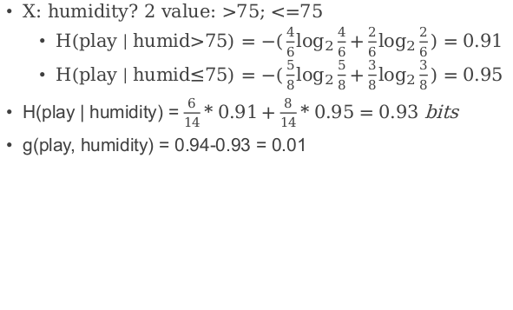
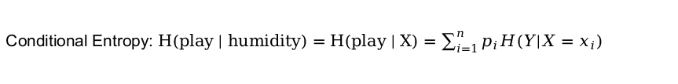
Conditional Entropy: $H(play | humidity)=H(play | X)=\sum_{i=1}^{n}{p_{i}H(Y|X=x_{i})}$
 | Weather | Humidity | Temprerature | Windy | Play outdoor
1 | sunny | 85 | 85 | FALSE | no
2 | sunny | 80 | 90 | TRUE | no
3 | overcast | 83 | 86 | FALSE | yes
10 | rainy | 75 | 80 | FALSE | yes
11 | sunny | 75 | 70 | TRUE | yes
13 | overcast | 81 | 75 | FALSE | yes
4 | rainy | 70 | 96 | FALSE | yes
5 | rainy | 68 | 80 | FALSE | yes
6 | rainy | 65 | 70 | TRUE | no
7 | overcast | 64 | 65 | TRUE | yes
8 | sunny | 72 | 95 | FALSE | no
9 | sunny | 69 | 70 | FALSE | yes
12 | overcast | 72 | 90 | TRUE | yes
14 | rainy | 71 | 91 | TRUE | no
X: humidity? 2 value: >75; <=75
H(play | humid>75) = $−(\frac{4}{6}\log_{2}{\frac{4}{6}}+\frac{2}{6}\log_{2}{\frac{2}{6}})=0.$91
H(play | humid$≤$75) = $−(\frac{5}{8}\log_{2}{\frac{5}{8}}+\frac{3}{8}\log_{2}{\frac{3}{8}})=0.95$
H(play | humidity) = $\frac{6}{14}*0.91+\frac{8}{14}*0.95=0.93$ bits
g(play, humidity) = 0.94-0.93 = 0.01

Slide 9
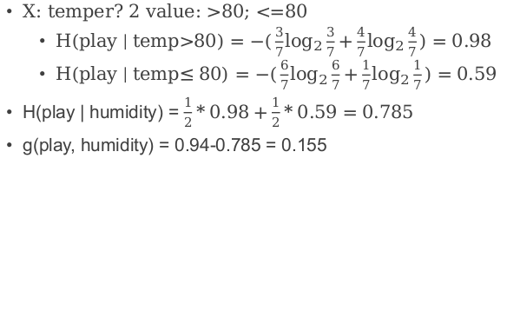
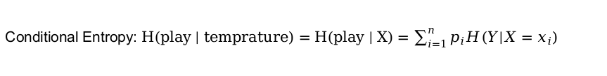
Conditional Entropy: $H(play | temprature)=H(play | X)=\sum_{i=1}^{n}{p_{i}H(Y|X=x_{i})}$
 | Weather | Humidity | Temprerature | Windy | Play outdoor
1 | sunny | 85 | 85 | FALSE | no
2 | sunny | 80 | 90 | TRUE | no
3 | overcast | 83 | 86 | FALSE | yes
4 | rainy | 70 | 96 | FALSE | yes
8 | sunny | 72 | 95 | FALSE | no
12 | overcast | 72 | 90 | TRUE | yes
14 | rainy | 71 | 91 | TRUE | no
5 | rainy | 68 | 80 | FALSE | yes
6 | rainy | 65 | 70 | TRUE | no
7 | overcast | 64 | 65 | TRUE | yes
9 | sunny | 69 | 70 | FALSE | yes
10 | rainy | 75 | 80 | FALSE | yes
11 | sunny | 75 | 70 | TRUE | yes
13 | overcast | 81 | 75 | FALSE | yes
X: temper? 2 value: >80; <=80
H(play | temp>80) = $−(\frac{3}{7}\log_{2}{\frac{3}{7}}+\frac{4}{7}\log_{2}{\frac{4}{7}})=0.$98
H(play | temp$≤80$) = $−(\frac{6}{7}\log_{2}{\frac{6}{7}}+\frac{1}{7}\log_{2}{\frac{1}{7}})=0.59$
H(play | humidity) = $\frac{1}{2}*0.98+\frac{1}{2}*0.59=0.785$
g(play, humidity) = 0.94-0.785 = 0.155

Slide 10
Choose the attribute brought max gain
weather
overcast
g(play , weather) = 0.25
g(play, humidity>75) = 0.01
g(play, temp>80) = 0.155
g(play, windy) = 0.05
rainy
sunny
Yes
paly
child node
child node
 | Weather | Humidity | Temprerature | Windy | Play outdoor
1 | sunny | 85 | 85 | FALSE | no
2 | sunny | 80 | 90 | TRUE | no
8 | sunny | 72 | 95 | FALSE | no
9 | sunny | 69 | 70 | FALSE | yes
11 | sunny | 75 | 70 | TRUE | yes
3 | overcast | 83 | 86 | FALSE | yes
7 | overcast | 64 | 65 | TRUE | yes
12 | overcast | 72 | 90 | TRUE | yes
13 | overcast | 81 | 75 | FALSE | yes
4 | rainy | 70 | 96 | FALSE | yes
5 | rainy | 68 | 80 | FALSE | yes
6 | rainy | 65 | 70 | TRUE | no
10 | rainy | 75 | 80 | FALSE | yes
14 | rainy | 71 | 91 | TRUE | no
Humidity | Temprerature | Windy | Play outdoor
85 | 85 | FALSE | no
80 | 90 | TRUE | no
72 | 95 | FALSE | no
69 | 70 | FALSE | yes
75 | 70 | TRUE | yes
Humidity | Temprerature | Windy | Play outdoor
70 | 96 | FALSE | yes
68 | 80 | FALSE | yes
65 | 70 | TRUE | no
75 | 80 | FALSE | yes
71 | 91 | TRUE | no

Slide 11
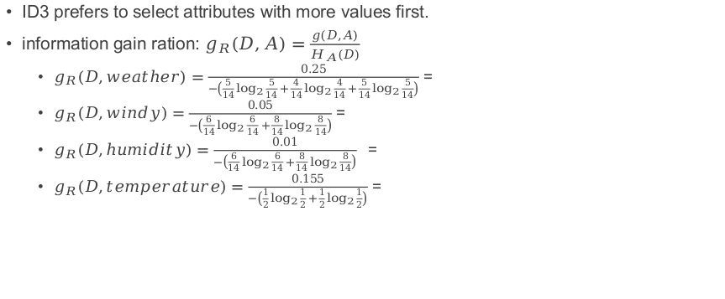
C4.5 :
ID3 prefers to select attributes with more values first.
information gain ration: $g_{R}(D,A)=\frac{g(D,A)}{H_{A}(D)}$
$g_{R}(D,weather)=\frac{0.25}{−\left({\frac{5}{14}log}_{2}{\frac{5}{14}}+{\frac{4}{14}log}_{2}{\frac{4}{14}}+{\frac{5}{14}log}_{2}{\frac{5}{14}}\right)}$ =
$g_{R}(D,windy)=\frac{0.05}{−\left({\frac{6}{14}log}_{2}{\frac{6}{14}}+{\frac{8}{14}log}_{2}{\frac{8}{14}}\right)}$ =
$g_{R}(D,humidity)=\frac{0.01}{−\left({\frac{6}{14}log}_{2}{\frac{6}{14}}+{\frac{8}{14}log}_{2}{\frac{8}{14}}\right)} =$
$g_{R}(D,temperature)=\frac{0.155}{−\left({\frac{1}{2}log}_{2}{\frac{1}{2}}+{\frac{1}{2}log}_{2}{\frac{1}{2}}\right)}$ =

Slide 12

Gini impurity
$1−\sum_{i=1}^{J}{{P(i)}^{2}}$

