Slide 1
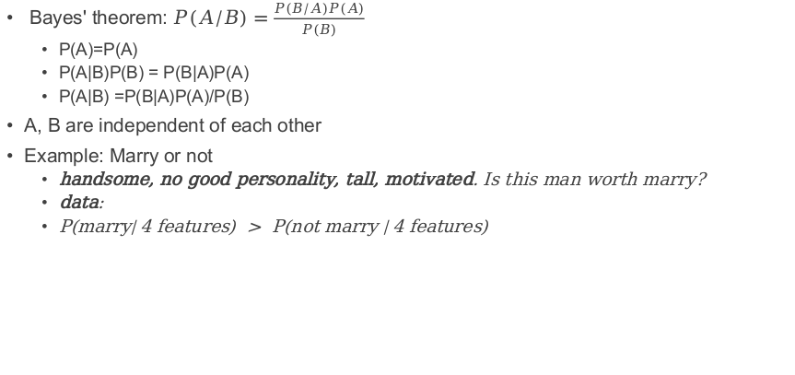
Naive(simple) Bayesian classify
Bayes' theorem: $P(A/B)=\frac{P(B/A)P(A)}{P(B)}$
P(A)=P(A)
P(A|B)P(B) = P(B|A)P(A)
P(A|B) =P(B|A)P(A)/P(B)
A, B are independent of each other
Example: Marry or not
handsome, no good personality, tall, motivated. Is this man worth marry?
data:
P(marry| 4 features) > P(not marry | 4 features)

Slide 2

handsome, no good personality, tall, motivated.
$$P(A/B)=\frac{P(B/A)P(A)}{P(B)}$$
$$P(Marry / 4feature)=\frac{P(4features/Marry)P(Marry)}{P(4features)}$$
Handsome? | Good personality? | Tall? | Motivated? | Marry?
Yes | No | No | No | No
No | Yes | No | Yes | No
Yes | Yes | No | Yes | Yes
No | Yes | Yes | Yes | Yes
Yes | No | No | Yes | No
Yes | No | No | Yes | No
Yes | Yes | Yes | No | Yes
No | Yes | Yes | Yes | Yes
Yes | Yes | Yes | Yes | Yes
No | No | Yes | Yes | Yes
Yes | Yes | No | No | No
Yes | Yes | No | No | No
$$P(×Marry / 4feature)=\frac{P(4features/×Marry)P(×Marry)}{P(4features)}$$
Independent features >> multiply together

Slide 3



$$P(Marry / 4feature)=\frac{P(4features/Marry)P(Marry)}{P(4features)}$$
$$P(4features/Marry)=$$
$$P(handsome/Marry)P(×good person/Marry)P(tall/Marry)P(motivated/Marry)$$
$$=\frac{1}{2}×\frac{5}{6}×\frac{5}{6}×\frac{5}{6}=\frac{125}{432}$$
$$P(Marry)=\frac{1}{2}$$
$$P(4features)=P(handsome)P(×good personality)P(tall)P(motivated)=\frac{8}{12}×\frac{1}{3}×\frac{5}{12}×\frac{8}{12}=\frac{5}{81}$$
$$\frac{625}{69984}$$

Slide 4

handsome, no good personality, tall, motivated.
$$P(×Marry / 4feature)=\frac{P(4features/×Marry)P(×Marry)}{P(4features)}$$
Handsome? | Good personality? | Tall? | Motivated? | Marry?
Yes | No | No | No | No
No | Yes | No | Yes | No
Yes | Yes | No | Yes | Yes
No | Yes | Yes | Yes | Yes
Yes | No | No | Yes | No
Yes | No | No | Yes | No
Yes | Yes | Yes | No | Yes
No | Yes | Yes | Yes | Yes
Yes | Yes | Yes | Yes | Yes
No | No | Yes | Yes | Yes
Yes | Yes | No | No | No
Yes | Yes | No | No | No
$\frac{5}{6} \frac{1}{2}$ 0 $\frac{1}{2} = 0$

