Slide 1

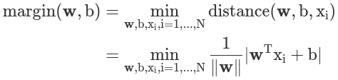
x2
too close to 2 groups
w^T x + b
Hyperplane
Navie baysian classify
Probabitliy
decision tree
Probability
SVM
distance
2 dimension line
y=1
Hard-margin SVM
max margin: make the distance of each point to the hyperplane max
Soft-margin SVM
Kernel SVM
y=-1
x1
Separation means:
Distance expression:

Slide 2



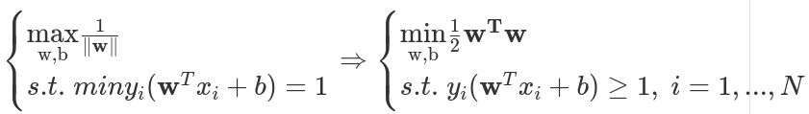
mathematical expression of max margin
primal problem:
constrains:
there is a minimum value: r
problem becomes :
make r = 1 because the hyperplane could be scaled
quadratic target function
N linear conditions
Convex optimization problem

Slide 3
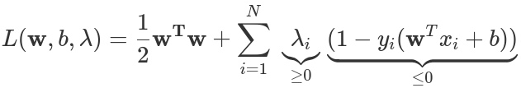
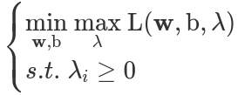
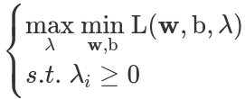

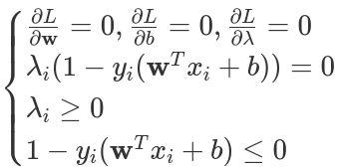
The method of Lagrange multipliers
Lagrange function
Dual function
Karush–Kuhn–Tucker conditions (KKT)
w*, b*

Slide 4

Soft-
x2
1
allow SVM to make a certain number of mistakes
1-
x1

