Slide 1
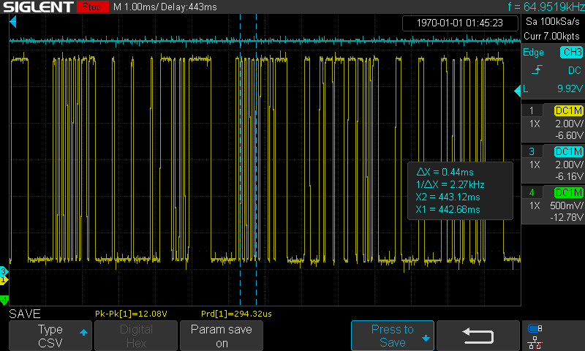
13bits
Data
0
Data
1
Data
2
Data
3
13bits
Master release
bus
PID
Data
2
Data
4
Data
6
Slave release
bus
Data
0
Sync
field
PID
Check
sum
Check
sum
Sync
field
Data
1
Data
3
Data
5
Data
7

Slide 2

13bits
Break
Data
0
Data
1
Data
2
Data
3
13bits
Break
Master release
bus
PID
Data
2
Data
4
Data
6
Slave release
bus
Data
0
Sync
field
PID
Check
sum
Check
sum
Sync
field
Data
1
Data
3
Data
5
Data
7

