Slide 1





EE-CN-42
Knowledge sharing
Shanghai,Feb., 2021
Zicheng Pan

Slide 2
Principle of multithreading lock and its application
--process this topic to show a way about learning java source code
Zicheng Pan / EE-CN-42

Slide 3
Zicheng-Pan
Shanghai
EE-CN-42
FT Lambda (AD Backend)
Since 19/12 came to BMW. For now more than 2 years
Java, Python, DB, AWS, Big Data.
Use less and less line number of code but build more and more high available, more and more high concurrency project.
Part-time job : take a baby.
As a father and developer. So if you also have a baby or you have some confusion about the micro service, do not hesitate to contact with me. I am pleasure to supply my knowledge.
Notes:
For example the aws platform the cloud platform has been already supple the high quality environment, so it a direction about this dream.
I think Use less and less line number of code but build more and more high available, more and more high concurrency project.
I am familiar with high concurrency and micro service. So if you want to discuss about baby or about the micro service, do not hesitate to contact with me. I am pleasure to supply my knowledge.

Slide 4
So Let’s get started
纽约和芝加哥两个州在美国大选期间通过我们的系统向特朗普投票，每个州会分别投1,000票给特朗普。
让我们来查看投票结果吧。
Scenario: American Election Voting for Trump
State New York has 1,000 votes
State Chicago has 1,000 votes
But, the total votes calculated by the system is less than 2,000
So, how should we help Trump from that mismatching votes situation?
talk is cheap ,code is valuable …
Notes:
you all know Trump, we are now in American election.
There are two states vote for trump. Each of them has 1000 votes for trump.
But after the end of date the total votes calculated by system is less than 2000
So what happened?
You know if trump know some votes just disapeared, 哈哈哈 imagine the situation, how angry he is. so we must solve this problem.
So firstly let’s see how does the system sum the number of the votes

Slide 5
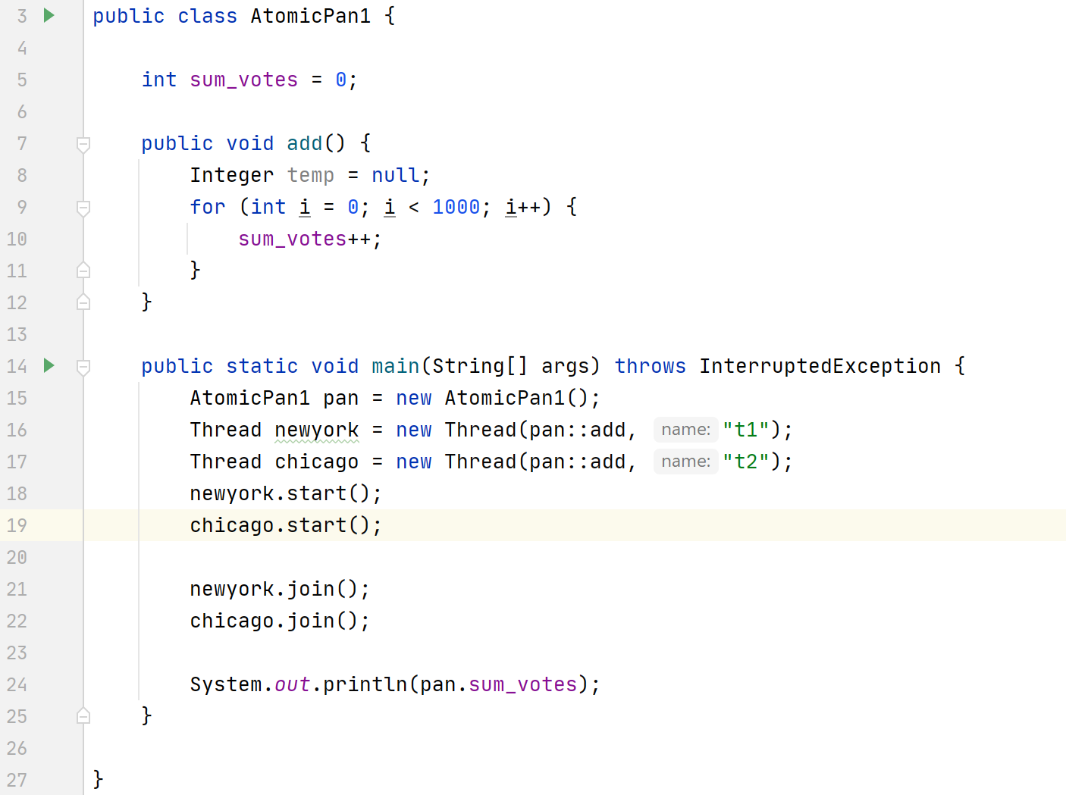
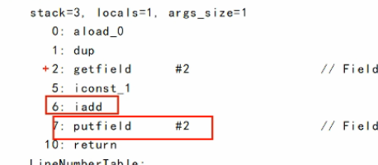
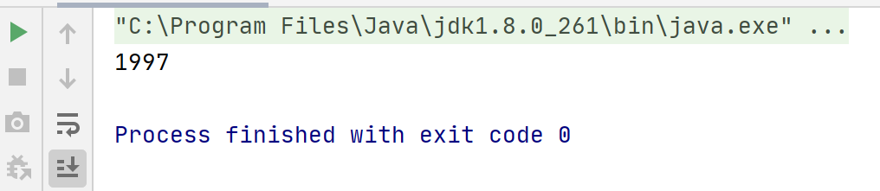
Notes:
In main method, I simulate the two states, one is newyork , another is Chicago. They both add the sum_votes variable.
you can see the result is 1997 is less than 2000
The system seems like having multithreading problem.
The sum_voes++ has been splited to two command one is to add
Another is set the add result back to variable.
Is there some key-world can solve this problem?
So it is not atomic. It cause this multithreading problem.

Slide 6
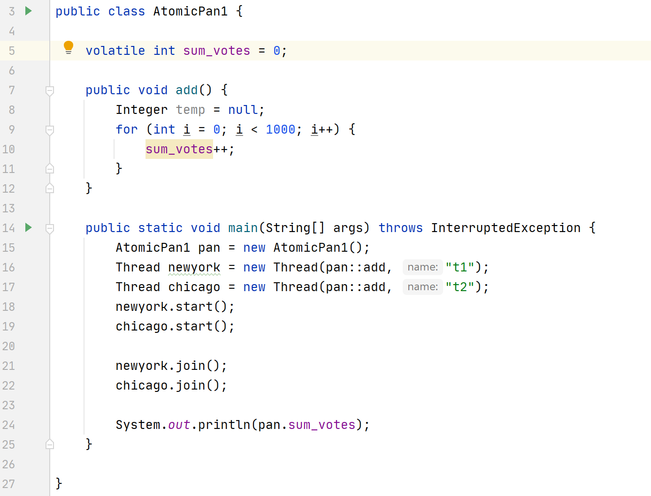
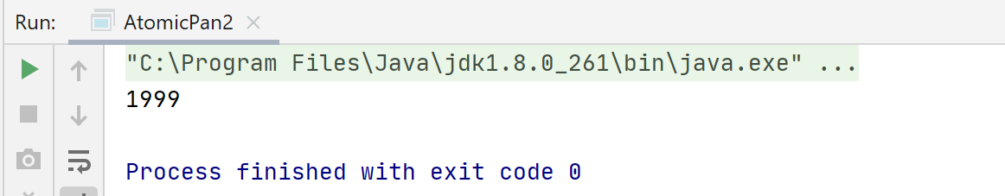
topic:
Issue about i++ in multithreading.
Use atomic class to solve this problem.
What is CAS?
How many kinds of types can use CAS in java?
What about using java lock? Does it get the same result?
What is the different between lock and atomic?
Notes:
I just add the volatile key-word here does it sum the right number now?
So it also gets the wrong number?
And if you are carefully you can notice that there is a warning for the variable [sum_votes]

Slide 7
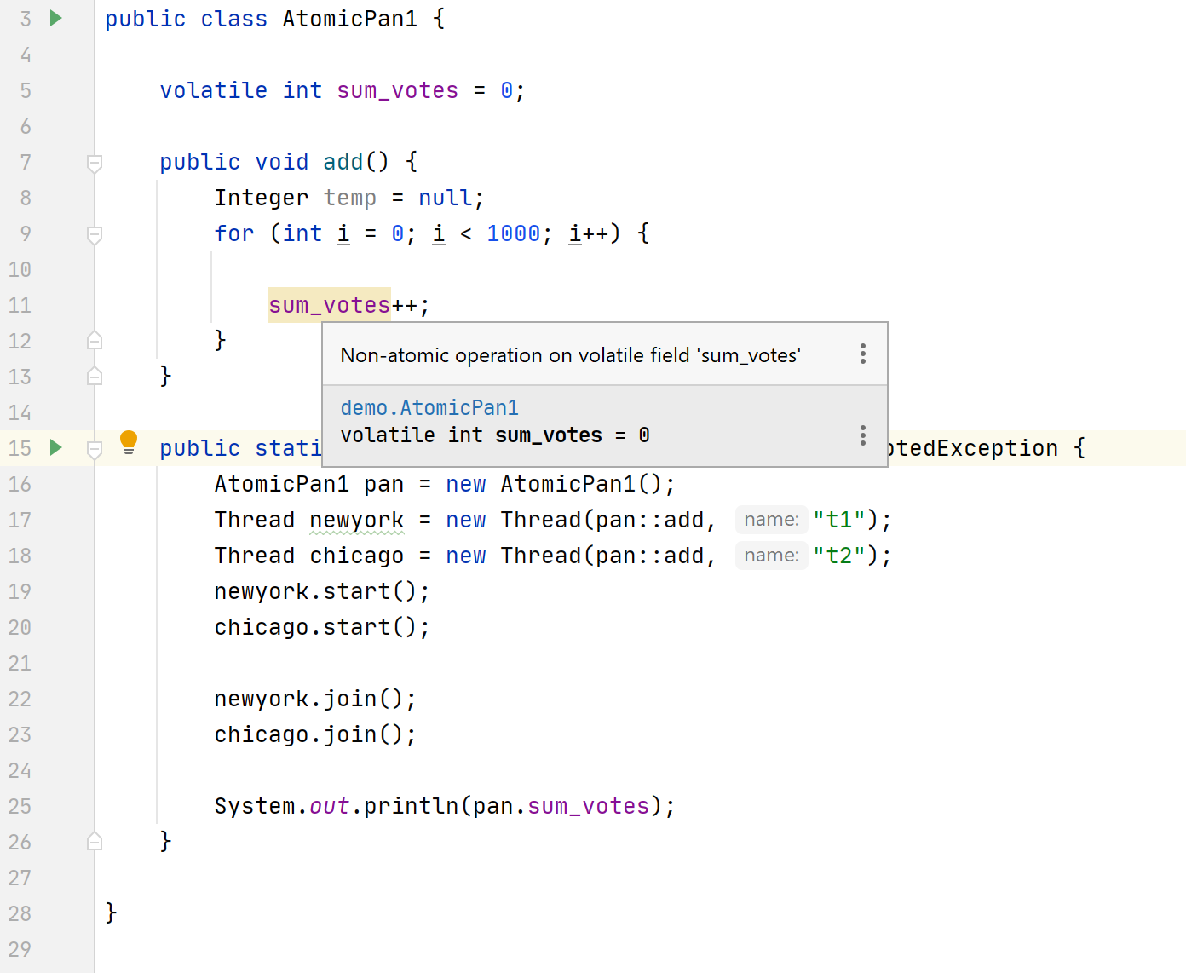

topic:
Issue about i++ in multithreading.
Use atomic class to solve this problem.
What is CAS?
How many kinds of types can use CAS in java?
What about using java lock? Does it get the same result?
What is the different between lock and atomic?
Notes:
The idea reminds me that I should use atomic operation
So I find a class [AtomicInteger]

Slide 8
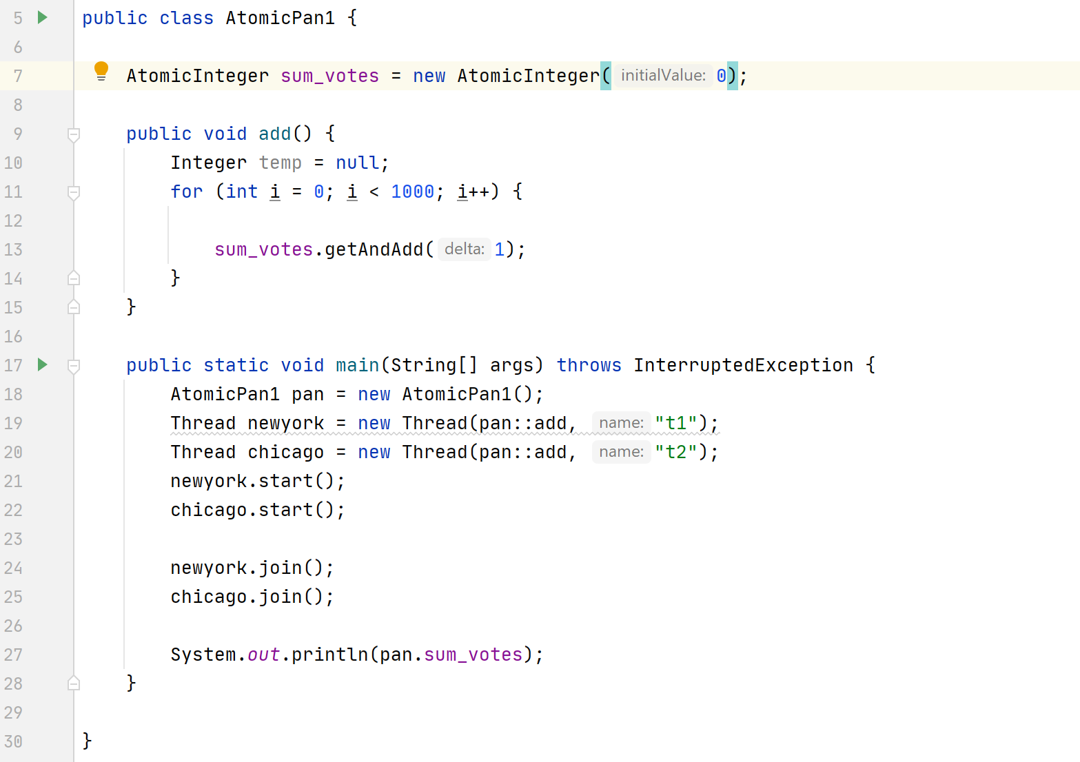
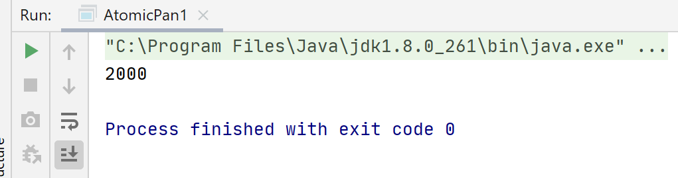
topic:
Issue about i++ in multithreading.
Use atomic class to solve this problem.
What is CAS?
How many kinds of types can use CAS in java?
What about using java lock? Does it get the same result?
What is the different between lock and atomic?
Notes:
So let’s try
A we finally got the correct number
So anyone interesting about it? How does it works?

Slide 9
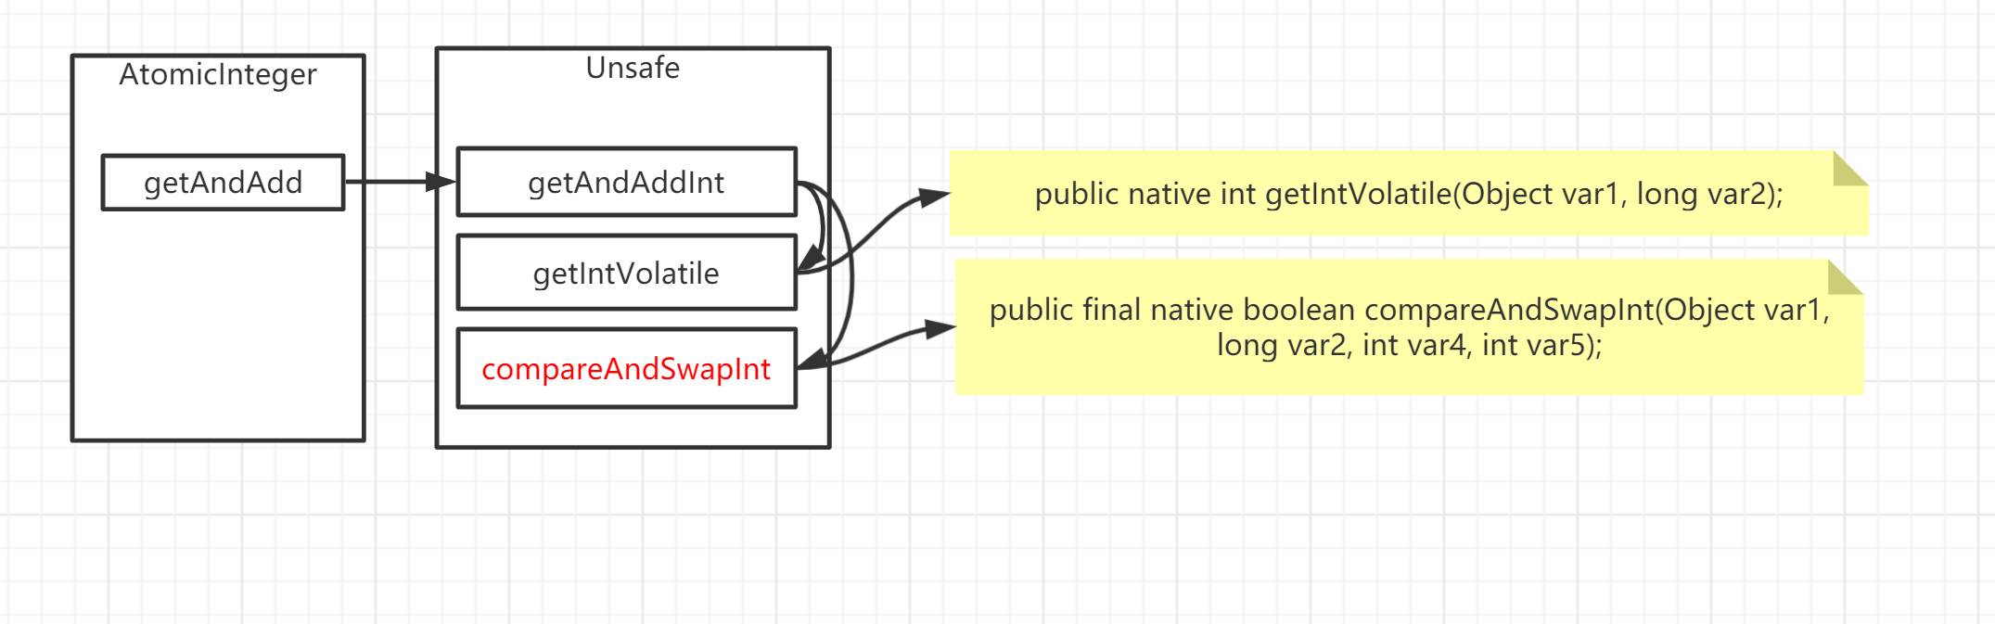
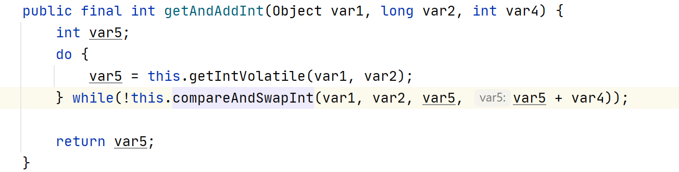
how does AtomicInteger work
Notes:
so If you go into Unsafe class you can see in this class contains all native method.
So What does the key word native mean? It means the method defined by java virtual machine, the keyword native means it was coded by other language such as c/c++ but java.
And then you see the red word you can see Compare and Swap so , what does compare and swap mean?

Slide 10
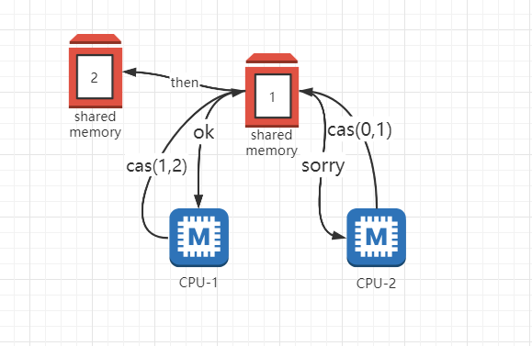
What is CAS
topic:
Issue about i++ in multithreading
Use atomic class to solve this problem.
What is cas?
How many kinds of types can use CAS in java?
What about using java lock? Does it get the same result?
What is the different between lock and atomic?
Compare and swap [CAS] belongs to hardware synchronization. CPU supply command to change the value atomically.
CAS operation needs to input two parameters, the old value (the value before the swap operation) and a new value. before the operation, CPU will compared the old value with the current value. if current value has not changed. Current value will change to a new value. If it has changed, then CPU will not change the current value.
The conclusion: Remember
CAS is responsible for operating / modifing variable [shared memory] in multithreading.
CAS is atomic.
Notes:
for example there are two cpus, one is to cas there are two parameters (1,2) means want to change from 1 to 2, so cpu firstly get the value of the shared memory 1 and then
The value is not change so it can modify this shared memory as value 2.
Another cpu will not change the shared memory value , because it call cas(0,1) the value of shared memory is already changed to 2.
So remember the conclusion.

Slide 11
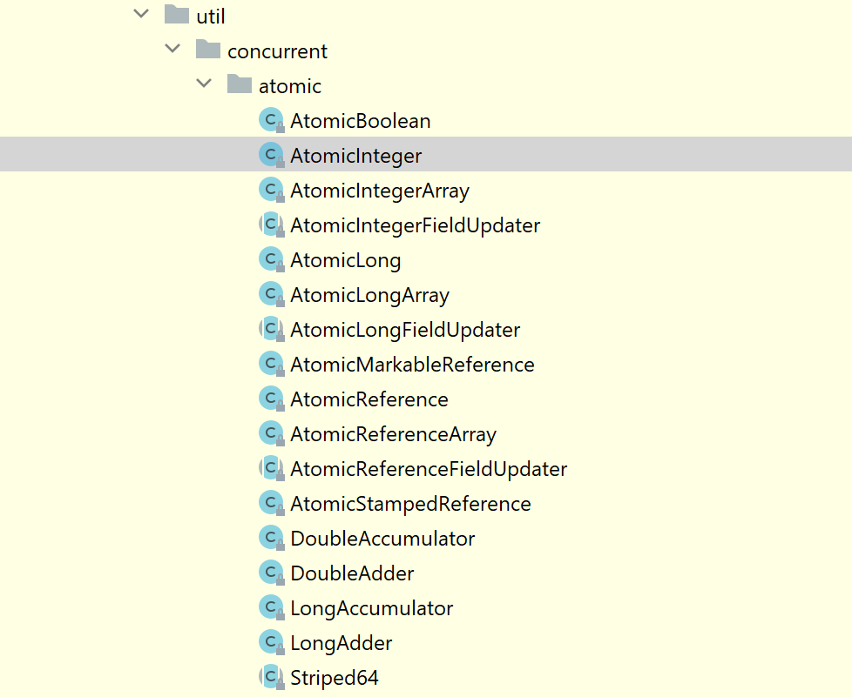
topic:
Issue about i++ in multithreading
Use atomic class to solve this problem.
What is cas?
How many kinds of types can use CAS in java?
What about using java lock? Does it get the same result?
What is the different between lock and atomic?
mention: Remember
AtomicInteger can change number type variable atomically.
AtomicReference can change Object type variable atomically.
Notes:
There are too many kinds of types can use cas in java
Pay attention for these two Classes, one is AtomicInteger another is AtomicReference.

Slide 12
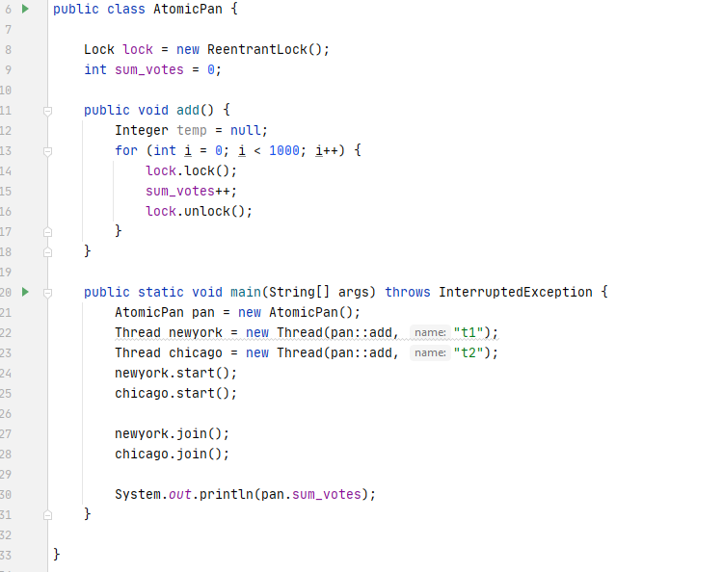
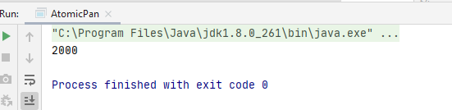
topic:
Issue about i++ in multithreading
Use atomic class to solve this problem.
What is cas?
How many kinds of types can use CAS in java?
What about using java lock? Does it get the same result?
What is the different between lock and atomic?

Slide 13
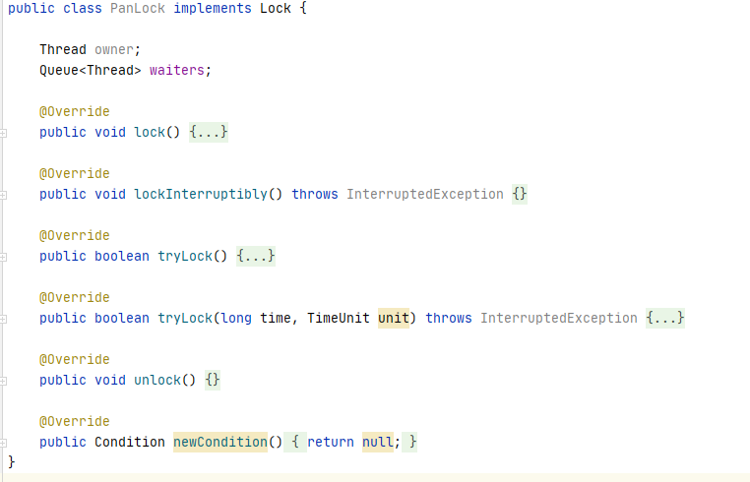
What is Lock?
topic:
Issue about i++ in multithreading
Use atomic class to solve this problem.
What is cas?
How many kinds of types can use CAS in java?
What about using java lock? Does it get the same result?
What is the different between lock and atomic?
Check the JDK ReentrantLock implements Lock interface.
So I define a class implements Lock interface.
I guess there must be a owner about this lock.
So I define a filed owner [Type is Thread]
But if one thread get this lock, others need to wait until the lock is free
So I define a filed waiters [Type is Queue]
Notes:
I just add the volatile key-word here does it sum the right number now?
So it also gets the wrong number?
And if you are carefully you can notice that there is a warning for the variable [sum_votes]

Slide 14
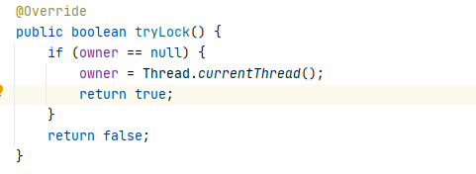
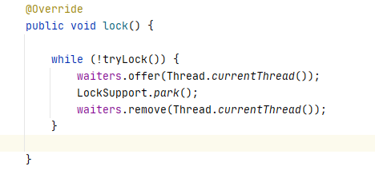
Complete the method
topic:
Issue about i++ in multithreading
Use atomic class to solve this problem.
What is cas?
How many kinds of types can use CAS in java?
What about using java lock? Does it get the same result?
What is the different between lock and atomic?
If the lock is empty, so the owner of this lock will be occupied by current thread.
In lock(), if current thread get this lock, then pass, if not, we will add current thread into the waiters.
Notes:
Use LockSupport park method to suspend the thread.
And use Locksupport unpark method to wake up this thread.

Slide 15
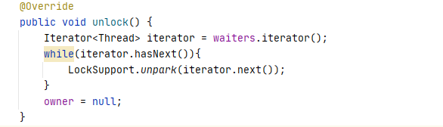
Complete the method
topic:
Issue about i++ in multithreading
Use atomic class to solve this problem.
What is cas?
How many kinds of types can use CAS in java?
What about using java lock? Does it get the same result?
What is the different between lock and atomic?
And the related method unlock is set the owner as null to release this lock. And notify other thread which are waiting for obtaining the lock.
So have we done?
Is there something wrong?
Notes:
I just add the volatile key-word here does it sum the right number now?
So it also gets the wrong number?
And if you are carefully you can notice that there is a warning for the variable [sum_votes]

Slide 16
Back to my Lock?
topic:
Issue about i++ in multithreading
Use atomic class to solve this problem.
What is cas?
How many kinds of types can use CAS in java?
What about using java lock? Does it get the same result?
What is the different between lock and atomic?
Synchronization are required.
mention: Remember
AtomicInteger can change number type variable atomically.
AtomicReference can change Object type variable atomically.
Notes:
So what should I do.
Do you also remember the CAS?
So the owner need to AtomicRefernce class

Slide 17
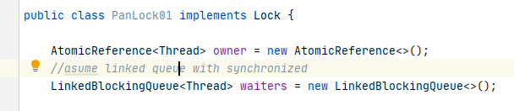
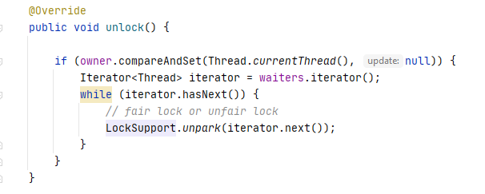
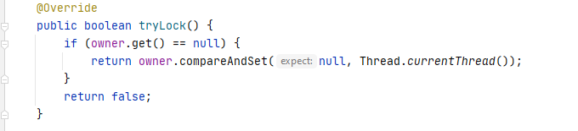
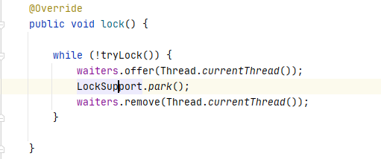
replace my lock with CAS and concurrent safe container
How to test it?
Use the Trump!!

Slide 18
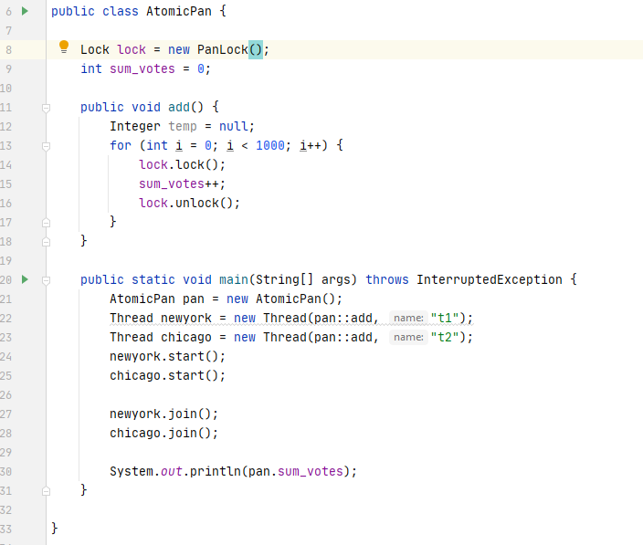
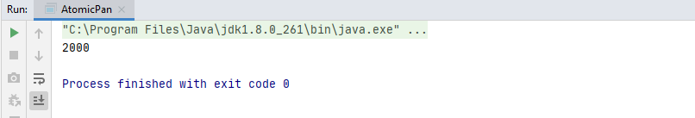
Check the result
topic:
Issue about i++ in multithreading
Use atomic class to solve this problem.
What is cas?
How many kinds of types can use CAS in java?
What about using java lock? Does it get the same result?
What is the different between lock and atomic?
Just replace the lock by my lock
Notes:
You can see even though I replace my lock as the jdk lock it also get the correct number.
So I

Slide 19
What is the difference between CAS and Lock?
In java the Lock composed by CAS.
The lock use more widely.
What is next?
Abstract the lock as an abstract class AbstractQueuedSynchronizer [AQS] by Template design pattern
Follow the approach above, hope you can use AQS to complete CountDownLatch.
Notes:
Firstly I will show you the best way to make i++ in synchrony in multithreading situation.
And Then I will show the my way to learn the java source code. You can see I just follow this step to understand the lock in java.
by this Methodology you can use in the time when you face a difficult code , hardly to understand or you see an amazing thing and want to know the details or how to realize it. so this is an usual thing, we can face everyday, so I supply a way maybe it is not the best but maybe useful for you)
maybe you are not a java develop but you also can follow this step to learn your code, I think it is the same approach to learn to understand the source code.
so I list the actions here. it is really easy, and I will show you how to follow this step to build my own java concurrent package. and through the process I will explain the related key-word.
Talk is cheap so I will show you the code.

Slide 20
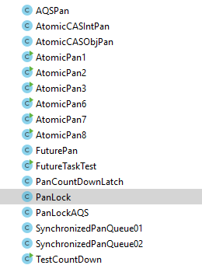
By this sharing we have got:
1. One knowledge point is about how to make i++ in synchrony
2. One Methodology is about how to learn source code such as jdk:
Use and guess
Abstract and code
Replace and check
Contrast and conclude [home work compare your Lock code with jdk and
understand the jdk source code]
3. One result we can build our own JUC package by two points above.
such as [lock, countdownlatch, cyclicbarrier, ext..]
Notes:
I think
you code and compare them will deepen your understanding

Slide 21
Thank you!

Slide 22
许多东西内容都是相通的，细节方面，学习cas可以学习cpu原语，嵌入式，宏观方面，学习多线程锁的应用，可以学习到aqs，可以学习多线程的应用，写框架。大可以无限延申到系统架构，小可以研究到cpu，计算机组成原理。
2，8 法则，今天的可能都是20% ，用不上的，哈哈哈，但是是不是返过来看我们已经超过了剩余的80%的人呢
程序员所需要的职业素质

Slide 23
Situation
The process of one request
Imagine:
there are more than 100 users request currently at the same time.
And the Maximum number of connections about DB are 50.
Web Application
Backend
User
Request
DB
Notes:
For example :
first group contains 100 requests. It will pend 50 requests in the backend server.
The Second group contains 150 people to send requests. So then the DB handled another 50 request , but the connections will increase to number 100.
And next time it comes another 200 requests. So count of requests contained by the backend server will rapidly increase and grow such as a running snowball.
So DB become the first Bottleneck。

Slide 24
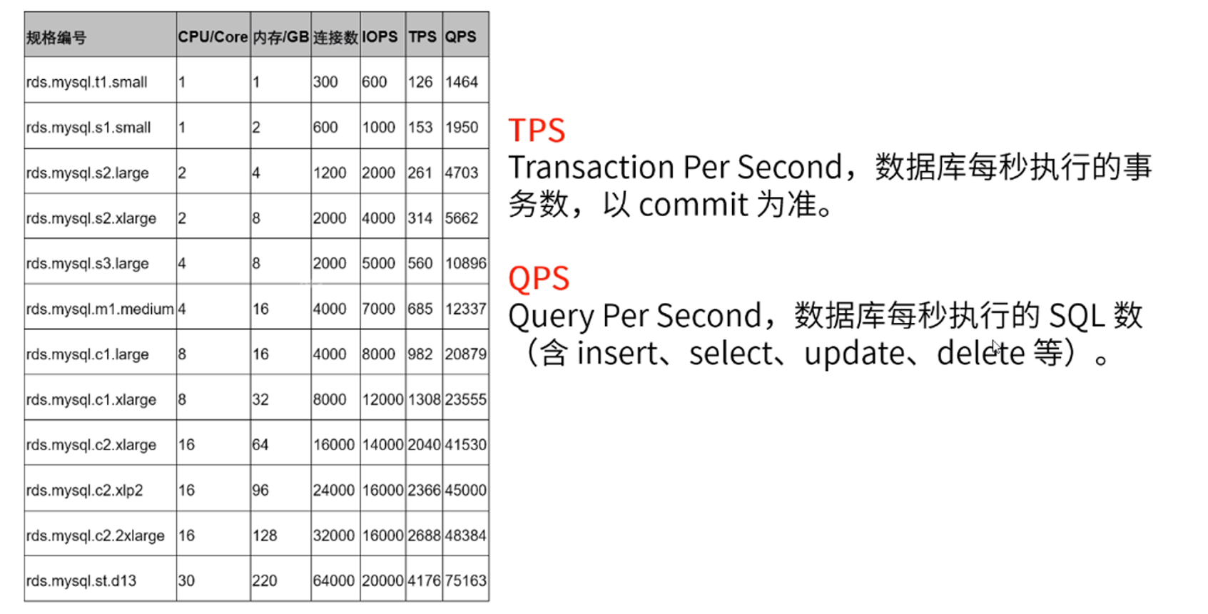
Then how to do? Expansion！
Notes:
Expensive but alse have the limited even though the best rds server alse cannot handle more than 5000 TPS,
but I think 5000 people purchase their order at the same time is usual.

Slide 25
So how to deal with it?
1.sub-division table
2.use redis / mq to decouple to delay satisfaction
Notes:
第一种解决方案，分库分表【 首先数据库集群不好做，对已有的数据很难拆分 现在数据库已经100w数据了，我现在想用hash算法来存，会发现现在很难做，并且需要维护的东西太多】
在硬盘里面读 数据库 比较慢的，从内存中读比较快
分布式缓存， 缓存本质 ---》将查询慢的东西，放入查询快的里面
写多读少，用缓冲 利用消息队列，减少对数据库的冲击
There are much more write operations than read operations such as the count of TPS is much more than QPS. Than use MQ to buffer the request.
Otherwise we can use redis to buffer the value.s

Slide 26
Then what else? & advantage
We don’t to change the env about system architecture.
We can hold more Including read request and write request meanwhile.
Notes:
1水平扩容
并且不定时不定量的 最高峰值和最低峰值相差很多的 50倍

Slide 27
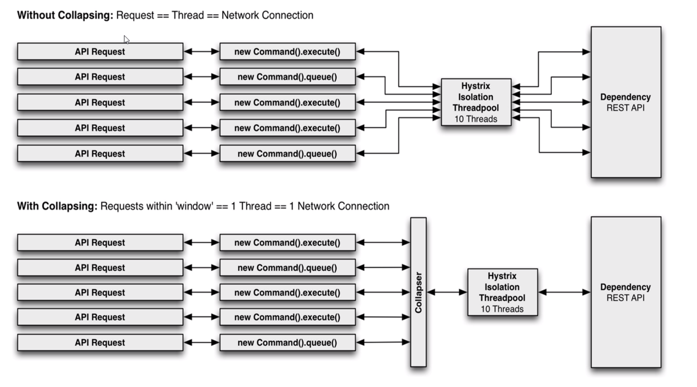
What is request conbination
Notes:
将100w请求压缩成1w请求这样减少线程数
再结合redis 可以完成更多的请求量

