Slide 1
Python Applicaton
Simulation, Monte Carlo methods
CS101 Lecture #13
2016-11-07

Slide 2
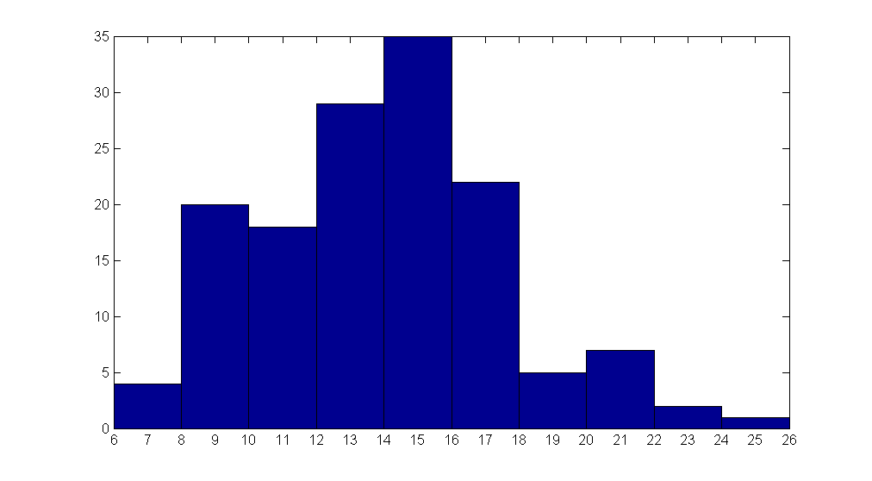
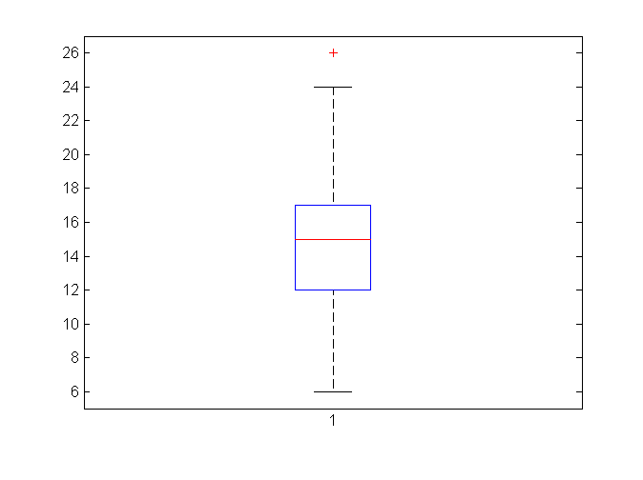
Mid-term I statistics (all)
count
score
Boxplot
Mean: 14.5
Median: 15
Percentile(25, 50, 75): 12, 15, 17
Highest: 26!
1

Slide 3
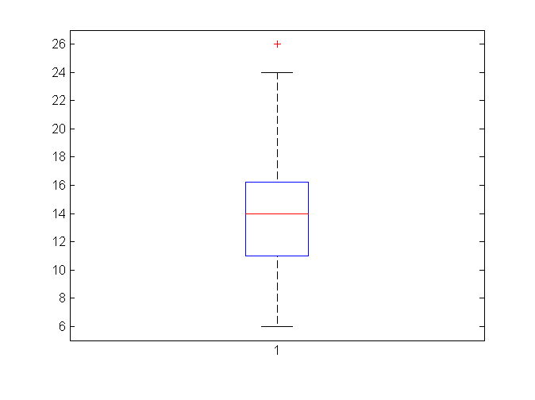
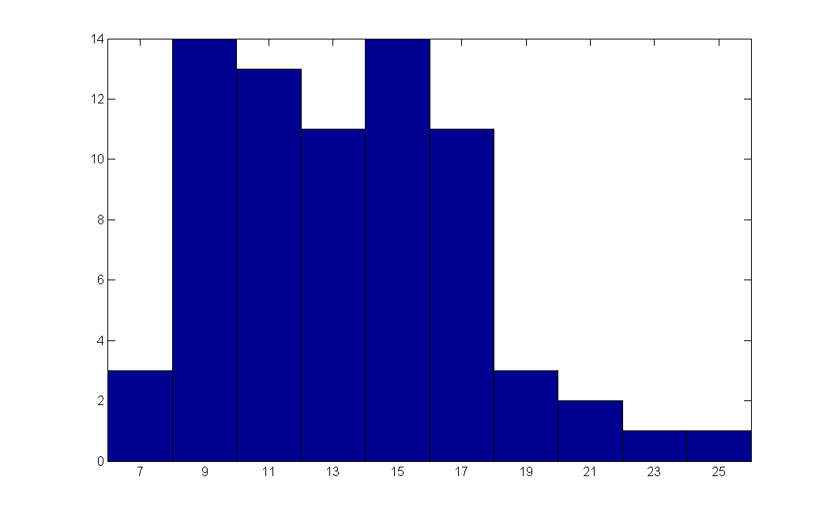
Mid-term I statistics (session A)
count
score
Boxplot
Mean: 13.9
Median: 14
Percentile(25, 50, 75): 11, 14, 16
Highest: 26!
1

Slide 4
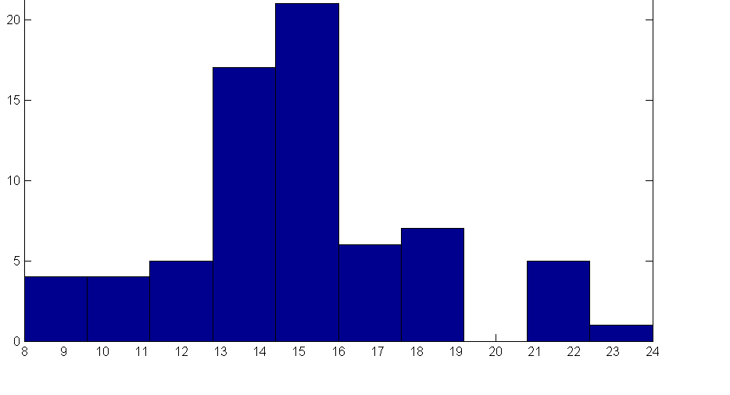
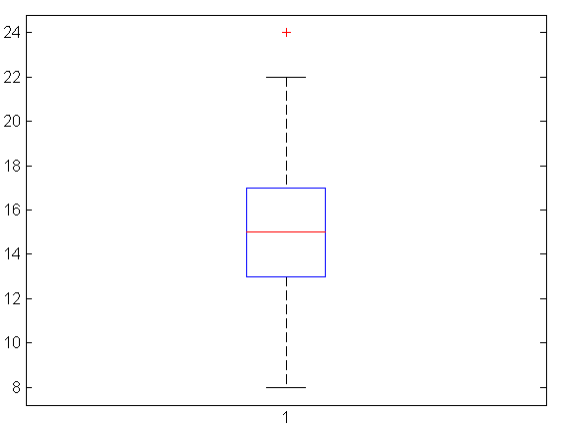
Mid-term I statistics (session B)
count
score
Boxplot
Mean: 15.0
Median: 15
Percentile(25, 50, 75): 13, 15, 17
Highest: 24
1

Slide 5
Find solution by Simulation
Predict the number of people taking Western/Chinese food in a month
Write a python script to simulate it!
No complicated mathematics
1

Slide 6
Find solution by Simulation
import numpy as np
W = 250
C = 250
for day in range(1,31):
nextW, nextC = W, C
for i in range(W):
if np.random.randint(10) < 3:
nextW -= 1
nextC += 1
for i in range(C):
if np.random.randint(10) < 2:
nextC -= 1
nextW += 1
W, C = nextW, nextC
print('Day %i: %i for Western food, %i for Chinese foot'%(day, W,C))
1

Slide 7
What is Simulation?
To model and imitate a hypothetical or real-life situation on a computer
Simulate the weather system
Trend of stocks
Military training
Crowd behavior in the canteen…
1

Slide 8
What is Simulation?
To model and imitate a hypothetical or real-life situation on a computer
Simulate the weather system
Trend of stocks
Military training
Crowd behavior in the canteen…
Simulate a stochastic process and count
Monte Carlo
1

Slide 9
Toss a coin
What is the probability of getting 5 heads by tossing a coin 10 times?
Use your expertise in math
Simulate the process many times and count!
Monte Carlo
1

Slide 10
Toss a coin
import numpy as np
repeat = 10000
count = 0
for trial in range(repeat):
head = 0
for i in range(10):
if np.random.randint(2) < 1:
head += 1
if head == 5:
count += 1
p = count/repeat
print(‘the estimated probability of 5 heads in 10 tosses is: %f’%p)
Monte Carlo
1

Slide 11
Find out the value of PI
Historical puzzle in mathematics
~1500 years ago
3.1415926 - 3.1415927
Monument of intellectual achievement
Monte Carlo
1

Slide 12
Find out the value of PI
Historical puzzle in mathematics
~1500 years ago
3.1415926 - 3.1415927
Monument of intellectual achievement
Not that difficult for us…
Monte Carlo
1

Slide 13
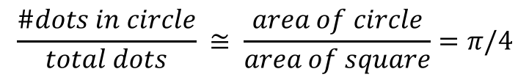
Find out the value of PI
$$\frac{\#dots in circle}{total dots} ≅ \frac{area of circle}{area of square}=π/4$$
animation from wikipedia
Monte Carlo
1

Slide 14
Find out the value of PI
$$\frac{\#dots in circle}{total dots} ≅ \frac{area of circle}{area of square}=π/4$$
animation from wikipedia
Find out PI by generating a ton of random dots and count!
Monte Carlo
1

Slide 15
Find out the value of PI
import numpy as np
def myrand():
return np.random.rand(1,1)[0][0]
samples = 10000
count = 0
for i in range(samples):
x, y = myrand(), myrand()
if (x**2 + y**2)**0.5 < 1:
count += 1
PI = count/samples*4
print('Pi = %f'%PI)
Monte Carlo

Slide 16
Monte Carlo methods
Use randomness to solve problems that might be deterministic in principle
optimization, statistical inference, biology, computer graphics
Simulating random samples is relatively cheap
Re-think the nature of computation
Computation vs. mathematics
Monte Carlo

Slide 17
Monte Carlo methods
Knowledge
Mathematics
Computation!
Monte Carlo

