Slide 1
Python Applications
Performance, debugging
CS101 Lecture #20
2016-12-02

Slide 2
Administrivia
1

Slide 3
Administrivia
Timeline
Last lecture on Python (lec01-20)
Midterm II on Tuesday
Start Matlab on Thursday (lec21-25)
Final exam
Dec 29th, 9:00-12:00 (East/West Lecture Hall 102)
1

Slide 4
Optimization strategy refresh
Brute-force search
Exhaustive search over the entire space
Hill-climbing
Iterative process
Greedily improving; Local optimum
Random walk
Iterative process
Allow down-hilling steps
Random sampling
random exploration of the search space
Non-iterative process
1

Slide 5
Code Performance
1

Slide 6
Code performance
Measure run time
Performance analysis
1

Slide 7
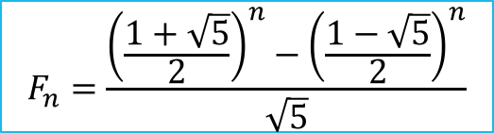
revisit the Fibonacci example
def fibo_a(n):
if n == 1 or n == 2:
return 1
else:
return fibo_a(n-1) + fibo_a(n-2)
def fibo_b(n):
if n == 1 or n == 2:
return 1
a, b = 1,1
for i in range(3,n+1):
a,b = b, a+b
return b
$$F_{n}=\frac{{\left(\frac{1+\sqrt{5}}{2}\right)}^{n}−{\left(\frac{1−\sqrt{5}}{2}\right)}^{n}}{\sqrt{5}}$$
def fibo_c(n):
p = (1+ 5**0.5)/2
q = 1-p
return int((p**n - q**n)/5**0.5 + 0.5)
1

Slide 8
Measure the runtime
Use the timeit module
Interpreter: timeit.timeit(‘stmt’, number = 100)
Command line: python –m timeit –n 100 ‘stmt’
Notebook: %timeit –n 100 func(n) (this is easiest)
1

Slide 9
Measure the runtime
Import timeit
%timeit –n 1000 fibo_a(10)
%timeit –n 1000 fibo_a(20)
%timeit –n 1000 fibo_a(30)
%timeit –n 1000 fibo_a(50) ##DON’T do!
%timeit –n 1000 fibo_b(10)
%timeit –n 1000 fibo_b(100)
%timeit –n 1000 fibo_b(1000)
%timeit –n 1000 fibo_c(10)
%timeit –n 1000 fibo_c(100)
%timeit –n 1000 fibo_c(1000)
1

Slide 10
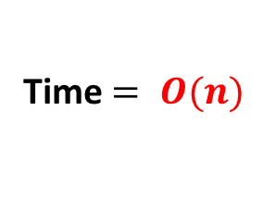
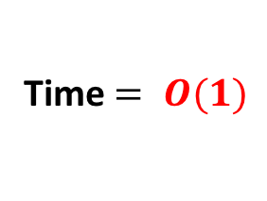
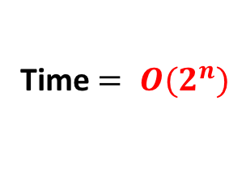
Time complexity analysis
def fibo_a(n):
if n == 1 or n == 2:
return 1
else:
return fibo_a(n-1) + fibo_a(n-2)
Time $= O(2^{n})$
def fibo_b(n):
if n == 1 or n == 2:
return 1
a,b = 1,1
for i in range(3, n+1):
a,b = b,a+b
return b
Time $= O(n)$
def fibo_c(n):
p = (1 + 5**0.5)/2
q = 1-p
return int((p**n - q**n)/5**0.5 + 0.5)
Time $= O(1)$
1

Slide 11
When Things Go Wrong
1

Slide 12

1

Slide 13
Errors are good
Errors reveal the boundary of what you know/don’t know
1

Slide 14
Debugging
A few definitions
Exceptions: unusual behaviors occurred in the execution of a program; caught by the try:{…}except e:{…} syntax
Errors: exceptions that cause the program to be unrunnable
Bugs: errors and exceptions; can also be miswritten, ambiguous, or incorrect code which is exception free and does not advertise its discrepancy
1

Slide 15
Common exceptions
SyntaxError
NameError
TypeError
ValueError
IOError
IndexError
KeyError
ZeroDivisionError
IndentationError
Exception
1

Slide 16
Common exceptions
SyntaxError: missing comma or parentheses
NameError: undefined variable or function names
TypeError: check variable types (coerce if necessary)
ValueError: built-in functions have valid type of arguments, but invalid values specified
IOError: File not exist
IndexError: index out of range for list, tuple, array
1

Slide 17
Common exceptions
KeyError: similar to IndexError, but for dictionary
ZeroDivisionError: 1/0
IndentationError: indentation not specified properly (python unique)
Exception: the most generic type; subsumes all the above exceptions and many others
More Exception types: http://www.tutorialspoint.com/python/python_exceptions.htm
1

Slide 18
Examples
>>> l = [1 2 3]
>>> print(l)
>>> ‘%i’%’5’
>>> a = int(‘a’)
>>> for i in range(5)
Print(‘%s’%i)
>>> a = 1/0.0
1

Slide 19
Catch an exception
try:
a = 1/0
except ZeroDivisionError:
print(‘division by zero’)
1

Slide 20
Catch an exception
try:
Print(‘%i’%’5’)
except NameError:
print(‘Name error occurred!’)
except TypeError:
print(‘Type error occurred!’)
except Exception:
print(‘some other errors/exceptions occurred’)
else:
print(‘all good’)
1

Slide 21
Catch an exception
try:
print(‘%i’%’5’)
except NameError:
print(‘Name error occurred!’)
except TypeError:
print(‘Type error occurred!’)
except Exception:
print(‘some other errors/exceptions occurred’)
else:
print(‘all good’)
1

Slide 22
Catch an exception
try:
Print(‘%i’%’5’)
except ValueError:
print(‘Name error occurred!’)
except IOError:
print(‘Type error occurred!’)
1

Slide 23
Catch an exception
try:
Print(‘%i’%’5’)
except ValueError:
print(‘Name error occurred!’)
except IOError:
print(‘Type error occurred!’)
except Exception:
print(‘some other errors/exceptions occurred’)
1

Slide 24
Catch an exception
try:
print(‘%i’%5)
except Exception:
print(‘some other errors/exceptions occurred’)
else:
print(‘all good’)
It is always a good programming/software engineering practice to enclose a block of sensitive code with
try: … except Exception: …
to catch and stop unusual behaviors under control
1

Slide 25
Question
# calculate squares
d = list(range(10))
while i < 10:
d[i] = d[i]**2.0
i += 1
Which error would this code produce?
A Syntax Error
B IndexError
C ValueError
D NameError
1

Slide 26
Question
Which of the following code would produce TypeError?
A ‘2’ + 2
B 2/0
C 2e8 + (1+0j)
D ‘2’*2
1

Slide 27
Course Overview
Python basics
Operators, expressions, data types, flow controls
Python applications
Workflow, I/O, performance analysis & debugging
Numerical Python
Simulation, modeling, randomization, plotting, optimization
MATLAB: to come
(we are here)
1

Slide 28
Style
1

Slide 29
Style
Use descriptive variable name
Reserve i,j,k for indices (s for tmp string, c for tmp char)
Keep consistent naming conventions
E.g. Variable: age, year_sale, price_in_may
E.g. Function name: GetKey(), CalculateValue()
Explicitness is good
Use parentheses even unnecessary
Leave proper space in expressions
Write comments!
1

Slide 30
Style
Comments
x_vals = [0, 0.1, 0.2, 0.3] # meters
faraday = 9723.2333 # coulombs
# electric charge
def Warning(msg):
‘‘‘Display a warning message.’’’
print(‘Warning: %s’%msg)
Docstring explaining what the function does and what its parameters are.
In triple-quoted strings following immediately after the function header
>> help(Warning)
1

Slide 31
Style
What makes a good (Python) code?
import this
1

