Slide 1
Python Basics
Scripting, logic, control
CS101 Lecture #5
2016-10-12

Slide 2
Administrivia
Administrivia
1

Slide 3
Administrivia
Homework #2 was due Oct 3rd.
Labs this Wednesday
Administrivia

Slide 4
Review
Administrivia
1

Slide 5
Example
def f(x):
y = x ** 2
area = 0.5 * math.pi * y
return area
function
1

Slide 6
Functions cont.d
Administrivia
1

Slide 7
Example
def greetings():
print(‘Bom dia!’)
print(‘Bonjour!’)
print(‘Hello’)
print(‘Ni Hao!’)
print(‘Shalom!’)
print(‘Guten tag!’)
print(‘Konichiwa!’)
print(‘As-salamu alaykum!’)
header
body
Administrivia
1

Slide 8
Example
def pow(a, b):
y = a ** b
return y
Administrivia
1

Slide 9
Defining a function
We define a function with the following
Keyword def
The name of the function
A pair of parentheses
Arguments inside the parentheses (optional)
Return value (optional)
A block of code
def pow(a, b):
y = a ** b
return y
Administrivia
1

Slide 10
Block
A section of code grouped together
Starts with a :
Contents of the block are indented
Blocks can be nested
def pow(a, b):
y = a ** b
return y
Administrivia
1

Slide 11
Example
a = 5
def fun():
a = 3
print(a)
fun(a)
Administrivia
1

Slide 12
Example
a = 5
def fun():
a = 3
print(a)
fun(a)
Administrivia
1

Slide 13
Scope
Variables defined inside of a block are Independent of variables outside of the block
Variables inside a block do not exist outside of the block – scope
The scope of a function is isolated from the rest of the code
def pow(a, b):
y = a ** b
return y
Administrivia
1

Slide 14
Example
a = 5
def fun():
a = 3
b = 4
a = a + b
fun()
print(a)
Administrivia
1

Slide 15
Example
def fun():
a = 3
b = 4
a = a + b
fun()
print(a)
Administrivia
1

Slide 16
Example
a = 3
def fun():
b = 4
a = a + b
fun()
print(a)
Administrivia
1

Slide 17
return
Functions can return values to the outer scope with the keyword return
def three():
return 3
Administrivia
1

Slide 18
return
Does the code below face an error?
Does the print statement take effect if invoking the function?
def three():
return 3
print(‘3’)
Administrivia
1

Slide 19
Arguments
Functions can accept values as argument (input, parameters)
These variables are declared in the function header
Multiple arguments are separated by commas
def print_message(msg):
print(msg)
Administrivia
1

Slide 20
Example
def fun(a):
return a+2
x = fun(2)*fun(3+1)
What is the value of x?
Administrivia
1

Slide 21
Example
def fun(a):
return a+2
x = fun(2)*fun(fun(2))
What is the value of x?
Administrivia
1

Slide 22
Example
def fun(a):
return m.title().swapcase()
x = fun(‘abc’)*fun(‘acab’)
What is the value of x?
A ‘AbbAcab’
B ‘aBBaCAB’
C ‘abbacab’
D ‘ABBACAB’
Administrivia
1

Slide 23
Example
def fun(a, b):
c = ((a+‘ ’)*len(b)).title()
x = fun(‘ab’, ‘caa’)
What is the value of x?
A ‘ab ab ab ’
B ‘Ab Ab Ab’
C ‘AB AB AB’
D None of the above
Administrivia
1

Slide 24
Conditional Execution
Administrivia
1

Slide 25
Control flow
A simple program execution flow
5
def pow(a, b):
y = a** b
return y
a = 2
b = -3
print(pow(a, b))
6
7
1
2
3
Administrivia
1

Slide 26
Control flow
We want more flexible control of the program execution flow logic than this!
5
def pow(a, b):
y = a** b
return y
a = 2
b = -3
print(pow(a, b))
6
7
1
2
3
Administrivia
1

Slide 27
Control flow
We want more flexible control of the program execution flow logic than this!
Control flow allows us to define it
Administrivia
1

Slide 28
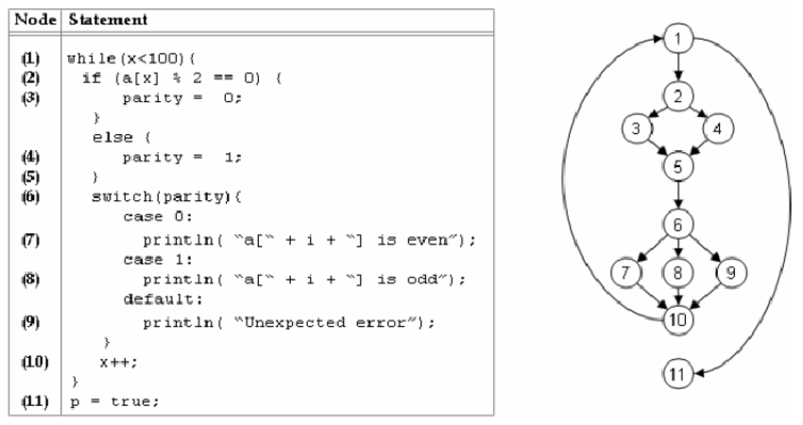
Control flow
A more expressive control flow graph (Code in C language; not required)
Administrivia
1

Slide 29
Conditional flow: if statement
Conditional flow allows you to execute (or not) a block of code based on logical comparison
Administrivia
1

Slide 30
Example: if statement
ans = input(‘Enter a number: ’)
if float(ans) < 0:
print(‘the input number is negative.’)
Administrivia
1

Slide 31
if statement
A if statement has the following:
The keyword if
A logical comparison (result in a boolean type)
A block of code (starts with a : )
Administrivia
1

Slide 32
if statement
Let us make decisions during the program execution
Change program behavior based on different execution conditions
Administrivia
1

Slide 33
Example: if statement
ans = input(‘Enter a number: ’)
if float(ans) < 0:
print(‘the input number is negative.’)
if float(ans) >= 0:
print(‘the input number is positive or zero.’)
Administrivia
1

Slide 34
Example: if-else statement
ans = input(‘Enter a number: ’)
if float(ans) < 0:
print(‘the input number is negative.’)
else:
print(‘the input number is positive or zero.’)
For two conditional branches that are logically complementary
Administrivia
1

Slide 35
Example: if-else statement
ans = input(‘Enter a number: ’)
if float(ans) < 0:
print(‘the input number is negative.’)
if float(ans) > 0:
print(‘the input number is positive.’)
if float(ans) == 0:
print(‘the input number is zero.’)
Administrivia
1

Slide 36
Example: if-else statement
ans = input(‘Enter a number: ’)
if float(ans) < 0:
print(‘the input number is negative.’)
elif float(ans) > 0:
print(‘the input number is positive.’)
else:
print(‘the input number is zero.’)
For multiple conditional branches that are logically complementary
elif means “else if”
Administrivia
1

Slide 37
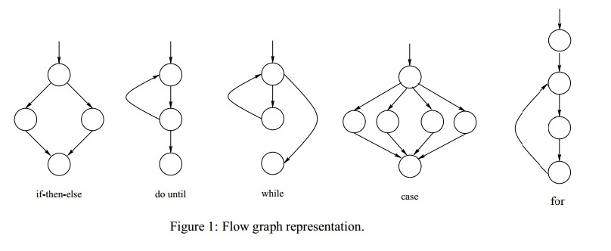
Control flow
More control flow syntaxes to come!
Administrivia
1

Slide 38
Control flow
If they have eggs, get six!
http://www.dslreports.com/forum/r25743814-Wife-of-a-computer-programmer
Administrivia
1

Slide 39
Boolean Logic
Administrivia
1

Slide 40
Boolean
Bool is a data type with two possible values
True
False
We use these to make decisions
Their logic is based on Boolean algebra
Operators
and (&)
or (|)
not
Administrivia
1

Slide 41
Example: Boolean logic
x > 0
(x > 0) or (x < -10)
(x > 0) and (x <= 10)
0 < x <= 10
Administrivia
1

Slide 42
Boolean
Assign a boolean operation to a variable
x = 5
y = (x < 0) or (x > -2)
type (x)
type (y)
print(y)
Administrivia
1

Slide 43
Boolean operators (review)
and | True | False
True | True | False
False | False | False
or | True | False
True | True | True
False | True | False
True when BOTH inputs are true
True when EITHER input is true
Administrivia
1

Slide 44
Boolean operators
not | result
True | False
False | True
Inverts input value
Administrivia
1

Slide 45
Example
def fun():
return True and False
x = fun() and not (True or False)
What is the value of x?
A True
B False
Administrivia
1

Slide 46
Comparison operators
Comparison operators also produces bool type
Less than, <
Greater than, >
Less than or equal to, <=
Greater than or equal to, >=
Equal to, ==
Not equal to, !=
Administrivia
1

Slide 47
Example
a = 5
b = 3
x = (a < 5) or ((b <= 5) and (a != b))
What is the value of x?
A True
B False
Administrivia
1

Slide 48
Example
a = 5
b = ‘hello world!’
x = (a < 5) or (b[len(b)] == ‘!’)
What is the value of x?
A True
B False
Administrivia
1

Slide 49
Example
a = 5
b = ‘hello world!’
x = (a < 5) and (b[len(b)] == ‘!’)
What is the value of x?
A True
B False
Administrivia
1

Slide 50
Example
a = ‘ABC’
b = ‘Abc’
x = a < b and a[1] != b[-2]
What is the value of x?
A True
B False
Administrivia
1

Slide 51
Example
def fun(a, b):
return a < b
a = 3
b = 4
if fun(b, a):
print(‘a is less than b’)
else:
print(‘a is greater or equal to b’)
What is the output of this piece of code?
Where does it go wrong?
Administrivia
1

Slide 52
Reminder
Administrivia
1

Slide 53
Reminder
Administrivia
1

