Slide 1
Python Basics
Lists, range and loop
CS101 Lecture #8
2016-10-19

Slide 2
Administrivia
Administrivia
1

Slide 3
Administrivia
Homework #4 is out
Due day is Oct 23, 6pm.
Administrivia
1

Slide 4
if-elif-else (Warmup review)
Administrivia
1

Slide 5
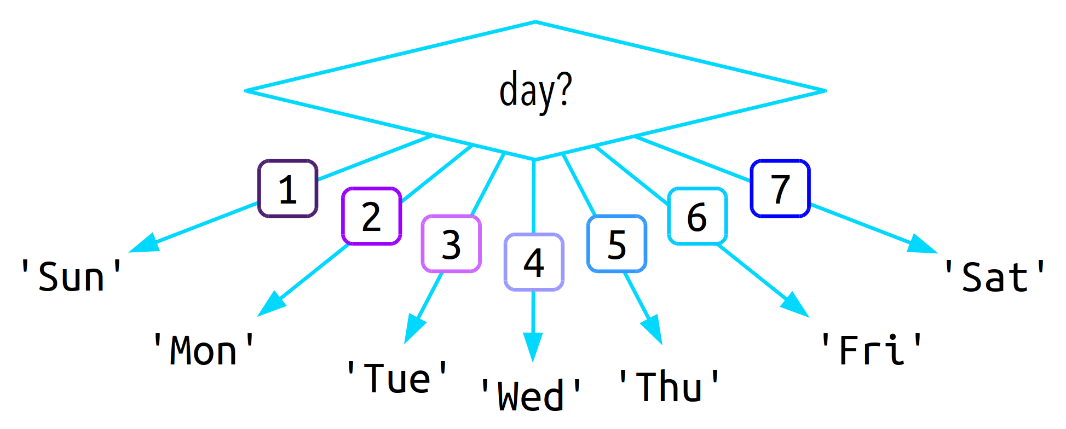
Administrivia
1

Slide 6
if day == 1:
print(‘Sunday’)
else:
if day == 2:
print(‘Monday’)
else:
if day == 3:
print(‘Tuesday’)
else:
if day == 4:
print(’Wednesday’)
else:
if day == 5:
print(‘Thursday’)
else:
if day == ‘6’
print(‘Friday’)
else:
if day == ‘7’
print(‘Saturday’)
else:
print(‘Not a good day’)
Administrivia
1

Slide 7
if day == 1:
print(‘Sunday’)
elif day == 2:
print(‘Monday’)
elif day == 3:
print(‘Tuesday’)
elif day == 4:
print(’Wednesday’)
elif day == 5:
print(‘Thursday’)
elif day == ‘6’
print(‘Friday’)
elif day == ‘7’
print(‘Saturday’)
else:
print(‘Not a good day’)
Administrivia
1

Slide 8
Container Data Type
Administrivia
1

Slide 9
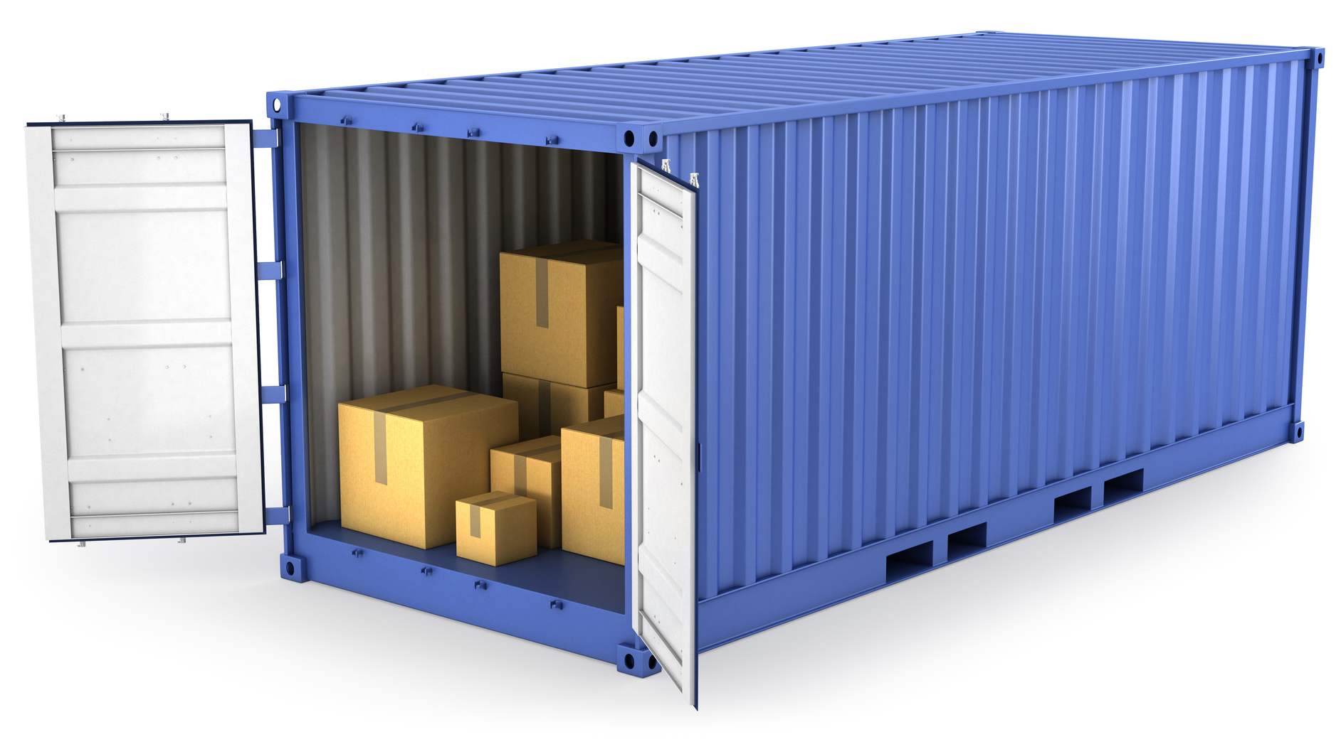
Container
Administrivia
1

Slide 10
Example
colors = [‘red’, ‘yellow’, ‘blue’, ‘purple’, ‘jale’]
Administrivia
1

Slide 11
list data type
It represents an listed collection of items
It is a container data type
Also an iterable data type
Can hold values of any type, and they don’t have to be the same (not the same as array)
Administrivia
1

Slide 12
How to create a list?
Syntax:
An opening bracket [
One or more comma-separated data values
A closing bracket ]
x = [10, 3.14, ‘2.71’]
Administrivia
1

Slide 13
How to access a list
Works a bit like strings:
x = [10, 3.14, ‘2.71’]
print(x[0])
print(x[1:3])
print(len(x))
Administrivia
1

Slide 14
Modify a list?
Modify a string
Strings are immutable; we cannot change its content without creating a new string
s = ‘strang’
s[3] = ‘i’ #nope
s = s[:3] + ‘i’ + s[4:] #bingo!
Administrivia
1

Slide 15
Modify a list?
We can change content of a list – it’s mutable
x = [4,1,2,4]
x[3] = -2 #item assignment
x.append(5) #add an item to the end
x.sort() #sort items by value
del x[1] #delete an item
Administrivia
1

Slide 16
for-loop
How to iterate a list?
print out all items of a list
colors = [‘red’, ‘yellow’, ‘blue’, ‘purple’, ‘jale’]
Administrivia
1

Slide 17
Loops
Administrivia
1

Slide 18
for loop
colors = [‘red’, ‘yellow’, ‘blue’, ‘purple’, ‘jale’]
for color in colors:
print(color)
Administrivia
1

Slide 19
for loop
A for loop requires:
Keyword for
A loop variable
Keyword in
An iterable data type
A block of code
For can iterate over items of a iterable type one at a time
Administrivia
1

Slide 20
Example
s = ‘abcdefg’
t = ‘’
for c in s:
t = c + t
What’s the value of t?
A ‘abcdefg’
B ‘gfedcba’
C ‘a’
D ‘g’
Administrivia
1

Slide 21
Exercise
Write a function to sum up all digits in a number, i.e.,
12145 → 1 + 2 + 1 + 4 + 5 → 13
Administrivia
1

Slide 22
Solution
def sum_digits(n):
results = 0
for digit in str(n):
result = result + int(digit)
return result
Administrivia
1

Slide 23
Exercise
Write a function to sum up numbers from 1 to 100
Administrivia
1

Slide 24
Solution
results = 0
for i in range(1, 101):
result = result + i
Administrivia
1

Slide 25
range function
The range function returns an iterator containing integers
range can be casted as a list
list(range(10))
Two arguments:
(optional) the starting value (inclusive)
The ending value (exclusive)
Administrivia
1

Slide 26
Solution
for I in range(10):
print(i**2)
Administrivia
1

Slide 27
while-loop
Administrivia
1

Slide 28
Python Basics
Lists, range and loop
CS101 Lecture #5
2016-10-19

Slide 29
Administrivia
Administrivia
1

Slide 30
Administrivia
Administrivia
1

