Slide 1
all models are wrong
(but some are useful)
—George Box, statistician

Slide 2
elements of modeling
the same story
model:
mathematics,
physics, code
input/
data
result/
prediction

Slide 3
elements of modeling
the model lifecycle
problem

Slide 4
elements of modeling
the model lifecycle
problem
model definition

Slide 5
elements of modeling
the model lifecycle
problem
model definition
calibration

Slide 6
elements of modeling
the model lifecycle
problem
model definition
calibration
application

Slide 7
elements of modeling
the model lifecycle
problem
model definition
calibration
application
extension

Slide 8
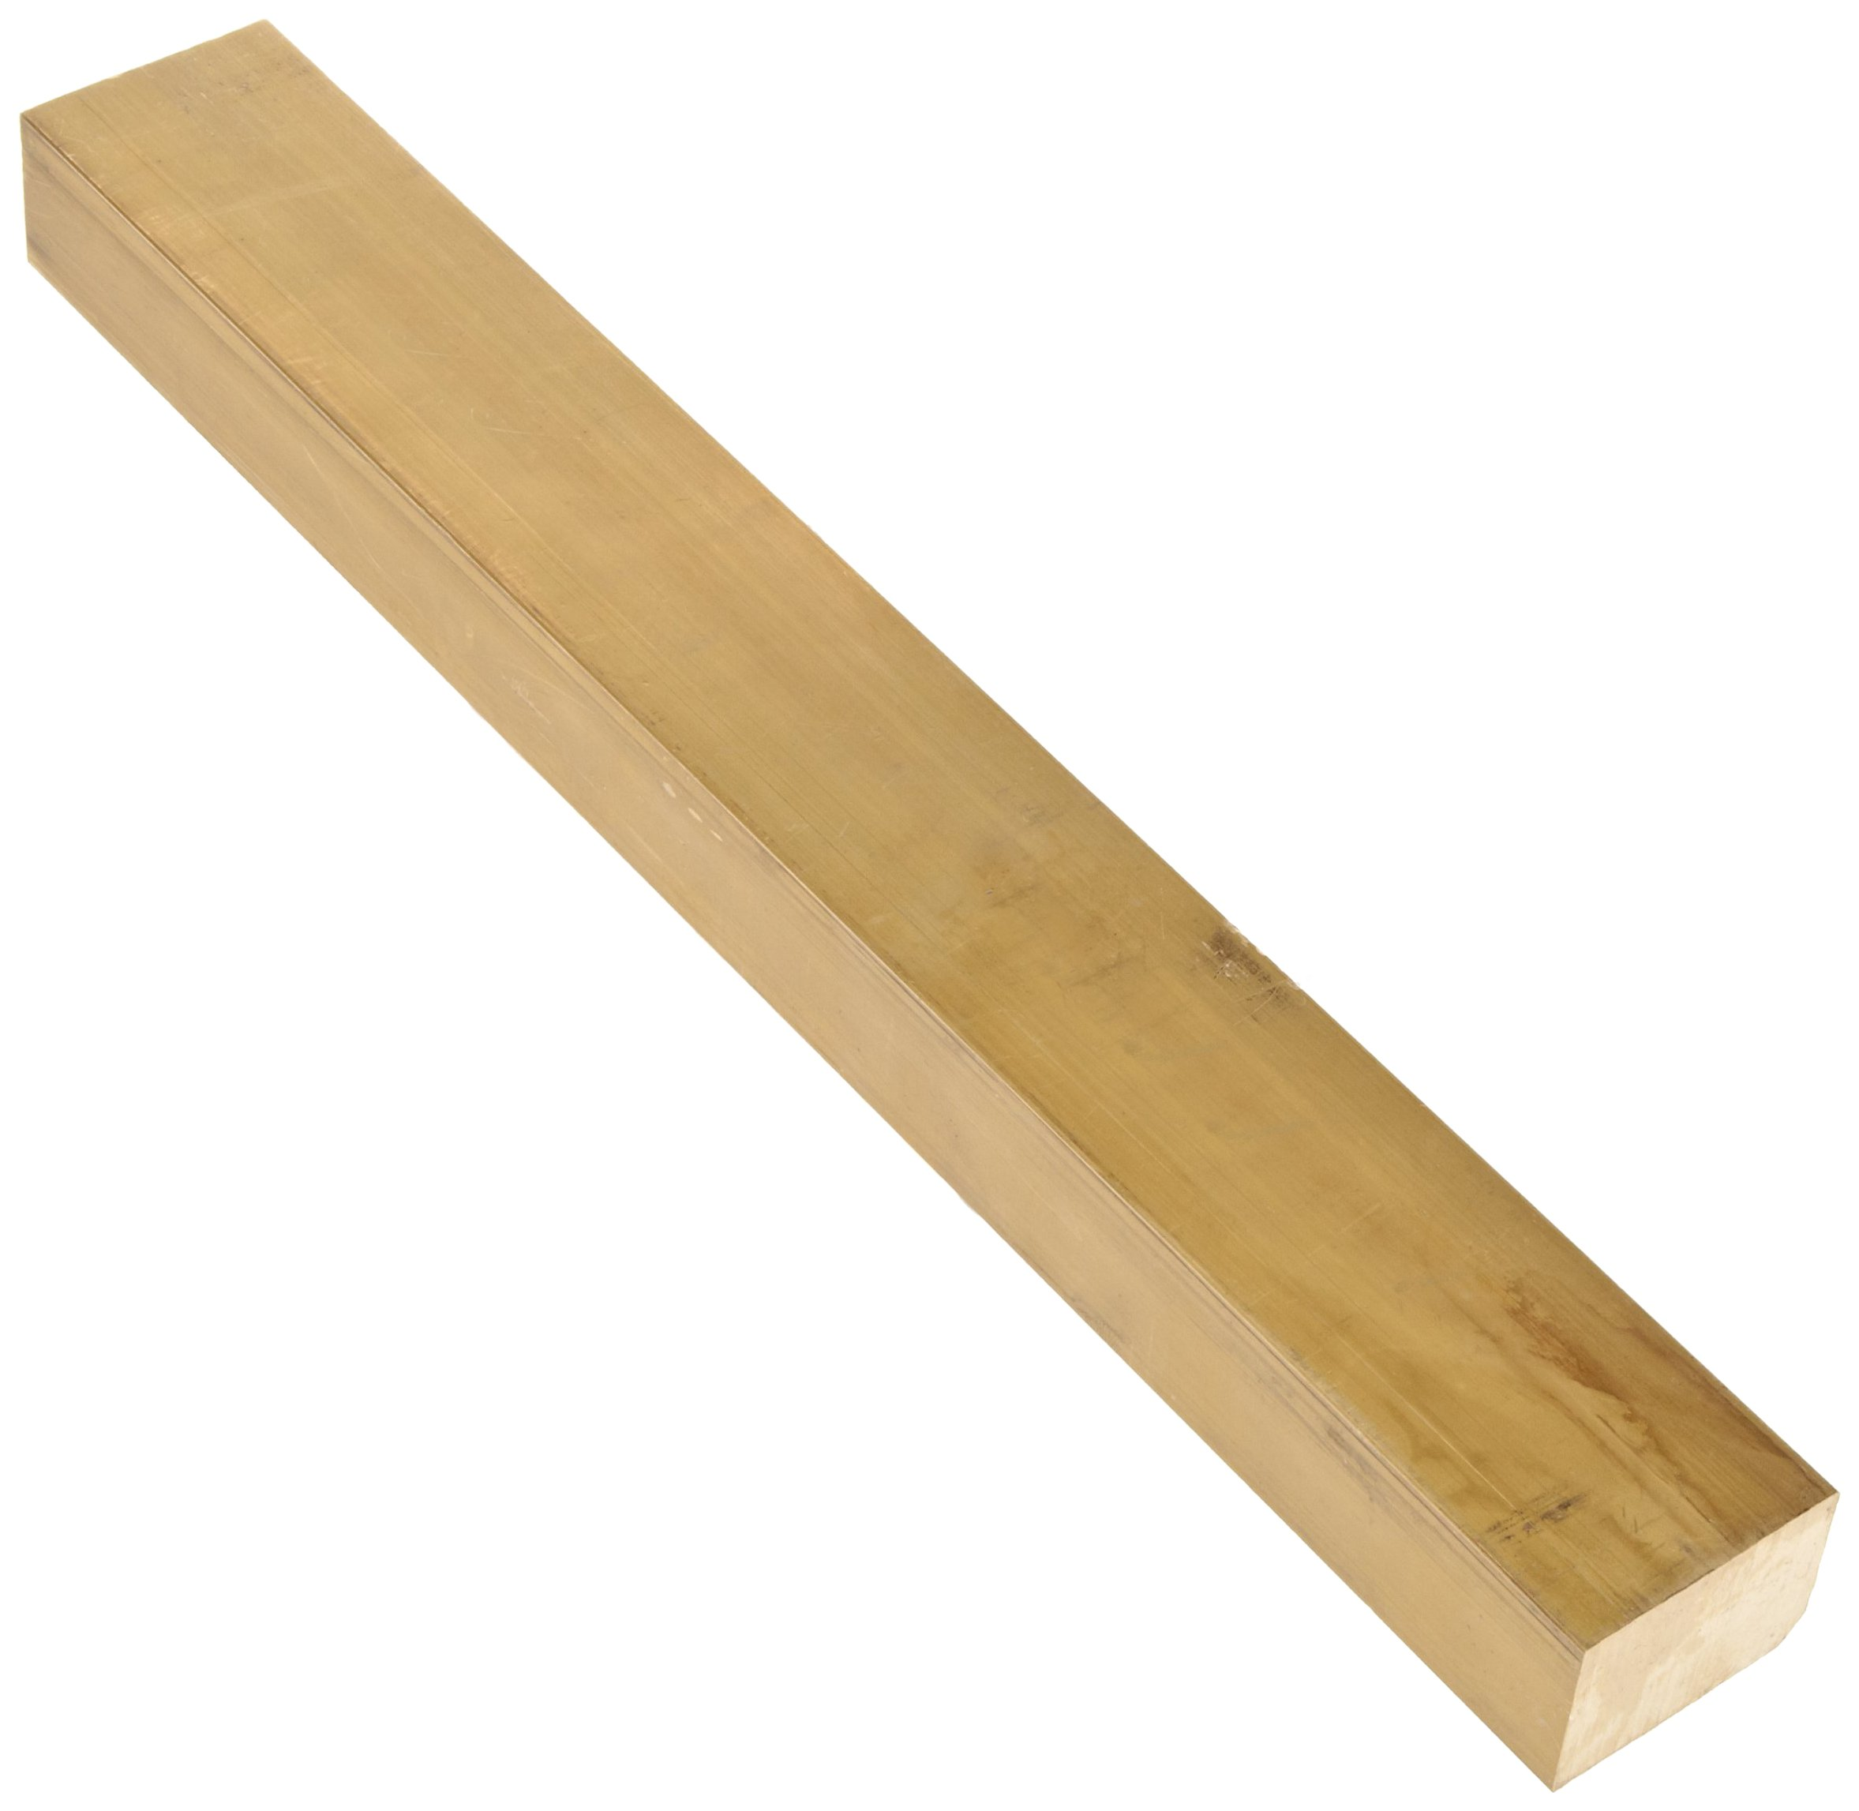
elements of modeling
problem statement
prob
defn
cal
app
ext

Slide 9
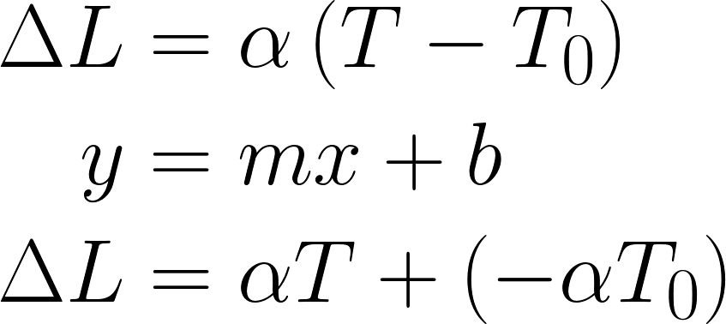
elements of modeling
model definition
prob
physics & math
defn
implementation
cal
app
ext

Slide 10
elements of modeling
model definition
prob
physics & math
defn
implementation
cal
app
ext

Slide 11
elements of modeling
model definition
prob
physics & math
defn
implementation
cal
app
ext

Slide 12
elements of modeling
calibration
prob
defn
calibration
cal
verification
app
validation
ext

Slide 13
elements of modeling
application
prob
defn
cal
solution
app
analysis & error
ext

Slide 14
elements of modeling
extension
prob
defn
cal
app
shortcomings
ext
surprises

Slide 15


scientific programming
model failure: ohm’s law
I
V

Slide 17
1
0
0
0
0
1
0
0
0
1
0
1
1
1
0
1

Slide 18
1
0
0
0
0
1
0
0
0
1
0
1
1
1
0
1

Slide 19
2²
2¹
2⁰
2^{–1}
2⁷
2⁶
2⁵
2⁴
2³
2^{–2}
2^{–3}
2^{–4}
2^{–5}
2^{–6}
2^{–7}
2^{–8}
1
0
0
0
0
1
0
0
0
1
0
1
1
1
0
1

Slide 20
2²
2¹
2⁰
2^{–1}
2⁷
2⁶
2⁵
2⁴
2³
2^{–2}
2^{–3}
2^{–4}
2^{–5}
2^{–6}
2^{–7}
2^{–8}
1
0
0
0
0
1
0
0
0
1
0
1
1
1
0
1
2⁷ + 2² + 2^{–2} + 2^{–4} + 2^{–5} + 2^{–6} + 2^{–8}
= 128 + 4 + ½ + 1/32 + 1/64 + 1/256
= 132.55078125

Slide 21
1.1₁₀ | 0001100110011001100110011001100110011001100110011010
0.8₁₀ | 1001100110011001100110011001100110011001100110011010
1.1–0.8₁₀ | 0011001100110011001100110011001100110011001100110100
0.3₁₀ | 0011001100110011001100110011001100110011001100110011
Δ₁₀ | 0000000000000000000000000000000000000000000000000001

Slide 22
1.1₁₀ | 0001100110011001100110011001100110011001100110011010
0.8₁₀ | 1001100110011001100110011001100110011001100110011010
1.1–0.8₁₀ | 0011001100110011001100110011001100110011001100110100
0.3₁₀ | 0011001100110011001100110011001100110011001100110011
Δ₁₀ | 0000000000000000000000000000000000000000000000000001

Slide 23
1.1₁₀ | 0001100110011001100110011001100110011001100110011010
0.8₁₀ | 1001100110011001100110011001100110011001100110011010
1.1–0.8₁₀ | 0011001100110011001100110011001100110011001100110100
0.3₁₀ | 0011001100110011001100110011001100110011001100110011
Δ₁₀ | 0000000000000000000000000000000000000000000000000001

Slide 24
1.1₁₀ | 0001100110011001100110011001100110011001100110011010
0.8₁₀ | 1001100110011001100110011001100110011001100110011010
1.1–0.8₁₀ | 0011001100110011001100110011001100110011001100110100
0.3₁₀ | 0011001100110011001100110011001100110011001100110011
Δ₁₀ | 0000000000000000000000000000000000000000000000000001

Slide 26
Don’t compare directly:
a == b # never do this for floats!
np.isclose( a, b, rtol=1e-05, atol=1e-08)
np.allclose(a, b, rtol=1e-05, atol=1e-08)
Parameters:
rtol # relative tolerance (w/i percent)
atol # absolute tolerance

Slide 27
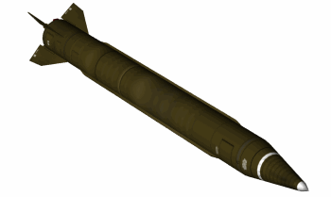
The number 0.1₁₀ is written in binary as
which the machine represents as
The difference of these numbers is
rendered in decimal as about 0.000 000 095₁₀.
0.0001100110011001100110011001100...₂,
0.00011001100110011001100₂.
0.0000000000000000000000011001100...₂,
min
s
100 hr × 60 × 60 × (10×0.000 000 095₁₀) = 0.34 s
hr
min

Slide 28
The number 0.1₁₀ is written in binary as
which the machine represents as
The difference of these numbers is
rendered in decimal as about 0.000 000 095₁₀.
0.0001100110011001100110011001100...₂,
0.00011001100110011001100₂.
0.0000000000000000000000011001100...₂,
min
s
100 hr × 60 × 60 × (10×0.000 000 095₁₀) = 0.34 s
hr
min

Slide 29
The number 0.1₁₀ is written in binary as
which the machine represents as
The difference of these numbers is
rendered in decimal as about 0.000 000 095₁₀.
0.0001100110011001100110011001100...₂,
0.00011001100110011001100₂.
0.0000000000000000000000011001100...₂,
min
s
100 hr × 60 × 60 × (10×0.000 000 095₁₀) = 0.34 s
hr
min

Slide 30
The number 0.1₁₀ is written in binary as
which the machine represents as
The difference of these numbers is
rendered in decimal as about 0.000 000 095₁₀.
0.0001100110011001100110011001100...₂,
0.00011001100110011001100₂.
0.0000000000000000000000011001100...₂,
min
s
100 hr × 60 × 60 × (10×0.000 000 095₁₀) = 0.34 s
hr
min

Slide 31
The number 0.1₁₀ is written in binary as
which the machine represents as
The difference of these numbers is
rendered in decimal as about 0.000 000 095₁₀.
0.0001100110011001100110011001100...₂,
0.00011001100110011001100₂.
0.0000000000000000000000011001100...₂,
min
s
100 hr × 60 × 60 × (10×0.000 000 095₁₀) = 0.34 s
hr
min

Slide 32
The number 0.1₁₀ is written in binary as
which the machine represents as
The difference of these numbers is
rendered in decimal as about 0.000 000 095₁₀.
0.0001100110011001100110011001100...₂,
0.00011001100110011001100₂.
0.0000000000000000000000011001100...₂,
min
s
100 hr × 60 × 60 × (10×0.000 000 095₁₀) = 0.34 s
hr
min

Slide 33
The number 0.1₁₀ is written in binary as
which the machine represents as
The difference of these numbers is
rendered in decimal as about 0.000 000 095₁₀.
0.0001100110011001100110011001100...₂,
0.00011001100110011001100₂.
0.0000000000000000000000011001100...₂,
min
s
100 hr × 60 × 60 × (10×0.000 000 095₁₀) = 0.34 s
hr
min

Slide 34
Which of the following expressions is liable to experience problems with numerical error? Assume all variables are defined and have appropriate type.
A. ( a / 1e5 < 0 )
B. ( b <= 1.0 )
C. ( c ** 0.5 ) / 2
D. ( d == 0.4 )

Slide 36
What does this mean?
seatingAvail = guests < 150

Slide 37
What does this mean?
seatingAvail = guests < 150
seatingAvail = \
guests < MaximumOccupancy

Slide 38
don’t use magic numbers!

Slide 40
