Slide 1
Python Basics
Mutability, container methods
CS101 Lecture #9
2016-10-24

Slide 2
For loops
warmup
1

Slide 3
Examples
for i in range(10):
print(i**2)
warmup
1

Slide 4
Examples
for i in range(10):
print(i**2)
for i in range(2,10):
print(i**2)
warmup
1

Slide 5
Examples
for i in range(10):
print(i**2)
for i in range(2,10):
print(i**2)
for i in range(2,10,3): # arithmetic sequence from 2 to # 10 (exclusive) w/ increment 3
print(i**2)
warmup
1
Notes:
等差数列：arithmetic sequence
等比数列：geometric sequence

Slide 6
Mutability and Aliasing
mutability
1

Slide 7
Examples
x = 1
y = x
y = 2
#What is the value of x?
mutability
1

Slide 8
Examples
x = 1
y = x
y = 2
#What is the value of x?
x = ‘Hello’
y = x
y = y + ‘ world!’
#What is the value of x?
mutability
1

Slide 9
Examples
x = 1
y = x
y = 2
#What is the value of x?
x = ‘Hello’
y = x
y = y + ‘ world!’
#What is the value of x?
x = [1,2,3]
y = x
y[0] = 0
#What is the value of x?
mutability
1

Slide 10
Mutability
Recall the distinction of mutability (of list) and immutability (of string)
The distinction arises from the storage in memory
mutability
1

Slide 11
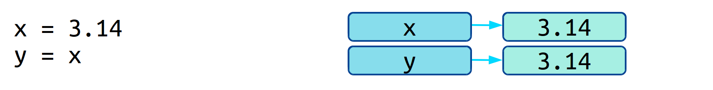
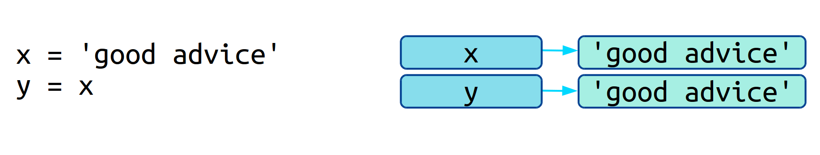
Mutability
Immutable types: value of x is copied in memory and assigned to y (copy by value)
mutability
1

Slide 12
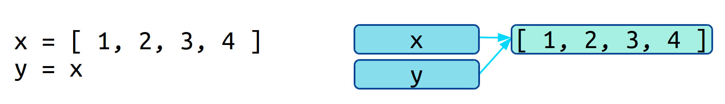
Mutability
Mutable type: the new variable y refers to the same memory location of the value that x refers to (copy by reference, or shallow copy)
mutability
1

Slide 13
Mutability
Mutable type: the new variable y refers to the same memory location of the value that x refers to (copy by reference, or shallow copy)
Benefit: avoid large chunks of memory copy
Drawback (?): aliasing
mutability
1

Slide 14
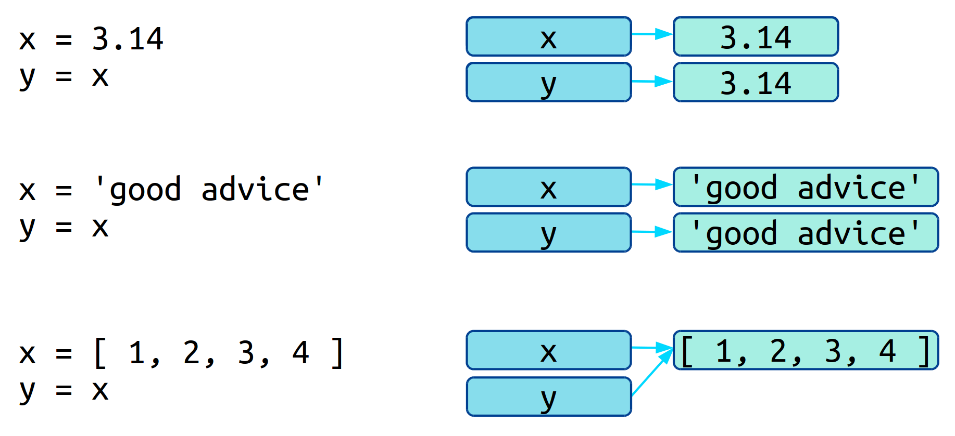
Mutability
mutability
1

Slide 15
Mutability
Python data types are either mutable or immutable
int, float, string, tuple
list, dictionary
x = [1,2,3,4]
y = x
x[-1] = 2
#What is the value of y?
mutability
1

Slide 16
Aliasing
Occurs in mutable types
Changes in one variable causes value of another variable to change
sometimes useful, sometimes cause trouble
Aliasing
1

Slide 17
Aliasing
x = [1,2,3,4]
y = x
Aliasing
1

Slide 18
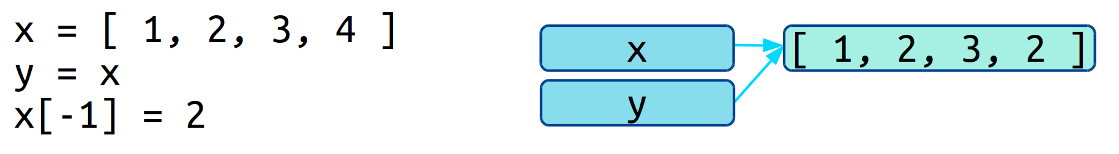
Aliasing
x = [1,2,3,4]
y = x
x[-1] = 2
#What is the value of y?
Aliasing
1

Slide 19
Examples
x = [’a’, ’b’, ’c’, ‘d’] # a dictionary
y = x
y[2] = ‘*‘
#What is the value of x?
A [’a’, ’b’, ’c’, ‘d’]
B [’a’, ’*’, ’c’, ‘d’]
C [’a’, ’b’, ’*’, ‘d’]
D None of the above
Aliasing
1

Slide 20
Examples
x = {1:’a’, 2:’b’, 3:’c’, 4:’d’} # a dictionary
y = x
y[2] = ‘*‘
What is the value of x?
A {1:’a’, 2:’b’, 3:’c’, 4:’d’}
B {1:’a’, 2:’b’, 3:’*’, 4:’d’}
C {1:’a’, 2:’*’, 3:’c’, 4:’d’}
D None of the above
Aliasing
1

Slide 21
Tuples
The immutable analogue of a list
Use the parentheses () instead of the square brackets []
Parentheses can sometimes be skipped
x = [1,2,3,4] # x is a list
y = (1,2,3,4) # y is a tuple
y = 1,2,3,4 # equivalent to above line
Tuples
1

Slide 22
Tuples
Access elements by index
x = [1,2,3,4] # x is a list
y = (1,2,3,4) # y is a tuple
print(y[0])
print(y[-1])
Tuples
1

Slide 23
Tuples
Cannot change elements within a tuple (like a string)
x = [1,2,3,4] # x is a list
y = (1,2,3,4) # y is a tuple
y[0] = -1 # error!
Tuples
1

Slide 24
Tuples
Cannot change elements within a tuple (like a string)
Copy by value
x = [1,2,3,4] # x is a list
y = (1,2,3,4) # y is a tuple
y[0] = -1 # error!
z = y
y
(1, 2, 3, 4)
z
(1, 2, 3, 4)
Tuples
1

Slide 25
Where can we use tuples?
Formatting multiple values in string format
Parentheses is required
‘%i %i %i’%(1,2,3)
Tuples
1

Slide 26
Where can we use tuples?
Formatting multiple values in string format
Parentheses is required
‘%i %i %i’%(1,2,3)
‘the avg. grade of HW%i is %.3f’%(4, 85.0)
Tuples
1

Slide 27
Exercise
s = ???
x = 10
y = ‘Hello’
Z = 3.14
print(s % x,y,z)
Which of the following are valid replacement of ???
A ‘%i %f %s’
B ‘%f %s %i’
C ‘%f %s %f’
D ‘%i %s %f’
Tuples
1

Slide 28
Where can we use tuples?
Can also be used on the left hand side of an assignment operator
Lets us make multiple assignment at once
Parentheses is optional
One, pi, hello = (1, 3,14, ‘Hi’)
One, pi, hello = 1, 3,14, ‘Hi’
Tuples
1

Slide 29
Where can we use tuples?
Can also be used on the left hand side of an assignment operator
Lets us make multiple assignment at once
Parentheses is optional
x,y = y,x # exchange values of two variables
# parentheses is skipped
x
1
y
‘Hi!’
Tuples
1

Slide 30
Where can we use tuples?
Can also be used on the left hand side of an assignment operator
Lets us make multiple assignment at once
Parentheses is optional
x,y = y,x # exchange values of two variables
# parentheses is skipped
x
‘Hi!’
y
1
Tuples
1

Slide 31
Where can we use tuples?
Return multiple values from a function
def foo():
return ‘hi’, 3, ‘3.14’
a,b,c = fun()
Tuples
1

Slide 32
Where can we use tuples?
Return multiple values from a function
def fun(x):
y = x**2
z = x**0.5
return y, z
Tuples
1

Slide 33
Where can we use tuples?
Return multiple values from a function
def fun(x):
y = x**2
z = x**0.5
return y, z
>>> a,b = fun(10)
Tuples
1

Slide 34
Where can we use tuples?
Return multiple values from a function
def fun(x):
y = x**2
z = x**0.5
return y, z
>>> a,b = fun(10)
>>> fun(10)[0]
100
>>> fun(10)[1]
3.1622…
Tuples
1

Slide 35
List and string Methods
Methods
1

Slide 36
List methods
Because lists are mutable, we can change their content by calling its method functions
x = [4,1,2,3]
x.append(5)
x.reverse()
x.sort()
Methods
1

Slide 37
List methods
Because lists are mutable, we can change their content by calling its method functions
x = [4,1,2,3]
x.append(5)
x.reverse()
x.sort()
x = [3.14, 1, ‘hi’]
x.sort() #error!
Methods
1

Slide 38
Example
x = [3,2,1]
y = x.append(5)
x[-1] = 3
What is the value of y?
A [3,2,1]
B [3,2,3]
C [3,2,1,5]
D [3,2,1,3]
E None of the above
Methods
1

Slide 39
List methods
Append, reverse, sort modify the list content itself
Returns a NoneType!
x = [3,2,1]
y = x.append(5)
type(y)
Methods
1

Slide 40
More List methods
index returns the index of the first occurrence of a value in a list (find for str)
count returns how many times a value occurs
in returns membership (True or False) in a list
* repeats a list
+ extends a list (also extend)
max, min, len,…
Methods
1

Slide 41
String methods
split splits a string by a delimiter
Returns a list
Takes a single argument, the delimiter
s = ‘Mary,Watson,Holmes’
names = s.split(‘,’)
print(names)
Methods
1

Slide 42
String methods
split splits a string by a delimiter
Returns a list
Takes a single argument, the delimiter
Default in ‘ ’
s = ‘Mary Watson Holmes’
names = s.split(‘ ’)
print(names)
s = ‘Mary Watson Holmes’
names = s.split()
print(names)
Methods
1

Slide 43
Example
x = ‘A+B+C’
y = x.split(‘+’)
What is the value of y?
A (‘A’, ‘B’, ‘C’)
B [‘A’, ‘B’, ‘C’]
C [‘A+B+C’]
D ‘A+B+C’
E None
Methods
1

Slide 44
Example
x = ‘A+B+C’
y = x.split()
What is the value of y?
A (‘A’, ‘B’, ‘C’)
B [‘A’, ‘B’, ‘C’]
C [‘A+B+C’]
D ‘A+B+C’
E None
Methods
1

Slide 45
String methods
join takes a list of string types and concatenate them together into a big string
The reverse of split
names = [‘Mary’, ‘Watson’, ‘Holmes’]
#goal: ‘Mary Watson Holmes’
‘ ’.join(names)
Methods
1

Slide 46
String methods
join takes a list of string types and concatenate them together into a big string
The reverse of split
names = [‘Mary’, ‘Watson’, ‘Holmes’]
#goal: ‘Mary Watson Holmes’
#also try:
‘’.join(names)
‘,’join(names)
Methods
1

Slide 47
Example
a = [‘X’, ‘A’, ‘G’]
b = a
a.sort()
x = ‘,’.join(b)
What is the value of x?
A [‘A,G,X’]
B [‘X,A,G’]
C ‘X,A,G’
D ‘A,G,X’
Methods
1

Slide 48
Example
a = [‘X’, ‘A’, ‘G’]
x = ‘#####’.join(a).split(‘#####’)
What is the value of x?
Methods
1

