Slide 1
Python Basics
Mutability, container methods
CS101 Lecture #9
2016-10-24

Slide 2
For loops
Administrivia
1

Slide 3
Examples
for i in range(10):
print(i**2)
Administrivia
1

Slide 4
Examples
for i in range(10):
print(i**2)
for i in range(2,10):
print(i**2)
Administrivia
1

Slide 5
Examples
for i in range(10):
print(i**2)
for i in range(2,10):
print(i**2)
for i in range(2,10,3): # arithmetic sequence from 2 to # 10 (exclusive) w/ increment 3
print(i**2)
Administrivia
1
Notes:
等差数列：arithmetic sequence
等比数列：geometric sequence

Slide 6
Mutability and Aliasing
Administrivia
1

Slide 7
Examples
x = 1
y = x
y = 2
#What is the value of x?
Administrivia
1

Slide 8
Examples
x = 1
y = x
y = 2
#What is the value of x?
x = ‘Hello’
y = x
y = y + ‘ world!’
#What is the value of x?
Administrivia
1

Slide 9
Examples
x = 1
y = x
y = 2
#What is the value of x?
x = ‘Hello’
y = x
y = y + ‘ world!’
#What is the value of x?
x = [1,2,3]
y = x
y[0] = 0
#What is the value of x?
Administrivia
1

Slide 10
Mutability
Recall the distinction of mutability (of list) and immutability (of string)
The distinction arises from the storage in memory
Administrivia
1

Slide 11
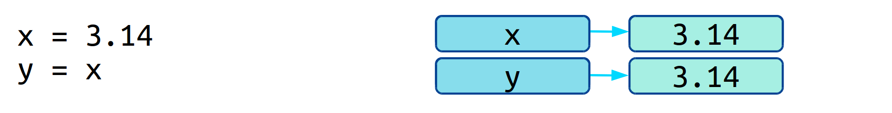
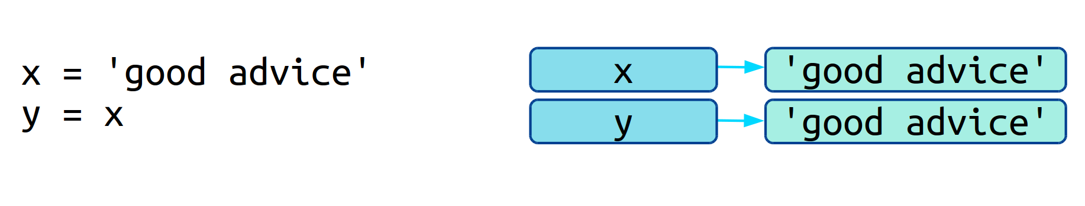
Mutability
Immutability occurs when values are copied in memory (copy by value)
Administrivia
1

Slide 12
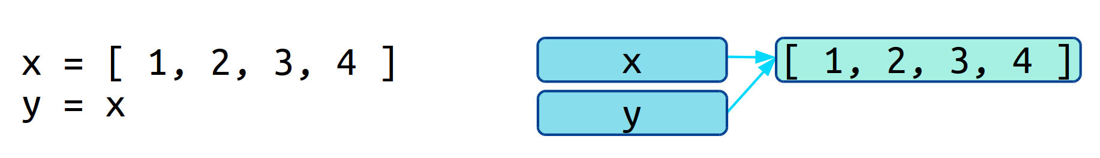
Mutability
Mutability occurs when variables refer to the same memory location of values (copy by reference, or shallow copy)
Administrivia
1

Slide 13
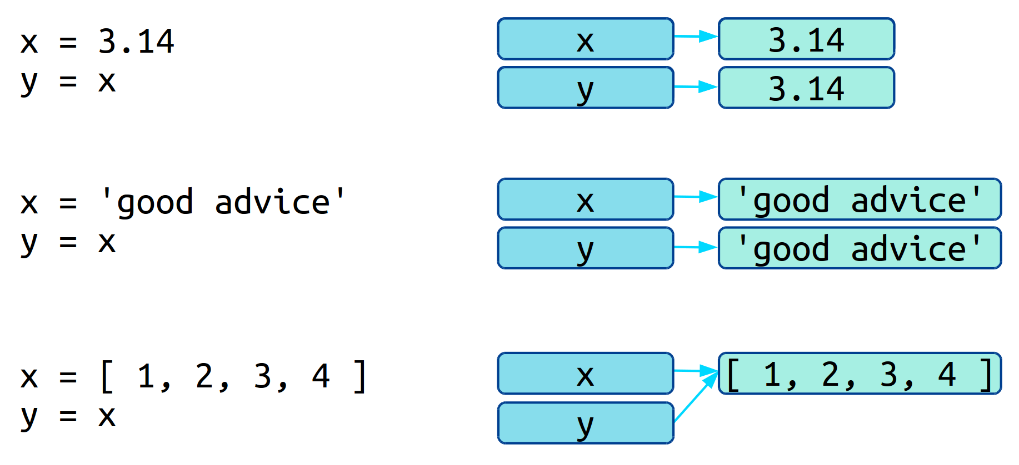
Mutability
Administrivia
1

Slide 14
Mutability
Python data types are either mutable or immutable
Int, float, string, tuple
list, dictionary
x = [1,2,3,4]
y = x
x[-1] = 2
#What is the value of y?
Administrivia
1

Slide 15
Aliasing
Occurs in mutable types
Changes in one variable causes value of another variable to change
sometimes useful, sometimes cause trouble
Administrivia
1

Slide 16
Aliasing
x = [1,2,3,4]
y = x
Administrivia
1

Slide 17
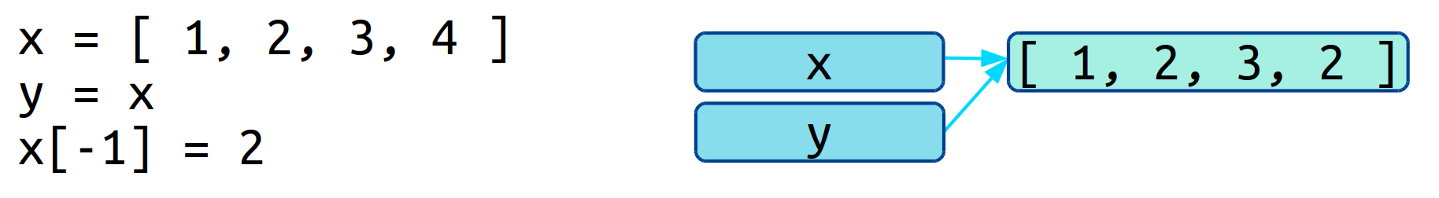
Aliasing
x = [1,2,3,4]
y = x
x[-1] = 2
#What is the value of y?
Administrivia
1

Slide 18
Examples
x = [’a’, ’b’, ’c’, ‘d’] # a dictionary
y = x
y[2] = ‘*‘
#What is the value of x?
A [’a’, ’b’, ’c’, ‘d’]
B [’a’, ’*’, ’c’, ‘d’]
C [’a’, ’b’, ’*’, ‘d’]
D None of the above
Administrivia
1

Slide 19
Examples
x = {1:’a’, 2:’b’, 3:’c’, 4:’d’} # a dictionary
y = x
y[2] = ‘*‘
#What is the value of x?
A {1:’a’, 2:’b’, 3:’c’, 4:’d’}
B {1:’a’, 2:’*’, 3:’c’, 4:’d’}
C {1:’a’, 2:’b’, 3:’*’, 4:’d’}
D None of the above
Administrivia
1

Slide 20
Tuples
The immutable analogue of a list
Use the parentheses () instead of the square brackets []
Parentheses can sometimes be skipped
x = [1,2,3,4] # x is a list
y = (1,2,3,4) # y is a tuple
y = 1,2,3,4 # equivalent to above line
Administrivia
1

Slide 21
Tuples
Access elements by index
x = [1,2,3,4] # x is a list
y = (1,2,3,4) # y is a tuple
print(y[0])
print(y[-1])
Administrivia
1

Slide 22
Tuples
Cannot change elements within a tuple (like a string)
x = [1,2,3,4] # x is a list
y = (1,2,3,4) # y is a tuple
y[0] = -1 # error!
Administrivia
1

Slide 23
Tuples
Cannot change elements within a tuple (like a string)
Copy by value
x = [1,2,3,4] # x is a list
y = (1,2,3,4) # y is a tuple
y[0] = -1 # error!
z = y
y
(1, 2, 3, 4)
z
(1, 2, 3, 4)
Administrivia
1

Slide 24
Where can we use tuples?
Formatting multiple values in string format
‘%i %i %i’%(1,2,3)
Administrivia
1

Slide 25
Where can we use tuples?
Formatting multiple values in string format
‘%i %i %i’%(1,2,3)
‘the avg. grade of HW%i is %.3f’%(4, 85.0)
Administrivia
1

Slide 26
Example
s = ???
x = 10
y = ‘Hello’
Z = 3.14
print(s % x,y,z)
What should replace the ???
A ‘%i %f %s’
B ‘%f %s %i’
C ‘%i %s %f’
D None of the above
Administrivia
1

Slide 27
Where can we use tuples?
Can also be used on the left hand side of an assignment operator
Lets us make multiple assignment at once
One, pi, hello = (1, 3,14, ‘Hi’)
Administrivia
1

Slide 28
Where can we use tuples?
Can also be used on the left hand side of an assignment operator
Lets us make multiple assignment at once
x,y = y,x # exchange values of two variables
# parentheses is skipped
x
1
y
‘Hi!’
Administrivia
1

Slide 29
Where can we use tuples?
Can also be used on the left hand side of an assignment operator
Lets us make multiple assignment at once
x,y = y,x # exchange values of two variables
# parentheses is skipped
x
‘Hi!’
y
1
Administrivia
1

Slide 30
Where can we use tuples?
Return multiple values from a function
def foo():
return ‘hi’, 3, ‘3.14’
a,b,c = fun()
Administrivia
1

Slide 31
Where can we use tuples?
Return multiple values from a function
def fun(x):
y = x**2
z = x**0.5
return y, z
Administrivia
1

Slide 32
Where can we use tuples?
Return multiple values from a function
def fun(x):
y = x**2
z = x**0.5
return y, z
>>> fun(10)[0]
100
>>> fun(10)[1]
3.1622…
Administrivia
1

Slide 33
List and string Methods
Administrivia
1

Slide 34
List methods
Because lists are mutable, we can change their content by calling its method functions
x = [4,1,2,3]
x.append(5)
x.reverse()
x.sort()
Administrivia
1

Slide 35
List methods
Because lists are mutable, we can change their content by calling its method functions
x = [4,1,2,3]
x.append(5)
x.reverse()
x.sort()
x = [3.14, 1+0j, ‘hi’]
x.sort() #error!
Administrivia
1

Slide 36
Example
x = [3,2,1]
y = x.append(5)
x[-1] = 3
What is the value of y?
A [3,2,1]
B [3,2,3]
C [3,2,1,5]
D [3,2,1,3]
E None of the above
Administrivia
1

Slide 37
List methods
Append, reverse, sort modify the list content itself
Returns a NoneType!
x = [3,2,1]
y = x.append(5)
type(y)
Administrivia
1

Slide 38
More List methods
index returns the index of the first occurrence of a value in a list (find for str)
count returns how many times a value occurs
in returns membership (True or False) in a list
* repeats a list
+ extends a list (also extend)
max, min, len,…
Administrivia
1

Slide 39
String methods
split splits a string by a delimiter
Returns a list
Takes a single argument, the delimiter
s = ‘Oliver,Wendell,Holmes’
names = s.split(‘,’)
print(names)
Administrivia
1

Slide 40
String methods
split splits a string by a delimiter
Returns a list
Takes a single argument, the delimiter
Default in ‘ ’
s = ‘Mary,Watson,Holmes’
names = s.split(‘,’)
print(names)
s = ‘Mary Watson Holmes’
names = s.split()
print(names)
Administrivia
1

Slide 41
Example
x = ‘A+B+C’
y = x.split()
What is the value of y?
A (‘A’, ‘B’, ‘C’)
B [‘A’, ‘B’, ‘C’]
C [‘A+B+C’]
D ‘A+B+C’
E None
Administrivia
1

Slide 42
Example
x = ‘A+B+C’
y = x.split(‘+’)
What is the value of y?
A (‘A’, ‘B’, ‘C’)
B [‘A’, ‘B’, ‘C’]
C [‘A+B+C’]
D ‘A+B+C’
E None
Administrivia
1

Slide 43
String methods
join takes a list of string types and concatenate them together
Returns a str
names = [‘Mary’, ‘Watson’, ‘Holmes’]
#goal: ‘Mary Watson Holmes’
‘ ’.join(names)
Administrivia
1

Slide 44
String methods
join takes a list of string types and concatenate them together
Returns a str
names = [‘Mary’, ‘Watson’, ‘Holmes’]
#goal: ‘Mary Watson Holmes’
#also try:
‘’.join(names)
‘,’join(names)
Administrivia
1

Slide 45
Example
a = [‘X’, ‘A’, ‘G’]
b = a[:]
a.sort()
x = ‘,’.join(b)
What is the value of x?
A [‘A,G,X’]
B [‘X,A,G’]
C ‘X,A,G’
D ‘A,G,X’
Administrivia
1

Slide 46
Reminder
Administrivia
1

Slide 47
Python Basics
Mutability, container methods
CS101 Lecture #9
2016-10-24

Slide 48
Administrivia
Administrivia
1

Slide 49
Administrivia
Administrivia
1

