Slide 1
all models are wrong
(but some are useful)
—George Box, statistician
Notes:
11/2/17
1
1

Slide 2
elements of modeling
the same story
model:
mathematics,
physics, code
input/
data
result/
prediction
Notes:
11/2/17
2
2

Slide 3
elements of modeling
the model lifecycle
problem
Notes:
11/2/17
3
3

Slide 4
elements of modeling
the model lifecycle
problem
model definition
Notes:
11/2/17
4
4

Slide 5
elements of modeling
the model lifecycle
problem
model definition
calibration
Notes:
11/2/17
5
5

Slide 6
elements of modeling
the model lifecycle
problem
model definition
calibration
application
Notes:
11/2/17
6
6

Slide 7
elements of modeling
the model lifecycle
problem
model definition
calibration
application
extension
Notes:
11/2/17
7
7

Slide 8
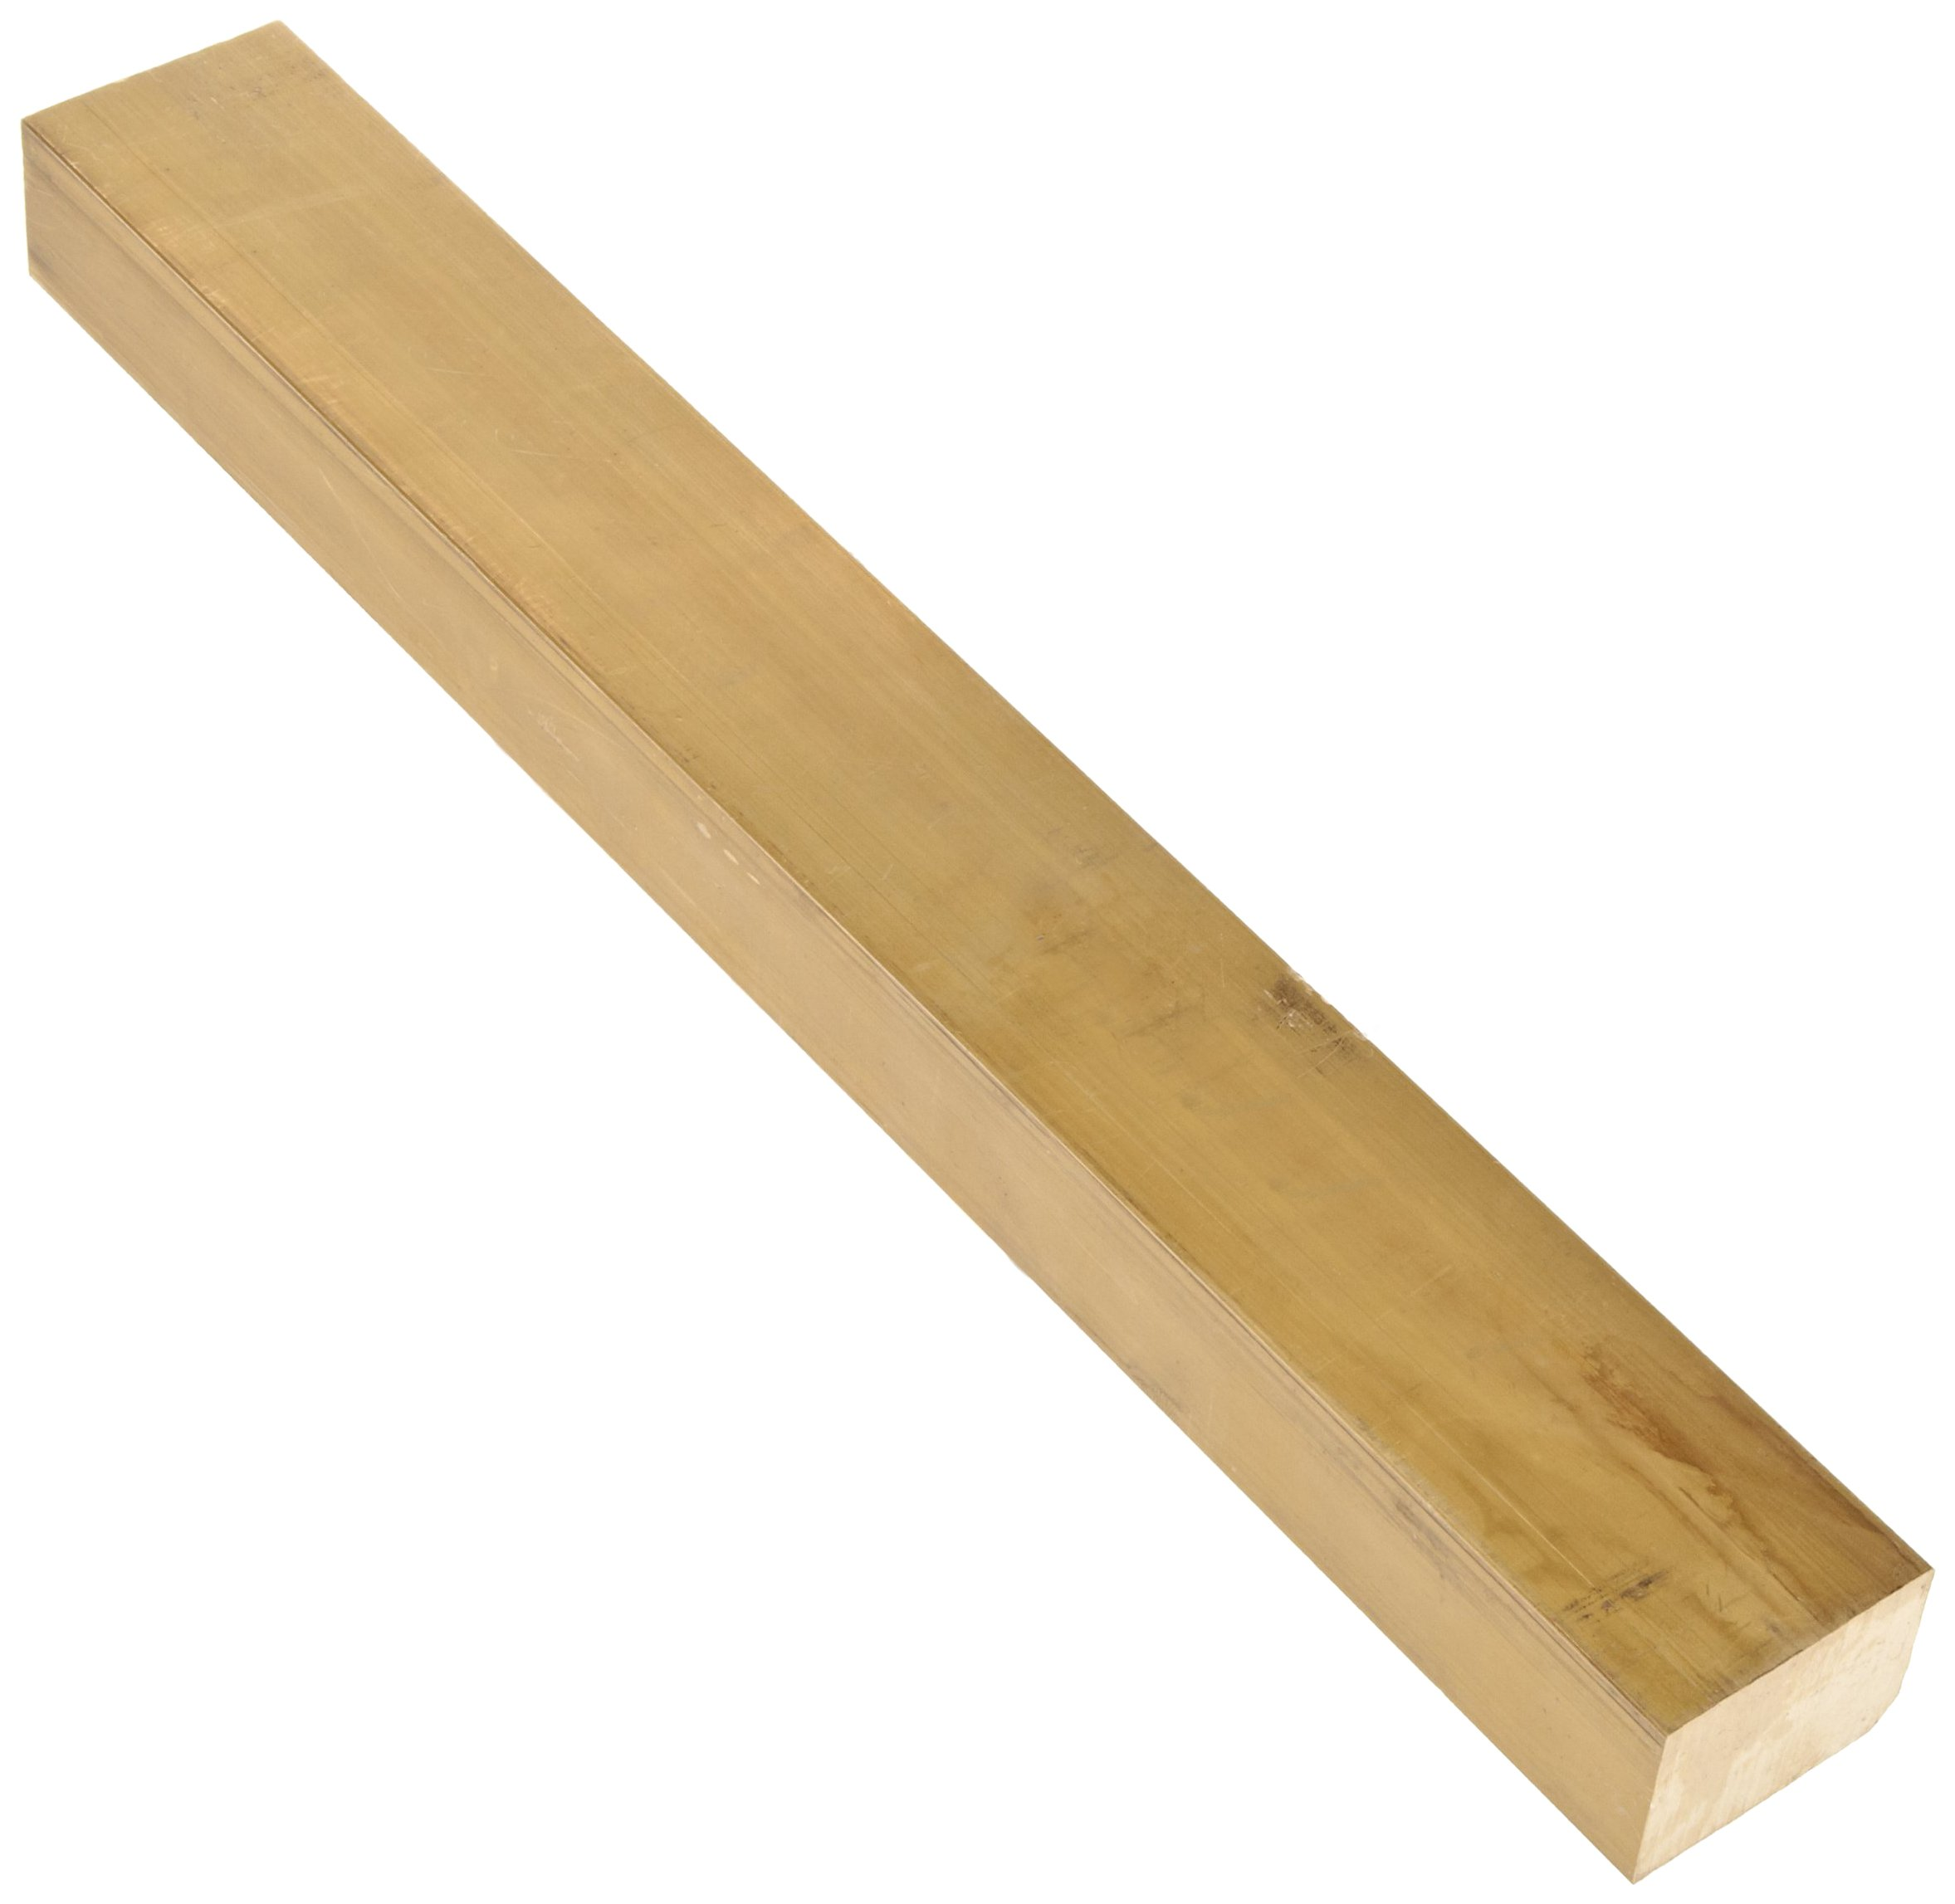
elements of modeling
problem statement
prob
defn
cal
app
ext
Notes:
11/2/17
8
8

Slide 9
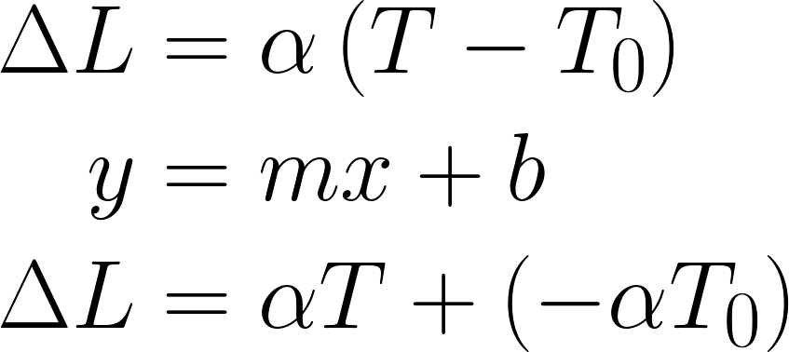
elements of modeling
model definition
prob
physics & math
defn
implementation
cal
app
ext
Notes:
11/2/17
9
9

Slide 10
elements of modeling
model definition
prob
physics & math
defn
implementation
cal
app
ext
Notes:
11/2/17
10
10

Slide 11
elements of modeling
model definition
prob
physics & math
defn
implementation
cal
app
ext
Notes:
11/2/17
11
11

Slide 12
elements of modeling
calibration
prob
defn
calibration
cal
verification
app
validation
ext
Notes:
11/2/17
12
12

Slide 13
elements of modeling
application
prob
defn
cal
solution
app
analysis & error
ext
Notes:
11/2/17
13
13

Slide 14
elements of modeling
extension
prob
defn
cal
app
shortcomings
ext
surprises
Notes:
11/2/17
14
14

Slide 15
scientific programming
model failure: ohm’s law
I
V
Notes:
11/2/17
15
15

Slide 16
Notes:
11/2/17
16
16

Slide 17
1
0
0
0
0
1
0
0
0
1
0
1
1
1
0
1
Notes:
11/2/17
17
17

Slide 18
1
0
0
0
0
1
0
0
0
1
0
1
1
1
0
1
Notes:
11/2/17
18
18

Slide 19
2²
2¹
2⁰
2^{–1}
2⁷
2⁶
2⁵
2⁴
2³
2^{–2}
2^{–3}
2^{–4}
2^{–5}
2^{–6}
2^{–7}
2^{–8}
1
0
0
0
0
1
0
0
0
1
0
1
1
1
0
1
Notes:
11/2/17
19
19

Slide 20
2²
2¹
2⁰
2^{–1}
2⁷
2⁶
2⁵
2⁴
2³
2^{–2}
2^{–3}
2^{–4}
2^{–5}
2^{–6}
2^{–7}
2^{–8}
1
0
0
0
0
1
0
0
0
1
0
1
1
1
0
1
2⁷ + 2² + 2^{–2} + 2^{–4} + 2^{–5} + 2^{–6} + 2^{–8}
= 128 + 4 + ½ + 1/32 + 1/64 + 1/256
= 132.55078125
Notes:
11/2/17
20
20

Slide 21
1.1₁₀ | 0001100110011001100110011001100110011001100110011010
0.8₁₀ | 1001100110011001100110011001100110011001100110011010
1.1–0.8₁₀ | 0011001100110011001100110011001100110011001100110100
0.3₁₀ | 0011001100110011001100110011001100110011001100110011
Δ₁₀ | 0000000000000000000000000000000000000000000000000001
Notes:
11/2/17
21
21

Slide 22
1.1₁₀ | 0001100110011001100110011001100110011001100110011010
0.8₁₀ | 1001100110011001100110011001100110011001100110011010
1.1–0.8₁₀ | 0011001100110011001100110011001100110011001100110100
0.3₁₀ | 0011001100110011001100110011001100110011001100110011
Δ₁₀ | 0000000000000000000000000000000000000000000000000001
Notes:
11/2/17
22
22

Slide 23
1.1₁₀ | 0001100110011001100110011001100110011001100110011010
0.8₁₀ | 1001100110011001100110011001100110011001100110011010
1.1–0.8₁₀ | 0011001100110011001100110011001100110011001100110100
0.3₁₀ | 0011001100110011001100110011001100110011001100110011
Δ₁₀ | 0000000000000000000000000000000000000000000000000001
Notes:
11/2/17
23
23

Slide 24
1.1₁₀ | 0001100110011001100110011001100110011001100110011010
0.8₁₀ | 1001100110011001100110011001100110011001100110011010
1.1–0.8₁₀ | 0011001100110011001100110011001100110011001100110100
0.3₁₀ | 0011001100110011001100110011001100110011001100110011
Δ₁₀ | 0000000000000000000000000000000000000000000000000001
Notes:
11/2/17
24
24

Slide 25
Notes:
11/2/17
25
25

Slide 26
Don’t compare directly:
a == b # never do this for floats!
np.isclose( a, b, rtol=1e-05, atol=1e-08)
np.allclose(a, b, rtol=1e-05, atol=1e-08)
Parameters:
rtol # relative tolerance (w/i percent)
atol # absolute tolerance
Notes:
11/2/17
26
26

Slide 27
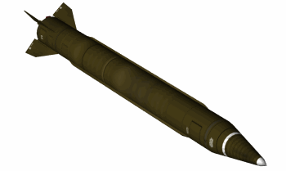
The number 0.1₁₀ is written in binary as
which the machine represents as
The difference of these numbers is
rendered in decimal as about 0.000 000 095₁₀.
0.0001100110011001100110011001100...₂,
0.00011001100110011001100₂.
0.0000000000000000000000011001100...₂,
min
s
100 hr × 60 × 60 × (10×0.000 000 095₁₀) = 0.34 s
hr
min
Notes:
11/2/17
27
27

Slide 28
The number 0.1₁₀ is written in binary as
which the machine represents as
The difference of these numbers is
rendered in decimal as about 0.000 000 095₁₀.
0.0001100110011001100110011001100...₂,
0.00011001100110011001100₂.
0.0000000000000000000000011001100...₂,
min
s
100 hr × 60 × 60 × (10×0.000 000 095₁₀) = 0.34 s
hr
min
Notes:
11/2/17
28
28

Slide 29
The number 0.1₁₀ is written in binary as
which the machine represents as
The difference of these numbers is
rendered in decimal as about 0.000 000 095₁₀.
0.0001100110011001100110011001100...₂,
0.00011001100110011001100₂.
0.0000000000000000000000011001100...₂,
min
s
100 hr × 60 × 60 × (10×0.000 000 095₁₀) = 0.34 s
hr
min
Notes:
11/2/17
29
29

Slide 30
The number 0.1₁₀ is written in binary as
which the machine represents as
The difference of these numbers is
rendered in decimal as about 0.000 000 095₁₀.
0.0001100110011001100110011001100...₂,
0.00011001100110011001100₂.
0.0000000000000000000000011001100...₂,
min
s
100 hr × 60 × 60 × (10×0.000 000 095₁₀) = 0.34 s
hr
min
Notes:
11/2/17
30
30

Slide 31
The number 0.1₁₀ is written in binary as
which the machine represents as
The difference of these numbers is
rendered in decimal as about 0.000 000 095₁₀.
0.0001100110011001100110011001100...₂,
0.00011001100110011001100₂.
0.0000000000000000000000011001100...₂,
min
s
100 hr × 60 × 60 × (10×0.000 000 095₁₀) = 0.34 s
hr
min
Notes:
11/2/17
31
31

Slide 32
The number 0.1₁₀ is written in binary as
which the machine represents as
The difference of these numbers is
rendered in decimal as about 0.000 000 095₁₀.
0.0001100110011001100110011001100...₂,
0.00011001100110011001100₂.
0.0000000000000000000000011001100...₂,
min
s
100 hr × 60 × 60 × (10×0.000 000 095₁₀) = 0.34 s
hr
min
Notes:
11/2/17
32
32

Slide 33
The number 0.1₁₀ is written in binary as
which the machine represents as
The difference of these numbers is
rendered in decimal as about 0.000 000 095₁₀.
0.0001100110011001100110011001100...₂,
0.00011001100110011001100₂.
0.0000000000000000000000011001100...₂,
min
s
100 hr × 60 × 60 × (10×0.000 000 095₁₀) = 0.34 s
hr
min
Notes:
11/2/17
33
33

Slide 34
Which of the following expressions is liable to experience problems with numerical error? Assume all variables are defined and have appropriate type.
A. ( a / 1e5 < 0 )
B. ( b <= 1.0 )
C. ( c ** 0.5 ) / 2
D. ( d == 0.4 )
Notes:
11/2/17
34
34

Slide 35
Notes:
11/2/17
35
35

Slide 36
What does this mean?
seatingAvail = guests < 150
Notes:
11/2/17
36
36

Slide 37
What does this mean?
seatingAvail = guests < 150
seatingAvail = \
guests < MaximumOccupancy
Notes:
11/2/17
37
37

Slide 38
don’t use magic numbers!
Notes:
11/2/17
38
38

Slide 39
Notes:
11/2/17
39
39

Slide 40
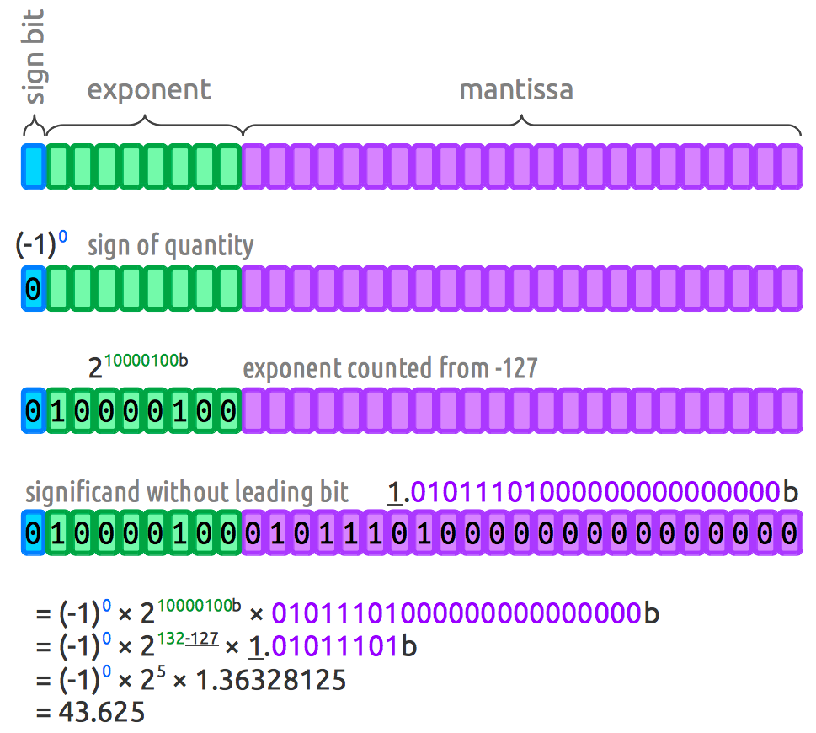
Notes:
11/2/17
40
40

