Slide 1
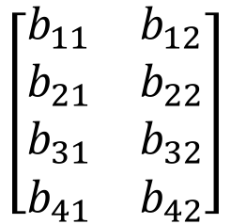





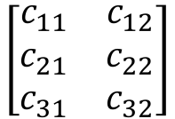
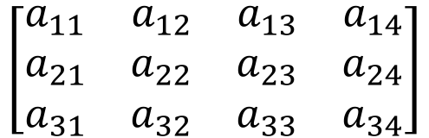
$$A$$
$$B$$
$$C$$
$$\left[\begin{matrix}\begin{matrix}a_{11} & a_{12} & a_{13} \\ a_{21} & a_{22} & a_{23} \\ a_{31} & a_{32} & a_{33}\end{matrix} & \begin{matrix}a_{14} \\ a_{24} \\ a_{34}\end{matrix}\end{matrix}\right]$$
$$∗$$
$$\left[\begin{matrix}\begin{matrix}b_{11} & b_{12} \\ b_{21} & b_{22} \\ b_{31} & b_{32}\end{matrix} \\ \begin{matrix}b_{41} & b_{42}\end{matrix}\end{matrix}\right]$$
$$=$$
$$\left[\begin{matrix}c_{11} & c_{12} \\ c_{21} & c_{22} \\ c_{31} & c_{32}\end{matrix}\right]$$

Slide 2
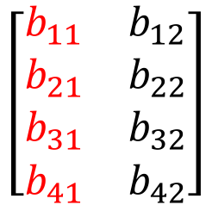
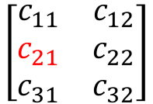
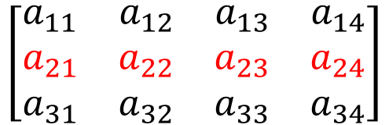
$$A$$
$$B$$
$$C$$
$$\left[\begin{matrix}\begin{matrix}a_{11} & a_{12} & a_{13} \\ a_{21} & a_{22} & a_{23} \\ a_{31} & a_{32} & a_{33}\end{matrix} & \begin{matrix}a_{14} \\ a_{24} \\ a_{34}\end{matrix}\end{matrix}\right]$$
$$∗$$
$$\left[\begin{matrix}\begin{matrix}b_{11} & b_{12} \\ b_{21} & b_{22} \\ b_{31} & b_{32}\end{matrix} \\ \begin{matrix}b_{41} & b_{42}\end{matrix}\end{matrix}\right]$$
$$=$$
$$\left[\begin{matrix}c_{11} & c_{12} \\ c_{21} & c_{22} \\ c_{31} & c_{32}\end{matrix}\right]$$
$$c_{21}=a_{21}∗b_{11}+a_{22}∗b_{21}+a_{23}∗b_{31}+a_{24}∗b_{41}$$

