Slide 1
MATLAB
Explore your data!
CS101 Lecture #25
2017-12-21

Slide 2
Administrivia
Administrivia
1

Slide 3
Statistics
Mean
Median
Percentile
Std/Variance
Administrivia
1

Slide 4
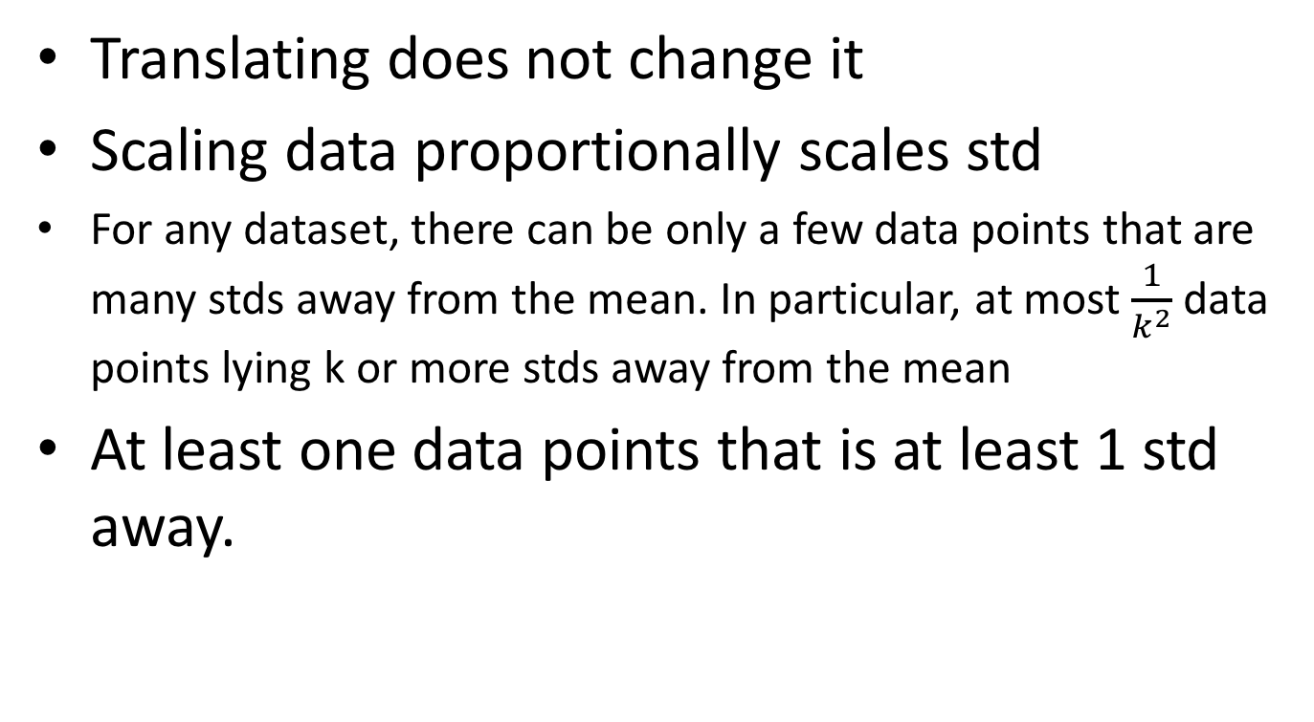
Properties of std
Translating does not change it
Scaling data proportionally scales std
For any dataset, there can be only a few data points that are many stds away from the mean. In particular, at most $\frac{1}{k^{2}}$ data points lying k or more stds away from the mean
At least one data points that is at least 1 std away.
Administrivia
1

Slide 5
Plot them out
Bar chart
Pie chart
Stacked bars
Heat map
Scatter plot
Administrivia
1

Slide 6
Why plotting?
Administrivia
1

Slide 7
Look at relations
Correlation
Positive correlation
Negative correlation
Zero correlation
Administrivia
1

Slide 8
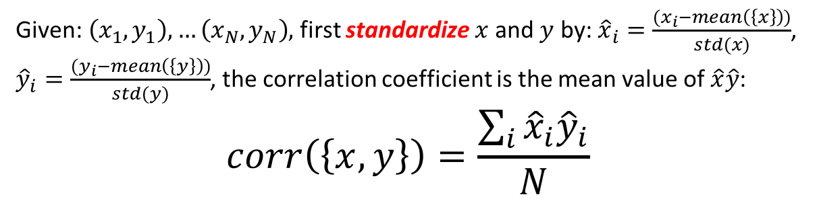
Look at relations
Correlation
Positive correlation
Negative correlation
Zero correlation
Given: $\left(x_{1},y_{1}\right),…\left(x_{N},y_{N}\right),$ first standardize $x$ and $y$ by: ${\hat{x}}_{i}=\frac{(x_{i}−mean\left(\left\{x\right\}\right))}{std(x)}$, ${\hat{y}}_{i}=\frac{(y_{i}−mean\left(\left\{y\right\}\right))}{std(y)}$, the correlation coefficient is the mean value of $\hat{x}\hat{y}$:
$$corr\left(\left\{x,y\right\}\right)=\frac{\sum_{i}{{\hat{x}}_{i}{\hat{y}}_{i}}}{N}$$
Administrivia
1

Slide 9
Causality vs Correlation
What is Causality?
Administrivia
1

Slide 10
Administrivia
Administrivia
1

Slide 11
Administrivia
Administrivia
1

